Slide 1
2020B Wet Mount Challenge

Slide 2
Instructions Wet Mount PT: 2020B Micrographs 1 - 8
Evaluate items 1 – 8 as if each is from a representative field (indicated as either low or high power) from an individual patient
Identify the cellular image indicated with an arrow in each photomicrograph
Enter results for items 1 – 8 on result sheet

Slide 3
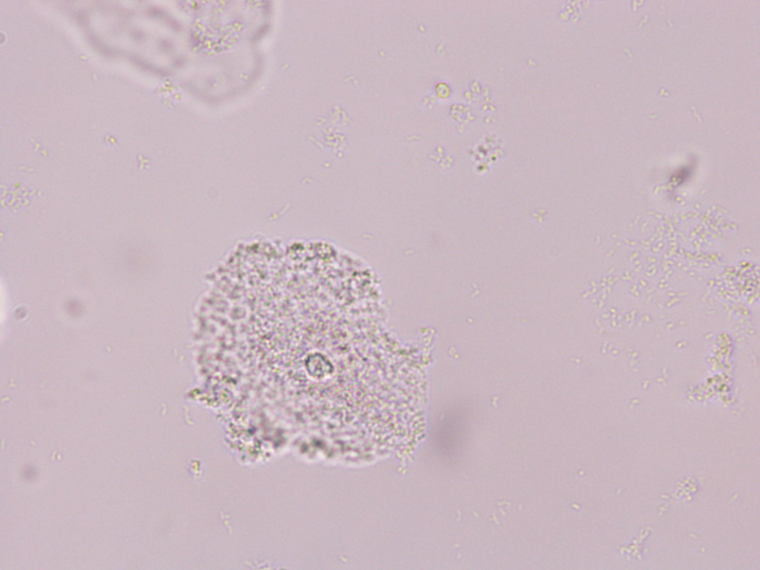
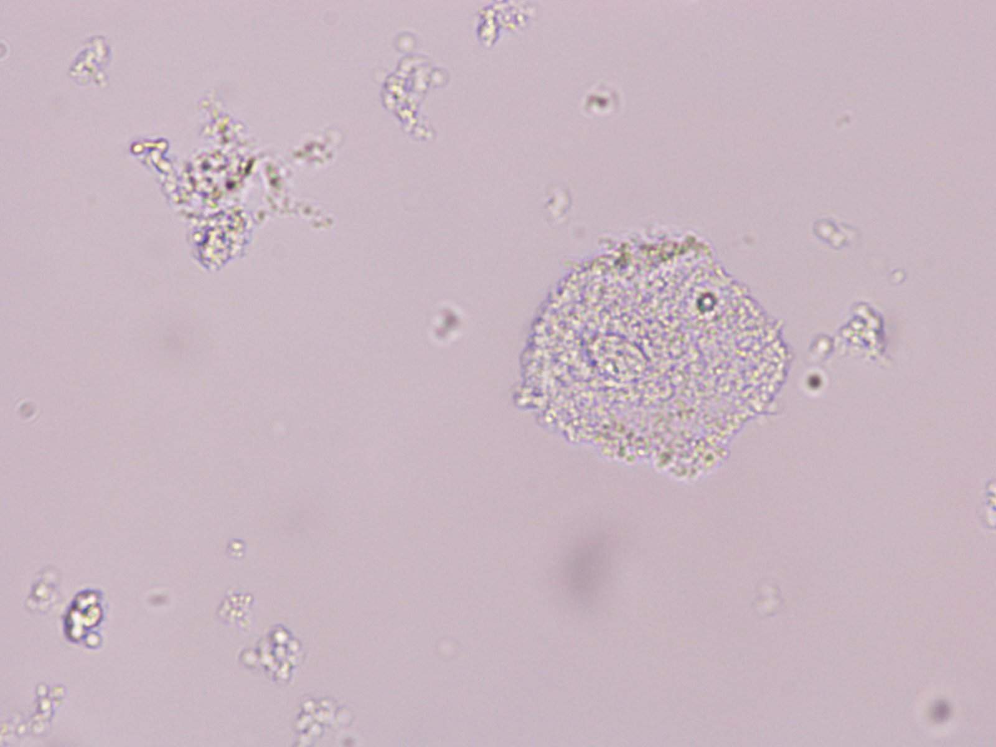
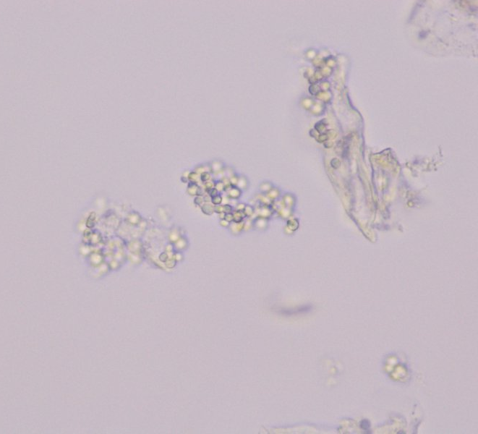
Slide 1
B
A
40X

Slide 4
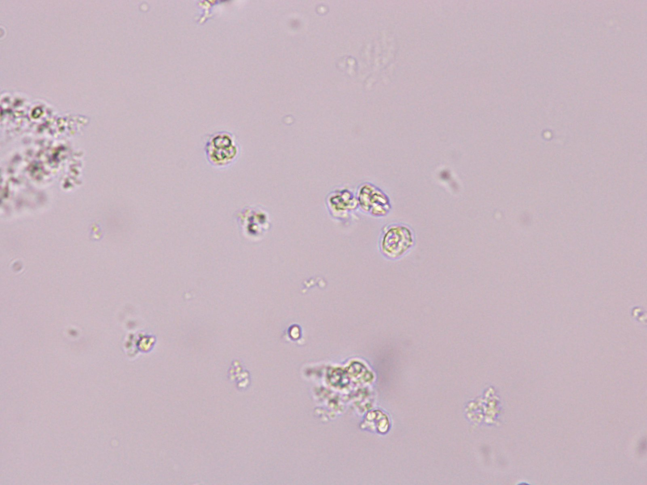
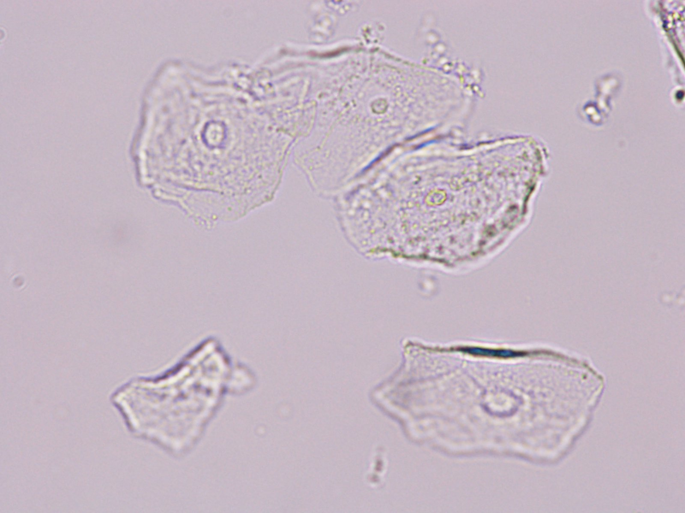
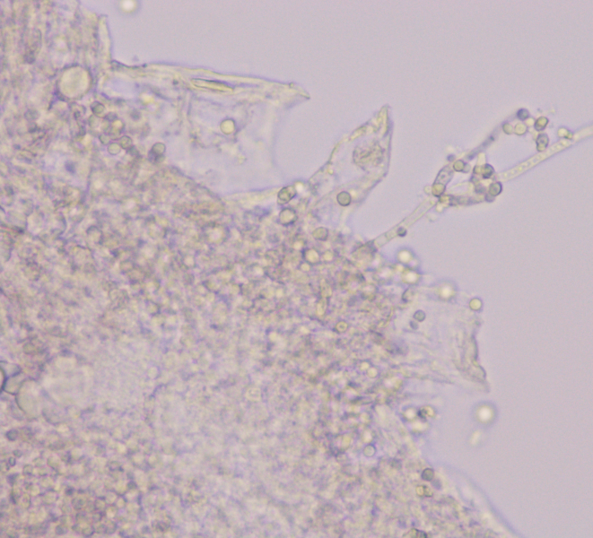
Slide 2
40X

Slide 5
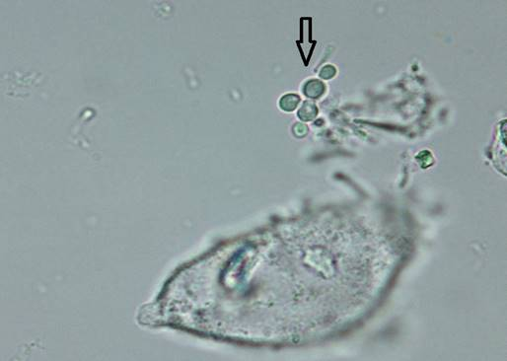
Slide 3
A
40X

Slide 6
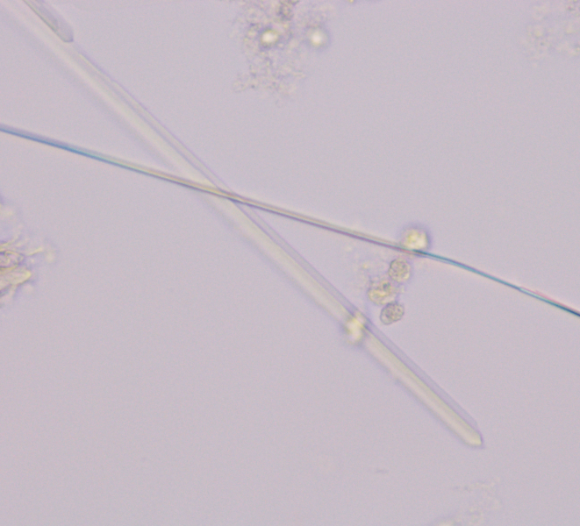
Slide 4
20X

Slide 7
Slide 5
A
B
20X

Slide 8
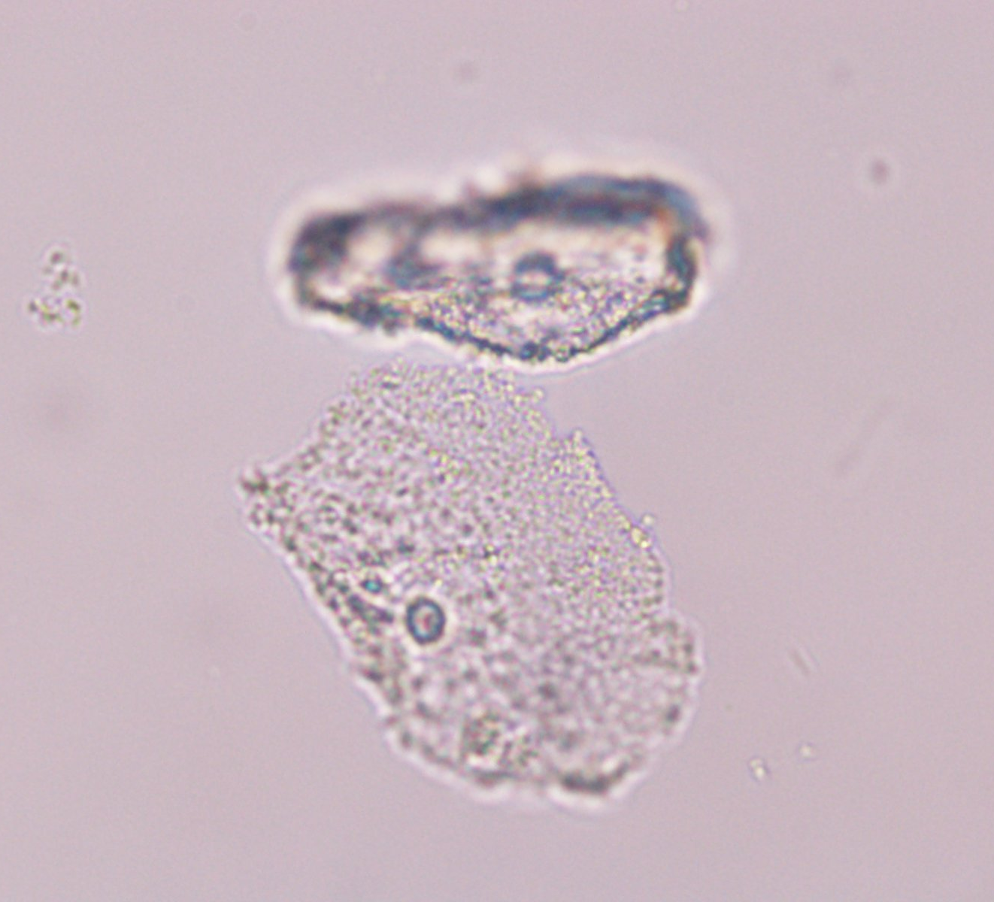
Slide 6
40X

Slide 9
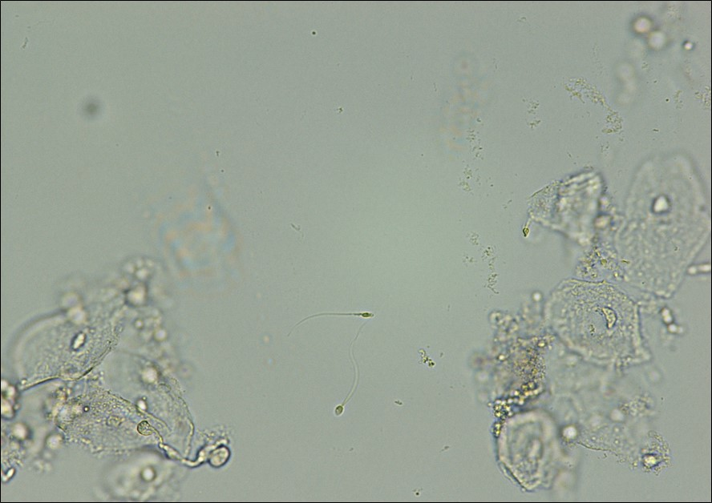
Slide 7
40X

Slide 10
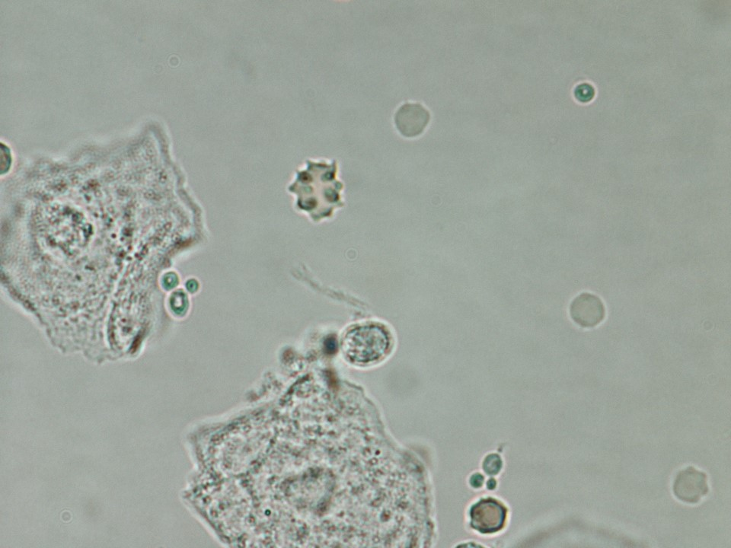
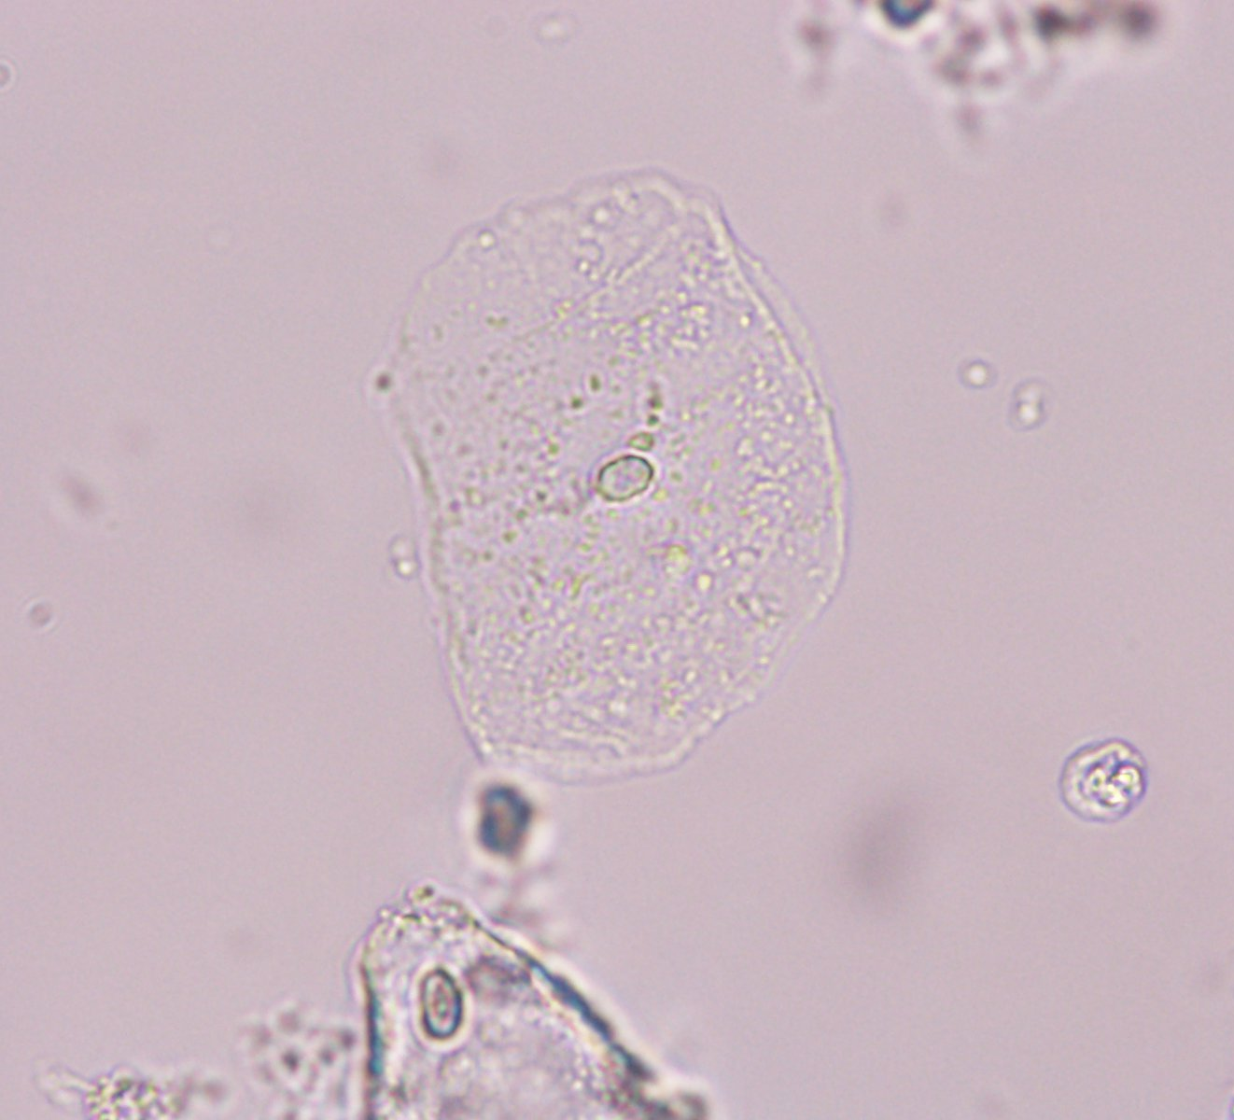
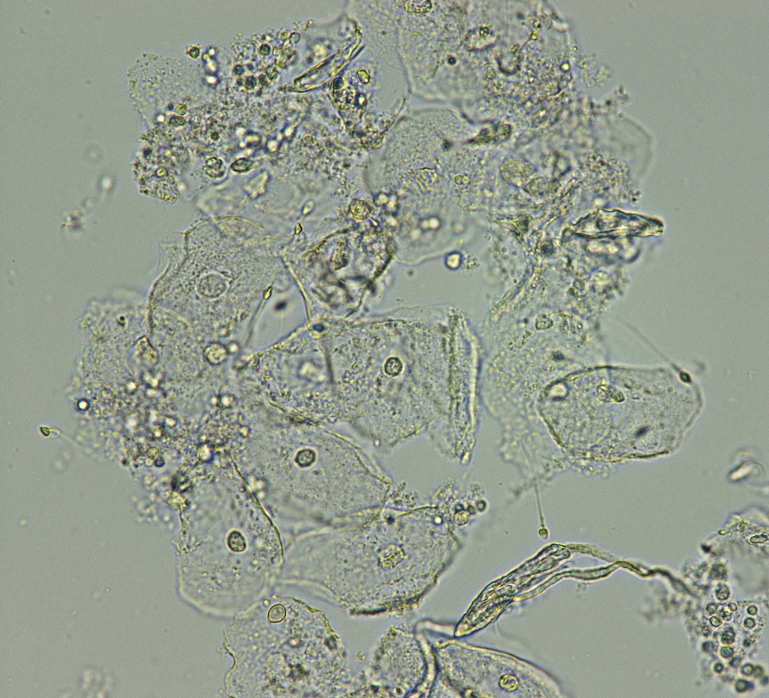
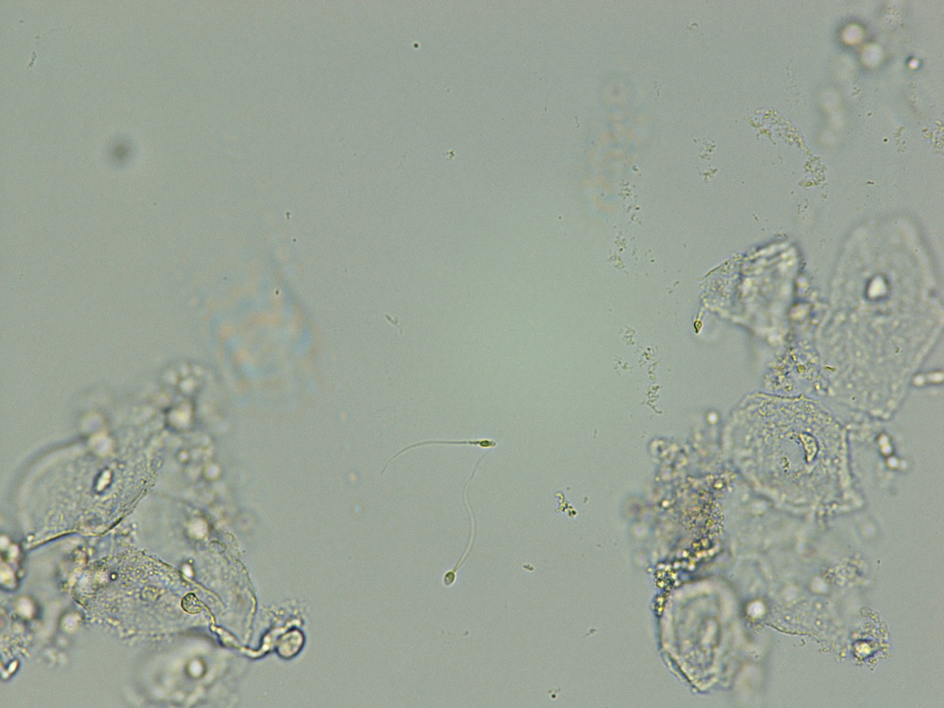
Slide 8
100X

