Slide 1
Blood Bank Delayed Crossmatch
Instructions for PAC / Pre-Op on proper specimen collection for Delayed Crossmatches to ensure safe and timely blood transfusions for surgical patients.
By Sheila Blanton, MLT, MT ASCP
2/9/17

Slide 2
What is a Delayed Crossmatch?
A Delayed Crossmatch is a Crossmatch (or type and screen) that is collected up to 30 days before surgery.
  Helps reduce delays in getting blood ready for surgical patients
In order to ensure patient safety with this process, there are multiple questions that need to be asked.
Abbreviations you will see in this presentation:
  XM = Crossmatch
  BB = Blood Bank
  MC = Main Campus
  AB = Antibody
  DMC = Davie Medical Center

Slide 3
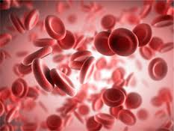
What are the questions?
Have you been transfused any blood or plasma products, including Rh Immune Globulin (RhIg) in the last 3 months?
  Why 3 months?
    The life cycle of a red blood cell is 3 months
    Transfused red cells can be circulating in the patient for up to 3 months, thus giving the immune system up to 3 months to make new antibodies
  Plasma products can contain antibodies
  RhIg is the antibody anti-D which will show up in blood bank testing as an unexpected antibody.

Slide 4

What are the questions?
For females: Have you been pregnant in the last 3 months or are you pregnant now?
  This is the same principle as the previous question. During pregnancy the mother can be exposed to fetal red cells. An immune response can also be triggered against these cells just as with a unit of blood.
  Most Rh negative mothers will receive RhIg during pregnancy which will show up in testing as an unexpected antibody

Slide 5

What are the questions?
Have you ever been told you have had transfusion problems?
  If the answer is yes, it may mean that compatible blood will be hard to find.
  What hospital identified these transfusion problems?
    The Blood Bank may have to contact that hospital’s blood bank to find out what the problem was to help ensure safe transfusions at WFBH

Slide 6
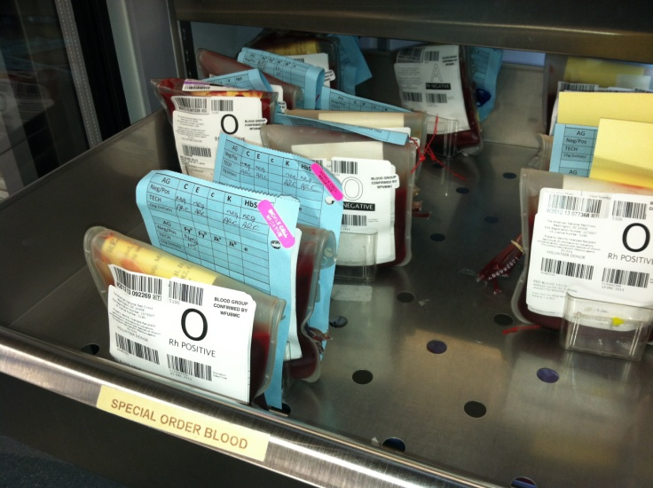
What are the questions?
Have you ever been told that you have red cell antibodies?
  This means that the patient has antibodies and that compatible blood may be hard to find.
  This information would allow the BB to have units available ahead of time to reduce delays during surgery.

Slide 7

What are the questions?
Why ask these questions twice?
  Asking the patient the same questions a second time on the day of surgery may trigger something that was forgotten the first time.
  There may be a family member with them on the day of surgery who remembers something the patient may have forgotten.
  A lot can happen in 30 days. The patient may have had a transfusion since they answered the Pre-Surgery questions.

Slide 8
What do the answers mean?
If the patient HAS been transfused or pregnant in the last 3 months, they DO NOT qualify for the Delayed XM.
If the patient HAS a history of red cell antibodies, they DO NOT qualify for the Delayed XM
Even though the patient is disqualified, still send the paperwork and the patient to the lab for collection.

Slide 9
Why use Delayed XM?
If an unexpected antibody is detected in a patient’s specimen on the day of surgery:
  It can take hours to identify the antibody and find compatible blood thus causing a delay in blood availability and possibly a delay in surgery.
Even if a patient has known antibodies in their historical files
  The Delayed XM allows the BB to confirm the patient has not developed additional antibodies.
  Some patients are hard to find compatible units for.
  Sometimes blood needs to be ordered from the blood supplier.

Slide 10

Why use Delayed XM?
Knowing about these antibodies early
  Allows the Blood Bank (BB) time to find compatible blood or to order blood from the blood supplier
  Allows DMC to keep the patient’s safe and ID patient’s that are disqualified for delayed Crossmatch.
  Disqualified patient’s or patient's
  with a positive AB screen
  will not have their surgery
  at DMC.

Slide 11
Initiation of Delayed XM Form
(The form is initiated on the day the sample is collected)
PAC Staff
PAC / Pre- Op staff fills out forms for patients who are coming in as outpatients to have surgery
When Writing, press down hard to ensure information is on all 3 pages. If patient labels are used, labels MUST be affixed to all 3 pages.
Incompletely filled forms will be rejected by the lab. Lab staff will not correct forms.

Slide 12


The Pre-Surgery Interview
PAC / Pre-Op
  The interviewer will fill out the top and Pre-Surgery part of the form as they ask the patient questions 1-6. the interviewer and patient (or guardian) must sign and date the form

Slide 13
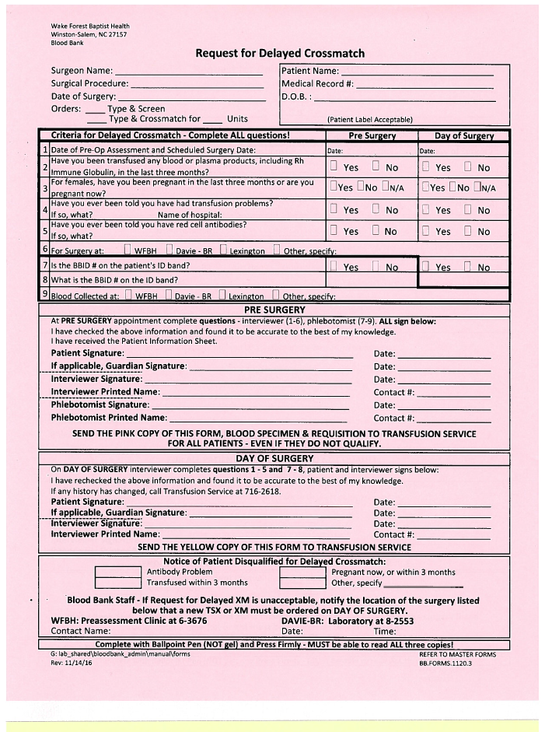
The Pre-Surgery Interview
(PAC and Pre-Op)
These 3 areas must be completed by the interviewer and the patient
  Surgeon / Patient information
  Criteria for Delayed questions 1-6
  Patient / guardian signature and interviewer signature
The patient will proceed to registration in plaza 2 for lab collection upon completion of these 3 areas

Slide 14

The Pre-Surgery Interview
(PAC / Pre-Op)
An attendant will walk the patient from PAC to a registrar in plaza 2. The Delayed Crossmatch paperwork will be kept with the patient.

Slide 15
PAC Pre-Surgery Phlebotomy
The Phlebotomist will:
  Ensure information is on all 3 copies of the form.
  Answer questions 7-9 on the Delayed XM form in the Pre-Surgery Section
  Collect the patient’s blood
  Label the sample correctly
  Sign and date the form
  Fill out the Blood Bank requisition and attach extra Blood Bank ID strip (BBID’s)
  Place the BB wristband, with the patient label attached, in the patient’s chart

Slide 16
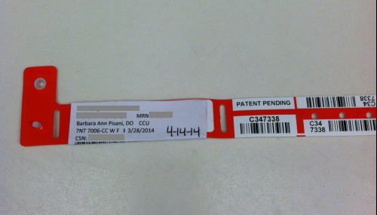
The patient information label and the date of surgery MUST be added to the BB wristband before placing it on the patient or in the patient’s chart

Slide 17
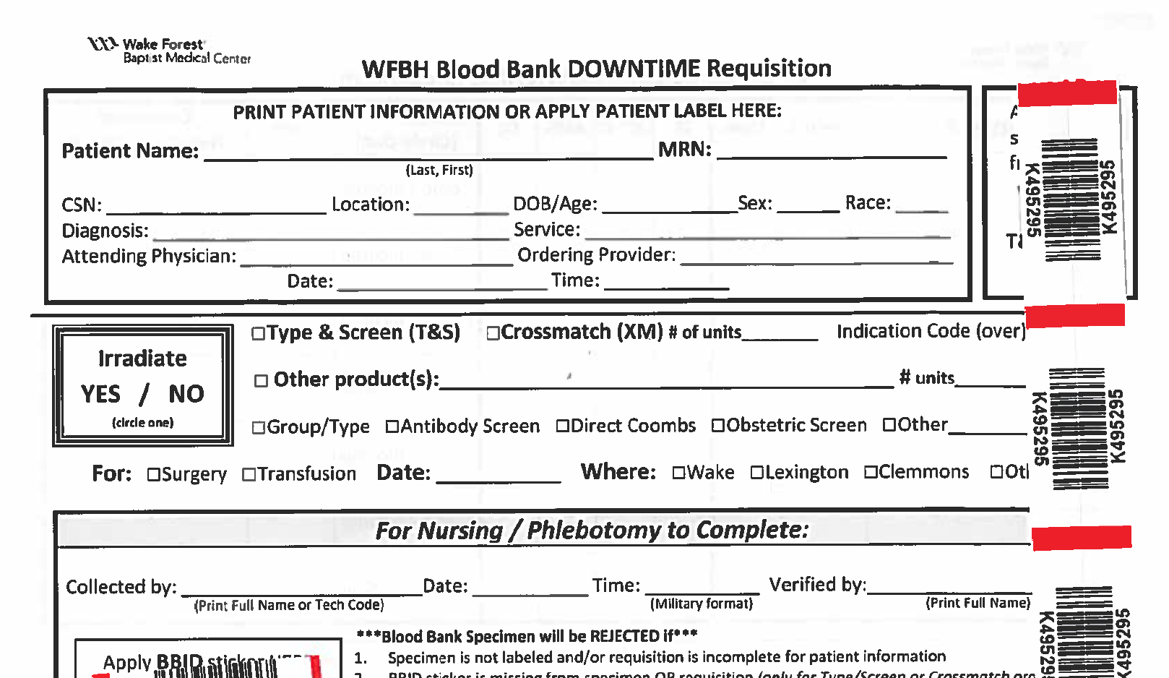
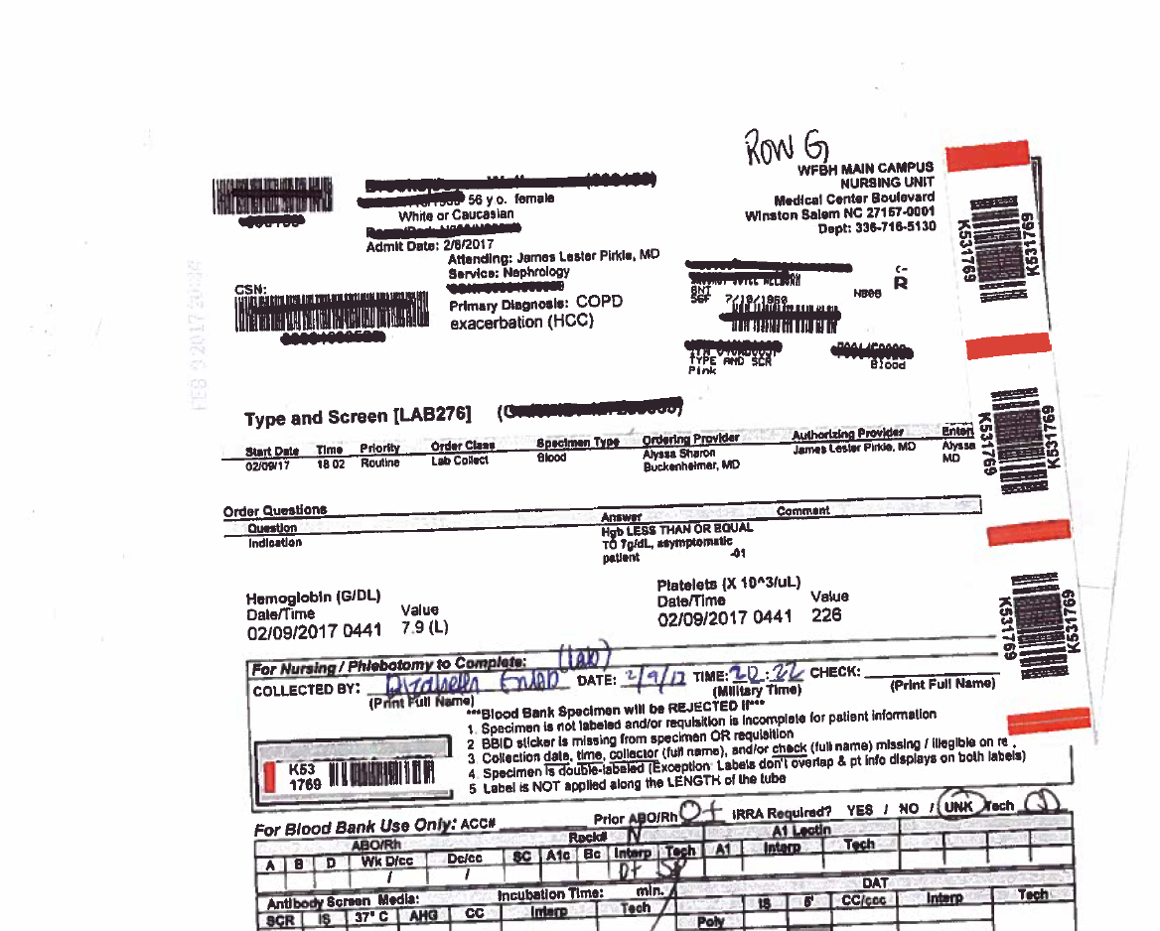
Required Elements
Completed Questionnaire
Completed Requisition with BBID ID labels attached as illustrated below
(use downtime requisition if No requisition prints and
During downtime)
Properly completed BB ID Band
Properly collected pink BB tube (patient ID label and BB ID Label.)

Slide 18
BBID Band
Detach here
The white strip is removed and attached to the WakeOne requisition
These are used by blood bank to label blood product units for issue.
Do not use these labels.

Slide 19
DMC Lab Responsibilities
Send the specimen, the pink copy of the Delayed Crossmatch Questionnaire, the Requisition, and sample to the Blood Bank
The white and yellow copies of the delayed Crossmatch paperwork and the patient’s BBID armband will be placed in a folder.
The Delayed Checklist will be completed and placed in the front of the paperwork in the folder.

Slide 20
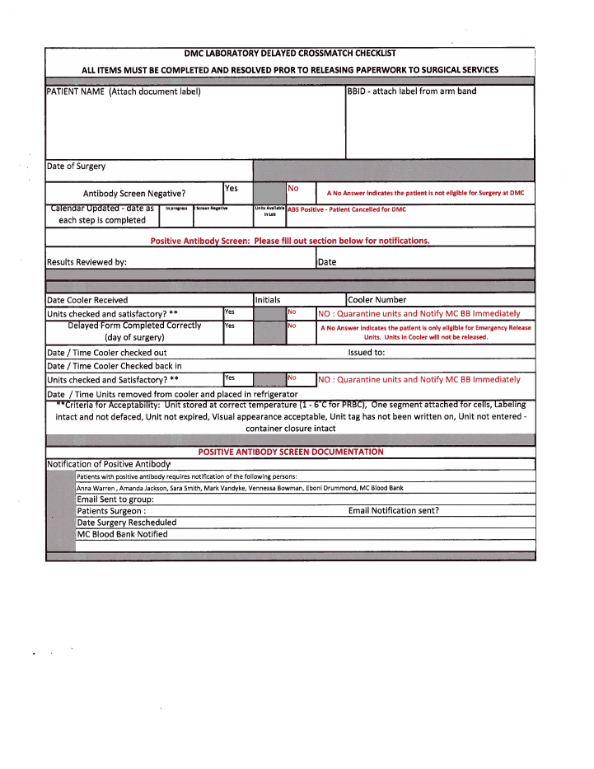
Delayed Crossmatch Checklist
Staff will complete the top portion
of the checklist and keep in the patient’s
folder with the BB paperwork.
Staff will check 1 week prior to the surgery
date the results of the AB screen and
update the shared calendar.
If the AB screen is Positive,
the patient will be deferred from
having Surgery at DMC.
Follow the instructions on the
bottom of the page for
Positive AB screen.

Slide 21

Alerts
Main Campus Blood Bank will call and notify DMC laboratory of any patient with a positive antibody screen or history that disqualifies them for the delayed Crossmatch.
DMC lab staff will call and email the centralized scheduling staff so the patient can be rescheduled at WFBMC.
DMC lab staff will send a group email to alert all necessary parties the patient is disqualified for surgery at DMC (see slide 31 for listing of the group)
Centralized schedulers will communicate to the group the new surgery date at WFBMC.
DMC lab will document on the Delayed Crossmatch checklist all notifications and remove the patient’s paperwork from the active file.

Slide 22
Week Before Surgery
DMC lab will review the patient’s paperwork 1 week prior to surgery.
  DMC and WFBMC BB will need to be notified of any surgeries that are cancelled or re-scheduled
Documentation of the check will be noted on the Delayed Crossmatch checklist.
If everything is acceptable, DMC lab will take the patient’s chart – containing the remaining yellow and white copies of the Delayed XM form and the BBID wristband – to Surgical Services where it will be held until the day of surgery
The delayed Crossmatch checklist will remain in DMC laboratory.

Slide 23
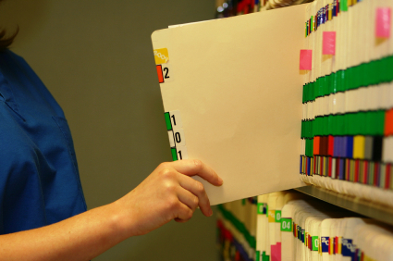
The patient’s chart will already be in Surgical Services on day of surgery
The patient will then be taken to a Surgical Services nurse for the final interview

Slide 24
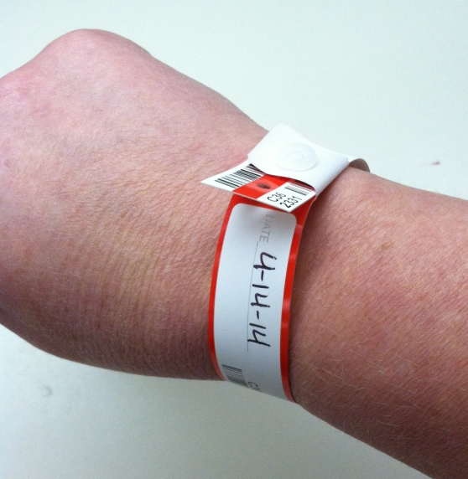

Day of Surgery
The Interview – Surgical Services RN
  On the day of Surgery the interviewer will:
    Obtain patient’s chart containing Delayed XM form and BBID wristband
    Confirm patient identity and
    Place patient registration band
    and BB wristband on patient

Slide 25
Day of Surgery
The Surgical Services RN / interviewer will:
  Complete the sections of the Delayed XM form under “Day of Surgery”
    Complete questions 1-5 on the Delayed XM form
    Sign and date the form
    Have patient / guardian sign the form

Slide 26
Day of Surgery
The Surgical Services RN will
  Call the DMC lab for the following situations:
    Patients who have been transfused within the last 3 months
    Women who have been pregnant within the last 3 months
    Patients who have historical or newly identified red cell antibodies
The Patient will no longer be qualified for delayed Crossmatch.

Slide 27
Patients who are disqualified
Delayed XM is no longer available.
Prepared units will not be released
Patient may not have surgery at DMC.

Slide 28
Meanwhile, in the Blood Bank and Lab……

Slide 29
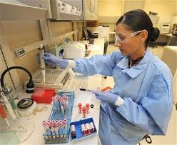
MC Blood Bank Testing – Pre-Surgery
When the pre-surgery sample, BB requisition and PINK copy of the Delayed XM form arrive:
  The specimen and requisition are checked for labeling and identification verification
  The pink form is checked for completeness
  The answers to the questions are reviewed to make sure the patient qualified for Delayed XM.
All properly labeled specimens are processed and tested.

Slide 30
MC Blood Bank Testing – Pre-Surgery
If the antibody screen is NEGATIVE and the patient has no history of antibodies:
  The sample is placed in a special rack and is held for up to 30 days (normal BB specimens are only kept for 14 days)
  On the day before surgery the Blood Bank at MC will send in a cooler the patient’s prepared units to DMC.
  DMC lab will confirm the units are here and ready. Information will be documented on the Delayed Crossmatch Checklist.
  On the day of surgery, the OR must return the completed YELLOW copy of the Delayed XM form to the lab. Once returned, the lab can release the patient’s cooler with blood products inside.
    DMC lab will not release multiple coolers on multiple patients. Only 1 patients blood cooler can be signed out at a time.
    DMC lab will not release the units without a completed Delayed XM form

Slide 31

MC Blood Bank Testing – Pre-Surgery
If the antibody screen is POSITIVE:
  The antibody is identified
  Compatible units are found in the BB blood inventory or ordered from the blood supplier and set aside for the patient
  DMC lab will be notified by the BB staff that the patient has a positive AB or history that disqualifies them for the delayed Crossmatch.
  DMC lab will notify by email centralized scheduling, Peri-anesthesia Charge Nurse, Surgical Services Nurse Manager, the surgeon, and MC BB of the patient’s status.
  Centralized scheduling will notify the group of the new surgery date.
    MC BB staff will document who they informed in the designated area at the bottom of the Delayed XM form.
    DMC lab staff will document on the Delayed Crossmatch checklist who has been informed and remove the patient’s paperwork from the active files.

Slide 32
In the Lab– Day of Surgery
On the day of surgery, If the lab does not receive the completed request for Crossmatch form, the prepared units will not be released.
The lab will offer O negative units for emergency release.
The patient’s surgeon will decide if the surgery will be cancelled or postponed until later in the day.
If the surgery will take place later in the day, the surgical staff will acknowledge the need for a new specimen in the patient’s chart and collect a new BB XM specimen with new requisition and new BBID wristband.
DMC lab will notify MC Blood Bank and send the specimen STAT.
The MC BB will
  Test the new sample to ensure that the patient has not made any additional unexpected antibodies
    This process will still take longer than a regular type and Crossmatch, but as long as nothing has changed since the patient’s Pre-Op visit, appropriate blood should be available for cross matching.
  Provide antigen negative, compatible blood for the patient
    If there are no additional antibodies then the units previously set aside for the patient will be cross matched with the new specimen and be ready to go.

Slide 33
WFBH Patient Goals Achieved
Keep You Safe
Care For You

