Slide 1
New BB Forms – Emergency Release and Blood product Release Education
DMC Laboratory

Slide 2
Dividing ER form into two…WHY?
Pushback from providers not wanting to sign a form that says “EMERGENCY” for blood when it isn’t an emergency
New ER (Emergency Release) form will only be used in true emergencies
BPR (Blood Product Release) form will be used in all other situations
Judgement call from techs as to which form to use…use common sense and use guidelines that follow
Either form, signed by a physician, fulfills the FDA req.
PA’s and NP’s CANNOT sign these forms.

Slide 3
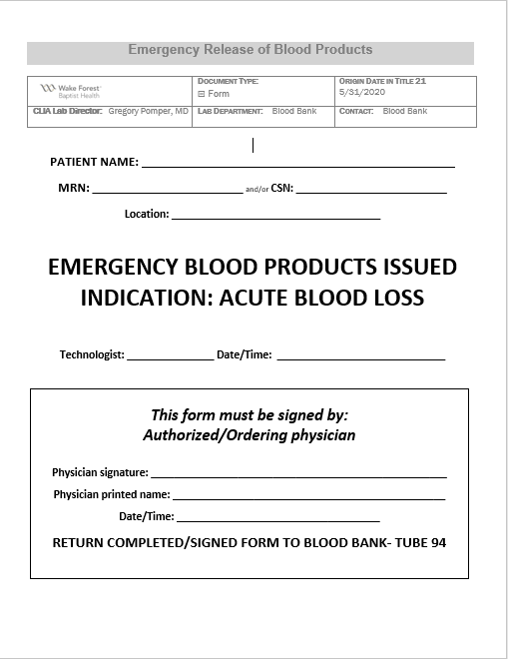
‘New’ Emergency Release

Slide 4
New Emergency Release
Acute blood loss:
  True emergency
  Majority will be Traumas, some surgical.

Slide 5
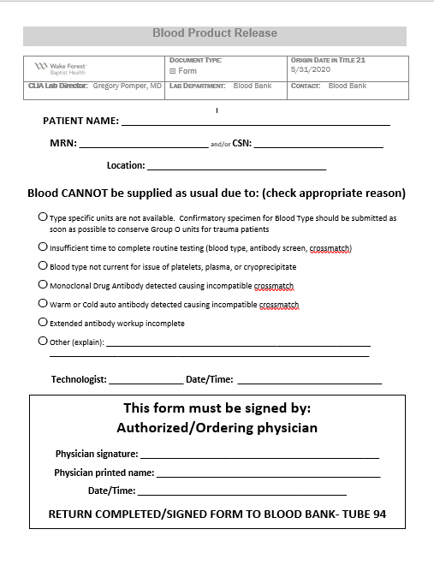
‘New’ Blood Product Release
Notes:
Do NOT call this emergency release.

Slide 6
New Blood Product Release
Used when there is something the physician needs to know
Examples:
    Unit incompatible due to warm autoantibody
    MM patient taking DARA
    Issuing O units b/c ABO2 sample hasn’t arrived
    Extended workup necessary and not complete. Not enough time to complete and they want to transfuse (before sending patient home, etc.)

Slide 7
Form Information for DMC
DMC Lab will keep the new ER forms on hand.
DMC Lab will keep a few of the BPR forms to use as needed – however – the majority of the time these forms will be sent with the blood from the Winston Campus blood Bank. This form will be kept with the patients paperwork.

