Slide 1
Blood Bank
Second ABO Check Procedure
2021

Slide 2
Why is a second ABO needed?
It is a CAP and AABB requirement to have the blood type confirmed with a second specimen when there is no previous history of a blood type. This specimen may either be collected by a different staff member or collected at a different time than the type and screen.
Without this 2nd specimen being collected at the same time as the type and screen, we will not have all the necessary testing performed on the day the patient has the surgery. This will be putting our patients at risk as we may have to collect on the same day of the surgery, delaying our ability to provide cross matched units if needed. We are committing to the physicians that we will do all that is needed to provide cross matched units if their patients require it and we have done all that we can to ensure their patients are safe.

Slide 3
A second ABO is also needed if…
The patient has a history, but it is from anytime before 2017.
2017 is the year that we switched to SoftBank, so any information obtained before then must be verified/repeated.

Slide 4
After Midnight each night…
The Lab Tech will go to the “DMCP2 02 PREOPERATIVE ASSESSMENTS CLINIC” schedule in Beaker.
Print a copy of the schedule.
Determine each patient’s MRN by opening their chart and write it on the schedule.
Enter each patient’s MRN into SoftBank to determine if they have a history.
Provide phlebotomy with a copy of the schedule in which each patient requiring a second ABO is highlighted.

Slide 5
If the patient DOES NOT have a history or history is older than 2017:
Highlight the patient’s name so phlebotomy will know that they need to order a second ABO when they collect the delayed type and screen.
If the patient DOES have a history:
No further action is needed

Slide 6
How to print the schedule:

Slide 7
How to check the patient’s history in SoftBank

Slide 10
If the patient has a history it will look like this:

Slide 11
IMPORTANT NOTE
You must “quit” between each patient.

Slide 12
If the patient does not have a history it will look like this:

Slide 13
Once the schedule has been checked and patients requiring a second ABO have been identified:
Make 2 copies of the schedule giving you a total of 3 copies all together.
One copy will go to each phlebotomist in Plaza 1 and one copy will remain in the laboratory.

Slide 14
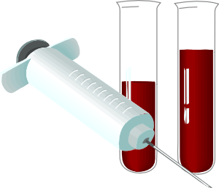
At the time of collection:
The patient will present to the phlebotomist with the usual delayed type & screen paperwork.
The phlebotomist will determine if a second ABO is needed by referring to the schedule provided by the nightshift tech.
If a second ABO is needed the phlebotomist will explain to the patient that they will have to be stuck twice and why.
The phlebotomist will draw the delayed type & screen per usual.
A second phlebotomist will order the second ABO, properly identify the patient, and collect the second ABO.

Slide 15
What to do if the patient is not on the schedule:
Call a tech and have them check before you draw the patient.

Slide 16
IMPORTANT NOTE
It is crucial that the second phlebotomist properly identify the patient according to our patient identification procedure before collecting the blood for the second ABO.

Slide 17
Example of how to explain procedure to patient
“Your physician has ordered a type and screen. We did not find a record of you having your blood typed at our facility. We will need to perform a second collection and confirm your blood type. This will allow us to have blood units available for you should you need them when you have your surgery.”

Slide 18
To order a second ABO on an outpatient:

Slide 19
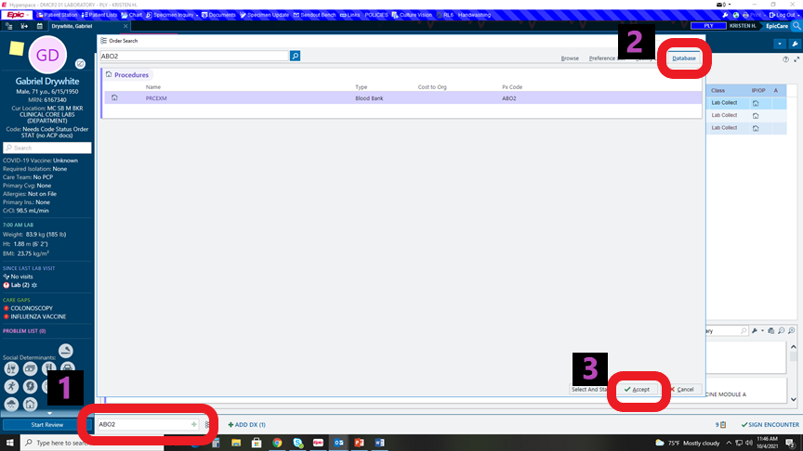

Slide 20
