Slide 1
Placing a Hold on a Test
When to Perform?
Any time a result is not ready to be released, such as when performing a slide review/diff, a dilution, or troubleshooting erroneous results.

Slide 2
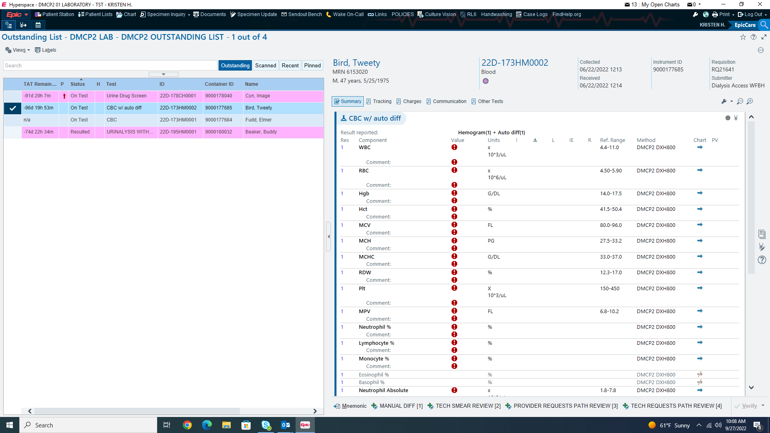
Select the desired result (make sure this is the only result selected) and select the three dots in the right hand corner.

Slide 3
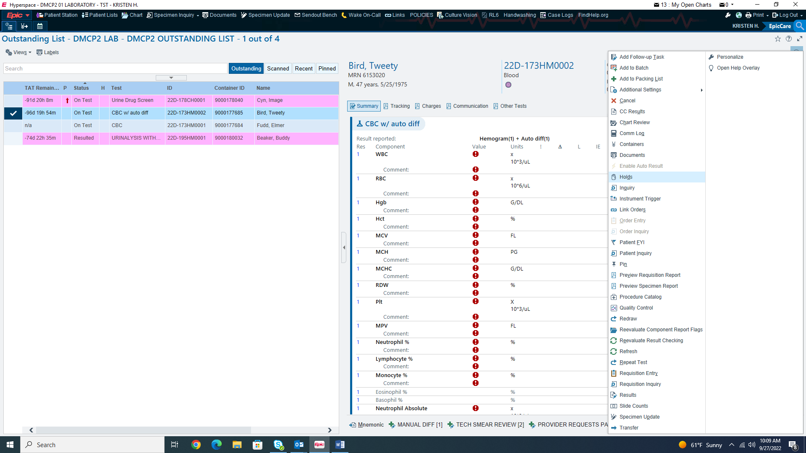
Select “Holds”

Slide 4
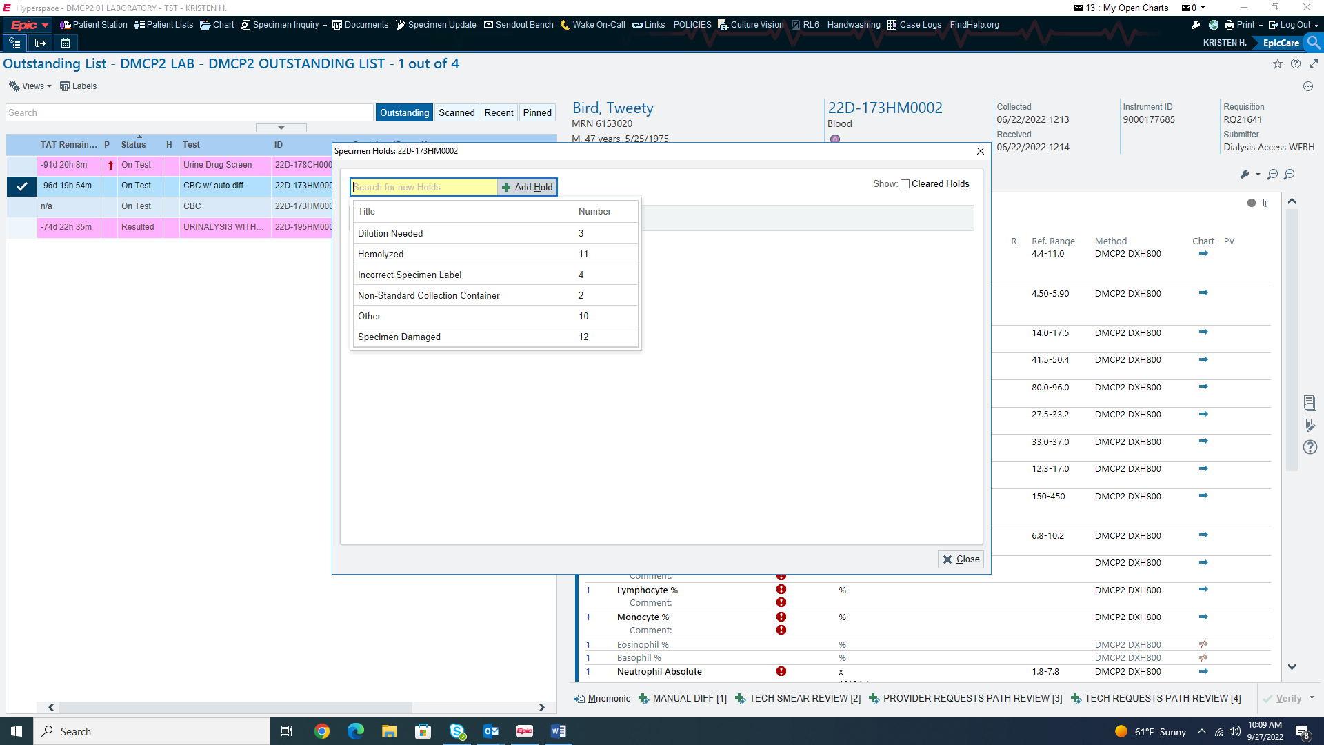
Always use “other” as the reason for the hold and elaborate in the comments.

Slide 5
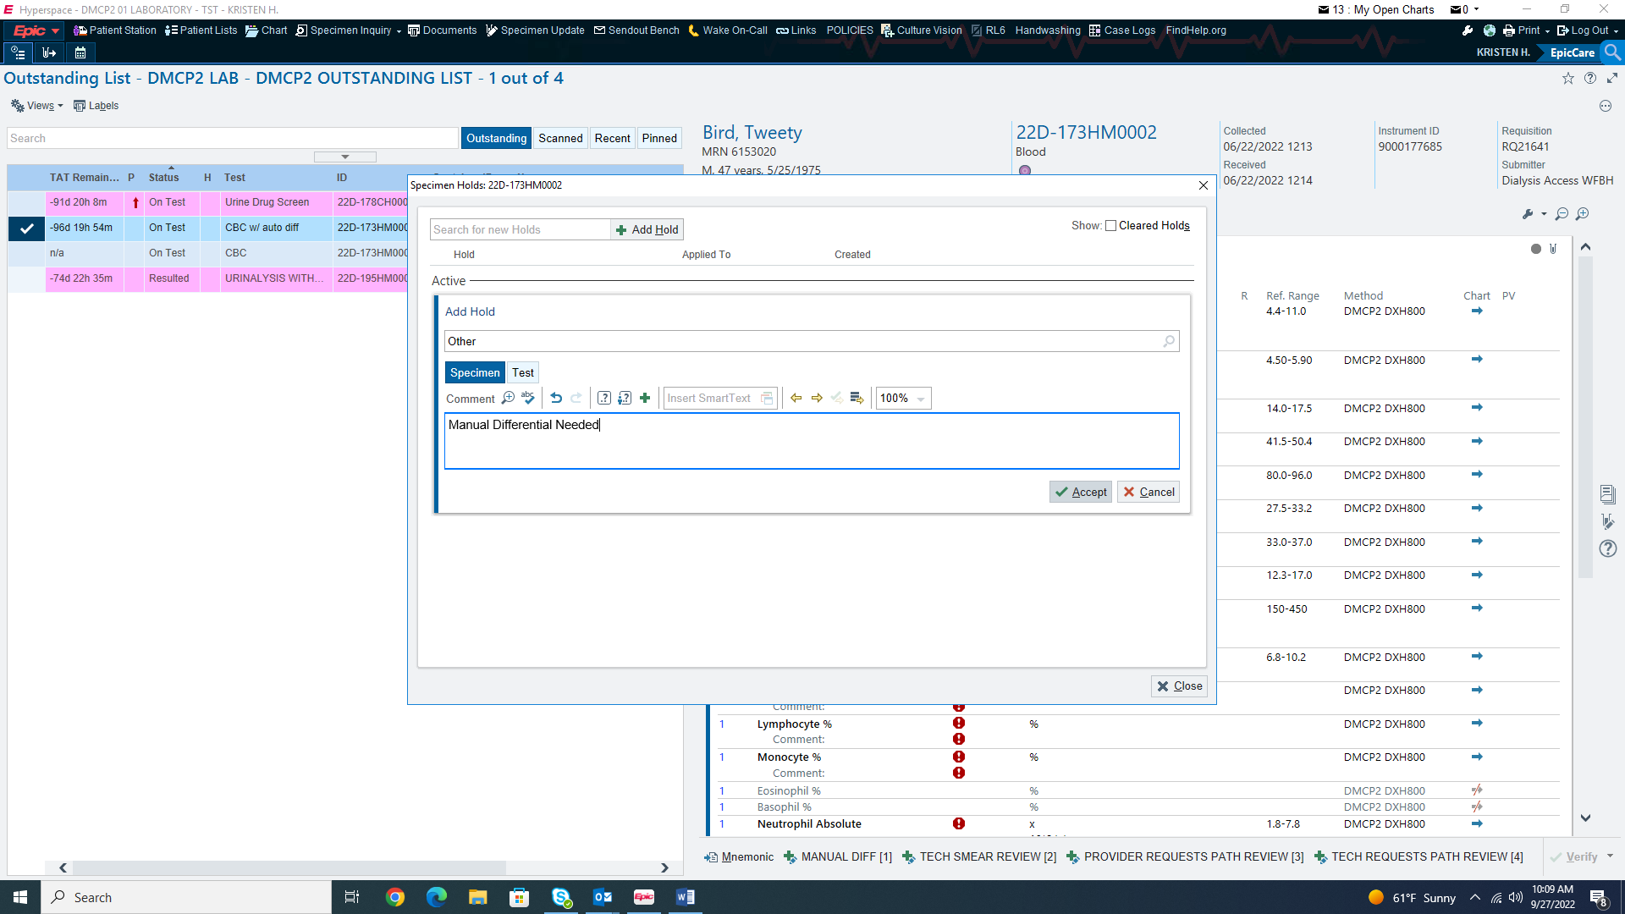
The comment box for your elaboration will not appear until after “other” has been selected.

Slide 6
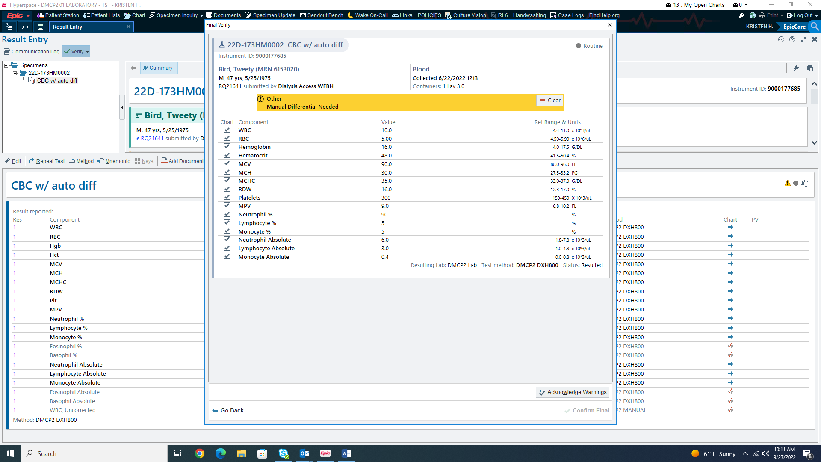
Similar to holds placed on criticals, this hold must be addressed before resulting. This can be satisfied by acknowledging the hold once a differential has been done such as shown below, or the hold can be removed.

Slide 7
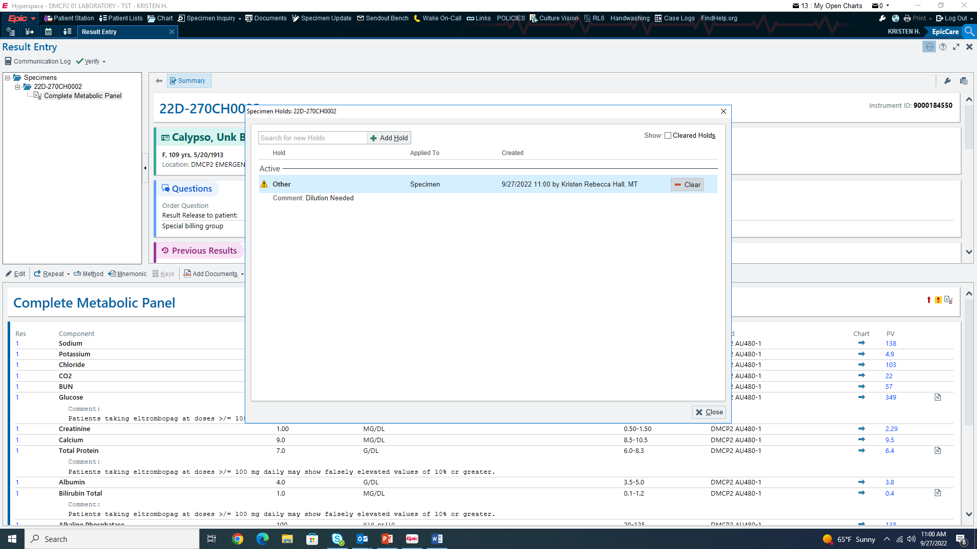
Select “clear”

Slide 8
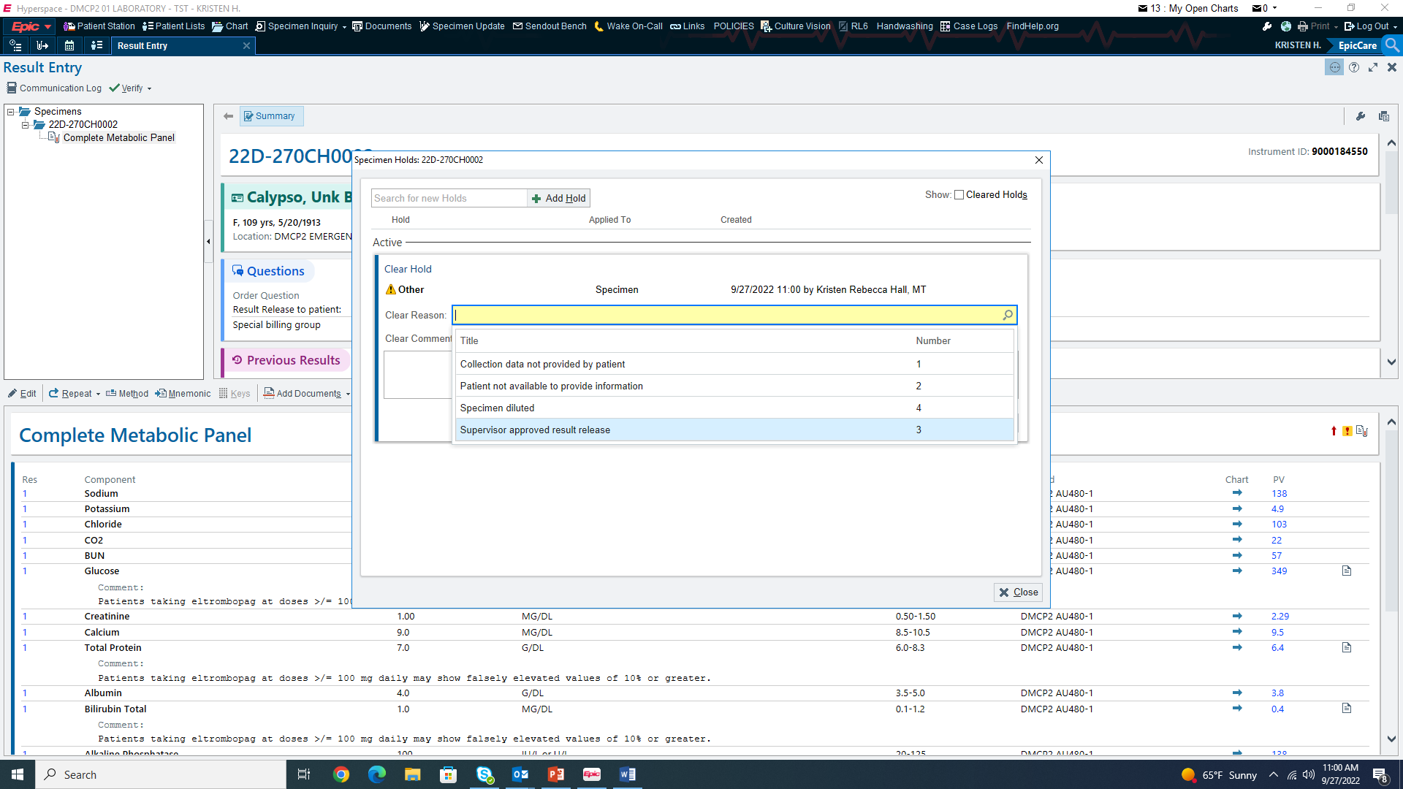
Select “Supervisor approved result release”

Slide 9
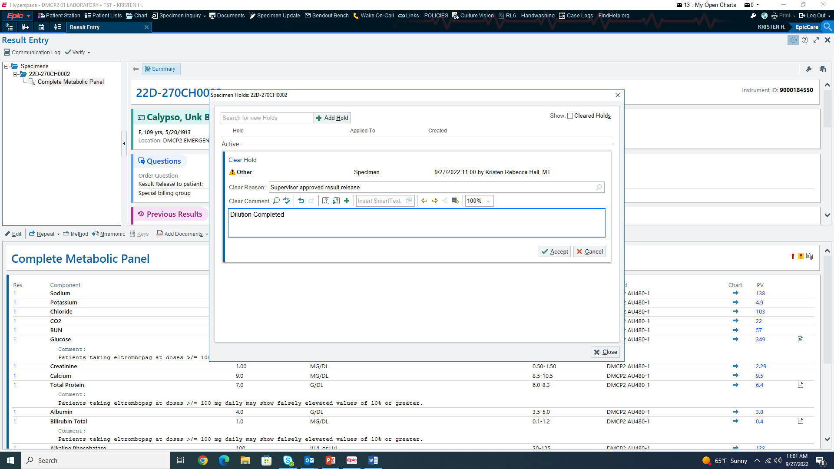
Enter the action taken to resolve the reason for the hold and accept to clear the hold.
Specimens may be released per usual from this point.

