Slide 1
Department of Pathology
Davie Medical Center
04/14/2025

Slide 2
DMC
Agenda for Today
Patient Safety Focus
Policies & Procedures
Future Focus

Slide 4
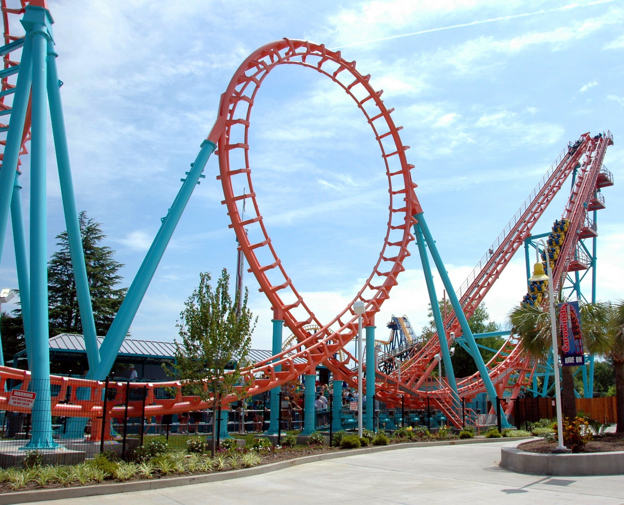
Reliability Experienced Daily
US Amusement Parks
Fatality chance: 1 in 34 Million
Rides operated daily by college students
US Commercial Flight
Fatality chance: 1 in 11 million
Fly daily for 123,000 years before fatality

Slide 5
Healthcare in the US
Johns Hopkins study in 2018 claims more than 250,000 people in the US die every year from unintentional medical errors.
Other studies claim the number to be as high as 440,000.
Medical errors are the 3rd leading cause of death in the US after heart disease and cancer.
Image by: Kevin Ridder

Slide 6
Davie Medical Center Department
The journey to becoming a highly reliable organization:
Identify opportunities (RL6)
Design processes that are reliable and follow them
Practice low risk behavior

Slide 7
Risky Behavior
High-Risk Situation
High-Risk Behavior
+
=
Safety Event

Slide 8
Job Performance Expectations

Slide 9
Promotion of a Just Culture

Slide 11
Workplace Violence
The medical center has zero tolerance for abusive or violent behavior, whether verbal or physical, toward employees, patients or visitors.

Slide 12
Workplace Violence

Slide 13
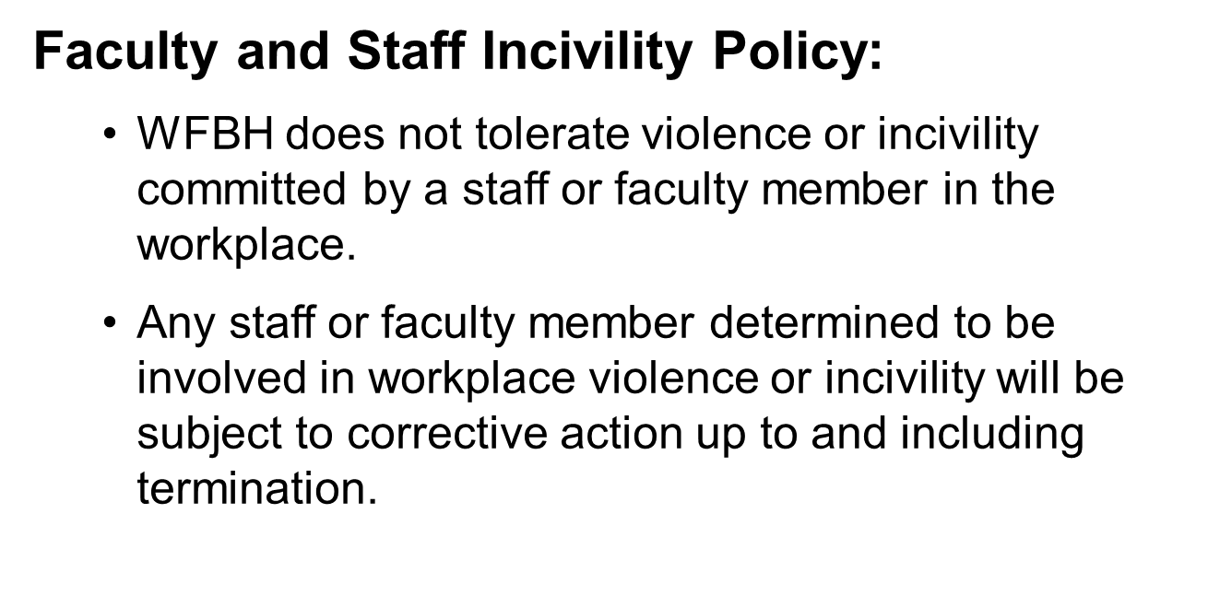
Workplace Violence

Slide 14
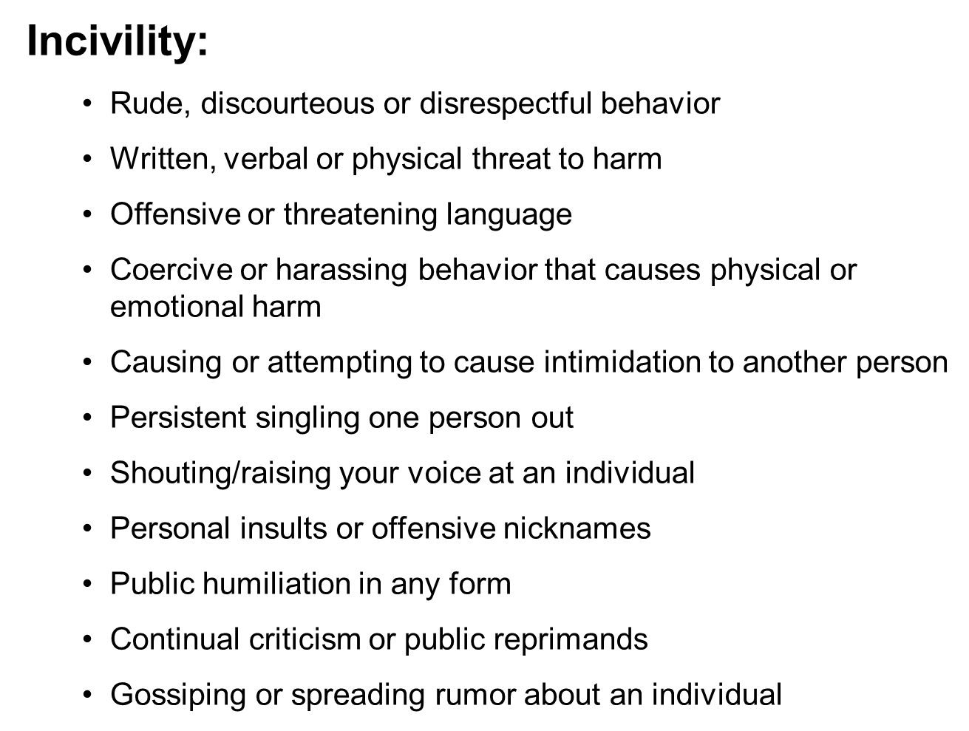
Workplace Violence

Slide 15
Personal Electronic Devices & Internet Use
Laboratory work and patient care take priority over personal use of PEDs. Use of PEDs must not be distracting to others or interfere with the performance of job responsibilities.
PEDs may be used for work-related and/or academic pursuits only and insofar as the use contributes to performance of one’s work duties.
Use of PEDs for non-work-related reasons, such as personal phone calls or text messaging, should be conducted in public non-patient care spaces, such as dining areas, conference rooms, staff lounges, and/or other staff-only areas, during approved breaks and meal periods. (Refer to Performance Standards Policy and Advocate Health Code of Conduct.)
PEDs must be set to silent or vibrate mode at all times and kept out of sight to minimize distractions.
PEDs must not be used in a way that compromises safety, increases risk of contamination, or distracts teammates from work duties
Internet access on laboratory computers and electronic devices is intended for work-related purposes only.
Use of Personal Electronic Devices and the Internet Policy (NCBH) v.4

Slide 16
Break & Meal Break Expectations Enterprise Alignment
Full 30-minute uninterrupted meal break (never to exceed 35 minutes)
45-minute lunches are not permitted (Department Specific Policy will be updated to reflect this)
Breaks are not guaranteed and are based on leadership discretion and operational need. If time allows, no more than one (1) break is allowed during an 8-hour shift and/or up to two (2) during a 12-hour shift.
Breaks are ten minutes (10) or less after 4 hours of work and cannot be combined with lunches.
Meal Period and Breaks Policy (Wake Market) v.6

Slide 17
Attendance & Work Assignments
Late in and early out: 10-minute courtesy time give for extenuating circumstances, not to be used consistently. (Policy to be updated)
Preassigned working areas should be maintained and work performed unless otherwise directed by leadership.

Slide 18
DMC POsitions
MLS/MLT
Day Shift – M, T, TH, Fri. 10am - 8:30pm
Night Shift Weekend – Fri, Sat, Sun, M 7pm – 7:30am
Weekday Night – Tue, Wed, TH, 7pm – 7:30am
Phlebotomy PRN – TBD
Welcome Tiffany and Gracie
Rebecca Cassel – April 21 begin
This Photo by Unknown Author is licensed under CC BY-NC-ND

Slide 19
DMC
What’s Next?
Pay attention to patient care & empower each other
Focus on the future & growth
May 26th IRA
Shelley Bowman guest speaker for Patient Safety date & time TBD
Jasna Walton Contact 336-661-5035

Slide 20
Remember the POWER OF Reliability & open communication

