Slide 1
March 2026 Phlebotomy Meeting
Davie Medical Center Laboratory

Slide 2
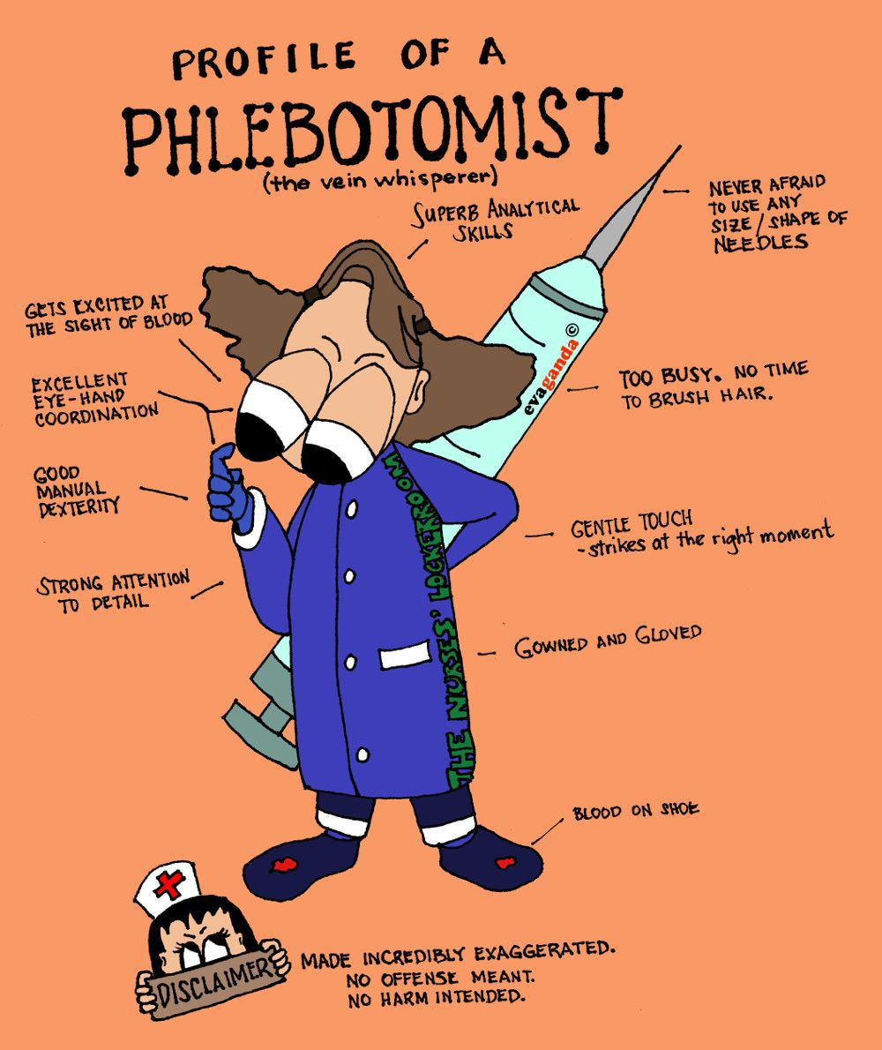
The vein whisperer!

Slide 3
Accomplishments
Only 2 blood cultures contaminated by phlebotomy in all of 2026. Zero so far this year!
Urine pregnancy turn around times at 99% last quarter!
1,684 patient collections occurred in February 2026!
2 positive patient surveys
4 coworker shout outs from Phlebotomy Week!

Slide 4
Blood Culture Bottle Training
Switch to Biomerieux go-live on April 15th
https://www.youtube.com/watch?v=AKsETpBWU3U&t=1s
https://www.youtube.com/watch?v=QAhOiWDiiok

Slide 5
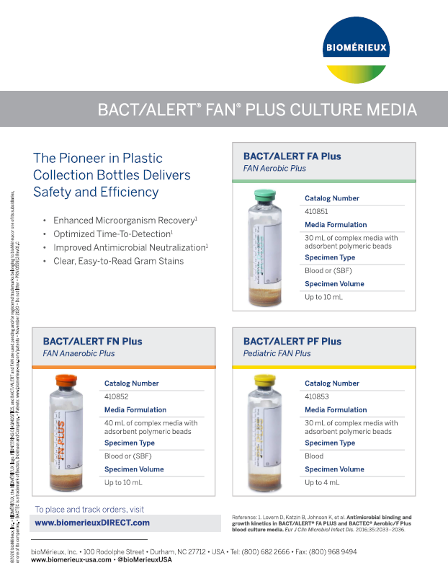

Slide 6
Shared Responsibilities: These represent the core phlebotomy expectations at all levels.
These duties are listed in every job level:
Accurate and timely collection of blood specimens
Accurate identification and delivery of samples
Following proper safety and patient/specimen identification procedures
Contributing to efficient department/section operations
Improving work skills through self‑study and continuing education
Preventing spread of bloodborne/airborne diseases (policies & procedures)
Exhibiting/promoting a professional laboratory image
Providing age‑appropriate specimen collection
Promoting a cooperative work environment through communication & teamwork
May require working any shift / weekends / holidays / taking call

Slide 7
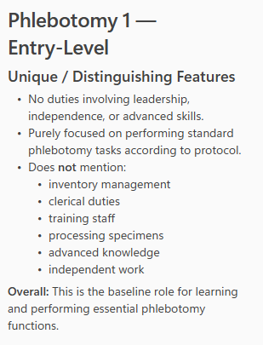
Phlebotomist AHWFB
High school diploma or GED
1 year phlebotomy experience preferred – does not require certification

Slide 8
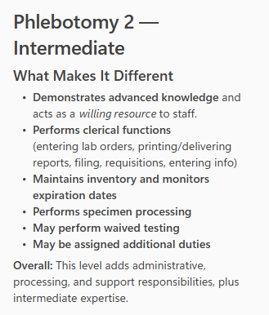
Phlebotomy Technician II AHWFB
High school diploma or GED
2 years phlebotomy experience
CPR Certification
ASCP, AMT, ASPT or equivalent certification from an accredited Phlebotomy training program that includes successful completion of a certification exam with passing scores.

Slide 9
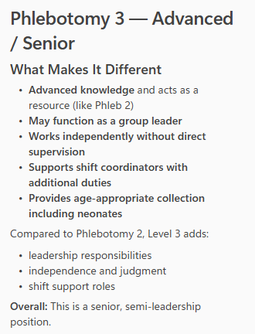
Phlebotomy Technician III
High school diploma or GED
2 years experience in home department
ASCP Phlebotomy Technician Certification
CPR Certification

Slide 10
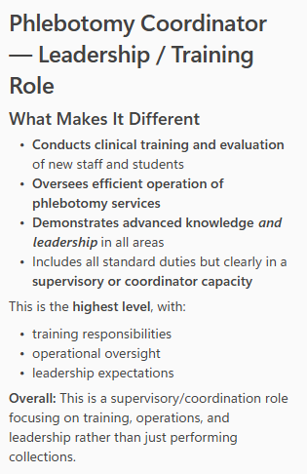
Phlebotomy Coordinator AHWFB
High school diploma or GED
3 years phlebotomy experience
Phlebotomy Technician certification, ASCP preferred.

Slide 11



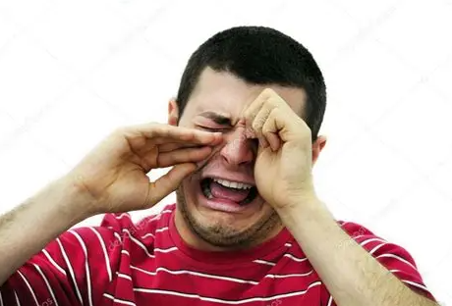

Slide 12
Metrics
Specimen containers (not tests) received into the lab: 15,231
# of tests verified: 17,597 - 2,791 manually resulted
Averaging about 600 containers per weekday.
Averaging about 400 containers per weekend day.

Slide 13
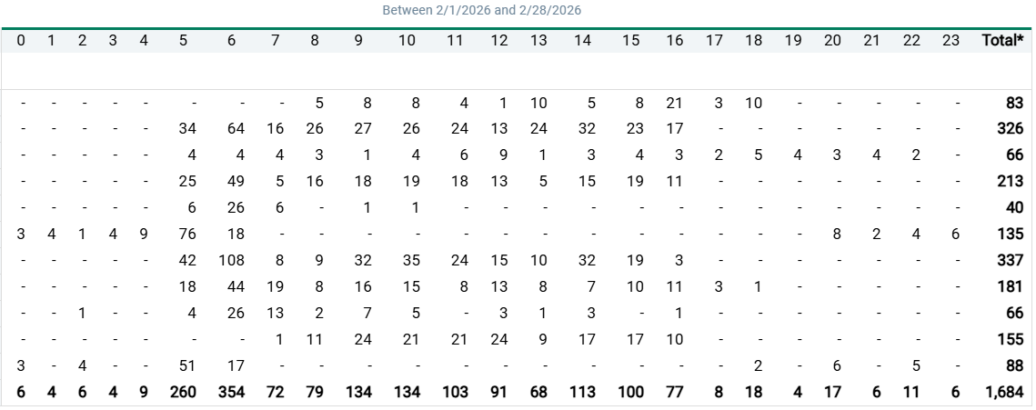
The Month of February

Slide 14
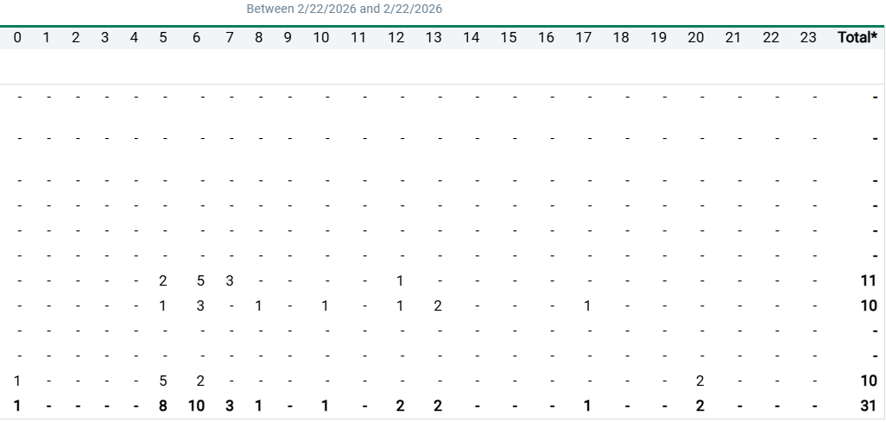
Sunday

Slide 15
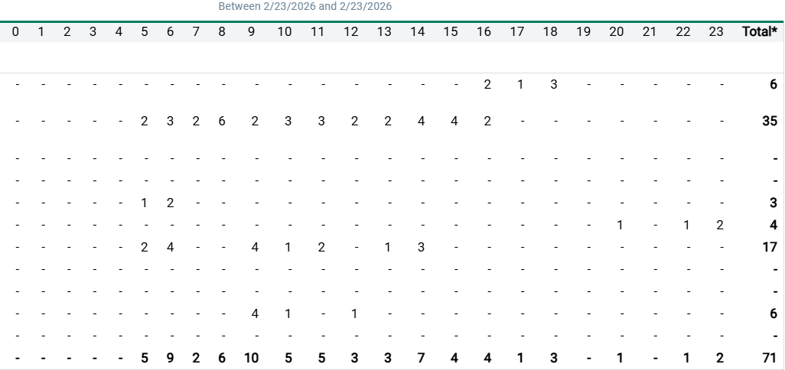
Monday

Slide 16
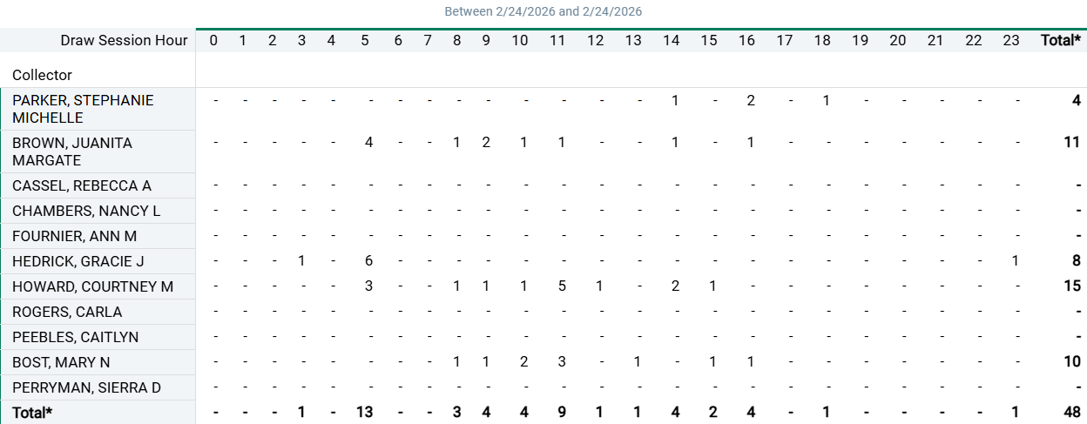
Tuesday

Slide 17
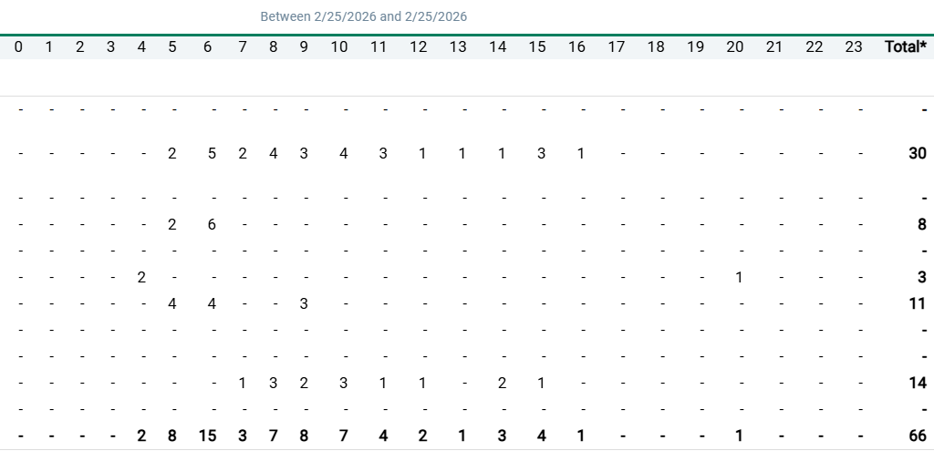
Wednesday

Slide 18
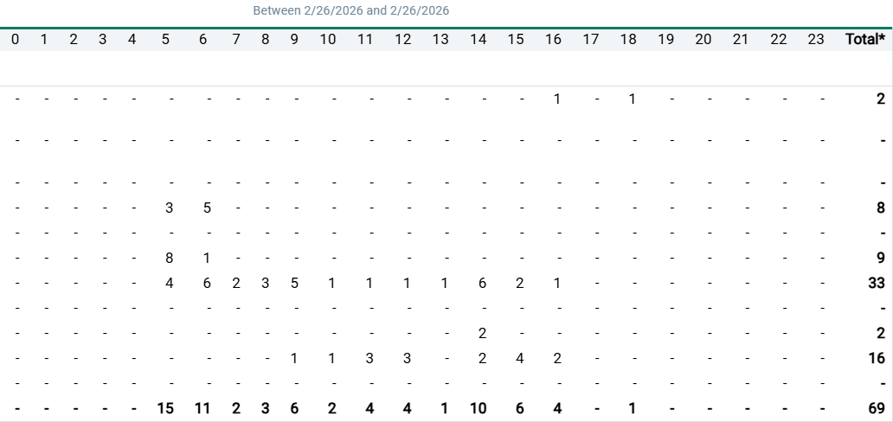
Thursday

Slide 19
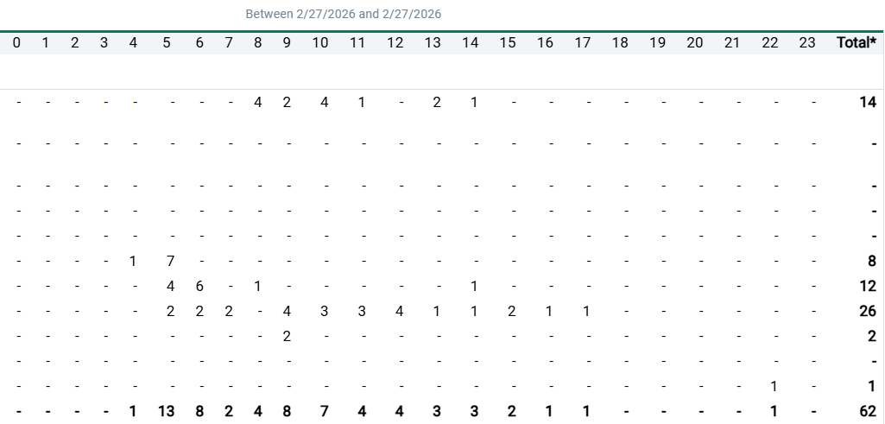
Friday

Slide 20
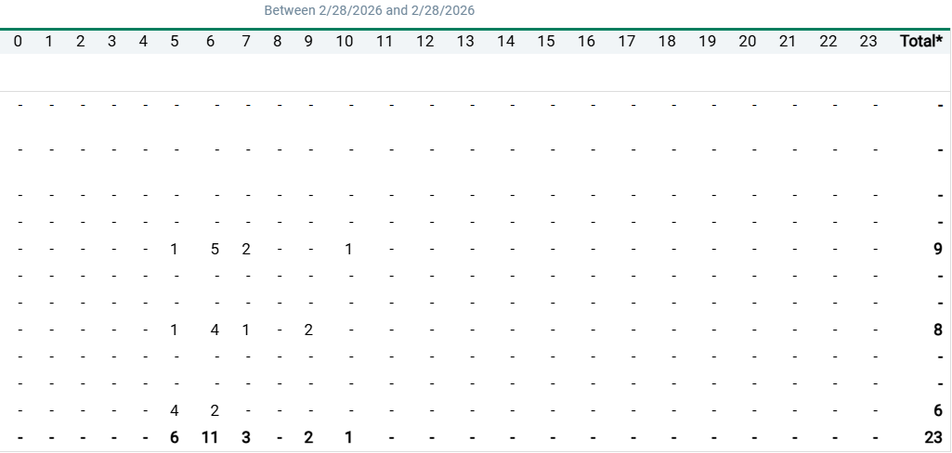
Saturday

Slide 21
Workflow changes based on volumes
Morning Rounds
2 day shifters and the nightshift person
Heavier staffing for plaza 2
Plaza 1 can call if help is needed (>4 people waiting, type and screen, needs to walk over a specimen, ect.)

Slide 22
When there are two phlebotomists in the laboratory
Phlebotomist #1- Tube Station
Specimen processing: answering the tube station, receiving specimens, gets specimens ready for testing (spin & pour off, rock, properly store send outs), add-on’s, answering phones.
Phlebotomist #2-Send out bench
Kit testing & urinalysis, sticks inpatients and outpatients, help Plaza 1, add-on’s, answering phones, packing lists, (be sure to watch the time and close the packing list if you’re going out for rounds)
Be sure to communicate and help each other, and if you need coverage ask the techs to step in.

Slide 23

Phlebotomy 3 Duties
Carla- rotate stock in draw room in Plaza 2 and all phlebotomy carts
Juanita- rotate supplies in Plaza 1
Nancy-Safety Walk, check expiration dates
*Refer to Stephanie for instructions and clarification

Slide 24
Planning for May Schedule
Who to call? – Valerie & Kristen rotate call. Stephanie should not be contacted off hours for call-ins or questions.
PTO – All PTO requests must be submitted via email by the 10th of the month prior.

Slide 25


Slide 26


