Slide 1
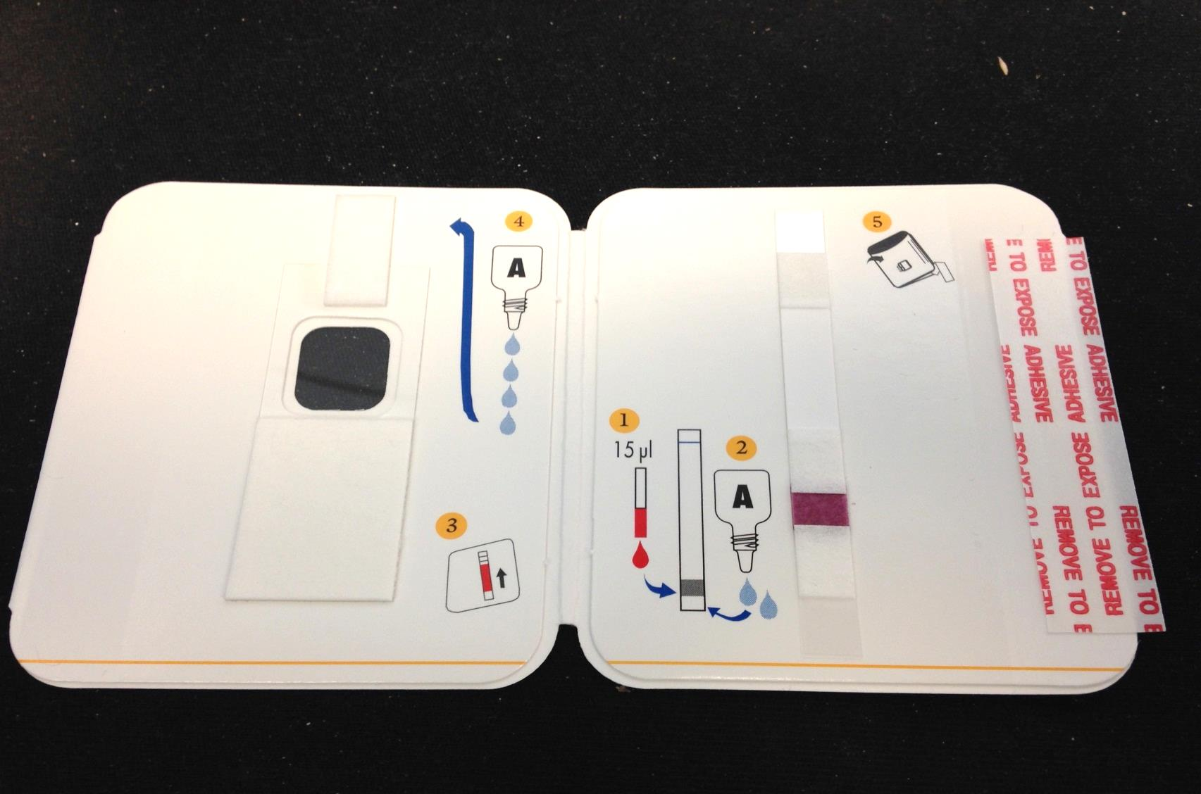
BinaxNow® Malaria
Rapid Antigen Testing

Slide 2
Principle
The BinaxNow® is an immunochromatographic membrane assay that uses monoclonal antibodies to detect malarial antigens in venous blood specimens
The antibodies are conjugated to visualizing particles and are immobilized on a membrane test strip enclosed within a small cardboard book-shaped device that aids in the rinsing and clearing of blood from the strip once closed
One monoclonal antibody is directed towards a histone rich protein II (HRPII) antigen specific for Plasmodium falciparum
The second monoclonal antibody is directed towards aldolase a pan malarial antigen shared by all Plasmodium species infecting humans
There is a procedural control line built in containing a gold conjugate that must react with color change in order for the test to be valid

Slide 3
Sample
Test is performed on EDTA (purple top) tube
Blood may be tested up to three days after collection if stored at 2-30ºC but if positive reflex testing recommends slides be made within two hours of collection
Let come to room temperature prior to testing if refrigerated
Mix gently prior to testing

Slide 4
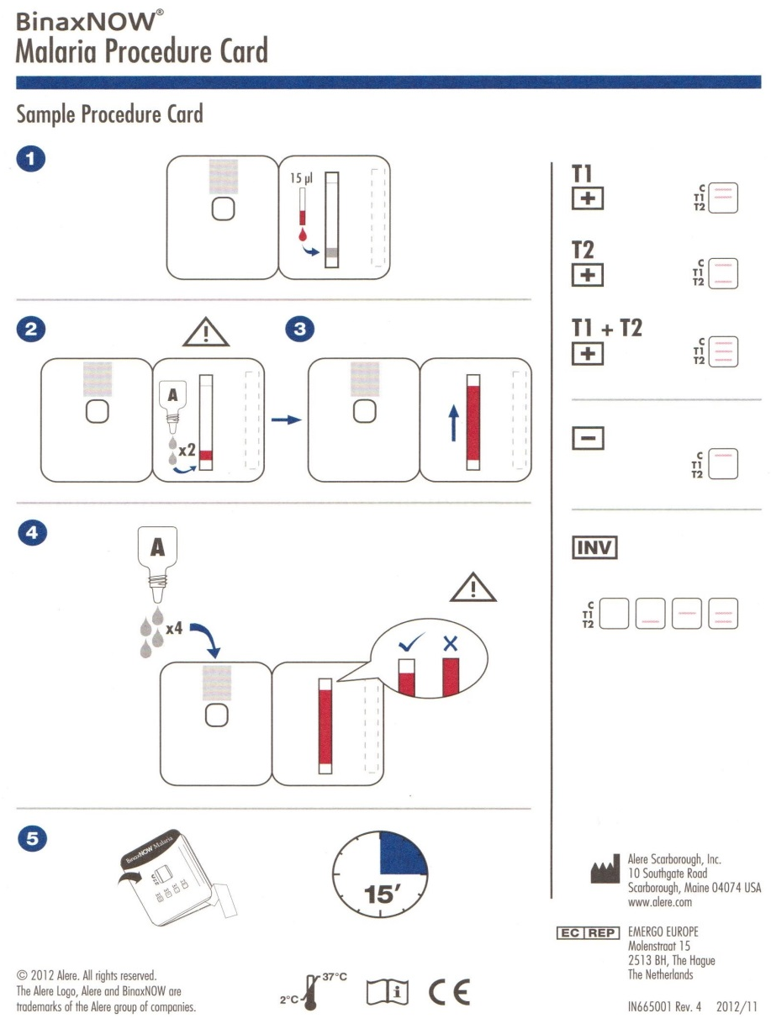
Procedure Cheat Sheet
There is a cheat sheet enclosed in every box that pictorially describes the testing process
These pictorial steps are also included on the test card itself

Slide 5
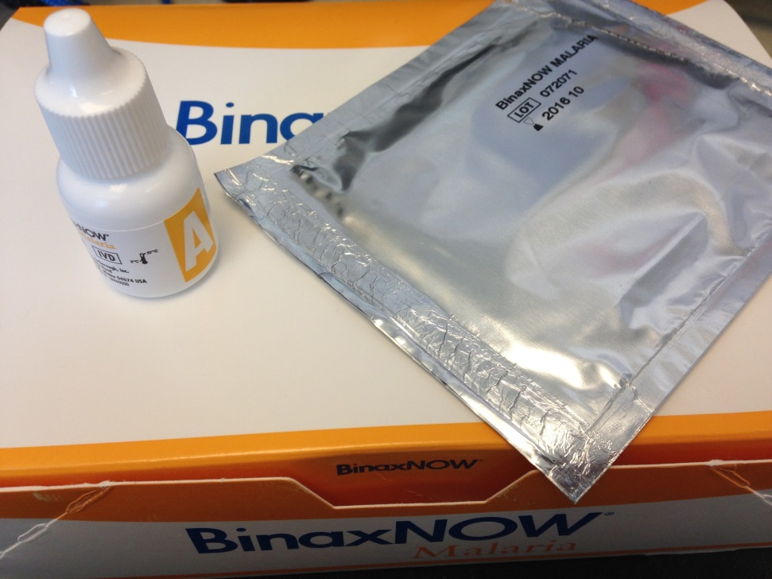
Test Kit
The kit comes with 12 test devices and a buffer (Reagent A) used to rinse excess sample away

Slide 6
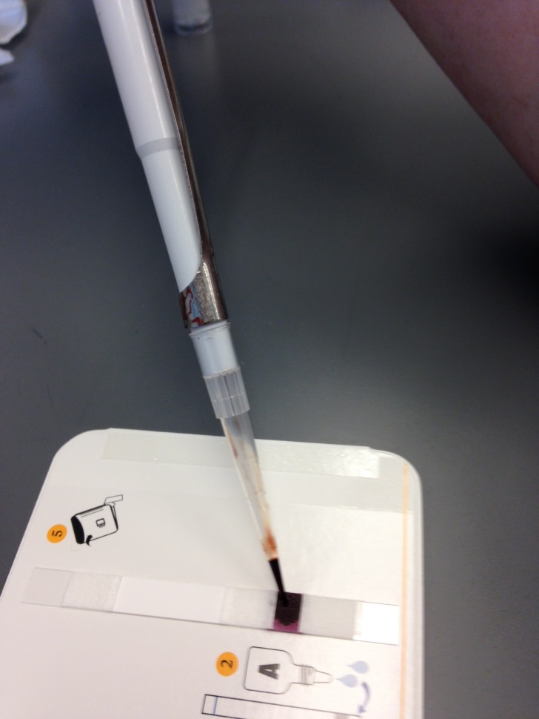
Performing the Test: Sample
Add 15 ul of sample to the center of the purple sample pad

Slide 7
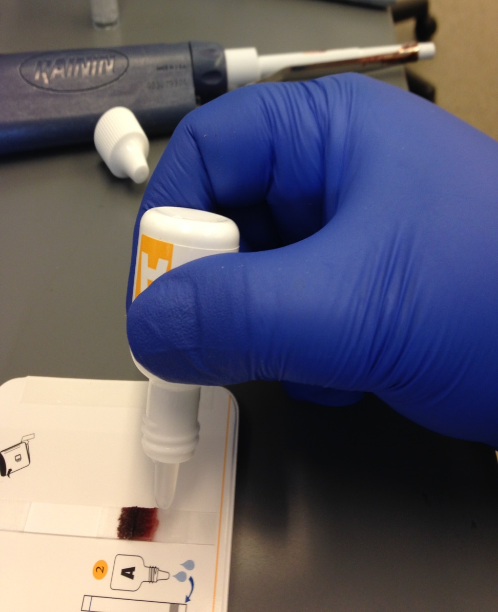
Performing the Test: Buffer 1
Add two free falling drops of Reagent A, one at a time, to the white pad immediately behind the sample pad
Allow the first drop to soak in prior to adding the second drop
This will drive the blood sample up the test strip pushing it up and over the reaction lines located towards the top of the strip

Slide 8
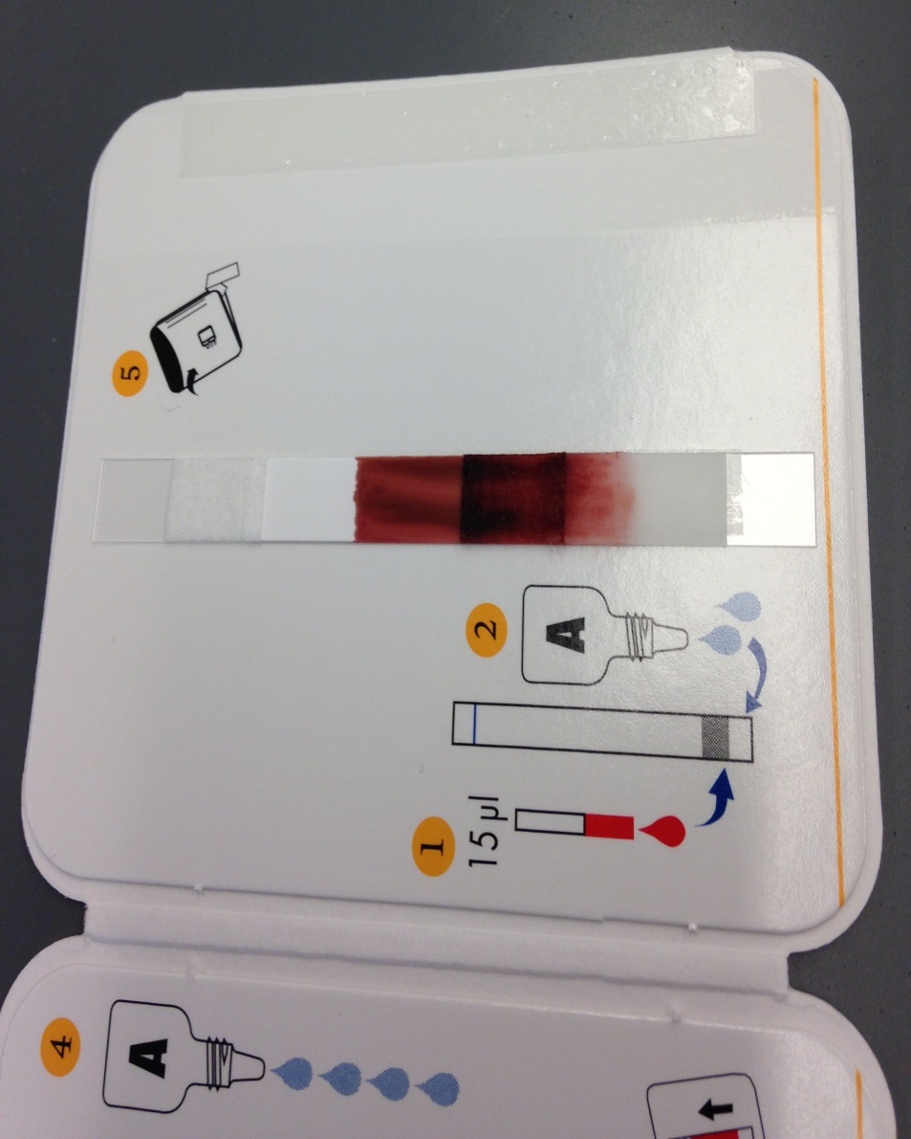
Performing the Test: Buffer 1
If the blood stalls halfway up the blood strip after a minute has passed, add one additional drop of Reagent A to the white pad below the sample to give the sample an extra push up the test strip

Slide 9
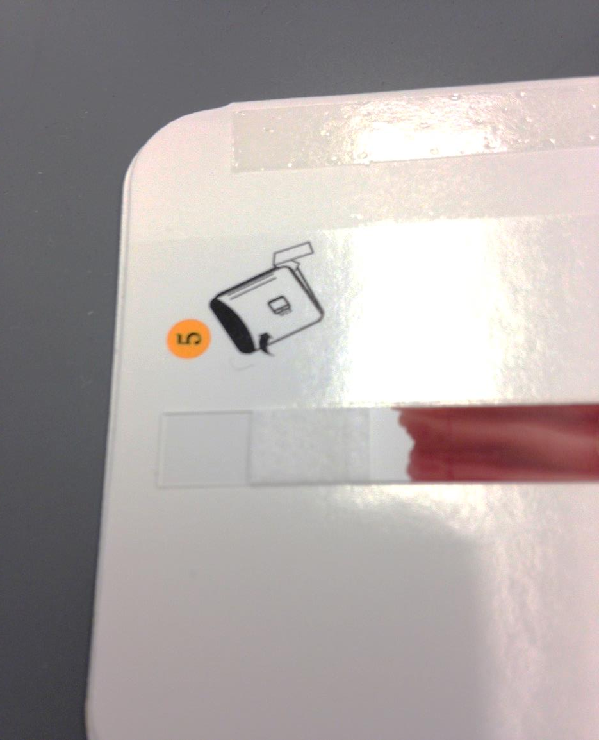
Performing the Test: Migration
Once the sample nears the end of the test strip, rinse is added to the rinse pad to clear
Do not let the blood migrate all the way up to or under the absorbance pad at the top of test strip (blue circle) to avoid hindering the washing of the sample

Slide 10
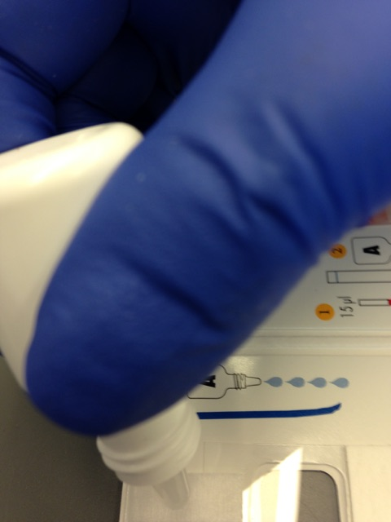
Performing the Test: Rinse
Prior to the sample migrating to the end of the test strip, slowly add 4 free falling drops of Reagent A to the wash pad on the opposite side of the test device allowing each drop to soak into the pad before adding the next drop

Slide 11
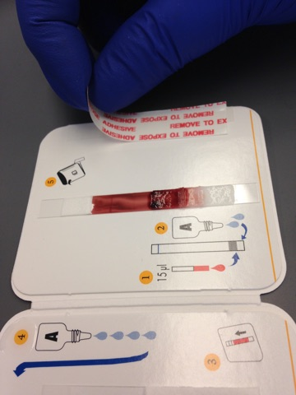
Performing the Test: Adhesive
After adding the rinse, remove the adhesive strip cover to expose the adhesive strip
Close the cover

Slide 12
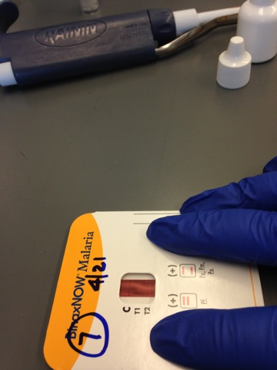
Performing the Test: Close Cover
Fold the card over and GENTLY press in all four corners avoiding the center test strip area to seal the test device and allow rinse pad to contact the test strip
The rinse will start to backwash the sample over the test strip area removing the excess blood

Slide 13
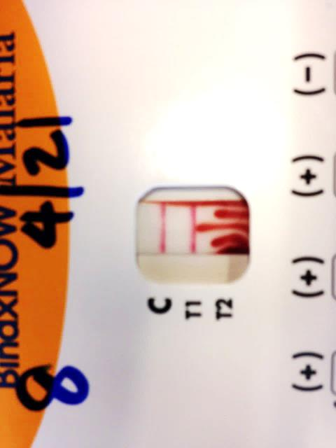
Performing the Test: Washing
The excess Reagent A will rinse the sample from the test strip leaving any conjugated antibody antigen complexes behind
Read the test 15 minutes after the test device has been closed to allow time for the rinsing to clear the test strip area completely
The instructions say that the test must be read AT 15 minutes because reading before or after may cause inaccurate results but I have had cards on my desk for weeks that are clearly readable even after drying

Slide 14
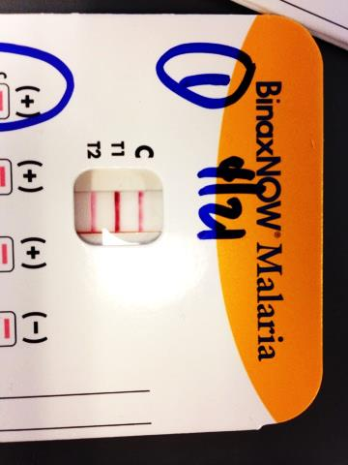
Performing the Test: Reading
The line labelled “C” is the procedural control and it must be positive for the test to be valid
Any amount of color change is deemed to be positive
Tests in which the background does not clear enough to see the color change are invalid and cannot be read

Slide 15
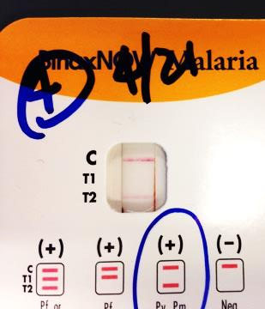
Performing the Test: Reading
T1 contains antibody to Histone Rich Protein II antibody and is specific for P. falciparum
T2 contains antibody to malarial aldolase and is pan malarial across all 4 species causing disease in humans
Match the pattern seen on the test to the patterns of positivity below the test window to speciate preliminarily.

Slide 16
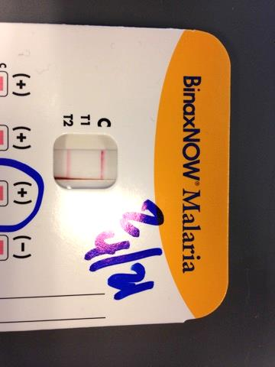
Performing the Test: Reporting
Testing is performed as a malarial screen and are reported as positive or negative with canned comments:
HT1: Control and T1 positive
HT2: Control and T2 positive with T1 negative
HT12: All three lines positive

Slide 17
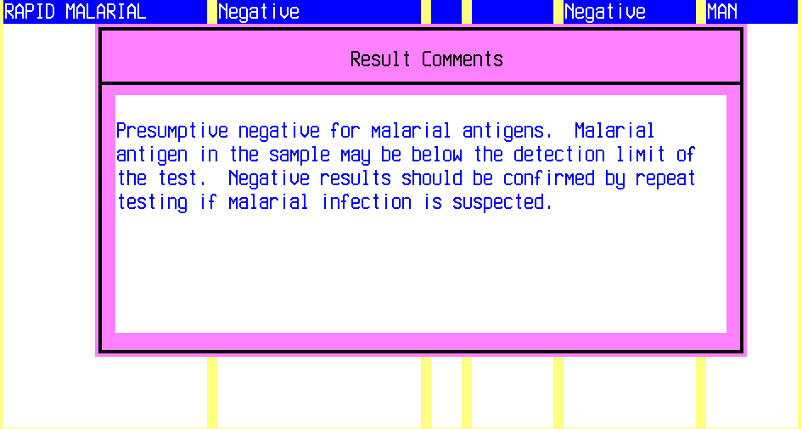
Reporting A Negative Test: LIS
Enter N for negative and the comment will be appended automatically to the sample

Slide 18
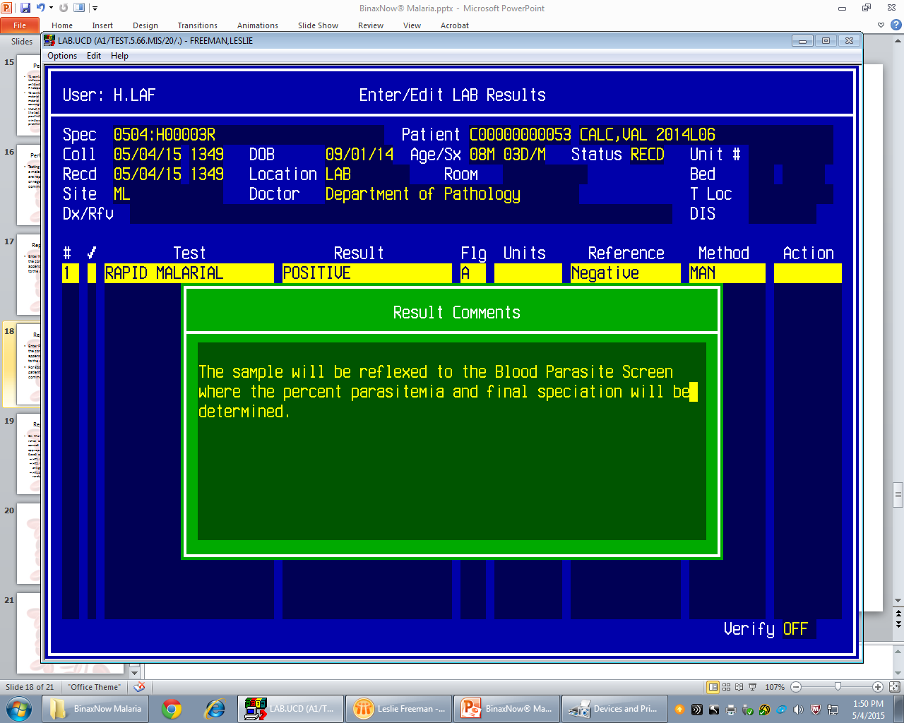
Reporting A Positive Test: LIS
Enter P for positive and the comment will be appended automatically to the sample
For Ebola protocol patients delete this comment

Slide 19
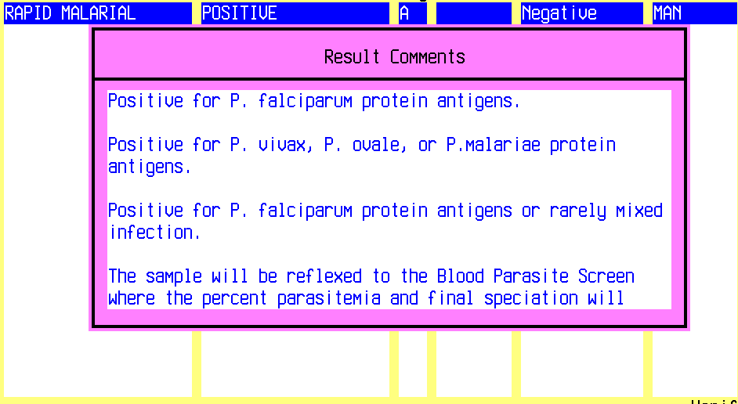
Reporting A Positive Test: LIS
On the line above the reflex comment, add a canned text comment appropriate to speciation based on test results:
  HT1: Pos for P. fal antigens
  OR
  HT2: Pos for P.v, P.o, or P.m antigens (T1 negative)
  OR
  HT12: Pos for P. fal or rarely mixed infection

Slide 20
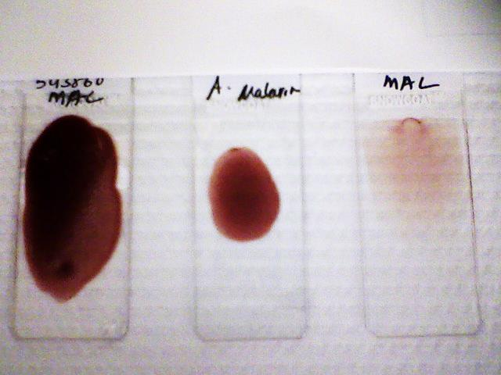
Reflexing
Positive samples will be reflexed to the Blood Parasite Screen for determining level of parasitemia and for confirmation of speciation from Public Health
See Blood Parasite Procedure #1240.t

