Slide 1
Heparin Testing
An Overview

Slide 2
Heparin
A glycosaminoglycan made from repeating sulfated disaccharide units of various lengths
Naturally occurring in basophils and mast cells
Highly negatively charged
Contains an antithrombin binding site giving it anticoagulant properties
Has a relatively short half-life
Prepared from porcine or bovine intestine or lung
Metabolized in liver and excreted in urine
Also binds to endothelial cells preventing its anticoagulant activity once bound

Slide 3
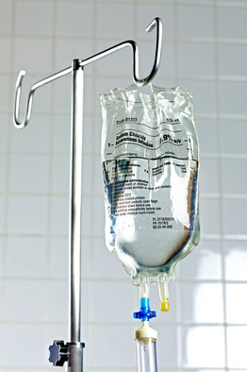
Indications
Used to treat or prevent blood clots in patients with Acute Coronary Syndrome (ACS), Myocardial infarctions (NSTEMI/MI), Atrial Fibrillation (Afib), Deep Vein Thrombosis (DVT) or Pulmonary Embolism (PE)
Used to prevent clots in other patient
populations such as trauma
Also used to keep tubing free of clots
during Coronary Pulmonary Bypass
heart surgeries (CPB),
Extracorporeal Life Support (ECLS),
Apheresis, Dialysis, and in catheters

Slide 4
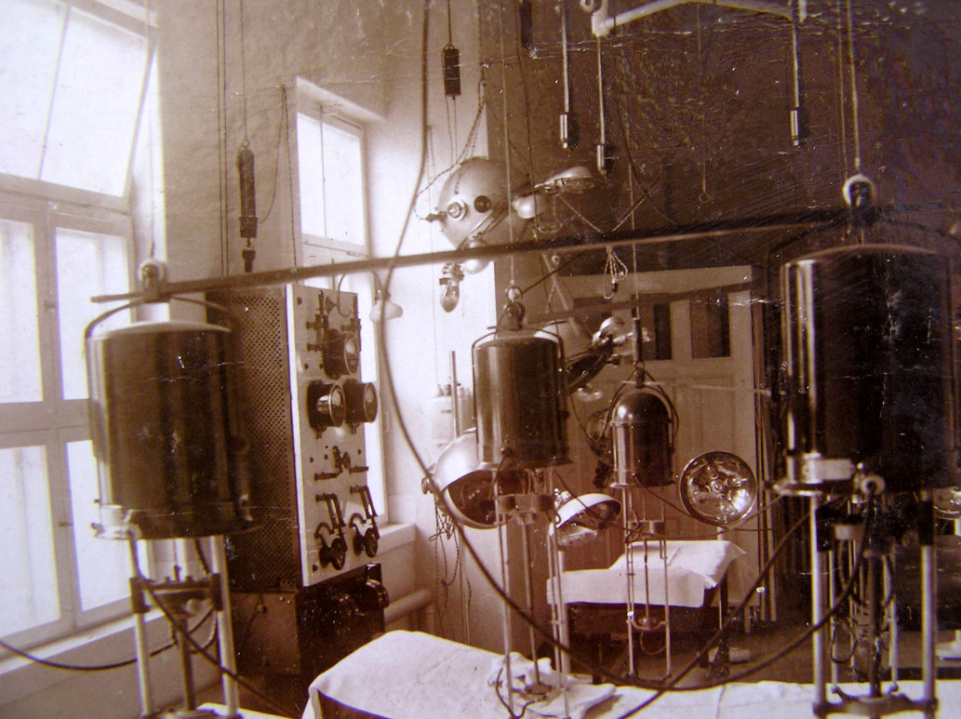
History
Discovered in 1916 by a John Hopkins medical student while looking for (ironically) procoagulant substances in canine livers
Not in use medically until the 1940’s as a cheap and easy to obtain anticoagulant

Slide 5
UFH vs LMWH vs FNDX
Unfractionated Heparin is a heterogeneous mixture of variable sized molecules ranging in size from 3000-30,000 Daltons
  The average half-life is very short: 1-2 hours (this is why it is very important to run the APTT or freeze the sample within minimal timeframes)
  Not absorbed through the GI tract
  Because of the short half-life must be continuous infusion and is therefore limited to inpatients
  Dosage is weight dependent and must be monitored

Slide 6
LMWH
Low Molecular Weight Heparin has the higher molecular weight molecules fractionated and removed leaving only the smaller sized molecules
  Lovenox, enoxaparin, and Fragmin (daltaparin) are LMWHs
  Slower clearance than UFH
  The average half-life is about four times longer than that of UFH
  Is given subcutaneously and can be used on an outpatient basis
  Is not weight dependent and does not need monitoring in most circumstances
    Very small or very large patients and patients with clearance issues do need to be monitored

Slide 7
FNDX
Fondaparinux is a synthetic polysaccharide of smaller size similar to LMWH that contains only the binding site for AT
  Arixtra is trade name for FNDX
  Also known as pentasaccharide heparin
  Slower clearance than UFH
  Given subcutaneously daily
  Has less risk of HIT associated with it
  Also has a longer half-life than UFH

Slide 8
Mechanism of Action
Heparin works by increasing the efficiency of AT due to binding of both the AT molecule and the molecules that AT acts upon (Xa and to a lesser extent IIa and IXa)
Once heparin is bound to AT, the AT undergoes a conformational change that enhances the binding ability with Xa and also IIa allowing AT to inhibit Xa and IIa in approximately a thousand times greater capacity than unbound AT

Slide 9
Mechanism of Action
UFH allows the enhanced inhibition of both Xa and IIa due to its larger size: inhibition of IIa requires at least 18 disaccharide units only present in the larger units
LMWH allows enhanced inhibition of Xa only (not IIa) because of its smaller size

Slide 10
Side Effects And Risks
Increased risk of bleeding if over-anticoagulation occurs
Increased risk of thrombosis if under-anticoagulation occurs
Heparin Induced Thombocytopenia (HIT)
Hypersensitivity
Osteoporosis
Alopecia
Risks are lower with LMWH but still exist

Slide 11
APTT Monitoring
Heparin therapy traditionally monitored with APTT
Advantages:
  Known entity
  Fast
  Cheap
  Easy
Disadvantages:
  Not a direct measure of heparin
  Variable responses to heparin between reagents and even different lots of the same reagent forces evaluation of each lot for heparin therapeutic ranges and response curves
  Individual physiological factors may influence APTT results
    Concomitant systemic anticoagulation (coumadin, etc), Antiphospholipid Antibodies and Factor Deficiencies, Liver disease or DIC may lead to elevation in APTT results resulting in under-anticoagulation
    Acute phase reactants (Fibrinogen and Factor VIII) may lead to decreases in APTT results and over-anticoagulation

Slide 12
Anti-Xa monitoring
A more direct measure of heparin levels is by anti-Xa monitoring
Advantages
  No lot to lot changes in sensitivity
  No interference from acute phase reactants or factor deficiencies etc
  Studies have shown proper anticoagulation levels are reached sooner with fewer dose adjustments with less monitoring tests performed making the higher cost of the anti-Xa test kits a wash
Disadvantages
  More specialized testing
  Underestimates heparin levels when patient is AT deficient (<50)
  Interference from other Anti-Xa direct oral anticoagulants (DOAC’s-Apixaban, Riveroxaban, and Endoxaban)

Slide 13
Anti-Xa Methodology
Known amount of Xa is added to sample
Heparin (if present in plasma) enhances Xa inhibition via antithrombin
Uninhibited Xa cleaves a chromogenic substrate and produces a color change directly in proportion to the amount of color change but INDIRECTLY proportional to the amount of heparin in the sample
  Lots of heparin present in sample leaves little uninhibited Xa and therefore little color change
  Less heparin present in sample leaves more unihibited Xa and therefore more of a color change
The rate of change in absorbance of the colored substrate is correlated to a standard curve derived from specific calibrators (UFH calibrators for UFH, LMWH calibrators for LMWH, and FNDX calibrators for Fondaparinux)
It is important for accurate measuring of the different heparins to perform the proper test for each type of heparin used
Accurate dosing requires accurate and correct measuring so double check the heparin test ordered when suspicious of incorrect orders (UFH on an outpatient, etc)
Unexpectedly high levels of heparin (>1.5 U/ml of especially LMWH) should lead you to suspect interference from the Xa DOAC’s or IV/port contamination with UFH
  Follow up with medications in EMR and query type of draw (IV? Etc)
Unexpectedly low values should lead you to suspect AT deficiency (especially in an ECLS patient)
  Query results for AT testing and if low dilute with PNP to supply AT and rerun. Calculate manually.

Slide 14
Transition to Anti-Xa Testing
Our plan is to transition from monitoring UFH therapy with the APTT to monitoring with the Anti-Xa method (LQHEPU-unfractionated heparin on the TOP
  Three step process with an Anti-Xa test available only in LIS (data gathering), followed by dual reporting of APTT and Anti Xa, then removal of the APTT for heparin therapy monitoring
We will also provide testing for the other two heparin types LQHEPL-low molecular weight heparin on the TOP, and LQHEPP-pentasaccharide or fondaparinux on the TOP)
We will be taking all heparin testing from Special Coagulation now, prior to the monitoring change as soon as enough people are trained
  Each person must have an individual check off sheet and be approved as competent prior to running testing
We will initially batch all heparins to be done once a day, on dayshift, seven days a week until Anti Xa heparin monitoring begins
  Batched on worksheet CGHEP and controls for each heparin type included in run
Once UFH is monitored with the Anti-Xa 24/7, we will continue to batch the LMWH and FNDX once a day on day shift unless emergent results are needed when they may be run on demand as long as controls are run each shift or batch

