Slide 1
QUALITY CONTROL
How to Evaluate QC and Troubleshoot Out of Control Results
Kathy Dagang, CLSS
Automated Chemistry/Urinalysis Department
UC Davis Health

Slide 2
OBJECTIVES
Define Quality Control and its basic elements.
Define the criteria we use to evaluate Quality Control: Mean, Standard Deviation, and Coefficient of Variation.
Review basic calibration theory.
Provide a consistent method to troubleshoot out of control results.
Describe Lot-to-Lot evaluation.

Slide 3
QUALITY CONTROL
What should I do?

Slide 4
WHAT IS QUALITY CONTROL?
Statistical process that tracks the ability of reagents, instrumentation (and techs) to obtain an accurate result…

Slide 5
WHY DO WE RUN QC?
Report out good results
Detect SIGNIFICANT errors in a timely manner
If there is an error, identify the source of the error

Slide 6
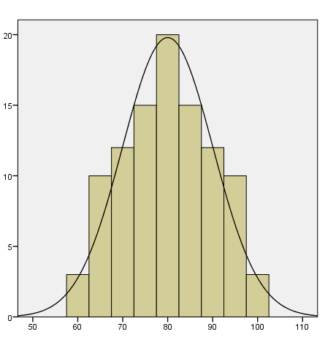
QC STATISTICS
FREQUENCY
GLUCOSE RESULTS

Slide 7
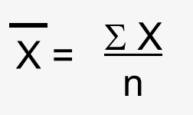
QC STATISTICS
The “MEAN”, or AVERAGE is a good estimate of a test’s ACCURACY:

Slide 8
QC STATISTICS
Normal Distribution
Skewed Distribution
Skewed Distribution
↑
MEAN
↑
MEAN
↑
MEAN

Slide 9
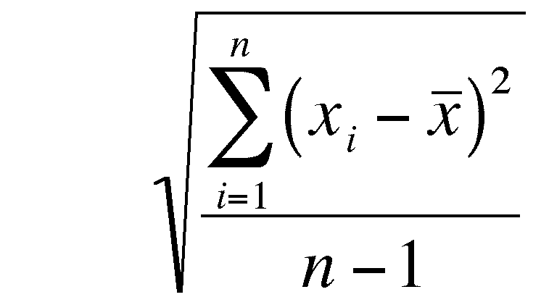
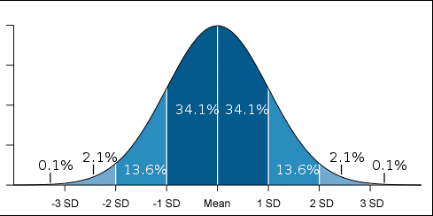
QC STATISTICS
The “STANDARD DEVIATION”, or SD, is a measure of PRECISION.
SD =
Statistically, 95% of QC points will fall within ±2SD of the mean.

Slide 10
QC CHARTS
QC CHARTS usually appear similar to this, with the line in the middle representing the MEAN, and lines above and below the mean representing the SDs.

Slide 11
QC STATISTICS
The “COEFFICIENT OF VARIATION”, or CV, is a ratio of the SD to the Mean, and is expressed as a %.

Slide 12
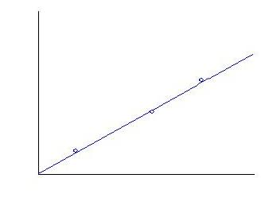
CALIBRATION
A calibration establishes the relationship between
ANALYTE
CONCENTRATION
and
INSTRUMENT
RESPONSE.
INSTRUMENT RESPONSE
ANALYTE CONCENTRATION

Slide 13
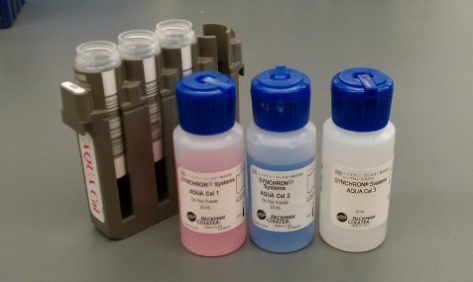
CALIBRATORS
A calibrator is a sample with a known analyte concentration.
The “set point” on the calibration report is the calibrator value.

Slide 14
CALIBRATION
CONDUCTIVITY
AQUACAL 3
AQUACAL 2
AQUACAL 1
BUN CONCENTRATION

Slide 15
CALIBRATION CRITERIA
Three criteria are used to evaluate a successful calibration:
ACCURACY
PRECISION
SENSITIVITY

Slide 16
ACCURACY
The definition of ACCURACY is
recovering expected results.
The values obtained must fall between a pre-determined minimum and maximum value.

Slide 17
PRECISION
The definition of PRECISION is reproducibility.
The values obtained must differ by less than a predetermined amount.

Slide 18
SENSITIVITY
SENSITIVITY allows us to see a difference in system response with different analyte concentrations.
Without an acceptable span, the instrument may not “resolve” two close, yet different, analyte concentrations.

Slide 19
CALIBRATION
Successful calibration requires acceptable results for ACCURACY, PRECISION, and SPAN.
QC that’s run after calibration can help you confirm that the calibration was successful.

Slide 20
SO, QC IS “OUT”
First, make sure your control is really “out”.
Compare acceptable range in BEAKER
with the ranges in the instrument or Remisol.

Slide 21
CHECK THE CONTROL
Are you using the correct control/level of control?
Is it outdated or expired, or the end of the bottle?
Has it been stored properly? Has it been sitting at room temperature for an extended time?
Is it the correct lot number?
Are there any signs of contamination or
degradation?
Is it a different shipment of control?

Slide 22
IF NO APPARENT ISSUES WITH THE CONTROL: Rerun the test on a New Aliquot of Same Bottle of Control IF THE BOTTLE OF CONTROL IS QUESTIONABLE, OR THE RERUN IS STILL OUT OF CONTROL: Open a NEW BOTTLE of control and rerun the test.

Slide 23
CHECK THE REAGENT
Was the reagent prepared properly?
Is it close to its outdate?
Is it due to be calibrated?
Are there just a few tests left (say, less than 10%)?
Is there anything going on in the instrument that could affect the reagents?

Slide 24
IF NO APPARENT ISSUES WITH THE REAGENT
Recalibrate the test and rerun the QC on all controls for the test. IF THE REAGENT IS QUESTIONABLE
Prepare and/or Load new reagent before you recalibrate the test and rerun the QC on all controls for the test.

Slide 25
CHECK THE CALIBRATOR
Check the expiration date and open stability of the calibrator.
Verify correct calibrator lot number is loaded/used.
(Compare the Lot# on the calibration printout with the Lot# on the bottle of calibrator.)
Load new calibrator data if required.

Slide 26
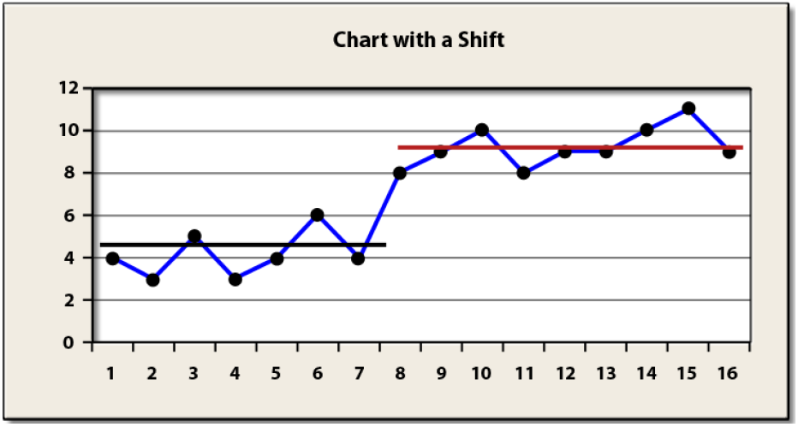
CHECK THE CALIBRATOR
Review QC charts for a “shift”.

Slide 27
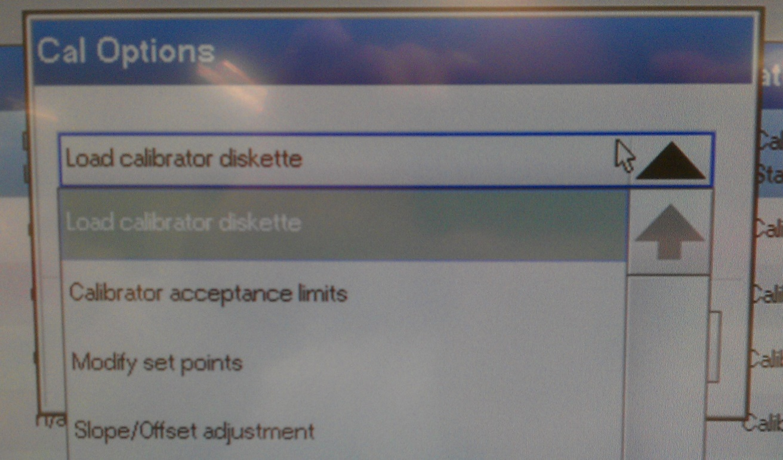
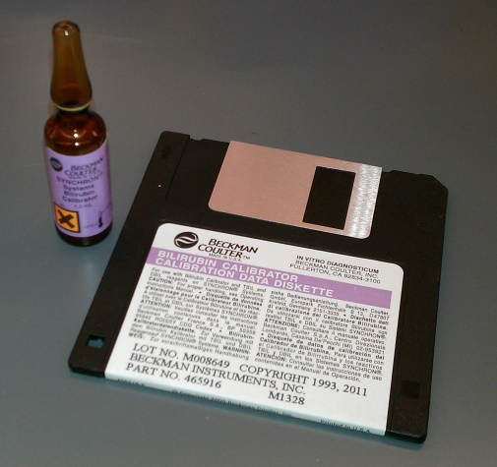
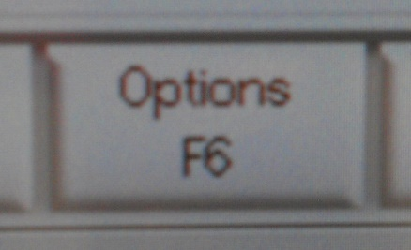
CHECK THE CALIBRATOR
RECALIBRATE AND
RERUN CONTROLS

Slide 28
STILL OUT??
Now’s the time to talk to a specialist or supervisor…

Slide 29
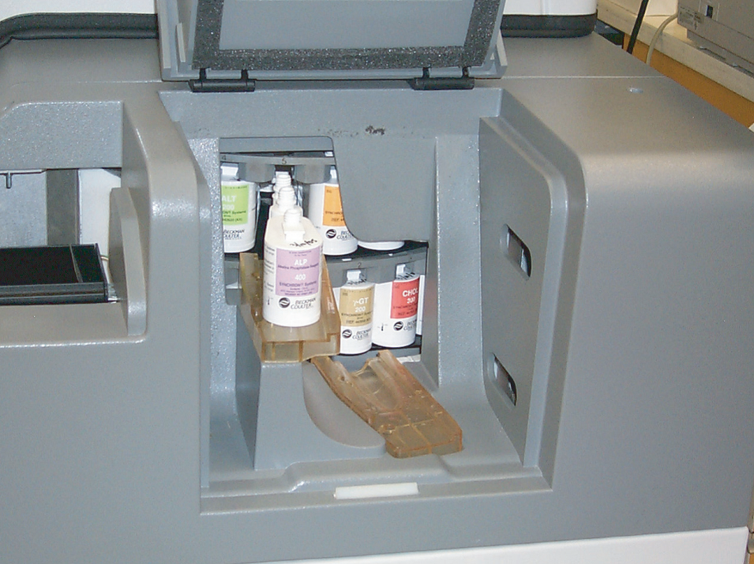
LOT CHANGES
Changing lots of reagent can often cause a shift in QC THAT IS NOT SEEN WITH PATIENT SAMPLES.

Slide 30
LOT-TO-LOT VERIFICATION
CONFIRMING THAT CHANGING LOTS OF REAGENT DOESN’T AFFECT PATIENT RESULTS IS REQUIRED BY CAP (COM.30450) AND CLIA REGULATIONS.
PATIENT SPECIMENS ARE RUN ON BOTH THE OLD AND NEW LOTS.

Slide 31
LOT-TO-LOT VERIFICATION
DO NOT USE THIS LOT NUMBER
NEW LOT Record # in Log before using
THIS LOT IS READY FOR USE
THAT MEANS WE NEED TO KEEP CLOSE TRACK OF WHICH LOTS ARE IN USE.
ALWAYS.

Slide 32
LOT-TO-LOT VERIFICATION
WHEN A NEW LOT IS RECEIVED, ORANGE STICKERS WILL BE PLACED ON EACH BOX.
WHEN THE NEW LOT HAS BEEN VERIFIED, YELLOW STICKERS WILL BE PLACED OVER THE ORANGE STICKERS.
WHEN THE NEW LOT IS PUT IN USE, GREEN STICKERS WILL BE PLACED OVER THE YELLOW STICKERS.
NEW SHIPMENTS OF THE SAME LOT WILL GET THE SAME COLOR STICKERS.

Slide 33
LOT-TO-LOT VERIFICATION
TO VERIFY A NEW LOT, SELECT A NORMAL AND ABNORMAL PATIENT THAT WAS RUN ON THE OLD LOT, KEEPING SPECIMEN STABILITY IN MIND.
 TROPONIN LOT CHANGES REQUIRE AT LEAST THREE PATIENT SAMPLES: A NORMAL, AN ALERT VALUE, AND A CRITICAL VALUE.
RUN APPROPRIATE QC ON THE NEW LOT.
 EACH REAGENT WILL HAVE ACCEPTABILITY CRITERIA FOR THE PATIENT COMPARISONS.
IF THE QC IS ABOUT THE SAME AS THE PREVIOUS LOT’S QC, AND THE PATIENT RESULTS AGREE WITHIN ACCEPTABLE LIMITS, PLACE A YELLOW STICKER OVER THE ORANGE STICKER.

Slide 34
LOT-TO-LOT VERIFICATION
IF THE QC IS OUT, OR IS SIGNIFICANTLY DIFFERENT (>1 SD), BUT THE PATIENT RESULTS ARE ACCEPTABLE, NOTIFY A SPECIALIST OR SUPERVISOR. PLACE YELLOW STICKERS OVER THE ORANGE STICKERS ON THAT LOT.
IF THE PATIENT RESULTS EXCEED THE ALLOWABLE DIFFERENCE, NOTIFY A SPECIALIST OR SUPERVISOR!

Slide 35
HELPFUL HINTS
DON’T RUN CONTROLS OVER AND OVER HOPING IT WILL COME IN, especially if you’re getting the same result.
Limit the time controls and calibrators are kept at room temperature to a minimum. Always.
Check expiration dates. Always.
Be aware of LOT#s of controls and calibrators. Always.
Review the QC chart at the right of the Beaker results. Look for results close to the mean, and scattered fairly evenly on both sides. Just because your control is “in”, doesn’t mean that you’re “in control”.
Ask for help if you need it.

Slide 36
It can’t always be like this, but with good lab practices and everyone’s help monitoring QC, running QC won’t be torture…

Slide 37
#QC123
#DONTPANIC
#YOUCANDOIT

Slide 38
REFERENCES
3000 Quality Control Procedure
3001 Lot to Lot Change Procedure
Basic Lessons in Laboratory Quality Control, BioRad QC Workbook, 2008
Basic QC Practices, 3rd Edition, James Westgard, Ph.D., 2010
Tietz Testbook of Clinical Chemistry, 2nd ed., Burtis, Ashwood, editors, 1998

