Slide 1
Performing Employee
End User Guide

Slide 2
Introduction to Document Control
MediaLab's Document Control system has been adopted to manage document
Viewing
Printing
Reviews
Approvals
Employee sign-offs
CAP checklist requirement COM.10300 "Knowledge of Procedures" requires that "The laboratory has a system documenting that all personnel are knowledgeable about the contents of procedure manuals (including changes) relevant to the scope of their testing activities."
MediaLab will notify you via email and provide notifications on your Document Control “Home & To-Do” tab whenever a document needs your sign off as a performing employee.

Slide 3
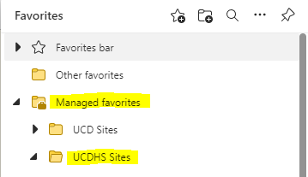
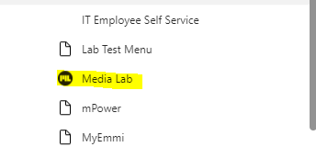
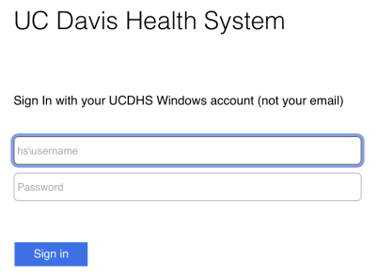
Accessing Document Control
Favorites
You can sign into the Document Control system by either of these 3 ways:
1. Open Microsoft Edge browser at your desktop(on any UCDH Network Computer).
In the upper right corner of the page, click on the Favorites Menu > Managed Favorites > UCDHS Sites, then scroll down to MediaLab
You will automatically be logged into your account.
NOTE – Since MediaLab is using SSO(single sign on), ensure you are logged in to desktop using your UCDH windows account credentials.
2. Type in any browser -medialab.com/sso/ucdavis.aspx
Log in using your UCDH windows account credentials.
3. Click hyperlink in any medialab email notification – may need to log in using your UCDH windows account credentials.
Windows Log In

Slide 4
Your To-Do List in Document Control
Once you log-in MediaLab, you will land on your Document Control – “Home & To-Do” page.
If not, click on the Apps selector in the upper right corner of your profile, then select "Document Control."
One of the most important areas of Document Control, as it contains the list of tasks that you are responsible for completing.
Most commonly, employees will have task items shown as “Documents requiring your sign-off as a performing employee.”
This is an important task, and one that helps your organization to stay in compliance with employee review of new documents and revised documents.
Be sure to always check your To-Do list for sign-off notifications.
MediaLab will send automated emails to your UCD email address whenever documents require your sign-off.
After receiving an email notification from MediaLab, you will click the link shown to log in and head to your task items shown for completion in the Document Control system.

Slide 5
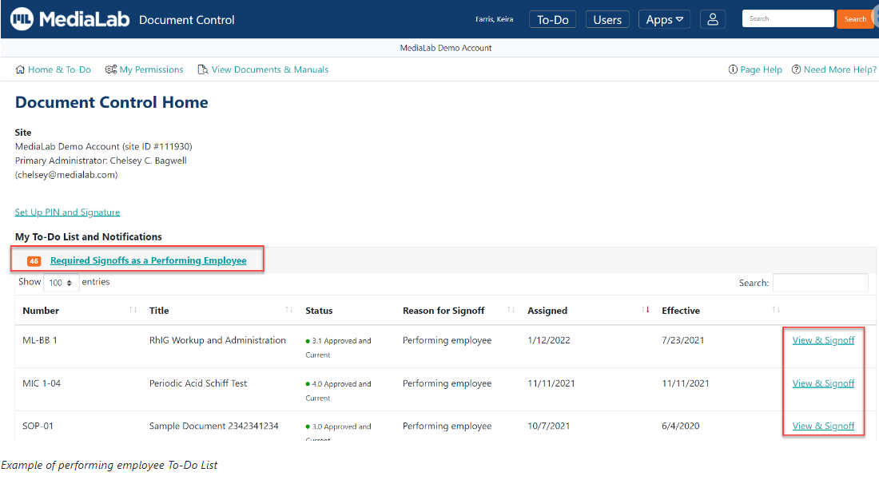

Slide 6
Setting Up a PIN & Signature(Optional)
Performing employees can create a PIN and signature(Optional). If you don't set up a PIN and signature, you can still sign off on documents.
A PIN and signature are used to approve and sign documents.
A PIN is a short code that will be used for identification when signing document each time.
The signature is an image that will be added to the document indicating you have signed off.

Slide 7
Setting Up a PIN & Signature
Optional for performing employees BUT required for other document control roles
(Lab Director, Administrator, Author)
Set Up a New PIN and Signature
Navigate to Document Control using the Apps selector in the upper blue bar.
On your Document Control "Home & To-Do" page, click "Set Up PIN and Signature."
Enter your MediaLab password.
Next, enter a PIN (letters or numbers).
Choose a signature. The signature can be an image file you upload, or you can generate a signature image by selecting a font and typing your name as you would like it to appear in the signature.
Click on the Save button.

Slide 8
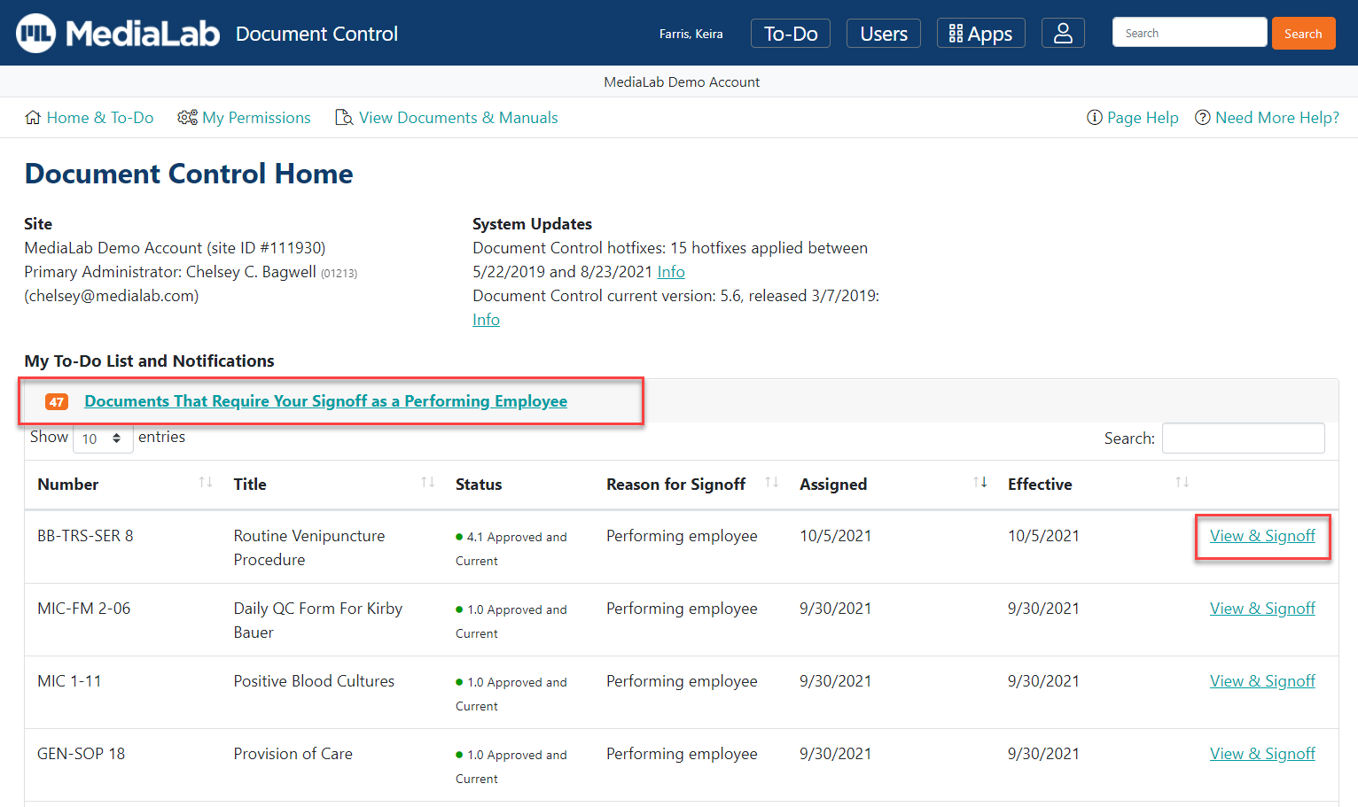
Signing a Document as a Performing Employee
From your Document Control “Home & To-Do” page -
Click on the “Documents That Require Your Signoff as a Performing Employee” folder
Click “View & Signoff” next to the document.

Slide 9
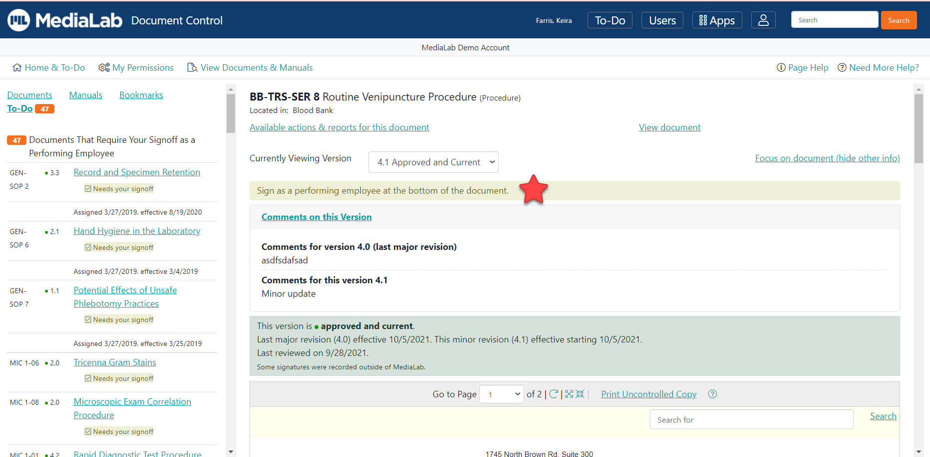
Signing a Document as a Performing Employee(Continued)
The button to sign the document is at the bottom of the document.
Once you review the document, locate the I Affirm that I Have Reviewed this Document button in the yellow box.
If you have set up a PIN & Signature, you must enter your PIN number.
Click the I Affirm That I Have Reviewed This Document button to apply your signature.

Slide 10
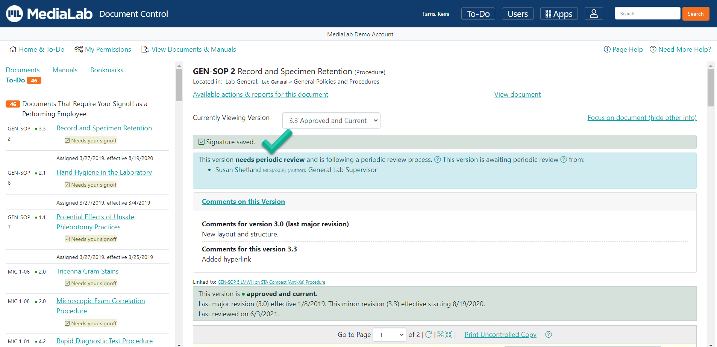
Signing a Document as a Performing Employee(Continued)
Once you complete your signature, the system saves your acknowledgement of the document and electronic sign-off with an internal date and time stamp.
Your sign-off will now appear in important sign-off reports, which are necessary to prove that your organization is in compliance with document management standards.

Slide 11
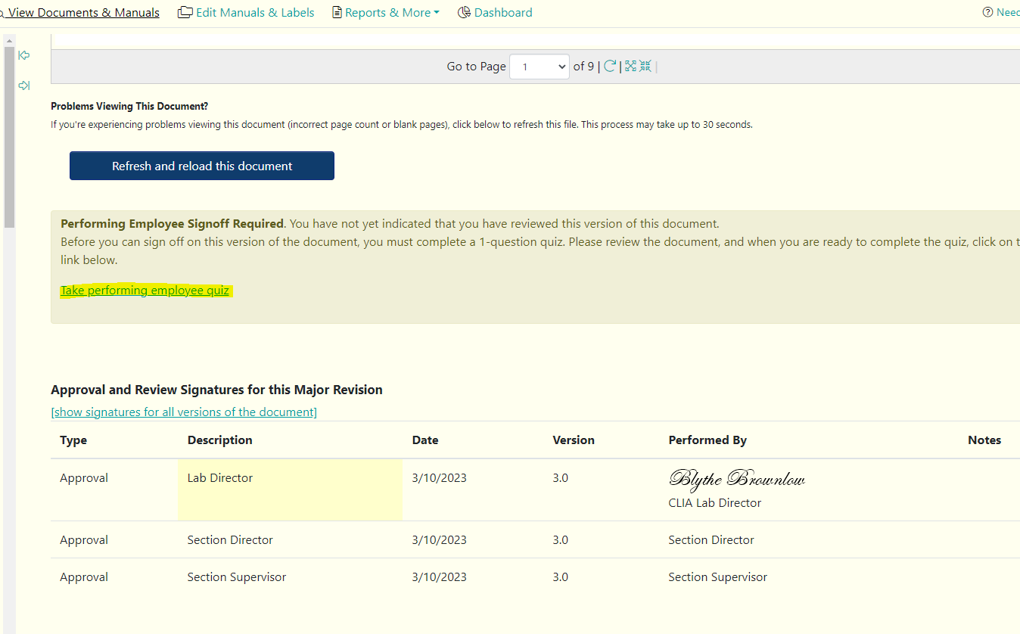
Performing Employee Quiz
Media Lab has option to build a quiz for performing employees.
Some SOPs readerships may have a quiz to reinforce new revisions or as part of training and education.
Staff must take quiz and answer correctly before sign-off can be completed.
Click on the ‘take performing employee quiz’ link to open quiz question.
Refer to next slide.

Slide 12
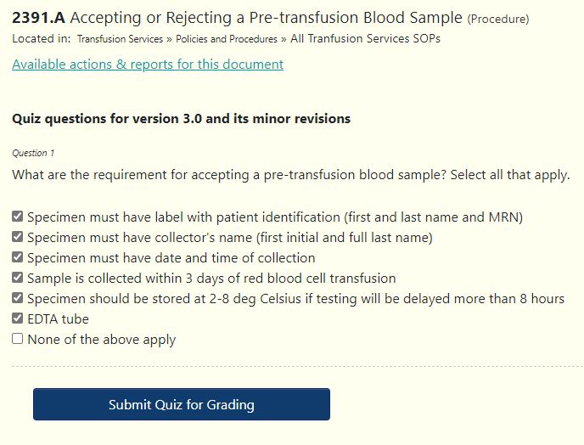
Example Quiz Question
Take quiz
Click Submit Quiz for Grading
Refer to next slide.

Slide 13
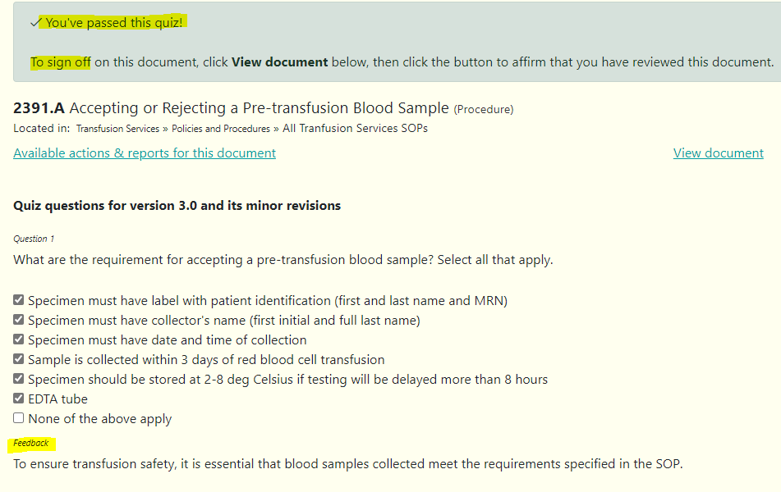

Slide 14
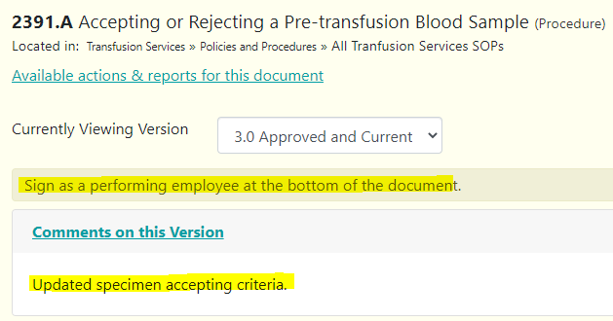
Signoff after Quiz
Scroll to bottom of document to sign-off.
Any revision comments for the document will show under Comments on this Version.
Click I Affirm That I Have Reviewed This Document to complete sign-off.

Slide 15
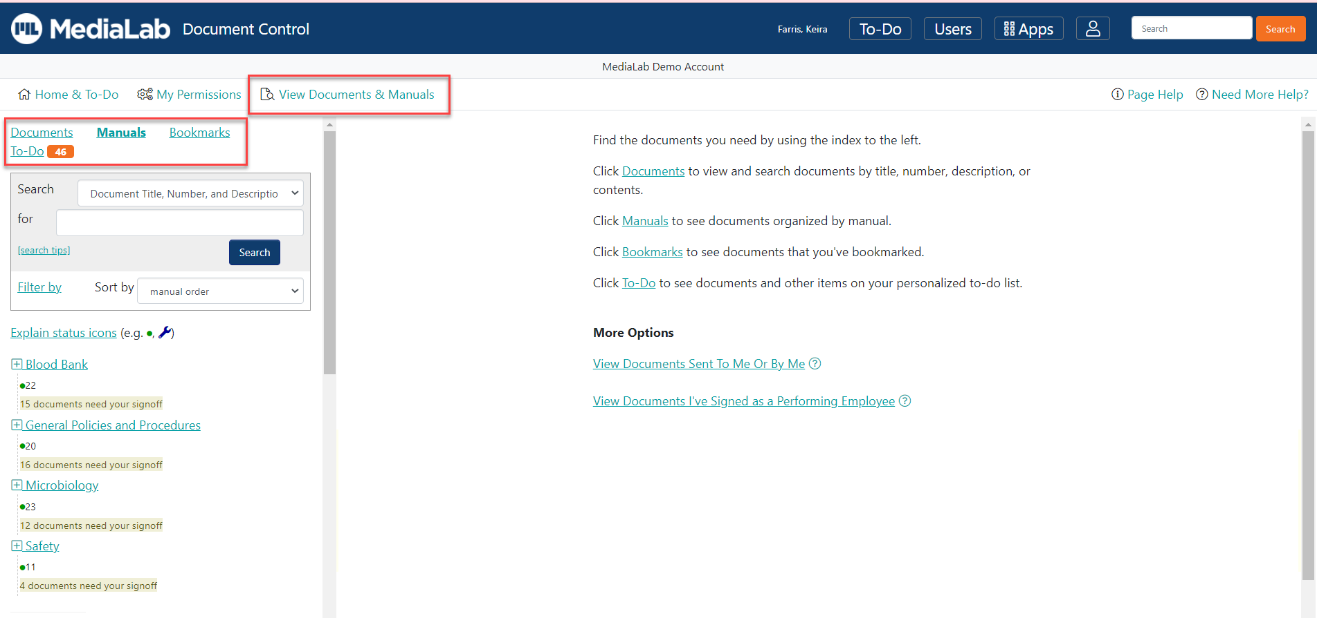
Viewing Documents & Manuals
Faster and easier than ever to search for and locate your organization’s current and approved documents.
Can search by document title, number, description, or even within the content.
Filters are also available to further refine the search.

Slide 16
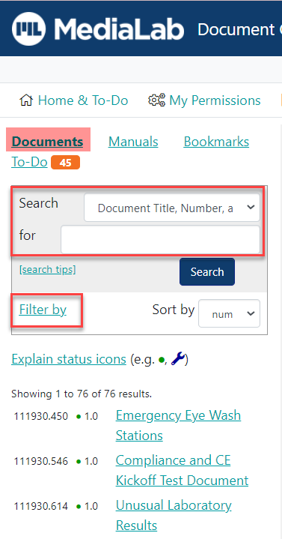
Search for Documents by Title, Number, Description or Content
On the “View Documents & Manuals” page, use the search index to the left and click on “Documents.”
Here, you can search for a document by title, number, description, or within the contents.
Use the “Search” drop-down box to select “Document Title, Number, Description” or “Document Body Text,” depending on where you want to search on the documents.
Enter important words into the “for” box that describes the document you are looking for and click on the Search button.
The documents matching your search will appear in a list. To further refine your search-
Can select “Filter By” to limit the search to only certain document types or statuses.
Can click on “Sort by” and use the drop-down box to sort the documents by title or number.

Slide 17
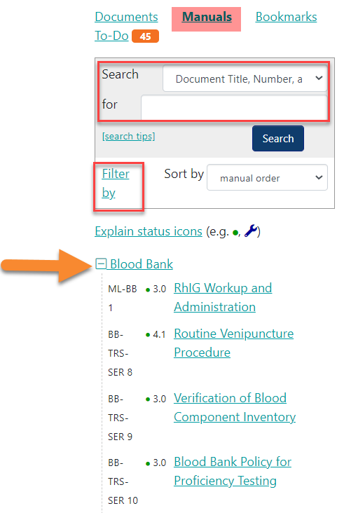
Search for Documents by Manual
To view documents organized by manual-
Click on “Manuals” in the index on the left side of the “View Documents & Manuals” page.
You will again have the option to use the “Search” drop-down box to select either “Document Title, Number, Description” or “Document Body Text.”
Enter important search words into the “for” box and click on the Search button.

Slide 18
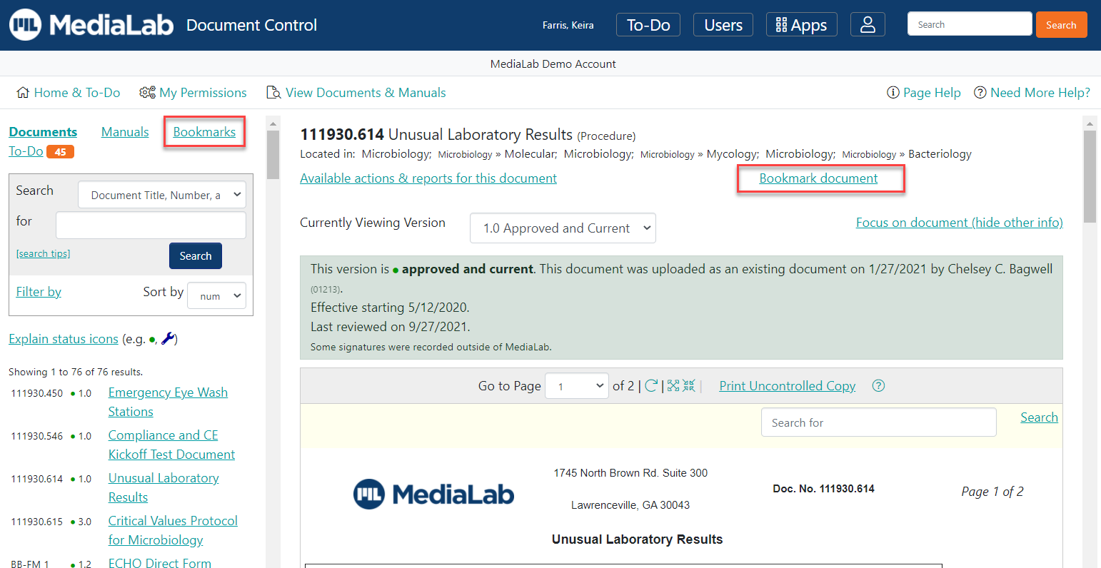
Search for Documents by Bookmarks
If you have bookmarked documents, you can select “Bookmarks” in the search index on the “View Documents & Manuals” page to view these documents.
To bookmark a document, click on a document, then click “Bookmark document” near the top of the page. Optionally add a note and click Add Bookmark.
You can select any of these documents for viewing, make any necessary edits, or delete the bookmarks that are no longer needed.

Slide 19
Sending a Document to Another User
Performing employees can use this functionality to point out any changes that may be needed.
Performing employees can only send a document to authors/collaborators or administrators(usually section directors, supervisors and CLS Specialists) over the document.
Cannot send a document to another performing employee.
To send a document:
Search for the document, then click on "Available actions & reports for this document."
Click on the "Approval and Review" sub-header, then "Send Document to Another User."
Choose the user(s) that you want to send the document to. Users are listed in order of their permissions over the document.
Enter your comment or question and click on ”Send Document.”
Document will appear in receiving users’ “Home and To-Do tab.”

Slide 20
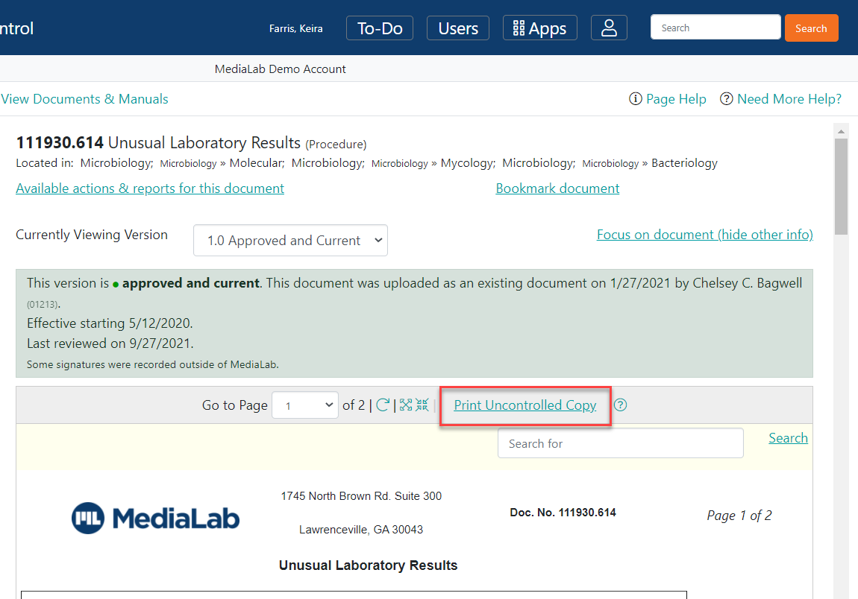
Printing Uncontrolled Copies of Documents
Unlike a controlled copy (which only administrators can print), an uncontrolled copy is not managed in MediaLab and can be printed by any user in Document Control.
Uncontrolled copies are watermarked as “uncontrolled,” and should only be used as a one-time reference.
Uncontrolled copies expire 24 hours after printing and should be destroyed after their expiration.
To print - Search for the document using the “View Documents & Manuals” search index, then click Print Uncontrolled Copy.

Slide 21
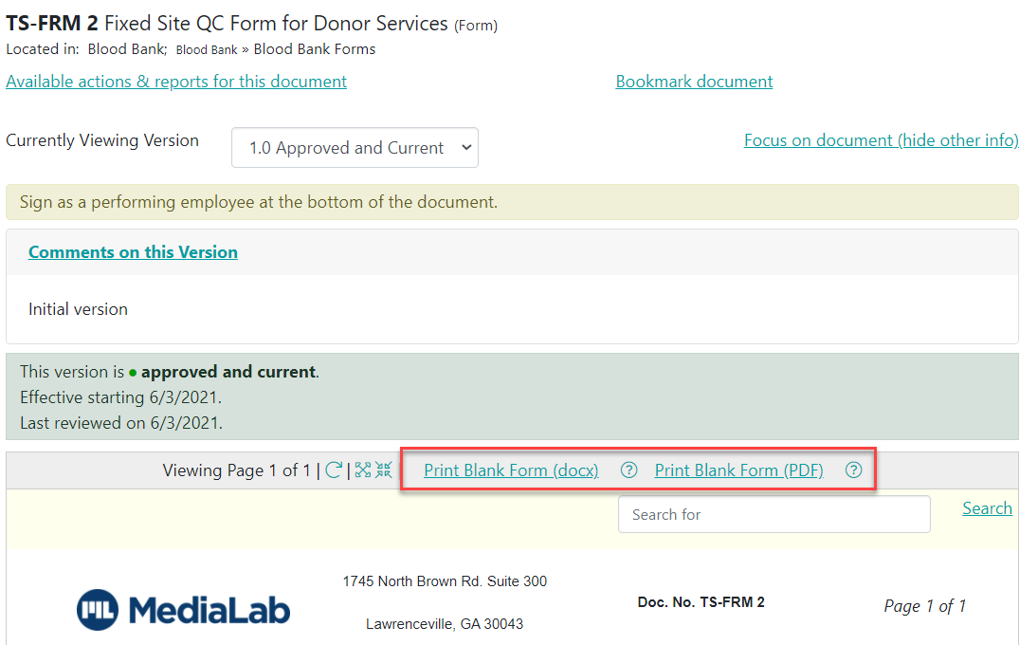
Printing Blank Copies(Forms, Worksheets)
Forms and worksheets have the option to print ”blank copies” (which are uncontrolled copies without watermark stamps) that you may need to use to complete your job.
To print a blank copy of a form or worksheet, search for the document using the “View Documents & Manuals” search index, then click Print Blank Worksheet or Form.

Slide 22
Questions & Help
If you have questions or need help, please utilize your point(s)-of-contact.
You may find your organizations’ point(s)-of-contact by clicking “Need More Help?” in the upper right corner of your profile.
You should first try and contact these users for support.

Slide 23
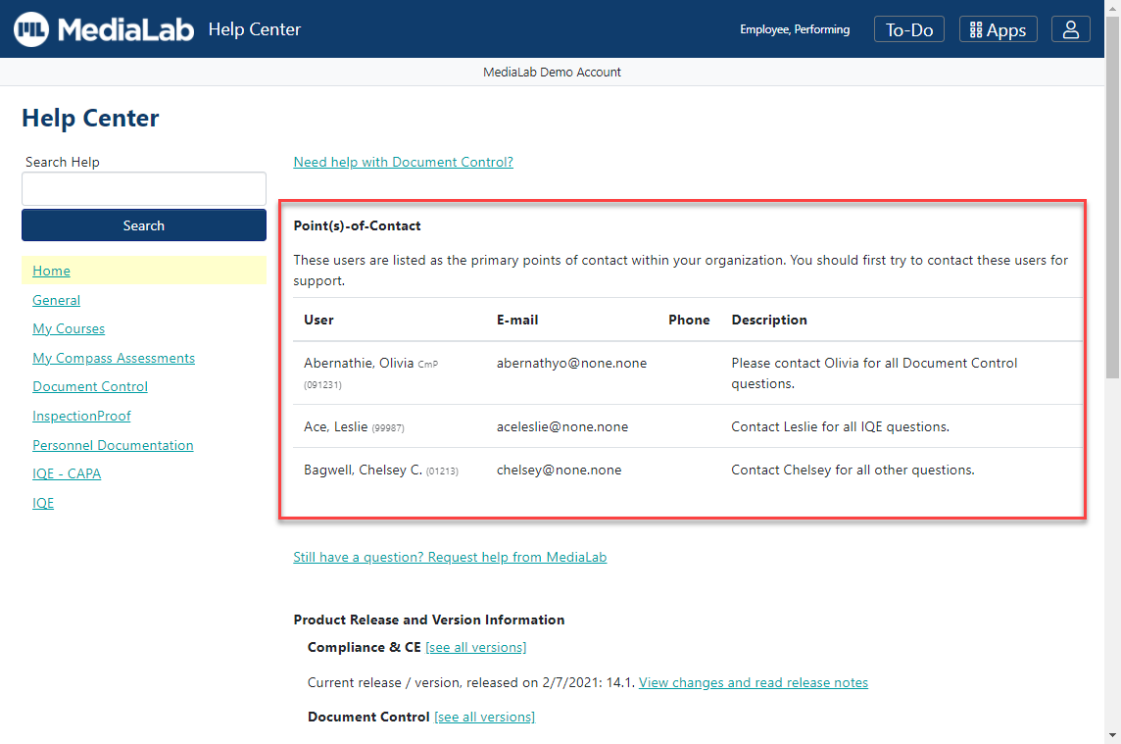
Sample Point(s)-of-Contact List

Slide 24
www.medialab.com

