Slide 1
Good Documentation Practices in the Clinical Laboratory
What is it and Why does it matter?

Slide 2
Objectives
What is GEN.20450?
Know the Dos and Dont’s of Good Documentation
Understand how to correctly read and record temperatures
Corrective Action: Know the steps to take when temperature/QC is out of range
The responsibilities of the staff and reviewers

Slide 3
Why do we care? GEN.20450
GEN.20450: Correction of Laboratory Records
This CAP checklist item states the laboratory must have a procedure to define how to make corrections to paper and electronic records. See policy 810.A
The original entry MUST BE visible (no erasing, white out, scribbling, etc)
Corrected entry MUST include the identify of the person changing the record and when the record was changed (This is so we can audit issues and track down any potential patients affected!)
21CFR211.194: Code of Federal Regulations which regulates laboratory records

Slide 4
What counts?
Temperature logs
Quality Control logs
Instrument maintenance/repair logs
Proficiency testing results
Validation plans and worksheets
Corrective Action Prevention Action (CAPA)
Staff training/competency records
…Plus any other official documentation that tracks back to quality of testing provided by a clinical laboratory

Slide 5
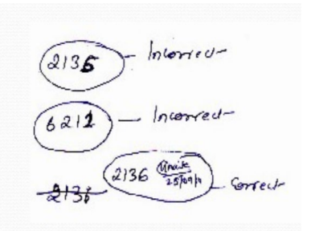
What are Good Documentation Practices?
Good documentation is the clear, legible recording and correction of laboratory records
Results must be:
Legible: everyone should be able to read what is written regardless of who, where or what has been written
Concise: the document must provide clear information that is understood by all
Traceable: who recorded it, where and why
Contemporaneous: the information should be documented at the correct time in the flow of events (ie, QC before patient testing)
Enduring: long lasting and durable
Accessible: easily available for review

Slide 6
Dos and Don’ts
Only use black, blue or red ink pens
Draw a single line through error
Add correct information above or to the side of original
Initial and date correction
Document each entry separately
Scribble out entries
Use white-out
Use pencils
Use colored pens
Use sticky notes
Draw lines through multiple boxes

Slide 7
Common Errors
Missing signature/initials and dates at the time of activity performed
Over Writing
Non-uniform date (3/22 vs 3/3/22) and signature
Illegible writing
Drawing an arrow through multiple boxes as a “ditto”
Using “” ditto marks

Slide 8
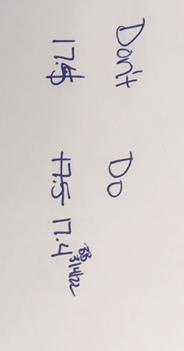
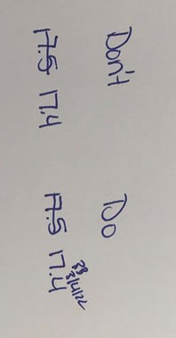
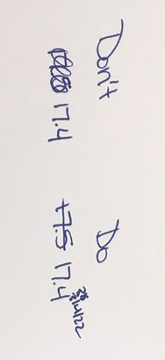
Common errors in document correction

Slide 9
Why should you care?
It’s good Patient Care! Clinical Staff rely on us to give them timely, accurate results, to treat patients appropriately!
We must be able to audit and quickly identify issues which could affect patient care.
We are responsible for ensuring our equipment, reagents and storage locations are in working order to give patients the best, most accurate results!
In the past we have been repeatedly cited for not following our own good documentation practices
It’s also the law ☺

Slide 10
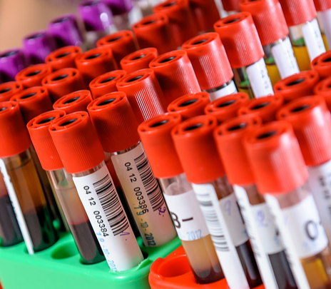
Temperatures, why do they matter?
Temperatures must be recorded in any area where supplies, collection devices, reagents or patient samples are handled or stored

Slide 11
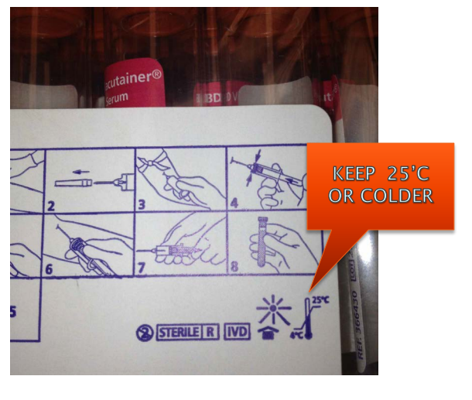
Temperatures, why do they matter?
Vendors determined what temperature ranges will affect the use of their products (tubes, reagents, controls, swabs, etc)
Storage requirements are listed on the collection device or in the product insert
Assay validation studies have determined at what temperatures products needs to be transported and stored before testing
We may get incorrect results if temperatures are out of range!
BOTTOM LINE: When the temperature is out of range there is NO CONFIDENCE that those products are stable and provide intended test results

Slide 12
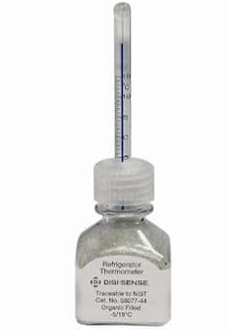
How to record temperatures
Traditional thermometer
Read the temperature on the thermometer either by digital display or using hash marks on the thermometer column
Compare reading to the acceptable range, listed on the log
Record on the log with date and initials. If it is above or below the range DO NOT IGNORE IT. Perform and document corrective action.
If issue needs escalation to be resolved, inform your lead or supervisor and document
Ensure the thermometer you’re using is the primary thermometer (ie, not the thermometer built into a fridge)

Slide 13
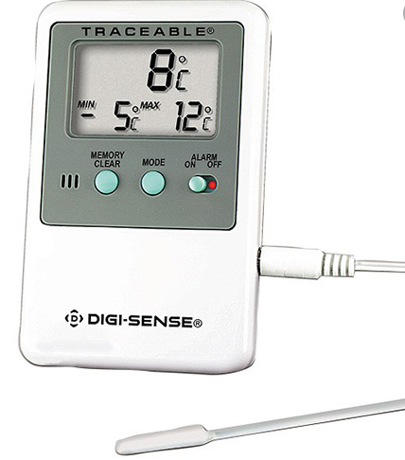
How to record temperatures
Min/Max Thermometer
Min/Max thermometers must be used in any location that is not operational 7 days per week
The digital screen will display 3 temperatures, an average for the recording period, a MIN and a MAX.
The values labeled as MIN and MAX should be recorded on the log in their respective box (Make sure you put them in the right box!)
If you notice the min or max is above/below the range DO NOT ignore it! Perform and document Corrective Action
Press the Memory Clear button on the front of the thermometer after logging the daily reading—this resets the thermometer to start recording the min and max until the next reading

Slide 14
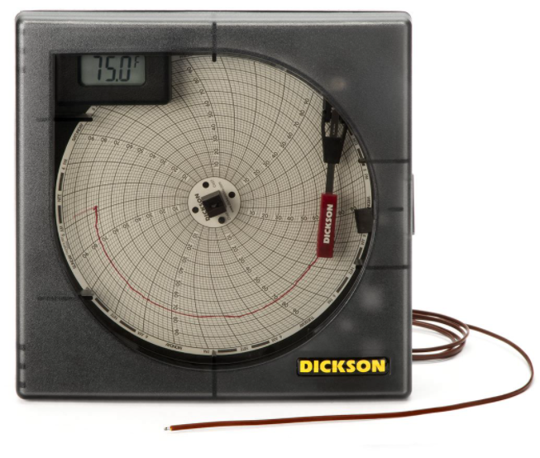
How to record temperatures
Refer to section policies for any alternative types of thermometers or temperature recording devices
NOTE: All laboratory thermometers must be NIST calibrated, if you notice there is no calibration date on the thermometer, notify your Supervisor!

Slide 15
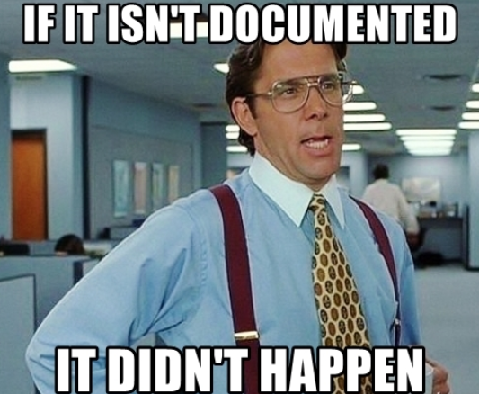
Corrective Action

Slide 16
Corrective Action: Temperature
If the temperature is above or below the range, you MUST document corrective action!
Examples of corrective action:
Call to PO&M for fridges/freezers out of range
Removing all reagents/equipment to an alternative temperature-controlled area
Make sure the fridge/freezer door is firmly closed and retake temperatures in 1-2 hours to ensure it has corrected
BOTTOM LINE: Do not ignore it and ALWAYS document what you did about it!

Slide 17
Corrective Action: Equipment/QC issues
Quality control records will vary between sections and equipment
Electronic Quality Control is recorded within the middleware or LIS system
Refer to section policies and procedures regarding how to document corrective action
Paper Quality Control is recorded on a paper log, which is retained for at least 3 years (10 years for Transfusion Services)

Slide 18
Corrective Action: Equipment/QC issues
If equipment is malfunctioning or Quality Control is outside of normal limit you MUST document corrective action!
Examples of corrective action:
Calling technical support to troubleshoot instrument
Route specimens to a backup analyzer
Check calibration, reagent expiration, control material expiration dates
Ensure calibration/reagent/control materials are well mixed and prepared properly
BOTTOM LINE: Take steps to correct and ALWAYS document what you did about it!

Slide 19
What is expected?
Basic elements of Corrective Action
When: the date the incident occurred
What: was out of range or “out of control”
Action: steps taken to correct the issue (equipment, out of control QC, out of range temp)
Who: initials of the person who took action
If you think patients’ results may have been affected, reach out to your lead or Supervisor
Duration: It should be clear when the test/equipment was out of service and when it was placed back in service following troubleshooting/repair
*Refer to section policies for specific instructions on how to document corrective action

Slide 20
Staff Responsibilities
Complete logs fully and on-time (daily, weekly, etc)
Use Good Documentation practices for all laboratory documents
Take and document corrective action for any equipment issues or out of range values
Communicate any issues affecting patient samples/results to the lead or Supervisor
If applicable, file a PET or RL incident for documentation purposes. See policy 775.A

Slide 21
Reviewer Responsibilities
Timely review (weekly, monthly, semiannual, annual) of logs to identify errors before they become bigger problems
Review for:
All data is within acceptable limits
Deviations must be noted with corrective action documented
Missing records
Incomplete entries
Illegible corrections
Supervisors will follow up with staff on any errors identified for further follow up and/or correction

Slide 22
What’s the big deal?
Peggy, a new CLS working night shift, performed QC as usual. The initial QC run was out of range, Peggy performed trouble shooting and the repeat value was within range.
Below is the weekly log for ESR QC turned into the Supervisor, the normal range is 35-45
Date | 2/28/22 | 3/1/22 | 3/2/22 | 3/3/22 | 3/4/22 | 3/5/22 | 3/6/22
ESR High | 40 | 36 | 38 | 43 | 30 | 44 | 38
Initials | AS | EK | EV | BB | PG | NK | NS

Slide 23
What’s the big deal?
The following week, Peggy’s Supervisor is reviewing the QC logs, she notices that the QC on 3/4/22 is out of range and no corrective action is documented.
Supervisor follows up with staff: Peggy says she remixed the QC suspension, reran and it was within range. However, she did not document corrective action

Slide 24
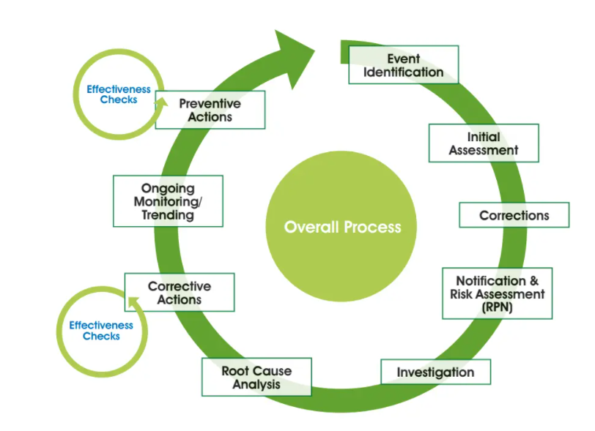
What’s the big deal?
Supervisor must file an incident report and investigate all ESRs performed on patients from 3/4/22-3/5/22 to identify any patients who may have had erroneous results
This erodes clinician’s trust in the laboratory and cost hours of time for the team investigating the incident

Slide 25
What’s the big deal?
Scenario 1 | What did happen? | What should have happened?
Staff forgot to take refrigerator temperature during their shift | Staff called PO&M and requested data from the backup system for the missing time. PO&M verified temperature remained within range since last reading. Staff documented on log. | This was the perfect response!
Date | 3/6/22 | 3/7/22 | 3/8/22 | 3/9/22 | 3/10/22 | 3/11/22 | 3/12/22
Fridge 1 (range: 2-8C) | 4 | 5 | 3 | * | 6 | 5 | 3
Initials | BB | AS | NK |  | EK | EV | NS
Corrective Action Log
*3/9/22: Temperature recording missed on 3/9/22, PO&M called on 3/10/22 to obtain backup temperature readings. All readings within range, records in Metasys, no further action needed. BB

Slide 26
What’s the big deal?
Scenario 2 | What did happen? | What should have happened?
CLS Specialist is organizing validation documents to present to medical director for signature | Original documents are messy, they have notes, cross outs, are damaged due to spills, etc. CLS Specialist decides to transcribe data to a new log for a clean presentation and then shreds originals and presents transcribed data to medical director for signature | Original documents MUST ALWAYS be kept. Data can be transcribed to a “clean” log to present the data. However, original documentation must be retained and presented to medical director for review and approval

Slide 27
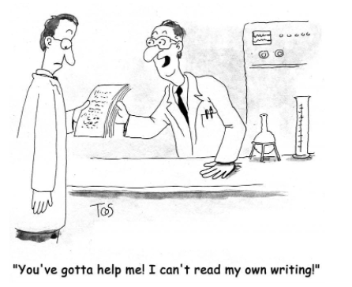
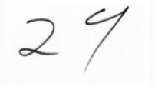
What’s the big deal?
Scenario 3 | What did happen? | What should have happened?
Staff performs proficiency testing, fills in result form, writing is illegible | Supervisor entered results on CAP website as a 29, without confirming with staff. Staff meant to write 24, CAP survey failed, causing the need for an investigation, corrective action, 3 month follow up and the potential loss of testing for that analyte (after 3 consecutive failures) | Staff should ensure writing is clear and legible, always using good documentation practices. Supervisor should have confirmed with staff if any questions arose before submitting results to CAP.

Slide 28
What can you do?
Be knowledgeable of your section policies
Double check logs to make sure all boxes have been properly completed
Think before you scribble!
Make sure you are only using blue, black or red inked pen
If you have questions or are unsure about a situation, communicate with your lead or supervisor right away!

