Slide 1
Labeling LABoratory specimens: Best Practice
Mammoth Hospital
Clinical Orientation

Slide 2
Purpose
It is a foundational principle for accuracy of any laboratory test procedure that the value of the test is influenced by
methods of collection,
labelling, handling, and
storage prior to and during the testing process.
Information provided with the sample affects processing.
Specimen mis-management can affect
patient care and outcomes,
hospital infection control,
patients’ length of stay in the hospital,
costs and laboratory efficiency.

Slide 3
objectives
Demonstrate correct methods of labeling specimens.
Identify how to use labels to match serum sample tubes.
Describe the process to access units of blood after hours: from lab.

Slide 4
Clearly Initial
Date-Time specimen drawn
Blood must be visible
https://www.osfhealthcare.org/media/filer_public/04/6b/046b5159-b54f-4ce3-9a34-c2cff73fe3b8/tube_label_diagram.jpg

Slide 5
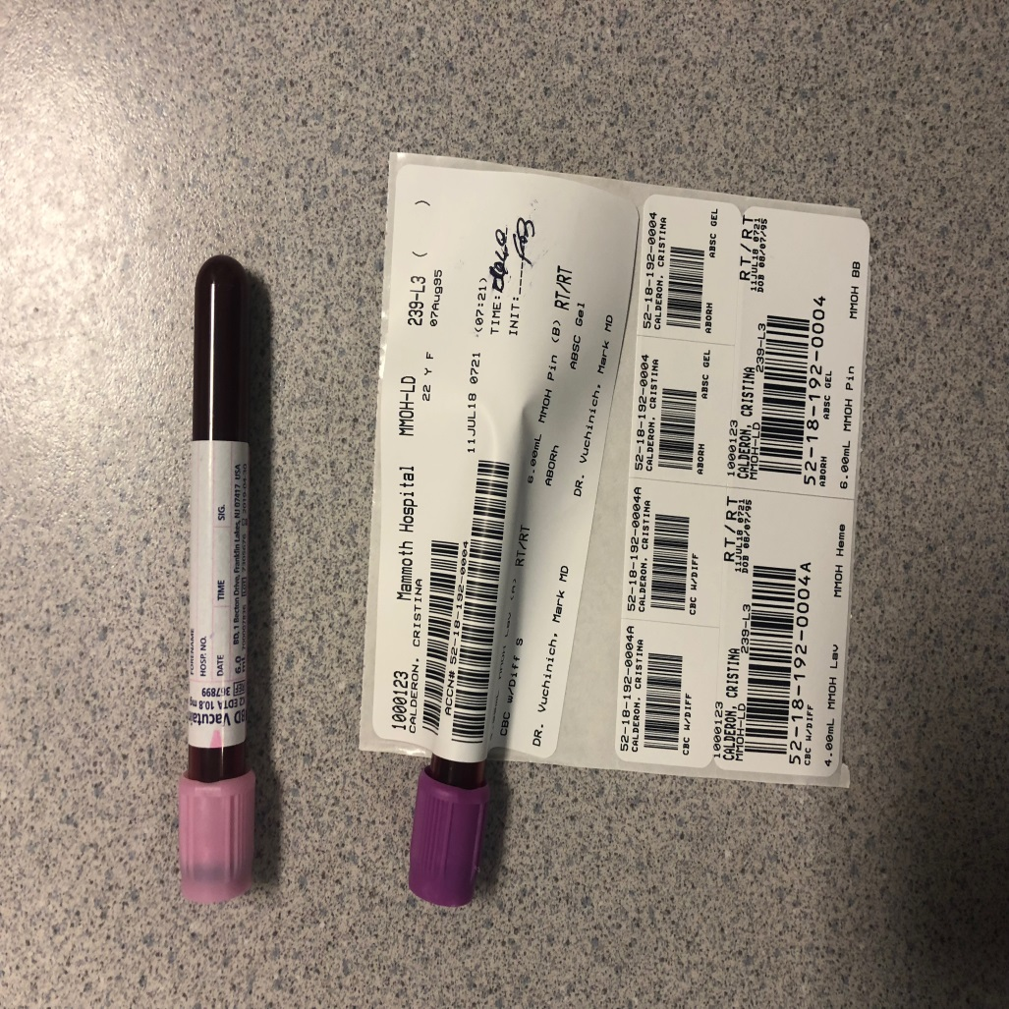
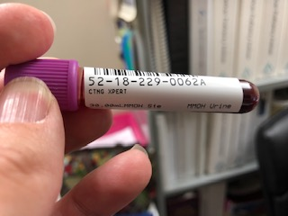
no-no’s
Oops! Urine label on serum sample

Slide 6
Serum Tube Selection
Located in all Departments for your Reference
SST
PST
Notes:
Note: Grey for Lactic Acid needs to be placed and transported on ice

Slide 7
How to Use MH Labels
Return to lab with sample: not to be applied to a sample
For extra samples without orders
Select tube: SST
Select Tube: SST

Slide 8
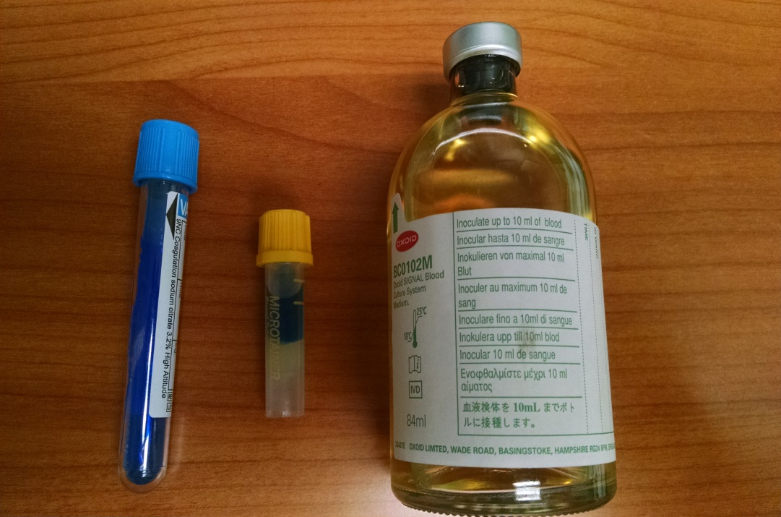
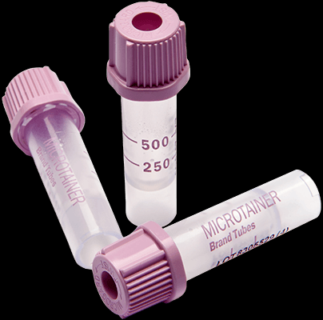
Specific Reminders
Blue top must be filled to the arrow
Pedi CBC violet color with heelstick must be rotated between drop fills to keep from clotting. This tube may be used on adults with low blood flow. Keep a few in each department just incase (acquired from the lab).
For Drug Screens: Use red top tubes (no gel): (gel may absorb drug from serum sample)

Slide 9
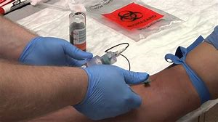
Blood Cultures
IODINE TO PREP THE SKIN (if allergic then Chloraprep).
Alcohol swab on the bottle top (dry before filling).
Bottle is dual use for both Aerobic and Anaerobic.
Must have min 1ml minimum to 10ml of blood.
Always send TWO bottles, each from a different site.
Must note LOCATION of the draw besides Date, time, initials.
Children under 8 yo only require 1ml per blood culture bottle.
Dual use bottle
Aerobic
and Anaerobic

Slide 10
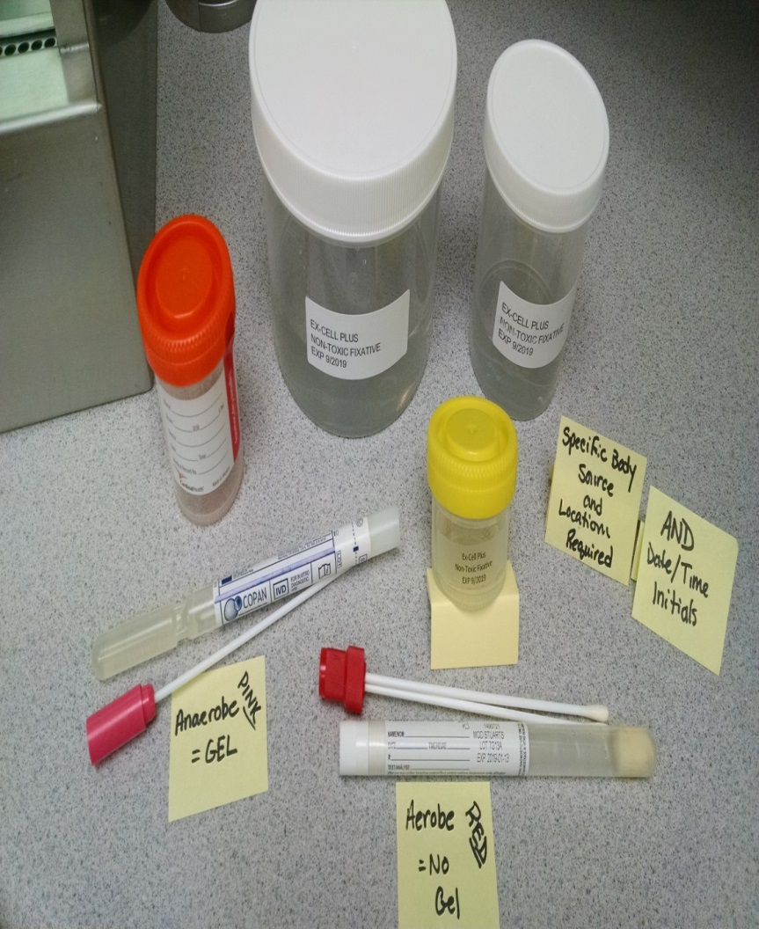
Critical: Labeling Pathology and Mircobiology Specimens
As with all specimens:
CLEARLY write Date, Time, Initials
Place labels same concept as
blood tubes.
Pathology and Microbiology Specimens must also include the BODY SOURCE and SPECIFIC LOCATION ID as defined by surgeon/physician
Cervix or polyp: by degree or clock
Bad Label: 2 specimens labeled arm
Good label: Rt Elbow and Rt Wrist
Bad label: All 5 labeled arm
Good label: Forearm1, Forearm2

Slide 11
Swabs Aerobic vs Anaerobic
Aerobic Swab: Aerobic (requires oxygen to survive): NO gel in swab.
Anaerobic Swab: Anaerobic (requires absence of oxygen to survive): “seal” it in a gel swab
Gel in Swab anaerobic
No gel in swab for aerobic

Slide 12
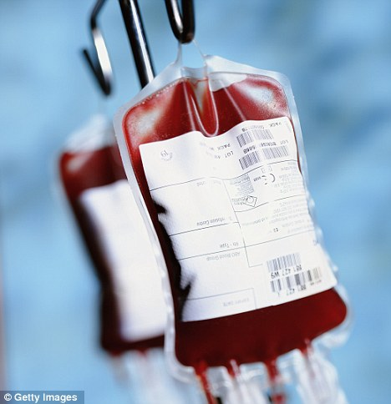
Acquiring Blood From the Lab after hours 2330-0600
After hours: Phone laboratory on-call for all blood transfusion needs
Removing blood from lab that is type and crossed will be completed with a Clinical Lab Scientist present. See after hours on call lab schedule on the intranet.
If emergency occurs after lab hours: use O– units in ED frig if patient is not typed and crossed, and call in the on-call Clinical Lab Scientist.
Notes:
This is done with the CLS (clinical lab scientist) present.

