Slide 1
The Mononuclear Phagocyte System
A Comparison of Macrophages and Monocytes

Slide 2
Overview
Mononuclear phagocyte system (MPS):
described in 1960s
consisting of committed precursors in the bone marrow, circulating blood monocytes and tissue macrophages in every organ
Monocytes:
circulating in peripheral blood
recruited into tissues in response to a wide range of stimuli
Macrophages:
recognized as phagocytes by Metchnikoff in 1884
found in all tissues; have specialized functions depending on their anatomical location:
Microglia: neuronal survival, connectivity and repair
Langerhans cells: immune surveillance in epidermis; keratinocyte proliferation control
Kupffer cells: liver tissue regeneration
Osteoclasts: bone remodeling

Slide 3
Central Nervous System Hemorrhage
Sequence of cells observed after intracranial hemorrhage or repeated lumbar punctures:
PMNs and macrophages: 2-4 hours
Erythrophages: 1-7 days
Siderophages: 2 days – 2 months
Hematoidin crystals: 2-4 weeks

Slide 4
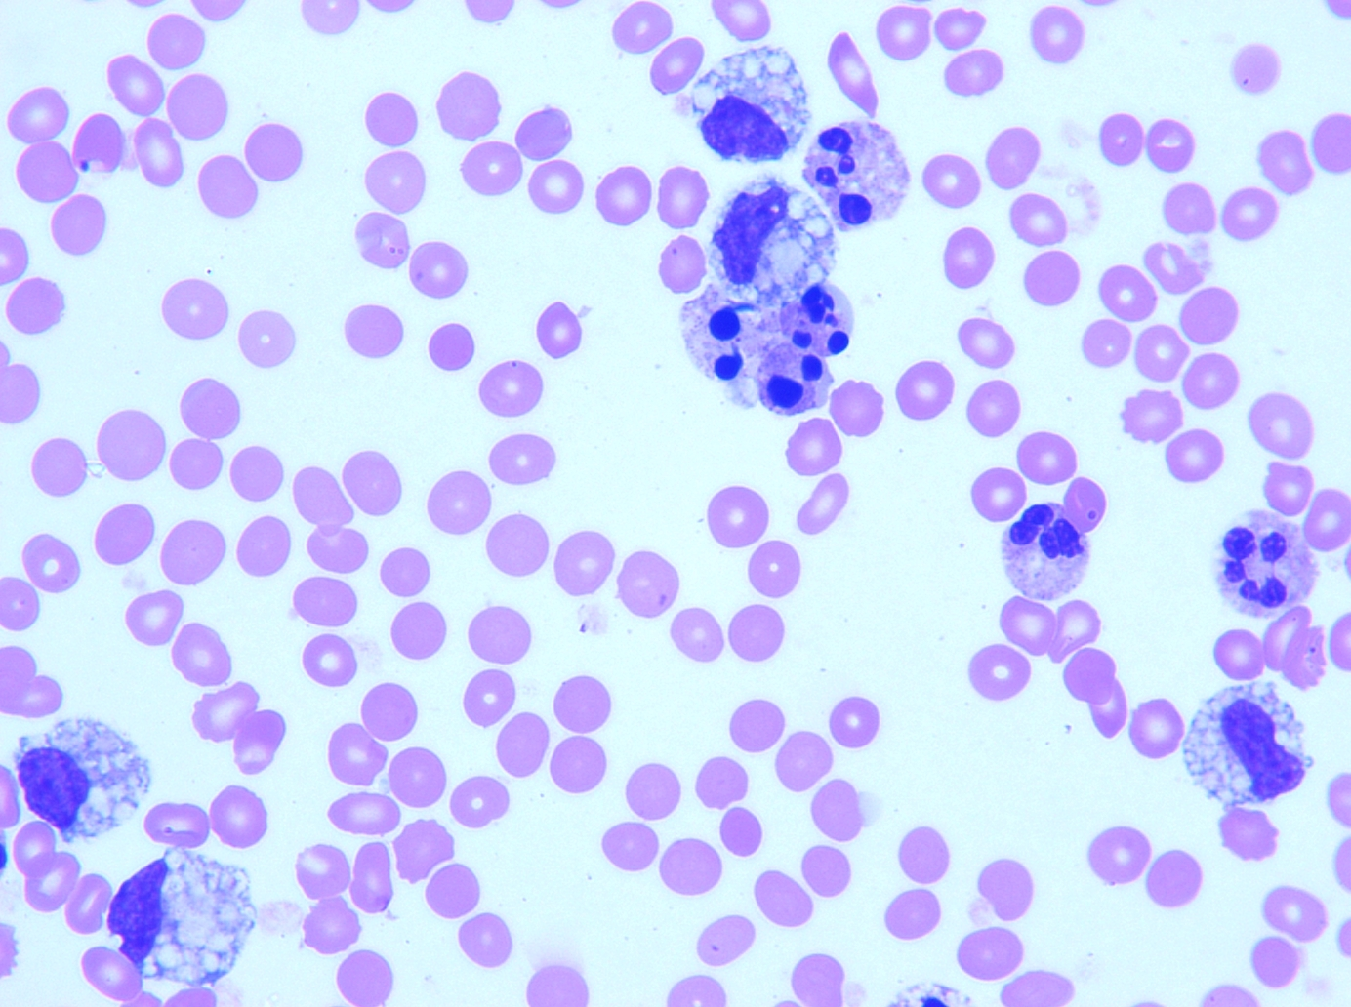
Non-phagocytizing Macrophage (A)
A
A
A
A

Slide 5
Monocyte v. Macrophage in BF
B
A
A. The monocyte nucleus is usually indented or curved with lacy chromatin. The monocyte is 12-20 um. Pseudopods and phagocytic vacuoles are common. Monocytes leave the circulation in response to chemotactic factors to differentiate into larger free macrophages, which possess greater phagocytic activity and a higher concentration of hydrolytic enzymes.
B. Macrophages are generally larger (15-85 um) than monocytes, with eccentric nuclei and pleomorphic shape. If the two cells (A & B) can’t be differentiated based on size and vacuoles alone, one must focus on the N:C ratio – much greater in monocytes.
The macrophage cytoplasm is highly vacuolated and often contains phagocytic debris. Phagocytosis by macrophages is similar to neutrophil phagocytosis, but much quicker – it requires less opsonization or complement, and can be initiated by simple contact. Targets for macrophage phagocytosis can be any non-self agent: dead or dying cells, bacteria, fungi, and viruses. They may also function as antitumor agent.

Slide 6
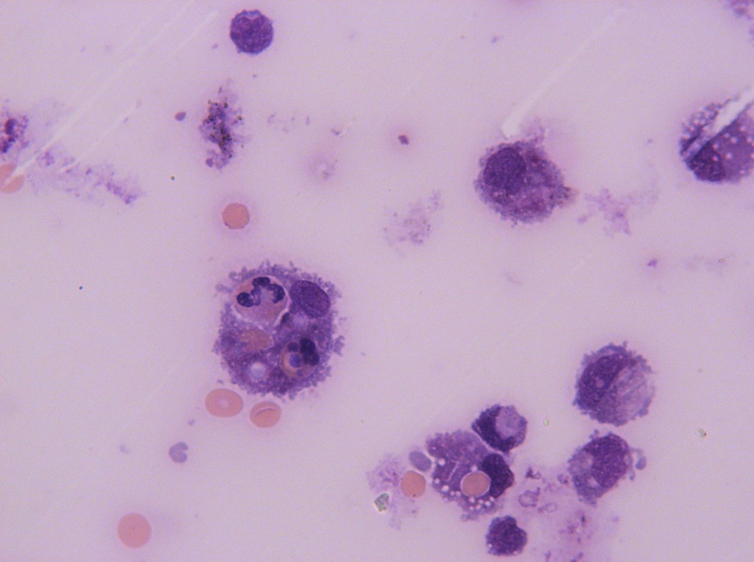
Erythrophages
A. Typical erythrophage showing the phagocytosed RBC within its cytoplasm. B. Large macrophage ingesting neutrophils and erythrocytes.
B
A

Slide 7
Erythrophages 2
A
B
A. Digestion of RBCs by enzymatic activity within the macrophage causes a discoloration of the erythrocytes and their appearance sometimes mimics vacuoles. B. Monocyte.

Slide 8
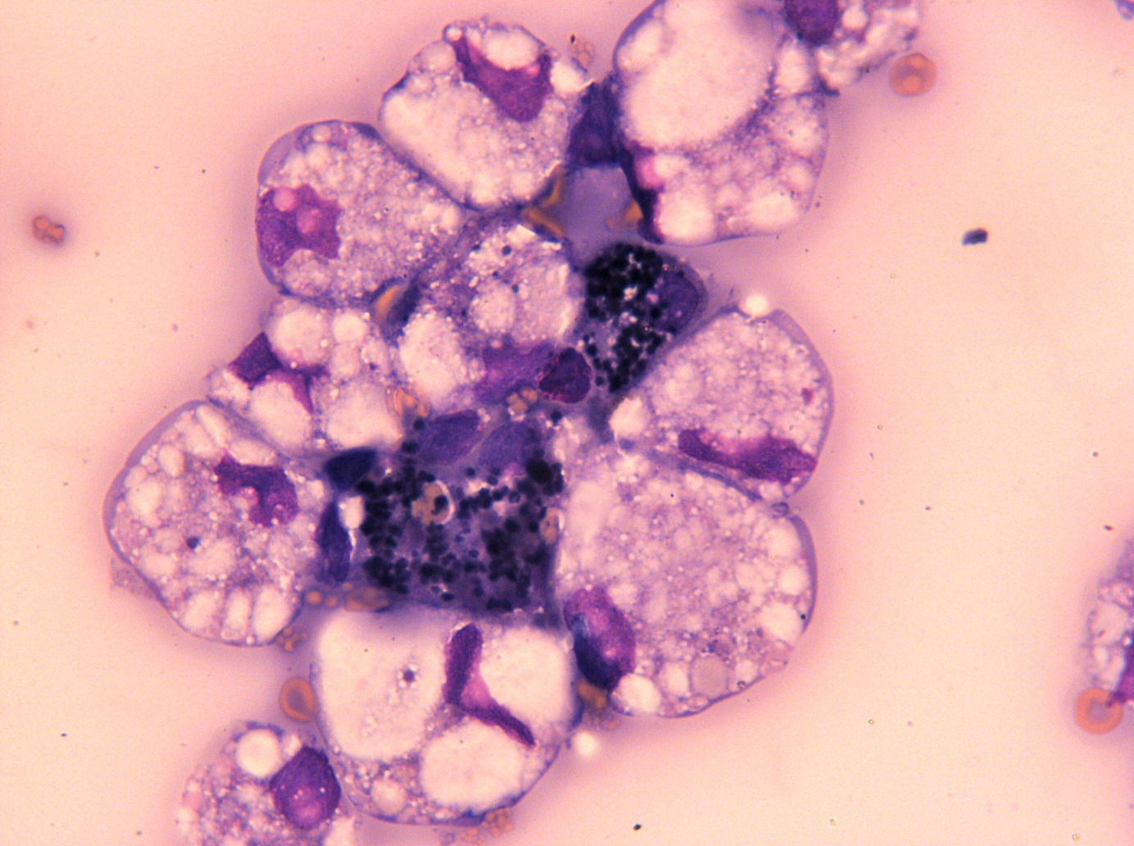
Siderophages
A
A
A. Macrophages containing hemosiderin - blue to black granules containing iron from the degradation of hemoglobin

Slide 9
More Macrophages*
*
*
*
**
*
** Monocyte

Slide 10
More Macrophages* 2
*
*
*

Slide 11
References
Dale DC, Boxer L, Liles WC. The phagocytes: neutrophils and monocytes. Blood. 2008; 15;112(4):935-45.
Gordon S, Taylor PR. Monocyte and macrophage heterogeneity. Nat Rev Immunol. 2005; 5(12):953-64.
Hume DA. The mononuclear phagocyte system. Curr Opin Immunol. 2006; 18(1):49-53.
Hume DA. Differentiation and heterogeneity in the mononuclear phagocyte system. Mucosal Immuno. 2008; 1(6):432-41.
Carr JH, Rodak BF. Clinical Hematology Atlas. 2004.

