Slide 1
Result GS under RESPC
In GUI Sunquest

Slide 2
For a respiratory culture and its Gram stain, we decide to combine the result entries under one test code, RESPC.
The reasons are to:
- Streamline the process. Per reflex policy, each respiratory culture needs a Gram stain. If the Gram stain is not ordered, it will be added on as a reflex. Combining Gram stain with RESPC will eliminate the manual reflex process.
- Eliminate multiple accession numbers and decrease errors
- Improve Gram stain and culture result correlation
- Increase client satisfaction by eliminating ordering steps in St. Vincent Quest and Community Epic order entries
RESPC = Respiratory culture with Gram stain

Slide 3
ACCEPTABLE SPUTUM

Slide 4
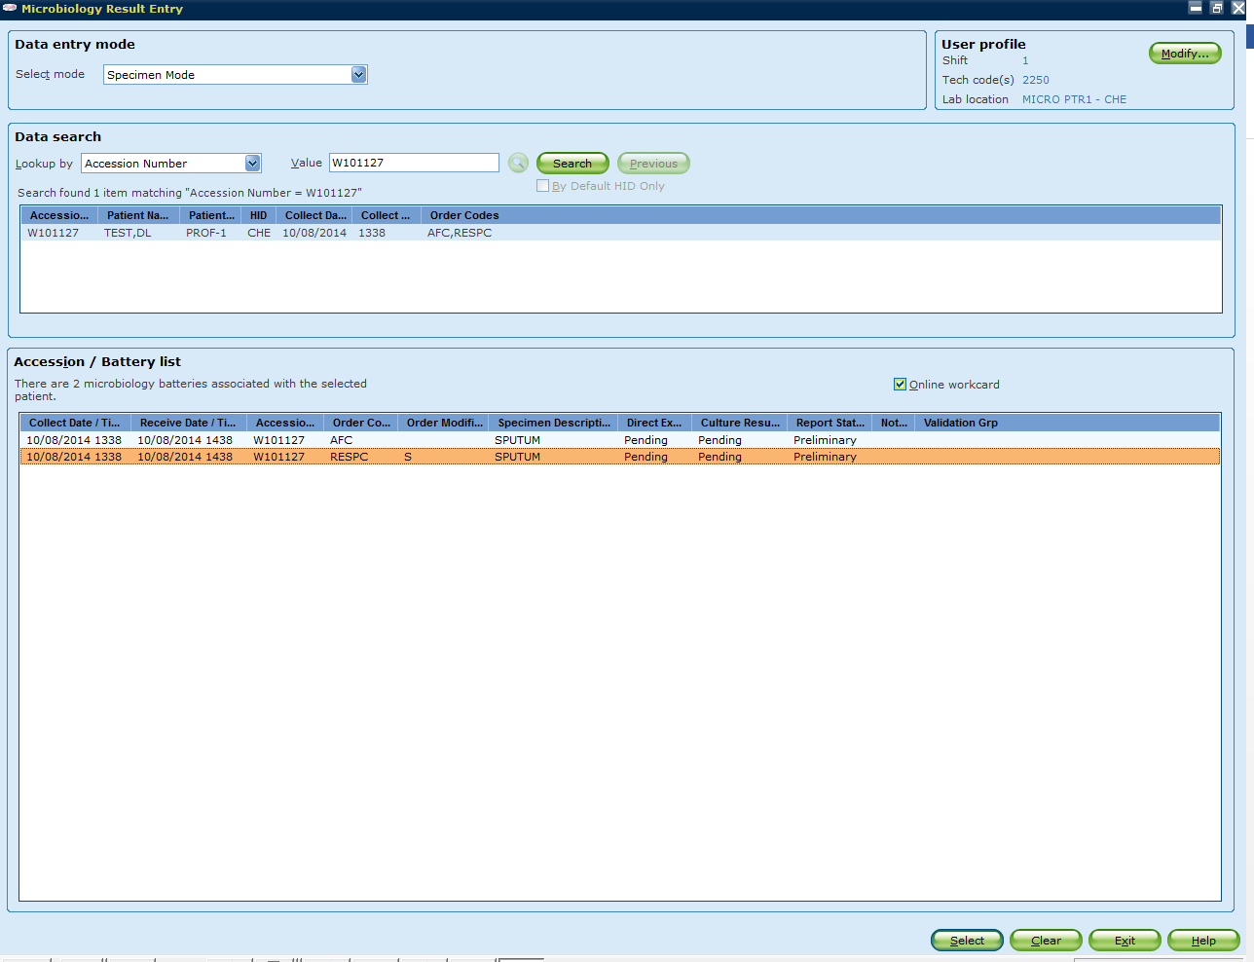
Step 1:
To perform STAT sputum Gram stain, select test code “RESPC”.

Slide 5
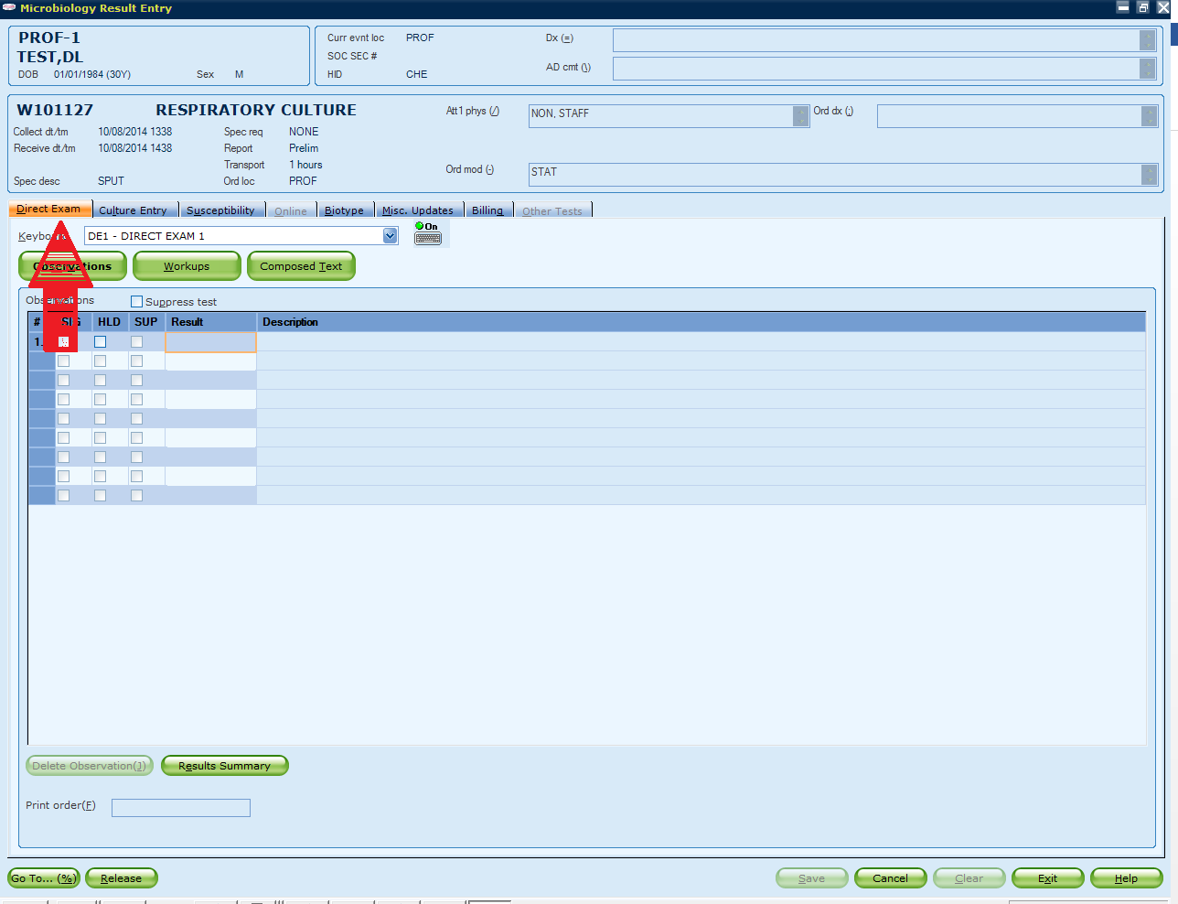
Step 2:
GUI Sunquest will bring you to the “Direct Exam” tab.

Slide 6
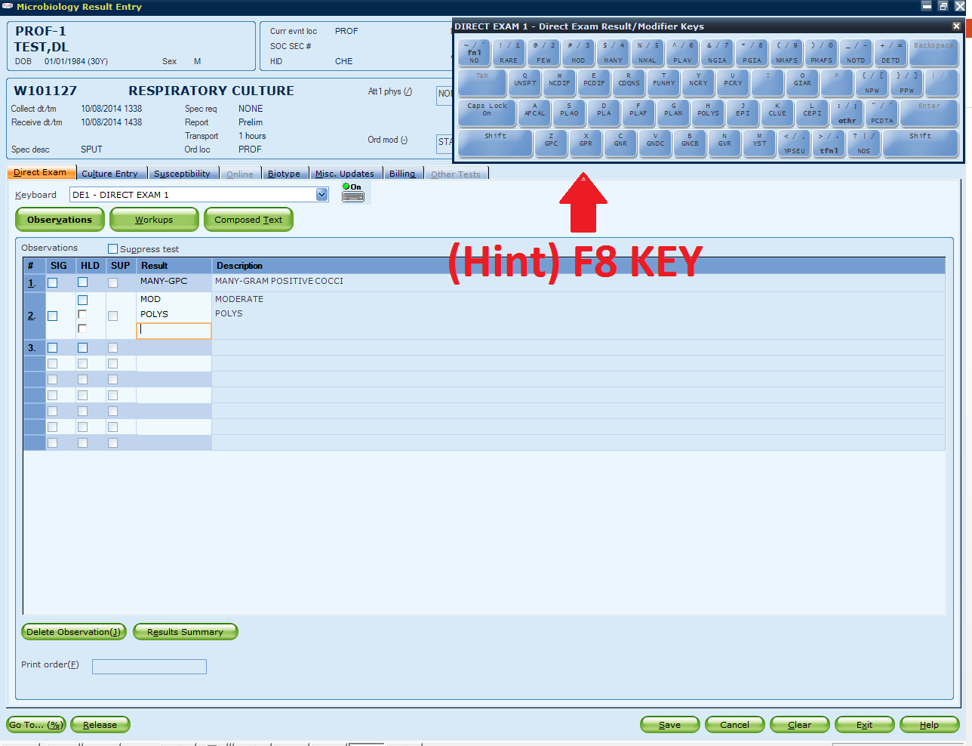
Step 3:
Enter Gram stain result under Direct Exam tab.

Slide 7
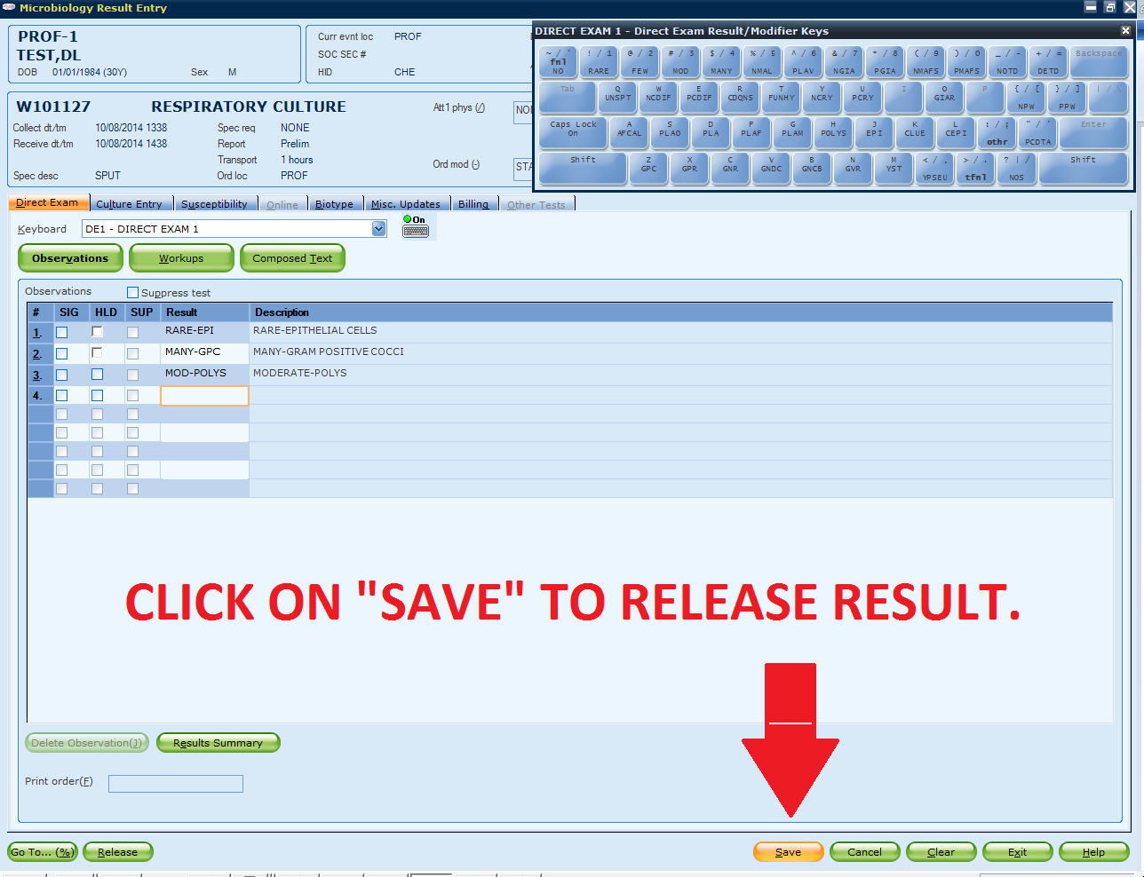
Step 4:
Once all Gram observations are entered under the Direct Exam tab, click “Save” to release Gram stain result.

Slide 8
UNACCEPTABLE SPUTUM

Slide 9
Step 1:
To perform STAT sputum Gram stain, select test code “RESPC”.

Slide 10
Step 2:
GUI Sunquest will bring you to the “Direct Exam” tab.

Slide 11
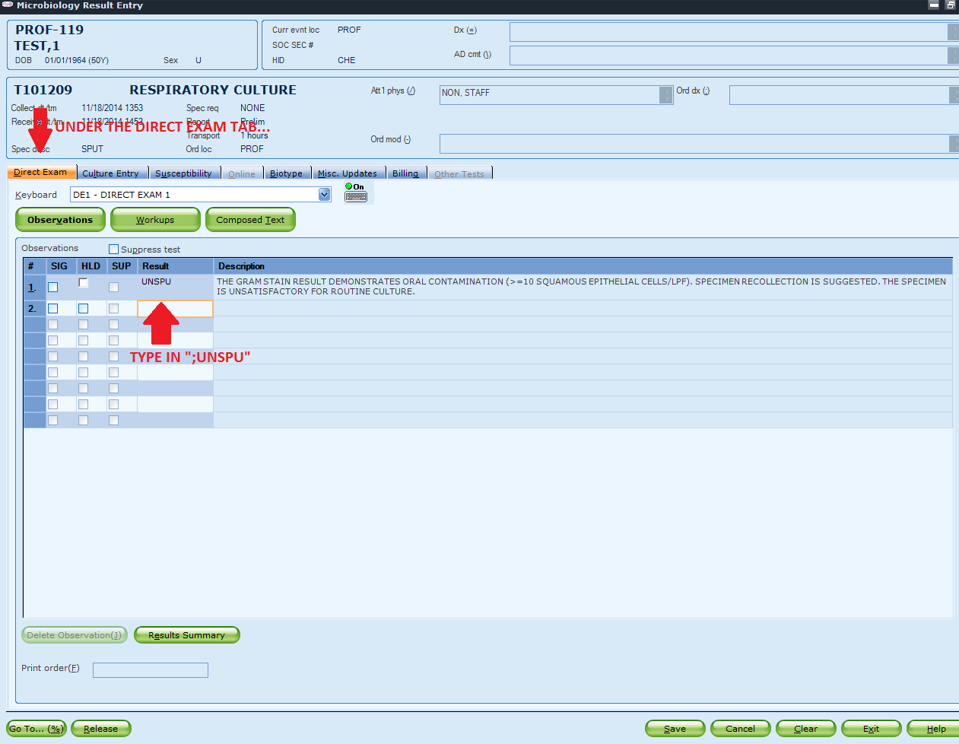
Step 3:
Under the Direct Exam tab, enter
“;UNSPU” code and press <↓> key. A
explanatory message should be translated out.

Slide 12
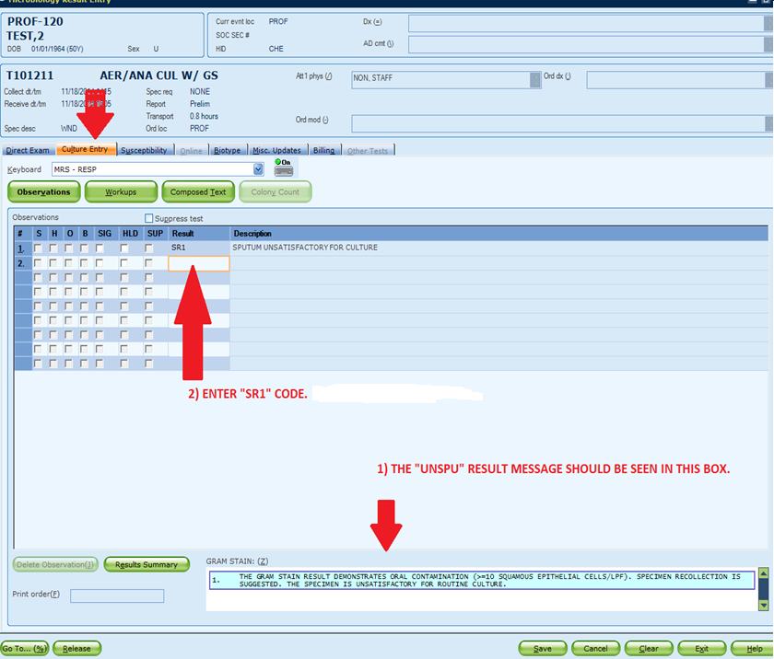
Step 4:
Click on the “Culture Entry” tab. The UNSPU message should be visible under the Gram Stain box. At Result 1, enter “SR1” then <↓>. The explanatory message should be translated out.

Slide 13
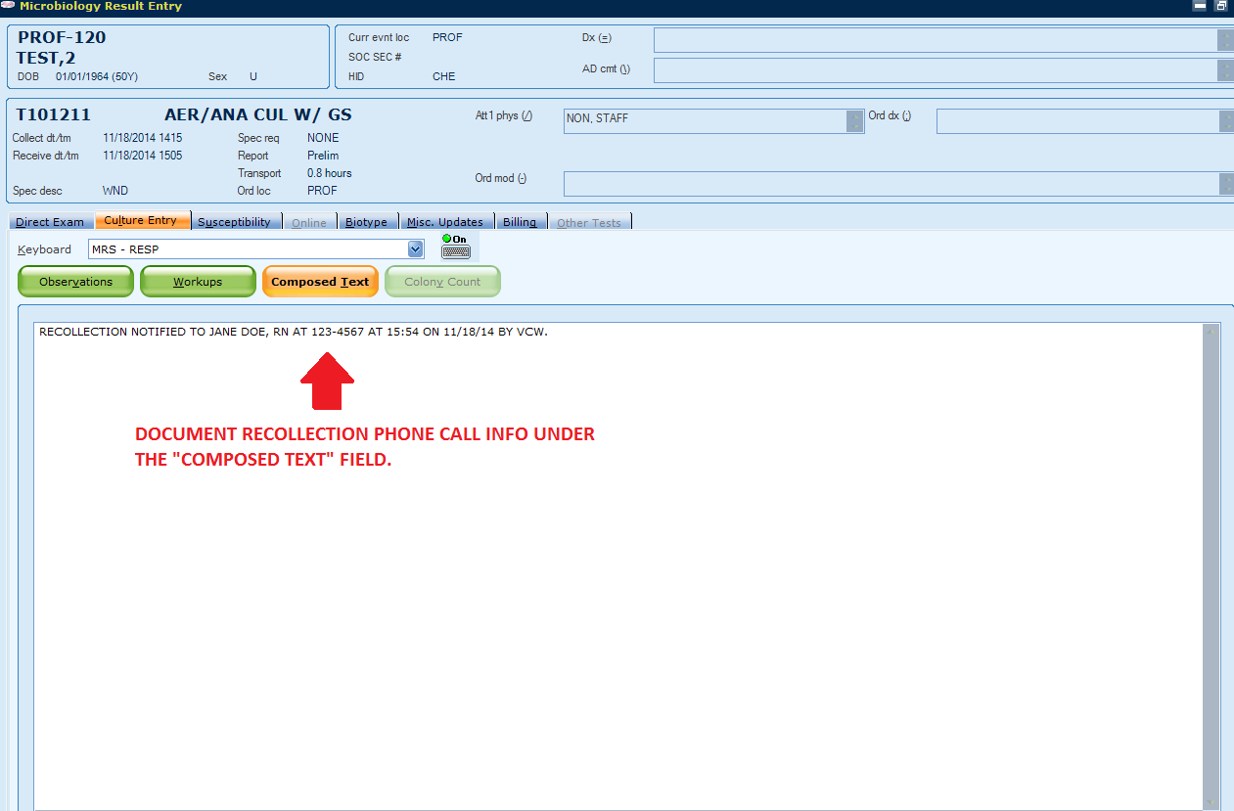
Step 5:
Click on “Composed Text” box. Document your phone call for recollection notification at the Composed Text field.

Slide 14
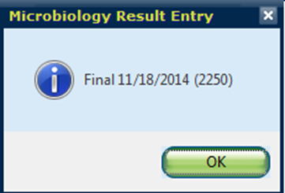
Step 6:
Click on “Observations” box. Press <Shift> and <~> keys at the same time to finalize the test. A confirmatory window will pop up. Click “OK”.

Slide 15
Step 7:
Now the report status is “Final”.
Click on “Save” once.

Slide 16
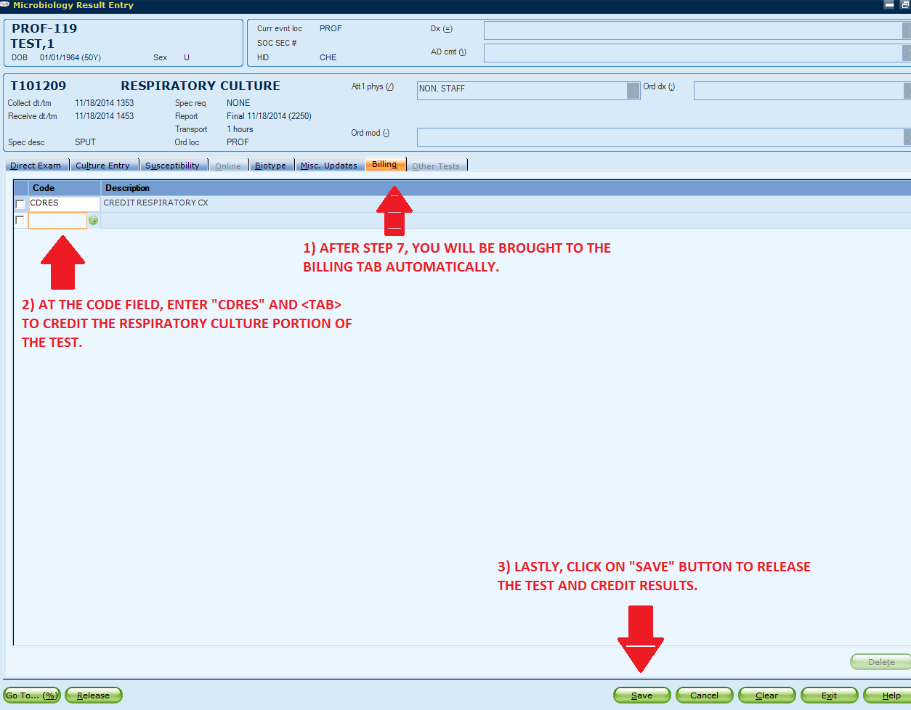
Step 8:
After Step 7, GUI Sunquest will bring you to the “Billing” tab automatically.
At the Code field, enter “CDRES” and press <Tab> key. This code will credit the respiratory culture portion of the test but still keep the Gram stain charge.
Lastly, click on the “Save” button to release the result.

Slide 17
Notes:
If a specimen has a RESPC with additional GS, please credit the individual GS as a duplicate request (DUPL).
The Gram stain procedure will be updated soon.

