Slide 1
Result GS under AERGS or ANAGS combo codes
In GUI Sunquest

Slide 2
Two new culture test codes are built by combining the result entries of the Gram stain (direct exam) with the culture.
The reasons are to:
- Eliminate multiple accession numbers and decrease errors
- Improve Gram stain and culture result correlation
- Increase client satisfaction by eliminating ordering steps in St. Vincent Quest and Community Epic order entries
AERGS = Aerobic culture with Gram stain
ANAGS = Aerobic/Anaerobic culture with Gram stain

Slide 3
Step 1: To perform STAT Gram stain for one of the combo codes, select test code “AERGS” or “ANAGS”.

Slide 4
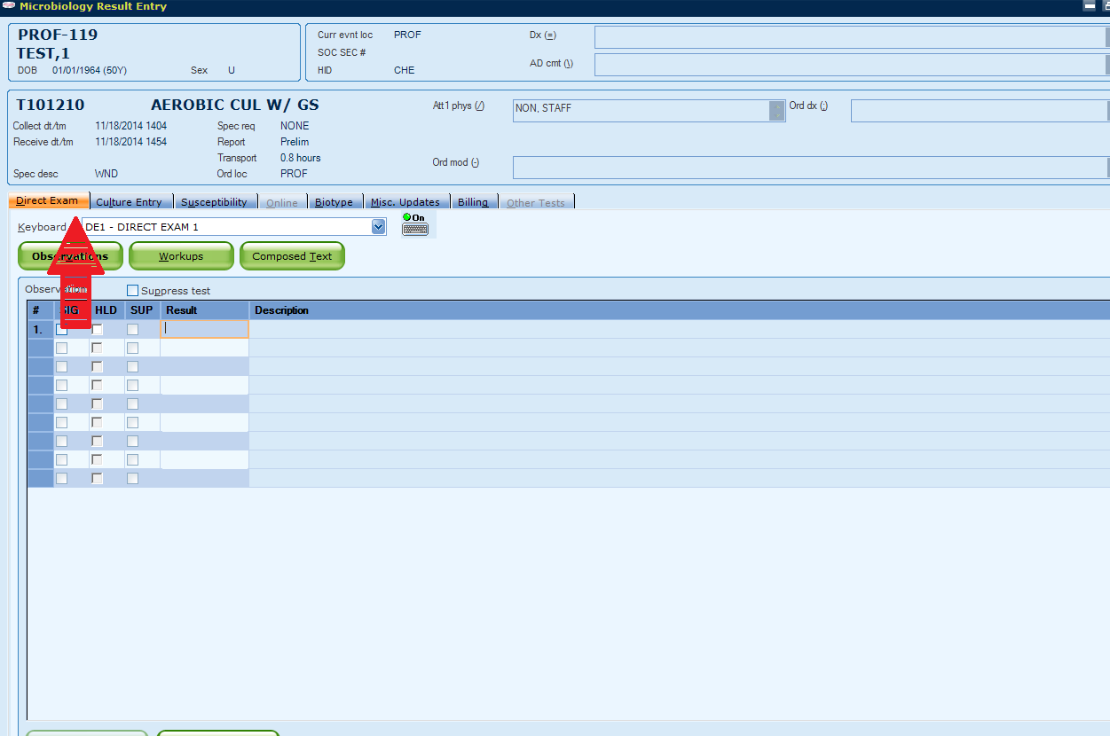
Step 2:
GUI Sunquest will bring you to the “Direct Exam” tab.

Slide 5
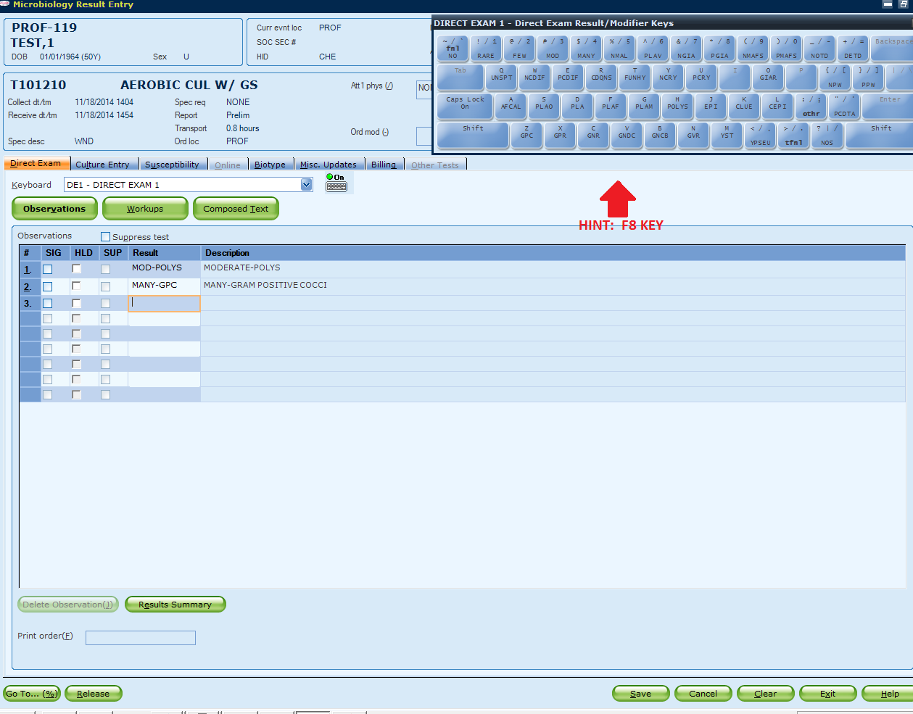
Step 3:
Enter Gram stain result under Direct Exam tab.

Slide 6
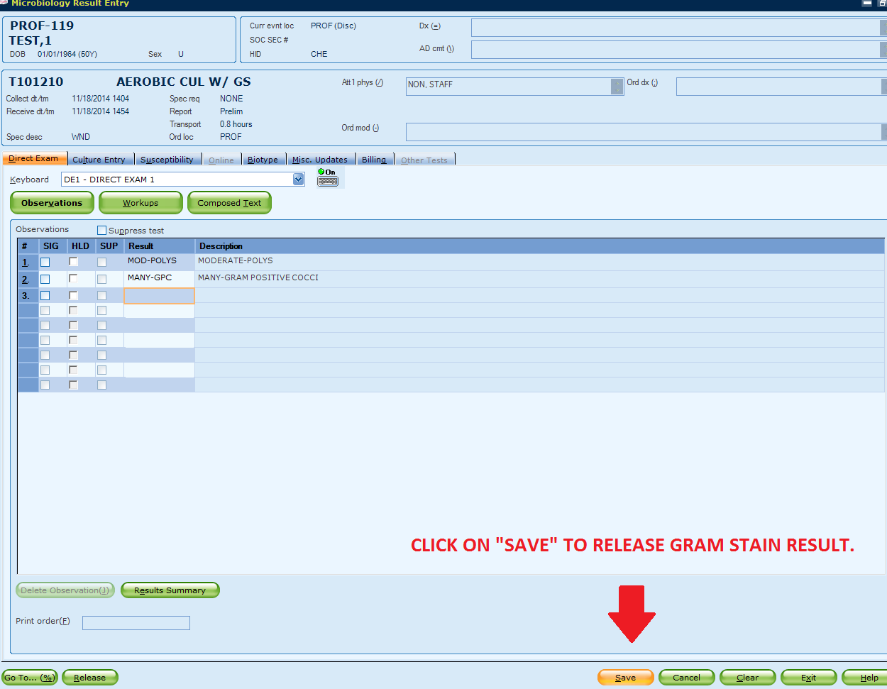
Step 4:
Once all Gram observations are entered under the Direct Exam tab, click “Save” to release Gram stain result.

Slide 7
Notes:
If a specimen has an AERGS or ANAGS with additional GS, please credit the individual GS as a duplicate request (DUPL).
GS, AERC, and ANAC are still available for individual orders. For a legit individual GS order (order with AERC and/or ANAC), please follow our current practice in the Gram stain procedure to result and finalize the Gram stain.
The Gram stain procedure will be updated soon.

