Slide 1
MARCH 2015 HEMATOLOGY QA CHALLENGE REVIEW
MID AMERICA CLINICAL LABORATORIES
MARCH 2015

Slide 2
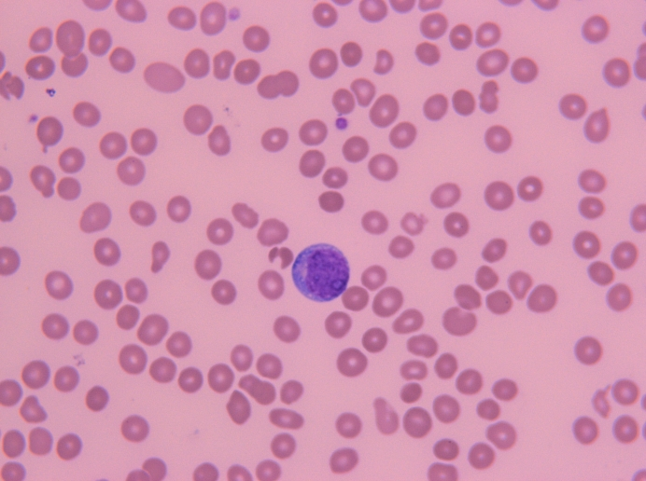
QA1: Blasts (AML)
Acute myeloid leukemia (AML) is a cancer of the myeloid line of blood cells, characterized by the rapid growth of abnormal white blood cells that accumulate in the bone marrow and interfere with the production of normal blood cells. AML is the most common acute leukemia affecting adults, and its incidence increases with age.
AML is slightly more common in men, with a male-to-female ratio of 1.3:1.
Real Image QA1

Slide 3
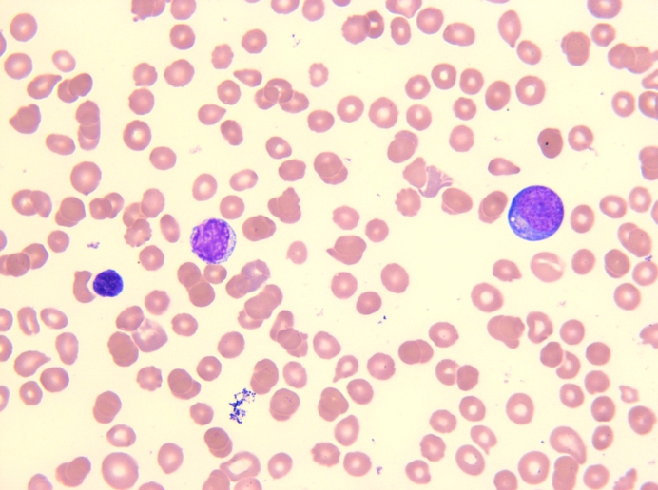
QA1: Blasts VS Lymphocytes
The blasts are large in size when contrasted with the surrounding erythrocytes, and has a moderate amount of basophilic and agranular cytoplasm with a high N:C ratio. The chromatin is fine and delicate with prominent nucleoli.
Key features
Size: 15 - 20 microns in diameter
Nucleus:
    large and round
    delicate chromatin
    nucleoli present
Cytoplasm:
    scant, blue
    granules absent
Blast
Lymphocyte
Lymphocyte
Blast
Real Image QA1

Slide 4
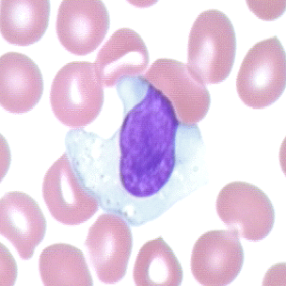
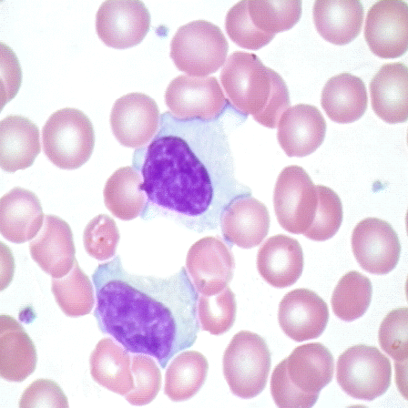
QA1: Blasts VS Atypical Lymphocytes
Morphology: lymphocytes with abundant cytoplasm often indented by surrounding red blood cells Comment: Reactive lymphocytes (atypical lymphocytes) may be associated with viral infections.
Atypical Lymphocytes

Slide 5
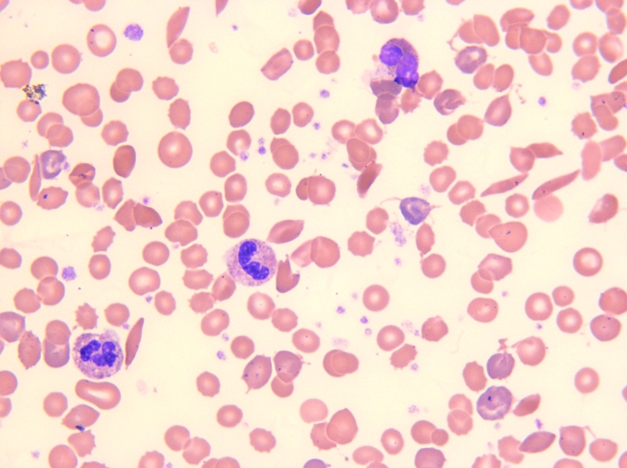
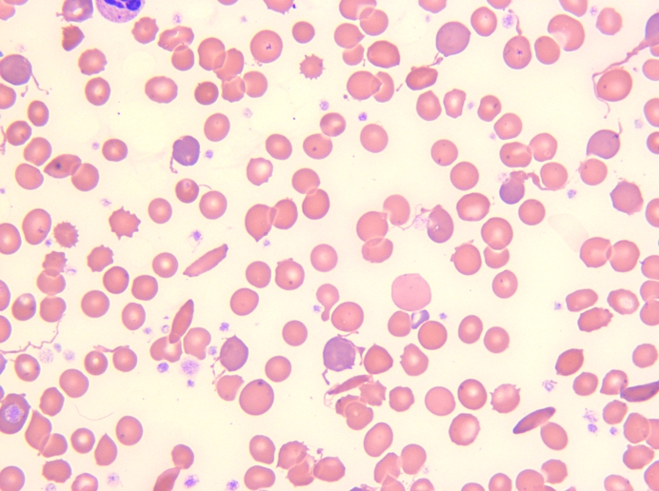
QA2: Sickle Cell Anemia
Real Image QA2
Real Image QA2
Sickle Cell
Sickle Cell
Sickle Cell
Sickle cell

Slide 6
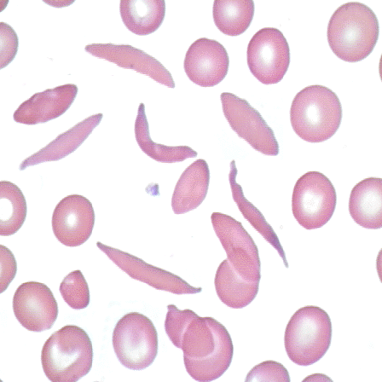
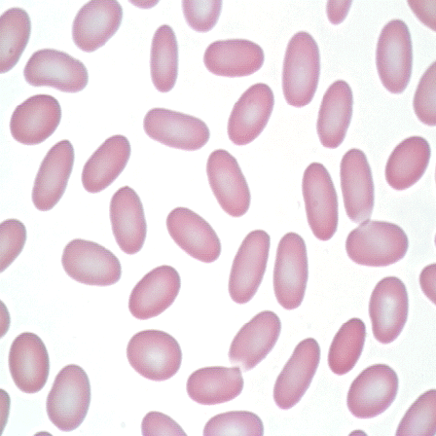
QA2: Sickle VS Elliptocytes
Morphology: oval or elliptical red blood cells Comment: Elliptocytes are seen in hereditary elliptocytosis and a variety of anemias.
Elliptocyte
Morphology: long, narrow, curved red blood cells with a point on at least one end Comment: Sickle cells are seen in sickle cell anemia.
Sickle Cell

Slide 7
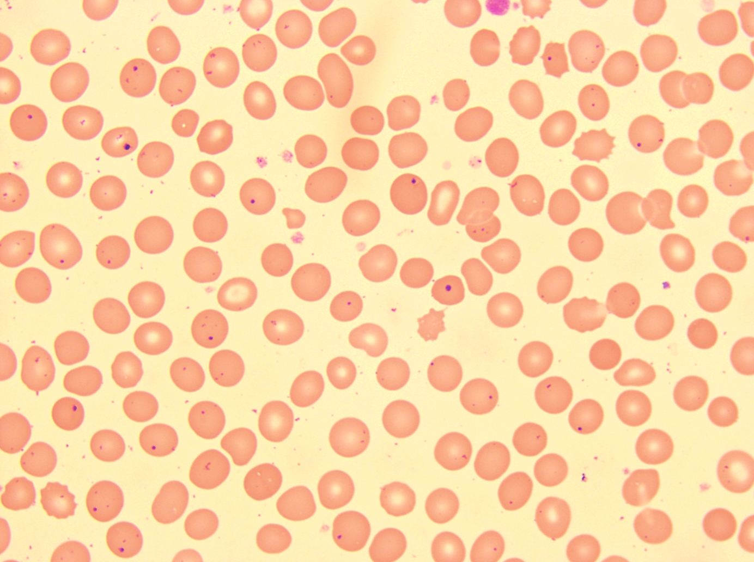
QA2: Howell-Jolly Bodies
Howell-Jolly bodies are nuclear fragments often seen in erythrocytes.
Howell–Jolly bodies are seen with markedly decreased splenic function. Common causes include asplenia (post-splenectomy), trauma to the spleen, and auto splenectomy caused by sickle cell anemia.
Morphology: dark purple, dense, round inclusions with distinct borders

Slide 8
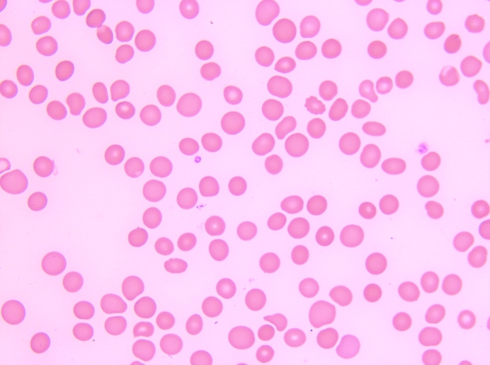
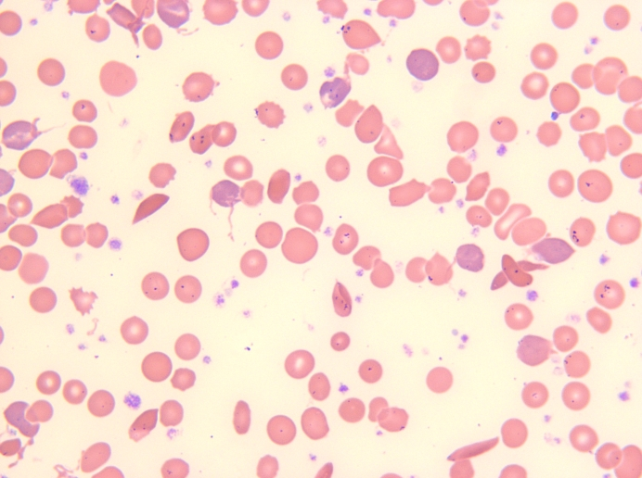
Platelet Estimates
Real Image QA1
Real Image QA2
Decreased Platelets
Increased Platelets
Perform estimate in area of smear where RBCs barely touch. Average the number of platelets counted in 10 oil immersion fields (100X obj).
Average number platelets 100X oil
x 10,000 if low RBC count
x 15,000 if normal RBC count
x 20,000 if high RBC count
Example: QA1
3 platelets seen per field-RBC=2.44 L
30 Platelets/10 fields X 10,000 low RBC = 30,000
Example: QA2
44 platelets seen per field-RBC=2.71 L
440 Platelets/10 fields X 10,000 low RBC =440,000

Slide 9
MACL RBC Morphology Terms:
We noticed that there were an abundance of different terms used to classify RBC morphology. Here is a reminder of how we classify at MACL.
Microcytes - RBCs smaller than 6 microns when compared to the nucleus of a small lymphocyte that is 7-9 microns.
Macrocytes - RBCs larger than 9 microns.
Anisocytosis - presence of more than one easily distinguishable cell line. The overall amount of anisocytosis is determined from the total of the average numbers of microcytes and/or macrocytes present per oil immersion field. .
Hypochromia - the area of central pallor is greater than 1/3 of the area of the cell.
Polychromasia - RBCs show increase bluish tinge with Wright’s stain due to presence of RNA.
Spherocytes - round cells lacking central pallor, showing increased staining intensity and having a smaller volume than a normal cell.
Elliptocytes - RBCs that have an oval or elliptical shape. These cells result from hereditary or acquired conditions and range from egg shaped or slightly oval to sausage, rod or pencil forms.
Burr cell (echinocyte) - RBCs with long, sharp irregularly spaced projections due to an abnormal environment; to be differentiated from crenated cells, which have regular, short blunt projections. Crenated cells are an artifact and should not be reported.
Target cells - RBCs that have a central area of hemoglobin surrounded by a relatively colorless ring and a peripheral ring of hemoglobin, due to a cytoplasmic defect.
Teardrops - oval cells with one end elongated as a result of membrane injury.
Fragments (schistocytes) - result from localized membrane damage.
Helmet cells - RBCs where the membrane develops a vacuole that enlarges causing the red cell membrane to rupture, leaving two horns which give the cell a half moon shape with a central crater effect.
Stomatocytes - RBCs that appear on a fixed and stained film to have an elongated or slitlike area of central pallor instead of the circular form.
Acanthocyte - RBCs similar to the burr cell, but more like a spiny spherocyte due to irreversible cell membrane alteration.
Sickle cells - elongated RBC with sharp double points in U, L or S shapes due to an abnormal hemoglobin.

Slide 10
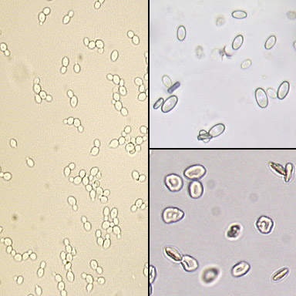
Urine Microscopic: Different Forms of Yeast
Calcium Oxalate
Crystals
The most common yeast seen in urine is Candida albicans. The yeast may be seen in budding or non-budding forms and may show pseudohyphae formation.
ALERT: Non-budding forms may be confused with red blood cells. Yeast and red blood cells can be differentiated by using dilute acetic acid which will lyse the red blood cells but leave the yeast intact. Yeast can also be confused with the dumbbell forms of calcium oxalate crystals and calcium carbonate crystals
Yeast
Red Blood Cells

Slide 11
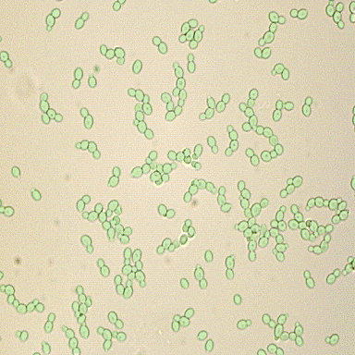
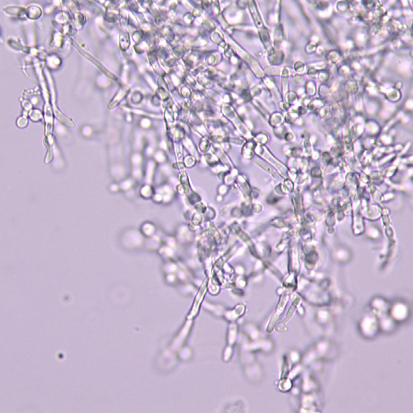
UA Microscopic: More Yeast Images
Budding Yeast
Pseudohyphae formation

Slide 12
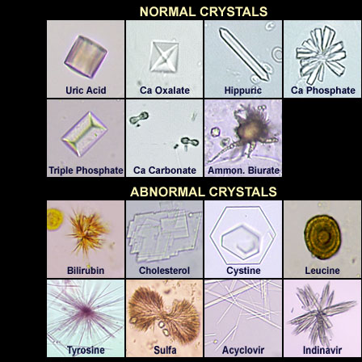
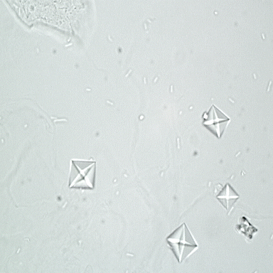
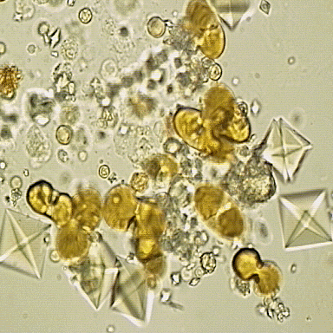
UA Microscopic: Calcium Oxalate Crystals
Calcium oxalate crystals can be octahedral ("envelope"), dumbbell, ovoid, or rectangular in shape.
Dumbbell Type Calcium Oxalate

