Slide 1
Plasma Cell Review
MACL
Indianapolis, IN

Slide 2
Information from API on Image BCI-13
Image BCI-13 shows a plasma cell. These cells are medium in size and generally round to oval. The nucleus is also round or oval and characteristically eccentrically located in the cytoplasm. The nuclear chromatin is clumped, although this particular cell is not as dense as is usually seen in mature plasma cells. However, the deep blue cytoplasm and prominent perinuclear halo, or hof, is a classic morphologic feature of plasma cells. This clear zone adjacent to the nucleus represents the Golgi body, a cellular constituent that packages protein for cells, in this case, immunoglobulin. Multiple myeloma is associated with an increased proliferation of plasma cells. Usually this overproduction is most evident in the bone marrow, where normally less than 1% of leukocytes will be plasma cells. It is never normal to see plasma cells in the peripheral blood.
The large size, roundish shape of the cell and its nucleus, and the deep blue cytoplasm of this cell may suggest some type of blast. However, the chromatin is not as fine or open as seen in blasts. What may appear to be nucleoli are most likely only lighter staining areas, as the chromatin is a darker purple and more dense. The cytoplasmic clearing or hof also indicates this is not a blast cell. Even immunoblasts (immature plasma cells) have an indistinct hof, but lacy chromatin. Likewise, this cell is not an immature granulocyte such as a promyelocyte or myelocyte as it lacks any evidence of primary or secondary granulation that characterizes these cells.

Slide 3
Information on BCI-14
Image BCI-14, is a plasmacytoid lymphocyte. This cell is transitioning from a lymphocyte to a plasma cell. Mature lymphocytes have a very dense chromatin; this cell’s chromatin pattern is less dense. If a rare plasmacytoid lymphocyte is seen in the peripheral blood, it is generally not significant and represents only a “reactive” lymphocyte (one responding to an antigenic stimulus). However, in the context of a red blood cell abnormality such as rouleaux and the presence of plasma cells, seeing such a cell in the peripheral blood contributes to the abnormal findings suggestive of multiple myeloma. Plasmacytoid lymphocytes vary in size. They may be round or oval in shape with a round or oval nucleus. In contrast to the plasma cell, however, the nucleus is generally centrically located within the cell. Likewise, the perinuclear clearing typical of plasma cells is generally not evident or is minimal. The nuclear chromatin may not appear as dense as that of the plasma cell. The cytoplasm in a plasmacytoid lymphocyte may still be a deep blue. Plasmacytoid lymphocytes are often difficult to distinguish from plasma cells because of the close resemblance between the 2 cell types.
The chromatin pattern, though less dense than a mature lymphocyte, is still not as loose and open as the chromatin seen in blasts. Again, the apparent nucleoli are probably only lighter staining areas in the nucleus. This dark purple nucleus is morphologically similar to the nucleus in the cell in image BCI-13. Blasts may also be variable in size, but this cell is also smaller than would be expected in a blast. The high nuclear to cytoplasmic ratio and lack of any cytoplasmic blebbing suggest this cell is not a megakaryoblast or immature megakaryocyte. Promyelocytes and myelocytes have granules, so these cells should be excluded as possible choices for the identity of this cell. Hairy cells are lymphoid in origin; however, the cytoplasm is usually more moderate in amount with typically frayed or stringy margins. Once again, it is helpful to view other cells seen in the peripheral blood as well as consider general hematologic parameters when trying to classify white blood cells.

Slide 4
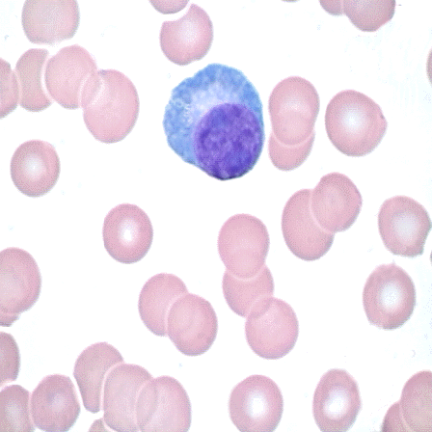
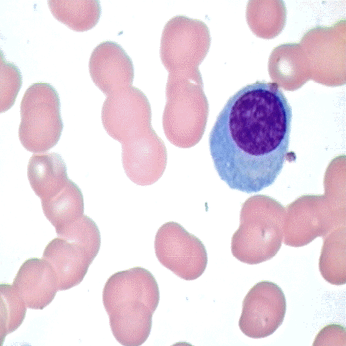
Plasma Cell
Morphology: blue cytoplasm, eccentric nucleus, prominent perinuclear clearing (hof) Comment: Plasma cells are rarely seen in the peripheral blood except in cases of severe inflammation or end stage multiple myeloma
Perinuclear clearing (hof)
Rouleaux
Morphology: rouleaux formation (four or more red blood cells lined up resembling a stack of coins)

Slide 5
Plasma Cells
They range in size from 10 to 20 μm and are oval shaped with relatively abundant cytoplasm and an eccentric nucleus. The nucleus demonstrates coarsely clumped chromatin often arranged in a cartwheel-like or clock-face pattern and there is an adjacent perinuclear clear (hof). Nucleoli are absent.
Compared to lymphocytes, plasma cells have a lower N:C ratio, more basophilic cytoplasm, and a perinuclear clear Golgi zone (hof). Osteoblasts may closely mimic plasma cells, but are typically larger, have a cytoplasmic Golgi zone that is located away from the nucleus, and the nucleus often protrudes past the cytoplasmic margin.
Plasma cell
Plasma Cell

Slide 6
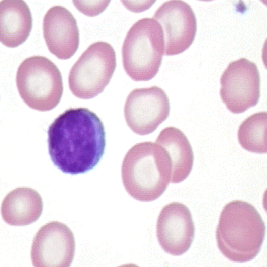
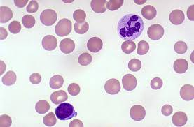
Normal Lymphocyte
Nucleus:
  round
  very coarse cromatin
  nucleoli absent
Cytoplasm:
  variable amount
  light blue
  few granules may be present

Slide 7
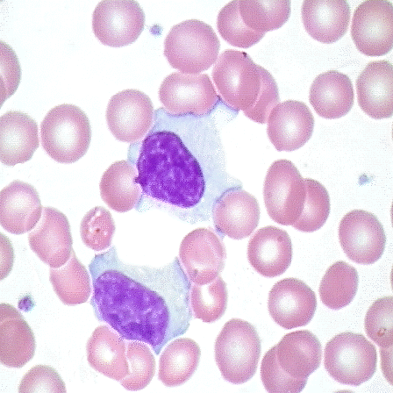
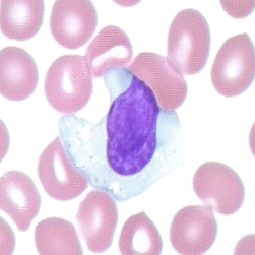
Reactive Lymphocyte
Morphology: lymphocytes with abundant cytoplasm often indented by surrounding red blood cells Comment: Reactive lymphocytes (atypical lymphocytes) may be associated with viral infections.

Slide 8
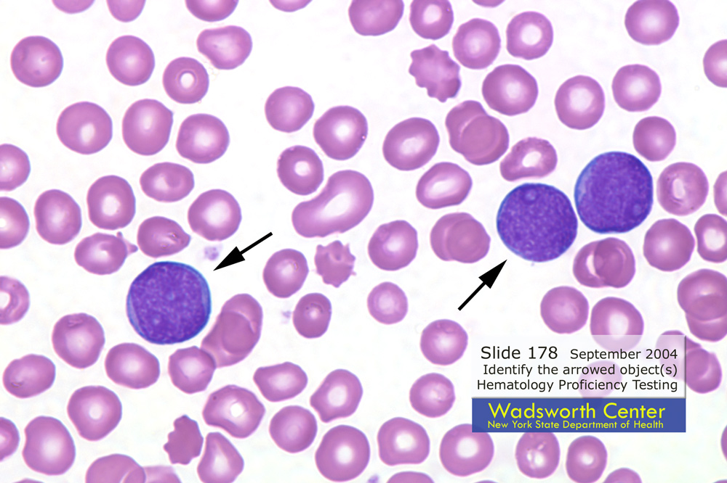
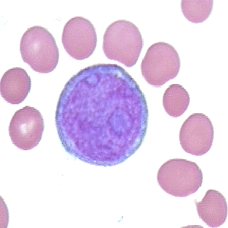
Lymphoblasts
Lymphoblast
Lymphoblast

Slide 9
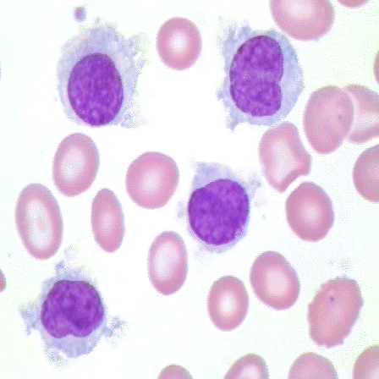
Hairy Cell
Morphology: lymphocytes with filamentous cytoplasmic projections and oval or folded nuclei (hairy cells)
Comment: Hairy cell leukemia is more common in adult males and is associated with splenomegaly and pancytopenia.

