Slide 1
Differences in Immature Granulocytes (Metamyelocytes Vs Promyelocytes)
Mid America Clinical Laboratories
Indianapolis, IN

Slide 2
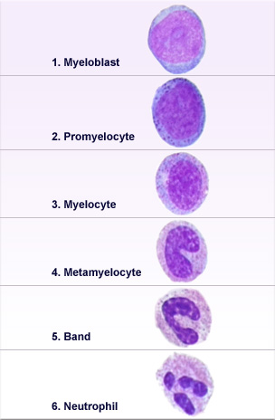
Granulocyte maturation
A metamyelocyte is a cell derived from a myelocyte, and leading to a band cell. It is characterized by the appearance of a bent nucleus, cytoplasmic granules, and the absence of visible nucleoli. (If the nucleus is not yet bent, then it is likely a myelocyte.)
Promyelocytes are generally larger than myeloblasts. The nucleus is similar in size to the myeloblast but the cytoplasm is more abundant at this stage. The nucleoli will begin to close and become less prominent than in the blast stage. The chromatin strand texture in promyelocytes tends to become slightly more coarse and clumped than the chromatin pattern present in a myeloblast.

Slide 3
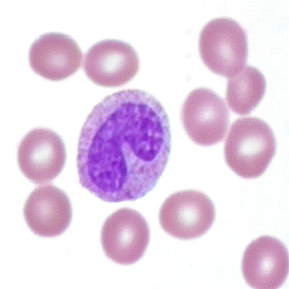
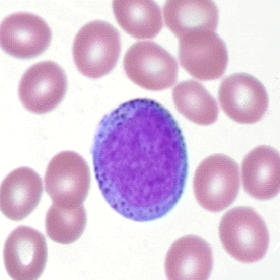
Metamyelocyte VS Promyelocyte
Metamyelocyte: Cytoplasm with nucleus that is indented less than one half of theoretical round nucleus. The Chromatin is clumped with distinct regions. The N:C ratio is 1.5:1 to 1:1.
Promyelocyte: round to oval cells that generally slightly larger than myeloblasts. A cell is considered to be a promyelocyte when it develops distinct primary granules in the cytoplasm. Their nuclei have fine chromatin and nucleoli like myeloblasts. The N:C ratio is 5:1 to 3:1.
Metamyelocyte
Promyelocyte

Slide 4
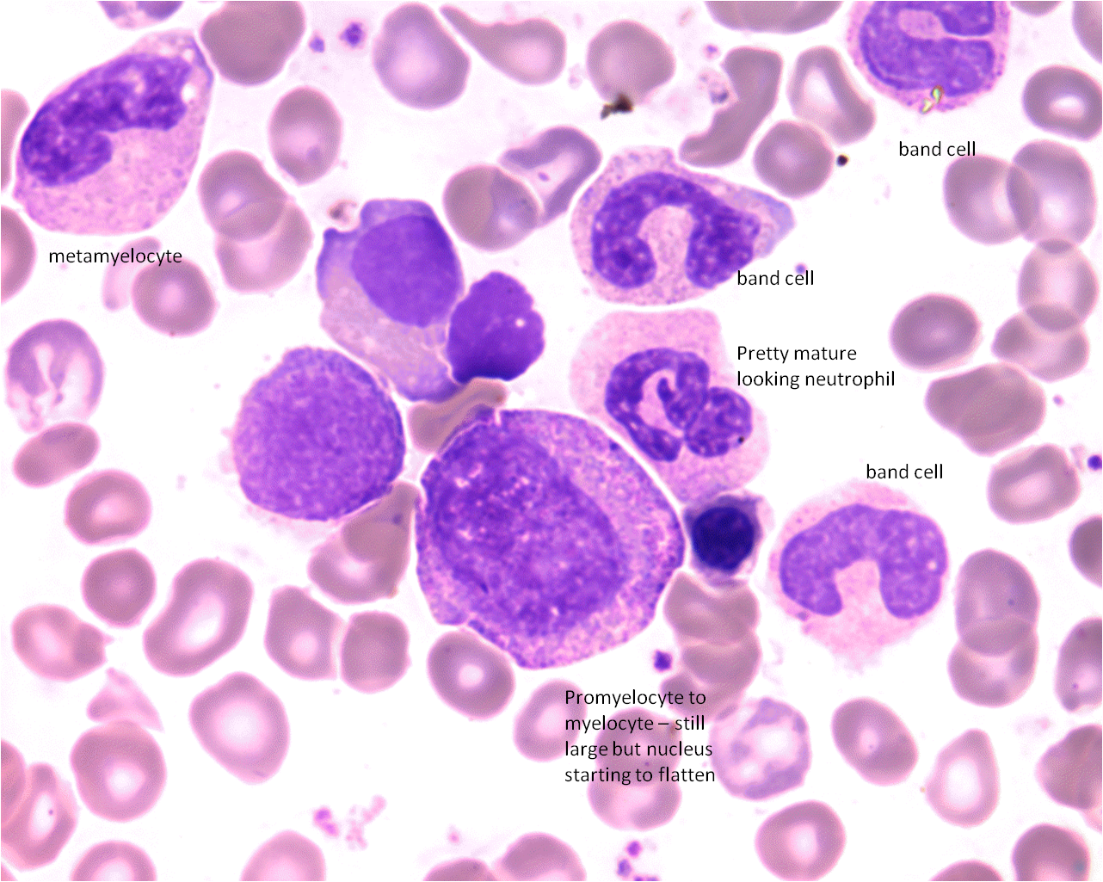
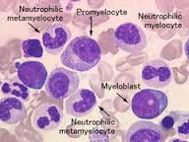
Examples of Immature Cells.

Slide 5
Promyelocytes…
Promyelocyte
Promyelocyte

Slide 6
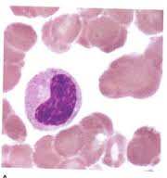
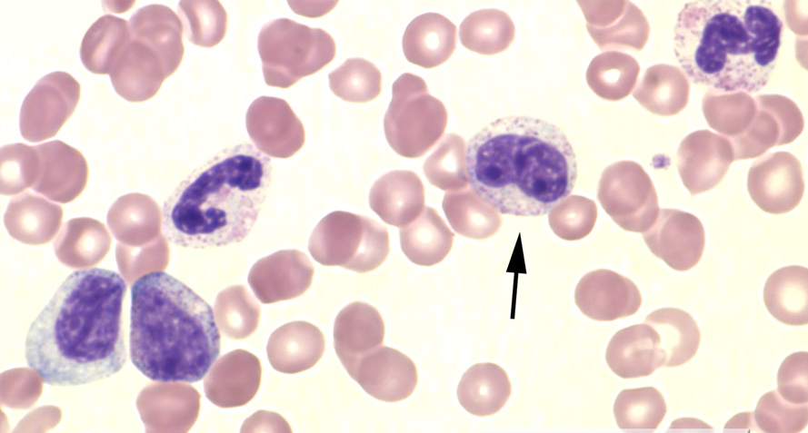
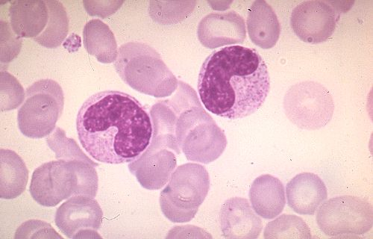
Metamyelocytes…
Metamyelocyte
Metamyelocyte
Metamyelocyte

