Slide 1
MARCH 2016 HEMATOLOGY QA CHALLENGE REVIEW
MID AMERICA CLINICAL LABORATORIES
MARCH 2016

Slide 2
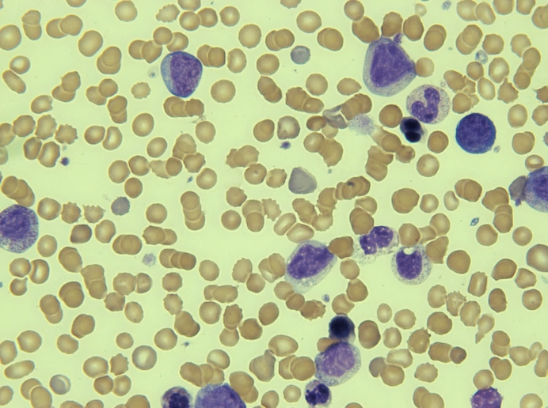
QA1: Myeloproliferative Disorder (Blasts)
Myelocyte
Band
The blasts are large in size when contrasted with the surrounding erythrocytes, and has a moderate amount of basophilic and agranular cytoplasm with a high N:C ratio. The chromatin is fine and delicate with prominent nucleoli. Note the presence of nRBC’s with QA-01.
Key features
Size: 15 - 20 microns in diameter
Nucleus:
    large and round
    delicate chromatin
    nucleoli present
Cytoplasm:
    scant, blue
    granules absent
Blast
Blast
Polychomasia
Promyelocyte
Nucleated RBC
Real Image QA1

Slide 3
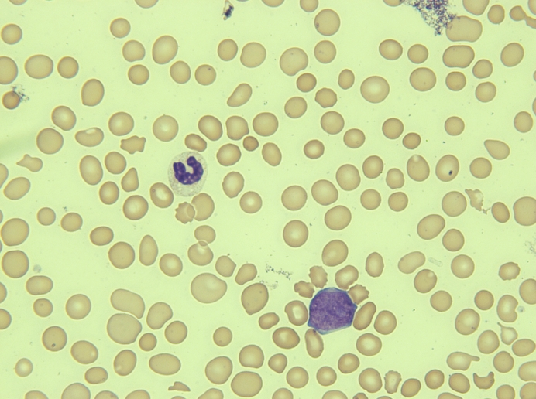
QA2: Acute Myeloid Leukemia (AML)
Acute myeloid leukemia (AML) is a cancer of the myeloid line of blood cells, characterized by the rapid growth of abnormal white blood cells that accumulate in the bone marrow and interfere with the production of normal blood cells. AML is the most common acute leukemia affecting adults, and its incidence increases with age.
Note the large size of blast cell compared to that of an RBC. There is little to no visible cytoplasm.
Real Image QA2
Blast

Slide 4
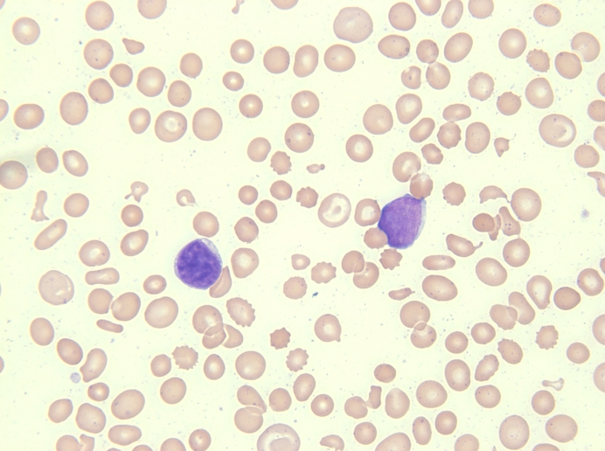
QA2: Blasts
Real Image QA 2
RBC Fragment
Note: The lymphocyte has clumped like chromatin and Blast has fine like chromatin.
Elliptocyte
Blast cell
Lymphocyte

Slide 5
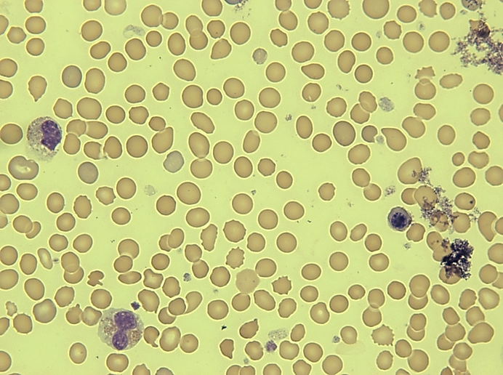
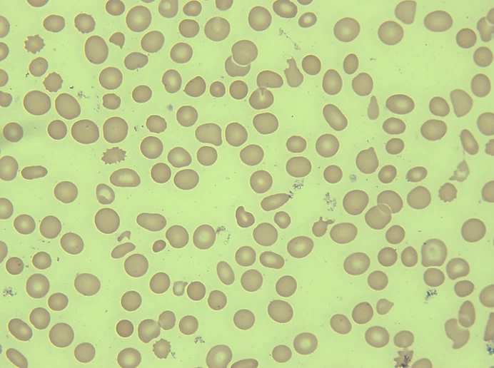
Platelet Estimates
Real Image QA1
Real Image QA2
Adequate Platelets
Decreased Platelets
Perform estimate in area of smear where RBCs barely touch. Average the number of platelets counted in 10 oil immersion fields (100X obj).
Average number platelets 100X oil
x 10,000 if low RBC count
x 15,000 if normal RBC count
x 20,000 if high RBC count
Example: QA1
15 platelets seen per field RBC=3.00 L
150 Platelets/10 fields X 10,000 low RBC = 150,000
Example: QA2
3 platelets seen per field RBC=3.00L
30 Platelets/10 fields X 10,000 low RBC =30,000

Slide 6
MACL RBC Morphology Terms:
We noticed that there were an abundance of different terms used to classify RBC morphology. Here is a reminder of how we classify at MACL.
Microcytes - RBCs smaller than 6 microns when compared to the nucleus of a small lymphocyte that is 7-9 microns.
Macrocytes - RBCs larger than 9 microns.
Anisocytosis - presence of more than one easily distinguishable cell line. The overall amount of anisocytosis is determined from the total of the average numbers of microcytes and/or macrocytes present per oil immersion field. .
Hypochromia - the area of central pallor is greater than 1/3 of the area of the cell.
Polychromasia - RBCs show increase bluish tinge with Wright’s stain due to presence of RNA.
Spherocytes - round cells lacking central pallor, showing increased staining intensity and having a smaller volume than a normal cell.
Elliptocytes - RBCs that have an oval or elliptical shape. These cells result from hereditary or acquired conditions and range from egg shaped or slightly oval to sausage, rod or pencil forms.
Burr cell (echinocyte) - RBCs with long, sharp irregularly spaced projections due to an abnormal environment; to be differentiated from crenated cells, which have regular, short blunt projections. Crenated cells are an artifact and should not be reported.
Target cells - RBCs that have a central area of hemoglobin surrounded by a relatively colorless ring and a peripheral ring of hemoglobin, due to a cytoplasmic defect.
Teardrops - oval cells with one end elongated as a result of membrane injury.
Fragments (schistocytes) - result from localized membrane damage.
Helmet cells - RBCs where the membrane develops a vacuole that enlarges causing the red cell membrane to rupture, leaving two horns which give the cell a half moon shape with a central crater effect.
Stomatocytes - RBCs that appear on a fixed and stained film to have an elongated or slitlike area of central pallor instead of the circular form.
Acanthocyte - RBCs similar to the burr cell, but more like a spiny spherocyte due to irreversible cell membrane alteration.
Sickle cells - elongated RBC with sharp double points in U, L or S shapes due to an abnormal hemoglobin.

Slide 7
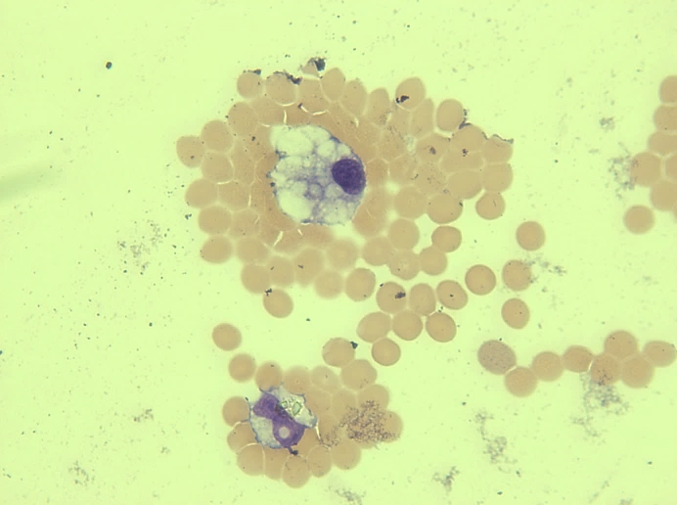
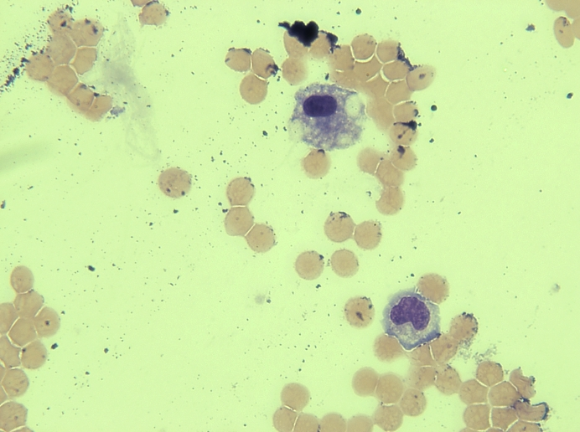
Monocytes vs Macrophages in Body Fluids
Real images from BF QA
Macrophage
Macrophage
Monocyte

Slide 8
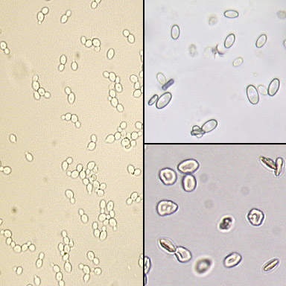
Urine Microscopic: Different Forms of Yeast
Calcium Oxalate
Crystals
The most common yeast seen in urine is Candida albicans. The yeast may be seen in budding or non-budding forms and may show pseudohyphae formation.
ALERT: Non-budding forms may be confused with red blood cells. Yeast and red blood cells can be differentiated by using dilute acetic acid which will lyse the red blood cells but leave the yeast intact. Yeast can also be confused with the dumbbell forms of calcium oxalate crystals and calcium carbonate crystals
Yeast
Red Blood Cells

Slide 9
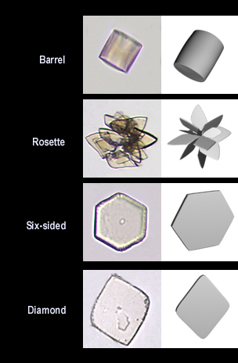
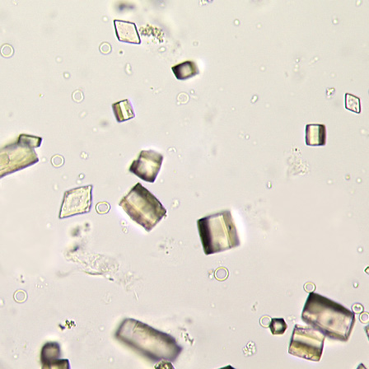
UA Microscopic: Uric Acid Crystals
Uric Acid Crystals can be found in multiple forms as shown here. They are often brown in color. Uric acid crystals are highly birefringent and can be easily seen with polarized light.
Diamond and Barrel Form

Slide 10
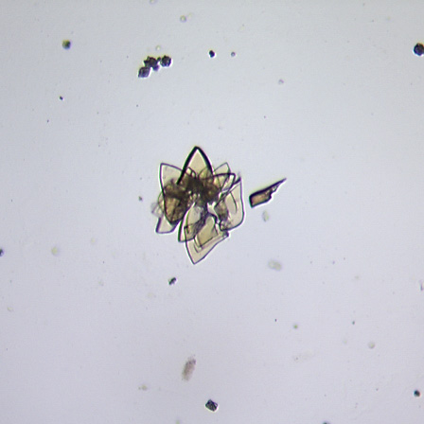
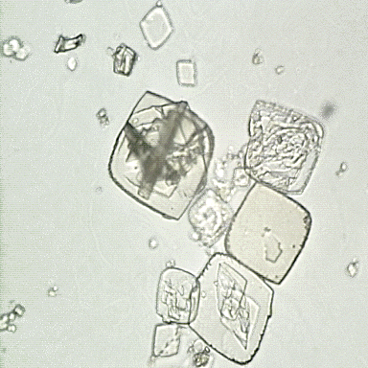
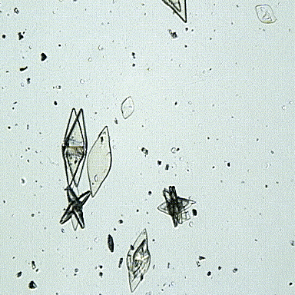
More Uric Acid Examples…
Amorphous
Rosette formation
Diamond form
Rosette formation
Diamond form

