Slide 1
Sunquest - GUI
Inquiry, Printing, Order Entry, Order Receipt
Label Printing, Credit
Transition of functions to the Sunquest GUI platform.

Slide 2
Transitioning to GUI
Single windows based platform for multiple functions
Version of Sunquest called the “Local SQ GUI (graphic user interface) 7.3
Patient Inquiry
Result Printing/Faxing
Order Entry
Order/Specimen Receipt
Reprint Labels
Credit with or without results

Slide 3
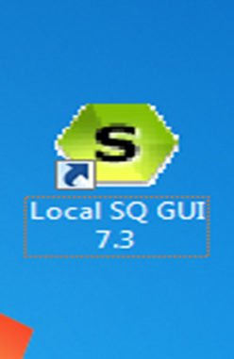
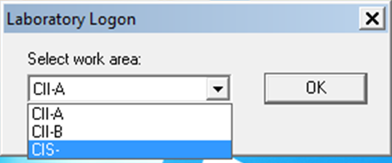
SUNQUEST GUI ACCESS
Access is from the MACL desktop
Double Click the Sunquest Gateway Icon
Select work area CII (Indy) CIS (Evansville)

Slide 4
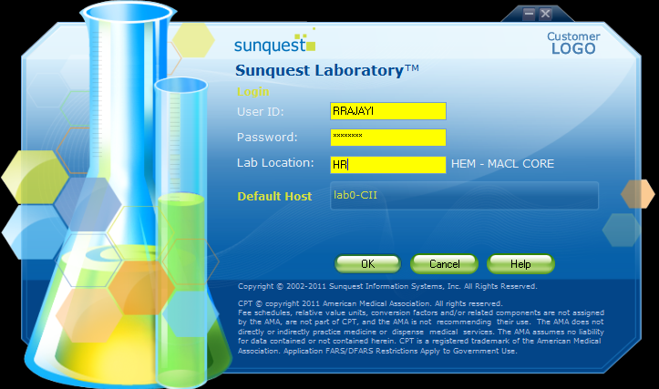
SUNQUEST GUI ACCESS
A login screen appears
  NOTE: Caps Lock must be turned on
Login with Sunquest User ID and password. Lab Location is the same as Device location used to login to Sunquest

Slide 5
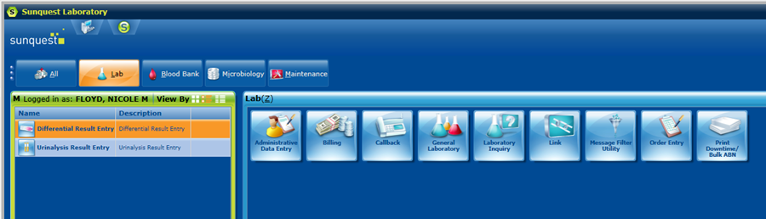
Inquiry / Printing
Tabs will display access icons associated with a specific area.
Access Laboratory Inquiry Icon from Lab tab.

Slide 6
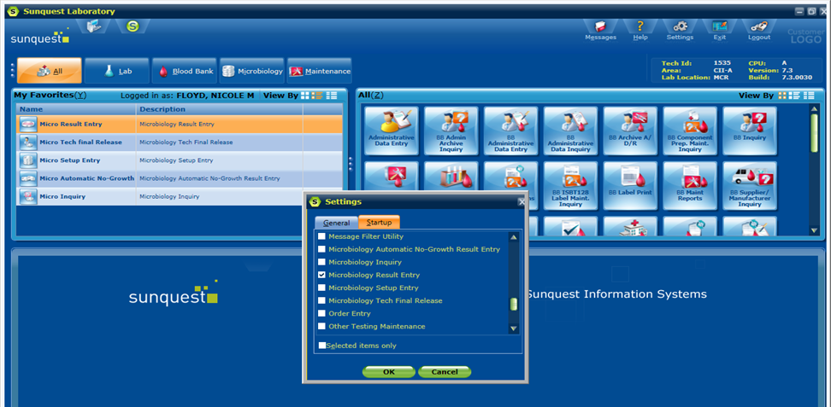
Inquiry / Printing
Laboratory Inquiry can be set to automatically open upon log-in
Click “Setting Tab” to open the Settings Window, then click “Startup” and check the box for Lab Inquiry and click “OK”
Multiple functions can be set.

Slide 7
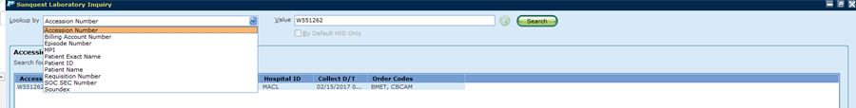
Inquiry / Printing
Use drop menu to select the lookup mode.
Enter Search Value
Click Search (or press Enter)

Slide 8
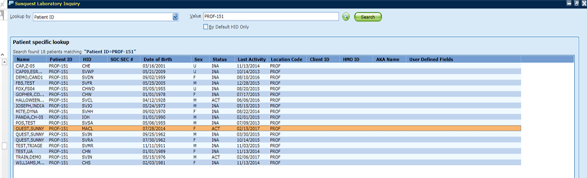
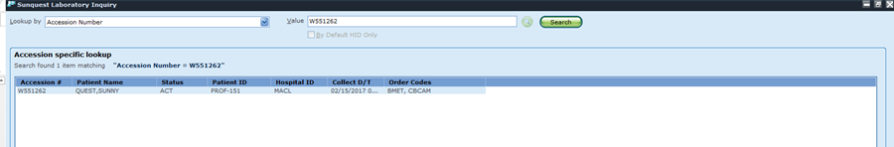
Inquiry / Printing
Patient ID:
Accession Number:

Slide 9
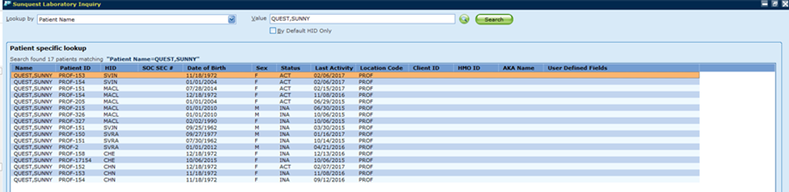
Inquiry / Printing
Patient Name:
Select Patient from displayed list using the mouse or arrow keys to highlight.

Slide 10
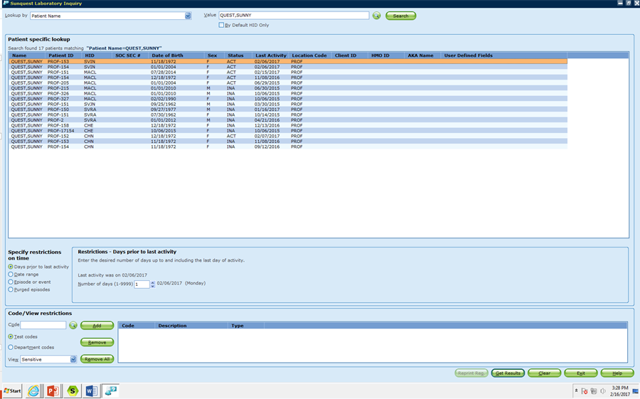
Inquiry / Printing
1. Highlight correct patient (mouse or arrow keys)
2. Adjust search parameters as necessary
  (select specific events or date ranges, search for specific test codes)
3. Click Get Results button
1.
2.
3.

Slide 11
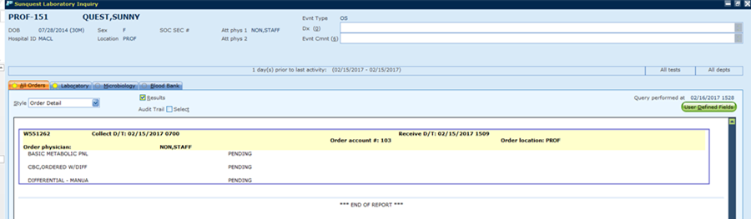
Inquiry / Printing
Pending/Completed results displayed.
Use tabs to display General Lab, Microbiology, and Blood Bank results.
  “Sun” on tab indicates results available.

Slide 12
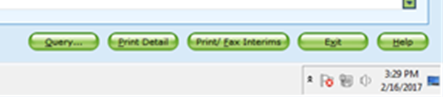
Inquiry / Printing
Action buttons displayed at bottom of screen.
  Query – Returns to the current query. Adjust search parameters. Search new patient.
  Print Detail – Prints Displayed results detail.
  Print/Fax Interims – Send report to desired printer/fax
  Exit – Exit Laboratory Inquiry

Slide 13
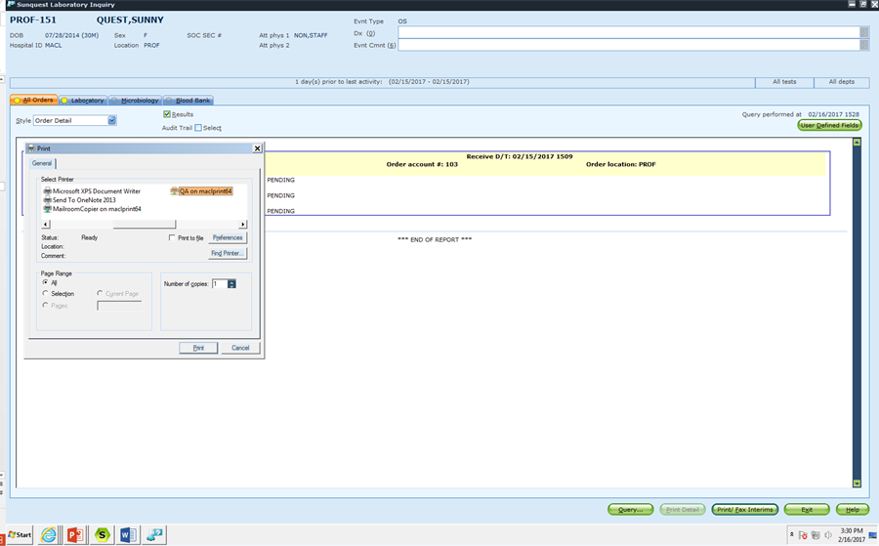
Print Detail
Select Document Printer
  This will be the list of printers associated with your MACL profile, follow on screen instructions to add printers as needed.

Slide 14
Print Detail
Detail Report –

Slide 15
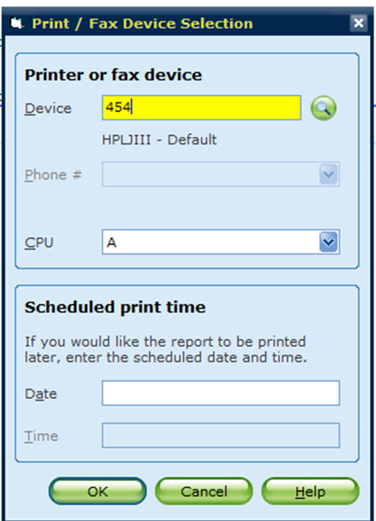
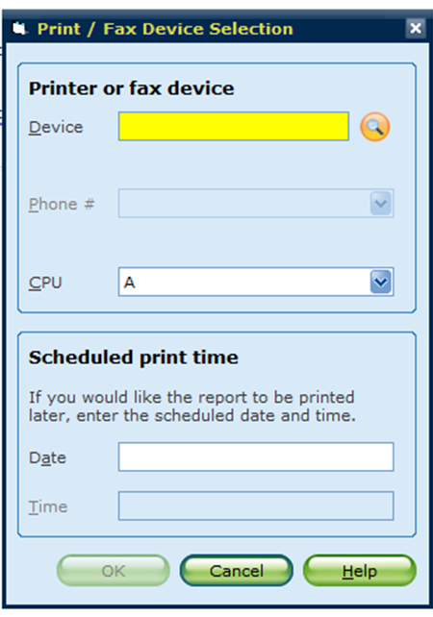
Print / Fax Interims
Select Printer/Fax Device
  This will be the Sunqest printer number or Fax Server Number
Enter Device and press Tab or search for Device
  The magnifying glass signals a search function.

Slide 16
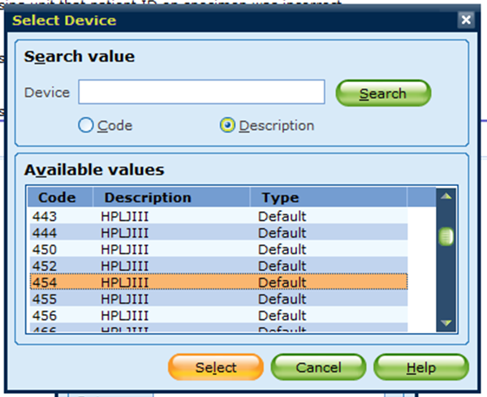
Print / Fax Interims
Device Search-
  Enter code or Description and Click Search
  Alternatively, leave blank, click search, select from list
  Highlight device, click select

Slide 17
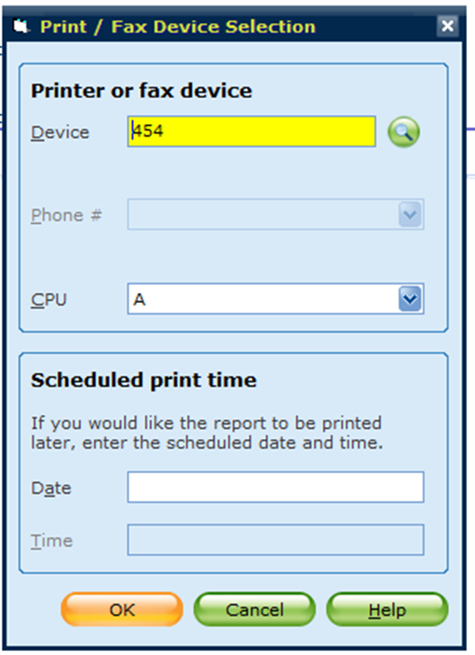
Print / Fax Interims
Click OK to print
Printing can be scheduled for a specific date and time in the bottom box.

Slide 18
Printed Interim Report

Slide 19
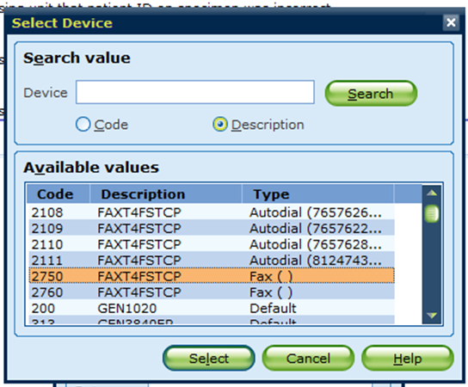
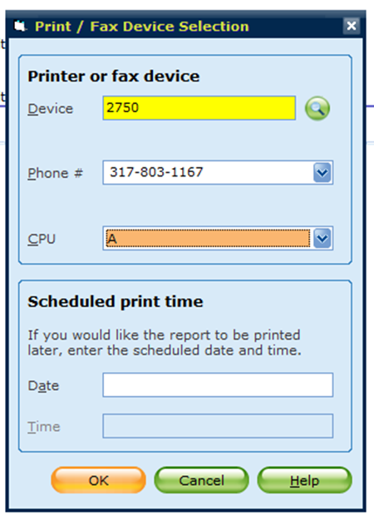
Print / Fax Interims - Fax
Specific Fax Device – 2750
Enter Fax number (area code required)
Follow same printing instructions, including faxing at a specific date and time

Slide 20
Faxed Interim Report
Same Report format as the Printed Interim Report with an appropriate fax cover sheet.

Slide 21
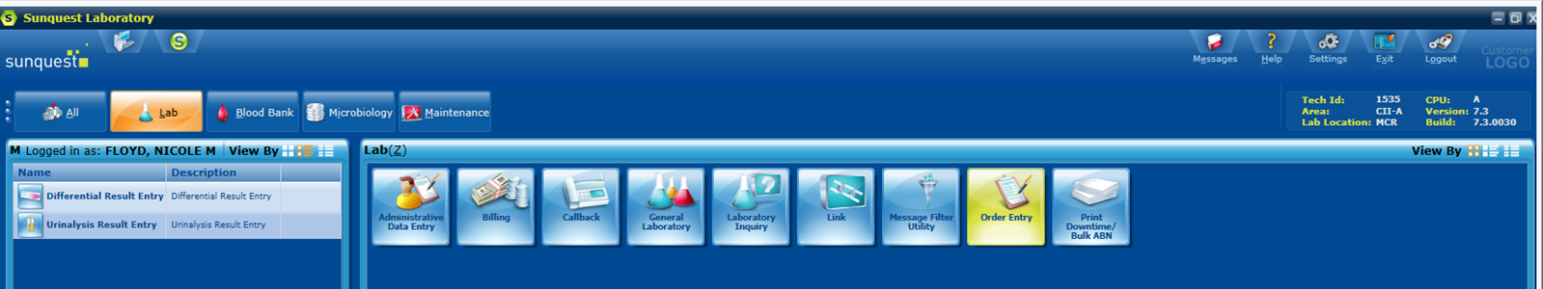
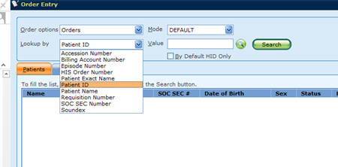
Order Entry
Select Order Entry Icon
Multiple look up options available for new or add-on orders

Slide 22
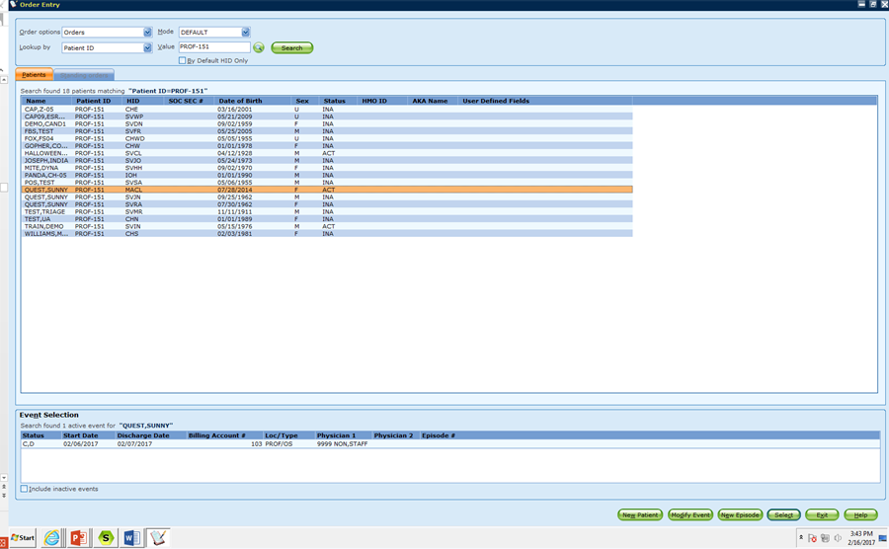
Order Entry
Enter Search Value, click Search (or press enter)
  Search Value is determined by the Lookup mode.
Select patient from displayed list. (use mouse or arrow keys)
Select Event (if more than one option available)
Click Select
Options for creating a new patient or new episode, and modifying an event, and viewing inactive events are also available from this screen.

Slide 23
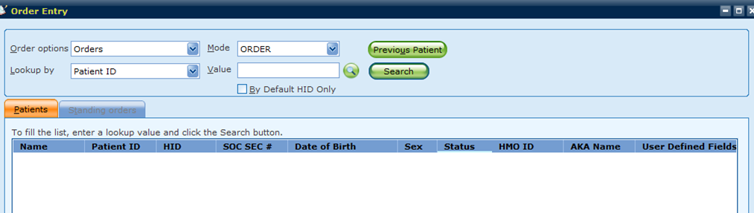
Order Entry
Previous patient button – redisplay previous Useful if ordering multiple accessions on a patient (e.g. Urine, Blood)
  Note: does not display until after a completed search
By Default HID Only – limit search to user default HID

Slide 24
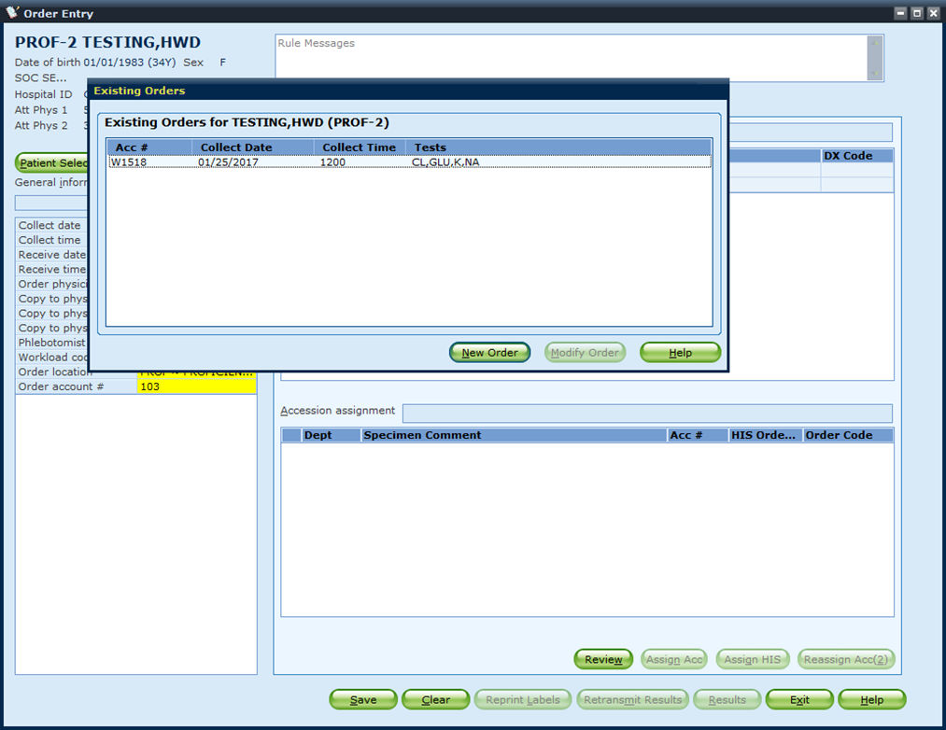
Existing Orders
A prompt may display showing the orders already existing for a patient.
Click “New Order” or press enter.
If an add on to an existing order, select from the existing order list.

Slide 25
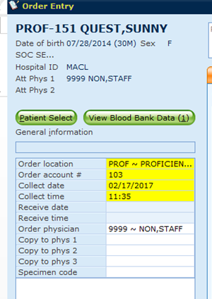
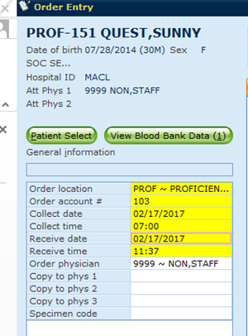
Order Entry
Enter Collect Time: Enter “N” or a future time to leave an accession unreceived. If a previous time is entered for collection, the system will automatically receive the accession.

Slide 26
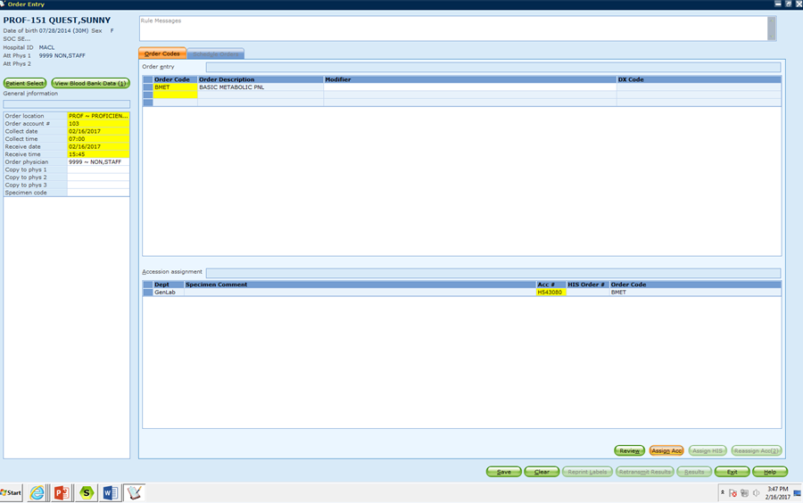
Order Entry
Enter Test Codes (press tab between)

Slide 27
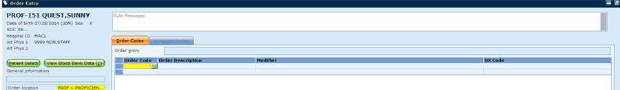
Order – Test Code Search
Click in the order code box to access the search button. Click on green magnifying glass search button.

Slide 28
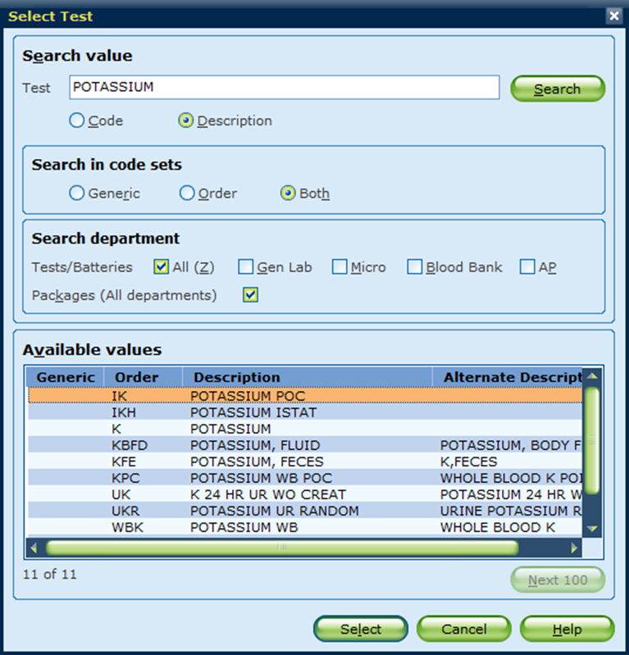
Order Search
Search can be done by Code (Order Code) or Description (Order Name)
Department can be filtered as well to limit returned results
Click Select after choosing (highlighting) the appropriate test

Slide 29
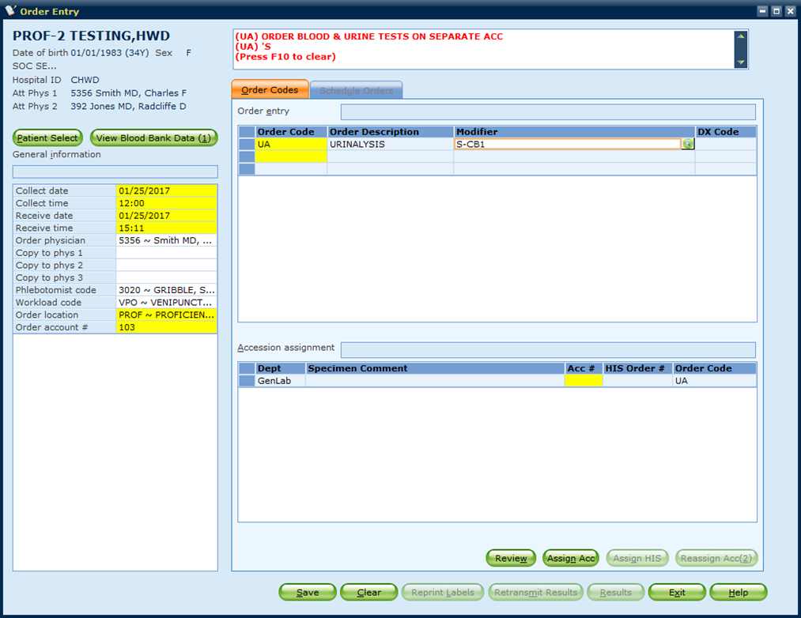
Order Modifier - Priority
Modifiers or Priority codes are entered under the Modifier section. There is also a look-up / search function.
  System automatically accesses Modifier box when TAB is pressed after entry of an Order Code
Priority codes should be entered first (i.e. S,X,A)
A hyphen can be used to string together modifiers (i.e. S-CB1)
A semi-colon can be used for free text (i.e. S-;Collect after transfusion)
Search button

Slide 30
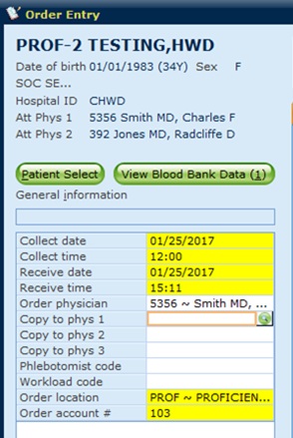
Ordering / Copy to Physician
Ordering physician is pulled from the Attending Physician 1 shown at the top of the screen or from the order interface.
To change or search for a physician, click in the box requiring the data, and then click on the green search button

Slide 31
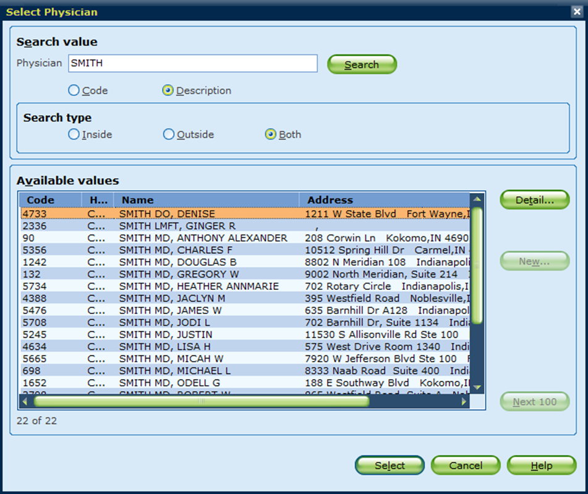
Select Physician – Search Results
Search by description (name) or code (physician number)
Highlight and click Select to choose a physician and return that value to the previous screen
The Detail button will show additional information if available (i.e. phone, fax)

Slide 32
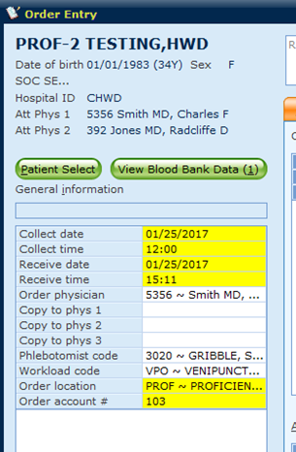
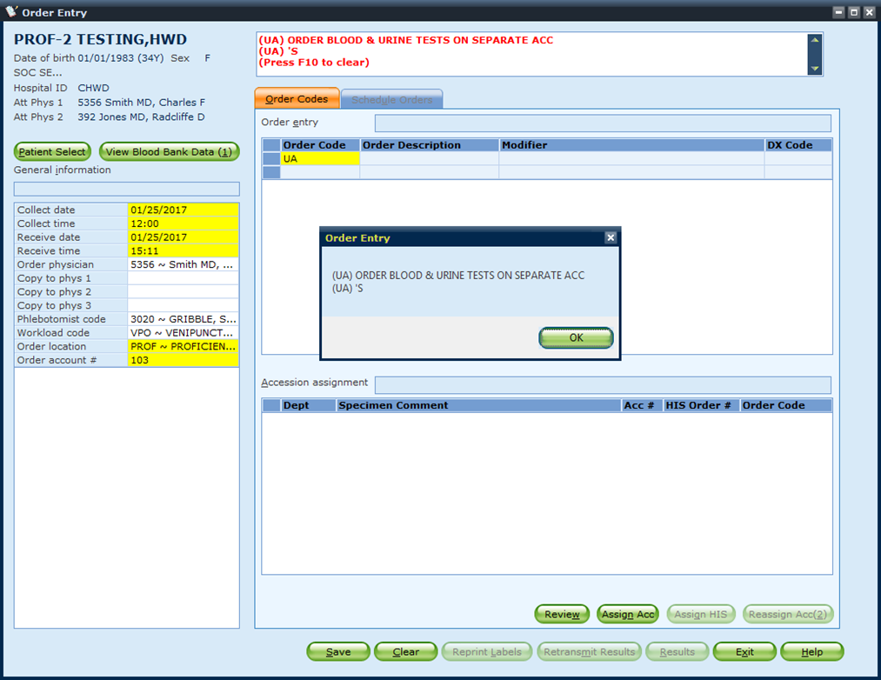
Additional Prompts and Messages
If your site (HID) uses “Phlebotomist Code” and “Workload Code”, these prompts will show.
If a test has an associated message, it will display in a pop-up box which the user must acknowledge.
Messages are recorded and can be viewed at the top of the screen.

Slide 33
Saving an Order
Sunquest will automatically assign an accession number once the “Save” button is clicked.
The “Patient Select” button will return to the patient section menu.
View Blood Bank Data will open Blood Bank inquiry
The “Clear” button will erase the form but keep the patient information.
The “Exit” button will exit the Order Entry application.

Slide 34
Saving an Order
Sunquest will automatically assign GenLab, Micro, and Blood Bank orders to separate accession number.
However, Urine and Blood GenLab must be ordered separately in different order entry sessions. After clicking save, the Previous Patient button can be used to start a new order quickly.

Slide 35
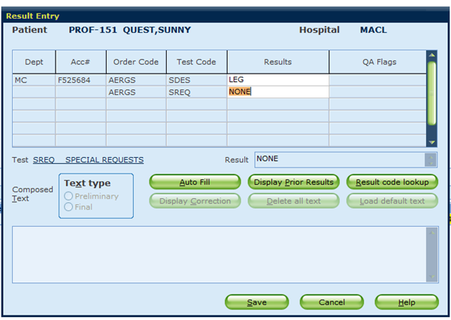
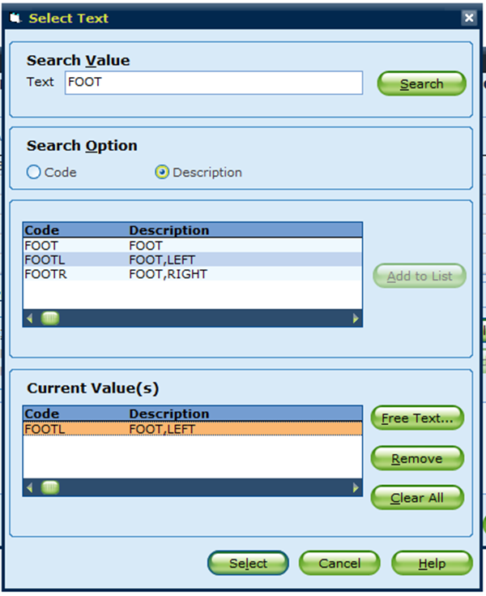
Microbiology Sources
Ask at Order Entry Results
If source data required, a pop up will open.
  This applies to all test which have “Ask at Order Entry” requirements
Enter source code or use the code lookup option.
Enter text, click search, highlight desired text from result box and click add to list, then click select

Slide 36
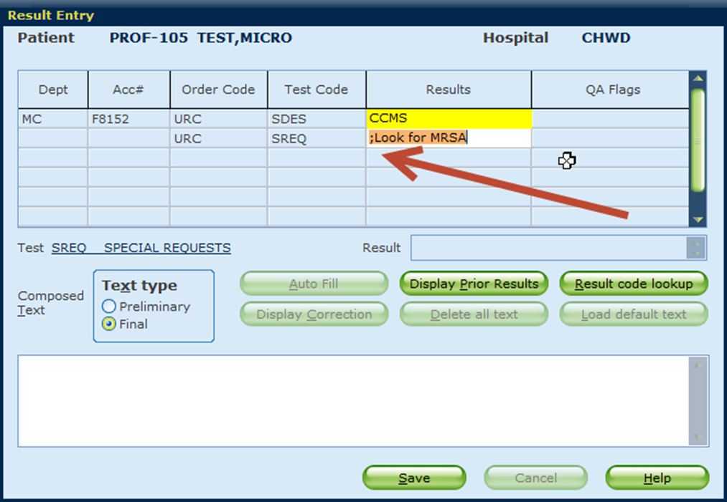
Ask at Order Entry – Free Text
Use a semi-colon if free text is needed
All Microbiology, and some GenLab tests (time urine testing) will require Ask at Order Entry Results.

Slide 37
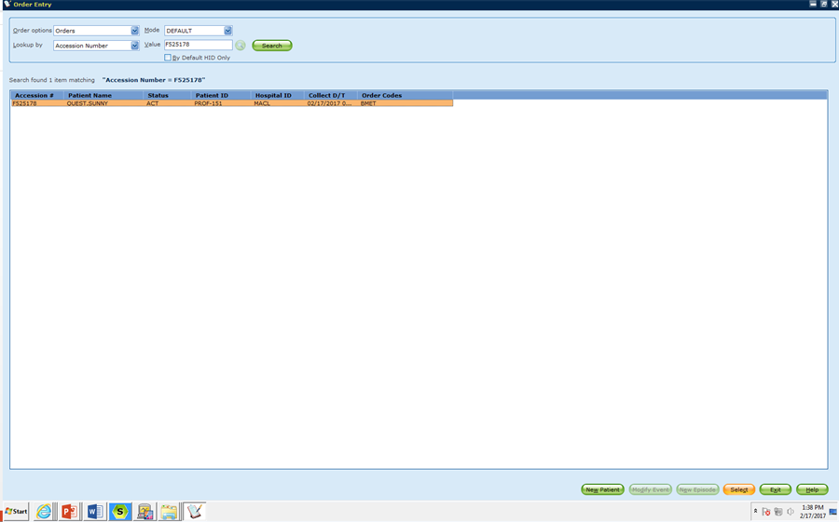
Reprint Labels – Order Entry
Labels can be printed from the Order Entry screen. Search by accession number.

Slide 38
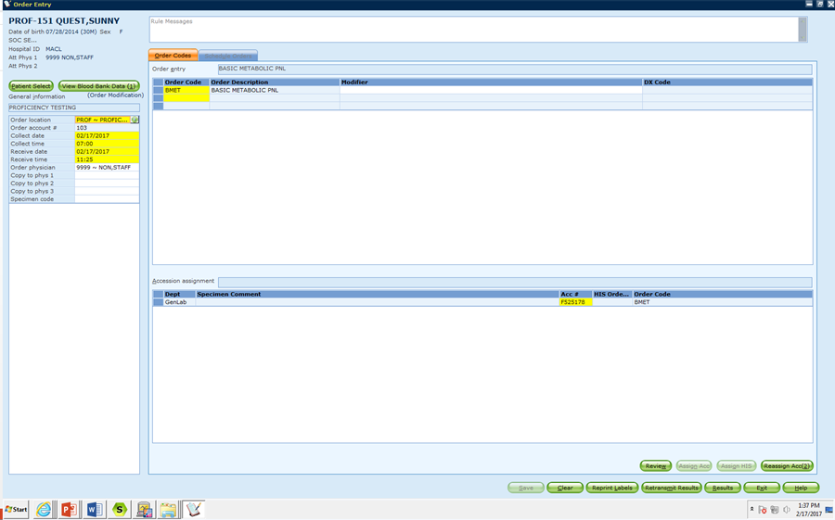
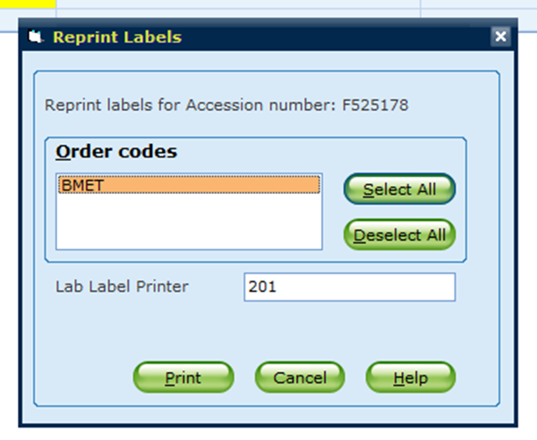
Reprint Labels – Order Entry
Select Reprint Labels at the bottom of the screen
Popup will open to allow for selection of specific test codes to reprint, or to select all
Default Printer will display, change as necessary
Click Print

Slide 39
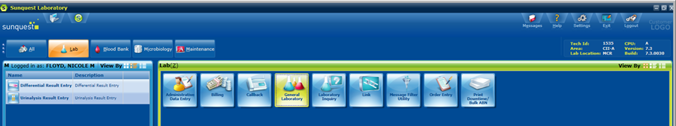
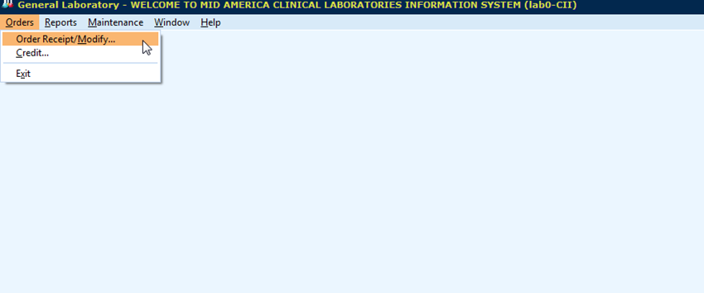
Receipt / Modify
Select General Laboratory Icon
Select Order Receipt/Modify

Slide 40
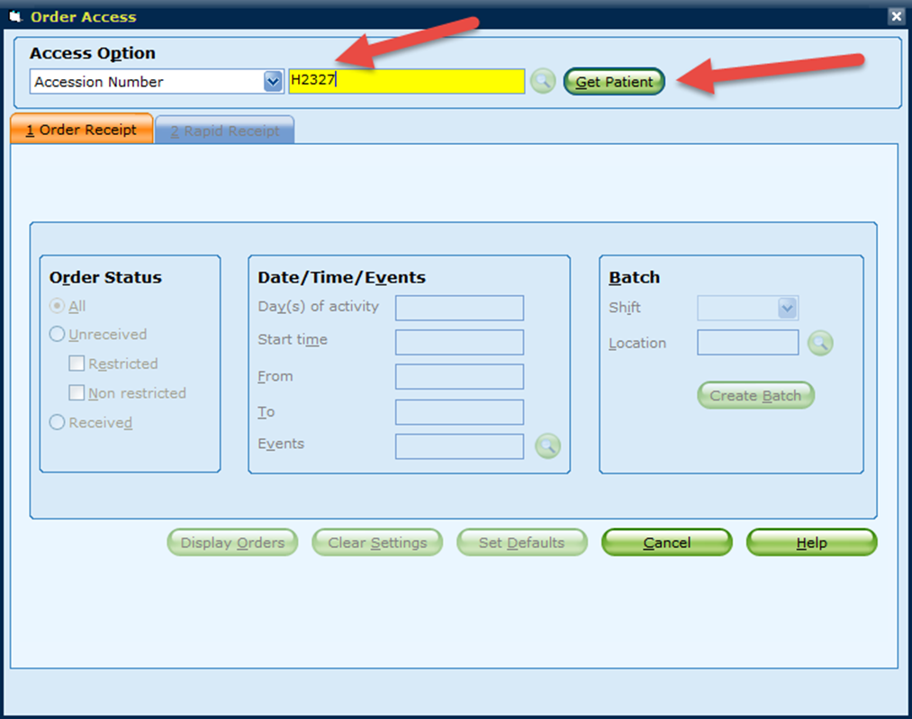
Order Access by Accession
Enter Accession number and Click “Get Patient” or press enter
Patient lookup defaults to “Accession Number”; additional lookup options are available in the drop down menu

Slide 41
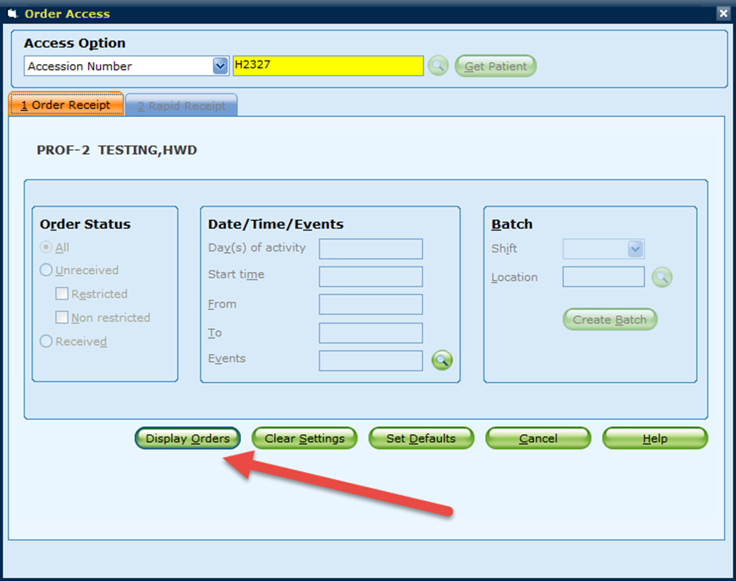
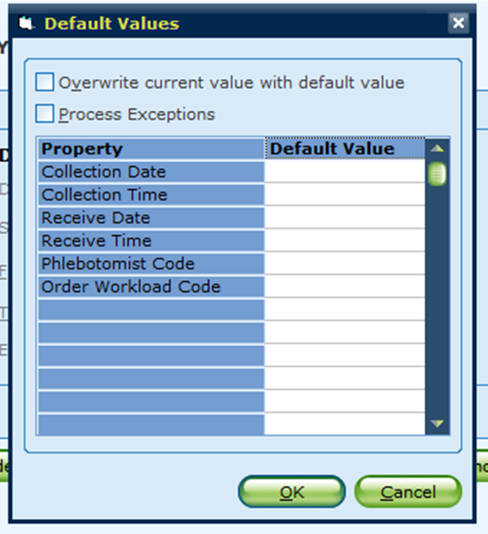
Order Receipt / Modify
Click Display Orders or press enter.
Clear settings will allow for a new search.
Cancel will exit the Order Receipt function.
Set Defaults will open a pop up box to allow for the setting of date, time and phlebotomist if required.
  Note: Do NOT set a default Receive Time.

Slide 42
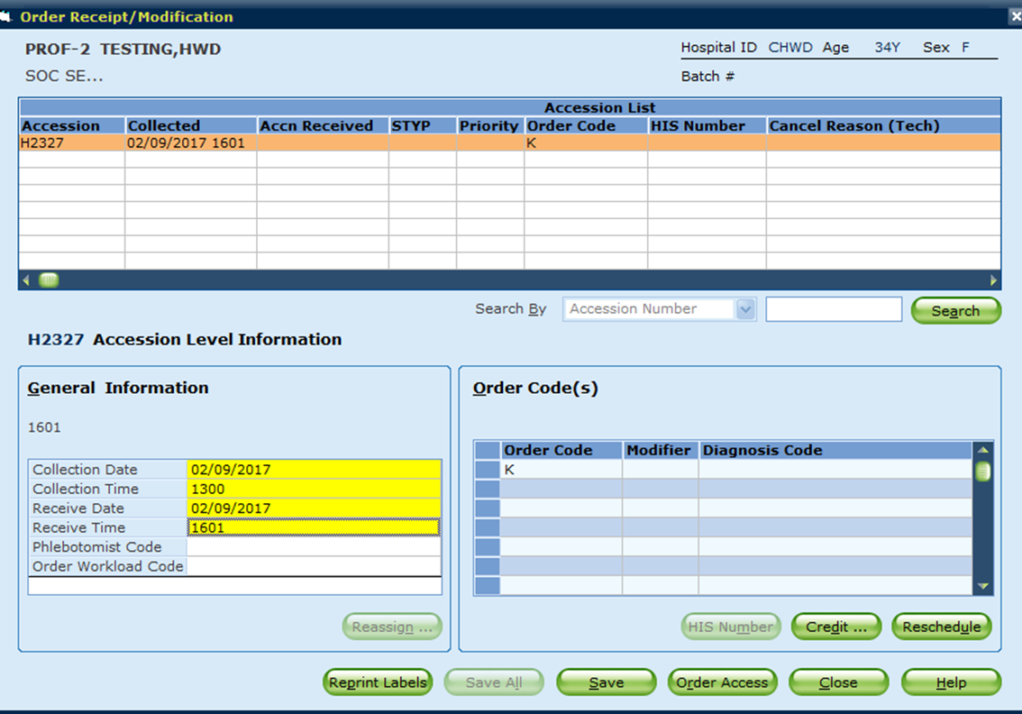
Order Receipt / Modify
Highlight accession requiring modification (if search not by accession)
Change information as required. Collection date/time, Receive date/time, modifier (priority), etc. (Press tab to advance through fields)

Slide 43
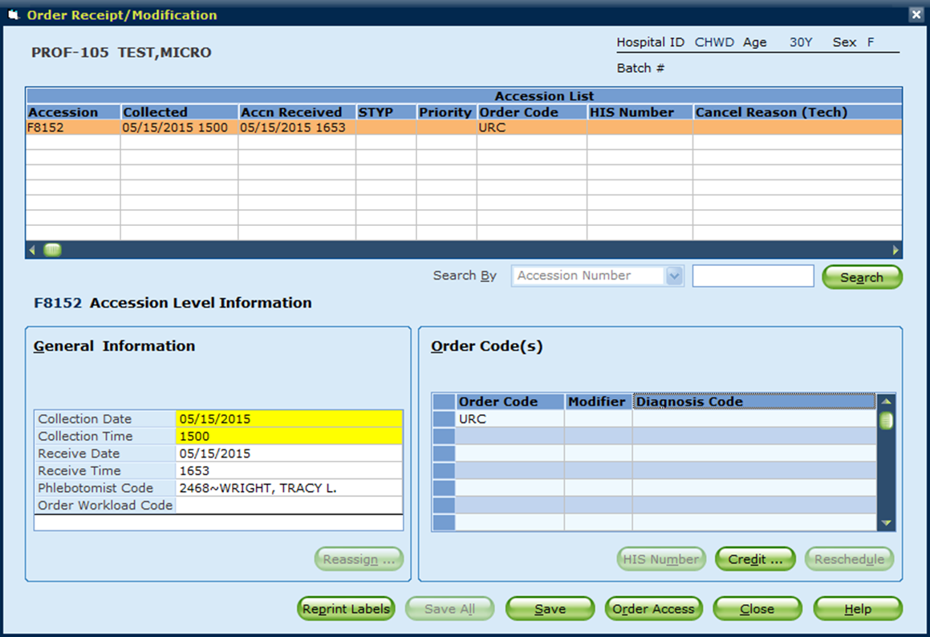
Order Receipt / Modify
Click “Reprint Labels” to generate the label reprint pop up box (as shown earlier)
Click “Save” to receive the accession
Click “Credit” to open the credit pop up box
  Use if the test will be received but not performed.
Click “Order Access” to return to the search screen.

Slide 44
Microbiology Sources
Ask at Order Entry Results
If source data required, a pop up will open.
Enter source code or use the code lookup option.
Enter text, click search, highlight desired text from result box and click add to list, then click select

Slide 45
Ask at Order Entry – Free Text
Use a semi-colon if free text is needed
All Microbiology, and some GenLab tests (time urine testing) will require Ask at Order Entry Results.

Slide 46
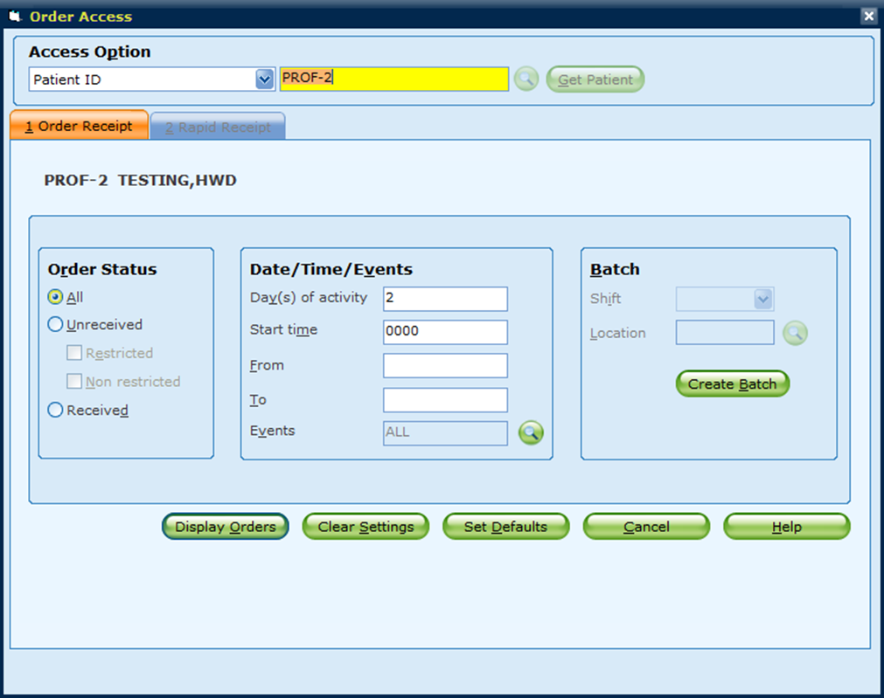
Order Access by Patient ID
Look up by patient ID to see all orders
Displayed orders can be filtered by:
  All
  Unreceived (Restricted and/or Non-restricted)
  Received
Displayed Orders can also be filtered by days of activity or specific date range

Slide 47
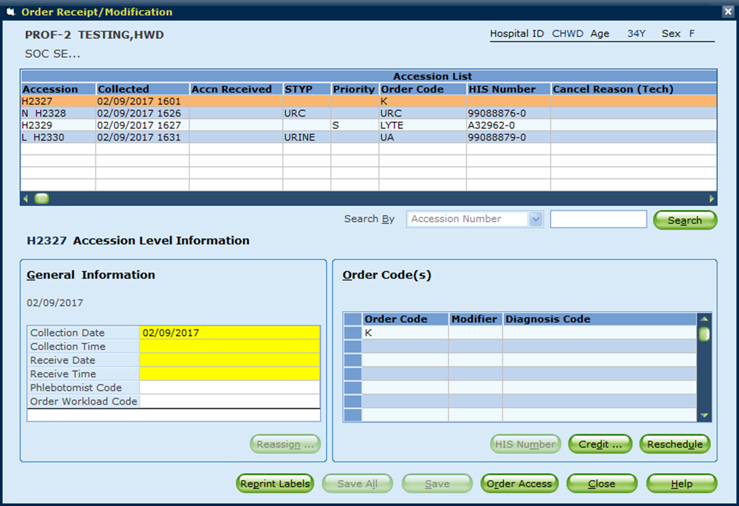
Order Receipt by Patient ID
Highlight accession to “receive”
Restricted Accessions have an “N” (Nurse Collect) or “L” (Lab Collect) preceding them
  These are the “Unreceived” accessions.
Enter the necessary modifications to Collect date/time, Receive date/time, modifier code (priority), etc. (use tab to advance through fields, some will auto-populate)

Slide 48
Order Receipt / Modify
Click “Reprint Labels” to generate the label reprint pop up box (as shown earlier)
Click “Save” to receive the accession
Click “Credit” to open the credit pop up box
  Use if the test will be received but not tested.
Click “Order Access” to return to the search screen.

Slide 49

Credit Options
Credit can be performed under both the Order Receipt/Modify and Credit options in General Laboratory.
Access the General Laboratory Icon

Slide 50
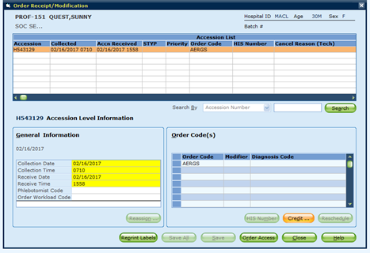
Credit – Order Receipt/Modify
Access patient accession number using the previously described methods of lookup.
On the Order Receipt/Modification window, click “Credit”

Slide 51

Credit – Order Receipt / Modify
Pop up box opens displaying tests ordered.
Select test to credit and click select.

Slide 52


Credit – Order Receipt / Modify
Enter the credit reason. If reason code requires lookup, use the green lookup button.
Search box works the same as described in previous sections

Slide 53

Credit – Order Receipt / Modify
If results have been entered a popup will display. Credit removing results is only allowed with Ask at Order Entry results (source codes, time duration, urine volume)

Slide 54


Credit – Order Receipt / Modify
Click SAVE
Note the only credit option available under Order Receipt/Modify is to Remove Results. This option should only be used for those tests being received which will not be performed. (This is the same as Function CR in the previous version of Sunquest)

Slide 55

Credit Only Option
Credit Window will open. Enter Accession Number requiring credit. Press Enter.

Slide 56


Credit – Remove Results (CR)
Select desired credit mode.
Select desired test to credit. Highlight test in list and click select.

Slide 57

Credit – Remove Results
Enter reason for credit. If credit code is unknown use the look up button as described in previous slides.
Click OK

Slide 58
Credit – Remove Results
If results have been entered a popup will display. Credit removing results is only allowed with Ask at Order Entry results (source codes, time duration, urine volume)
Credit Remove Results is used with unresulted tests and those tests with Ask at Order Entry results only

Slide 59

Credit – Retain Results (CRW)
Select Retain Results as the Credit Mode
If results have been reported and patient care decisions may have been made, modify the reported result to reflect the reason for the credit and the call information. Then proceed to the credit function.

Slide 60


Credit – Retain Results
Select desired test to credit. Highlight test in list and click select.
Click OK

