Slide 1
Fire Safety and Evacuation

Slide 2
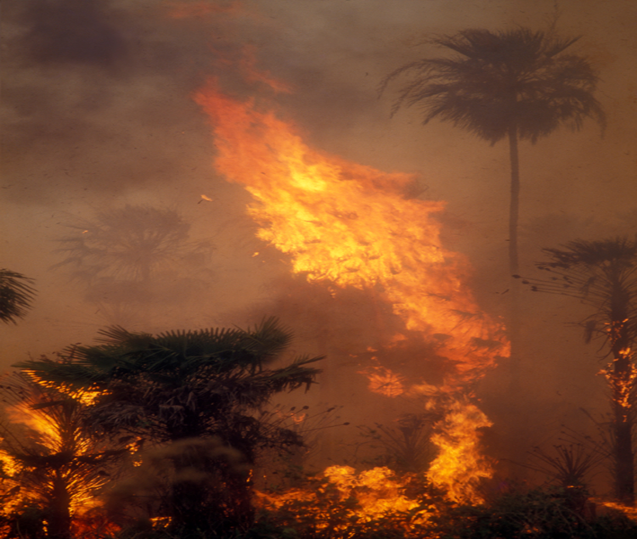
OSHA REGULATIONS
Your employer must provide you with basic fire safety training
MACL has a fire evacuation plan to show you how to evacuate immediately in the event of fire
You should also be trained in the use of fire extinguishers

Slide 3
Evacuation
Understand and follow your assigned role in the fire safety and emergency evacuation plan
Only operate a fire extinguisher if you have received proper training
If you are told to evacuate the premises, LEAVE!

Slide 4
The Fire Triangle
Fuel – anything that will burn. A vapor
or gas, a solid or a liquid.
+
Heat – the energy that ignites the fuel.
A spark, flame or spontaneous
combustion.
+
Oxygen – the chemical in our air
that is required to sustain
combustion.
= FIRE
All 3 elements must be present at the same time to form a chemical reaction known as FIRE.

Slide 5
Understand the Fire Triangle
Understanding the fire triangle is the key to fire safety
By keeping two essential elements, fuel and heat separate, you can prevent fires from igniting
All three elements in the fire triangle must be present for a fire to burn
Fire extinguishers work by removing at least one of the triangle’s three elements

Slide 6
When a Fire Occurs: RACE!
When you smell smoke or see a fire…
R – Rescue
A – Alarm
C – Confine
E – Extinguish
STOP
THINK
SAFETY
Every second counts. A fire can double in size every 30 seconds. Any delay could be fatal!
Your role is spelled out in the Fire Response and Recovery plan (SAFE.EMER.4.0)

Slide 7
R is for Rescue
When you smell smoke or see fire, your first priority is to get anyone in immediate danger to safety, including YOU!
The first thing to do is rescue any employee or visitor and move them to a safe location. This might be the nearest exit or beyond the closest firewall/fire door.

Slide 8
A is for Alarm
*Once anyone who is in immediate danger from the fire has been moved to a safe location, you should activate the alarm system. Alarm pull stations are located at every exit.
*This will notify the fire department and alert other employees and visitors that there is an emergency in the building.
*We practice fire drills so you know exactly what to do when the fire alarm is activated.

Slide 9
C is for Confine or Contain
*Once individuals in immediate danger have been safely evacuated and the alarm has been activated, the next step is to begin trying to control the spread of fire and smoke.
*Always close the door to the room where a fire has started, and make sure any fire doors, which are supposed to be closed, have not been blocked open.

Slide 10
E is for Extinguish or Evacuate
*When all other steps have been undertaken, evaluate whether you can safely attempt to extinguish the fire.
*Do not try to extinguish a fire unless the appropriate type of fire extinguisher is available and you have been trained in its use.
*Sound the alarm first BEFORE using the fire extinguisher, however small the fire may appear to be.
*If the fire is too big to extinguish, evacuate.
*Meet at your department’s designated place outside.
*Follow the evacuation plan.

Slide 11
Your responsibilities
Know where your alarms are located
Know when to pull the alarm
Pull alarm
Call or designate someone to call the Hospital operator, give the exact location of the fire.
Isolate fire by containing the spread of smoke and flames by closing doors. Last person out of department turn off light and close door.
Know your evacuation path and meeting area.
Know where fire extinguishers are located and their proper use.
Who is responsible? YOU ARE

Slide 12
FIRE EXTINGUISHERS
Fire Classification | Examples | Type of Extinguisher
Class A Ordinary combustibles | Wood, Textiles, paper, plastics, and similar materials | Water Dry Chemical/ABC
Class B Flammable liquids | Gasoline, oil, grease, paint and kerosene | Dry Chemical/ABC Dry Chemical/BC Carbon Dioxide
Class C Electrical | Electrical wires, equipment, or appliances | Dry Chemical/ABC Dry Chemical/BC Carbon Dioxide
Class D Metal | Magnesium, potassium, and powdered aluminum | Dry powder/D Graphite-based Sodium Chloride

Slide 13
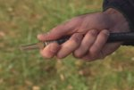
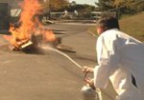
Operating an Extinguisher- Remember PASS
There are 4 basic steps to operating portable fire extinguishers |  | P = Pull the pin A = Aim the Nozzle at the base of the fire S = Squeeze the handle S = Sweep side to side at the base of the fire

Slide 14
Situations when Fire Extinguishers Should NOT be used
Don’t attempt to extinguish a fire if ANY of the following apply:
You are unsure if the fire is small enough to safely extinguish.
You are unsure of the type of combustible material and are unsure of type of extinguisher to use.
The fire is out of control and spreading.
The fire has blocked your only escape route.

Slide 15
Safety Precautions
If the fire is outside, try to get upwind. This will allow you to get closer without being overcome by smoke.
Always leave an escape route. Keep your back to a clear exit and stand 6 to 8 feet away from the fire.
If you are not sure whether or not a fire is too big to fight, it is – get out! Evacuate, don’t extinguish.

