Slide 1
Secondary Desktops
How to access dual Sunquest GUI Sessions

Slide 2
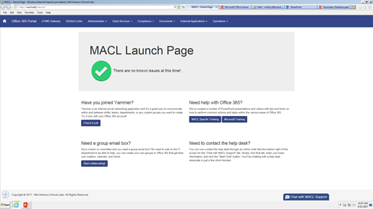
1. Open the MACL Launch Page
Access the MACL intranet by launching internet explorer.

Slide 3
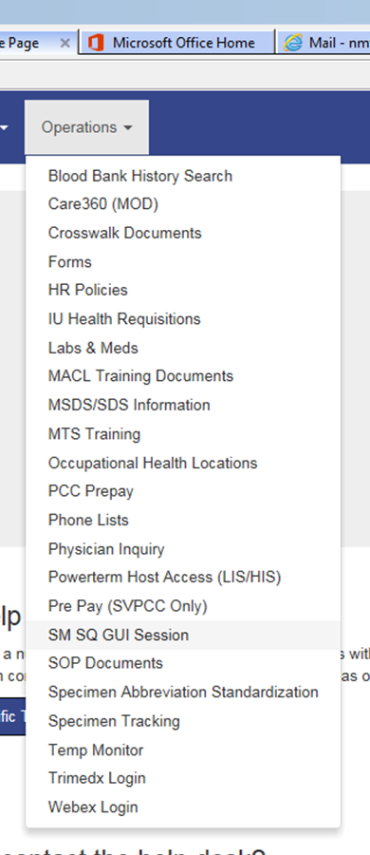
2. Select SM SQ GUI from the Operations drop menu

Slide 4
3. Select HTML login option
Click anywhere in the box with the blue computer.

Slide 5
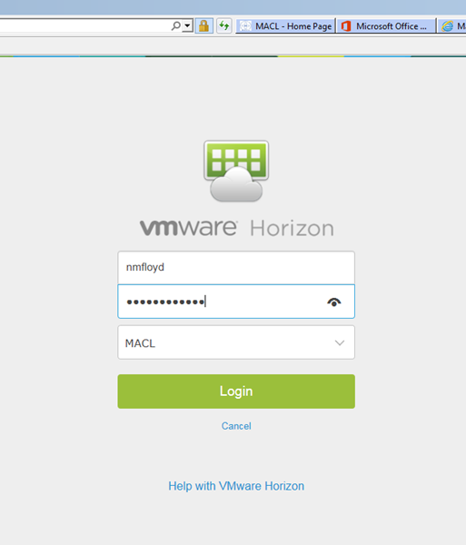
4. Sign into VMware
If you have accessed Vmware already for another process, this step may not appear.
Username and Password is the same as your MACL network access.

Slide 6
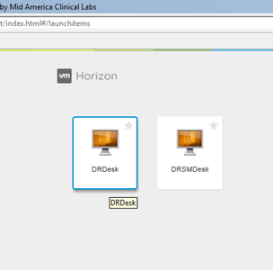
5. Access the desktop icon
Click on the DRSMDesk icon for Evansville.
Click on DRDesk icon to access a secondary CII (Sunquest A or B) Desktop
IMPORTANT NOTE:
The DRSMDesk is the Evansville Desktop.
Make sure to open the correct desktop.

Slide 7
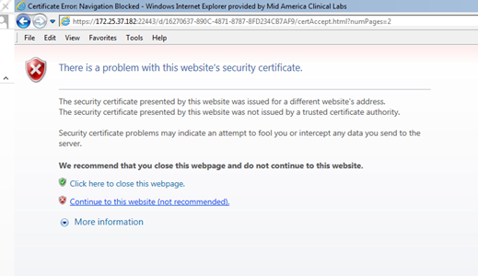
6. Security Warning
If a Security Warning comes up, go ahead and use the “Continue to this Website Option”
Select Continue to Website. This is OK for this MACL website.

Slide 8
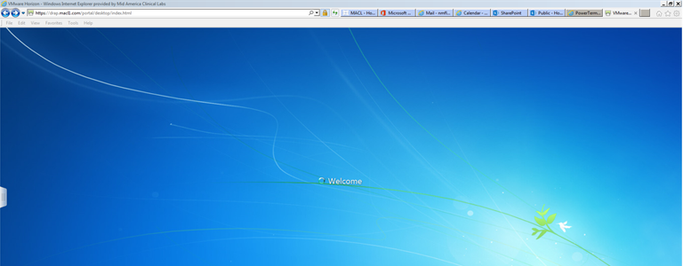
7. Desktop will load
This may take some time. The drap desktop opens a lot slower than your regular desktop. The first time you access the drap the system will have to verify your information and assemble your desktop information.

Slide 9
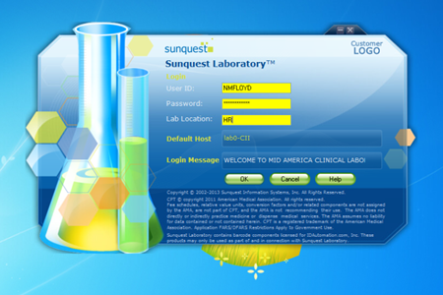
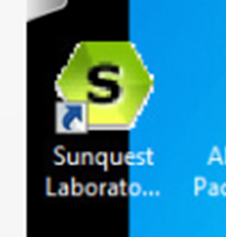
8. Open Sunquest GUI
Once the desktop loads, you will be able to access Sunquest GUI. The login process is the same as on your Primary Desktop.
Click on the GUI Icon and follow the login process.

Slide 10
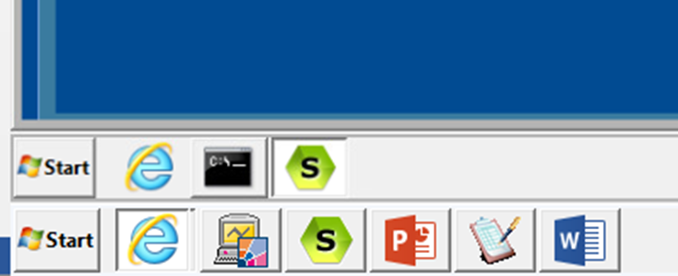
9. Toggle between GUI sessions
Your Secondary Desktop with active GUI session will be accessed by making the internet tab active.
To see the Primary Desktop, minimize the internet tab down to the taskbar.
Click on the “e” to see your open browser windows. Your secondary Desktop is Vmware Horizon.
Click on the Vmware to make that tab active.
When the second desktop is active you will have a taskbar within the larger primary desktop.
This is your open active Primary GUI on the task bar
Secondary GUI
Primary GUI

Slide 11
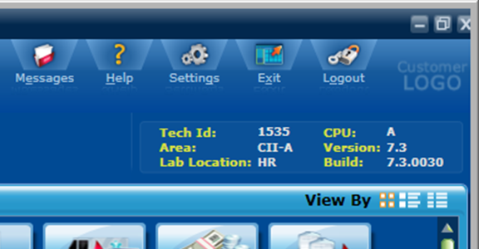
Another way to verify GUI session
When logged into GUI, the main GUI screen has the location in the upper right corner

