Slide 1
VerifyNow Testing Updated Workflow
Laboratory Meeting – September 20, 2017

Slide 2
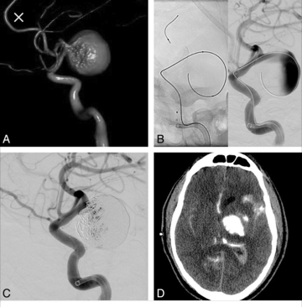
Why an updated workflow?
The hospital is now performing Embolism Pipeline Surgery for Subarachnoid Aneurysm
The VerifyNow – PRU – P2Y12 testing is needed pre, intra and post operatively

Slide 3
Providing the Collection Tubes
Specimen collection sets will be made by processing and kept in the processing storage cabinet
See Laura for additional supplies to make up the collection sets
The collection sets will contain the following
3 Blue Top Greiner Vacuette: 1 labeled DISCARD, and 2 for testing
Sample Collection Procedure
Specimen collection sets will be sent to the departments as requested – surgery can receive 2-4 sets at a time

Slide 4
Intraoperative Testing Workflow
Surgery will call to inform the laboratory of intraoperative testing – similar to iPTH testing.
Pre-scheduled testing will be documented on the white board like iPTH testing.
The nursing staff will walk the specimen to the Coag department in the laboratory. The specimen CANNOT be sent via the pneumatic tube system.
The coag support tech/lab tech must receive the specimen in Sunquest
The specimen must rest for 10 minutes prior to testing. The VerifyNow representative stated that this time begins at the time of COLLECTION not the time received in the lab.
The testing must be performed IMMEDIATELY after the 10 minute period as a patient is in surgery with his/her skull open.
The nurse may wait for the result. If he/she doesn’t wait for the result, a phone number will be given and the result MUST be called immediately.

Slide 5
Pre / Post Surgery Testing Workflow
The unit/outpatient lab will call for the tubes and Processing will send the collection set to the unit.
The nursing staff/outpatient lab will walk the specimen to the Laboratory. Processing must direct them to the Coag department in the laboratory. The specimen CANNOT be sent via the pneumatic tube system.
The Coag support tech/lab tech must receive the specimen in Sunquest/QLS
The specimen must rest for 10 minutes prior to testing. The VerifyNow representative stated that this time begins at the time of COLLECTION not the time received in the lab.
The testing must be performed IMMEDIATELY after the 10 minute period.
The nurse may give a phone number for the result to be called.

Slide 6
VerifyNow Testing Review
https://www.youtube.com/watch?v=zPGqtK8_JwM

