Slide 1
Point of Care
St. Vincent 86th Street

Slide 2
Contact Information
Staffing Hours: Monday through Friday (6am until 7pm……once Candace is fully trained, she will be available until 8pm)
We are located in the back of the Ameripath Room
Director: Angie Wolff
      aswolff@macl1.com
      Office: 317-803-0559 Cell: 317-515-7798
Technical Supervisor: Jennifer Hancock
      jehancoc@macl1.com
      Office: 317-803-0486 Cell: 317-690-9044
Support Technicians:
      Kim Smithey (day shift)
      Candace Anderson (evening shift)
      ***Cell: 317-407-6958*** Desk: 317-803-0364
      SVPOC@macl1.com

Slide 3
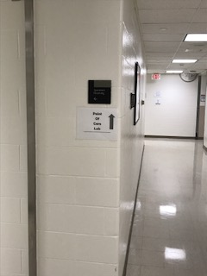
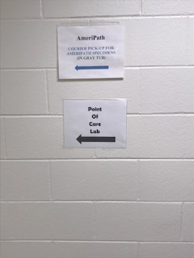
POC Location: We are in the back of the Ameripath Room
Follow the signs in the hallway:

Slide 4
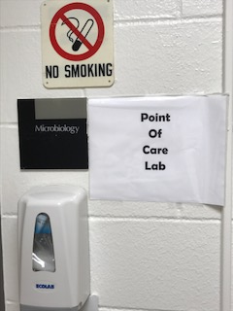
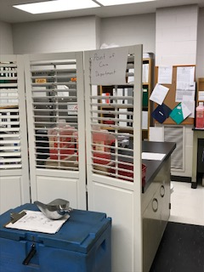
Once in the Ameripath room, turn right…..

Slide 5
What do you do if someone comes to the lab or calls for POC?

Slide 6
If the associate calls or comes to the lab during our hours (M-F from 6am-7pm)…….
Send them down to our department (either direct them through the hallway or give them our number) and we will be happy to help them
If nobody answers the phone, have them leave a message. It is likely that Kim and/or Candace are up on the floor helping someone.
The preferred number to call on is 317-407-6958. Either Kim or Candace will have this on them at all times during our hours.

Slide 7
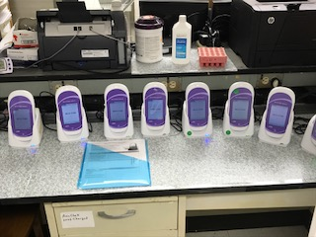
If the associated calls or comes to the lab after hours (overnight, weekends, or holidays) with an AccuChek issue…….
AccuChek Problem:
They can fill out the form on the counter with the replacement AccuCheks, and leave the completed form with the device they bring back (please have them place the return device on the charger and put the paper with it). The should select an AccuChek that does not already have a paper with it to take back.
If they are from the 7th floor (7SW/Stress), they should then send us an email at SVPOC@macl1.com to let us know what device they brought in and what device they are replacing it with. For this floor only, they cannot use the device until we switch the location in RALs.

Slide 8
If the associated calls or comes to the lab after hours (overnight, weekends, or holidays) with an I-Stat issue…….
They will need to hold on to the device until our next shift.
They should be instructed to call and leave a voicemail and/or send us an email with the following information:
    Associate name
    Unit
    Problem they are having
    Best number to call and who should we speak with
    Serial Number of device
On our next shift, we will follow-up with the message and troubleshoot accordingly.
If they do not have any other I-Stats in their department, and the I-Stat is non-functional, they should be instructed to draw blood and send it to the lab until we can get them a replacement.

Slide 9
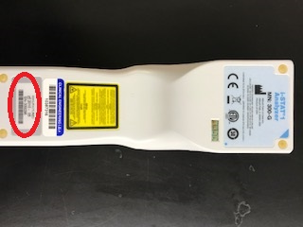
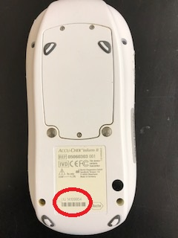
Serial Numbers are located on the back of the device……
AccuChek
I-Stat

Slide 10
Why can’t they just use an I-Stat from another department???
I-Stats are specifically set up for the department in which they are located.
  This means that certain I-Stats are set up to only run specific cartridges.
  Some departments have different set-ups for which barcode it will scan (example…..the OR is set up differently because armbands can be difficult to get to for surgery patients)
QC is programmed based on what cartridges are run in each unit.
  If their unit runs PT/INR cartridges, but the unit they borrow the I-Stat from does not, then that I-Stat has not had PT/INR QC done on it.
***NEVER suggest that they use an I-Stat from another area***

Slide 11
Odds & Ends….
If an associate is locked out of a device……have them email us and we will reply with their individual requirements to get re-instated. They should NEVER use someone else’s badge.
Critical results will get held up in RALS until we go in and push them through. If they see that results are not crossing, they should email and/or call us and leave a voicemail.

