Slide 1
SVIN Laboratory Meeting
December 27, 2017

Slide 2
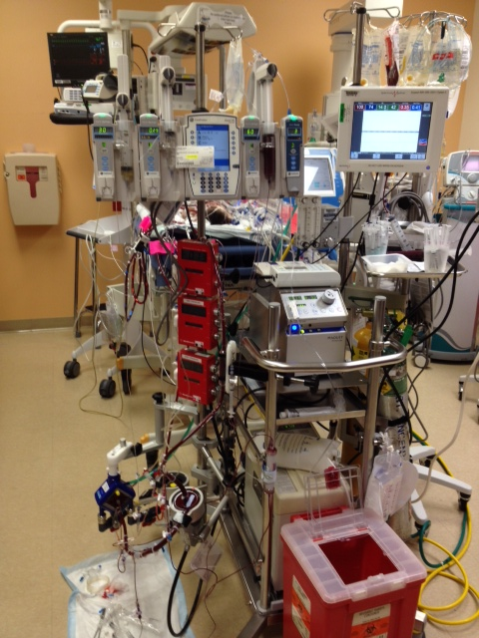
ECMO – What is it?
ECMO stands for ExtraCorporeal Membrane Oxygenation
ECMO is a therapy that takes over the work of the lungs and/or heart when they are unable to support the body.
The ECMO machine is similar to the heart-lung bypass machine used for open-heart surgery but can be used for longer periods of time.
The patients on heart-lung bypass for surgery are on the machine for hours, where ECMO patients can be on from days to weeks.

Slide 3
ECMO – Who needs it?
The majority of infants and children who require ECMO usually have one of the following problems:
Meconium Aspiration Syndrome
Sepsis (infection)
Persistent Pulmonary Hypertension
Congenital Diaphragmatic Hernia
The need for heart support after open heart surgery
Pneumonia-bacterial or viral

Slide 4
ECMO – Complications?
The risks associated with ECMO are:
Bleeding - #1 concern
Altered Blood Flow to the Brain
Infection
Air or Blood Clots

Slide 5
ECMO – Critical Lab Tests
0400 – CMET, NTRIG, MG, PHOS, DBIL, IBIL, CBC, SVO2*, LACT,PT, PTT, FIB, UA, PF-HB, Heparin Level, ATIII level,(Met Hb if on Nitric Oxide)
1000 – CBC, SVO2*, PT, PTT, FIB
1600 – CBC, SVO2*, LACT, PT, PTT, FIB, BMET
2200 – CBC, SVO2*, PT, PTT, FIB
CRP every Monday/Thursday
Other STAT Lab Tests May Be Ordered
Based on Patient’s Condition

Slide 6
ECMo – Lab Processing
These infants are the most critical patients in the hospital
Receive these specimens in Sunquest IMMEDIATELY – especially between 3am – 6am
Place a STAT sticker on the ECMO specimens
If there are issues with the specimens, call the unit IMMEDIATELY

Slide 7
ECMo – Lab Testing
These infants are the most critical patients in the hospital
If there are issues with the specimens, call the unit IMMEDIATELY
Support Techs – Physically give result printout to techs
Perform the testing BEFORE other specimens-especially during early morning run between 3am – 6 am
Review results and CALL critical results IMMEDIATELY

Slide 8
Help Save a Life
by focusing on ECMO specimens

Slide 9
2018
Moving in a positive direction

Slide 10
Staffing
Tech Positions filled
3 Support Tech positions to fill
3 Lab Assistant positions to fill
Offer being extended for a Specimen Processing Manager

Slide 11
Accountability
Associates will receive a Deviation of SOP form if an error is made. This will:
Inform the associate that he/she made an error
Allow the associate to detail circumstances of error
Allow the associate to proactively put in place steps to prevent the error from occurring

Slide 12
instrumentation
Chemistry analyzer evaluation being performed
New analyzers in 2018 – SVIN 1st to receive
Procalcitonin Testing will be performed onsite

