Slide 1
Credit Using GUI
Credit with Results – “Retain Results” formerly CRW
Credit without Results – “Remove Results” formerly CR

Slide 2
Credit Options
Credit can be performed under both the Order Receipt/Modify and Credit options in General Laboratory.
Access the General Laboratory Icon

Slide 3
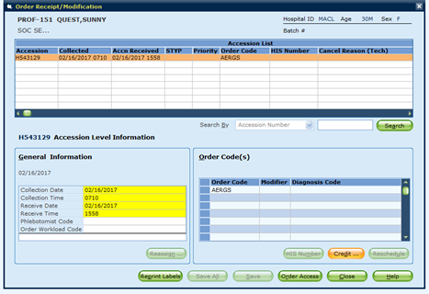
Credit – Order Receipt/Modify Use this method to credit a test upon receipt – no testing to be performed.
Access patient using either the accession or patient ID methods of lookup. (This is the same method to “receive” a sample into the system.)
On the Order Receipt/Modification window, click “Credit”

Slide 4
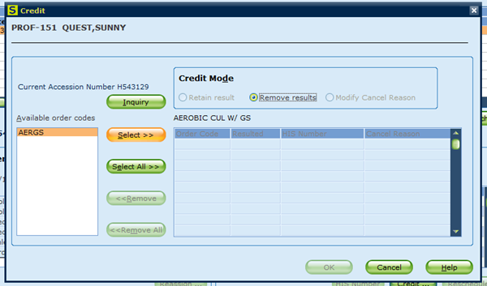
Credit – Order Receipt / Modify
Pop up box opens displaying tests ordered.
(NOTE: the CREDIT MODE is “Remove Results”. This is OK since NO TESTING has been performed.)
Select test to credit and click select.

Slide 5
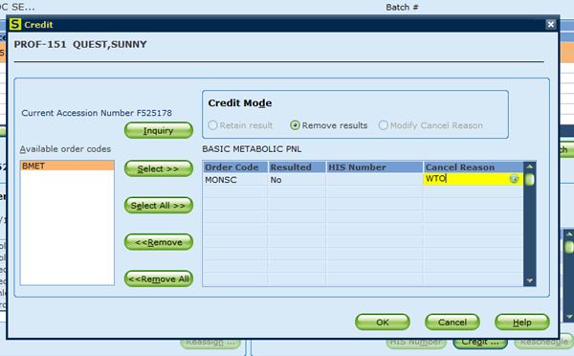
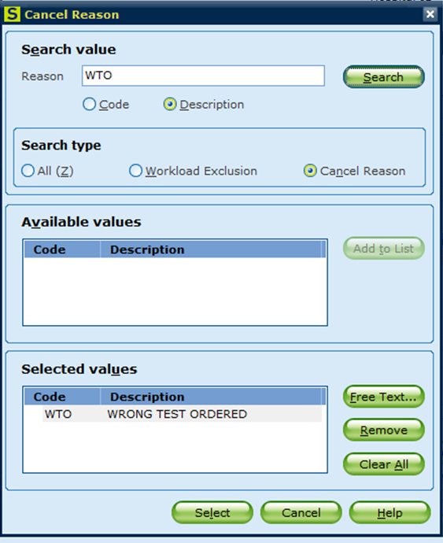
Credit – Order Receipt / Modify
Enter the credit reason. If reason code requires lookup, use the green lookup button.
The user also has the option to enter both code and free text directly in the Cancel Reason box utilizing the appropriate format: WTO-;called to John Smith ED Unit Clerk
Search box works the same as described in previous sections, and includes the availability to utilize both code and free text to document all necessary information.

Slide 6
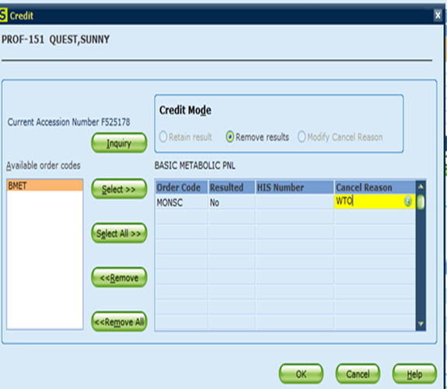
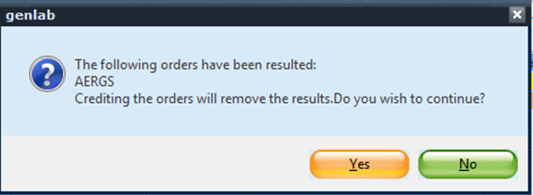
Credit – Order Receipt / Modify
When crediting tests upon receipt, only “Ask at Order Entry” results should have been entered. These are sources, volumes, height, weight, etc.
Sunquest considers all answers as “results”. When crediting it is important to understand the difference between testing results and ask at order entry results.
If the system has “results” a pop up will appear. If the only “results” in the system are “Ask at Order Entry”, then the user can answer yes to the pop up question.
The system will note if there are “results” which have been entered. Report can be verified by utilizing the Inquiry button.

Slide 7
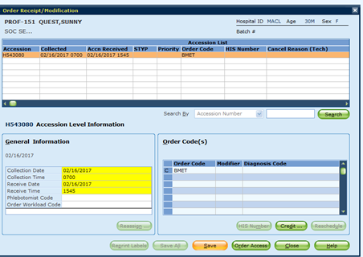
Credit – Order Receipt / Modify
After entering the Credit information, the user is directed back to the receipt screen a “C” will be displayed to the left of the test which has been credited.
Click SAVE.
NOTE: This process is used to credit a test upon receipt which will not be sent to the testing department.

Slide 8
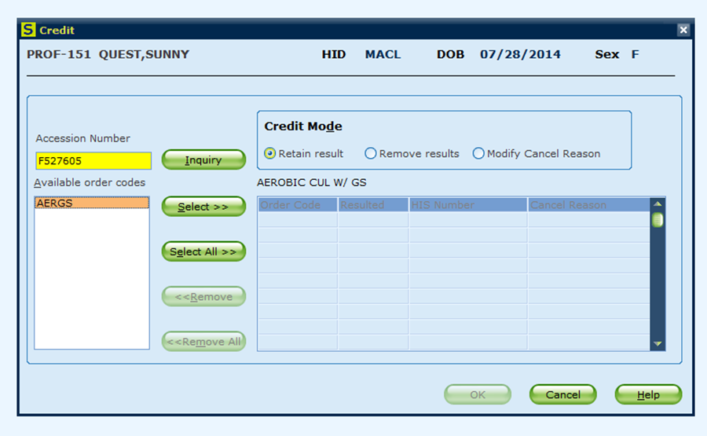
Credit Only Option This process is used to credit a test after receipt of the specimen into GUI
Select the CREDIT option from the General Laboratory function.
Credit Window will open. Enter Accession Number requiring credit.
Press Enter.

Slide 9
Determine the Correct CREDIT MODE
In GUI there are two different credit modes.
Retain Result – this mode is equivalent to the previously used CRW function. Use this credit mode when testing results have been reported.
Remove Results – this mode is equivalent to the previously used CR function. Use this credit mode when testing results have NOT been reported.

Slide 10
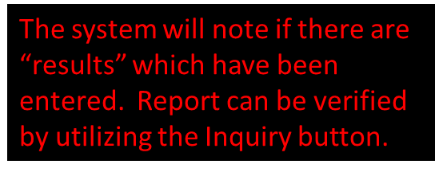
Determining the Correct CREDIT MODE
Remember that Sunquest considers all “Answers” to be “Results”. If a test has “Ask at Order Entry” questions such as source, duration, volume, height, weight, etc., those questions are considered resulted.
Use the REMOVE RESULTS mode to credit when NO TESTING has been performed.

Slide 11
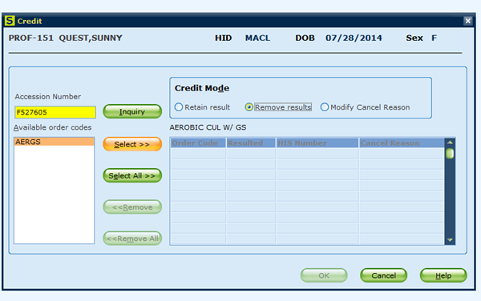
Credit – Remove Results (CR)
Select desired credit mode. (This step must be done first.)
Select desired test to credit. Highlight test in list and click select.

Slide 12
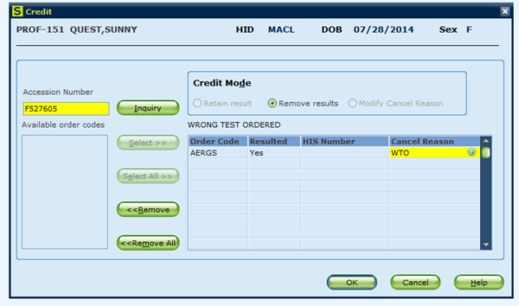
Credit – Remove Results
Enter reason for credit. If credit code is unknown use the look up button as described in previous slides.
Click OK
If the system does not prompt for a Cancel Reason, then the user has not selected the “REMOVE RESULTS” credit mode.

Slide 13
Credit – Remove Results
If results have been entered a popup will display. Credit removing results is only allowed with Ask at Order Entry results (source codes, time duration, urine volume)
Credit Remove Results is used with unresulted tests and those tests with Ask at Order Entry results only
Remember you can always answer NO and verify what has been resulted using the Inquiry button.

Slide 14
Credit – Retain Results (CRW)
Select Retain Results as the Credit Mode
If testing results have been reported and patient care decisions may have been made, modify the reported testing result to reflect the reason for the credit and the call information. Then perform the credit function.

Slide 15
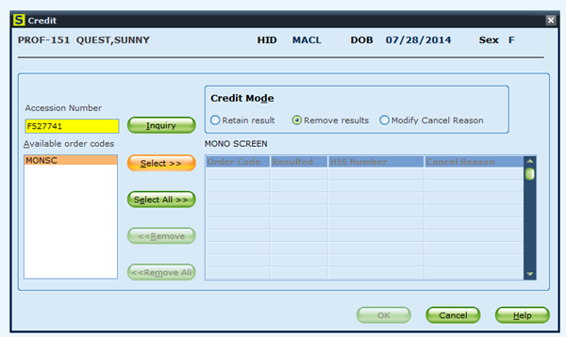
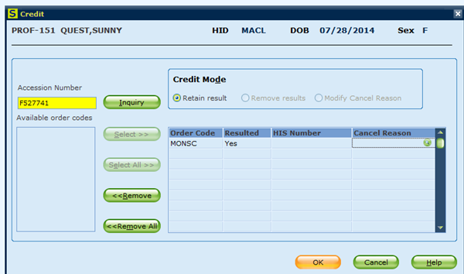
Credit – Retain Results
Select desired test to credit. Highlight test in list and click select.
Click OK
In the “Retain Results” credit mode, no cancel reason is required. The user performing the credit should first modify the testing results to reflect the cancel information.

Slide 16
Important User Tips:
The default Credit Mode when applying the credit during receipt of the specimen is REMOVE RESULTS. The system understands that NO TESTING has been performed.
The default Credit Mode when accessing the Credit directly from General Laboratory function is RETAIN RESULTS. The system assumes that TESTING has been performed. Make sure to select the CREDIT MODE prior to selecting the test to credit.
If specimens are credited using the RETAIN RESULTS mode and NO TESTING was performed, the test will still appear on the department pending log.

