Slide 1
Blood Cell Identification
ApI Hematology 1st event – Hairy cell leukemia

Slide 2
Learning Outcomes
On completion of this exercise, the participant should be able to:
discuss morphologic characteristics of normal peripheral blood leukocytes;
identify distinguishing morphologic features of hairy cells, normal lymphocytes, and reactive lymphocytes; and
describe the cytochemical characteristic and immunophenotyping results in hairy cell leukemia.

Slide 3
Case History
A CBC with differential was ordered on a 71 year old male patient with weakness, fatigue, and weight loss. His CBC results are as follows: WBC=7.1 x 10⁹/L, RBC=3.53 x 10¹²/L, Hgb=10.6 g/dL, Hct=32%, MCV=90.6 fL, MCH=30.0 pg, MCHC=33.1 g/dL, Platelet=94 x 10⁹/L, RDW-CV=21.9 %.

Slide 4
Introduction
The patient is a 71 year old man diagnosed with hairy cell leukemia, a malignant lymphoproliferative condition. This disorder frequently causes weakness, fatigue, and weight loss, symptoms experienced by this patient. The patient’s complete blood cell count values indicate anemia, with low hemoglobin and hematocrit results explaining his weakness and fatigue; he also has thrombocytopenia. Additional symptoms reported in hairy cell leukemia can include infection and splenomegaly. The images provided for initial identification and discussion represent examples of both normal peripheral white blood cells and hairy cell lymphocytes.

Slide 5
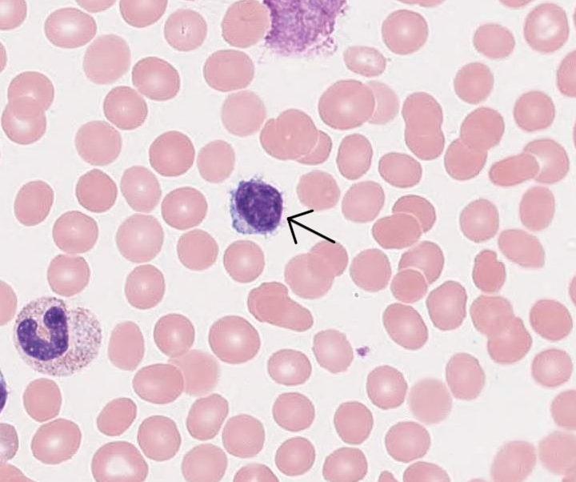
BCI-01

Slide 6
Commentary
Image BCI-01 is a classic hairy cell. Hairy cells vary in size but often are larger than normal lymphocytes. The cell is generally round or oval; the nuclei are also usually round or oval, but may be indented. Hairy cell chromatin is often finer than that seen in normal lymphocytes, although this feature is not evident in this particular cell. Sometimes nucleoli are visible, but they are not seen in this example. Hairy cells derive their name from their distinctive frayed cytoplasmic margins. These projections are often irregular, blunted, and fine and appear hairlike. The cytoplasm is generally a pale or grayish blue and moderate to abundant.

Slide 7
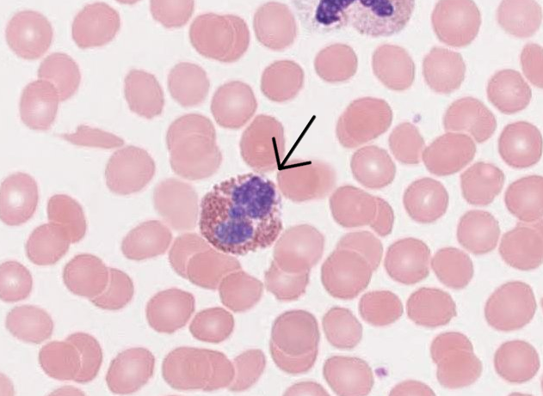
BCI-02

Slide 8
Commentary
Image BCI-02 is an eosinophil. Eosinophils are about the same size as segmented neutrophils. The nuclei are frequently bilobed, although it is difficult to see how many lobes are present in this cell. The nuclear chromatin is condensed and clumped. Eosinophils are distinguished by their numerous large, red-orange cytoplasmic granules. These granules have been referred to as “copper pennies” and give the cytoplasm an overall pinkish color.

Slide 9
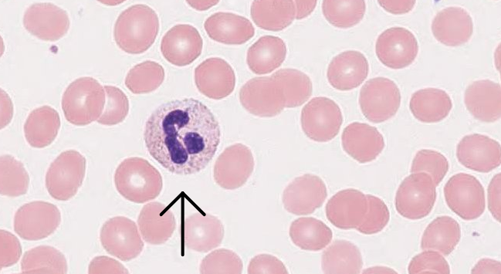
BC1-03

Slide 10
Commentary
Image BCI-03 is a neutrophil. Note that this cell is similar in size to the eosinophil discussed in Image BCI-02. Segmented neutrophils have two to five nuclear lobes connected by thin strands of chromatin. The chromatin is condensed and clumped, as seen in the eosinophil. However, in contrast to the eosinophil, the cytoplasm in the neutrophil has numerous granules that are pink or pink-violet. The cytoplasm in a neutrophil appears pinkish because of these cytoplasmic granules

Slide 11
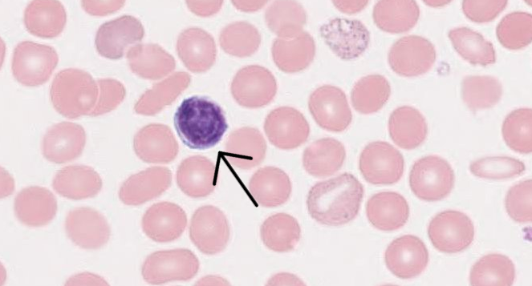
BCI-04

Slide 12
Commentary
A lymphocyte is identified in Image BCI-04. This is an example of a small, resting lymphocyte, although normal lymphocytes vary in size. The nucleus may be round, as in this cell, or slightly indented. The nuclear chromatin is condensed and clumped. These cells typically have a high nuclear to cytoplasmic ratio, so the blue cytoplasm is often scanty, just rimming the nucleus. Note that larger lymphocytes may have a few azurophilic granules, but small lymphocytes usually have no granules.

Slide 13
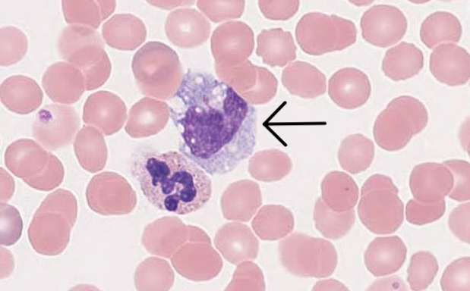
BCI-05

Slide 14
Commentary
Image BCI-05 is a monocyte. Monocytes are the largest cells normally present in the peripheral blood. The nuclei in monocytes may appear round, oval, lobulated, or kidney shaped. The nuclear chromatin is minimally clumped and stains lighter shades of pink or purple; nucleoli should not be visible. The cytoplasm in monocytes is often abundant and blue-gray. Sometimes cytoplasmic extensions may be seen. The cytoplasm stains unevenly and may look rough, “bumpy,” or as if grains of sand are present. Cytoplasmic vacuoles are frequently present.

Slide 15
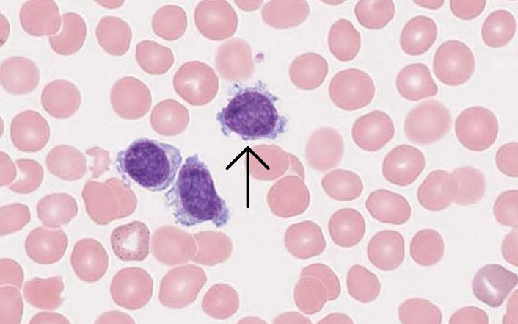
BCI-06

Slide 16
Commentary
Image BCI-06 is another hairy cell. This cell is similar to the hairy cell shown in Image BCI-01, but this cell has more numerous cytoplasmic projections, or “hairs.” It also has nuclear chromatin that is slightly less clumped and finer than the nuclear chromatin seen in Image BCI-01, but which is still characteristic of a hairy cell.

Slide 17
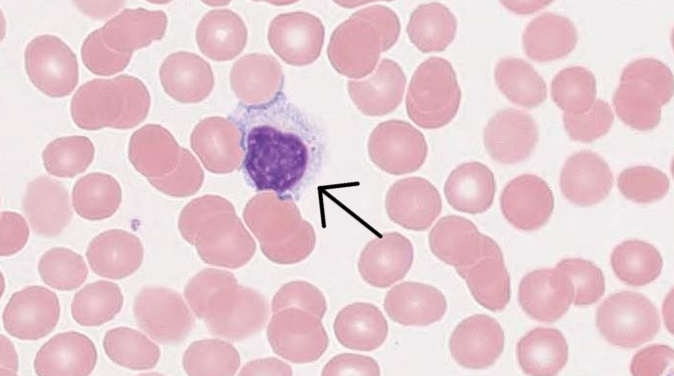
BCI-07

Slide 18
Commentary
The final image in this testing event, Image BCI-07, is a reactive lymphocyte. Reactive lymphocytes are distinguished by a wide variety of morphologic features. These variations in cellular characteristics reflect the heterogeneity of immune responses, as these lymphocytes are, by definition, reacting to an abnormal stimulus, often resulting from a viral infection. It is not unusual to see a small percentage of reactive lymphocytes on a normal peripheral blood smear. Likewise, it is not unexpected to see a reactive lymphocyte on a blood smear from a patient with hairy cell leukemia. Leukemia causes great stress to the body’s immune system.

Slide 19
Reactive Lymphocytes
Although reactive lymphocytes demonstrate many different morphologic characteristics, some generalizations can be made. Reactive lymphocytes are usually large cells. Their nuclei vary in shape and may be round, oval, indented, or lobulated. The nuclear chromatin is often more fine and open than that seen in a nonreactive lymphocyte. Areas of parachromatin may be more visible, and nucleoli may be evident and prominent. Cytoplasm is typically abundant in reactive lymphocytes. The color varies and may be gray, pale blue, or deep blue. The cytoplasmic margin is often indented by surrounding red blood cells, with darker blue evident at this cellular interface. Note the darker blue borders where this cell interacts with nearby erythrocytes. Also, note how the cytoplasm is a lighter blue near the nucleus, another general feature of reactive lymphocytes. It is possible to see azurophilic granules and vacuoles in the cytoplasm of reactive lymphocytes.

Slide 20
Reactive Lymphocytes (cont.)
The morphologic variety associated with reactive lymphocytes can be contrasted with the homogeneity of morphologic features seen in a malignant condition such as hairy cell leukemia. Although hairy cells can vary morphologically from case to case, the cells seen in an individual patient are generally more monotonous in appearance. This lack of morphologic diversity characterizes malignant neoplasms and helps distinguish a benign disorder, such as a viral infection, from a neoplasm like leukemia. For example, the hairy cells in Images BCI-01 and BCI-06 share several morphologic features. Also, note two additional hairy cells in Image BCI-06 that closely resemble the cell selected for identification (arrow).

Slide 21
Features of Hairy Cell, Normal, and Reactive Lymphocytes
Feature | Hairy Cell | Normal Lymphocyte | Reactive Lymphocyte
Size | Variable, usually larger than normal lymphocyte | Variable, but small when resting | Usually large
Nucleus | Round, oval, indented; nucleoli may be seen; fine chromatin | Round, oval, indented; no nucleoli; clumped chromatin | Round, oval, indented, lobulated; nucleoli may be prominent; fine chromatin
Cytoplasm | Pale or grayish blue; moderate to abundant with fine, hairy projections | Blue and scanty; even cellular margins | Gray, pale blue, dark blue, abundant; margins indent where cell interfaces with red blood cells

Slide 22
Hairy Cell Leukemia
Hairy cell leukemia is rare and seen more frequently in middle-aged men, with a median age at diagnosis of 54 years. It is a B-cell malignant neoplasm and is often characterized by pancytopenia, a decrease in all blood cells in the peripheral blood. Pancytopenia is common at presentation and causes the symptoms usually associated witih this disorder, notably, weakness, fatigue, and infection. The current patient has a normal white blood cell count and although his platelet count was decreased, there is no indication that he experienced infection or bleeding. Splenomegaly may may also be seen in hairy cell leukemia, but it was not reported in the patient presented for this testing event. As discussed previously, the most distinctive cellular feature is the gray or pale blue cytoplasm with numerous irregular, or hairlike, projections.

Slide 23
Hairy Cell Leukemia (cont.)
Even with this distinctive morphology, several types of lymphocytes may be confused with hairy cells. These include reactive lymphocytes and lymphoma cells. Typically, these other cells lack the fine cytoplasmic protrusions unique to hairy cells. In addition, other disorders often present with an elevated white blood cell count, in contrast to the normal or decreased level of white blood cells associated with hairy cell leukemia. Confirmatory testing is necessary to define this malignant neoplasm. Historically, hairy cells were confirmed using tartrate-resistant acid phosphatase cytochemical stain; however, newer testing methods, such as flow cytometry for immunophenotyping, have reduced the use of cytochemical stains in many laboratories. Hairy cells usually express surface immunoglobulin, CD 19, CD 20, CD 22, FMC 7, CD 79b, CD 25, CD 11c, and CD 103. Hairy cell leukemia progresses slowly and is effectively managed with several possible therapeutic interventions.

Slide 24
Summary
Hairy cell leukemia is a disorder with characteristic peripheral blood findings. The laboratory professional contributes to an accurate evaluation of this condition through initial identification of both normal and abnormal cells on the peripheral blood smear. Recognition of the classic cells present in this disorder, as well as differentiation of these malignant cells from other causes of an increase in lymphocytes, are key components in the diagnosis of hairy cell leukemia. Fortunately, hairy cell leukemia progresses slowly and can be managed effectively.

Slide 25
References
Glassy EF. Color Atlas of Hematology. 2nd ed. Northfield, IL: College of American Pathologists; 2018.
Gulati G, Caro J. Blood Cells: Morphology and Clinical Relevance. 2nd ed. Chicago, IL: ASCP Press; 2014.
Kjeldsberg CR, Perkins SL. Practical Diagnosis of Hematologic Disorders. Vol 2: Malignant Disorders. 5th ed. Chicago, IL: ASCP Press; 2010.

