Slide 1
EDUCATIONAL MODULE FOR QUALITY CONTROL AT MACL

Slide 2
QC AT MACL TOPICS
Review of LJ charts
Definition of shifts and trends
Westgard rules
Definition update in GUI
Maintenance update in GUI
Printing QC Summary
Submission of QC data to peer groups
Definition of SD, CV, SDI, CVR, mean
Review of Peer group data
Mean adjustment guidelines
Case studies
QC issues and questions
QC Documentation and troubleshooting

Slide 3
REVIEW OF LJ CHARTS

Slide 4
LEVEY-JENNINGS INQUIRY
Start Date: 04/01/2018
End date: 05/07/2018
TEST:
WORKSHEET:
METHOD: CAHW1 ARCHITECT CI4100 - CHWD
METHOD:
CONTROL: LIQ1 LIQUIMMUNE LEVEL 1 (LIQ1)
CONTROL: LIQ2 INVALID ENTRY
CONTROL:
SHIFT #:
TECH:
TESTS REQUESTED
ALL
ACCEPT (A), MODIFY (M), OR REJECT (R) A
WORKSHEETS REQUESTED
NONE
ACCEPT (A), MODIFY (M), OR REJECT (R) A
METHODS REQUESTED
CAHW1 ARCHITECT CI4100 - CHWD
ACCEPT (A), MODIFY (M), OR REJECT (R) A
CONTROLS REQUESTED
LIQ1 LIQUIMMUNE LEVEL 1 (LIQ1)
ACCEPT (A), MODIFY (M), OR REJECT (R) A
SHIFTS REQUESTED
ALL
ACCEPT (A), MODIFY (M), OR REJECT (R) A
TECHS REQUESTED
ALL
ACCEPT (A), MODIFY (M), OR REJECT (R) A
Results averaged (A) or plotted singly (S) S
These are the steps to review LJ charts. If you want to delete a point you must delete it before the 5th day of the next month. So I try to review QC at least twice a month to check if I need to remove results.
MACL procedure is Sunquest QC program has these instructions as well.

Slide 5
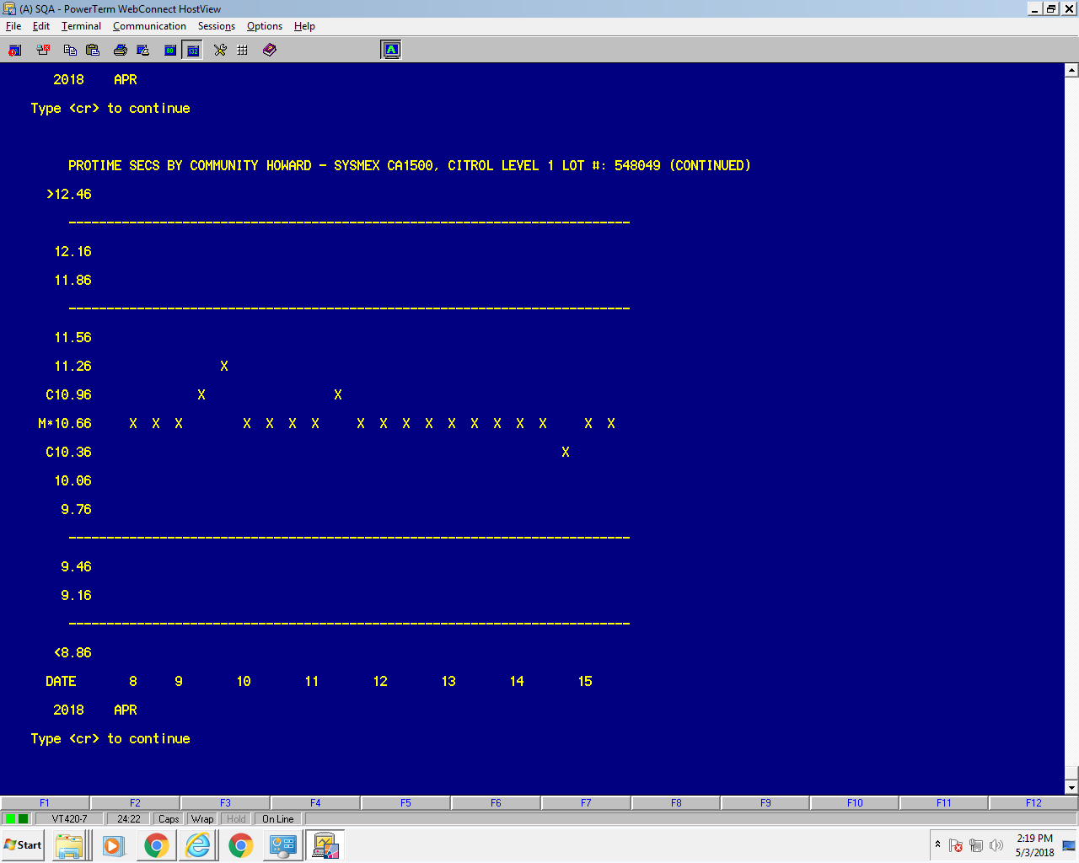
Normal QC graph some analytes above mean and some below. Typical coagulation normal control LJ chart.

Slide 6
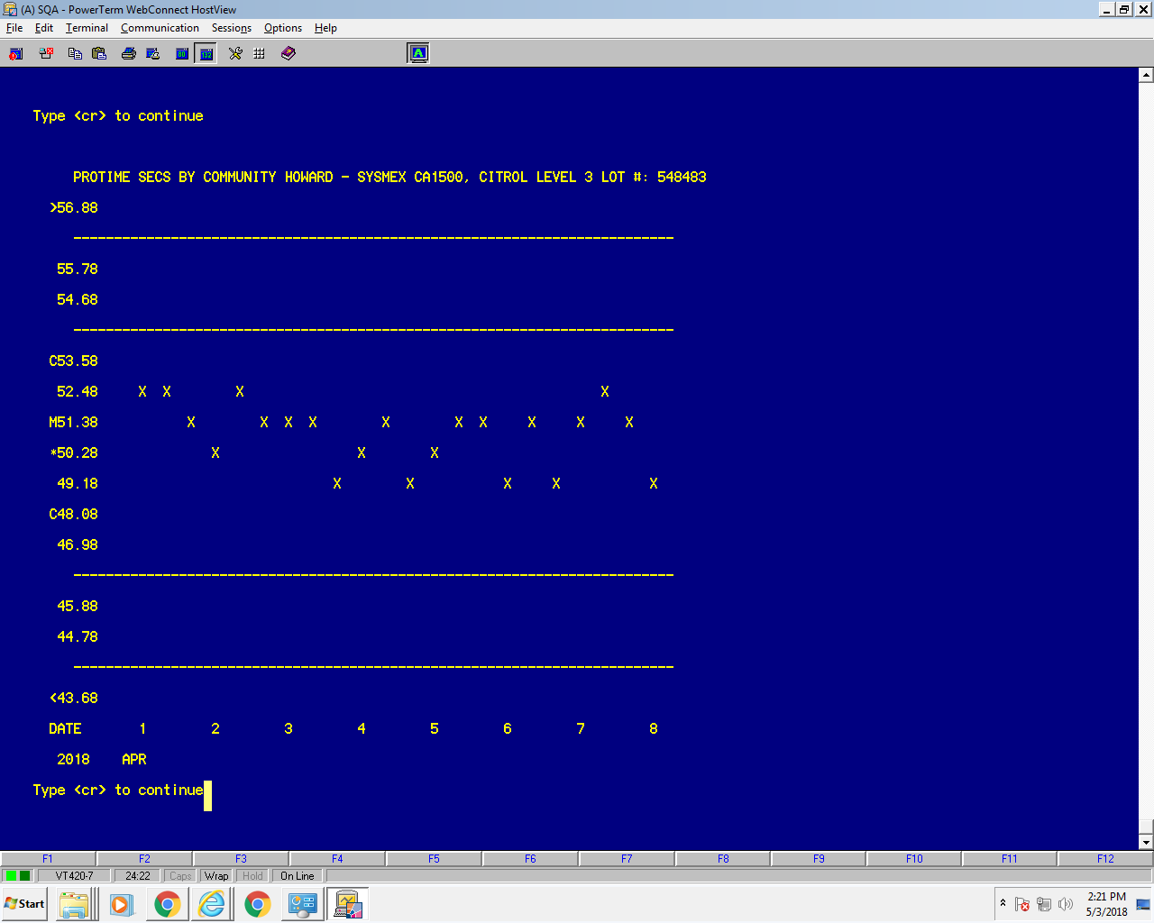
Coagulation level 3 normal LJ chart, above and below mean, not as stable due to the control is made to simulate the typical patient on coumadin.

Slide 7
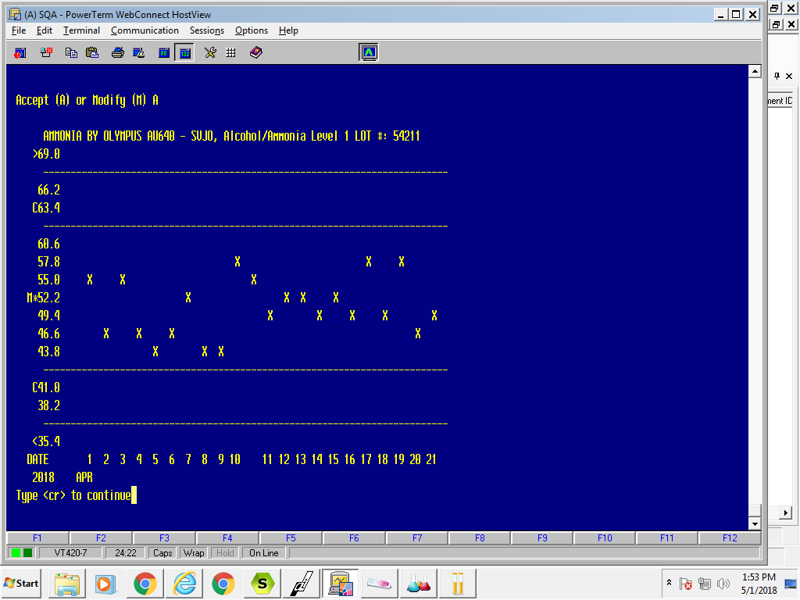
Notes:
Typical LJ chart.

Slide 8
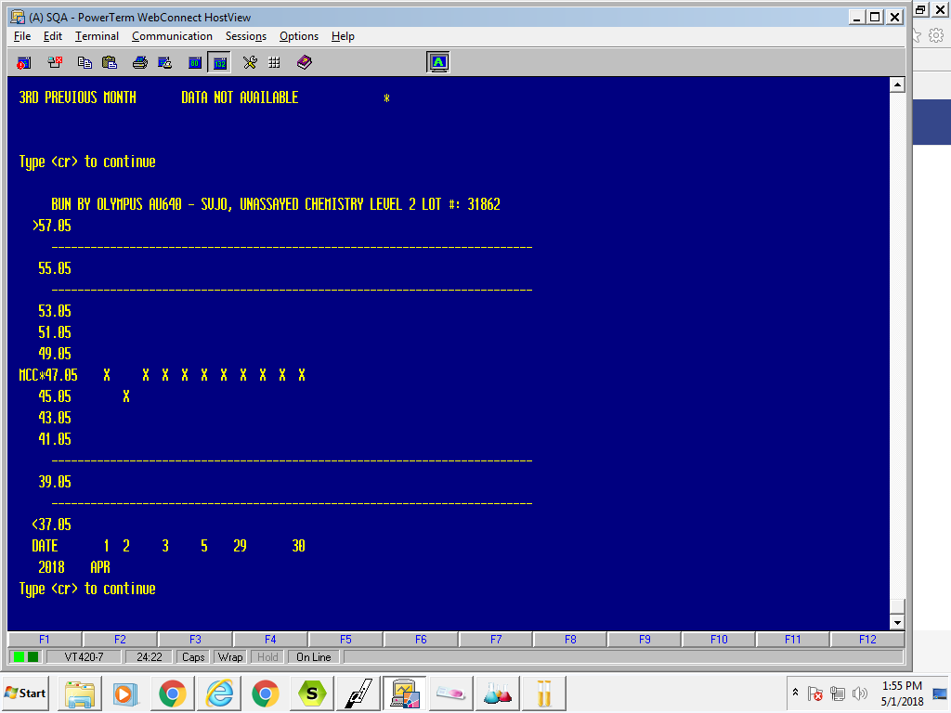
Notes:
BUN is a very stable analyte. What is an analyte that is stable in your facilities?
What is the squealer at your facilities?

Slide 9
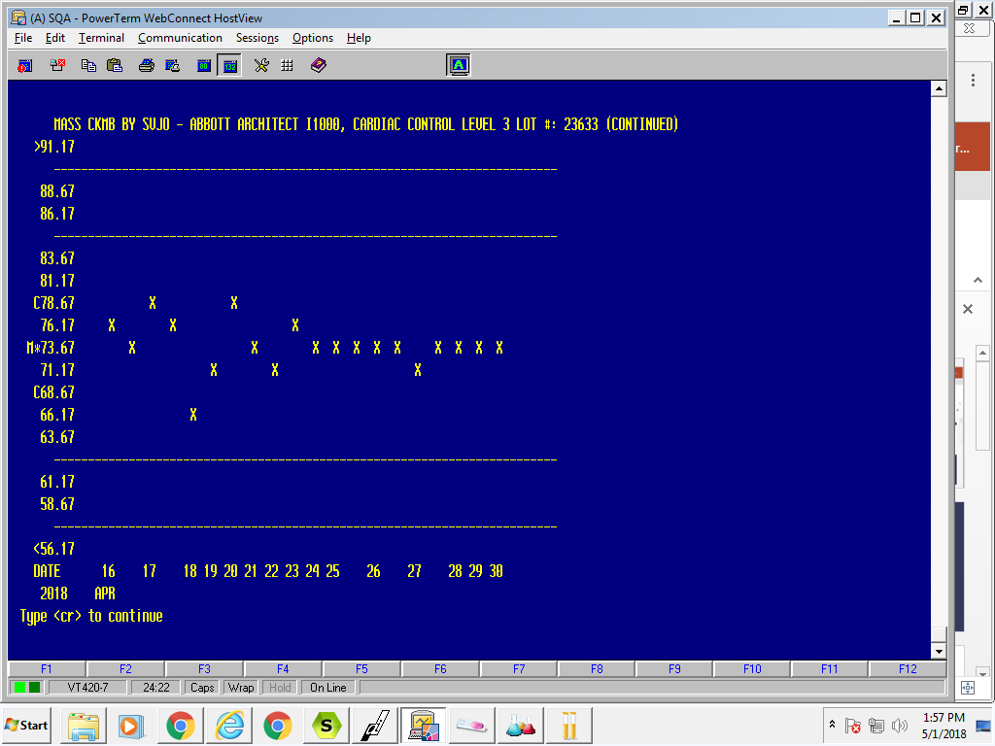
Notes:
On April 22 calibrated analyte

Slide 10
Steps to delete a QC value, select M for modify as shown above.
DATE TIME TECH SHIFT RESULT
05/04/2018 17:15 3834 2 418 REPEATED/SAME VIAL OF CONTROL
1 2SD FAILURE
17:54 3834 2 422 REPEATED/SAME VIAL OF CONTROL
1 2SD FAILURE
1 3SD FAILURE
DATE TIME TECH SHIFT RESULT
05/05/2018 02:25 3794 3 428 REPEATED/SAME VIAL OF CONTROL
1 2SD FAILURE
DATE TIME TECH SHIFT RESULT
05/06/2018 02:02 3794 3 427 REPEATED/SAME VIAL OF CONTROL
1 2SD FAILURE
Accept (A) or Modify (M) M
Notes:
Call

Slide 11
QUALITY CONTROL VALUE MODIFICATION
TECH: 3796 NORWICH,KAREN S
DATE: 05/05/2018
DATE SHIFT SD OFFSET TEST RESULTS
05/05/2018 3 2.24 ALKP 428-RSV-R12SW
-
ACCEPT (A), MODIFY (M), OR REJECT (R) ?
Enter your tech number at TECH:
Enter the date of the QC you wish to delete
Then enter a minus sign as shown above by the blue arrow.
Then ACCEPT (A), MODIFY (M), OR REJECT (R) ?
If the outliner is within 3 SD you probably should not delete it. Only delete it if the wrong level was ran or wrong control, was ran mutiple times in troubleshooting
Notes:
Enter your tech number at TECH:
Enter the date of the QC you wish to delete
Then enter a minus sign as shown above by the blue arrow.
Then ACCEPT (A), MODIFY (M), OR REJECT (R) ?

Slide 12
DEFINITION OF SHIFT AND TRENDS

Slide 13
A shift is a sudden change of values from one level of the control chart to another. A common cause of a shift is failure to recalibrate when changing lot numbers of reagents during an analytical run. A trend is a continuous movement of values in one direction over ten or more analytical runs. Trends can start on one side of the mean and move across it or can occur entirely on one side of the mean. Trends can be caused by deterioration of reagents, tubing, or light sources. Shifts and trends can occur without loss of precision and can occur together or independently .The occurrence of shifts and trends on the Levey-Jennings control chart is the result of either proportional or constant error.
Notes:
Do you have examples of when you see shifts or trends?

Slide 14
A Shift in Control Values
+3s |  |  |  |  |  |  |  |  |  |  |  |  | x |  |  |  |  | x
+2s |  |  |  |  |  |  |  | x | x |  |  | x |  | x | x |  | x |  | x
+1s |  |  |  |  |  |  | x |  |  | x |  |  |  |  |  | x |  |  |  | x
u |  | x | x |  |  |  |  |  |  |  | x
-1s | x |  |  |  | x
-2s |  |  |  | x |  | x
-3s
Day | 01 | 02 | 03 | 04 | 05 | 06 | 07 | 08 | 09 | 10 | 11 | 12 | 13 | 14 | 15 | 16 | 17 | 18 | 19 | 20
Notes:
A shift in control values in is still going up and down, but appears to have a new mean.

Slide 15
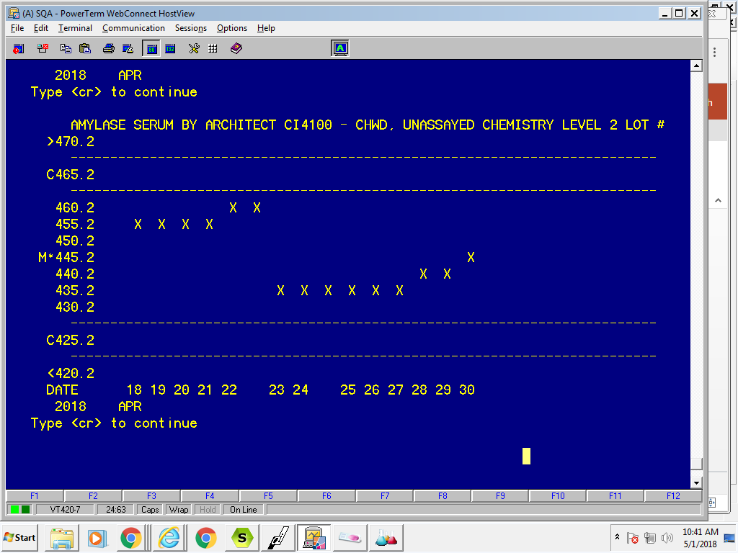
An example of shift
Happens a lot with amylase usually due to reagent lot # change

Slide 16
A Trend in Control Values--
Trend—goes up on down (usually down) due reagent or control deterioration.
+3s
+2s
+1s |  |  |  | x | x
u |  | x |  |  |  | x
-1s | x |  | x |  |  |  | x | x
-2s |  |  |  |  |  |  |  |  | x | x |  |  |  | x |  | x |  | x
-3s |  |  |  |  |  |  |  |  |  |  | x | x | x |  | x |  | x |  | x | x
Day | 01 | 02 | 03 | 04 | 05 | 06 | 07 | 08 | 09 | 10 | 11 | 12 | 13 | 14 | 15 | 16 | 17 | 18 | 19 | 20

Slide 17
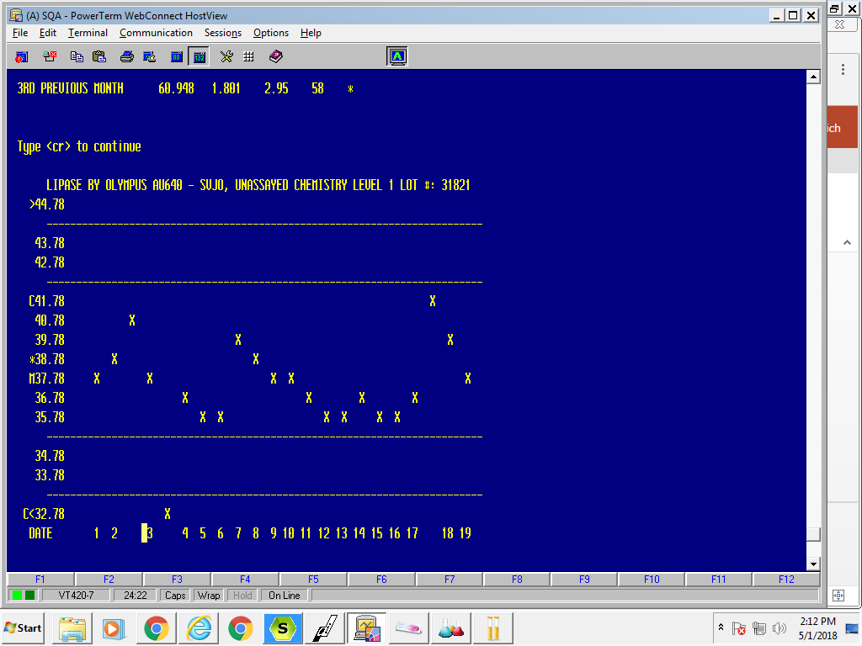
Notes:
Another example and another enzyme

Slide 18
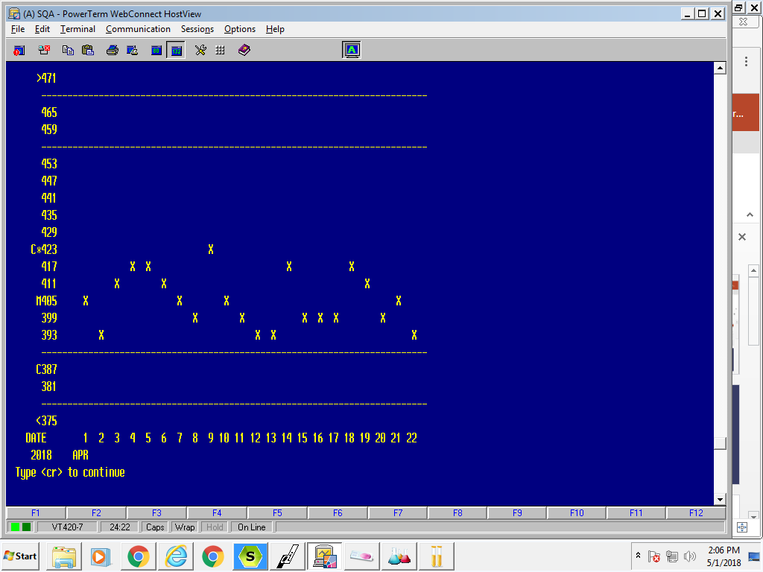
Notice the downward trend at the two blue arrows, this happen as reagent ages or the control ages especially with enzyme tests.
Notes:
This ALP which is common. Do you have an analyte like this?

Slide 19
Westgard rules

Slide 20
QC acceptability is determined using the following Westgard Rule as guidelines:
1₂s Rule: A single QC result falls outside the range, defined as +/- two standard deviations (SD) from the mean. Applies only to results within a control.
QC is acceptable when all levels are within 2 SD, unless specified otherwise by SOP
When applicable, the LIS is utilized to monitor QC data by daily entry of QC results. QC results are entered into the LIS for statistical evaluation. Out of range results will automatically be flagged by the LIS based on the Westgard Rules. If results are outside of the established limits. The bench technologist must insure that the correct level of QC material is run at proper intervals. Refer to site specific External Quality Controls Chart Performance Information.
Notes:
Excerpt from General Laboratory Quality Control Performance—LAB.GEN.2.0.

Slide 21
DEFINITION OF QC IN GUI

Slide 22
DEFINITION OF QC IN GUI
You must fill in all yellow boxes and use the tab button to maneuver in GUI

Slide 23
DEFINITION OF QC IN GUI
Then click the search button and it will open up the test code section so you can add tests (must be the test code from the instrument), descriptions, means (your lab), SDs, assay ranges, days on file, assay mean (package insert), assay range (package insert), then click copy existing definition.

Slide 24
Entering Lot numbers
After clicking copy existing definition the following will pop up, enter your instrument interface code, the name of the QC and then click the lookup button beside the lot # (see red arrow)

Slide 25
Selecting lot #
Select the current lot # in use which is Index #1 and is in bold lettering, click on the Index #1 line and then click select. When the lot # comes up in this box hit cancel if it is not your lab location and it will default to your lab location.

Slide 26
Copying previous lot #
Click search then all the analytes that are in the current lot # will appear, you can click the boxes in the test code column (purple arrow) or if you want all the tests click select all which is indicated by the red arrow. After you select the tests you want, click select at the bottom of the screen.

Slide 27
This will bring in the tests to the new lot # from the previous lot #.

Slide 28
Decide if you are ready to implement the lot #. Click current lot to advance this lot # to the current lot. This will advance the previous lot to Index 2 and this lot to Index 1. If you are not ready to advance lot numbers do not click current lot. You will need to do a study of 5 runs for each lot # before the lot is implemented if the control is assayed and 20 runs if the control is unassayed. Then click Save at the bottom of the screen (purple arrow).

Slide 29
Maintenance update in GUI

Slide 30
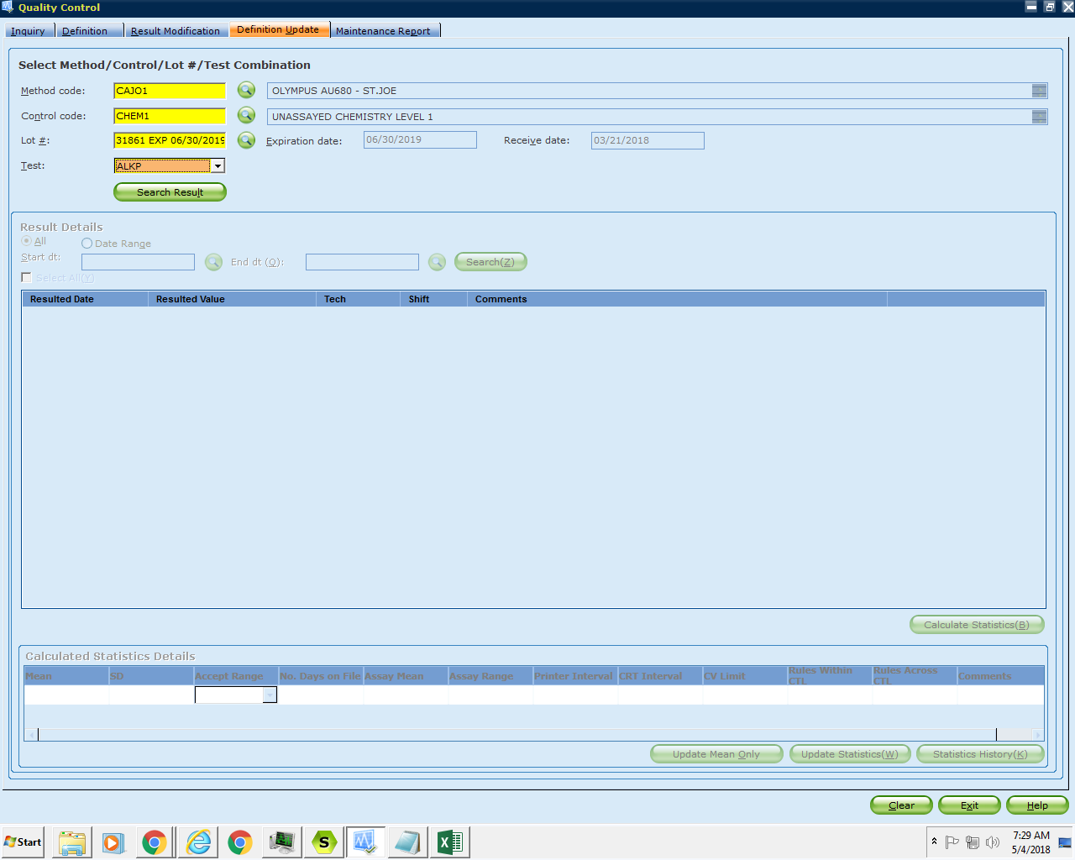
Maneuvering in GUI
Fill in all boxes highlighted in yellow, tab to maneuver in GUI then click select analyte to review and click search result

Slide 31
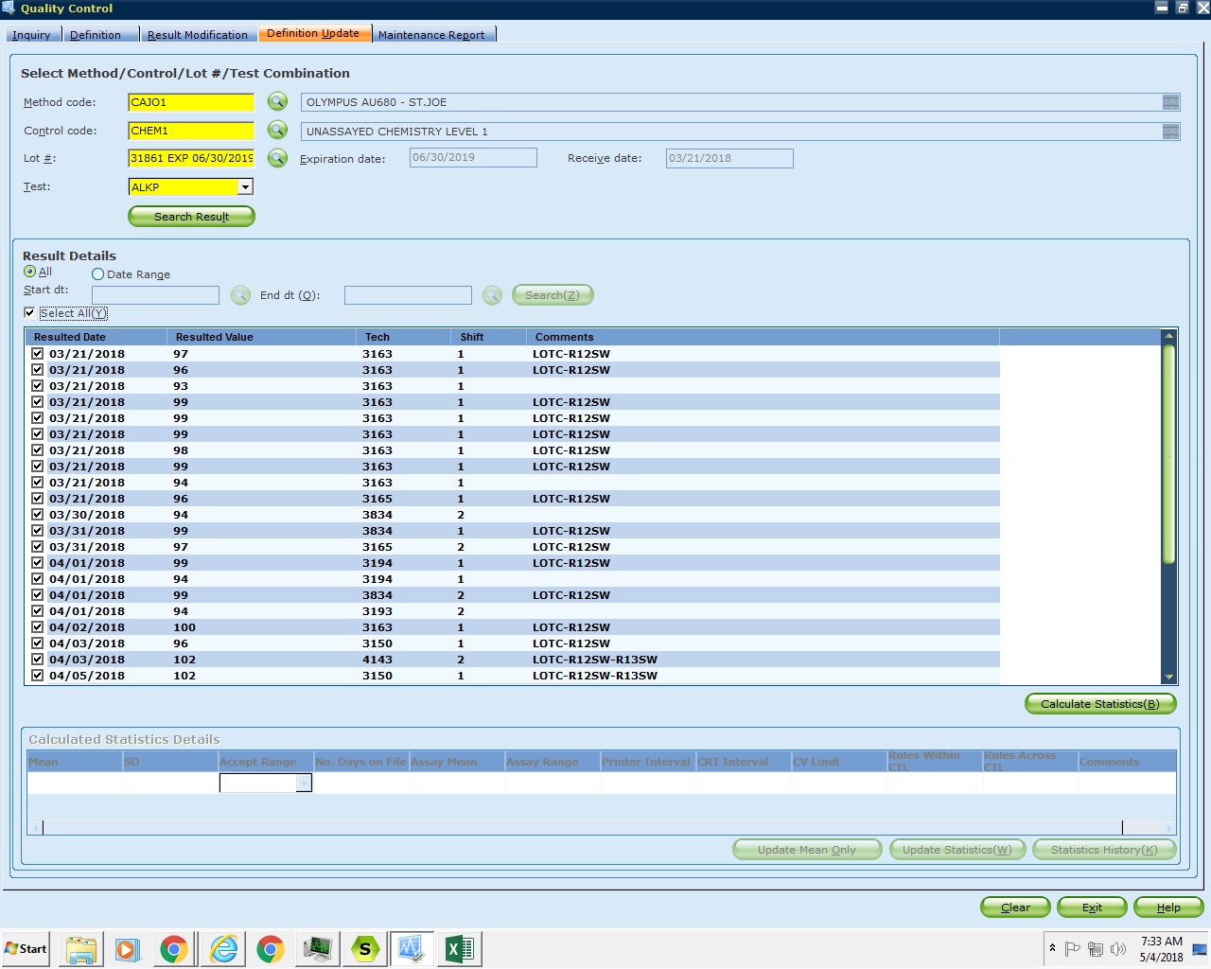
Notes:
By the red arrow, you can select all or enter a date range, then click select all or you can individually choose results or click on the check by each result to eliminate any outliners or QNS results. Then click on calculate statistics noted with the blue arrow.

Slide 32
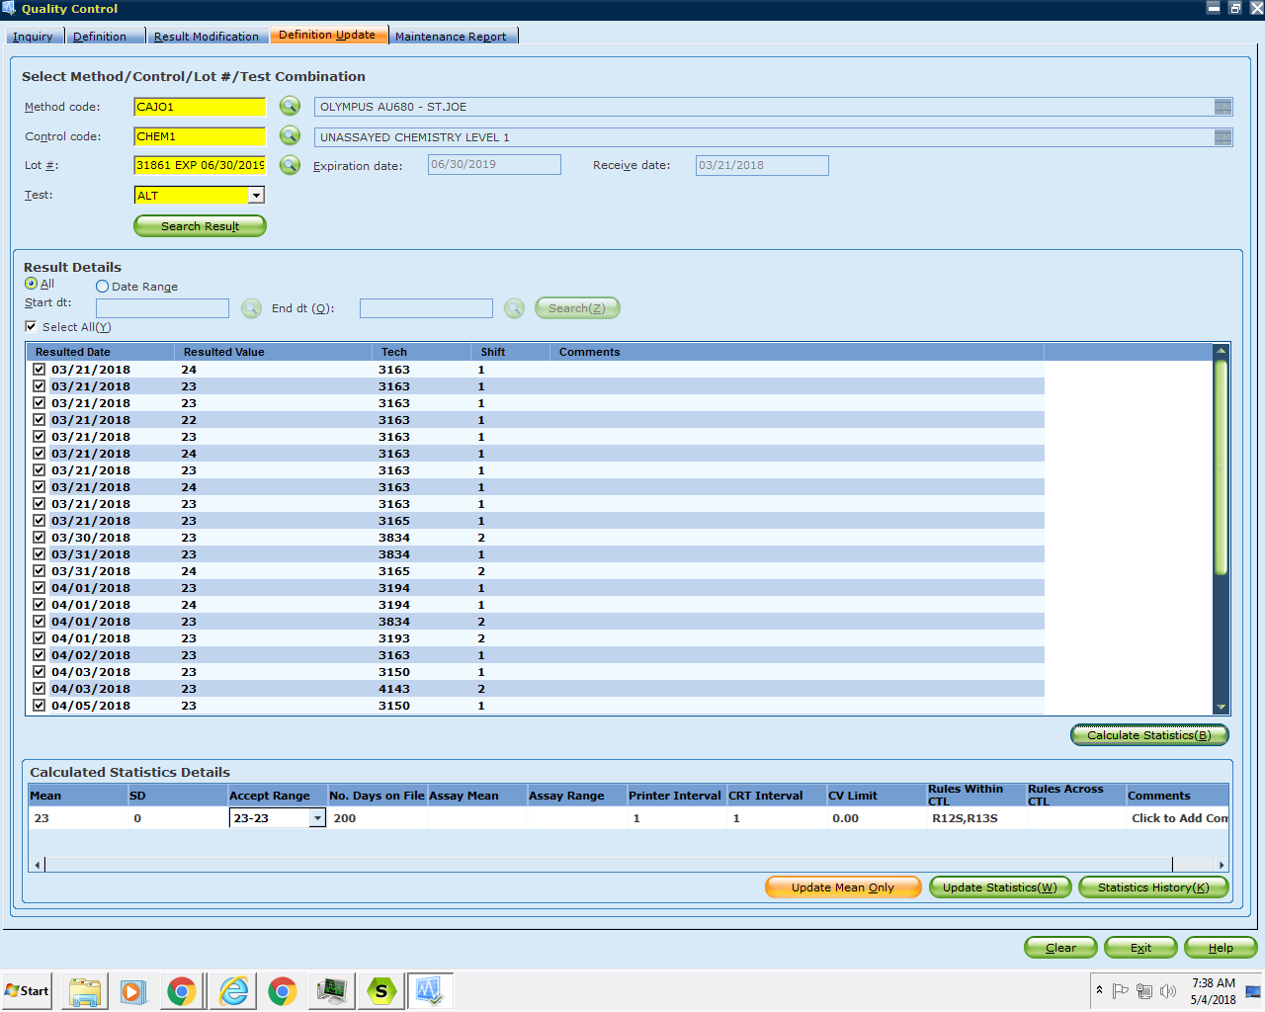
Notes:
You can now update the mean or update all statistics associated with the analyte. If the analyte is unassayed, you must have 20 values ran over several days and shifts. If the values are assayed, review that the mean you calculated is close to the mean in the package insert. Also verify that the SD calculated is within the range on the package insert. For example the package mean is 25 with the range of 20-30 (SD of 2.5). In your above study your mean is 23, you SD should be set at 1.5, so you don't go below the range of the package insert.

Slide 33
Printing QC summary and extracting QC for Biorad files

Slide 34
Generating QC files from Sunquest Smart Term Summary Data Report​

Slide 35
Log into Sunquest
Under function QC
Printer type 0 to print to the screen
Select “S” for summary
Condensed, Executive or Cumulative? Choose “E” for executive.
Start date enter the start date for the report (the first of the month)
End date—enter the end date for report (last day of the month)
TEST—return through to include all tests.
Worksheet-return through to include all worksheets
Method—list all methods/instruments with Bioroad controls to be included in the file
Control enter through to include all controls
Shift—return through to include all shifts
Tech return through to include all techs
Each choice will now be listed on the screen in order—select A for accept until you get to techs, then stop.

Slide 36
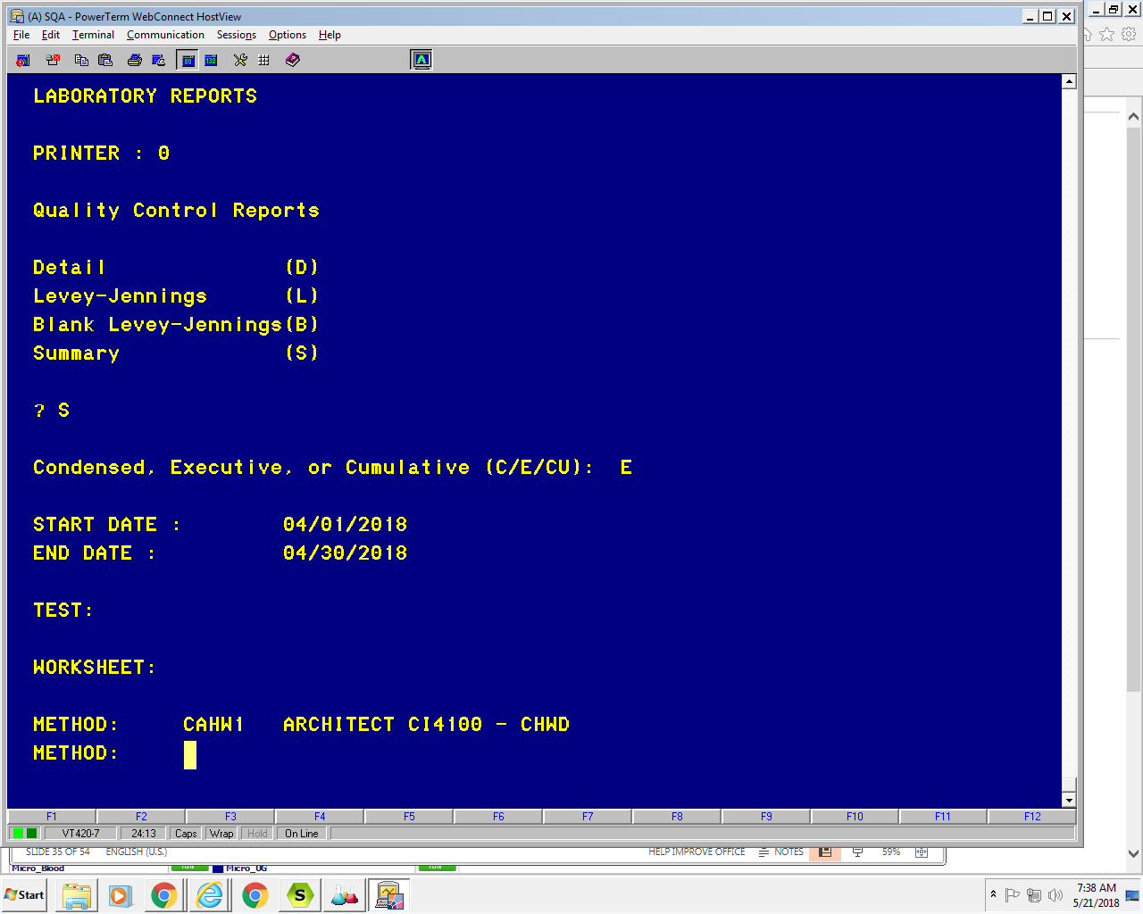

Slide 37
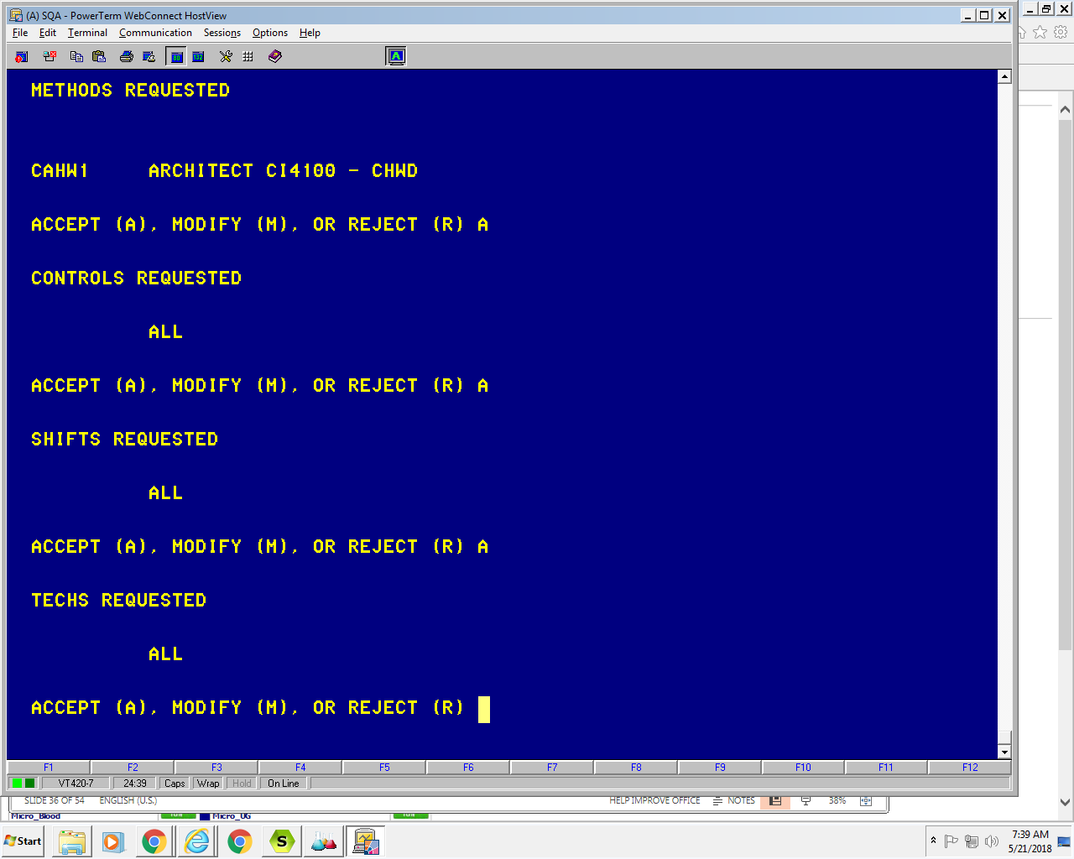

Slide 38
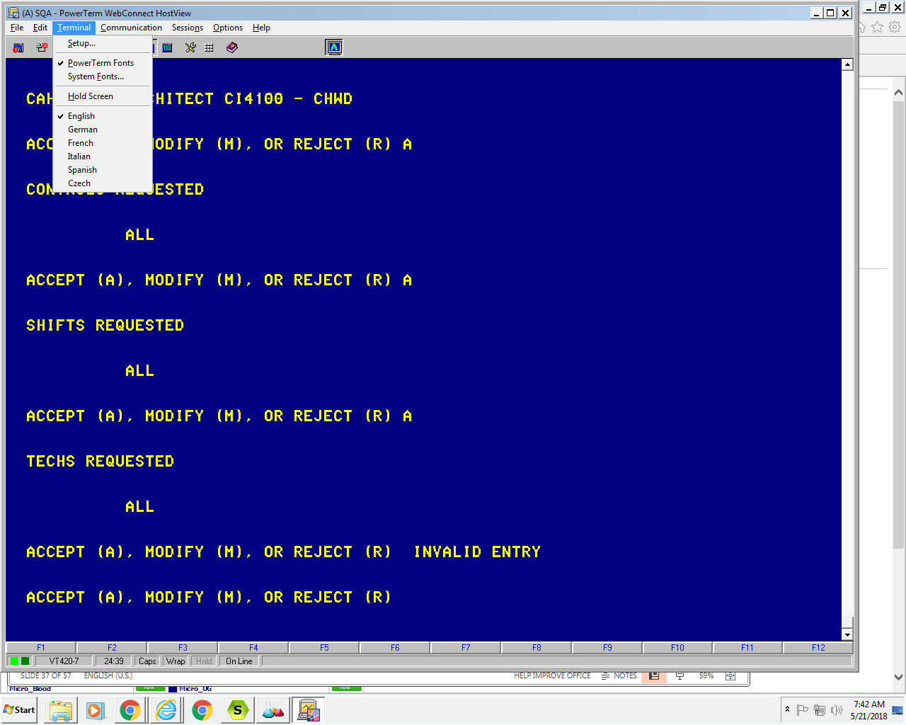

Slide 39
Notes:
Go to printer tab (green arrow), select file under printer device (red arrow) then enter the file name from a location on your computer (blue arrow)

Slide 40
From the powerterm session click on the Terminal menu item and then setup
Click on the printer tab
Change the print device to File. Notice the file name defaults to print.txt at the end.
In the file box name the file whatever you want but be sure it ends in .txt. For example C:\biorad chwd May 2018.txt
Click OK to close the terminal setup box.
Click on file menu
Select start auto pint and A to accept techs
Click on file menu and select stop auto print “A” to accept @ techs requested
Data scrolls across screen.

Slide 41
Submission of QC to Biorad for peer group analysis

Slide 42
Go to website qcnet.com
Click login Type in login ID and password, then click login
Click on unity interlab tab
Click on unity web 2.0
Type in user and password, then click login
Go to data entry tab
Click on Web connect
Click on web connect home
In the browser enter the name of file you made above (for example u:\chwd biorad nov 2016.txt) or click bowser and pick the file you made above

Slide 43
Then click go, if it works correctly—it will give you this statement- “Transformed a total of 146 data records. Data was passed to the Import utility. Please confirm that your data is imported before transmitting results to Bio-Rad for peer comparison.”

Slide 44
If there is a problem—it will say while transforming your data some codes were found that require additional configuration. Click on to add configuration. This happens when you add a new lot. Go to the lot and change to all instead of existed lots and the correct lot and correct level and save. Then click close.​
Go to data entry tab, web connect, and web connect file import and review that your file is there.​
Go to data entry tab, web connect, and web connect rejection log and it should say no records found in red. If there are rejected resolve by going back to step 11 and do another rejection after resolving the files.​
Go to data entry tab, web connect, and web connect history and review that your file is there.​
Go to tools tab, then unity interlab tab, then send data to Biorad tab, then it will pop a box that asks “Are you sure you want to send to Biorad?” Click OK and then it should say Data successful transmitted to Biorad.​

Slide 45
QC SUBMISSION TO BIORAD VIDEO
https://drive.google.com/file/d/1GF-BVecjLjoHGQtEW_L4OWshfRjq9vH4/view

Slide 46
Notes:
Note the existing lots and change it all lots

Slide 47
Definition of SD, CV, SDI, CVR, mean

Slide 48
Standard deviation is the measure of dispersion of a set of data from its mean. It measures the absolute variability of a distribution; the higher the dispersion or variability, the greater is the standard deviation and greater will be the magnitude of the deviation of the value from their mean.​

Slide 49
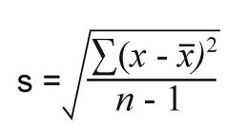

Slide 50
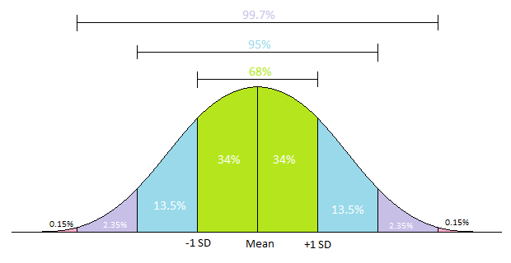

Slide 51
The standard deviation index is a measurement of bias (how close your value is to the target value). The Bio-Rad Unity™ Interlaboratory Program uses the consensus group value as the target value. Use the following formula to calculate the SDI:

Slide 52
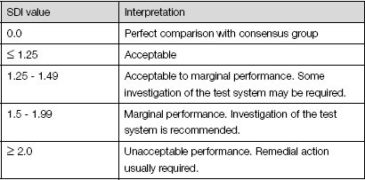
Interpreting the SDI—as described by Westgard website in QC calculations
The target SDI is 0.0, which indicates there is not any difference between the laboratory mean and the consensus group mean. A SDI ±1 indicates a possible problem with the test.
The SDI expresses bias as increments of the standard deviation. A SDI of -1.8 indicates a negative bias of 1.8 standard deviations from the consensus group mean. This is not favorable.
Bias increases or decreases the percentage of patients outside the defined reference limit. For example, a positive bias decreases the percentage of patients normally outside the lower limit and increases the percentage of patients normally outside the upper reference limit. This creates an increase in false positive test results. Negative bias has an opposite effect and decreases true positives and creates false negatives.
Use the following guidelines to interpret the SDI:

Slide 53
What's a CV?
CV refers to the "coefficient of variation," which describes the standard deviation as a percentage of the mean, as shown in the following equation:
CV = standard deviation/mean X 100
Notes:
Any ratio less than 1.0 indicates that precision is better than the peer group. Any score greater than 1.0 indicates that imprecision is larger. Ratios greater than 1.5 indicate a need to investigate the cause of imprecision and any ratio of 2.0 or greater usually indicates need for troubleshooting and corrective action. Each analyte might have a different CV, very small values such as CRP may have a large CV and it is appropriate.

Slide 54
What's a CVR?
CVR = LAB CV
PEER GROUP CV
Notes:
Any ratio less than 1.0 indicates that precision is better than the peer group. Any score greater than 1.0 indicates that imprecision is larger. Ratios greater than 1.5 indicate a need to investigate the cause of imprecision and any ratio of 2.0 or greater usually indicates need for troubleshooting and corrective action.

Slide 55
QC Documentation and troubleshooting

Slide 56
EXCERPT from: GENERAL LABORATORY QUALITY CONTROL PERFORMANCE
QC Documentation and Troubleshooting
All quality control material is tested in the same manner and by the same personnel as patient samples. Quality Control must be acceptable before patient results are reported.
Notes:
Be sure and follow manufacturers recommendation for QC how long it needs to sit out at room temperature before running for example cardiac markers need to set out 15 min, but chem 1 can be ran right away.

Slide 57
Control Systems (2 OR 3 controls/run)
Accept the controls if:
All Control(s) read within 2 SD of the mean value. Enter the values in Sunquest.

Slide 58
Reject the controls if:
One or more control value is greater than 2 or more SD. Enter the value into Sunquest with appropriate comment (See QC modifier codes).
Hold all patient results.
If a Run is Rejected:
Remember all outliners of QC must have a comment

Slide 59
Re-run control (once)​​
If control is now acceptable, accept control and patients. Enter control into Sunquest with the appropriate comment (See QC modifier codes).​​
If control is still not acceptable Reconstitute/Open fresh control and repeat control testing (once).​​
If control is now acceptable, accept control and patients. Enter into Sunquest with the appropriate comment (See QC modifier codes)
If control is still not acceptable, steps in the next slide.​​

Slide 60
Check controls and reagents. Ensure that correct lot number is in use, that control and reagents have not expired.​​
If lot number of controls not correct, obtain correct lot number, and re-run controls (once). Enter results into Sunquest with the appropriate comment (See QC modifier codes).​​
If there is no correct lot number of controls available, alert Manager, or Lead Technologist.​​
Notes:
Do you have a QC problem you have investigated?

Slide 61
If lot number of reagent is expired, replace, recalibrate as needed, and repeat patients and controls as needed. Enter the results into Sunquest.
If both controls and reagents are okay, proceed to next slide​​
Include the comment: LOTR (for new LOT of reagent).​ If reagent is empty, replace, recalibrate as necessary and re-run controls (once). above for acceptability. Enter values into Sunquest and include comment: RNRG. Repeat patients as needed

Slide 62
Recalibrate/ re-blank and re-run the controls (once).​​
If controls are now acceptable, repeat patients as needed Enter values into Misys and comment: with appropriate comment (See QC Modifier codes).​​
If control(s) are still unacceptable, troubleshoot in conjunction with Manager, or Lead Technologist.​​
Notes:
What QC problems have you experienced? What resolutions have you used?

Slide 63
Additional guidelines to consider when to recalibrate or replace reagent
Evaluate the number of tests left in reagent pack, if very few tests are left or close to expiration date, replace reagent. If level 1 control is acceptable and level 2 or 3 is not acceptable
Consider that even though the calibration passed, it might not be a good calibration, check to see if calibrators are almost expired or if there is very little calibrator left, try new calibrators and recalibrate.
​Evaluate if both levels of QC are in if close to 2SD (example both levels are -1.9 SD). Consider it might be a bad calibration and recalibrate and rerun QC.​​

Slide 64
DO NOT ACCEPT CONTROLS OR REPORT PATIENT RESULTS UNLESS CONTROLS ARE ACCEPTABLE
Enter ALL controls into Sunquest, and comment what was done to correct problem. Free text if necessary, use canned comments when appropriate(see QC modifier codes) for available canned comments).​
Run an alternate control when possible. Examples: run calibrators as patients; use old CAP samples of known values. This will help determine if the problem is the control or the instrument. Check with Manager or Lead Technologist before accepting patients based on this information- usually, other information listed below will be used to make decision.​
NOTE: Don’t run calibrators back as patient right after calibrating with them. This information isn’t useful. If available, use a different lot of calibrators, or run calibrators BEFORE calibrating to see if Cal curve is holding.​

Slide 65
Check the control insert or peer means to see if the range is okay (the mean may not be exactly what is listed in the insert, but our mean must be within the range listed in the package insert or QA report).​
Check patients against other instruments when possible to see if they have a clinically significant difference.​
Perform any maintenance, cleaning or repair that is needed​
Call the instrument hotline and troubleshoot as instructed​

Slide 66
If the problem was not just related to the control material, patient follow up is needed.
After problem is resolved, and controls are acceptable, select 5 patients from previous run and re-test. Vary time testing was performed and level of result. Compare patient’s previous results (since last acceptable QC) with the new results.​
If report category is the same (normal is still normal, high is still high, low is still low), and previous results are within Total Acceptable Error (Total allowable specifications) for the analyte, accept previous run.​
If the difference does change the report category or greater than total error, re-test all patients from previous run and correct results in Sunquest and QLS as necessary. Any exceptions must be approved by Lead Technologist or Manager.​
If more than 5 patients require correction, give to Lead Tech, Supervisor or Manager for next steps, Exception documentation on form.​
Fill out form for checking patient results (Checking patient results after unacceptable QC).​
A RUN/BATCH is defined as the interval within which the accuracy and precision of a testing system is expected to be stable. We will define this interval as the period between acceptable control runs.​

Slide 67
Review of Peer group data

Slide 68
On corrective action—document what you did or will do to correct the problem.
In this nothing, only 2 points, monitor, on analytes where you only run qc when the test is performed you will want to call up several months to evaluate for shift and trends.
Notes:
On corrective action—document what you did or will do to correct the problem.
In this nothing, only 2 points, monitor, on analytes where you only run qc when the test is performed you will want to call up several months to evaluate for shift and trends.

Slide 69
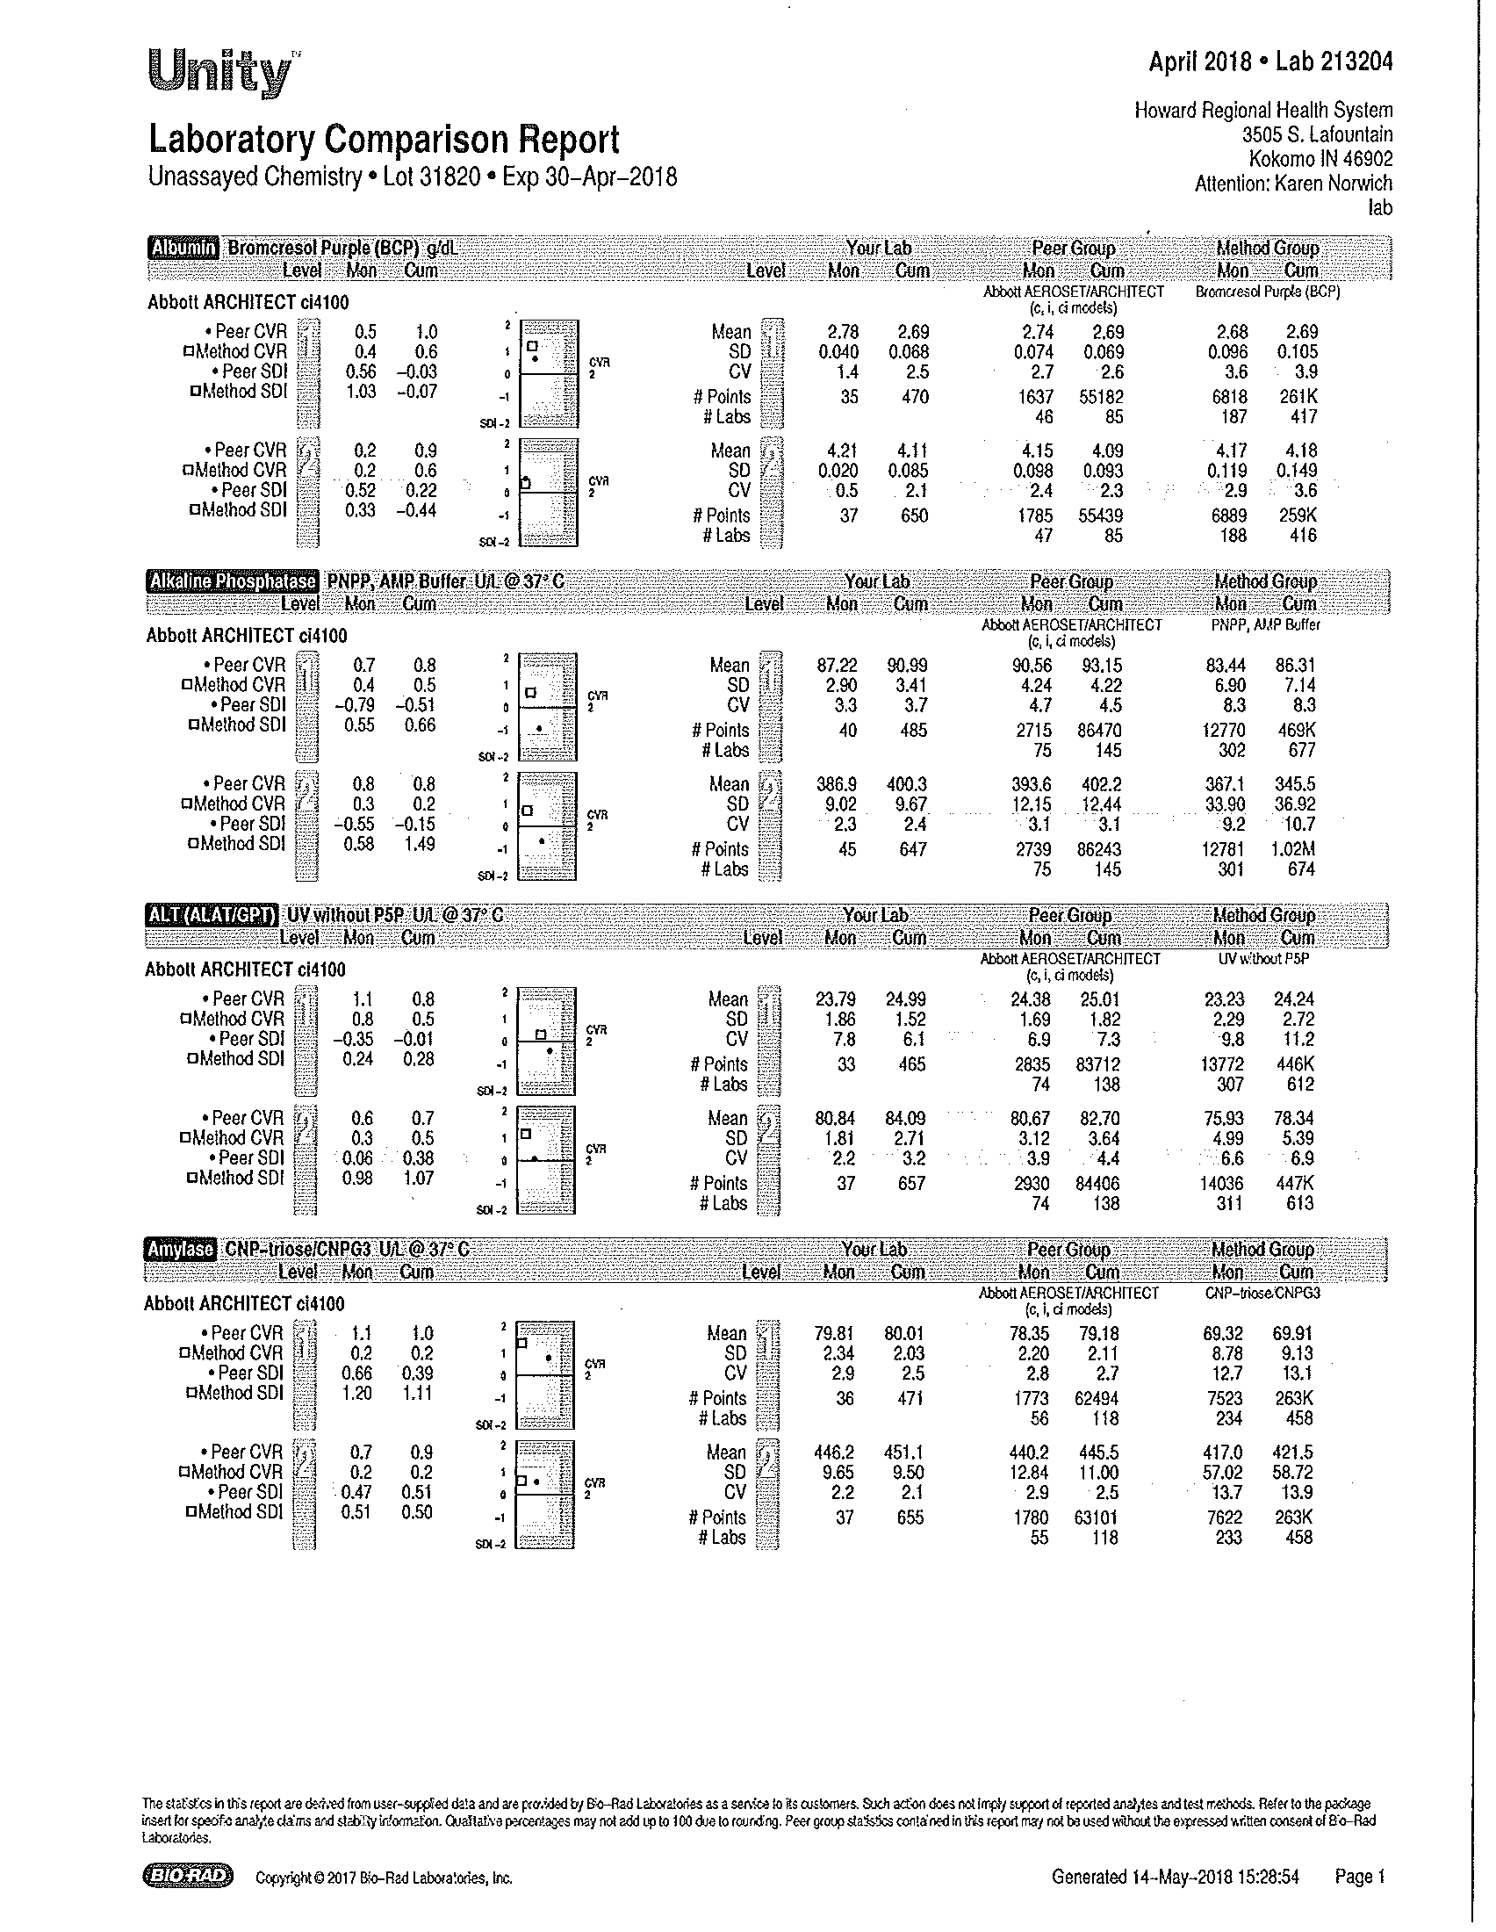
Typical laboratory comparison-review the peer group mean verses your current mean, make sure your mean is within the peer mean ± 2 SD
Notes:
Typical laboratory comparison-review the peer group mean verses your current mean, make sure your mean is within the peer mean ± 2 SD

Slide 70
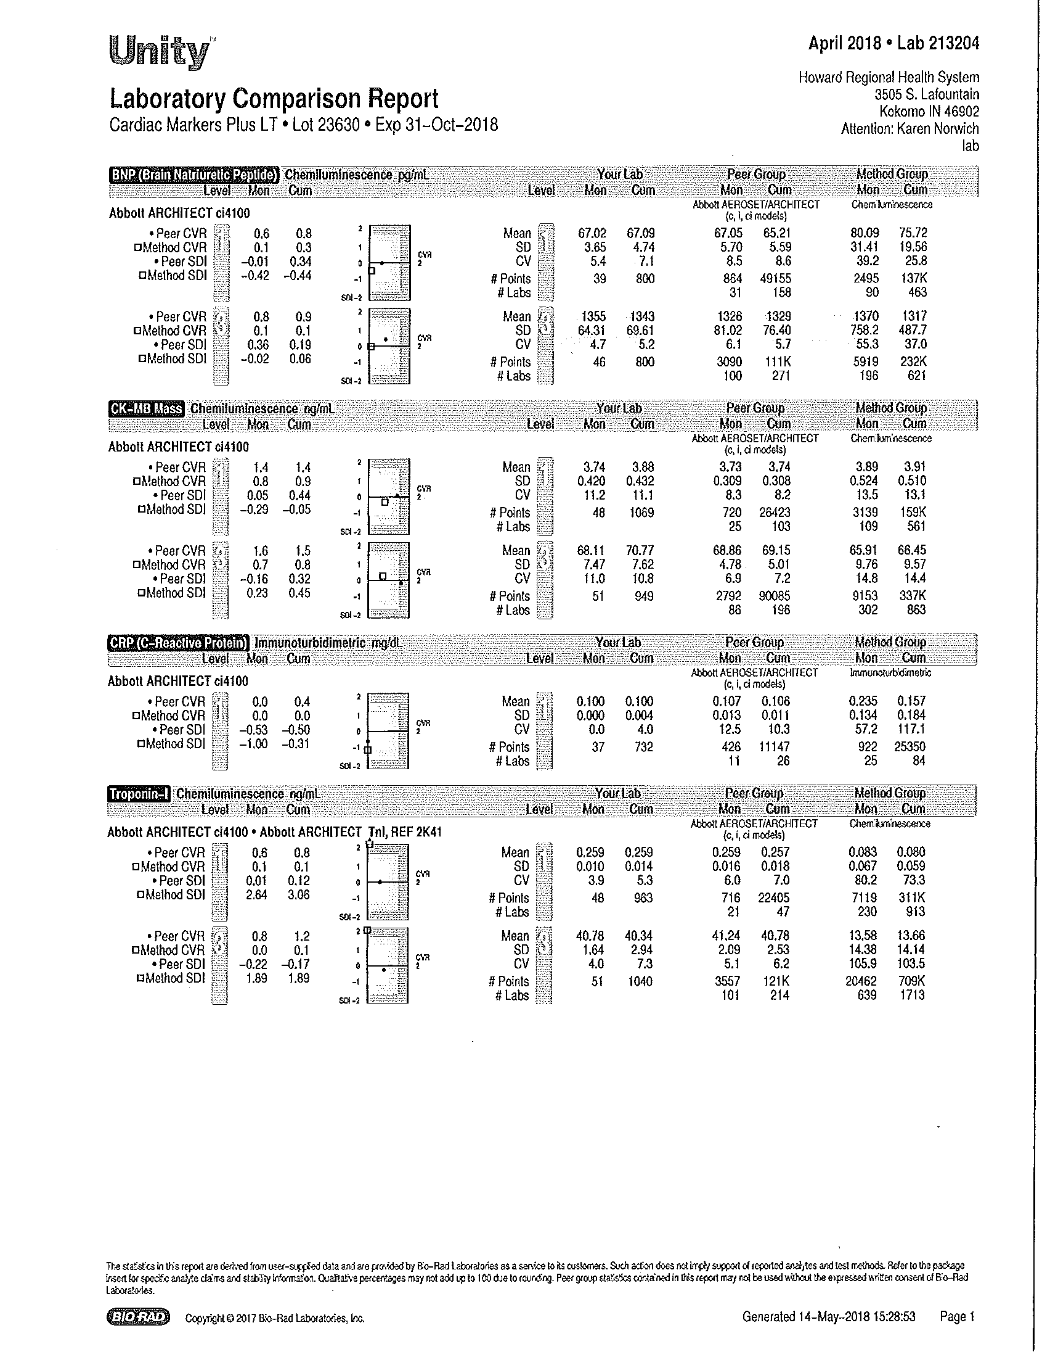
Note troponin peer SDI vs method SDI

Slide 71
Mean adjustment guidelines. When do you adjust the mean??

Slide 72
IF QC IS STILL OUT OF RANGE, MAKE SURE TO FOLLOW THESE STEPS BEFORE ADJUSTING THE MEAN
1. Rerun QC with same vial of QC, Rerun QC with new QC.
2. Check to see when the control is going to expire.
3. Check to see onboard stability of the reagent.
4. Look for the trends and make sure to review at least 10 points.
5. Check to see when the analyte was last calibrated. Calibrate if appropriate and rerun QC.
6. Check to see when the reagent was changed (especially in regards to enzymes with the exception lipase), did the problem start then.
7. If the problem is not resolved, evaluate the peer group data and make sure that we are within 2 SD of the peer group mean using the peer group SD.
8. If necessary adjust the mean. (should be close to the peer mean).

Slide 73
CASE STUDIES

Slide 74
Scenarios??
API survey--missed troponin value on a specimen
What are the next steps?

Slide 75
RESOLUTION!!!!!!
Review QC and look at SDs.
Evaluate what the peer group mean was and what the peer group SD was.
Our mean was within 2 SDI, but our SD was bigger than the peer group.
Tightened SD and haven’t missed a troponin since.

Slide 76
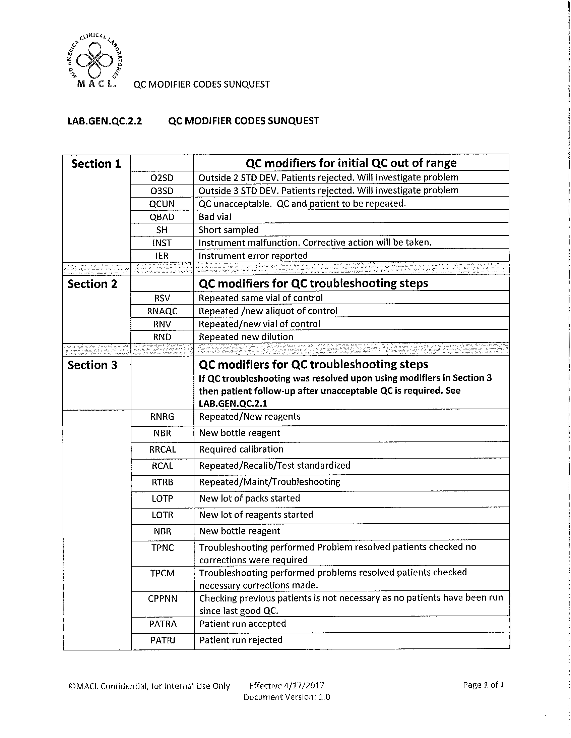

Slide 77
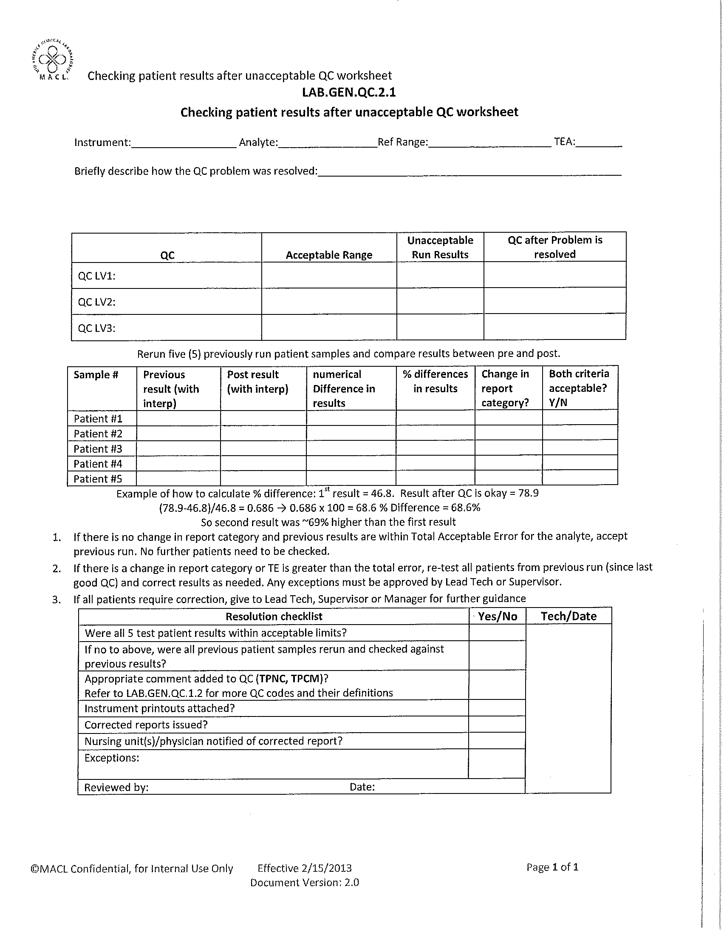

Slide 78
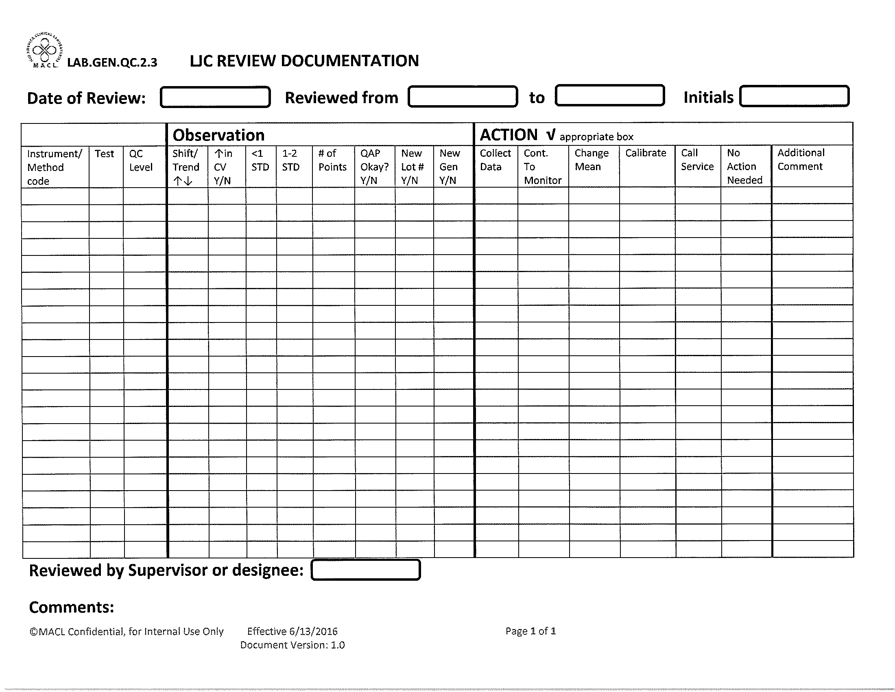

Slide 79
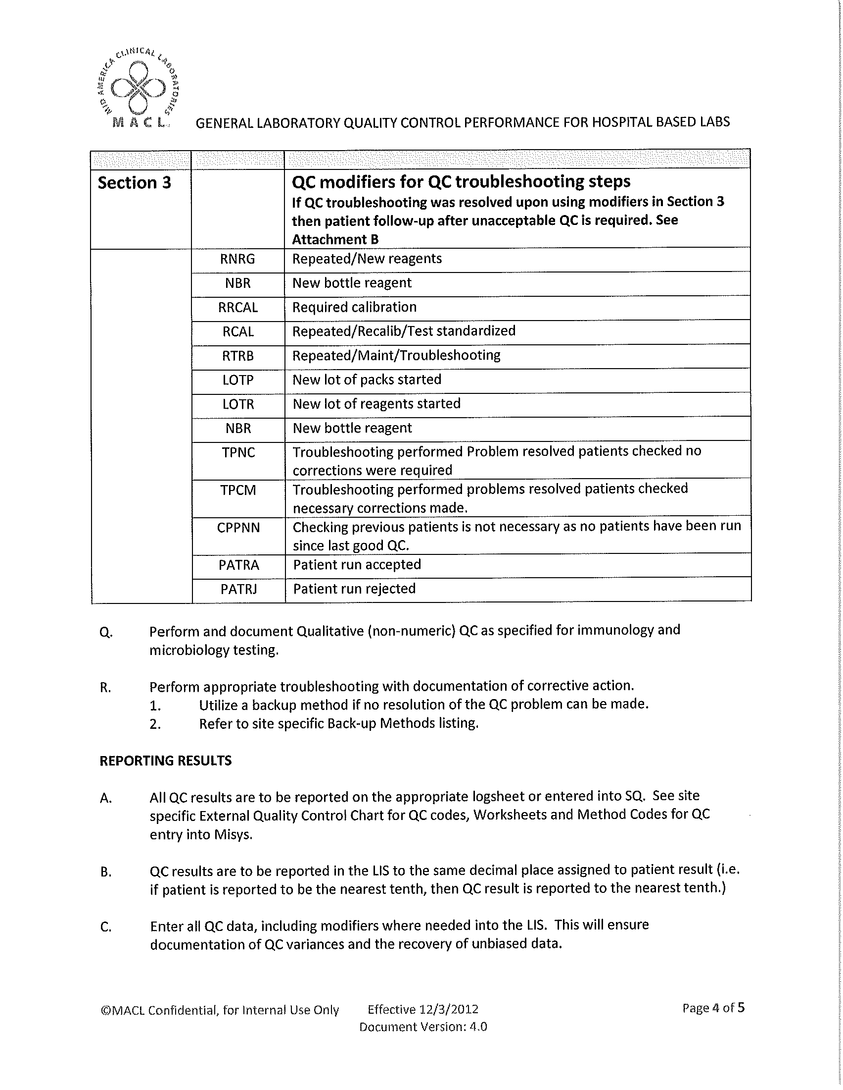

Slide 80
Q and A?

