Slide 1
Sodium
Clinpath Biochemistry Education…….Episode 1☺

Slide 2
Sodium in The Body
Plasma contains ~154 mmol/L of inorganic cations
90% is sodium. Approx 140 mmol/L. (135 – 145 mmol/L)
Very tightly regulated. Biological Variation Goal (minimum total error) = 2%
Sodium is the major extracellular cation, the amount in cells is 1/10th that in ECF.

Slide 3
Sodium in The Body
Sodium in contributes ~48% of osmotic pressure.
Osmo = 2xNa + Urea + Glucose + 9
Therefore sodium maintains distribution of body water between ICF and ECF. (Also oncotic pressure plays a role)
A 3 mmol/L change in sodium = ~2% change in osmolality.
This is enough to activate osmoreceptors.

Slide 4
Dietary Sodium
Around 8 – 15 mg of sodium is consumed per day.
This is around 100-200 mmol/day
Absorbed in the gut.
Body requires only 1 – 2 mmol/day
The remainder is excreted mainly via the kidney, though <10 mmol/day excreted via gut and <10 mmol/day via sweat.
Losses should = intake to maintain constant.

Slide 5
Regulation of Sodium
Kidneys major regulator of sodium concentration and water.
Na freely filtered by Glomeruli. Then reabsorbed in tubules.
70-80% reabsorbed in proximal tubule
20 – 25% loop of Henle
5 – 10% distal tubule (Aldosterone)
Remains in collecting duct (ADH)
Around 1% is finally passed in urine which means reabsorbtion = 100-200 mmol/day

Slide 6
Regulation of Sodium
Intravascular volume is major factor
IVV = increased retention, ADH and H2O
IVV = increased renal loss, increased H2O in urine and decreased ADH.

Slide 7
Renal Sodium Handling
Under control of :
GFR – increased GFR = increased excretion
Aldosterone – increase = increased absorbance
ADH – regulates H2O reabsorbtion in collecting duct
ANP – increase = increased excretion, increased GFR and decreased renin/aldosterone

Slide 8
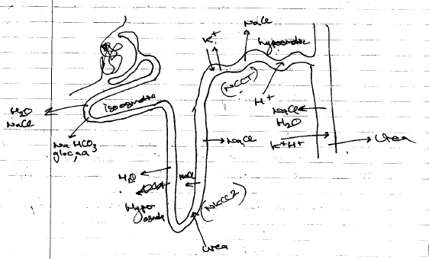
Prox tubule – 70-80% via Na+/H+ pump and NaHCO3-
Loop of Henle – 20-30% via NKCC2 pump
Distal tubule – 5 – 8% via NCCT pump (under influence of Aldosterone and thiazide diuretics)
Collect Duct – remainder – exchange for K+ and NaCl/H2O (ADH)

Slide 10
ANP
ANP causes increase GFR, decrease renin/aldo, vasodilation
End result is decrease blood pressure, increase Na reabsorbtion

Slide 11
ADH
A 2% change in osmo, or 10% change in IVV will stimulate production of ADH.
End result is to normalise osmolality at the expense of IVV. When acute cardiac event this is overridden.

