Slide 1
BSL 3 Tornado Drill Training Program
By Eric St Germain 2015

Slide 2
BSL 3 Tornado Drill Training
Emergency::
- Secure any select agents or infectious agents by placing inside the BSC and lower the sash to ‘closed height’. Select agents in refrigerators, freezers or incubators are to be left in place.
- Leave the BSC blower running to provide continued exhaust of the cabinet. The BSC will continue to move air out of the lab area adding a safety margin for work in progress within BSC.

Slide 3
BSL 3 Tornado Drill Training
Emergency: Insufficient notice to evacuate-Shelter in Place
-Move to Room 105, do not remain in Room 104 or 105A as these rooms have external walls.
-If wearing PAPR, remain under respiratory protection.
-Provided no damage to building and immediate danger is past, proceed with evacuation of BSL3
After the tornado
If building is damaged so that total evacuation is required, evacuate and proceed to emergency evacuation “hot zone” external to building.

Slide 4
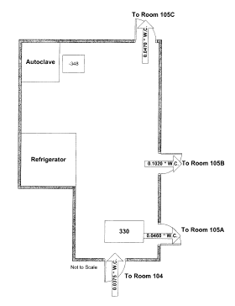
BSL 3 Tornado Drill Training
Emergency: Insufficient notice to evacuate-Shelter in Place
-Move to Room 105, do not remain in Room 104 or 105A as these rooms have external walls.
-If wearing PAPR, remain under respiratory protection.
-Provided no damage to building and immediate danger is past, proceed with evacuation of BSL3

Slide 5
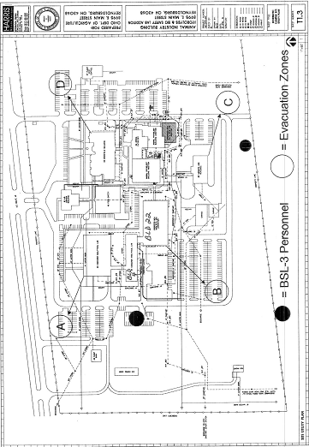
BSL 3 Tornado Drill Training
After the tornado
If building is damaged so that total evacuation is required, evacuate and proceed to emergency evacuation “hot zone” external to building.

Slide 6
BSL 3 Tornado Drill Training
Emergency: Sufficient notice to evacuate
Evacuate BSL3 suite following normal exit protocol and proceed to designated ‘Tornado Evacuation Area’ in basement of building 4.
Upon arrival at the basement, gather in your section’s designated area as marked by signage and report to nearest Floor Warden taking role. Since there will be a lot of people in an enclosed area, keep conversation and noise to a minimum so the Floor Wardens can communicate with you and each other.

Slide 7
BSL 3 Tornado Drill Training
At the first opportunity, notify supervision of the status of any select agents or infectious agents that were in use at the time of evacuation. This information may be needed if there is a fire or other emergency to assist and protect first responders.

Slide 8
BSL 3 Tornado Drill Training
Re-entry following evacuation:
Facility undamaged
immediate re-entry allowed
Facility damaged
re-enter only upon approval of supervision
Respiratory protection required
Account for and document in activity log the status of all select agents and infectious agents and notify supervision of findings.

Slide 9
Questions?

Slide 10
BSL 3 Tornado Drill Training Quiz
September 2015
1. If sheltering in the BSL III you should take off you PAPR and Move to room 105.
True / False
2. If damage occurs to the building during the tornado you should exit immediately and go to the evacuation spot.
True / False
3. If you have enough time to leave the BSL III during a
Tornado drill and no damage occurs you can re-enter
immediately with respiratory protection.
True / False
Print Name: ________________________ Date: _____

