Slide 1
BSL- 3 Fire Emergency Evacuation Protocol

Slide 2
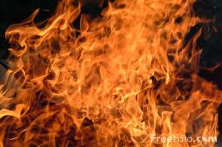
What I Need To Know…
3 goals in effectively managing an emergency evacuation from the BSL-3
Protect individuals directly affected
Prevent exposure of other staff members
Protect the facility outside the BSL-3

Slide 3
What I Need To Do…
Place any infectious agents inside the BSC
Lower the sash of the BSC and leave the blower running
Exit the BSL-3 through the gowning room (room 104 door)

Slide 4
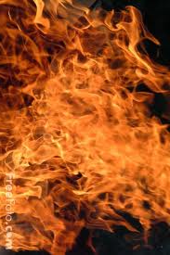
Where I Need To Go…
Proceed to the emergency evacuation ‘hot zone’ external to the building.

Slide 5
Who Do I Inform…
Notify supervision of status of select agents, infectious agents, or hazardous materials in use
Re-enter only after approval from supervision if facility is damaged
Account for status of agents in activity log

Slide 6
September 2015
What is one thing you need to do while still in the BSL-3 in the event of a fire emergency?
If the facility has been damaged by fire, when can I return to my work in the
BSL-3?
Name: Date:

