Slide 1
BSL III PAPR Training- Entering and Exiting the BSL III
By Eric St Germain

Slide 2
Entering The BSL III

Slide 3
Log In
Scan your ID badge to enter into Room 103.
Sign into the book in 103, then scan to enter 104.
*each person must scan to enter Room 104
9 / 99
10:249
E. St Germain9

Slide 4
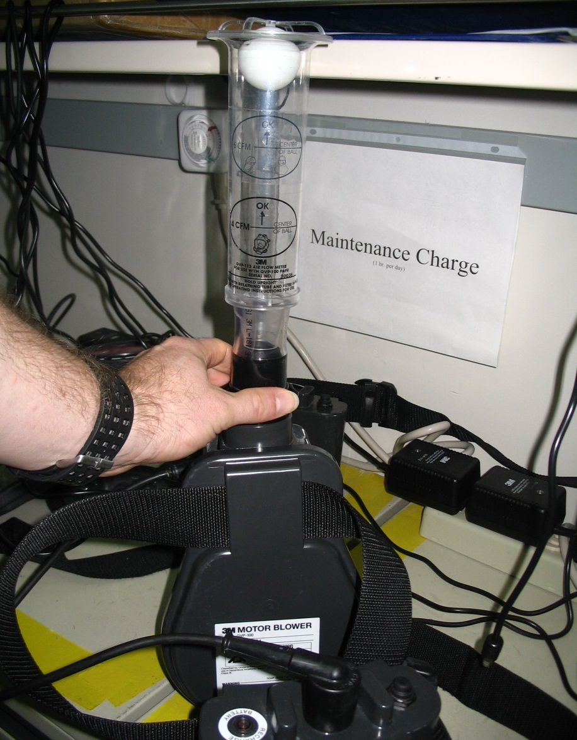
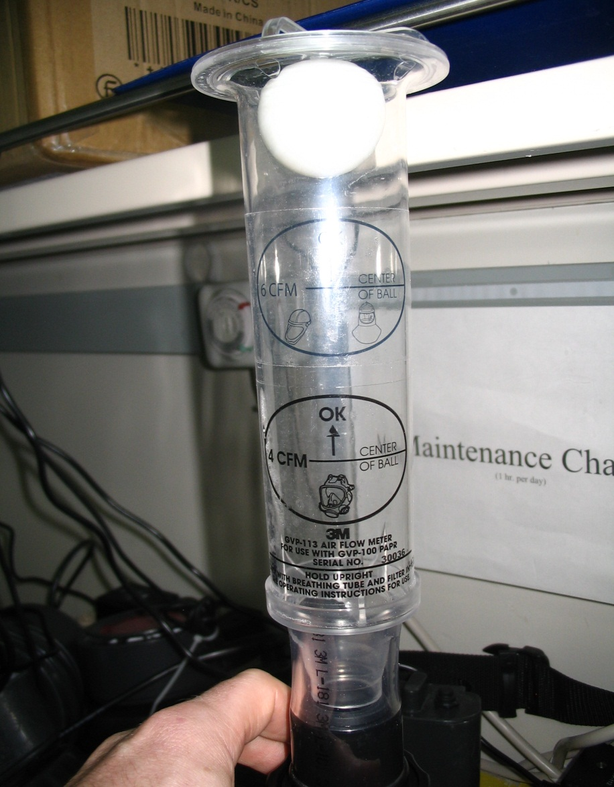
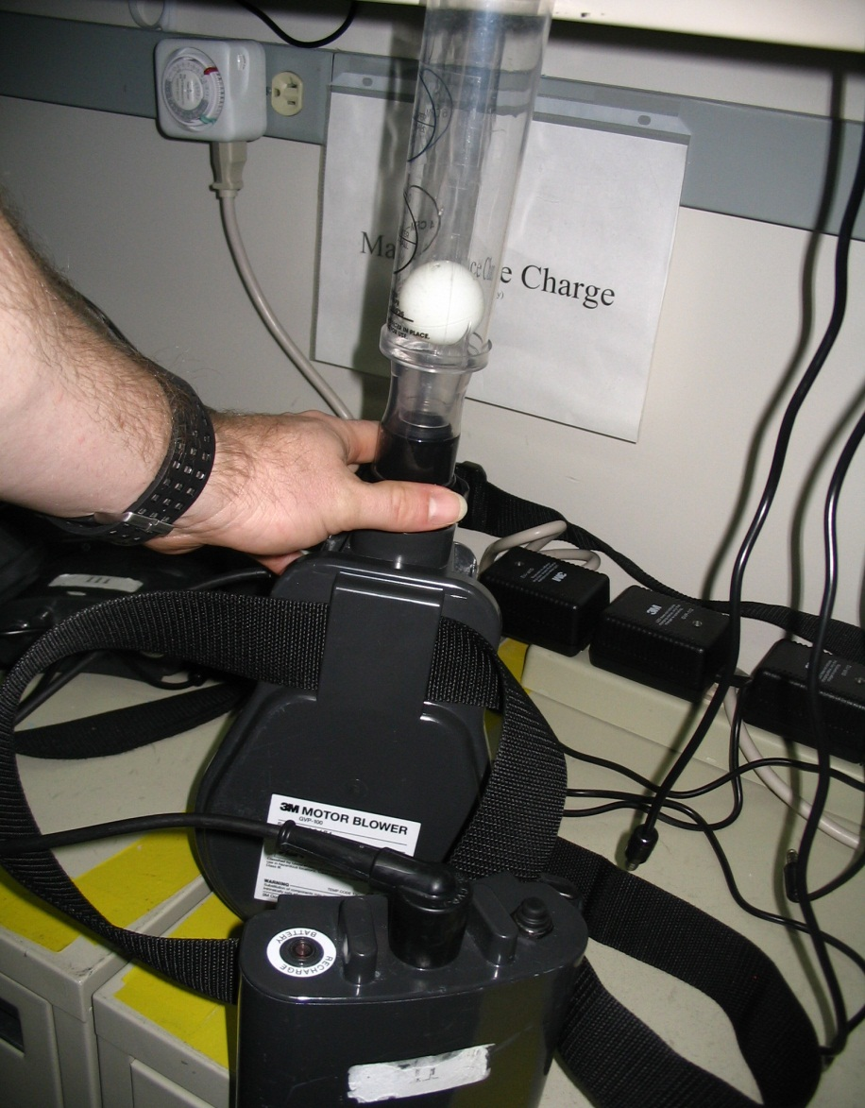
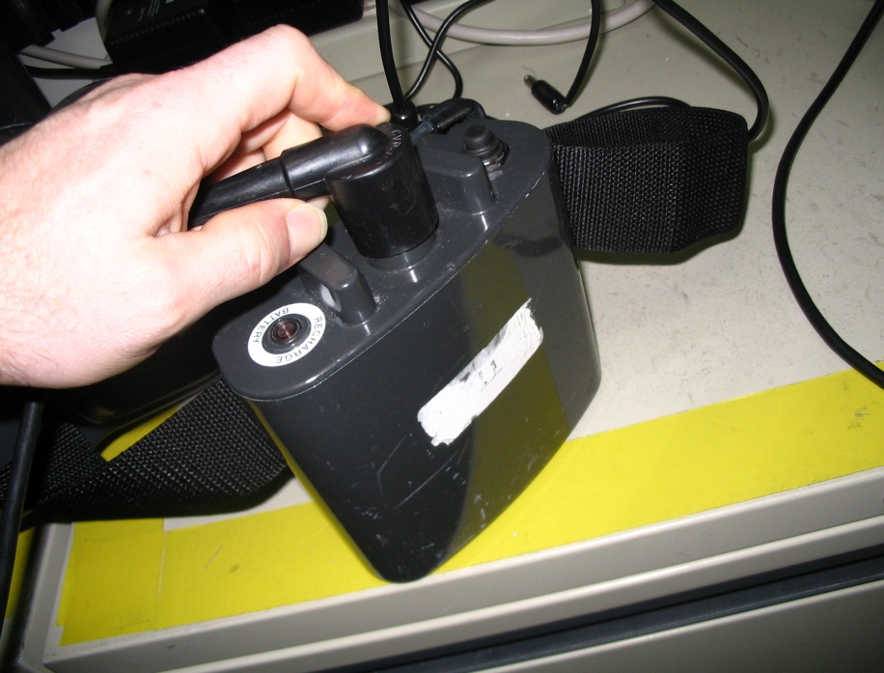
How to Check your PAPR Belt Unit
Select a PAPR Belt & unplug from charging.
Plug blower cord into battery
Place flow meter onto the blower.
Turn on the battery
Verify the flow meter is reading at lease 6cfm.

Slide 5
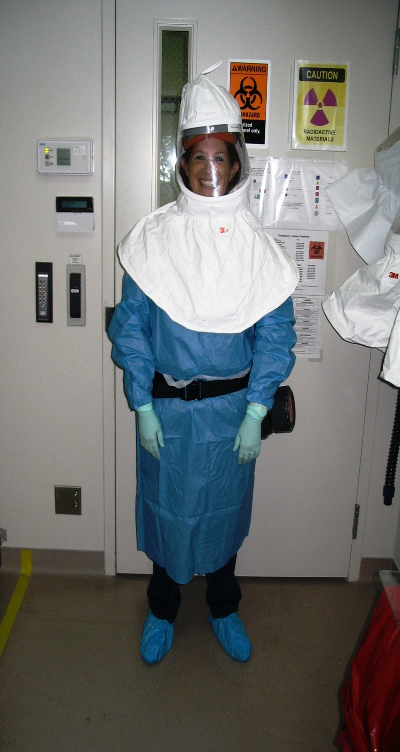
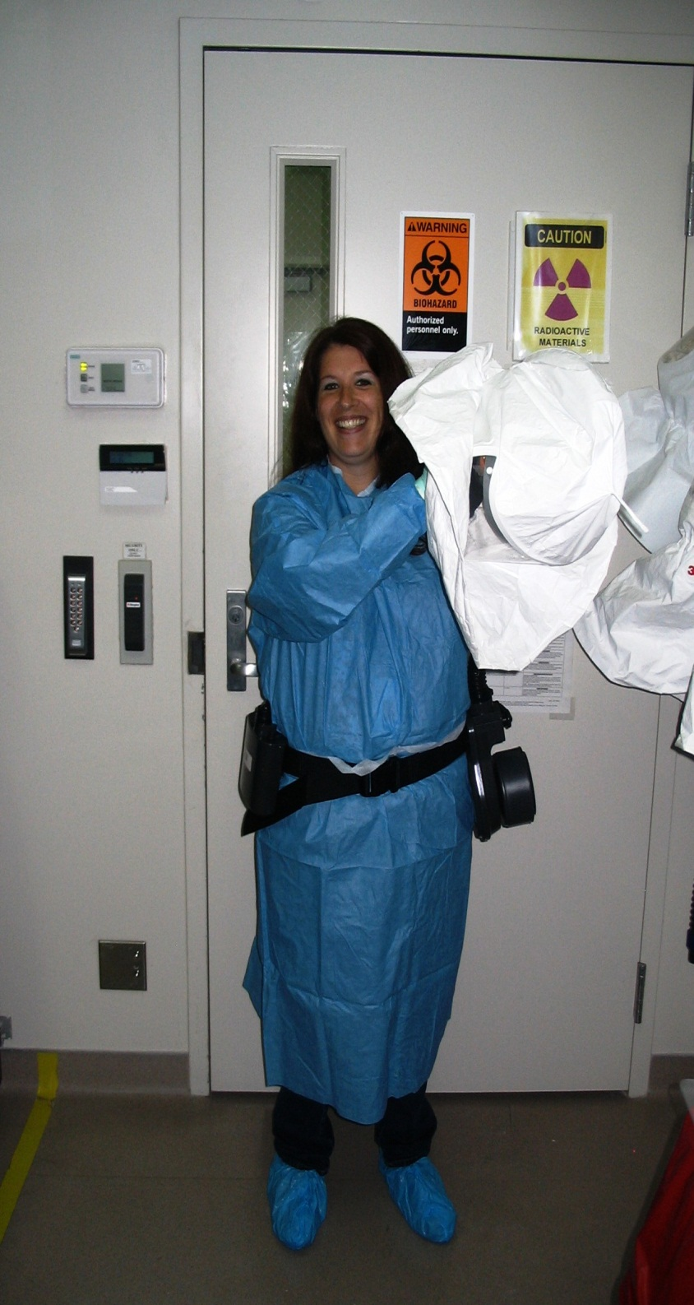
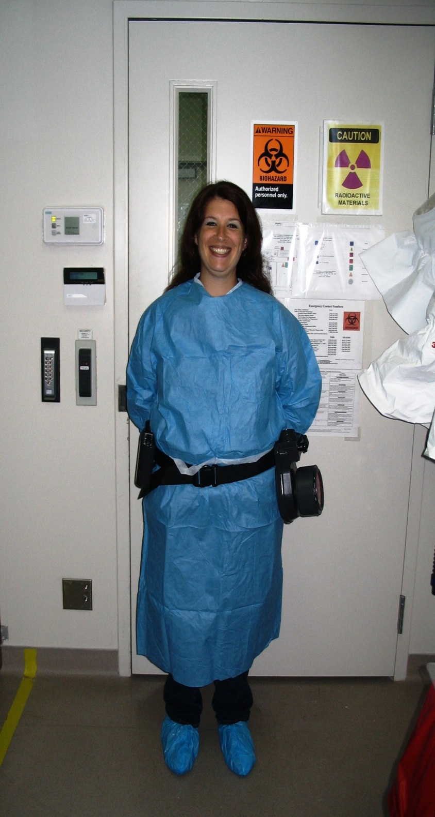
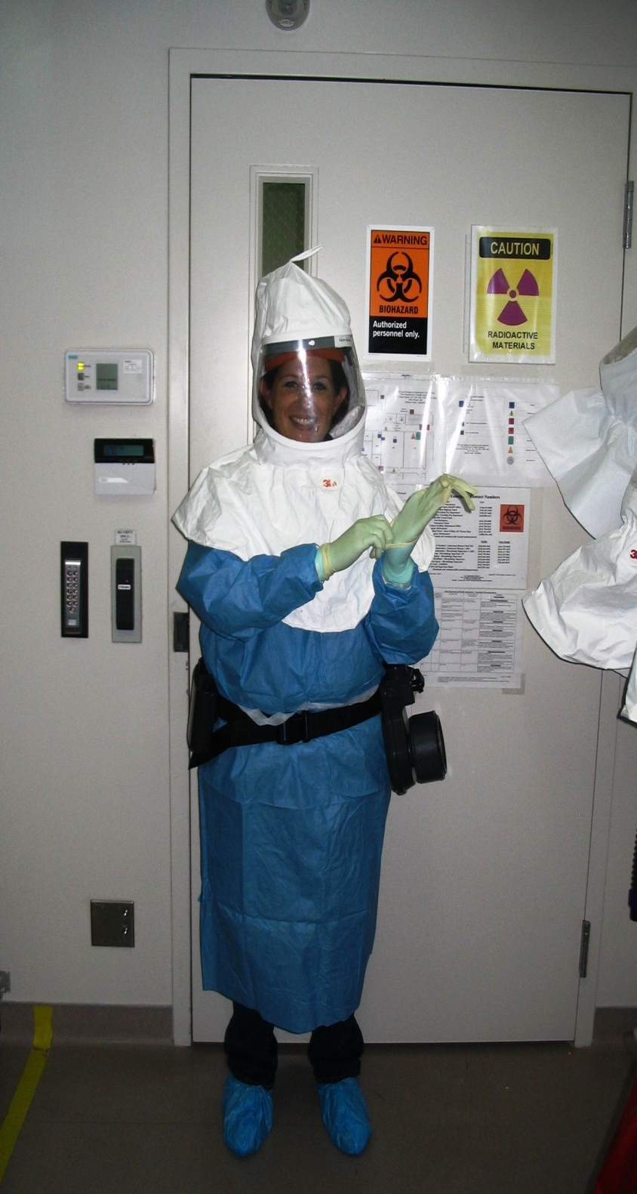
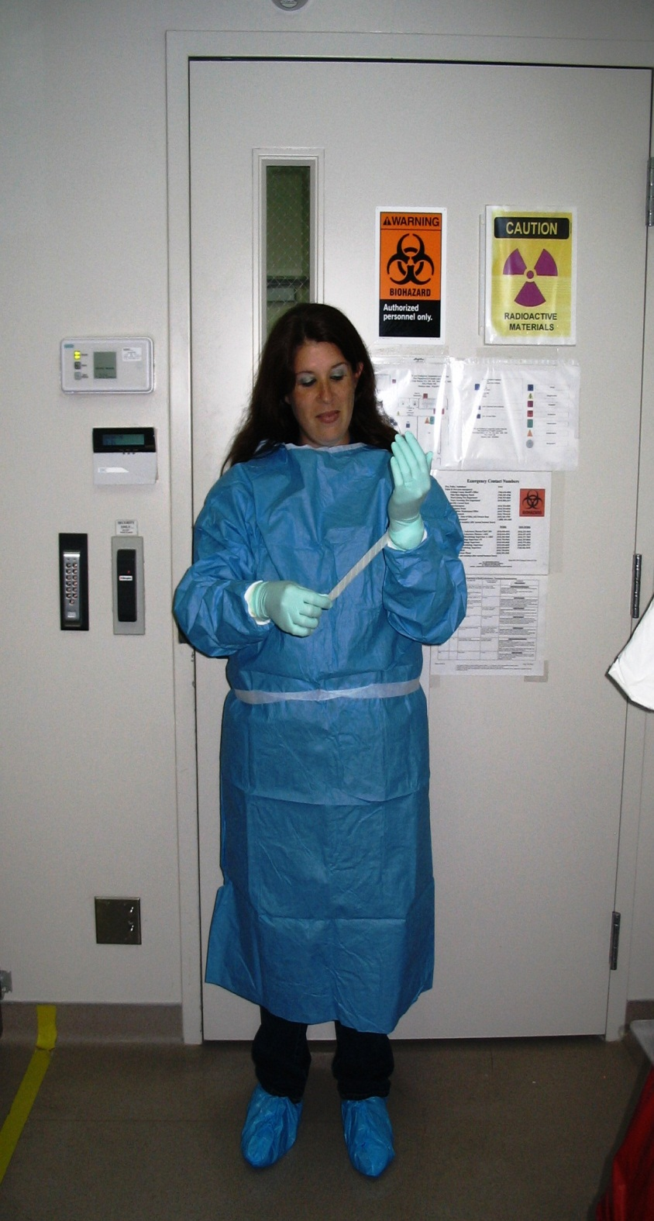
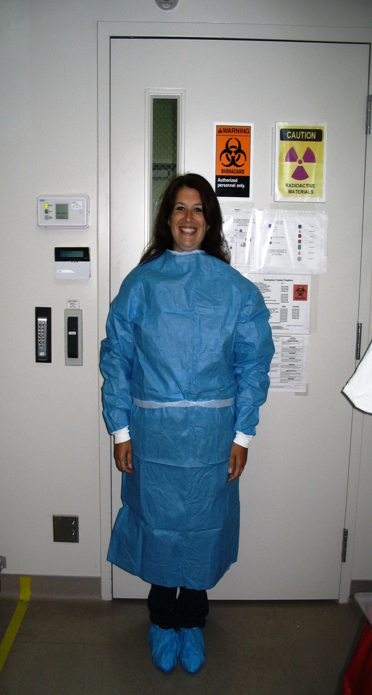
How to put your PAPR on
Put on shoe covers.
Put on gown.
Put on 1st pair of gloves and tape them to the cuffs of the gown.
Put on a PAPR belt that has passed QC, Press the on button.
Do a hood check and place the hood on your head, verify that you can feel the air in the hood.
Put a second pair of gloves on.
Complete PAPR QC
You are now ready to enter the BSL III.

Slide 6
PAPR Inspection & Flow Meter QC
Initial that you inspected your hood.
Check that the flow meter passed
Check that you feel air in the hood
estg

Slide 7
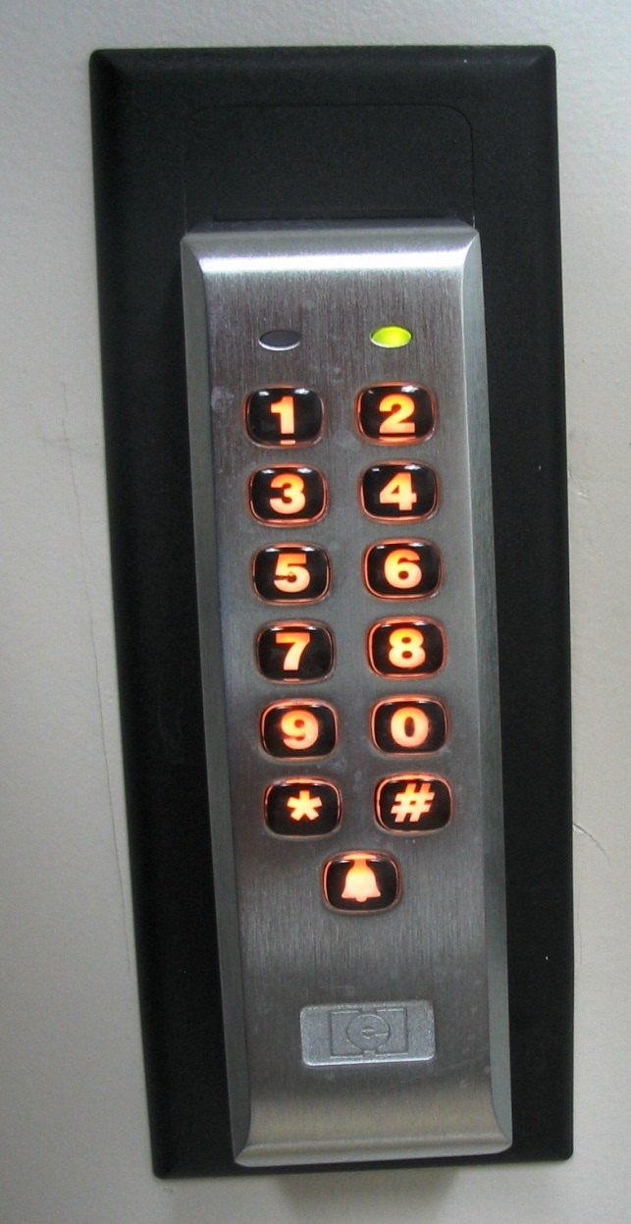
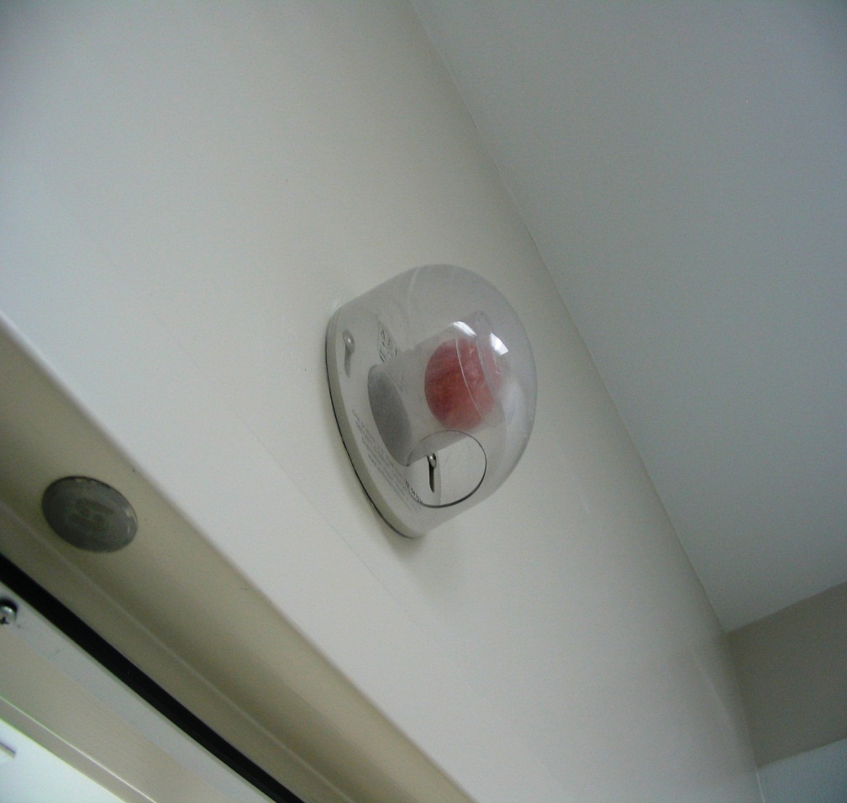
Entering The BSL III
Check the ping pong ball air sensor. If you do not see the Red ball you may enter.
Punch your 5 digit code and press * to enter
If the ping pong ball sensor displays the Red ball do not enter and contact your supervisor.

Slide 8
Exiting The BSL III

Slide 9
Exiting The BSL III
Remove your most outer layer pair of gloves in the laboratory.
While on, wipe the hood down with bleach, prior to leaving the laboratory.
Leave the BSL III and step into the yellow tape zone in room 104.
Remove you hood and hang on hook.
Remove the PAPR Belt and place on the outside of the yellow tape.
Remove the tape from your 1st pair of gloves.
Remove the gown and place in biohazard box.
Remove 1 shoe cover and step out side of the yellow zone, repeat for second shoe cover. Place in biohazard box.
Remove gloves and place in biohazard box.
Plug in PAPR Belt and wash hands.

Slide 10
Logging Out
1. Sign out of the log book when you exit 104.
9 / 99
10:249
2:549
E. St Germain9

Slide 11
BSL III PAPR Training-Quiz
September 2015
Circle all of the correct answers
How many pairs of gloves should you have on prior to entering the BSL III?
A) 1 B) 2 C)3 D) none
How many CFM should the PAPR Blower to pass QC?
4 cfm B) 6 cfm C) 2 CFM D) none
When do you remove your outer pair of gloves if leaving the BSL III.
Before I want to remove my hands from the hood
Before I exit the lab
After I get to the gowning room
At the same time I remove the first pair.
When do you decontaminate your Hood?
After I get to the gowning room
Before I exit the lab
Never
Someone else does for that for me
Print Name: _______________________________ Date: ____________________

