Slide 1
Entering/Exiting the BSL III with Maximum Personal Protective Equipment

Slide 2
Entering the BSL III room 104
Scan your ID badge to enter room 103
Sign into the ‘BSL3 Suite Activity Log’ located outside of the door to room 104
Record date, time in, name and check off the box for ‘work with infectious agent or material’

Slide 3
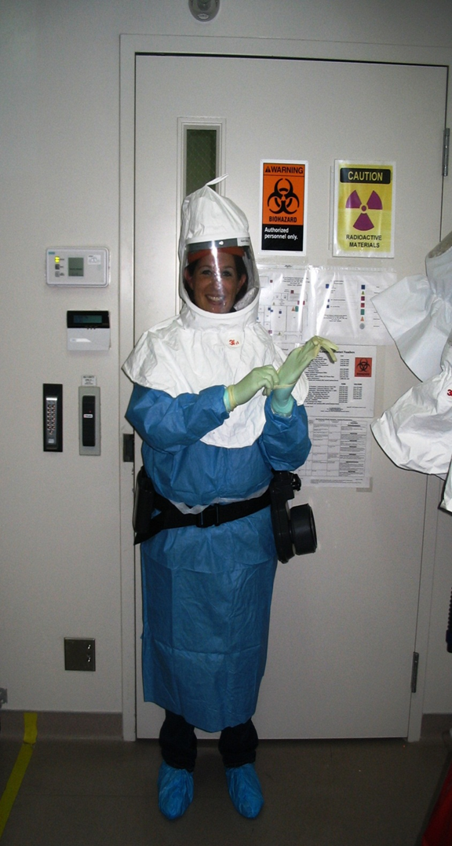
Entering the BSL III room 104
Scan your ID badge to enter room 104
PPE Required to enter the BSL III
Shoe Covers
Two pairs of gloves
Gown
PAPR belt
PAPR hood

Slide 4
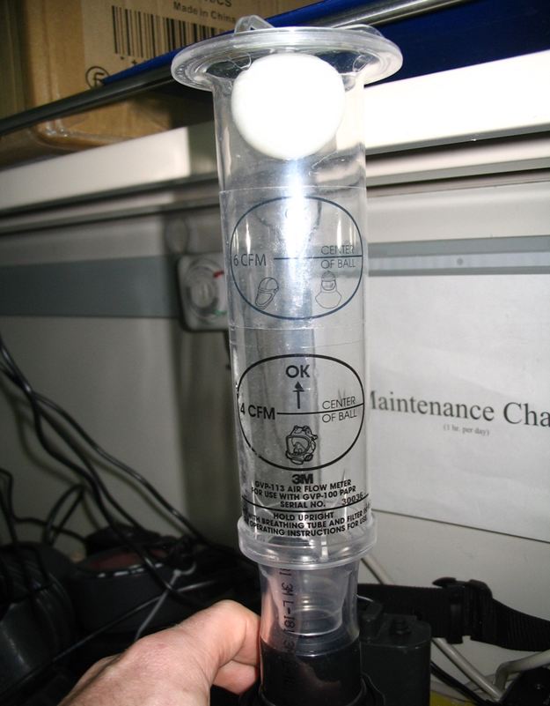
PAPR Check
Select a PAPR belt and unplug from the charger.
Plug blower cord into battery.
Place flow meter onto the blower.
Turn on the battery.
Verify the flow meter is reading at least 6 cfm and record this in the PAPR QC log.

Slide 5
Donning your PPE
Put on shoe covers.
Put on gown.
Put on 1st pair of gloves and tape them to the cuffs of the gown.
PAPR QC Chart Completion
Battery number: Select a battery from the battery charging station, document the number of the battery on the chart next to the PAPR number used.
Battery test: Push the test button to confirm battery charge, if satisfactory place a √ mark in the box.

Slide 6
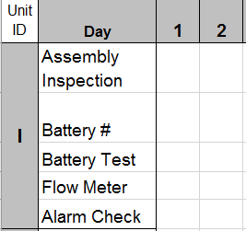
Donning your PPE
Flow meter: place a flow meter tube on the blower assembly to check for proper air flow. Air flow should be at zone F or greater, if satisfactory place a √ mark in the box.
Alarm test: cover the blowers hole until it alarms, if the unit alarm’s place a √ mark in the box.
Put on a second pair of gloves and attach your hood to the PAPR blower.
You are now ready to enter the BSL III.
PAPR QC log
estg
9

Slide 7
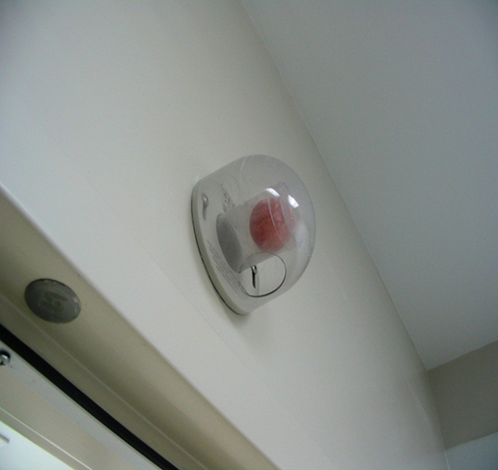
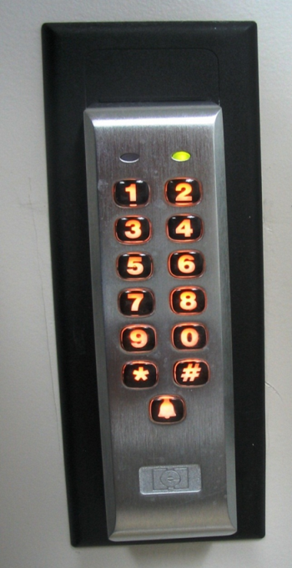
Entering the BSL III room 105
Check the ping pong ball air sensor over the door to room 105. If you do not see the ball, you may enter the room. If you see the ball, do not enter and contact your supervisor.
Enter your 5 digit code and press * to enter.

Slide 8
Exiting the BSL III
Wipe down your hood and shroud with a bleach wipe and remove your most outer layer pair of gloves in the laboratory.
Leave the BSL III and step into the yellow tape zone in room 104.
Remove your hood and hang on a hook.
Remove the PAPR belt and place on the outside of the yellow tape.
Remove the tape from your 1st pair of gloves and remove your gown. Place in biohazard box.

Slide 9
Exiting the BSL III
Remove one shoe cover and step outside of the yellow zone. Repeat for the second shoe cover. Place in the biohazard box.
Remove gloves and place in the biohazard box.
Plug in your PAPR belt and wash your hands.
Leave room 104 and sign out of the Activity Log in room 103 by entering the time out.

Slide 10
BSL III Entry/Exit with maximum PPE
Please take the quiz online: Passing grade is 80%
Questions?
Please send an email to:
Eric St Germain, BT Coordinator Larry King, PI Steve York, RO, LSO Kevin Sohner, ARO
Tammy Bannerman, ARO

