Slide 1
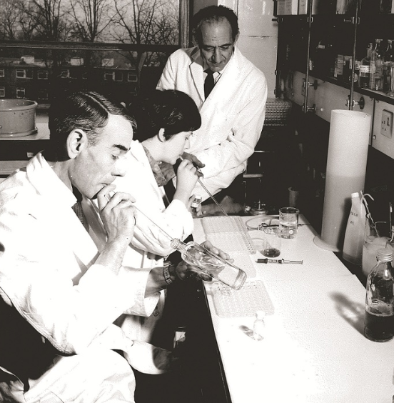
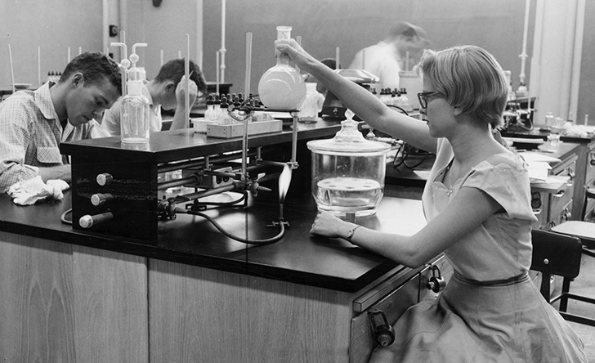
Laboratory Chemical Hygiene Plan
By Lai Ming Woo

Slide 2

Why?
OSHA Hazard communication standard (HCS) 29 CFR 1910.1200 states employee has the right-to-know…
-The standard (CHP Appendix B)
-Hazardous chemicals & products in the workplace
-Methods of protecting themselves from exposure

Slide 3
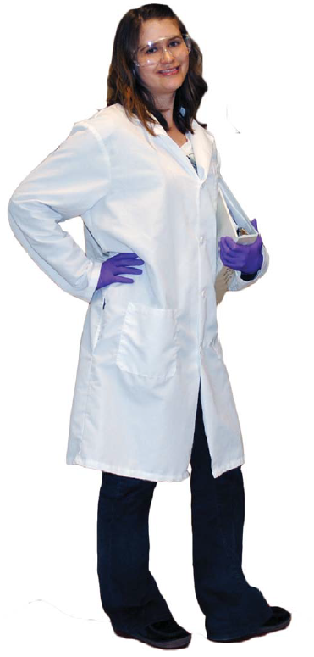
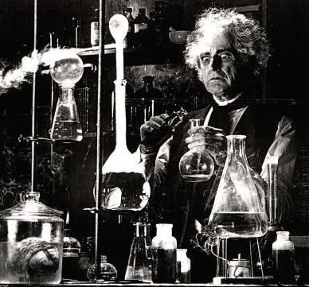
Why? (Cont’d)
Under OSHA, employer is responsible for providing a safe & healthful workplace
-but employees are responsible for their own safety &
the safety of the others
Proper PPE
Mad Scientist
VS

Slide 4
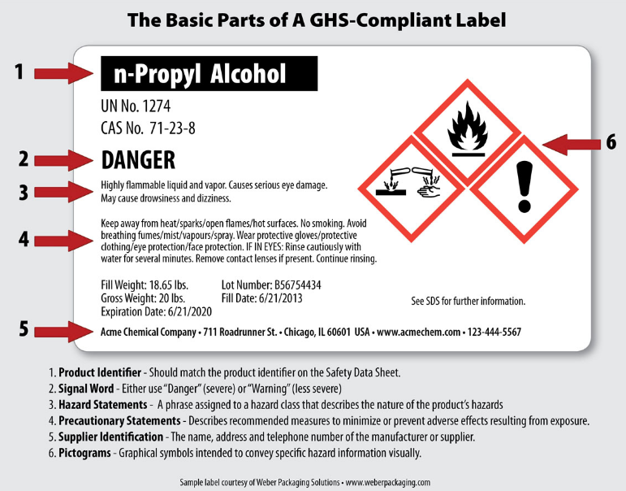
Hazard Communication GHS Elements
  1. Labels

Slide 5
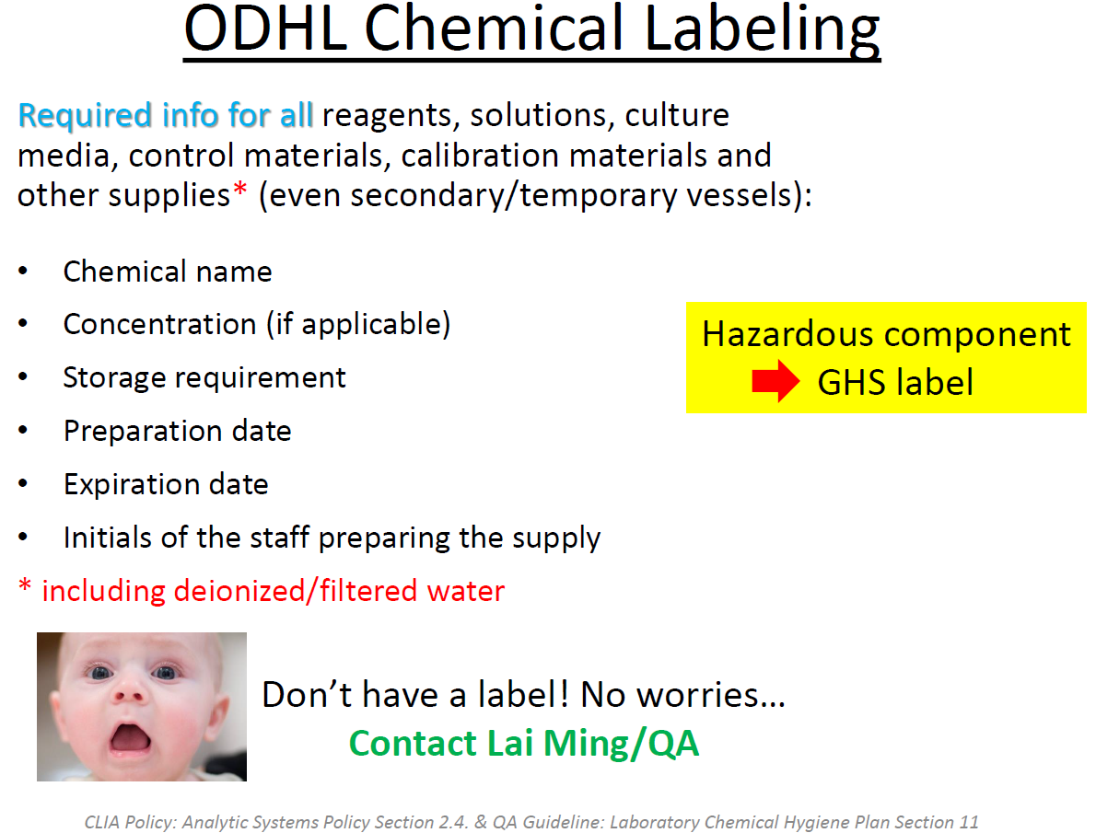

Slide 6
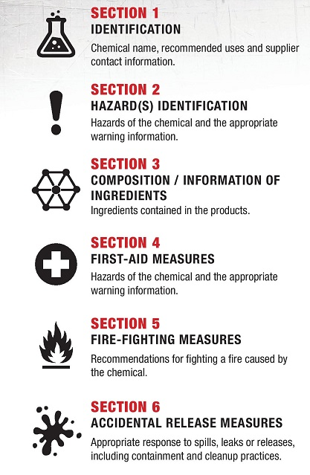
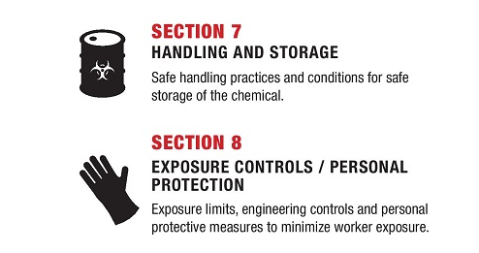
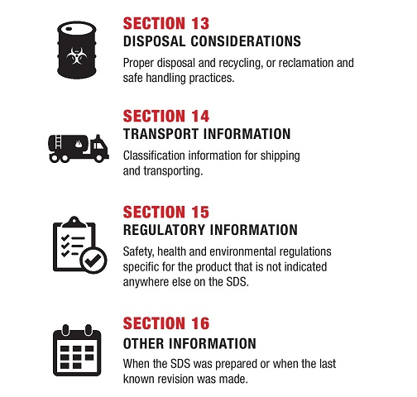
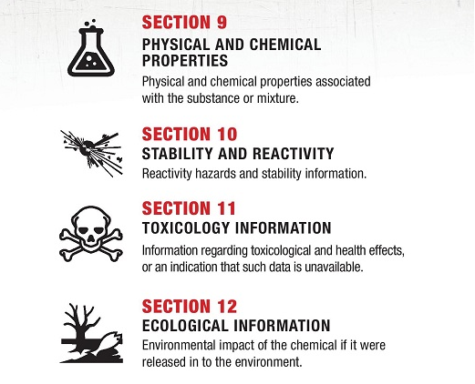
2. 16 sections Format Safety Data Sheets (SDSs) (Appendix M)
Non-mandatory Sections 12- 15 for OSHA are regulated by EPA or DOT

Slide 7
How to read your SDSs? (Appendix M)
Section 2 Signal word, hazard & precautionary
statements
Section 4 First aid measures & symptoms/effects
Section 7 Handling & storage conditions
Section 8 Exposure control limits, engineering controls
& PPE selection recommendations
Section 10 Stability, reactivity, conditions to avoid &
incompatible materials. Store away from incompatibles
Section 11 for toxicological effects
https://time.com/5722129/buffalo-wild-wings-employee-dies-fumes/

Slide 8
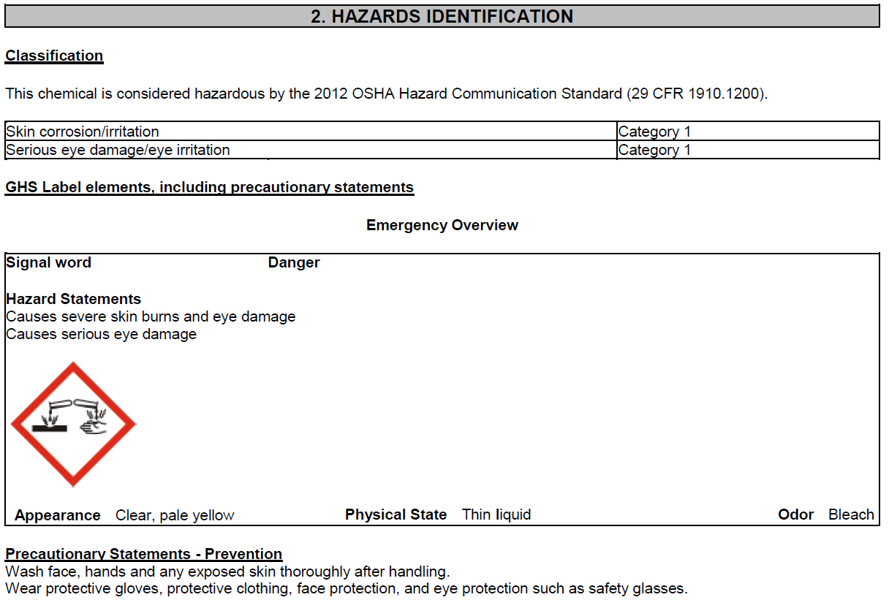
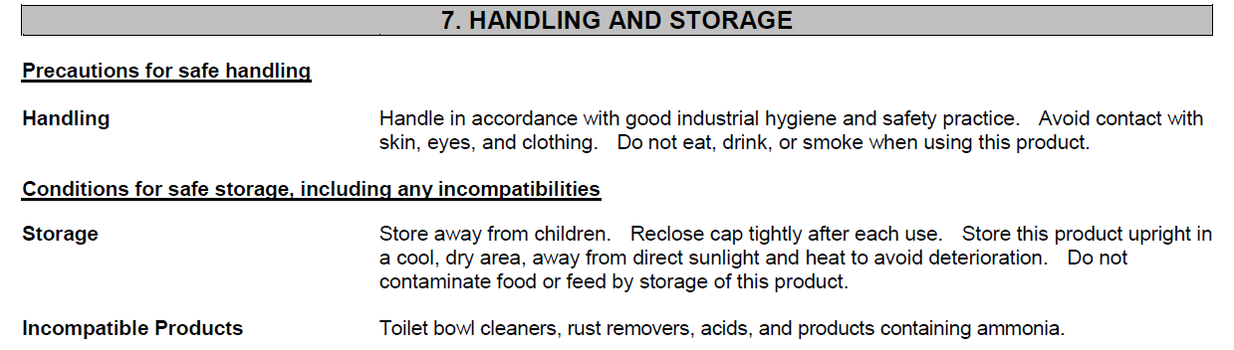
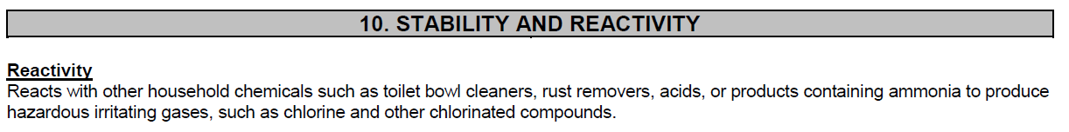
Bleach SDS

Slide 9
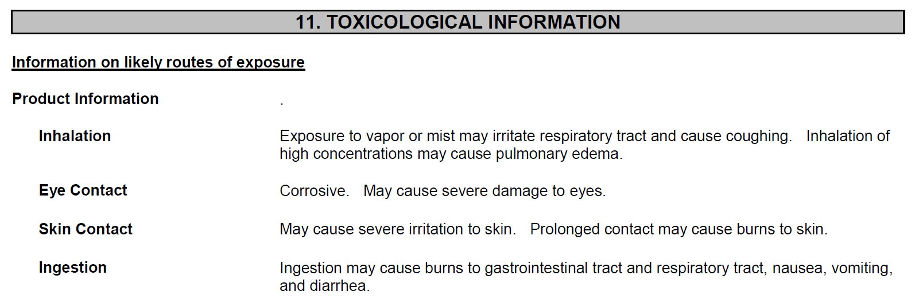
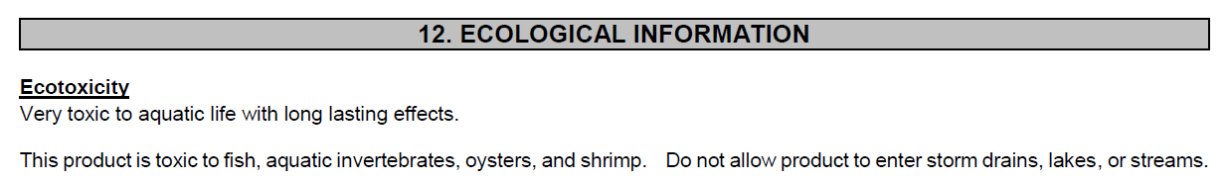
Pulmonary edema is a condition caused by excess fluid in the lungs

Slide 10
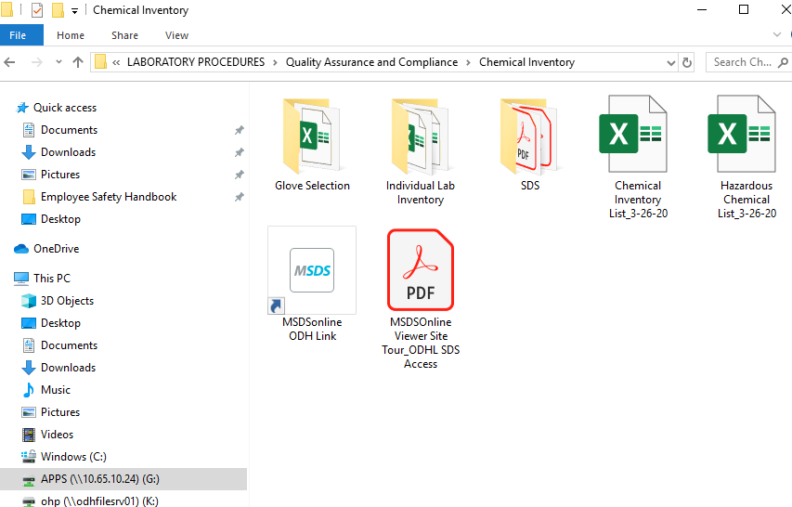
Current inventory & SDSs are accessible on:
G:/drive & MSDS Online link

Slide 11
Hazardous Chemical SOPs (CHP Appendix E)
Aspiration Toxicity Irritant and Sensitizer
Carbon Dioxide (Dry Ice) Liquid Nitrogen
Carcinogens Nitric Acid
Chloroform Oxidizers
Compressed Gases Peroxide Forming Chemicals
Corrosives Phenol
Cyanide Reproductive Toxins
Flammables Sodium Azide
Formaldehyde Sulfuric Acid
Germ Cell Mutagen Target Organ Toxicity
Glacial Acetic Acid Toluene
Hydrogen Gas Toxic or Highly Toxic

Slide 12
Ordering
Purchasing the smallest amount required for work
Disposal $$$/Hazards Not cheaper to purchase in bulk
Ensuring proper storage available
Ensure capability to cleanup if the amount ordered is spilled; e.g. amount of absorbent & PPE

Slide 13
Storage
University of California, Santa Barbara
Household/laboratory refrigerators have electrical components inside
Spark inside
Flammable liquid in an open container/incompletely sealed container evaporate to concentration of lower explosive limit

Slide 14
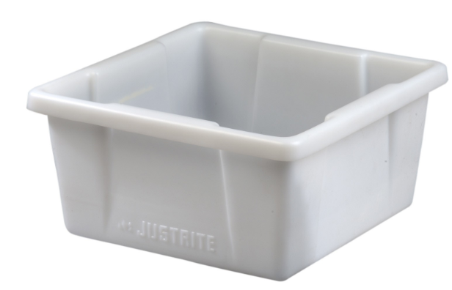
Secondary Containment
Can be used to segregate chemicals or store chemicals on the floor
Should be
-sturdy, chemical resistant
plastic AND
-able to hold the total
volume of chemical inside
Contact QA if you need one

Slide 15
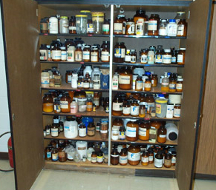
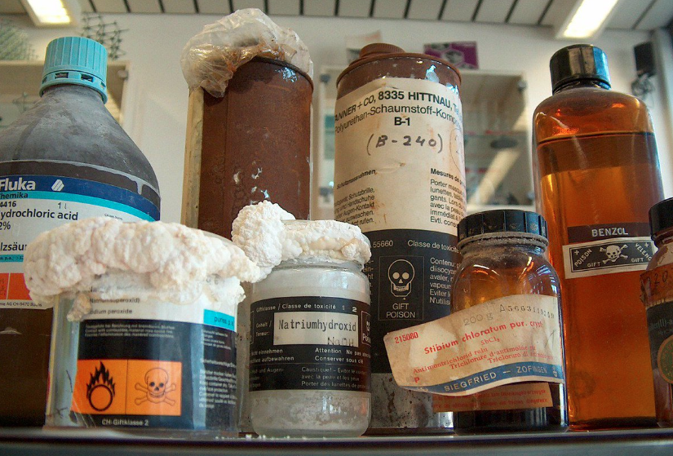
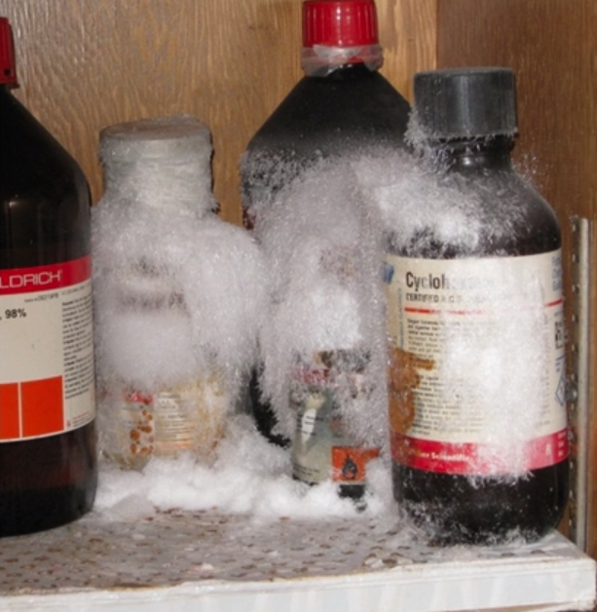
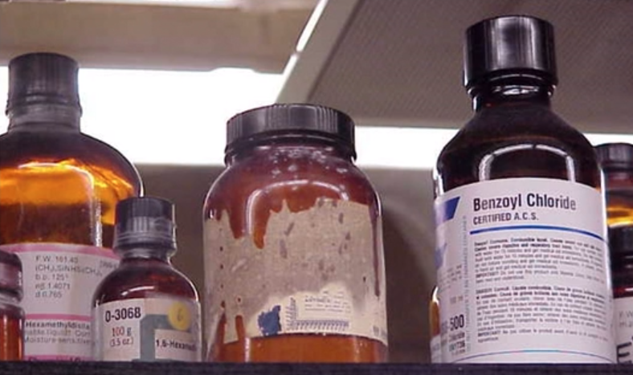
Storage- What wrong with this picture?

Slide 16
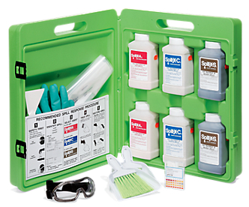
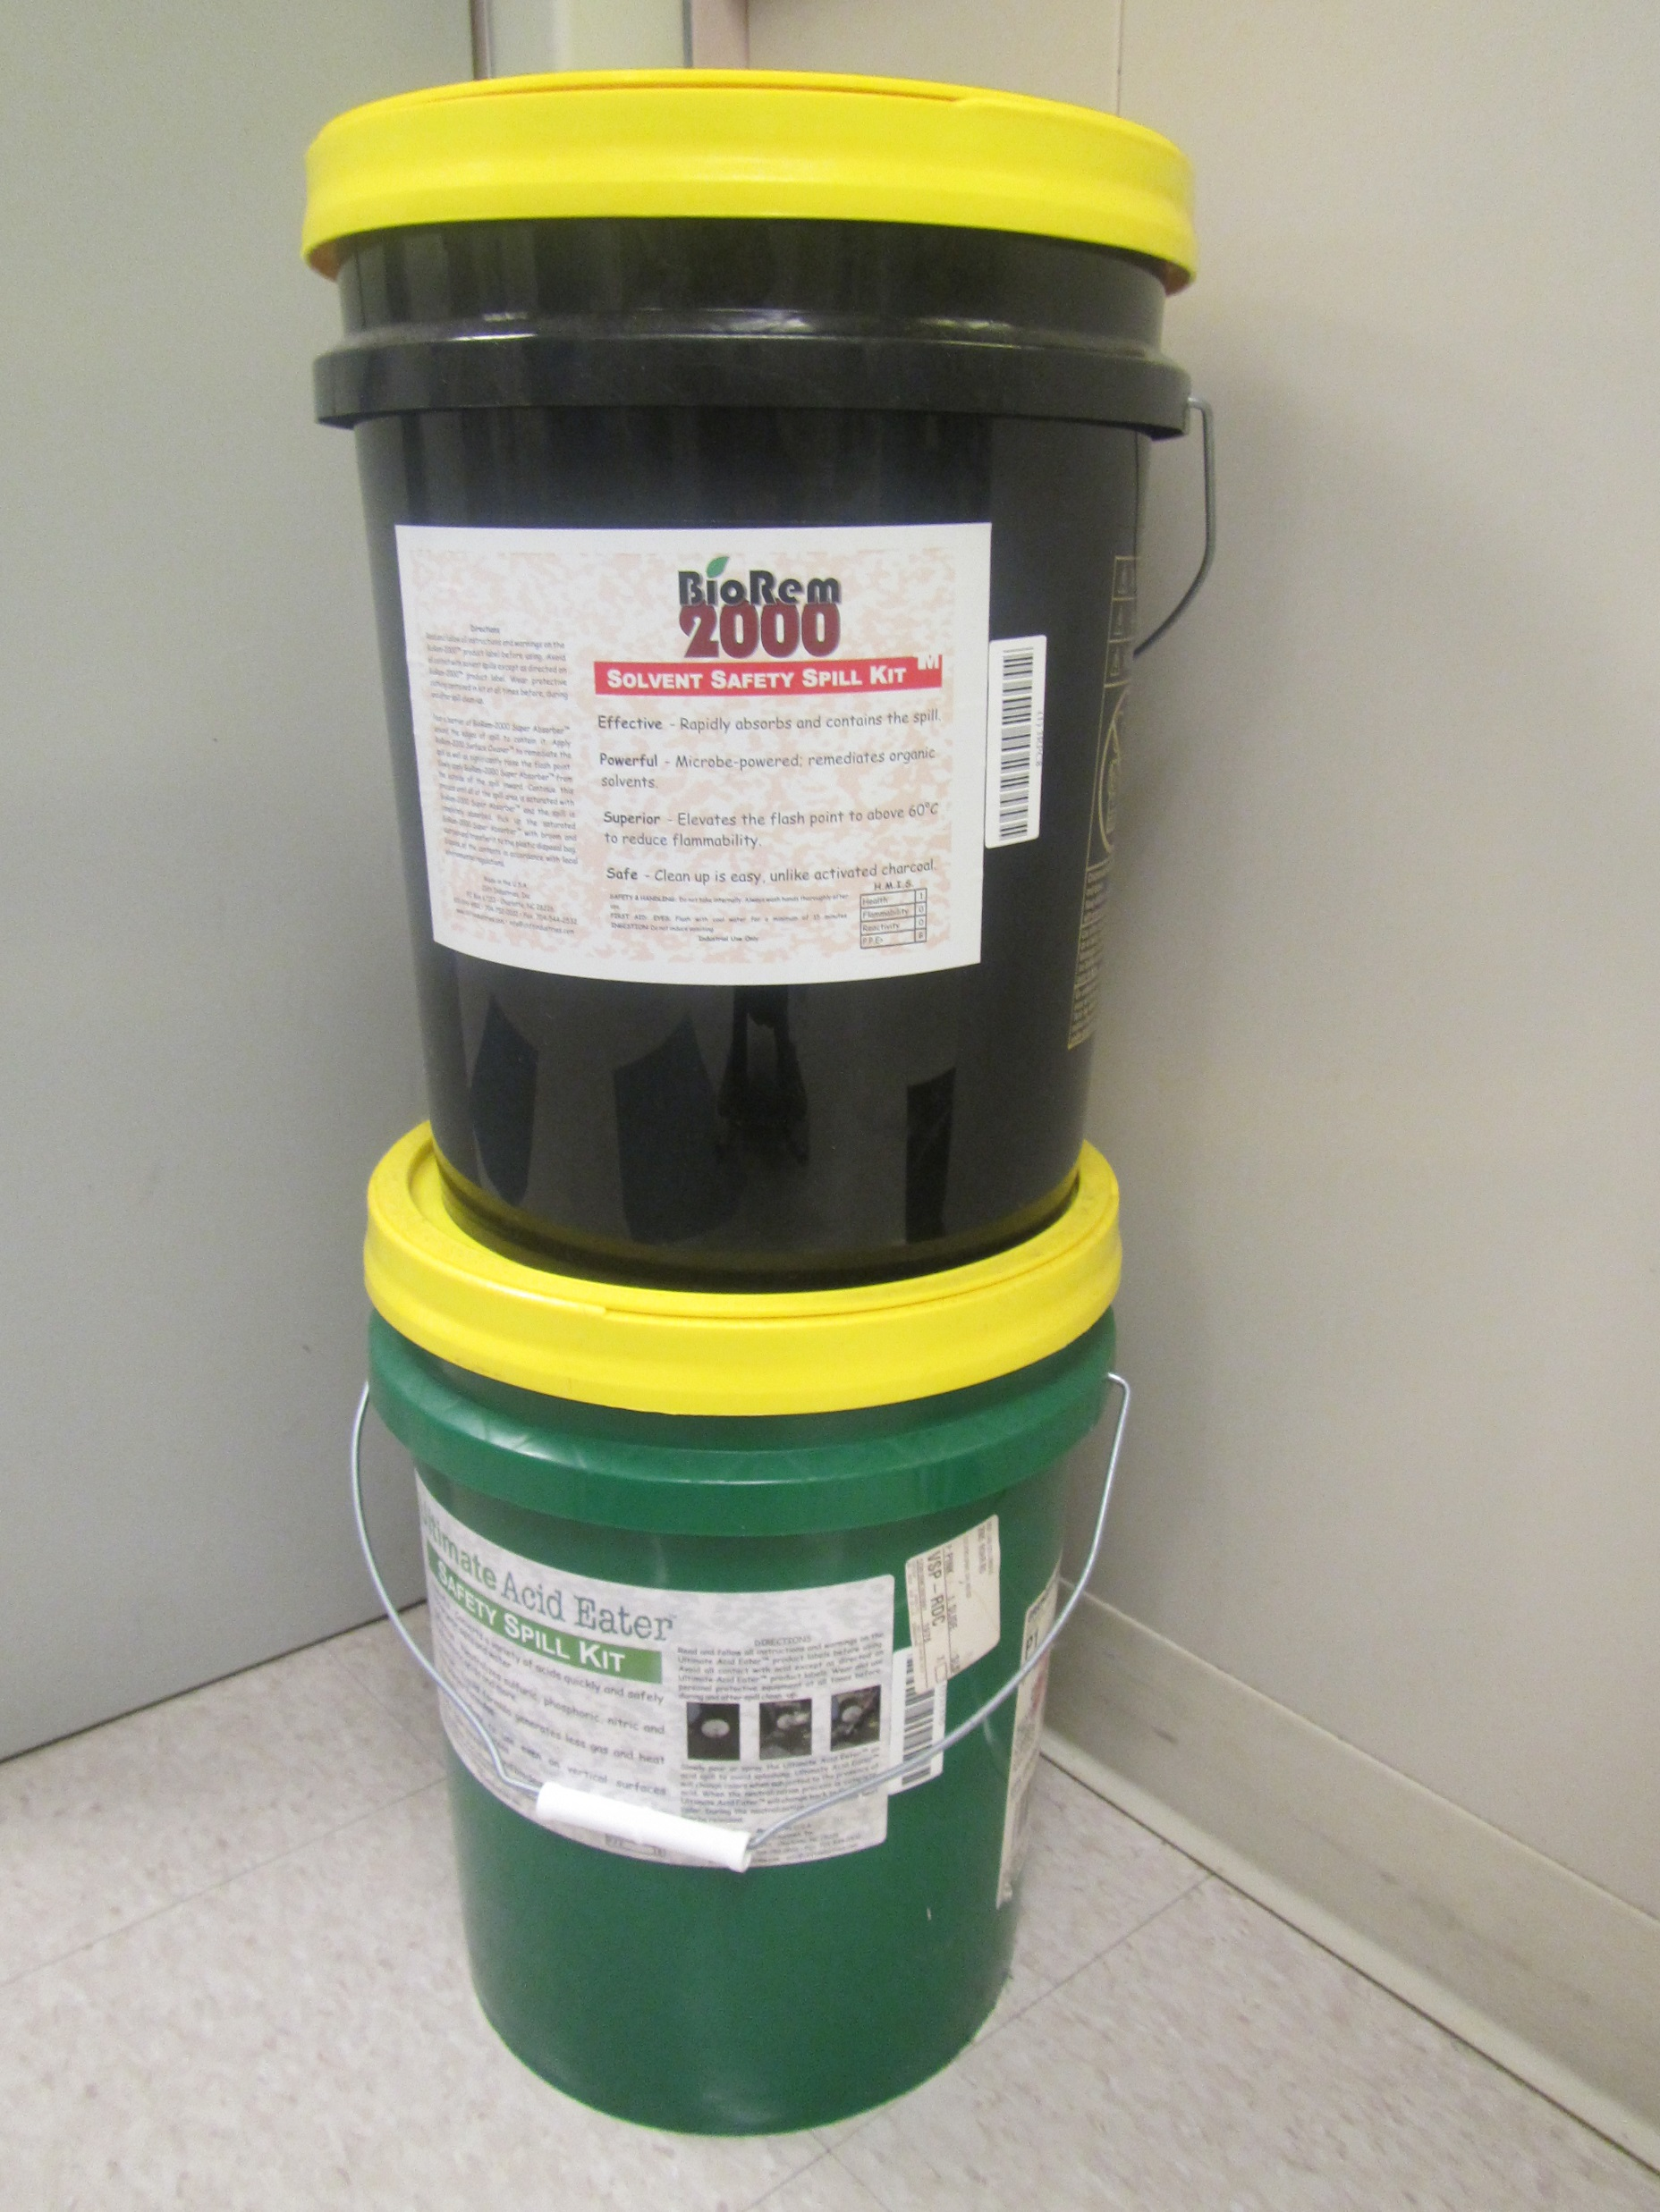
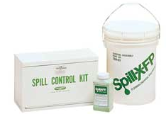
Chemical Spill Response Guidelines
CHP Appendix F

Slide 17
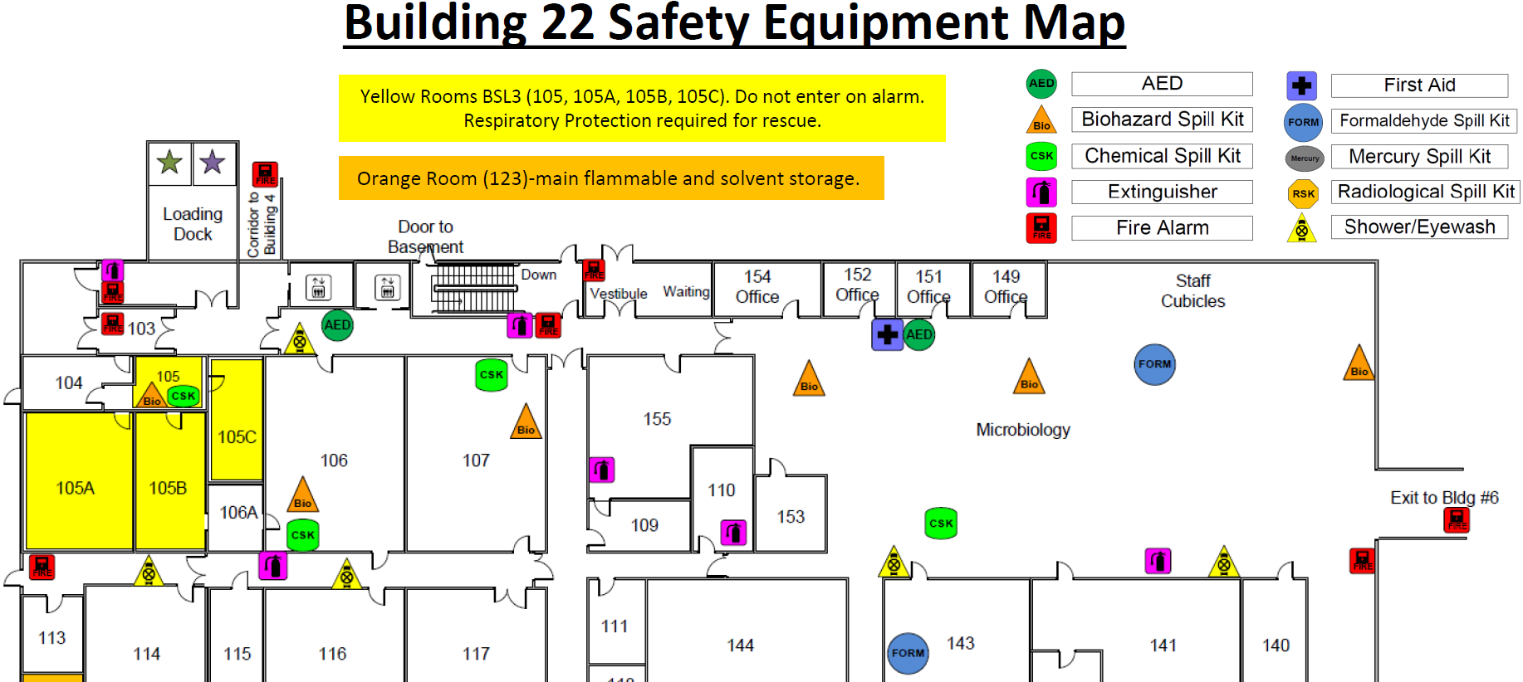
What kit is where?
CHP-Appendix F.1: Spill Kits and Safety Equipment Maps

Slide 18
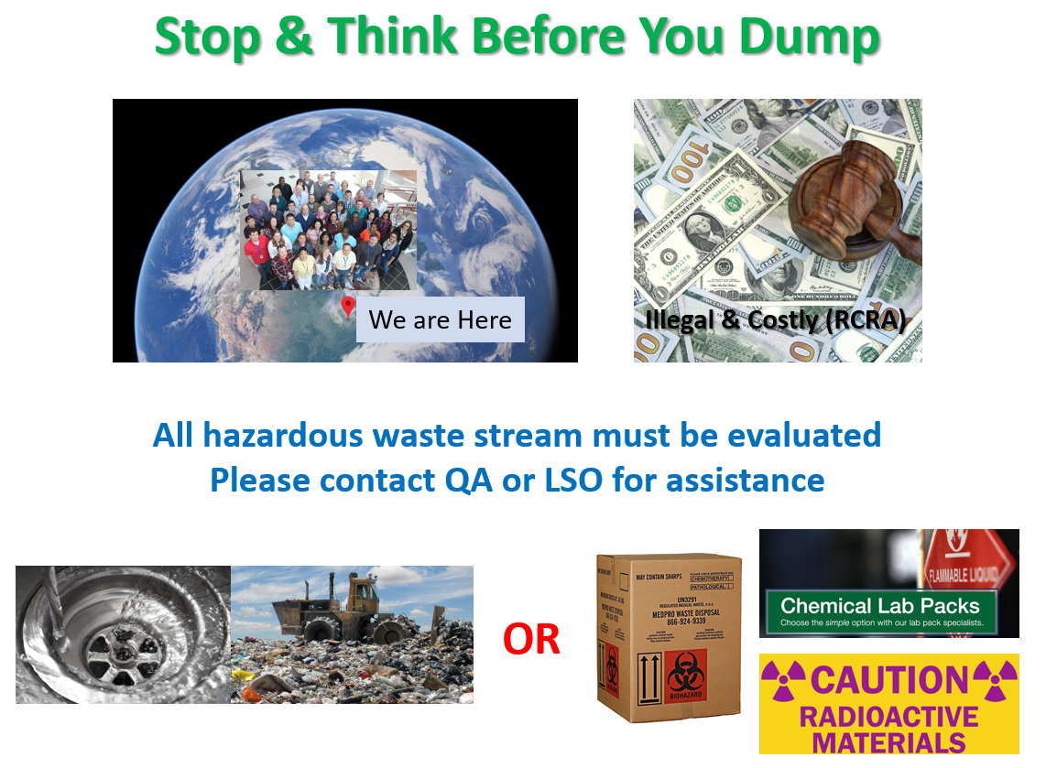
Hazardous Waste Management

Slide 19
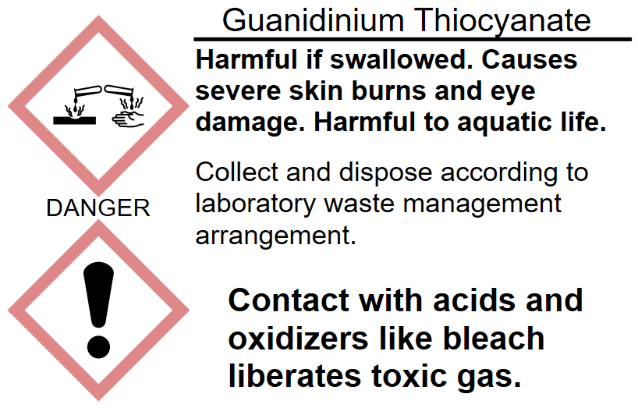
Incompatible Chemicals
Here at ODHL
Toxic gases which can include chloramines, chlorine & hydrogen cyanide
Dispose down the drain with plenty of water
NEVER put bleach right after

Slide 20
G:\LABORATORY PROCEDURES\Quality Assurance and Compliance\Chemical Inventory
Name of Chemical | Chemical Resistance Materials SDS = Recommend in SDS Blank = No Info Red = Poor/Not Recommend Orange = Fair Green = Good |  |  |  |  |  | Chemical Used in
 | Butyl | Neoprene | PVC | Nitrile | Latex | Other
Acetaldehyde |  |  |  |  |  |  | BADT
Acetone | SDS |  |  | 10 mins | 10 mins |  | VIR/BADT/Rad Chem
Acetonitrile |  |  |  |  |  |  | NBS
Chloroform |  |  |  |  |  |  | PARA
Ethyl Acetate |  |  |  | 8 mins |  |  | PARA/NBS
Formic Acid |  |  |  |  | SDS |  | NBS
Methanol |  |  |  | 32 mins |  |  | BADT/BT/NBS/PARA/TB
Nitric acid |  |  |  | 12 mins |  |  | Rad Chem
Phenol Liquid |  |  |  | 39 mins |  |  | BT
Sulfuric acid |  |  |  | 1.9 hrs |  |  | Rad Chem
Toluene | 6 mins |  |  | 11 mins |  | Viton >16 hrs | BADT
Xylene |  |  |  | 21 mins |  | Viton >8 hrs | BT

Slide 21

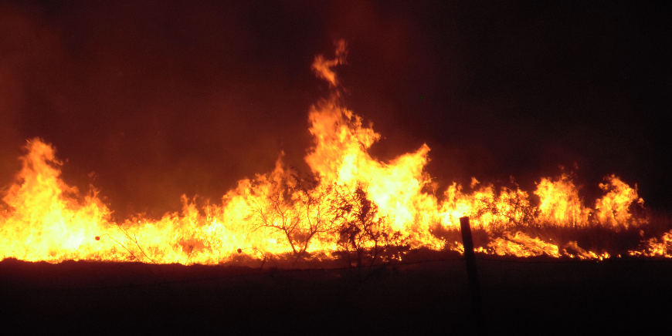
Incompatible Chemicals (Cont’d)
Acids with cyanide highly toxic hydrogen cyanide gas
Acids (Vinegar) with bleach highly toxic chlorine gas
Nitric acid or solid oxidizer (Nitrates)
with combustible materials (Paper/alcohols/solvents)
May result in
Hydrogen peroxide/sulfuric acid mixtures
May spontaneously detonate

Slide 22
Current CHP:
G:\LABORATORY PROCEDURES\Safety and Security\Laboratory Chemical Hygiene Plan
MediaLab # 51793.768

Slide 23


