Slide 1
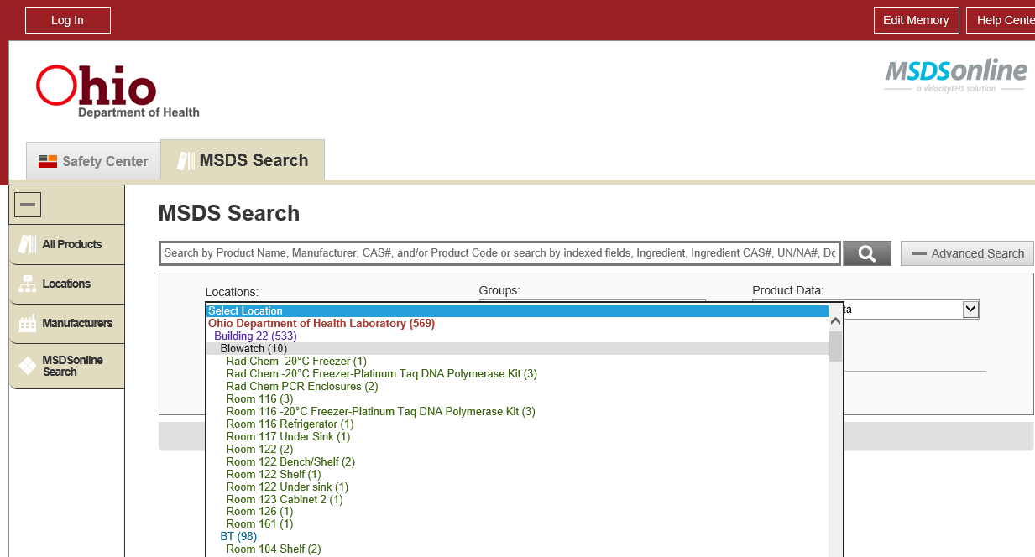
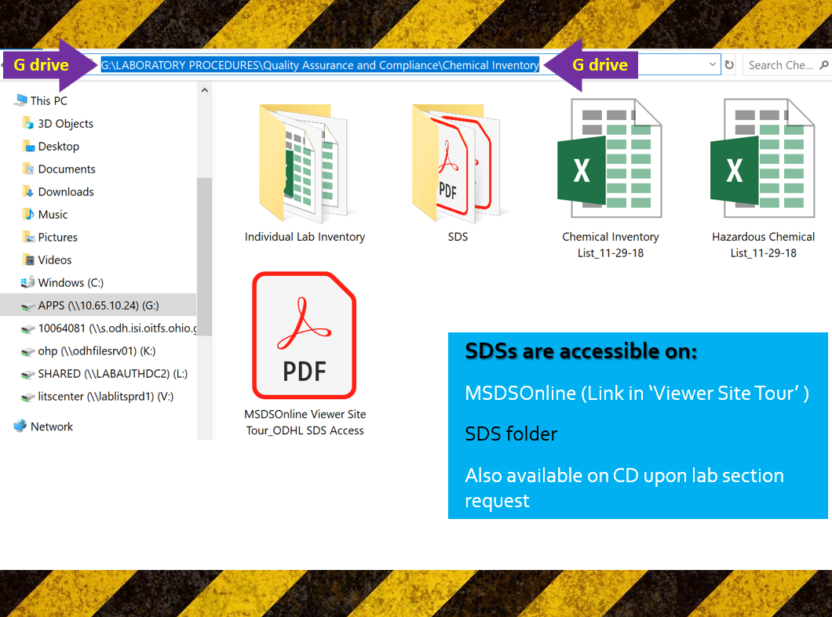
Chemical Inventory, Ordering and Labeling
By Lai Ming Woo

Slide 2

Why Chemical Inventory and Labeling?
OSHA Hazard communication standard (HCS) 29 CFR 1910.1200 states employee has the right-to-know…
-The standard (CHP Appendix B);
-Hazardous chemicals & products in the workplace; AND
-Methods of protecting themselves from exposure

Slide 3

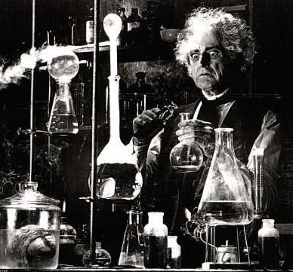
Why? (Cont’d)
Under OSHA, employer is responsible for providing a safe & healthful workplace
-but employees are responsible for their own safety &
the safety of the others
Proper PPE
Mad Scientist
VS

Slide 4
Why Chemical Inventory? (Cont’d)
Important to the safety of employees, first responders & visitors
- Obtain SDSs
- Anticipate hazard control
- Spill responses/ Cleanup requirements

Slide 5
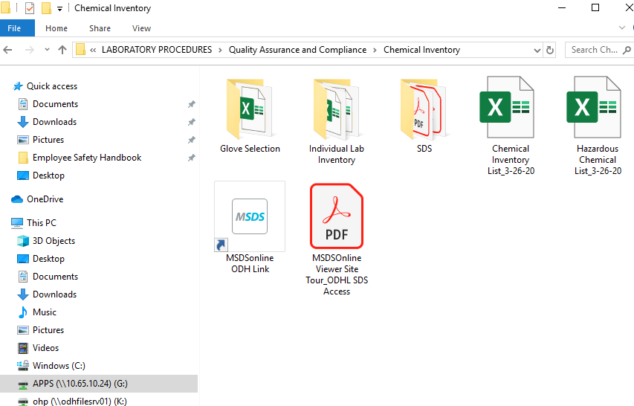
Current inventory & SDSs are accessible on:
G:/drive & MSDS Online link
Current CHP:
  G:\LABORATORY PROCEDURES\Safety and Security
  MediaLab # 51793.768

Slide 6
Ordering
Purchasing the smallest amount required for work
Disposal $$$/Hazards Not cheaper to purchase in bulk
Ensuring proper storage available
Ensure capability to cleanup if the amount ordered is spilled; e.g. amount of absorbent & PPE

Slide 7
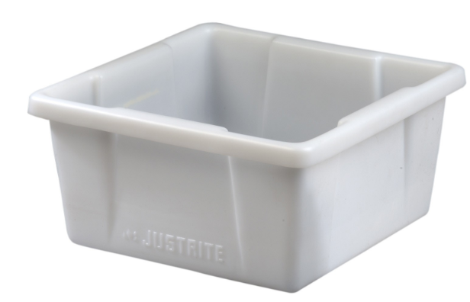
Secondary Containment
Can be used to segregate chemicals or store chemicals on the floor
Should be
-sturdy, chemical resistant
plastic AND
-able to hold the total
volume of chemical inside
Contact QA if you need one

Slide 8
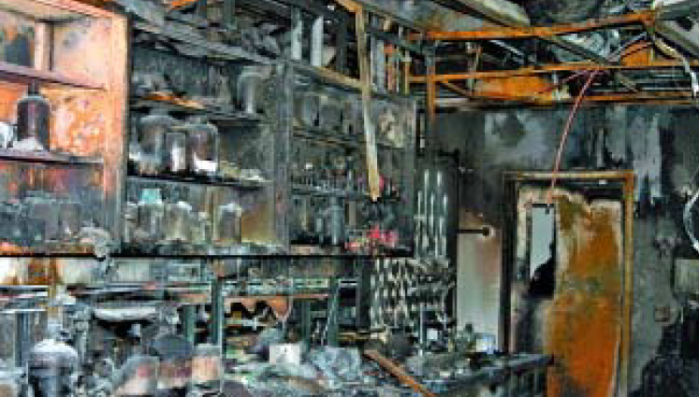
What happened at OSU?
Destroyed lab after April 8th, 2005 explosion & fire
Took firefighters >1 hour to extinguish
Student recalled, “I was loading solvent bottles to the top shelf of a flammable cabinet...I put the 12th bottle up, the shelf collapsed…large amounts of hexane spilled on the floor & my jeans were soaked…”

Slide 9
What happened at OSU? (Cont’d)
“This has happened before & it's not something where you get too alarmed…more concerned about breathing the vapors & a small cut on my arm…within 5 minutes, the explosion occurred.”
Luckily, all 11 students evacuated because of the fumes
Lesson Learned:
DO NOT overload the shelves (weight limit?)
Investigation- the cabinet was properly vented but located close to a freezer
Vapor + Spark

Slide 10
Lesson Learned (Cont’d):
Safety Culture Issues
- 95% grad students interviewed said they won’t report a
safety hazard due to fear of reprisals
-”happened before & it's not something where you get
too alarmed” Hexane shower should never be a norm!
Lack of training on chemical SDS, handling, spill responses…

Slide 11
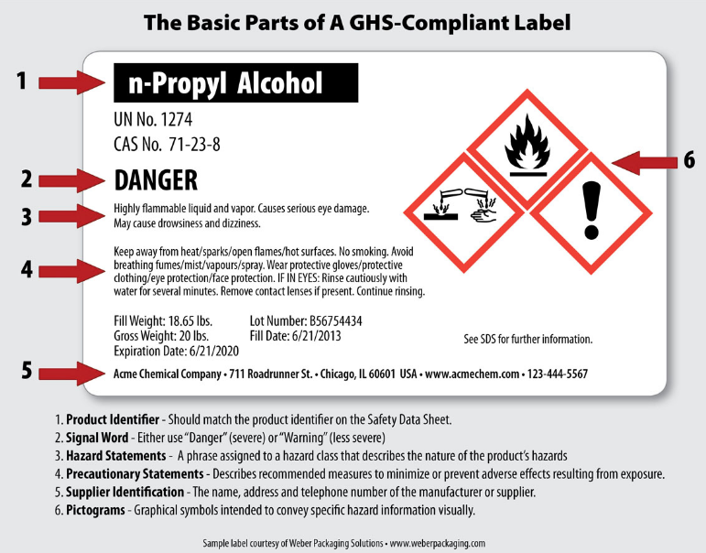
Hazard Communication GHS Elements
  1. Labels

Slide 12
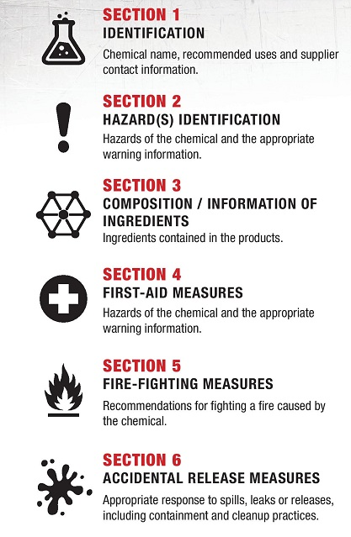
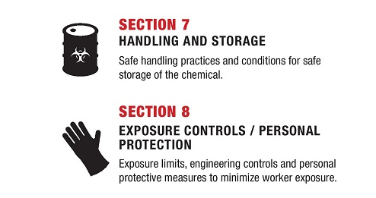
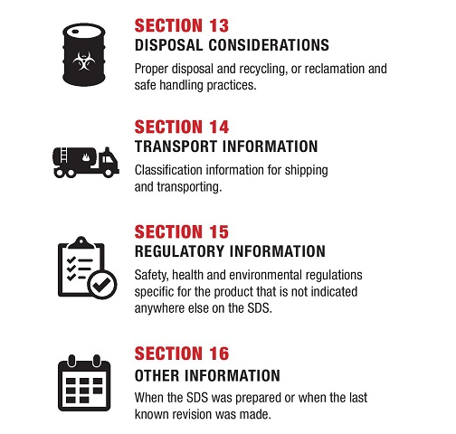
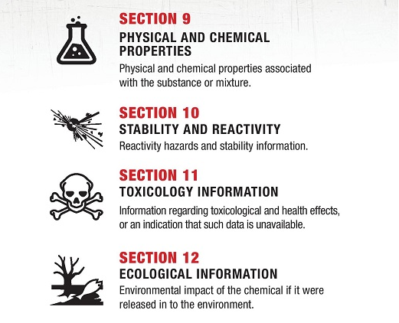
2. 16 sections Format Safety Data Sheets (SDSs) (Appendix M)
Non-mandatory Sections 12- 15 for OSHA are regulated by EPA or DOT

Slide 13
Chemical labeling
Supervisor will ensure primary & secondary chemical container labels meet GHS standards
Product arrives w/ improper/mutilated labels contact LSO
Received & opened dates are required on all; including containers inside a kit
Upon request, QA will provide labels

Slide 14
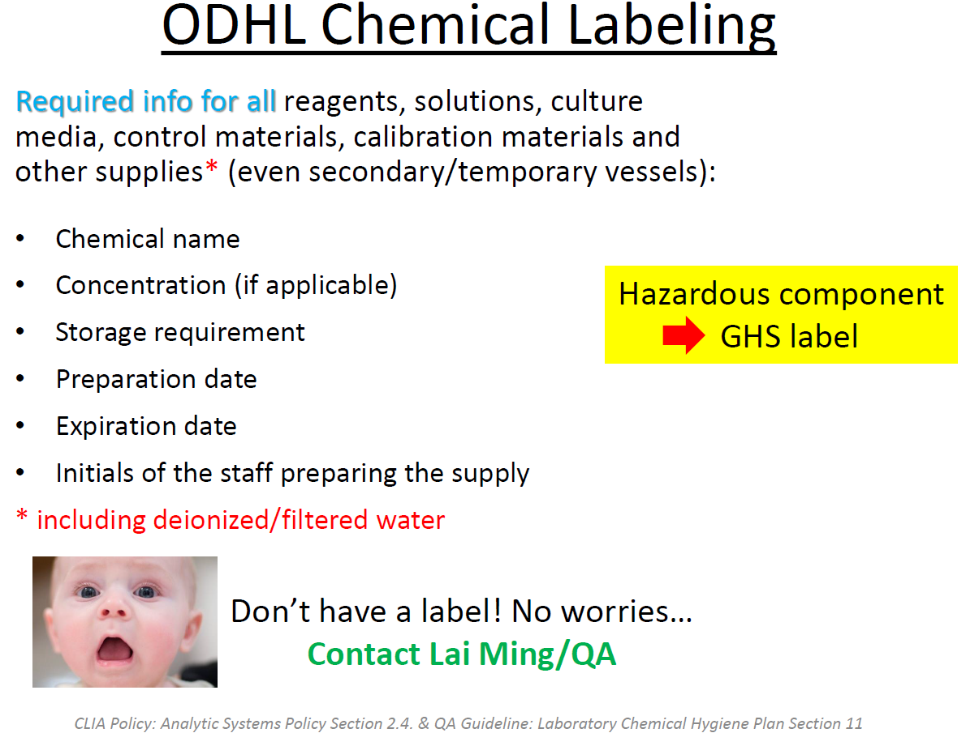

Slide 15
How to read your SDSs? (Appendix M)
Section 2 Signal word, hazard & precautionary
statements
Section 4 First aid measures & symptoms/effects
Section 7 Handling & storage conditions
Section 8 Exposure control limits, engineering controls
& PPE selection recommendations
Section 10 Stability, reactivity, conditions to avoid &
incompatible materials. Store away from incompatibles
Section 11 for toxicological effects
https://time.com/5722129/buffalo-wild-wings-employee-dies-fumes/

Slide 16
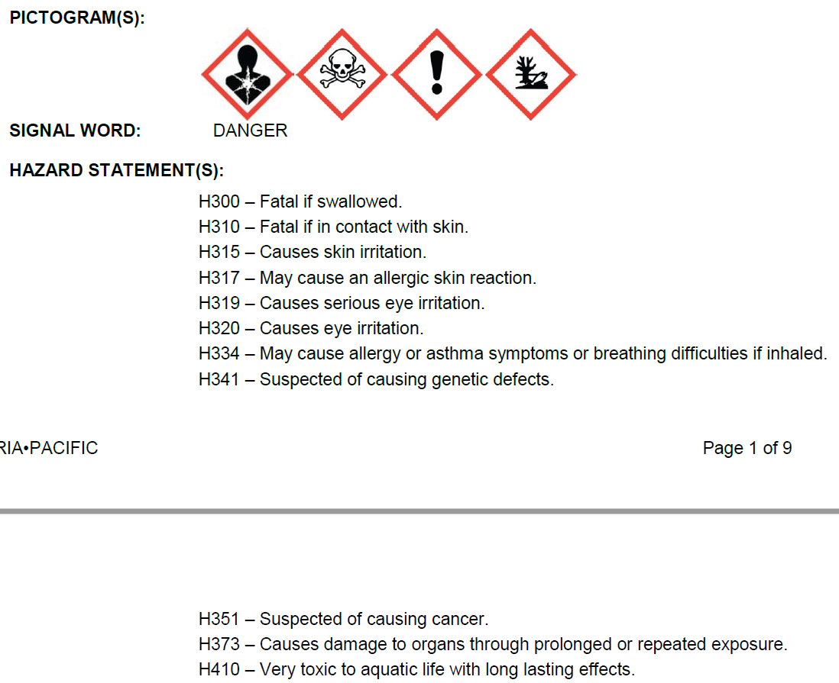
Spotcheck Neonatal GALT Microplate Reagent Kit
GALT MP Color Reagent SDS Section 2

Slide 17

What does mean?
Appendix E: ODHL Hazardous Chemical SOPs-Toxic or Highly Toxic
Exposure ≠ 100% Death
Lethal Dose, 50% (LD50)- amount given all at once causes death of 50% of a group of test animals
Lethal Concentration, 50% (LC50)- concentration of a chemical in air/water causes death of 50%
= Highly Toxic = Low LD50 and LC50

Slide 18
Hazardous Chemical List and SOPs
Hazardous Chemical List
G:\LABORATORY PROCEDURES\Quality Assurance and Compliance\Chemical Inventory-hazards info from SDSs
-Updates by QA
-When receive newer version/new SDS
SOPs for each hazard on the list & some highly hazardous chemicals (CHP Appendix E)
-SOPs & SDSs together provide instructions to work
with hazardous chemicals safely

Slide 19
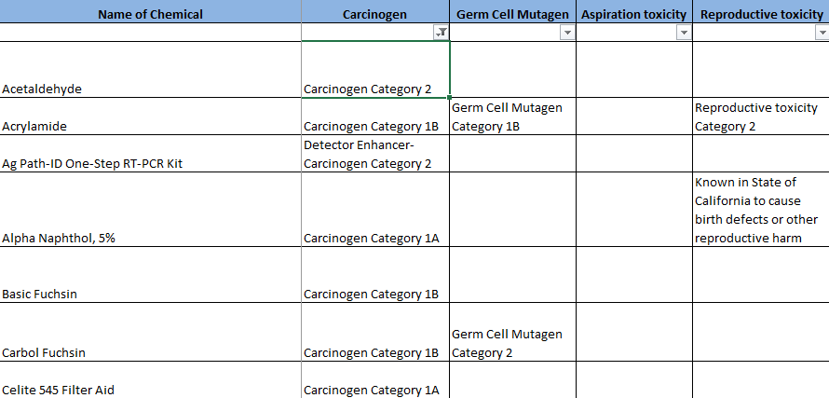
Hazardous Chemical List and SOPs (Cont’d)
Uncheck ‘(Blanks)’ from Filter of the hazard column to view the list of chemicals with that hazard

Slide 20

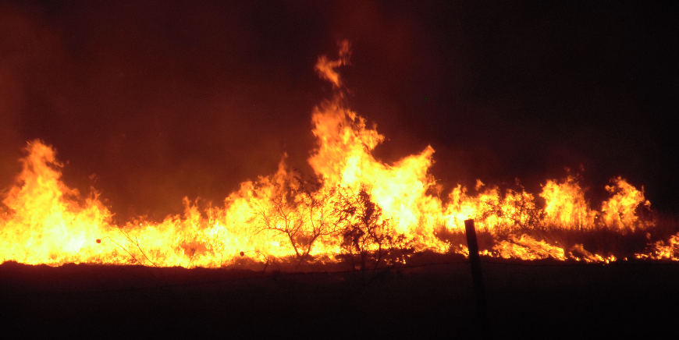
Incompatible Chemicals
Acids with cyanide highly toxic hydrogen cyanide gas
Acids (Vinegar) with bleach highly toxic chlorine gas
Nitric acid or solid oxidizer (Nitrates)
with combustible materials (Paper/alcohols/solvents)
May result in
Hydrogen peroxide/sulfuric acid mixtures
May spontaneously detonate

Slide 21
G:\LABORATORY PROCEDURES\Quality Assurance and Compliance\Chemical Inventory
Name of Chemical | Chemical Resistance Materials SDS = Recommend in SDS Blank = No Info Red = Poor/Not Recommend Orange = Fair Green = Good |  |  |  |  |  | Chemical Used in
 | Butyl | Neoprene | PVC | Nitrile | Latex | Other
Acetaldehyde |  |  |  |  |  |  | BADT
Acetone | SDS |  |  | 10 mins | 10 mins |  | VIR/BADT/Rad Chem
Acetonitrile |  |  |  |  |  |  | NBS
Chloroform |  |  |  |  |  |  | PARA
Ethyl Acetate |  |  |  | 8 mins |  |  | PARA/NBS
Formic Acid |  |  |  |  | SDS |  | NBS
Methanol |  |  |  | 32 mins |  |  | BADT/BT/NBS/PARA/TB
Nitric acid |  |  |  | 12 mins |  |  | Rad Chem
Phenol Liquid |  |  |  | 39 mins |  |  | BT
Sulfuric acid |  |  |  | 1.9 hrs |  |  | Rad Chem
Toluene | 6 mins |  |  | 11 mins |  | Viton >16 hrs | BADT
Xylene |  |  |  | 21 mins |  | Viton >8 hrs | BT

Slide 22


