Slide 1

Entering/Exiting the BSL III with
Maximum Personal Protective Equipment

Slide 2
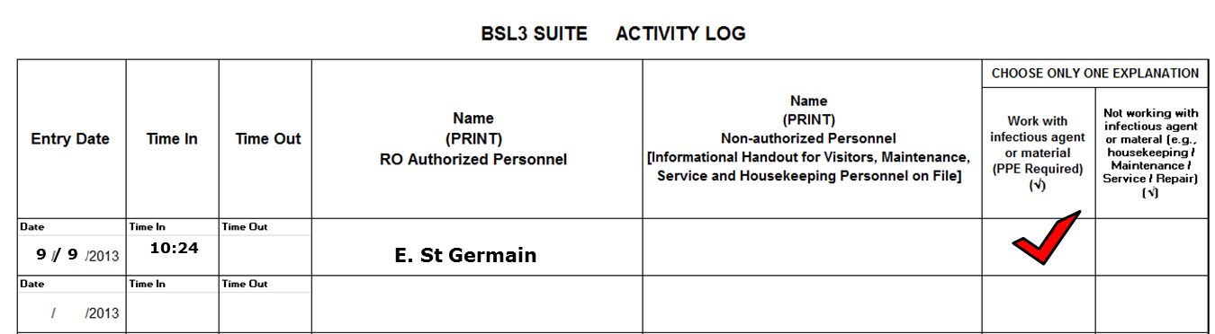
Entering the BSL III room 104
Scan your ID badge to enter room 103
Sign into the ‘BSL3 Suite Activity Log’ located outside of the door to room 104
  Record date, time in, name and check off the box for ‘work with infectious agent or material’

Slide 3
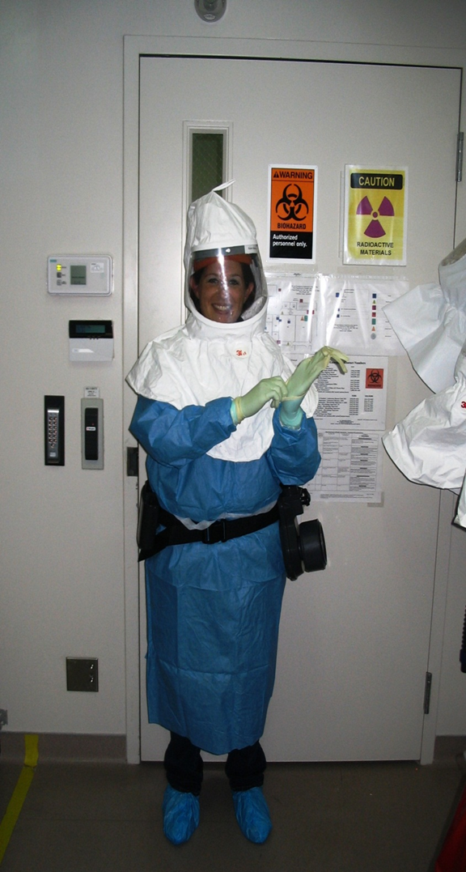
Entering the BSL III room 104
Scan your ID badge to enter room 104
PPE Required to enter the BSL III
  Shoe Covers
  Two pairs of gloves
  Gown
  PAPR belt
  PAPR hood

Slide 4
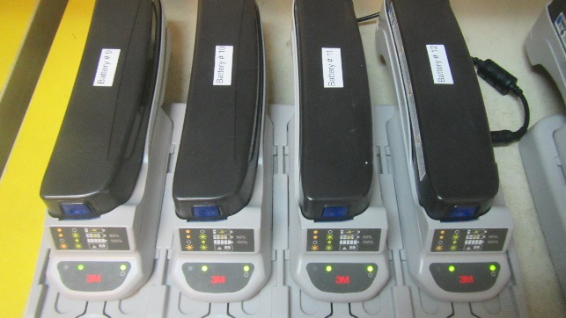
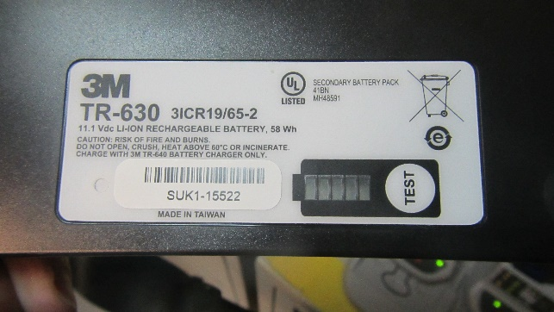
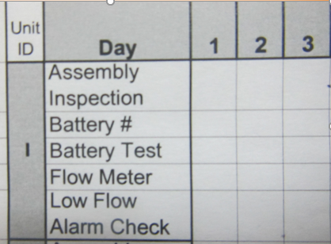

PAPR Check
Select a Battery and remove from the charger. Write the Battery # on the PAPR QC Chart.
On the underside of the battery, press and hold the ‘Test’ button until all the lights are green. Put a check mark on the PAPR QC Chart.
Install the battery by clicking in place and turn on unit.

Slide 5
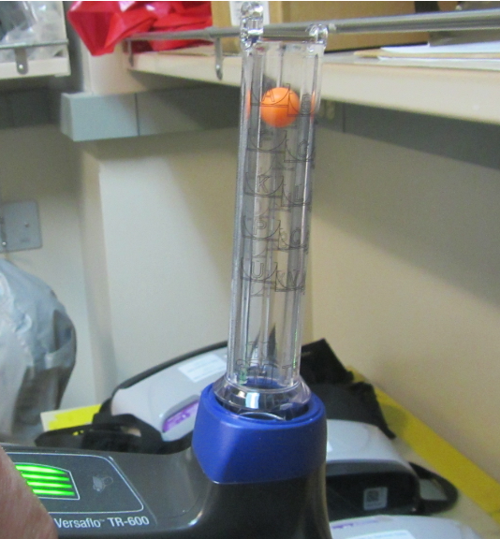
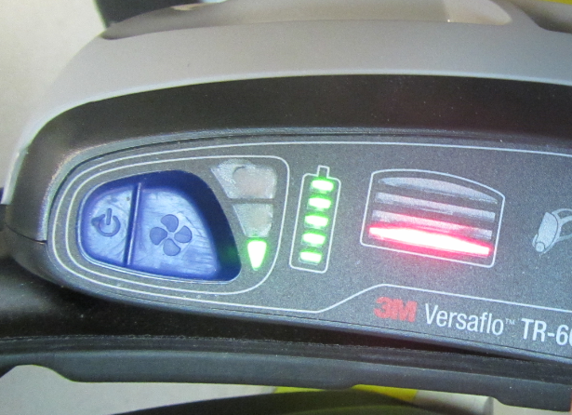
PAPR Check
Check the flow meter to verify the floating ball is at or above ‘zone F’ and put a check mark on the PAPR QC Chart.
Check the ‘Low Flow Alarm’ by covering the air hole with your hand until the alarm sounds and the button turns red. Place a check mark on the PAPR QC Chart.

Slide 6
Donning your PPE
  Put on shoe covers.
  Put on gown.
  Put on 1st pair of gloves and tape them to the cuffs of the gown.
  Put on PAPR belt or backpack.

Slide 7
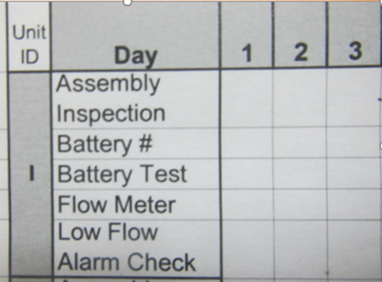


Donning your PPE
  Plug the hood hose into the PAPR belt and do a hood check. Place the hood on your head, verify that you can feel the air in the hood. Complete the PAPR QC log.
  Put on a second pair of gloves.
  You are now ready to enter the BSL III.

Slide 8
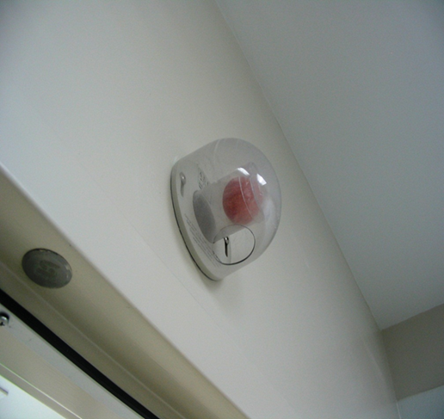

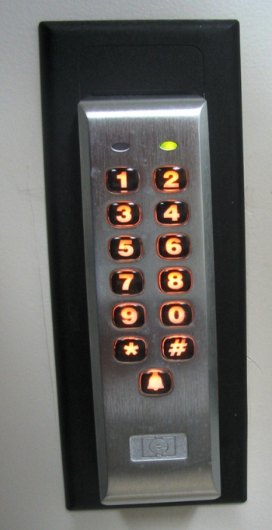
Entering the BSL III room 105
Check the ping pong ball air sensor over the door to room 105. If you do not see the ball, you may enter the room. If you see the ball, do not enter and contact your supervisor.
Enter your 5 digit code and press * to enter.

Slide 9
Exiting the BSL III
Wipe down your hood and shroud with a bleach wipe and remove your most outer layer pair of gloves in the laboratory.
Leave the BSL III and step into the yellow tape zone in room 104.
Remove your hood and hang on a hook.
Remove the PAPR belt and place on the outside of the yellow tape.
Remove the tape from your 1st pair of gloves and remove your gown. Place in biohazard box.

Slide 10
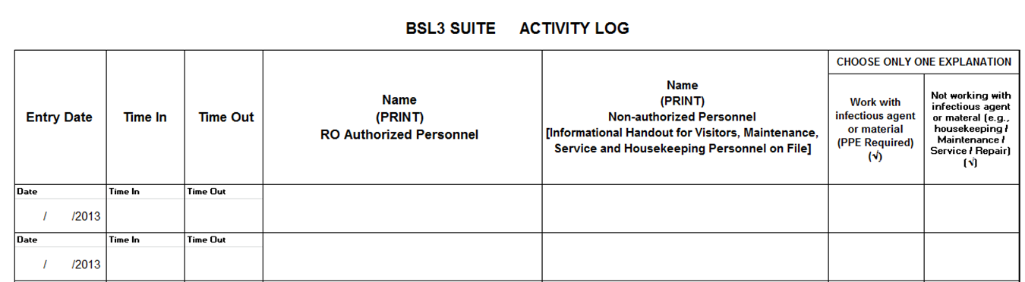





Exiting the BSL III
Remove one shoe cover and step outside of the yellow zone. Repeat for the second shoe cover. Place in the biohazard box.
Remove gloves and place in the biohazard box.
Remove the battery and place on the charging station, place belt/backpack back on shelf and wash your hands.
Leave room 104 and sign out of the Activity Log in room 103 by entering the time out.

Slide 11
BSL III Entry/Exit with maximum PPE
Please take the quiz online: Passing grade is 80%
Questions?
Please send an email to:
Eric St Germain, BT Coordinator Larry King, PI Beth Kolp, RO, LSO
Tammy Bannerman, ARO

