Slide 1
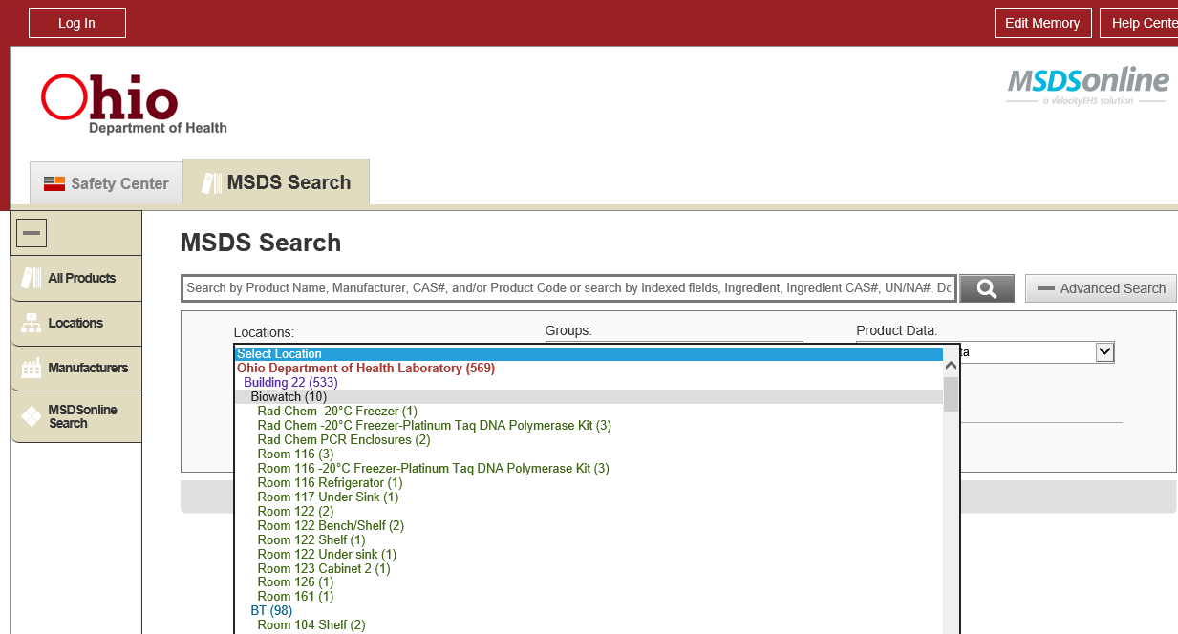
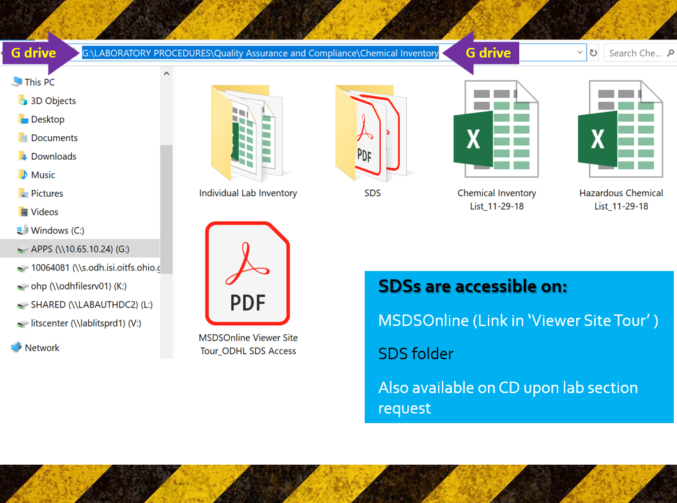
Chemical Inventory & Ordering
By Lai Ming Woo

Slide 2

Why Chemical Inventory?
OSHA Hazard communication standard (HCS) 29 CFR 1910.1200 states employee has the right-to-know…
-The standard (CHP Appendix B);
-Hazardous chemicals & products in the workplace; AND
-Methods of protecting themselves from exposure

Slide 3

Why Chemical Inventory? (Cont’d)
Under OSHA, employer is responsible for providing a safe & healthful workplace
-but employees are responsible for their own safety &
the safety of the others

Slide 4
Why Chemical Inventory? (Cont’d)
Important to the safety of employees, first responders & visitors
Bonus Question 1:
What do you think the inventory is use for?
- Obtain SDSs
- Anticipate hazard control
- Spill responses/ Cleanup requirements

Slide 5
Ordering
Purchasing the smallest amount required for work
Disposal $$$/Hazards Not cheaper to purchase in bulk
Ensuring proper storage available
Ensure capability to cleanup if the amount ordered is spilled; e.g. amount of absorbent & PPE
No mercury thermometer/hydrometer/mercury containing equipment
-Contact QA/LSO if need a thermometer/hydrometer

Slide 6
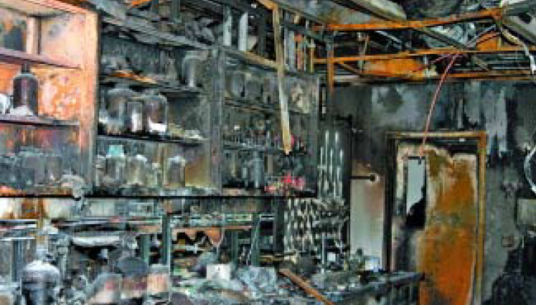
What happened at OSU?
Destroyed lab after April 8th, 2005 explosion & fire
Took firefighters >1 hour to extinguish
Student recalled, “I was loading solvent bottles to the top shelf of a flammable cabinet...I put the 12th bottle up, the shelf collapsed…large amounts of hexane spilled on the floor & my jeans were soaked…”

Slide 7
What happened at OSU? (Cont’d)
“This has happened before & it's not something where you get too alarmed…more concerned about breathing the vapors & a small cut on my arm…within 5 minutes, the explosion occurred.”
Luckily, all 11 students evacuated because of the fumes
Lesson Learned:
DO NOT overload the shelves (weight limit?)
Investigation- the cabinet was properly vented but located close to a freezer
Vapor + Spark

Slide 8
Lesson Learned (Cont’d):
Safety Culture Issues
- 95% grad students interviewed said they won’t report a
safety hazard due to fear of reprisals
-”happened before & it's not something where you get
too alarmed” Hexane shower should never be a norm!
Lack of training on chemical SDS, handling, spill responses…
Check out the Hexane SDS on next page

Slide 9
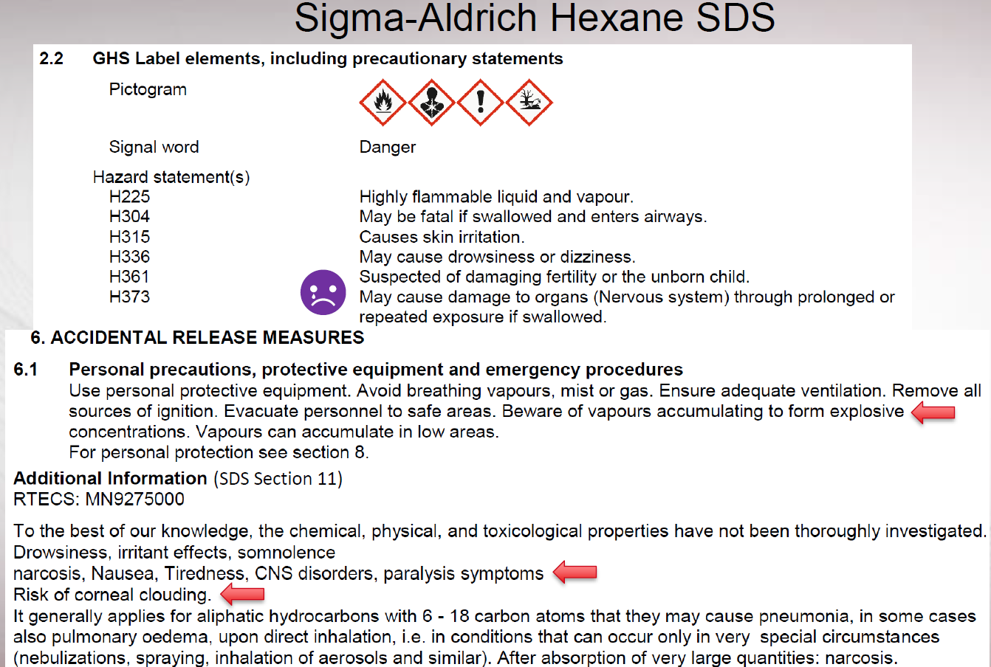

Slide 10
Chemical Inventory
Chemical Inventory & Hazardous Chemical Lists
-Every June for lab section check
-Annual QA Audit
-QA send updated list to section staff/LS3/Supervisor
Bonus Question 2: Where can you find the current inventory & SDSs?

Slide 11
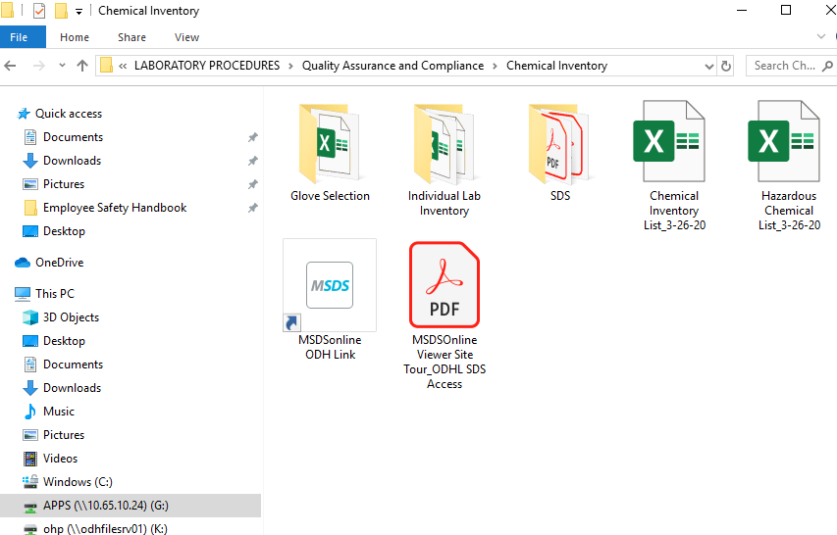
Bonus #2 Answer: G:/drive
& MSDSOnline

Slide 12
Chemical Inventory Change Form (Appendix C)
Before ordering a new chemical/significant higher conc.
-LS3/Supervisor MUST complete the form
-Prior LSO approval is required
LS3/Supervisor fill out to add/remove/change information
Inventory will be updated by Lai Ming
Used to get SDS, anticipate hazard control, spill response

Slide 13
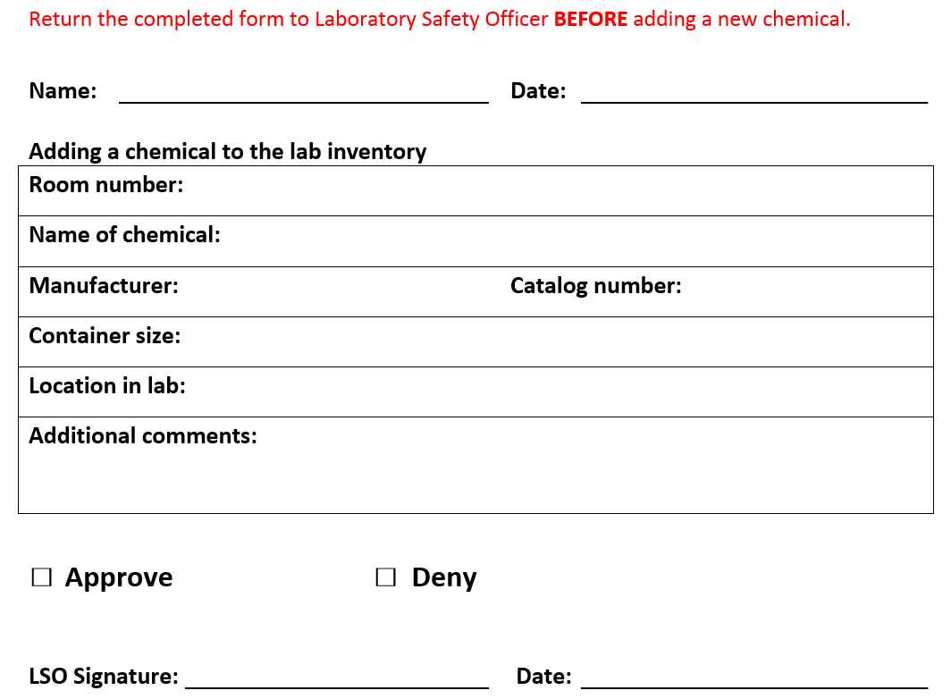
Chemical Inventory Change Form (Cont’d)
LSO will
-Return a copy of Appendix C to the submitter
-Notify QA of the change
If there is any change upon receipt of the chemical,
send the updated info to LSO

Slide 14
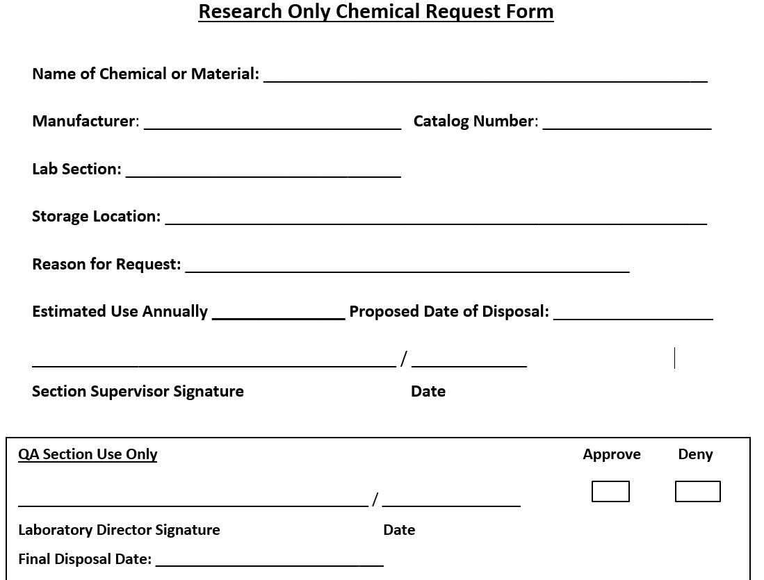
Research Only Chemical Form (Appendix K)
Required for ALL chemicals used for research/training
Need 1 every time even for the same chemical/kit requested
The approved QA labeled chemical will be disposed after ‘Proposed Date of Disposal’

Slide 15
Research Only Chemical Form (Cont’d)
Submitted to the Laboratory Director for approval
QA maintain a file for all completed forms
‘Approved Research Only Chemical’ label w/
-Chemical name
-Use by date
-QA staff initials/date
QA follow up on the final disposal

Slide 16
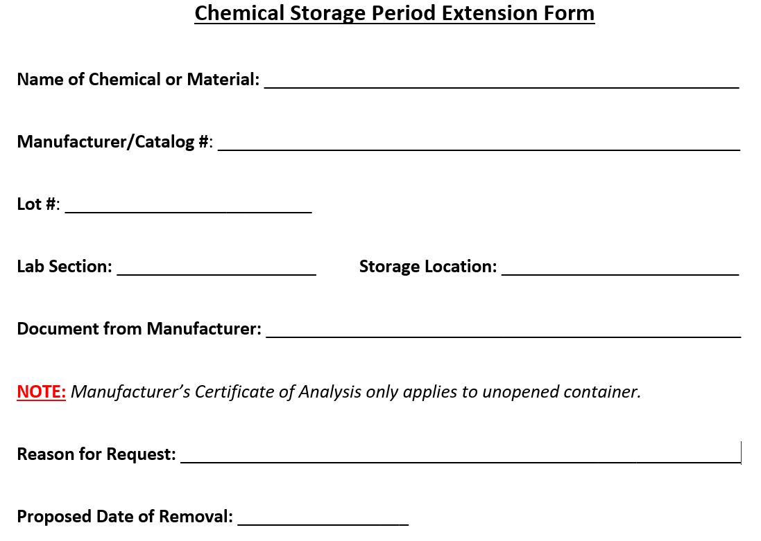
Chemical Storage Period Extension Form (Appendix J)
For chemicals/commercial reagents opened for 1 year

Slide 17
Chemical Storage Period Extension Form (Cont’d)
Lab section provides documentation that the opened chemical has not deteriorated
Submitted to the Laboratory Director for approval
QA maintain a file for all completed forms
QA follow up on the final disposal

Slide 18
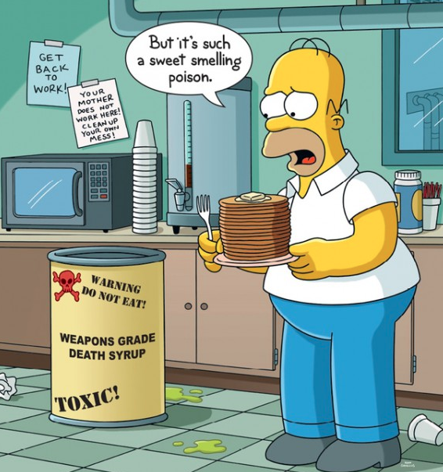

Labeling/SDSs/SOPs
CHP Appendix E, L & M
By Lai Ming Woo

Slide 19



Why?
OSHA Hazard Communication Standard 29 CFR 1910.1200-HCS violations = the most frequent citations
You have the right to know…and understand
SERIOUSLY

Slide 20
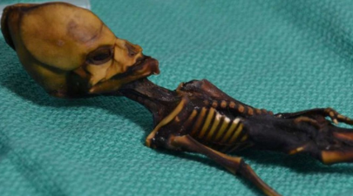

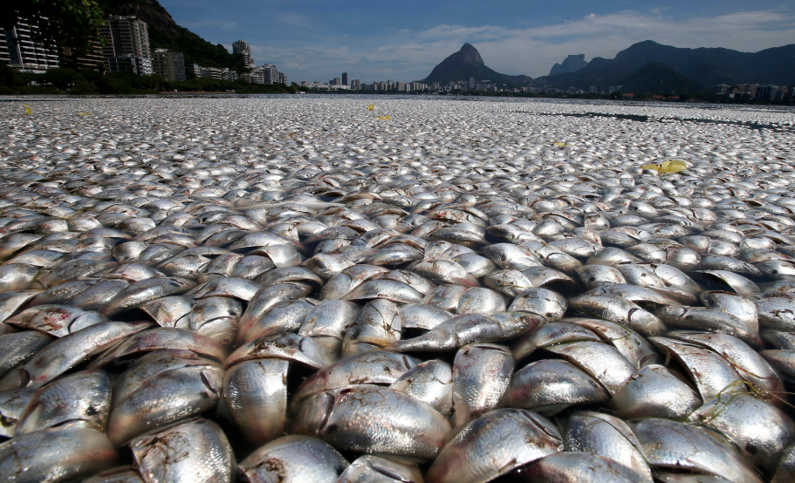

Need More?
Genetic mutation???
corrosive
Fatal
Ruin environment

Slide 21
Chemical labeling
Supervisor will ensure primary & secondary chemical container labels meet GHS standards
Product arrives w/ improper/mutilated labels contact LSO
Received & opened dates are required on all; including containers inside a kit
Upon request, QA will provide labels

Slide 22
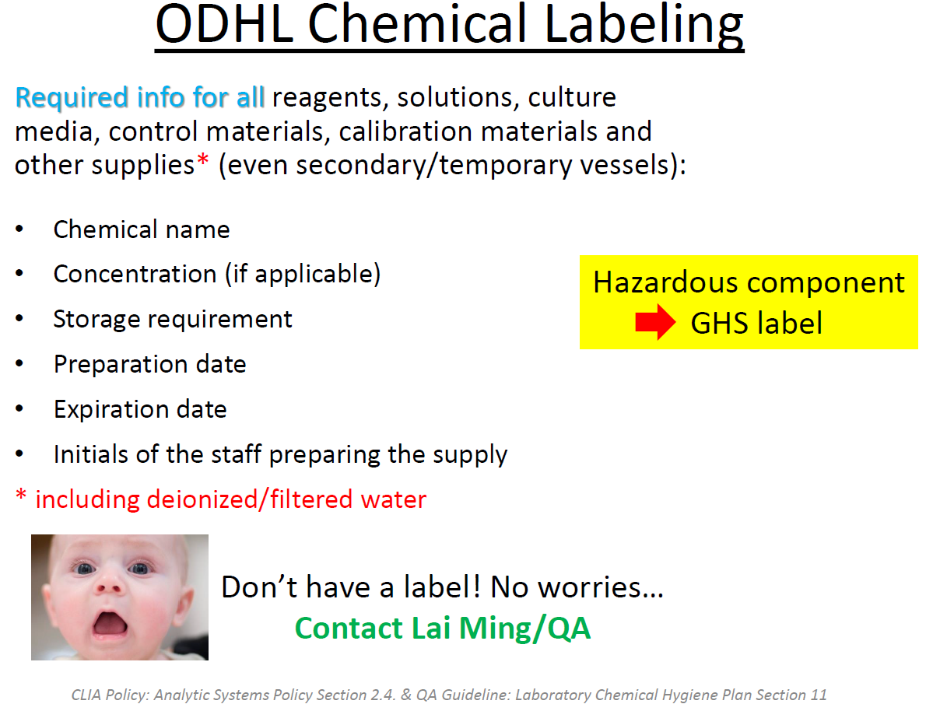

Slide 23
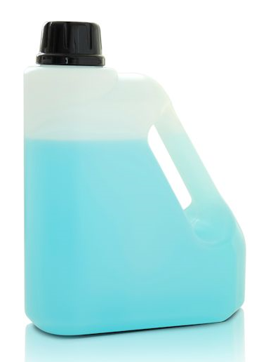
Chemical labeling (Cont’d)
Replace torn, damaged or misplaced label immediately
If there is no label on a container, do not handle
- Contact section LS3 then label it
- If unable to id, contact QA/LSO
for assistance

Slide 24
Safety Data Sheets
Access to SDSs
-MSDSOnline
-G:\LABORATORY PROCEDURES\
Quality Assurance and Compliance\Chemical Inventory
-SDS Binders of hazardous chemicals are in rooms w/
no computer
-Lab section may request SDSs on a CD
SDSs for the chemicals used in a procedure
Provided by trainer prior to training

Slide 25
How to read your SDSs? (Appendix M)
Section 2 Signal word, hazard & precautionary
statements
Section 4 First aid measures & symptoms/effects
Section 7 Handling & storage conditions
Section 8 Exposure control limits, engineering controls
& PPE selection recommendations
Section 10 Stability, reactivity, conditions to avoid &
incompatible materials. Store away from incompatibles
Section 11 for toxicological effects
https://time.com/5722129/buffalo-wild-wings-employee-dies-fumes/

Slide 26
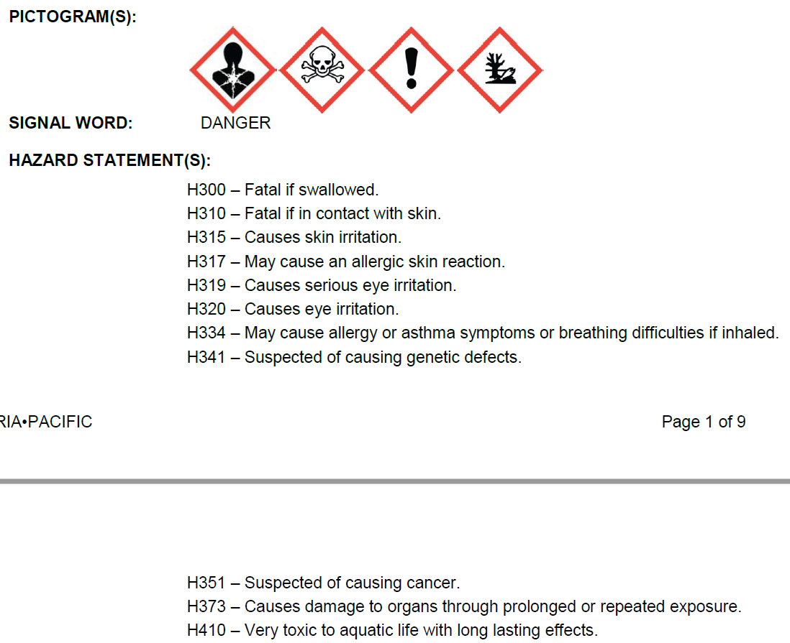
Spotcheck Neonatal GALT Microplate Reagent Kit
GALT MP Color Reagent SDS Section 2
Bonus Question:
What do you think we can do to protect ourselves from this?
Use fume hood

Slide 27

What does mean?
Appendix E: ODHL Hazardous Chemical SOPs-Toxic or Highly Toxic
Exposure ≠ 100% Death
Lethal Dose, 50% (LD50)- amount given all at once causes death of 50% of a group of test animals
Lethal Concentration, 50% (LC50)- concentration of a chemical in air/water causes death of 50%
= Highly Toxic = Low LD50 and LC50

Slide 28
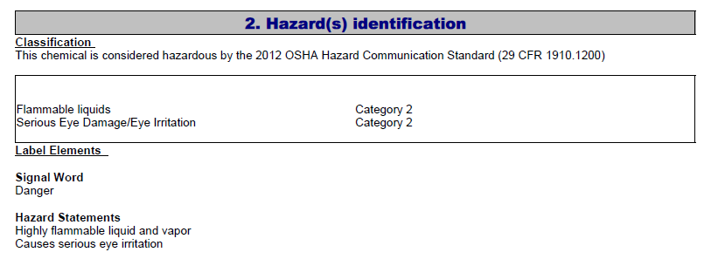
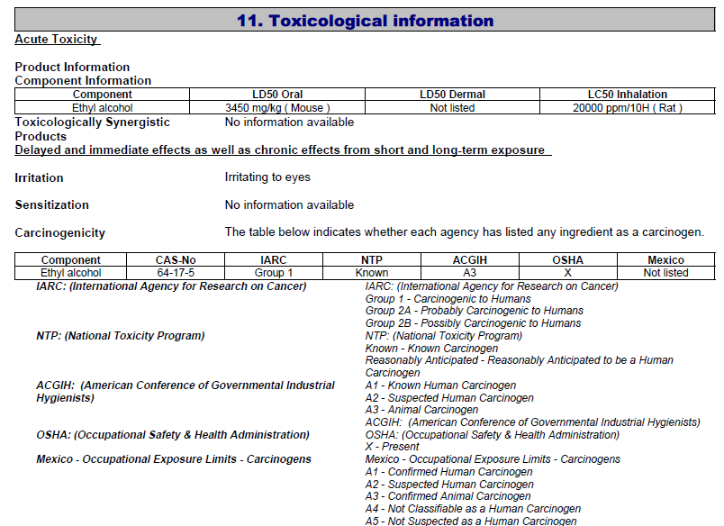
Ethyl Alcohol 200 Proof (Acros 61509-0010)
Not in Section 2/product label
But
In Section 11

Slide 29
Hazardous Chemical List and SOPs
Hazardous Chemical List
G:\LABORATORY PROCEDURES\Quality Assurance and Compliance\Chemical Inventory-hazards info from SDSs
-Updates by QA
-When receive newer version/new SDS
SOPs for each hazard on the list & some highly hazardous chemicals (CHP Appendix E)
-SOPs & SDSs together provide instructions to work
with hazardous chemicals safely

Slide 30
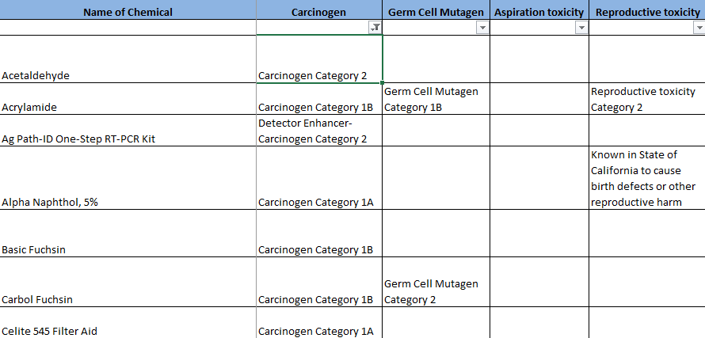
Hazardous Chemical List and SOPs (Cont’d)
Uncheck ‘(Blanks)’ from Filter of the hazard column to view the list of chemicals with that hazard

Slide 31
Hazardous Chemical SOPs (Appendix E)
Aspiration Toxicity Irritant and Sensitizer
Carbon Dioxide (Dry Ice) Liquid Nitrogen
Carcinogens Nitric Acid
Chloroform Oxidizers
Compressed Gases Peroxide Forming Chemicals
Corrosives Phenol
Cyanide Reproductive Toxins
Flammables Sodium Azide
Formaldehyde Sulfuric Acid
Germ Cell Mutagen Target Organ Toxicity
Glacial Acetic Acid Toluene
Hydrogen Gas Toxic or Highly Toxic
Hydrogen Peroxide 30%

Slide 32
Information Includes:
Signal Word & Pictogram
How to look up the chemicals w/ the hazard-Hazardous Chemical Inventory
Description of the hazard
Symptoms
Handling/Storage/Engineering controls/PPE/Disposal

Slide 33
Information Includes: (Cont’d)
Routes of exposure/OSHA Permissible Exposure Limits (PELs)
Toxicological Effects = Immediate & Long term
Exposure Response/First Aid Measures-Not all the same
-Aspiration Toxicity risk of damage to lungs
-Dry Ice Frostbite/cryogenic burns
IF ON SKIN-if frostbite has occurred, do NOT rub the
affected areas or flush with water…

Slide 34
Exposure Response/First Aid Measures (Cont’d)
-Liquid Nitrogen/Compressed Gases Frostbite
IF ON SKIN-take off contaminated clothing. Immediate
warm frostbite area with water for 15 minutes
-Chloroform/Hydrogen Peroxide 30%/Nitric & Sulfuric Acid
Symptoms may be delayed. Medical observation after exposure
-Phenol/Toluene
Symptoms may be delayed. Medical observation is indicated
Depend on degree of exposure, suggest periodic examination

Slide 35
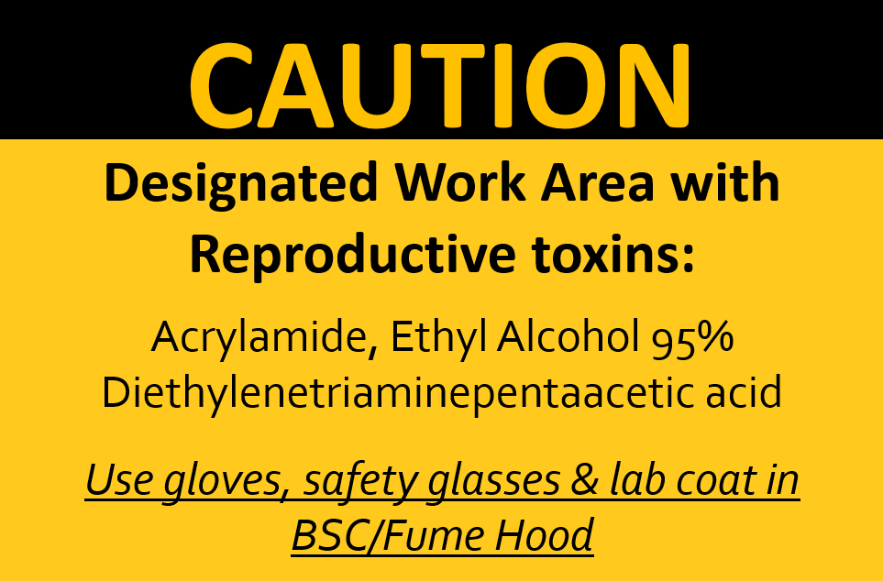
Designated Work Area (Appendix I)
OSHA regulated carcinogens, reproductive toxins or chemicals with high level of acute toxicity OSHA Standard 29 CFR 1910.1450(e)(3) (viii)
- Formaldehyde, reproductive toxin or any with ‘Fatal’
Based on chemical’s SDS
Different manufacturers, different hazard statements

Slide 36
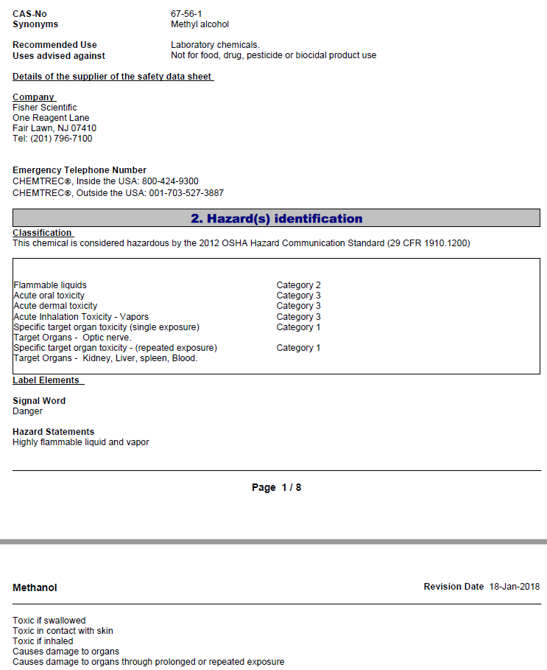
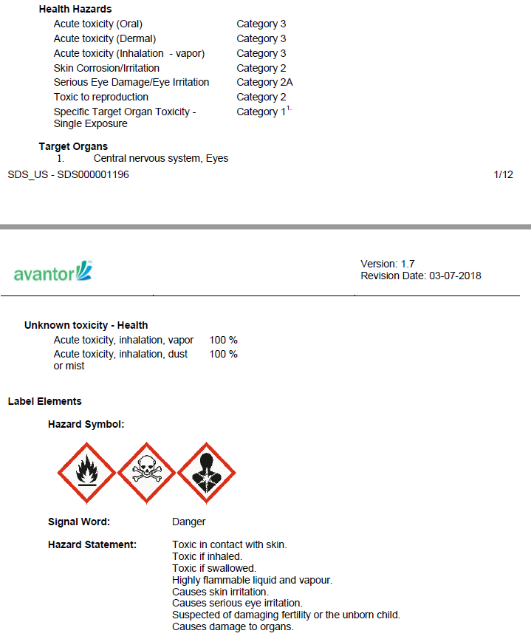

Slide 37
Designated Work Area (Cont’d)
For safe handling, refer to
CHP Section 8.6.
Appendix E- ODHL Hazardous Chemical SOPs-
Reproductive Toxins
Appendix E- ODHL Hazardous Chemical SOPs-
Toxic or Highly Toxic

Slide 38



