Slide 1
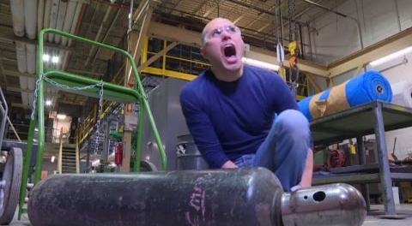

Hazardous Chemical SOP-Compressed Gases
My toes…
By Lai Ming Woo

Slide 2
Why? OSHA 1910.101 - Compressed gases
Each employer shall determine that compressed gas cylinders under his control are in a safe condition to the extent that this can be determined by visual inspection…(49 CFR parts 171-179 and 14 CFR part 103)…Compressed Gas Association Pamphlets C-6-1968 and C-8-1962
The in-plant handling, storage, and utilization of all compressed gases in cylinders, portable tanks…shall be in accordance with Compressed Gas Association Pamphlet P-1-1965
Need safety relief devices for compressed gas containers
[61 FR 9236, March 7, 1996]

Slide 3
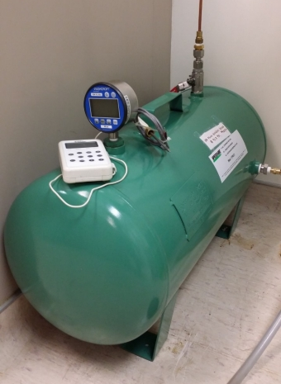
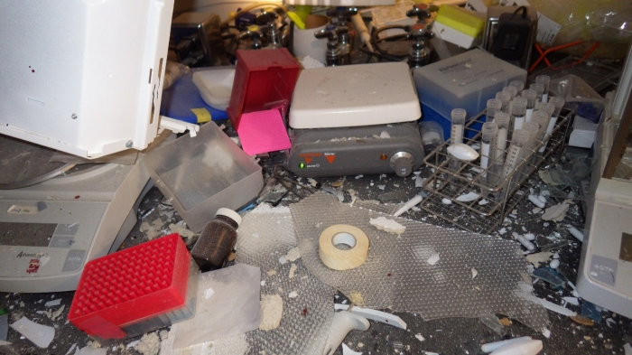
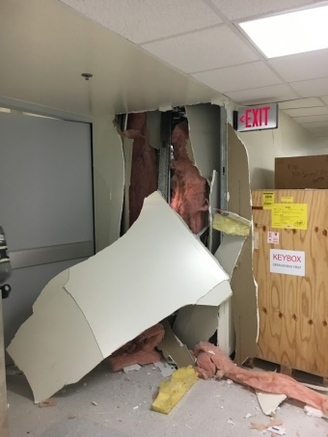
Why? University of Hawaii explosion
March 16, 2016
https://www.dailymail.co.uk/news/article-4142300/Researcher-lost-arm-blast-sues-University-Hawaii.html
http://www.hawaii.edu/news/wp-content/uploads/2016/07/Report-2-University-of-Hawaii.pdf
A student lost an arm
Used a gauge not intrinsically safe to combine
Extremely flammable hydrogen, carbon dioxide & oxygen

Slide 4
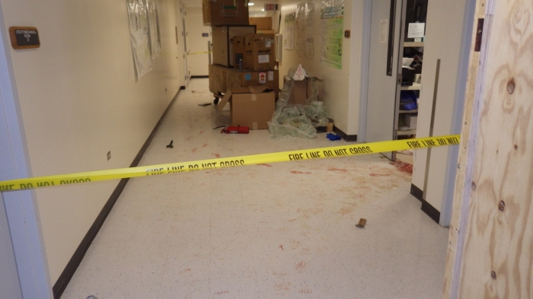
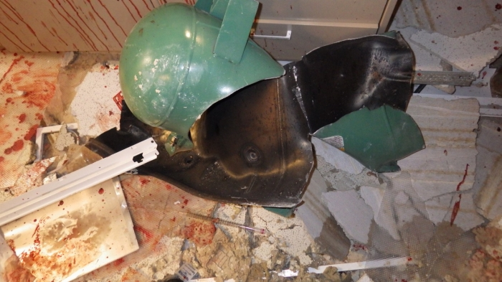
University of Hawaii explosion
Warning Signs ignored by the lead researcher:
-“Small internal explosion” not reported to University
-Tank not grounded occasion static shocks
-Several leaks were detected

Slide 5
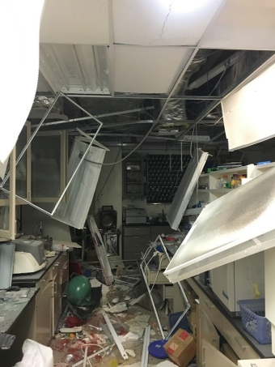
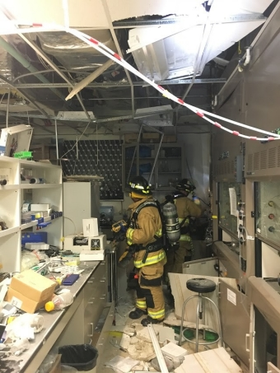
Safety training requested but refused
University of Hawaii faces $115,500 fine
Lesson learned:
- Training, competency & reinforcement
- ≥ 2 Swing out Exit Doors
- Check for potential ignition sources
in areas with flammable gases
- Risk assessment for appropriate PPE
- Hazardous Chemical SOPs

Slide 6
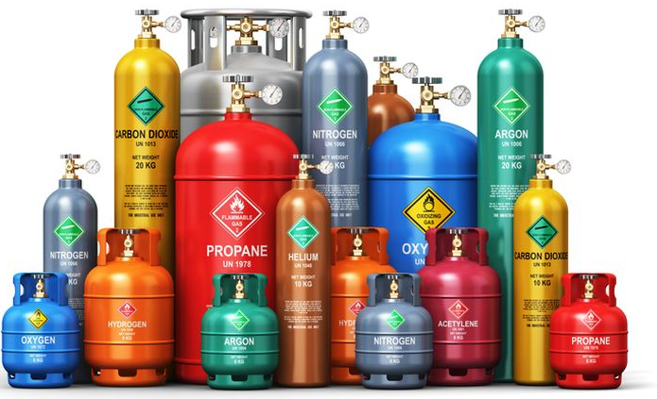
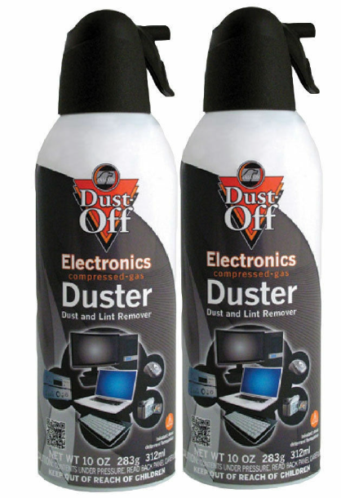
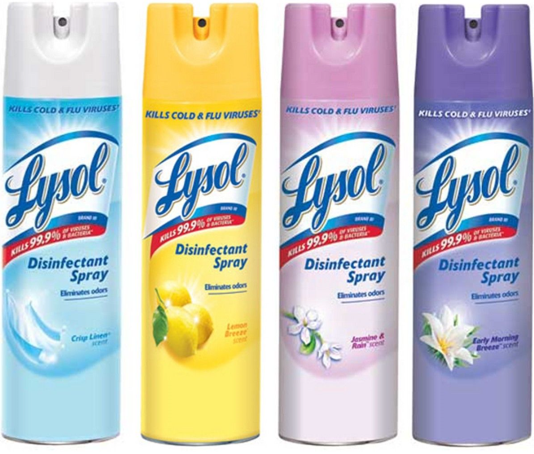

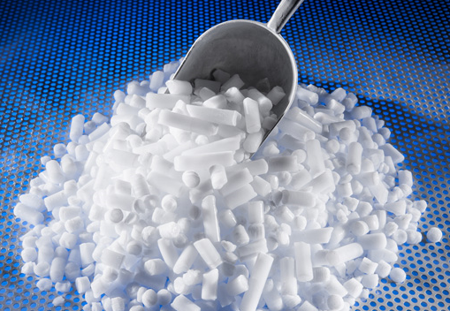
What do we have? (Compressed Gas Hazards)
May explode if heated
Simple asphyxiant that displaces oxygen
Argon, Carbon Dioxide, Helium, Hydrogen,
Liquid Nitrogen, Nitrogen, P-10
Desk and Office Cleaner, Spray mount & Dry Ice
Also

Slide 7
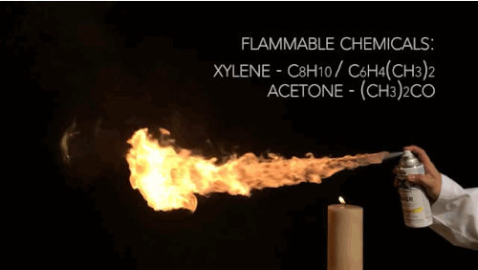
What do we have? (Cont’d)
Frostbite, cryogenic burns or injury
- Refer to SDS
Extremely flammable or flammable
-Black Flag, Chewing Gum Remover, Gas duster
-Disinfecting Office Cleaner, Lysol Disinfectant Spray…
-Hydrogen Compressed Gas
Additional safety measures for Flammables, Cryogenic Liquid Nitrogen & Asphyxiant (Hazardous Chemical SOPs)

Slide 8
Receiving
Check if:
-Without heavy rust or pitting
-Safety caps on
-Container labels legible
Bonus Question: Why?
If yes, ACCEPT

Slide 9
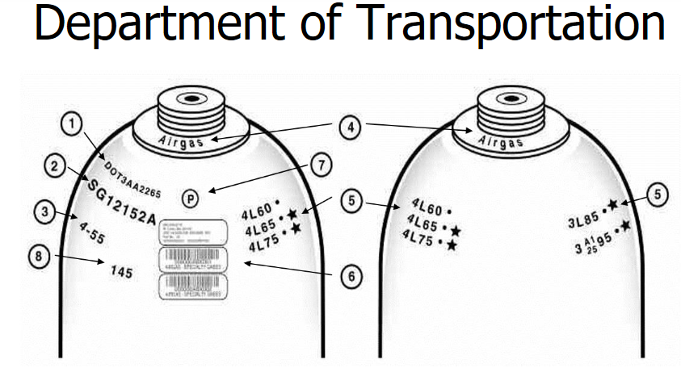
DOT Regulation
Serial #
Manufacture Date
Ring of original manufacturer
Retest Date
Tracking # Barcode
Manufacturer Inspection Mark
Weight of the unfilled cylinder

Slide 10
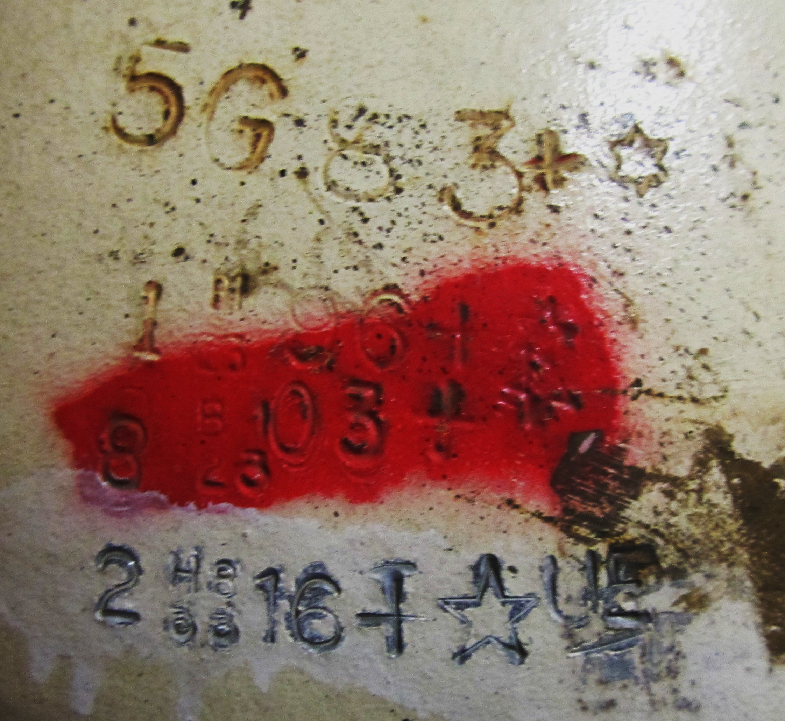
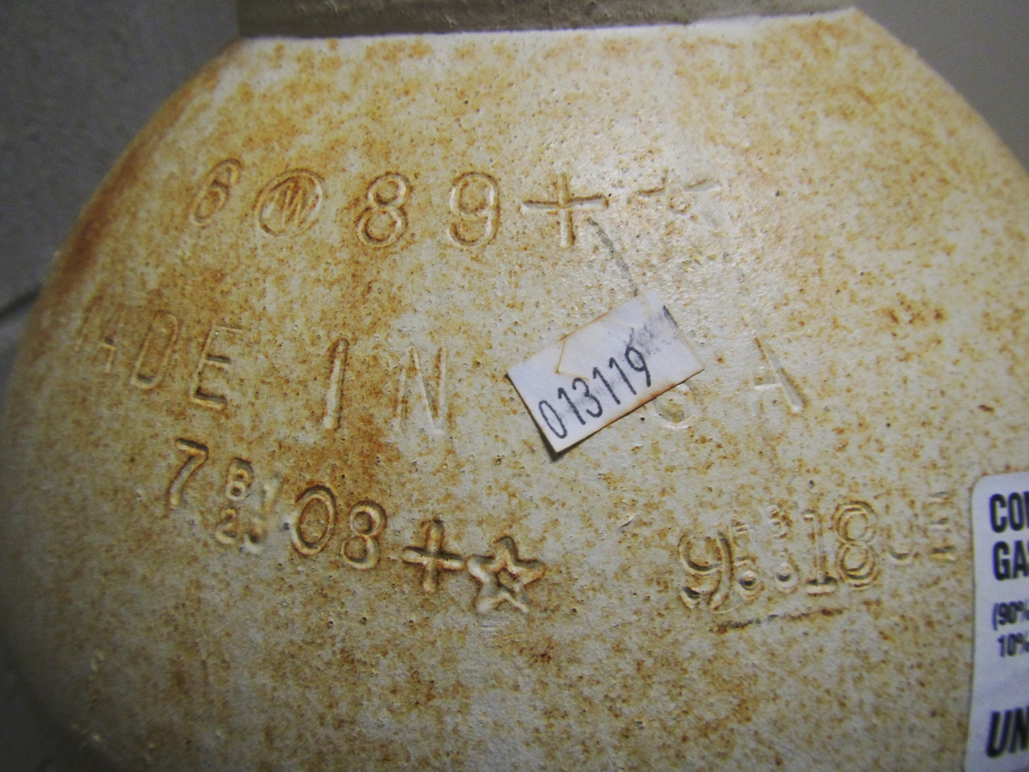
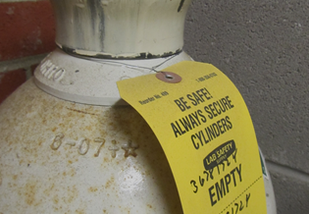

Receiving (Cont’d)
Hydrostatic Pressure Test Date
Vendor’s responsibility to do the test
All ( ) 10 years (49 CFR §180.209)
Carbon Dioxide 5 years (49 CFR §180.207)
EXCEPT

Slide 11
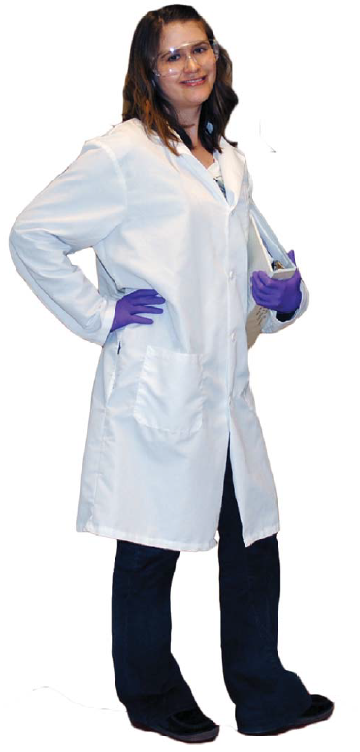
Personal Protective Equipment (PPE)
Additional if needed:
Lab apron & Tychem sleeves
Safety goggles and face-shield
Appropriate gloves for the Compressed Gas
e.g. Long cryogenic gloves

Slide 12
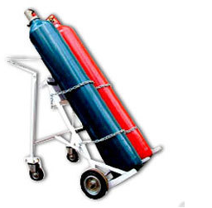
Transporting
Chain on specially designed carts & never dragged… OR rolling long distance
Do not allow to strike each other/other surface violently
Do not lift or move by the safety cap
Keep safety cap in place
Bonus Question 2: Why bother?

Slide 13
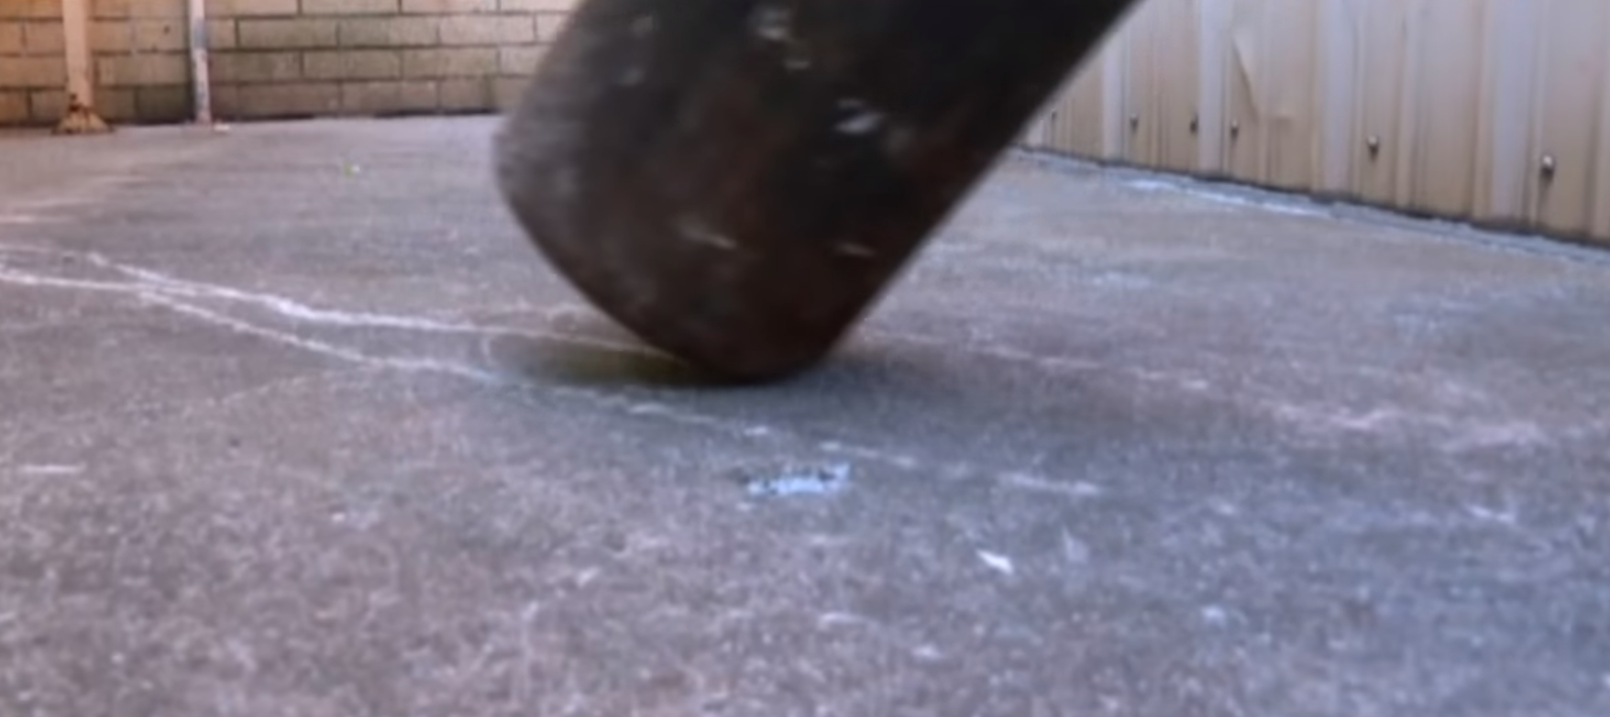
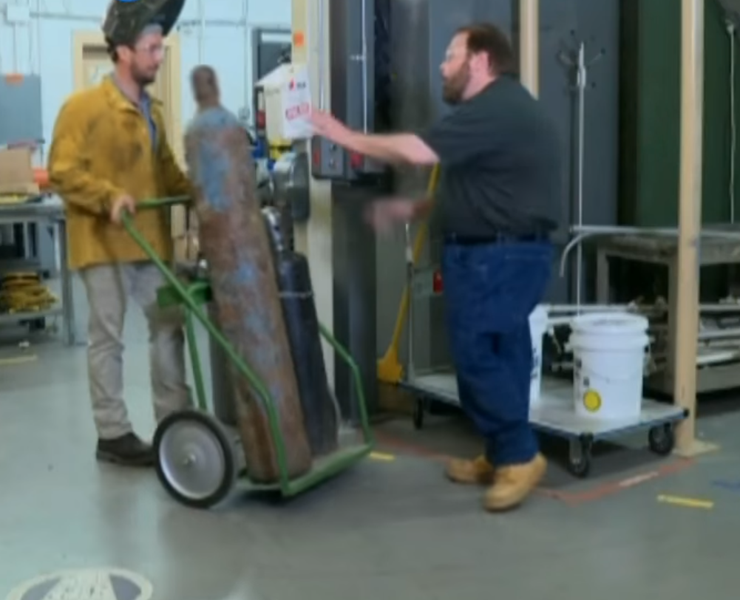
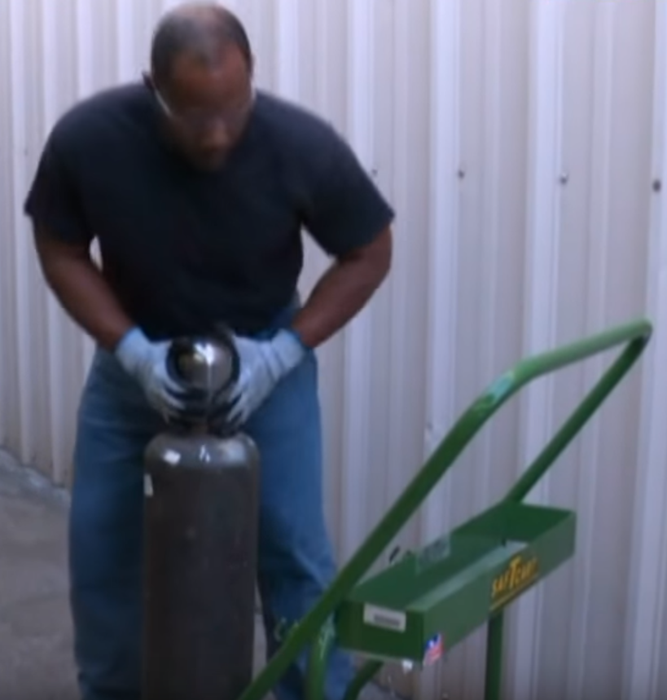
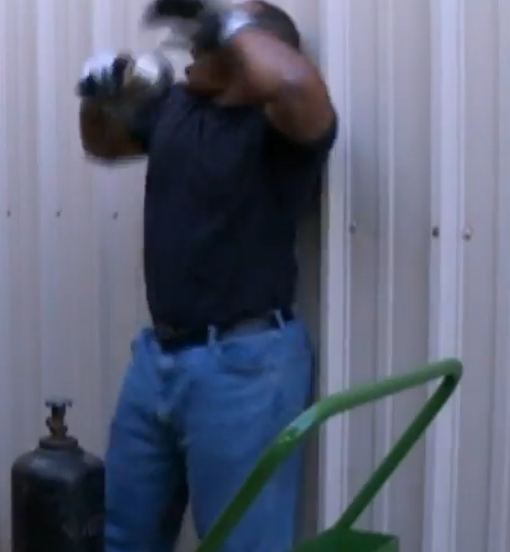

Slide 14
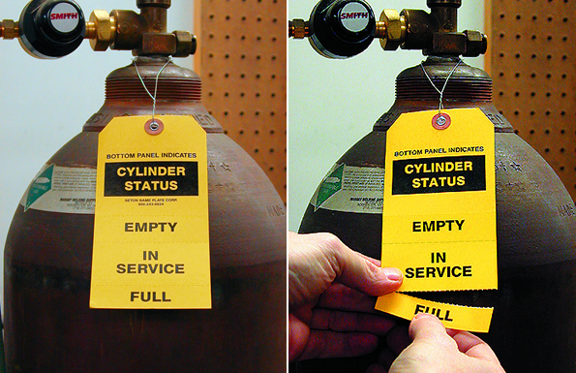
Mark your cylinders
LMW 5-31-19

Slide 15
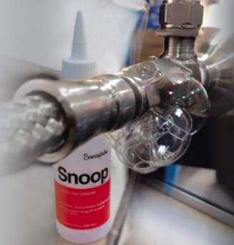
Assembly
Do Not use the tubing/cylinder top as a storage area
Do Not use oil/lubricant in a tubing system with oxygen
Use regulators approved for the specific gas
Check for leak after installation & periodically
with Snoop Leak Detector

Slide 16
Assembly (Cont’d)
Mount pressure gauges to be easy to read & pressure-relieving devices pointing away from people
Open cylinder valves slowly & carefully after connected to the process
- Stand clear of the regulator/valve outlet while opening
If a cylinder valve is difficult to operate
Discontinue Use,
Contact QA to return to supplier

Slide 17
General Safety
Remove metal jewelry/watches b4 working cryogen
Protect containers against physical damages & away from corrosives
Secure above the midpoint
Do not use excessive force or a plier to open a valve
When not in use: Shut valves, relieve pressure, remove gas regulators & put safety cap on

Slide 18
General Safety (Cont’d)
Keep flammables away from combustible materials
Order cylinders so they wouldn’t be stored 4 a long time
Must return b4 next Hydrostatic Pressure Test Date
- Required by DOT
- Retest Between 3-10 years
2007 Test Date

Slide 19
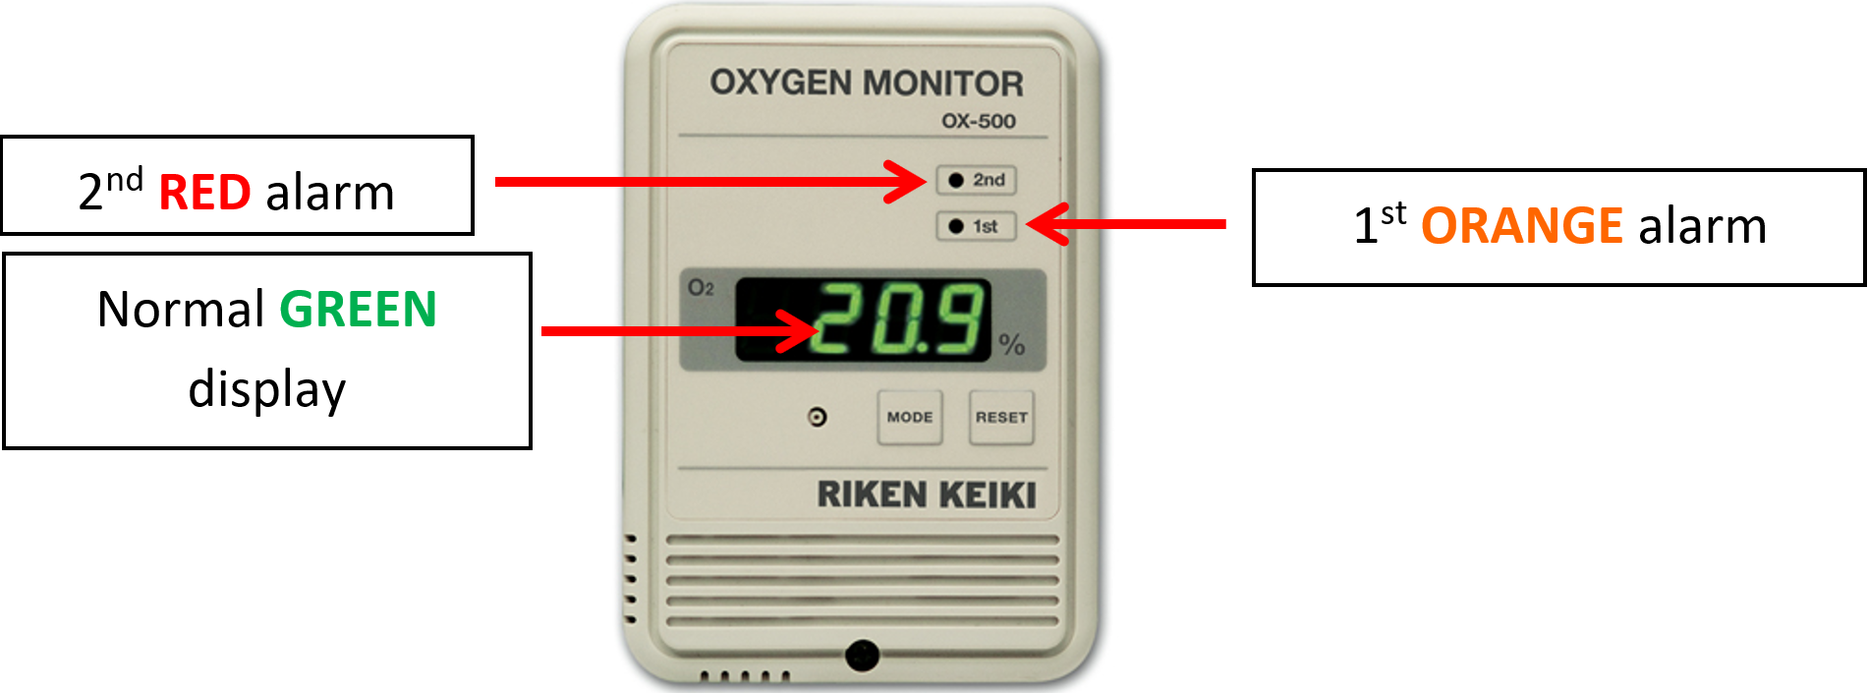
Oxygen Diffusion Gas Monitors
Used to monitor air quality in confined spaces with asphyxiating gas cylinders
Check oxygen content before entering area

Slide 20
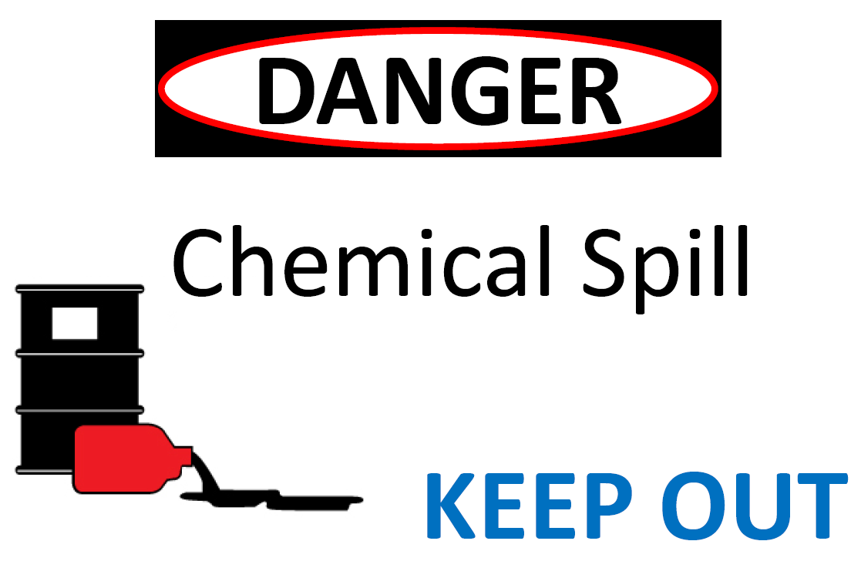
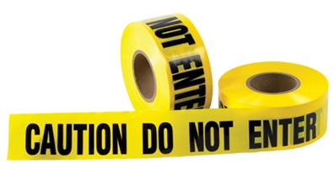
Emergency Procedure
A leak of the cylinder or orange/red alarm on Oxygen Diffusion Gas Monitor
Stop the leak if safe to do so
Isolate area w/ ‘Chemical Spill Keep Out’ OR ‘Do Not Enter’
Do not re-enter until approved by Supervisor/LSO

Slide 21
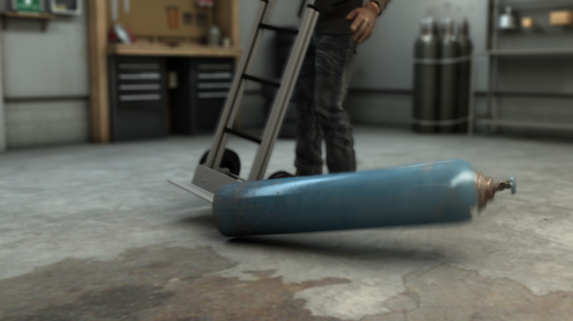
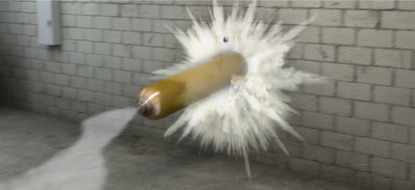
The 101 wrong ways?

Slide 22
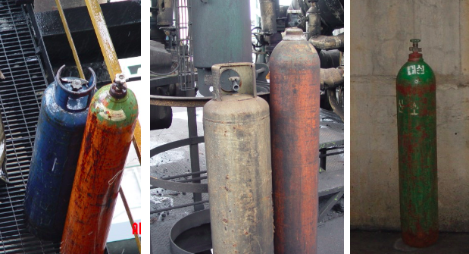
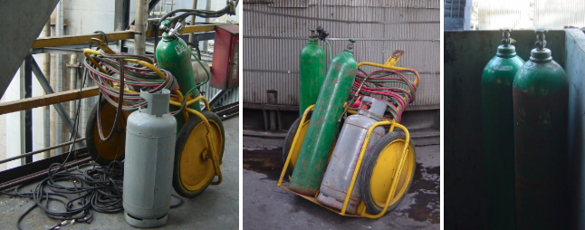
The 101 wrong ways (Cont’d)?

Slide 23
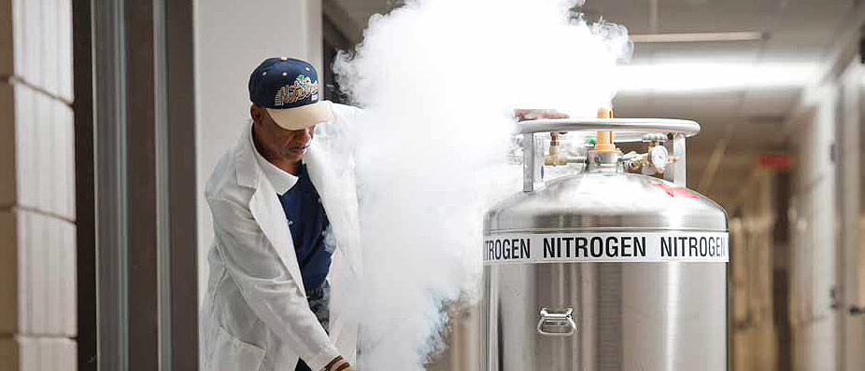
What’s wrong with this picture?
Direct contact with liquid nitrogen, uninsulated pipes/equipment can cause cryogenic burns
Eye fluids will freeze on contact causing permanent eye damage
A jet of cryogen vapor can freeze the skin/eye faster than liquid/metal contact

Slide 24
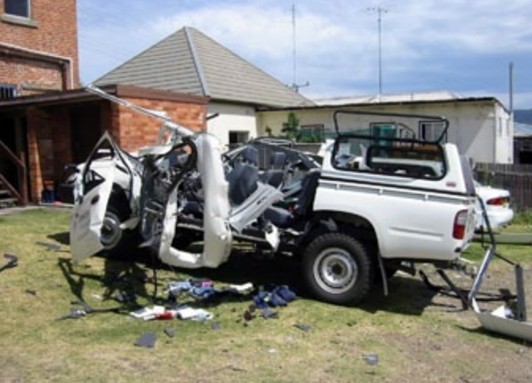
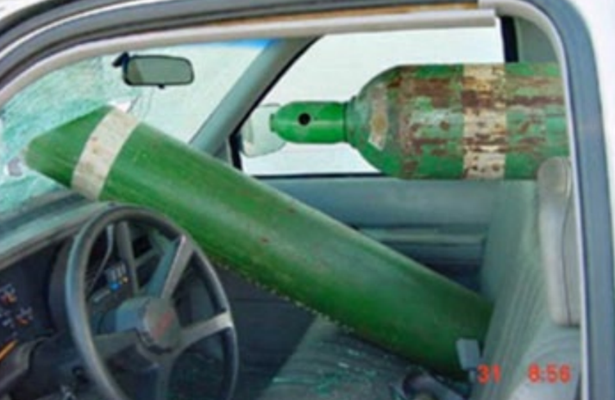
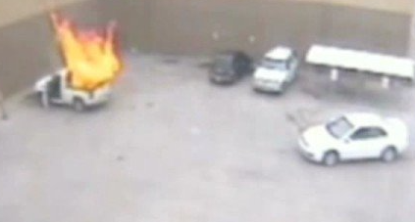
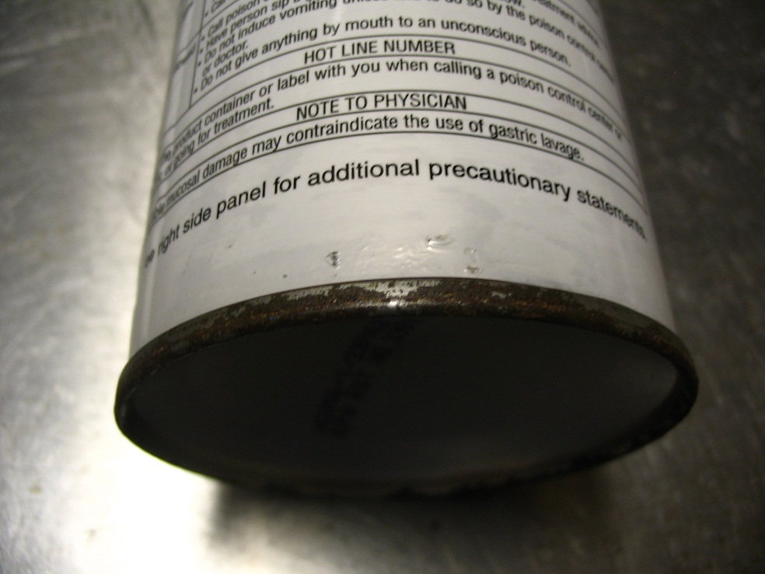
Take Home Messages
Store in hot car
Store near sink could lead to rust and explode

