Slide 1
Safe Use of Chemical Fume Hoods CHP Appendix H
By Lai Ming Woo

Slide 2
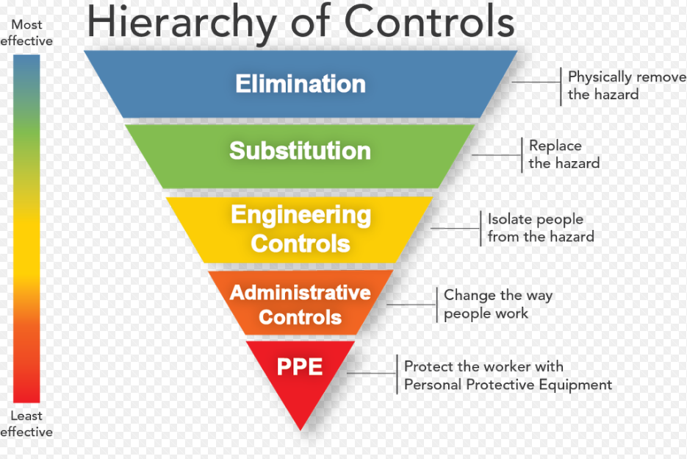
Why?
Engineering Control
Protects from chemical vapors, dust or radionuclides
Only when use appropriately
Safety is everyone’s responsibility
- Contact LSO if you have any concern

Slide 3
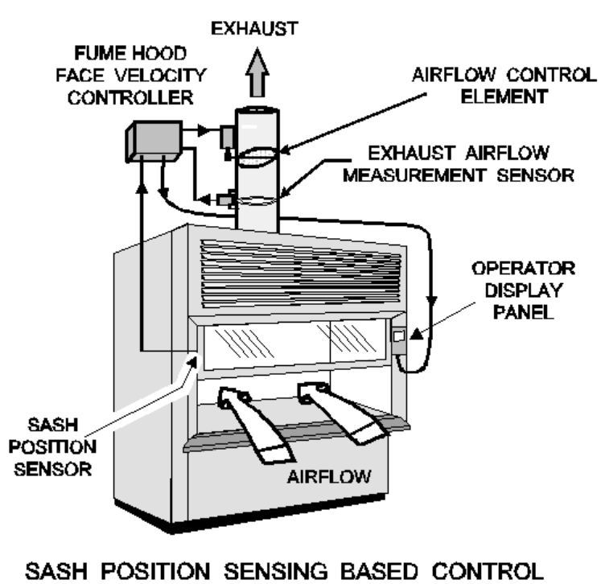
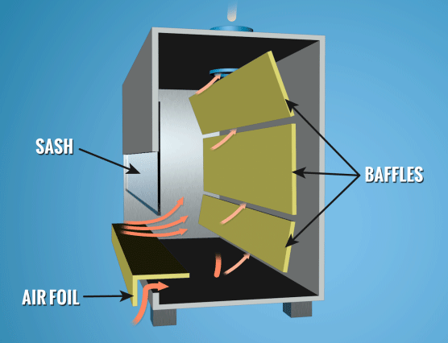
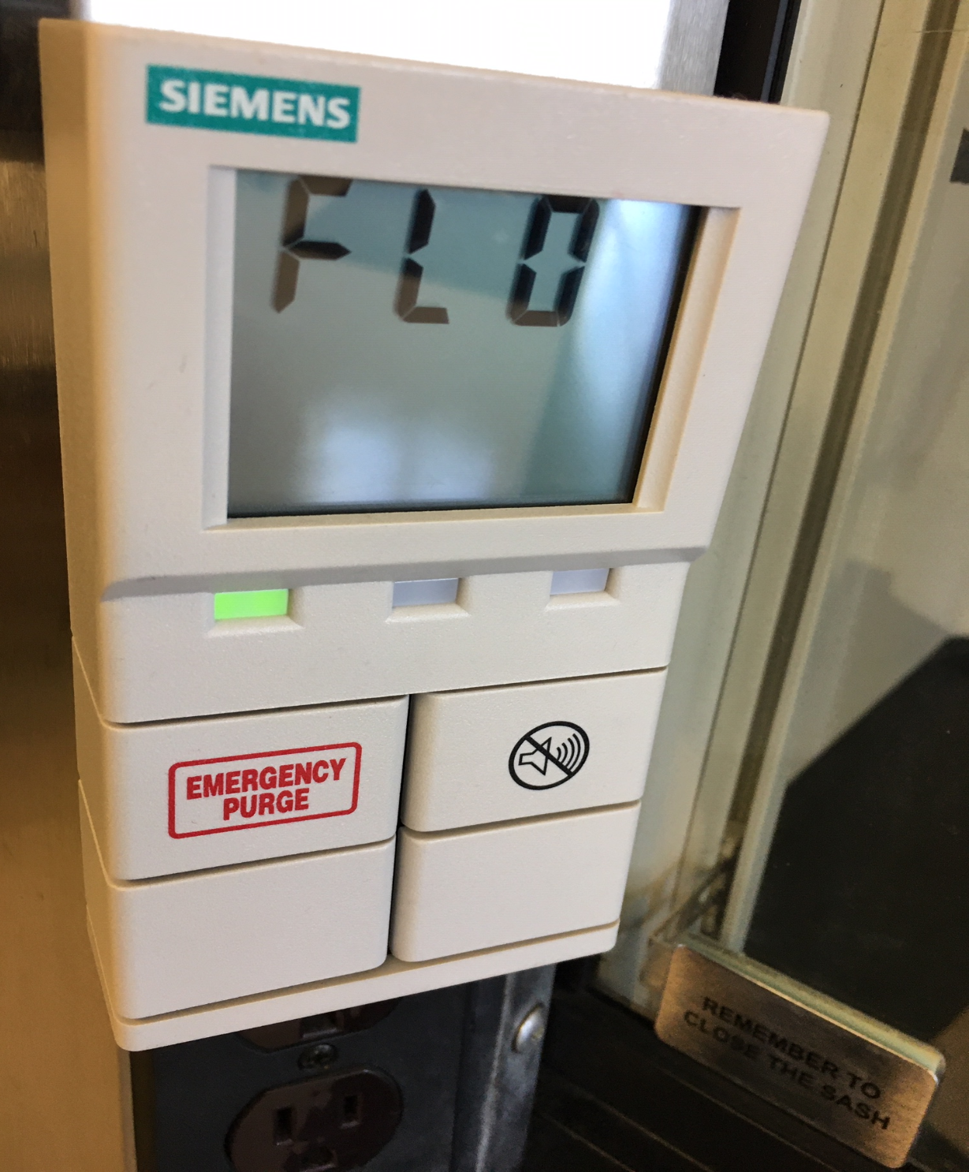
Know Your Chemical Fume Hood
User Manuals for fume hoods/Variable Air Volume (VAV) Controller:
G:\LABORATORY PROCEDURES\Lab Equipment\User Manuals for Fume Hoods

Slide 4
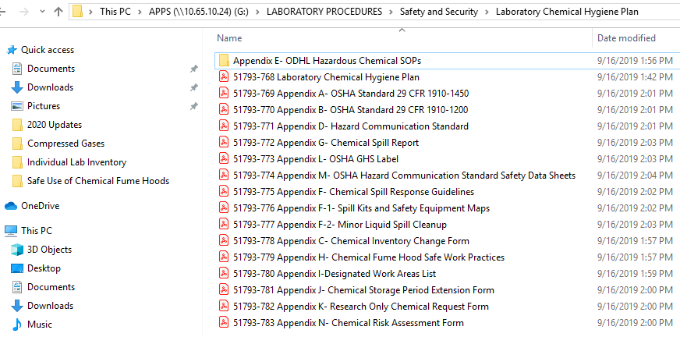
Where can you find Appendix H?
Current version of the Chemical Hygiene Plan is here:
G:\LABORATORY PROCEDURES\Safety and Security\Laboratory Chemical Hygiene Plan
Also on MediaLab

Slide 5
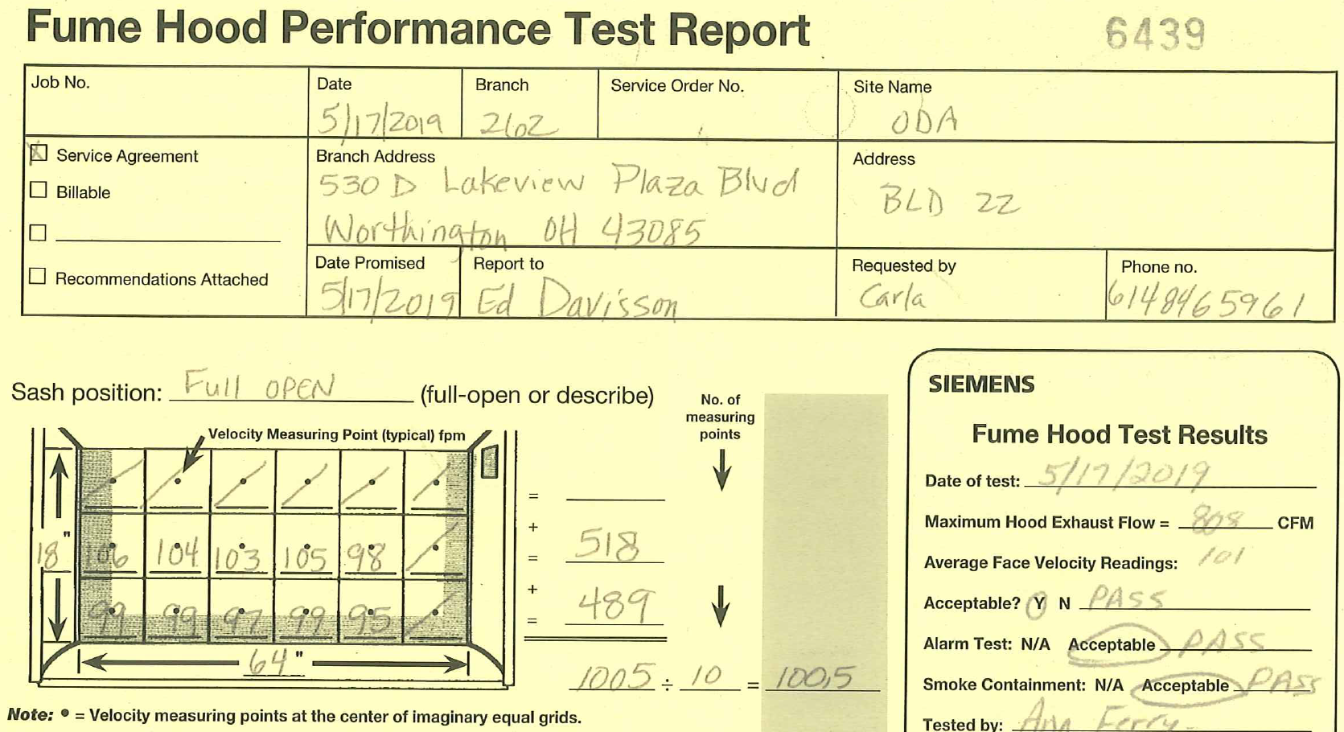
Certification and Performance Checks
Certified by LCS annually
Fume Hood Controller Calibration/Hood Performance Check by Siemens annually

Slide 6
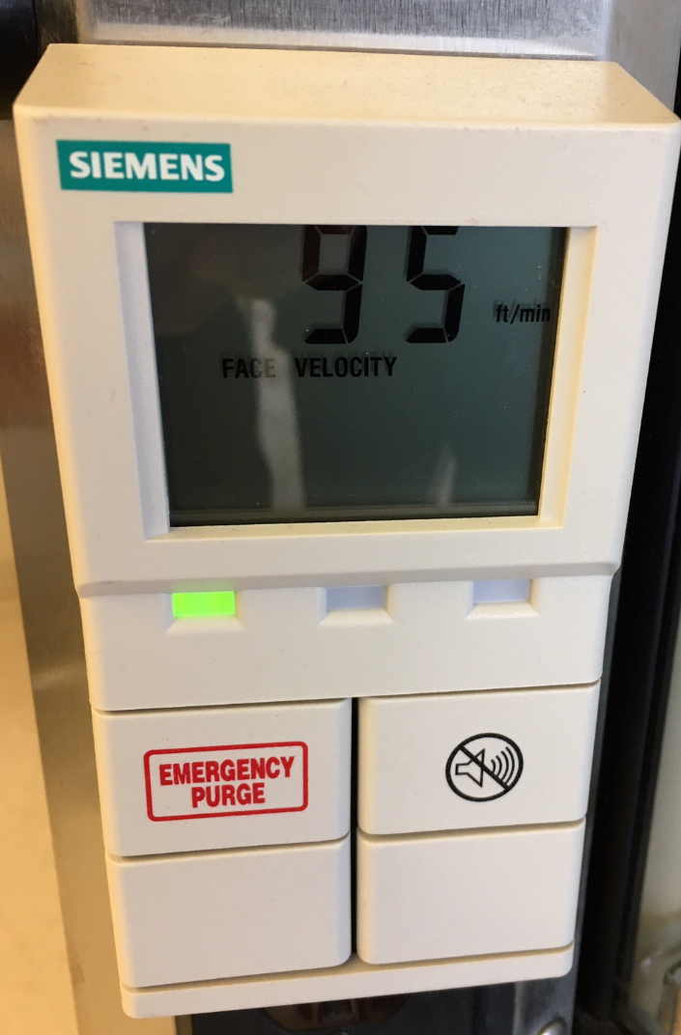
Check Before Use
Check before EACH use
- Certification Dates within 1 year (LCS & Siemens)
- Acceptable face velocity value is 80-120 ft/min
No Audial Alarm
Green LED on Operator Display Panel
If not, IMMEDIATELY report to Supervisor
DO NOT USE until it has been repaired & within range

Slide 7
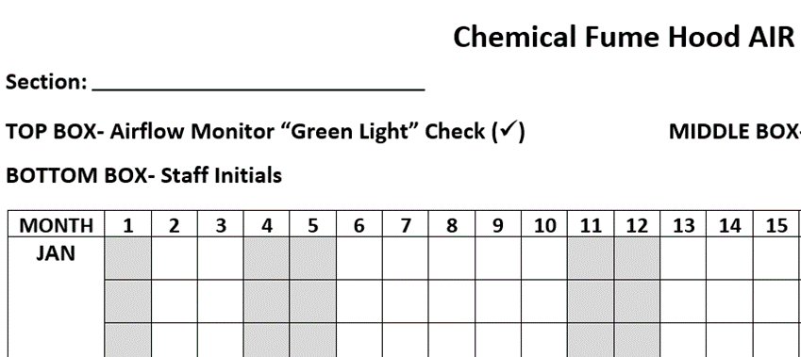
Check Before Use (Cont’d)
Document everyday in Chemical Fume Hood Air Flow Record
95
LW

Slide 8
Air Flow Issue?
Initials/Date in Chemical Fume Hood Air Flow Record for out of range face velocity value
- Notify Supervisor
- Supervisor will submit a maintenance request and
follow up
10/11/19 LMW

Slide 9
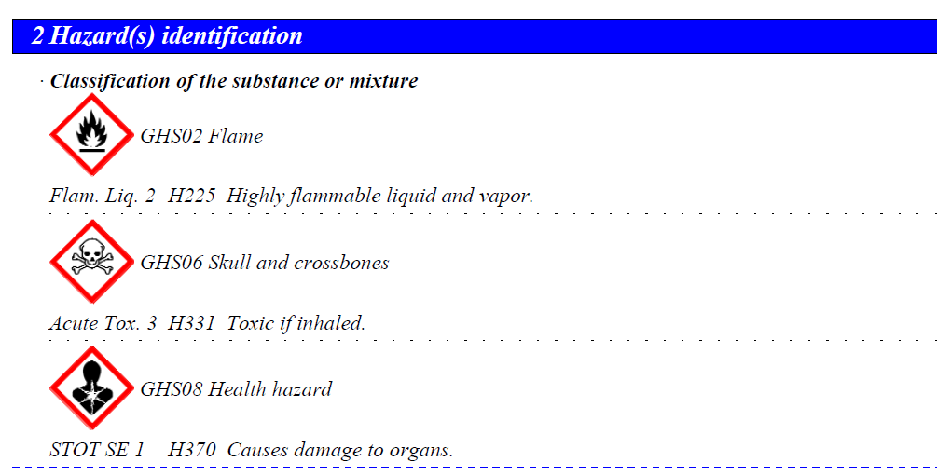
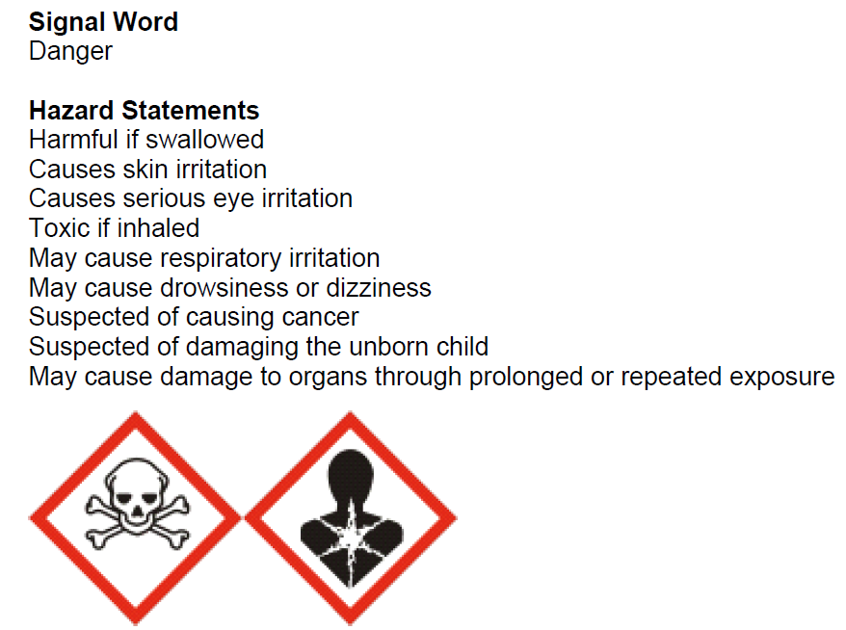
Bonus Question: Why can’t You use it?
Protect you from the hazard with airflow
Low flow could cause chemical to escape into the lab

Slide 11
CDC Fundamentals of Chemical Fume Hood Safety
Airflow, Airflow and Airflow
Work at least 6 inches from the front
Sash height the arrow (Certification Height)
Place large items on 2-3 inches’ legs
Opening/Closing sash slowly
Minimize personnel traffic past the hood
Move arms slowly perpendicular to sash

Slide 12
Good Work Practices Video

Slide 13
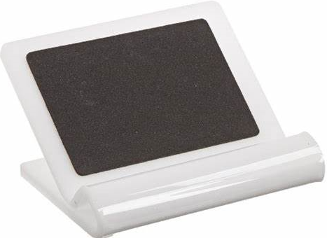
Good Work Practices
Yellow LED/Red LED with audial alarm stays on
Finish the task at hand & close sash
IMMEDIATELY report to Supervisor
Never put your head inside
Keep everything out except what you need…Clutter?
10/11/19 LMW

Slide 14
Good Work Practices (Cont’d)
DO NOT block the back vent
Keep the hazards inside
Close sash & sliding glasses when unattended
After work, clean surfaces & close sash
Weigh fine chemical (highly toxic/reproductive toxin) or specimens ONLY with horizontal sash open to arrows
Airborne fine particulate could leak outside

Slide 15
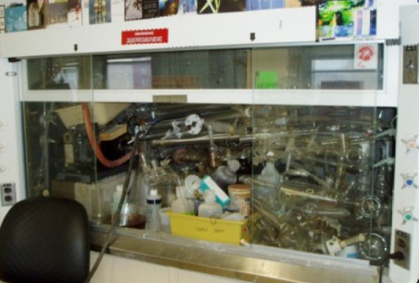
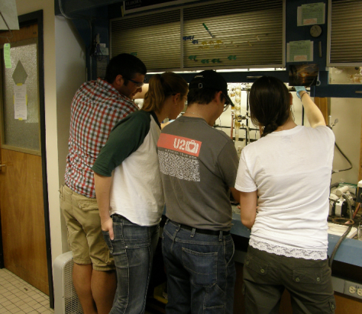
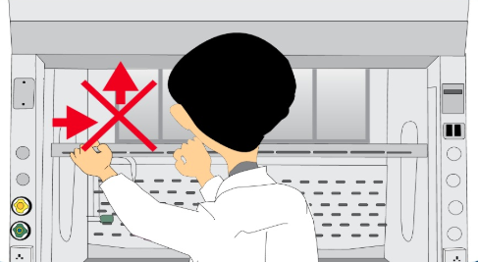
What’s wrong with this picture?

Slide 16
Together We Can Do It

