Slide 1
Quidel Triage® MeterPro System Training

Slide 2
Agenda
Quidel Triage MeterPro System Overview
Quidel Triage Test Device Overview
Quidel Triage CODE CHIP™ Module
Quidel Triage Quality Control
Quidel Triage Test Procedure
Quidel Triage Summary

Slide 3
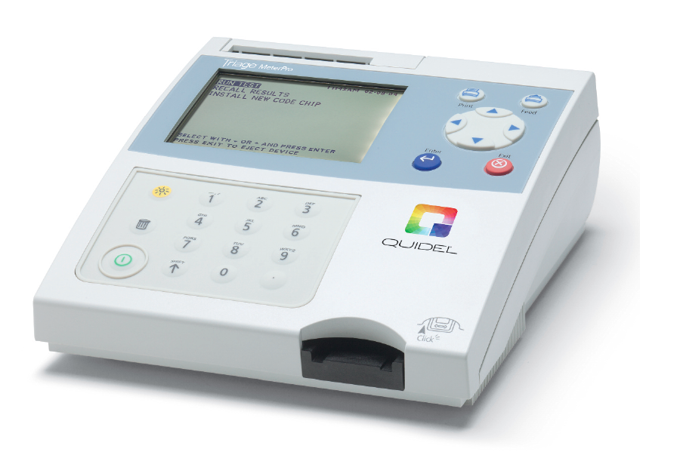
Quidel Triage MeterPro
System Overview

Slide 4
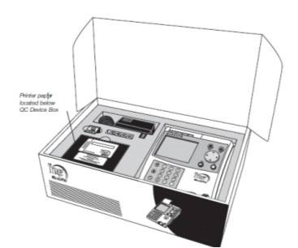
Quidel Triage MeterPro box
What’s inside?
1 MeterPro
4 batteries
4 paper rolls
QC Device and CODE CHIP module (in the QC Device box)
Supervisor CODE CHIP module and CODE CHIP module box
1 AC/DC adapter

Slide 5
Quidel Triage System
Quidel Triage MeterPro
Fluorometer
Runs individual test devices
Quantitative results in ~15 minutes
Built-in QC and QA functions
Portable
Stored memory
AC or battery powered
Full connectivity

Slide 6
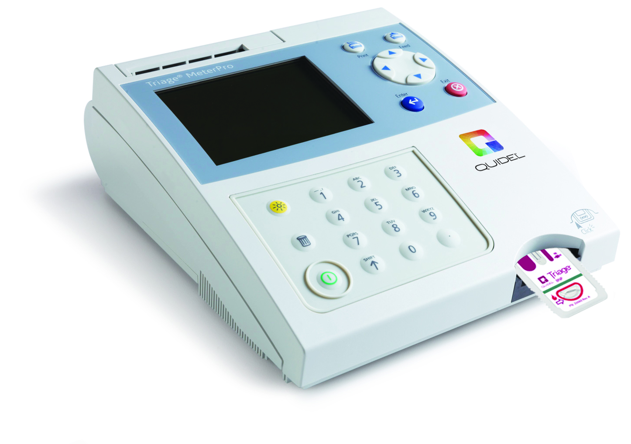
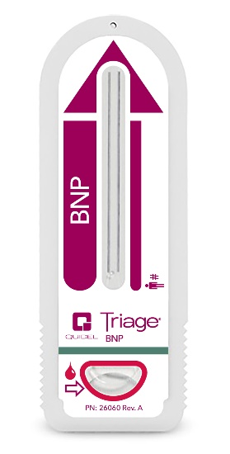
What is the Quidel Triage System?
MeterPro
Test Device

Slide 7
Quidel Triage MeterPro specifications
7
Memory Capacity | Record Type
750 records | Patient Records
200 records | QC Sample Results
70 records | QC Device Results
250 records | Misc. Test Results
32 Reagent Lot 200 QC Sample 4 QC Device | CODE CHIP modules
Storage
Temperature | 15°C to 30°C
Humidity | 10% to 85%
Location | Dry, clean, flat horizontal surface away from direct sunlight

Slide 8
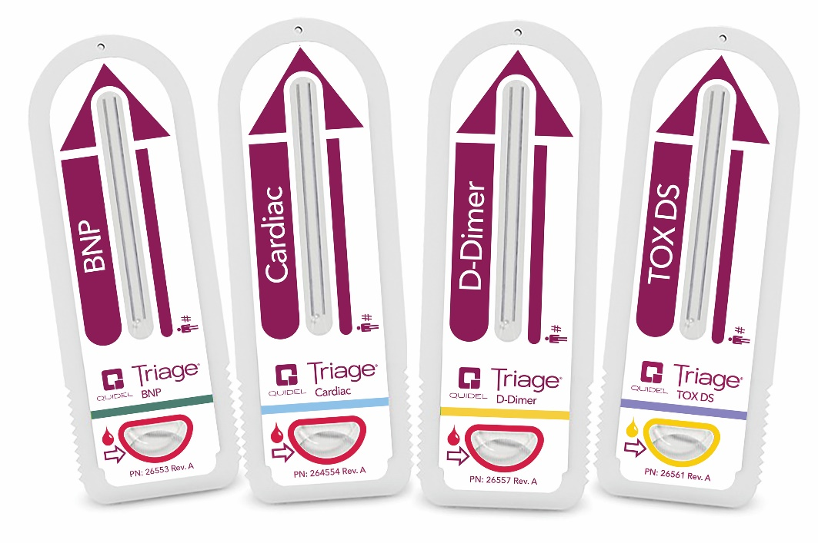
Quidel Triage tests
BNP (CLIA waived for whole blood)
Cardiac Panel with TnI, CK-MB, and Myoglobin
Cardiac Panel with TnI and CK-MB
Cardiac with TnI
D-Dimer
Toxicology

Slide 9

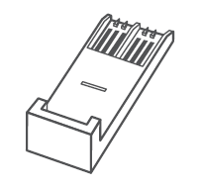

Quidel Triage kit
What’s inside?
25 separate foiled devices
25 plastic transfer pipettes
1 reagent code chip
1 printer roll (2 for TOX)
Product Insert

Slide 10
Service and maintenance procedure
No maintenance other than paper / battery replacement and periodic external cleaning is required by the operator. Please see Quidel Triage MeterPro User Manual for more information.
If any service or maintenance is required, the Quidel Triage MeterPro should be sent to the manufacturer.

Slide 11
Quidel Triage Test Device Overview

Slide 12
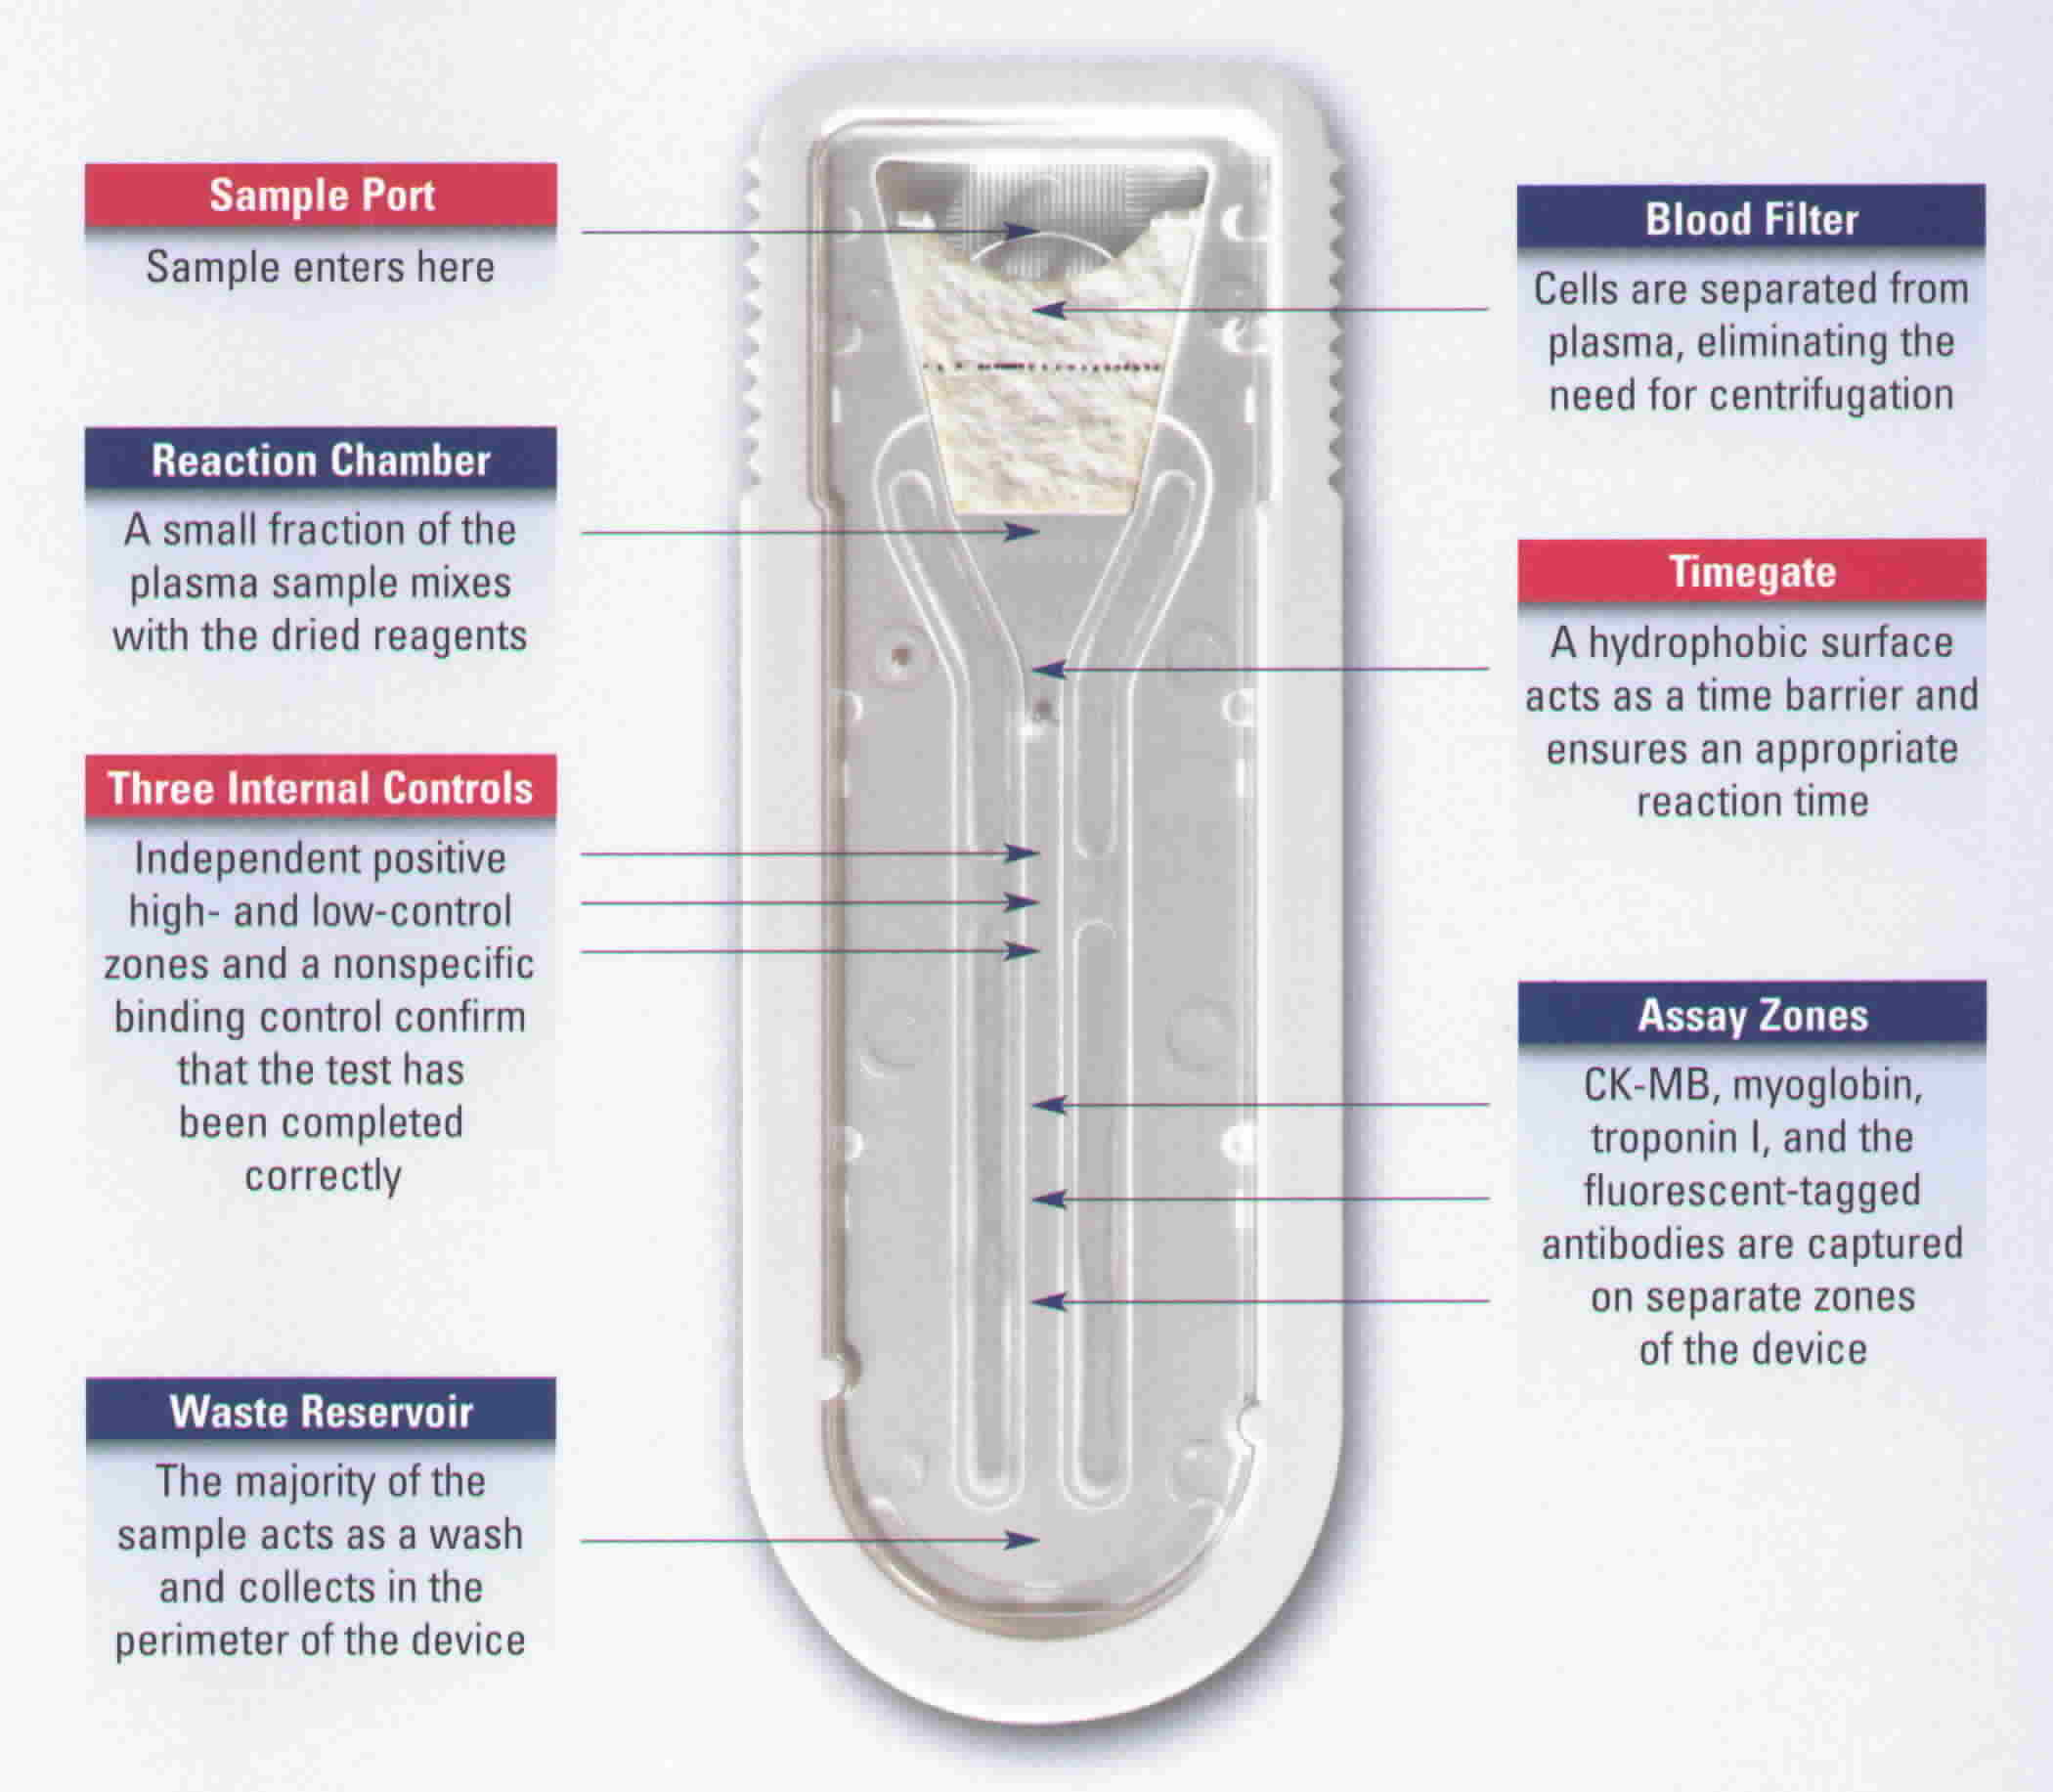
Quidel Triage device component

Slide 13

Quidel Triage test device
Reaction occurs in the test device;
Meter is a reader
Results available in approximately
15 to 20 minutes
Can inoculate several Test Devices,
multiple patients, at the same time
Meter requires about 3 minutes to read
each additional Test Device
Built-in Controls within each device
Whole blood or plasma specimens

Slide 14
Quidel Triage test device
The test device holds the sample and also contains the reagents and other materials needed to run a test.
Test devices are to be stored between 2°C to 8°C.
Test devices must be at room temperature before use.
Once the test device has been removed from the refrigerator it is good at room temperature for 14 days

Slide 15
Quidel Triage MeterPro CODE CHIP Module

Slide 16




Quidel Triage CODE CHIP Module
Reagent CODE CHIP module
  CODE CHIP module in each box of test devices. Lot # begins with a W.
  Color coded to test device e.g. BNP is green, Cardiac is blue, etc.
Control CODE CHIP module
  CODE CHIP module in each box of controls. Lot # begins with a C
  Color is white.
QC Device CODE CHIP module
  CODE CHIP module for the QC Device in black QC Device box. Labeled with serial number of QC Device – loaded once per installation of the MeterPro.
  Color is dark gray.
Supervisor CODE CHIP module
  Allows access to setting parameters on Meter software. Included with each Meter. Lot # begins with SPR.
  Color is light gray.

Slide 17
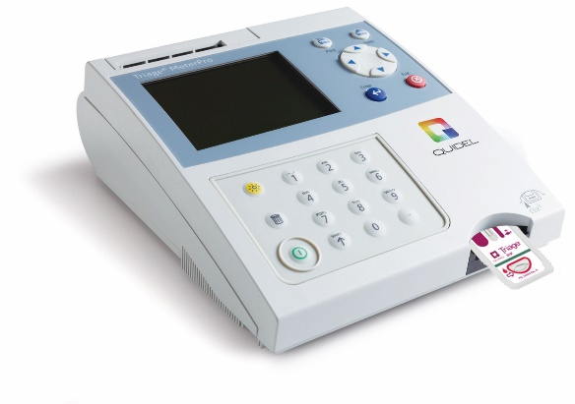
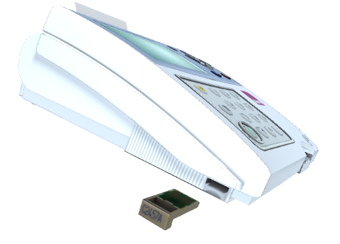
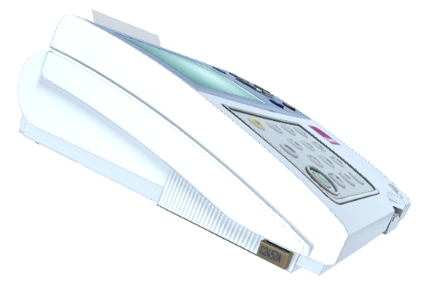
Installing CODE CHIP modules
From the Main Menu select INSTALL NEW CODE CHIP using the keys.
Press the key.
Slide the CODE CHIP module into the CODE CHIP module port in the MeterPro.
Press the key.
The meter will display a confirmation message that the information was installed into the MeterPro’s memory.
Press the key to return to acknowledge the message.
Remove the CODE CHIP module from the CODE CHIP module port.
Place the CODE CHIP module back into its original container for storage.

Slide 18
Quidel Triage
Quality Control

Slide 19
Quality Assurance functions
Four key QC parameters
Internal device Quality Assurance
MeterPro Quality Assurance
Software Quality Assurance
Quality Control samples

Slide 20
Internal device Quality Assurance
There are three internal controls built into every test device
Internal QC run automatically with every patient
Built-in controls ensure that:
  Test procedure performed properly
  Test system is performing correctly
If any of these built-in controls are outside of the range set during manufacturing, no patient results will be reported and you will get a message that says:
! INTERNAL QC OUT OF RANGE

Slide 21
MeterPro Quality Assurance
Barcode printed at the bottom of every test device
  Identifies reagent lot number to prevent use of expired reagents
The power-on / start up test
  Verifies memory, optics, power
If Internal QC MeterPro algorithm fails, patient results will not be reported
  Analyzes the trace for each Test Device
If QC Device test fails, MeterPro will not allow patient testing
  Verifies laser operation and internal standard
External QC test must be current
  Verifies high/low controls and system integrity

Slide 22
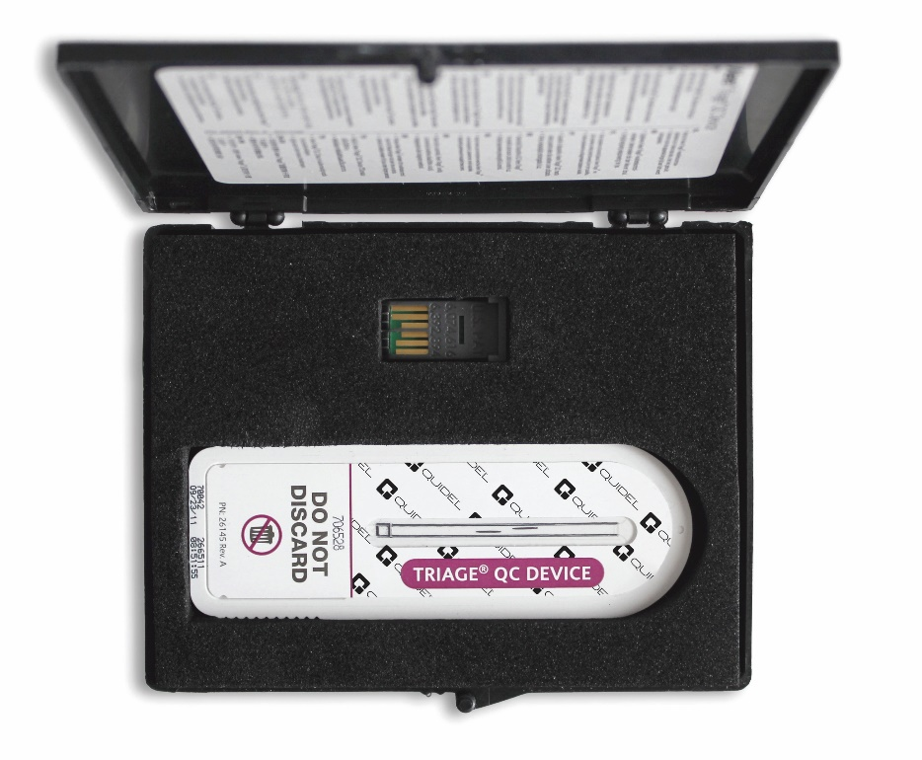
QC Device
Looks like a Test Device
Shipped with every MeterPro
  1 x QC Device and 1 x QC Code Chip
Reusable
Run each day of patient testing, every 24 hours
QC device specific to its own MeterPro serial number

Slide 23
QC Device
QC Device tests proper function of the MeterPro and monitors:
  Calibration
  Laser
  Alignment
If any parameters on the QC Device fails, then the MeterPro will not permit patient testing.

Slide 24
Software Quality Assurance
Supervisor CODE CHIP module allows access to MeterPro functions not available to routine users
  Selection of parameter settings, deletion of results from MeterPro memory
  User ID can be assigned to limit access to patient testing mode to trained and proficient users
  Partial masking on User ID displays and print outs preventing unauthorized users from using existing User ID
Patient ID required for all patient tests performed
QC frequency can be set up for performing external liquid control samples
  QC Lockout function prevents testing patient samples if QC samples are not within an acceptable range or if patient testing being performed past 30 days

Slide 25
External QC
There are two plasma levels of control that are value assigned for external QC
  Level 1 (Low) or (Neg)
  Level 2 (High) or (Pos)
When should QC be run?
  With each new lot of Quidel Triage Test Devices
  With each new shipment
  Every 30 days for any given shipment or lot
  As otherwise required by the laboratory’s standard quality control procedures

Slide 26
Quality Control
The external QC material requires storage at –20°C or colder in a non-defrosting freezer.
Thaw required quantity of vials at room temperature for at least 30 minutes and use complete contents within one hour of removal from frozen storage.
  Upon selection of ‘QC Sample’ from MeterPro ‘Run Test’ menu, enter the QC Sample (Control) Lot Number and test the Controls in the same manner as patient specimens. Refer to the Package Insert for additional information.
Do not refreeze unused vials.
  Results should fall within the expected ranges provided on the Expected Values Card within the kit.
  Using the CODE CHIP module, the MeterPro will flag results that are outside of three standard deviations. The user as the option of changing the settings to two standard deviations to flag results.

Slide 27
QC Sample: Results out of range
If the QC Sample for a specific analyte on that device lot is unacceptable, the analyte in question will display a pound sign ( # ) in place of a value and a warning is displayed:
# QC SAMPLE OUT OF RANGE.
A panel with multiple analytes will still be able to report patient results on those analytes which passed QC. An analyte that failed QC will not be reported on patient tests (instead will be flagged with a # symbol).
If an individual analyte is outside the specified range, the MeterPro allows the user to rerun only the failed analyte on the next QC Sample Test. When all analytes have passed, the QC Sample timer is set to the date of the first passing analyte.

Slide 28
Quidel Triage
Test Procedure

Slide 29
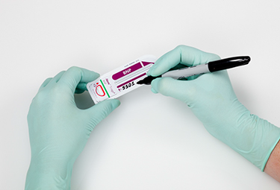
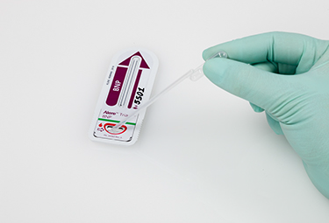

How does the Quidel Triage System work?
Collect a blood/urine sample from a patient
Label room temperature Quidel Triage Test Device with patient ID and time of inoculation
Add the sample to the Test Device
Go to the Main Menu and select Run Test

Slide 30
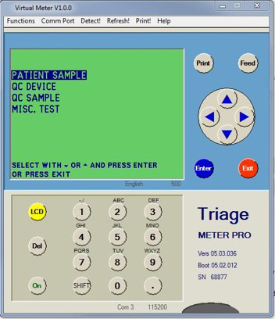
Run a test
Highlight Patient Sample using arrow keys
Press Enter
Enter the patient ID using either the keyboard or the barcode scanner
Press Enter

Slide 31
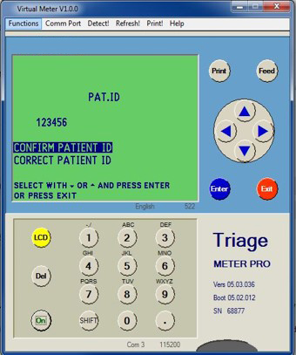
Run a test
MeterPro displays entered ID
MeterPro will ask user to confirm that the ID was entered correctly
If correct, press Enter
If incorrect, arrow down to highlight correct Patient ID
  MeterPro then gives the opportunity to overwrite the ID

Slide 32
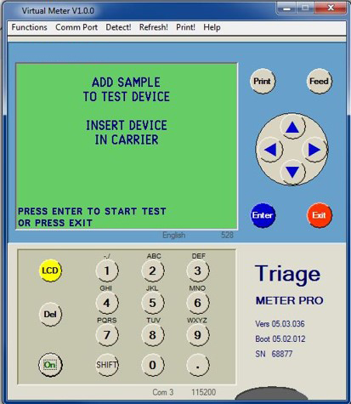
Run test
MeterPro prompts user to add sample
  If sample was added before programming, device should be ready for insertion
Insert device gently
  Until a “click” is heard
  Until you feel resistance
Press Enter

Slide 33
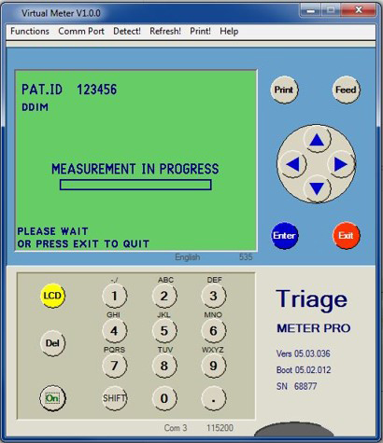
Run test
Message “Measurement in progress” is displayed
Test takes approximately 15 to 20 minutes to complete

Slide 34
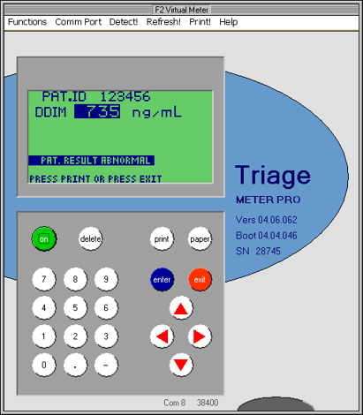
Test results
When test is complete results print on screen and on paper tape
Results on tape include:
  Normal Range
  Date and Time
  Device Lot Number
  Meter SN
  Patient ID

Slide 35
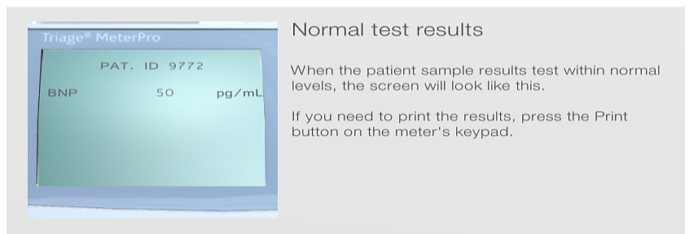
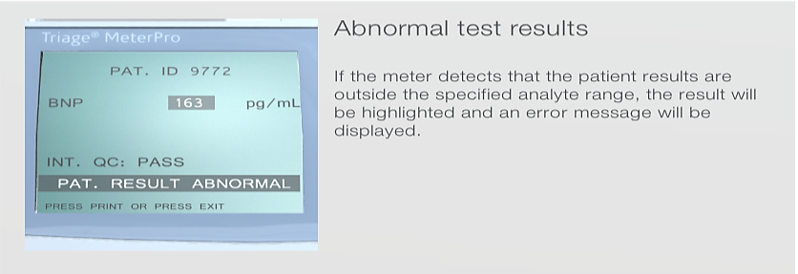
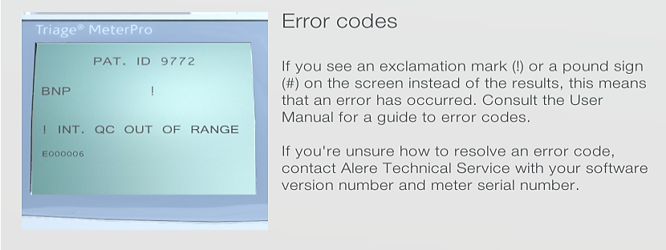
Test results

Slide 36
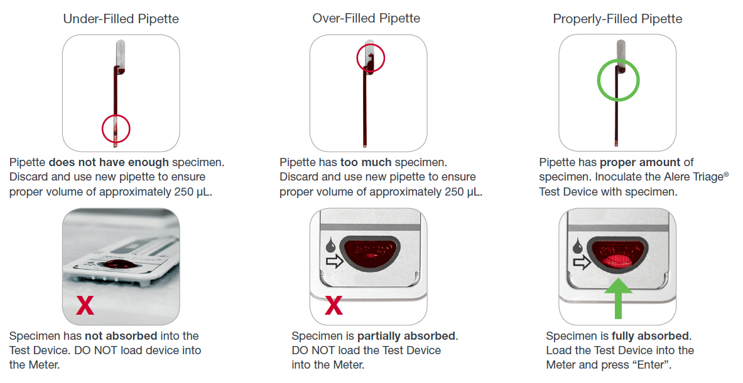
Ensuring quality results through proper technique

Slide 37
Questions?
Please contact our Technical and Customer Support services at 800.874.1517.
Technical Support Specialists supporting the Quidel Triage System are available in the office Monday through Friday, 5:00 a.m. to 5:00 p.m. Pacific Time, with 24/7 phone support.

