Slide 1
Oral Liquid Glucose Administration

Slide 2
Introduction
The Glucose Tolerance Test (GTT) is completed to screen pregnant and postpartum patients for evidence of abnormal carbohydrate metabolism and to identify patients at risk for developing gestational diabetes.
To screen patients for insulin resistance.
This training will provide written instructions for administering Glucose Tolerance Test oral liquid (Glucola®) stock glucose drink ordered by the physician.
2

Slide 3
Objectives
Provide clear guidelines on the correct dosage of oral liquid glucose based on the order provided by the physician.
Demonstrate correct technique for measuring and administering oral liquid glucola.
Correct documentation and references for any questions or concerns.

Slide 4
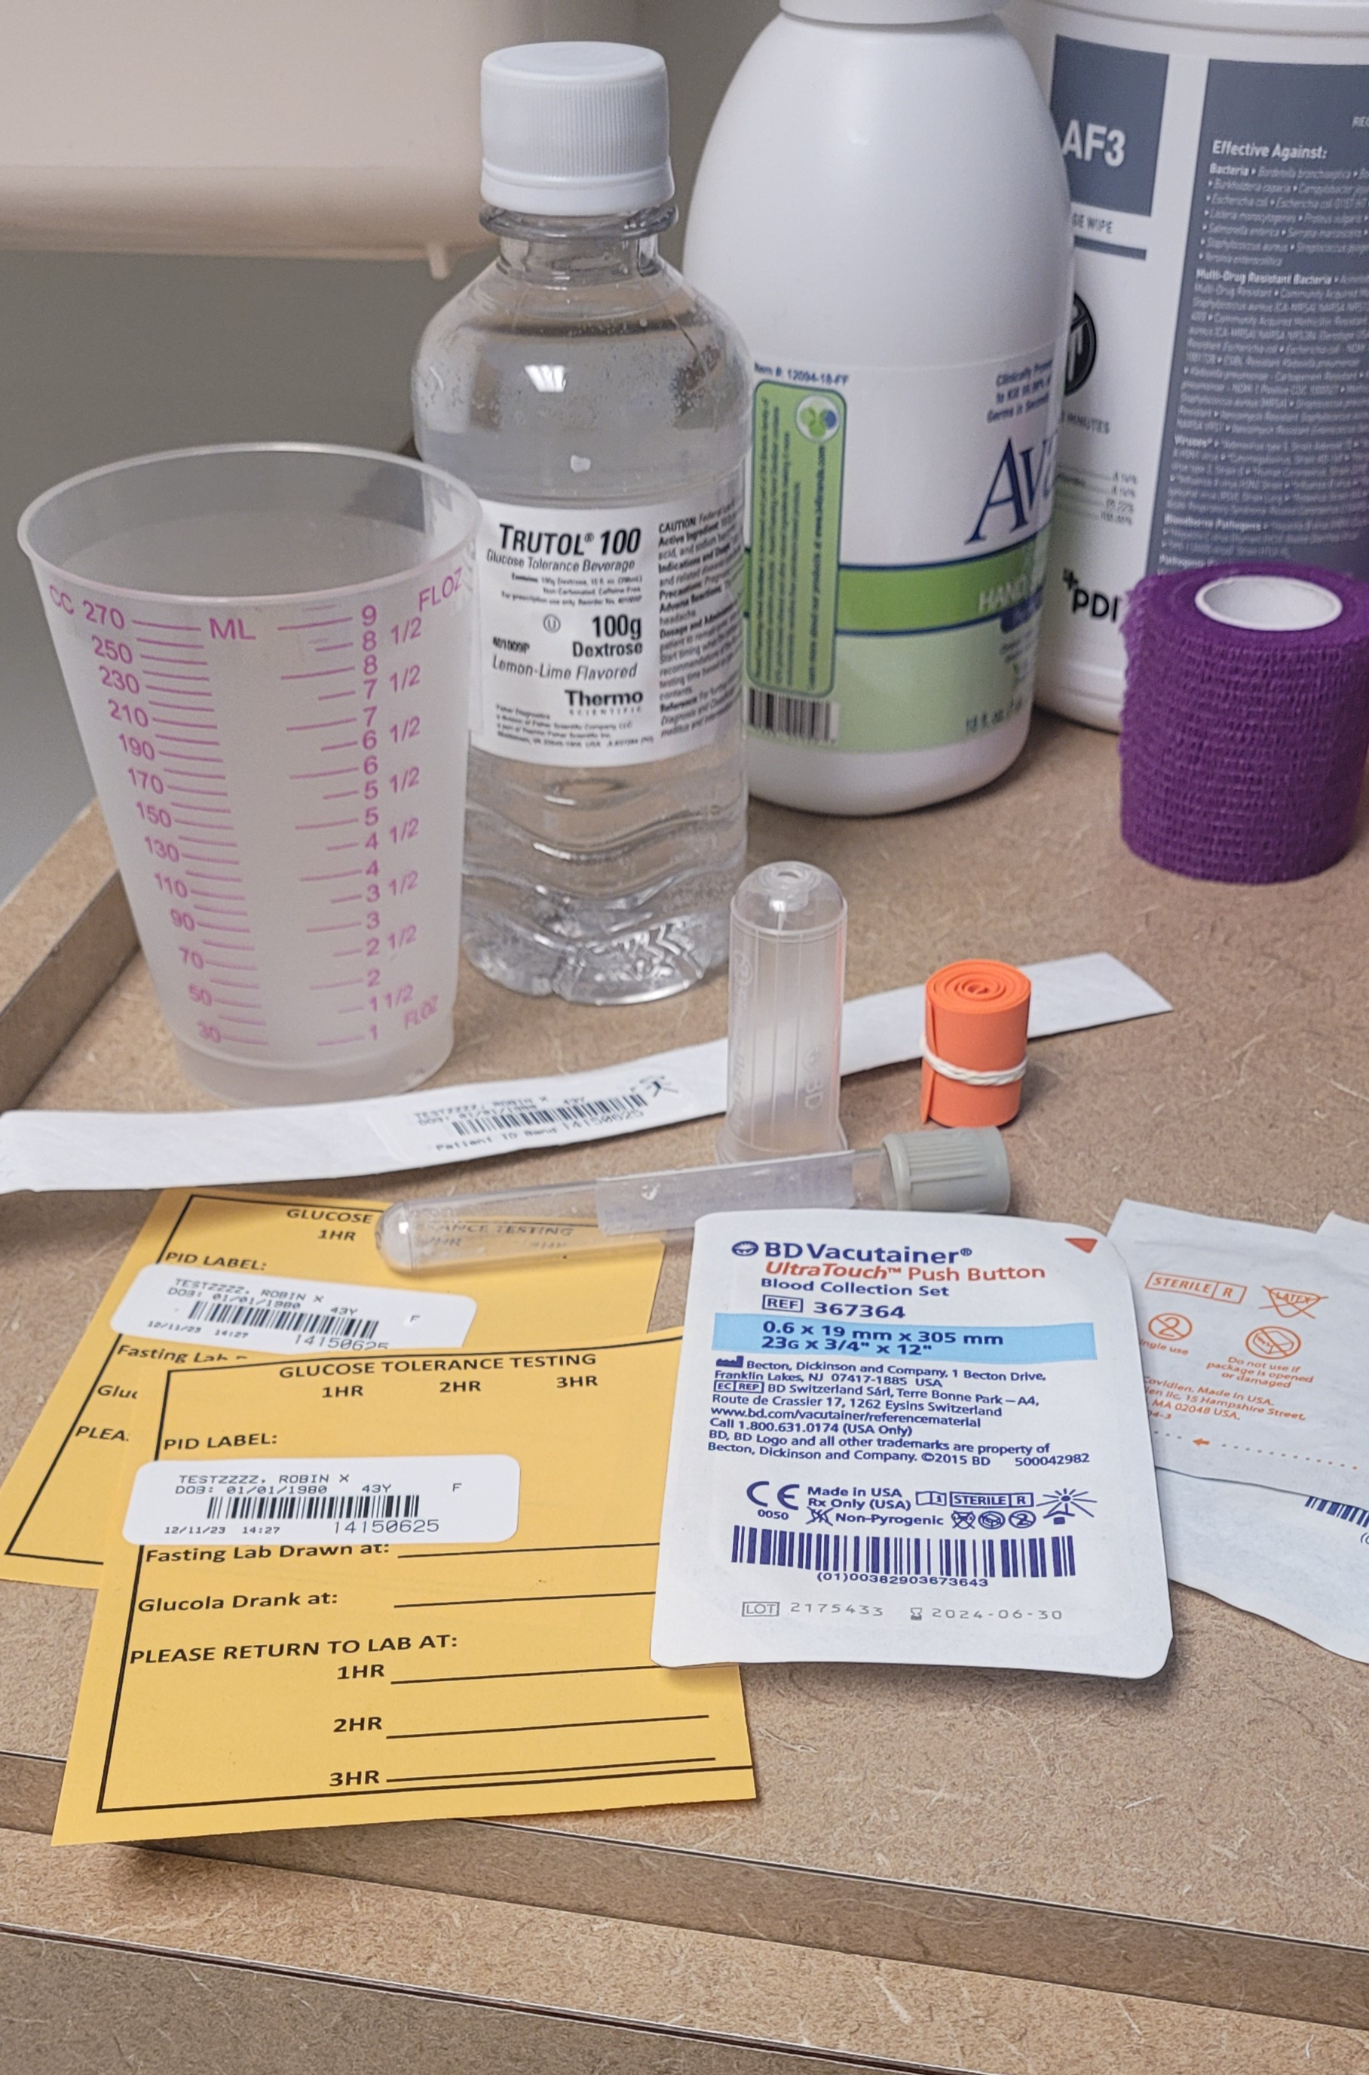
Supplies
Labels
Disposable gloves
Alcohol preps
2x2 gauze sponges
Paper or plastic tape or self-stick wrap
Tourniquet
Butterfly needle; 21 or 23 gauge
6 ml Grey top tube (fluoride)
Glucose tolerance test oral liquid
Measuring cup (single use)
Patient Communication Tool for Glucose Tolerance Testing X2

Slide 5
PROCEDURE (Part 1)
Patient will arrive to the phlebotomy area.
Prepare 2 patient communication sheets with the patient PID label on both.
Inform the patient how long the screening will take to complete (1, 2, or 3 hours pending the specific GTT ordered).
Assemble equipment (glucose tolerance test oral liquid 100gm and measuring cup).
Explain the procedure to the patient.
If this is a 2- or 3-hour GTT, the patient MUST be fasting (cannot eat, drink, chew gum, or smoke) for 8 hours prior to test.

Slide 6
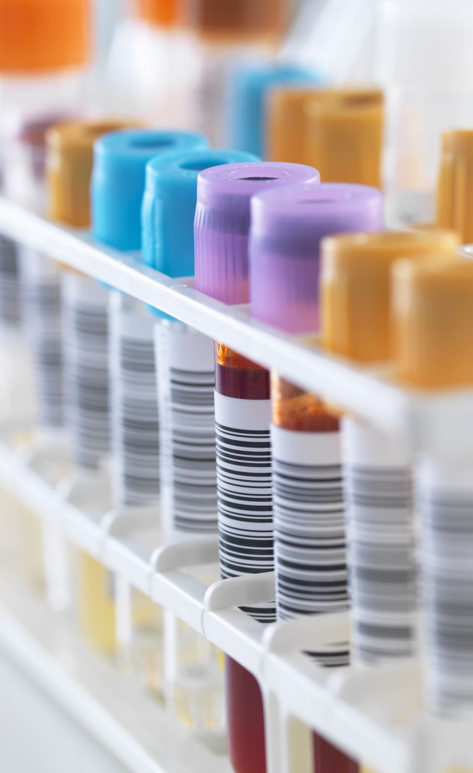
PROCEDURE (Part 2)
Collect fasting glucose (if applicable) and all other lab orders needed with the exception of the 1-, 2- or 3-hour post drink labs.
Check the EPIC GTT order to see the volume of Glucola the patient needs to drink.
Phlebotomist will pour off the volume of the Glucola that the patient needs to drink (50gm (150 mL), 75gm (225 mL), or 100gm (300 mL).
Observe the patient as they drink the Glucola. Measuring cup is single use.
**NOTE: The patient must drink ALL OF the stated volume within 5 minutes (1-hour) and 10 minutes (2&3-hour).

Slide 7
PROCEDURE (Part 3)
Write on both copies of the glucose tolerance test sheet the time the fasting lab was drawn, the time the patient drank the Glucola, and the time they need to return to the lab (1, 2 and 3 hours from the time they completed the drink).
Give one copy to the patient and verbally tell them the time they need to return to the lab.
You may call the patient back to a draw room about 3 minutes before the patients stated draw time.
Follow standard phlebotomy procedures when drawing the patient’s blood.
**NOTE: If the patient arrives outside the allowed draw time window (10 minutes), call the ordering provider to cancel.
Keep one copy as a reminder for staff in lab.

Slide 8

Special Consideration
Pay close attention to the order provided by the physician.
The amount of oral liquid glucola to be administered, along with the exact time frame of the test, is detailed in the order.
Example:

Slide 9
Administering Oral Liquid Glucola
Select the correct glucose drink. Read the label on the container for identification of the glucose drink. Double check label before preparing the glucose drink and after administration.
For 2- and 3-hour GTT, make sure the patient has been fasting (cannot eat, drink, chew gum, or smoke) for 8 hours prior to medication administration.
Wash hands thoroughly and don patient care gloves.
Identify patient by 2 patient identifiers.
Administer glucose drink at the appropriate time for the intended effect.
Observe the patient consume the glucose drink within a 5-minute period (1-hour) or 10-minutes (2 &3-hour).
Inform the patient that they need to remain fasting (not eat, drink, chew gum, or smoke) during the entire test.
Wash hands after administration of glucose drink.

Slide 10
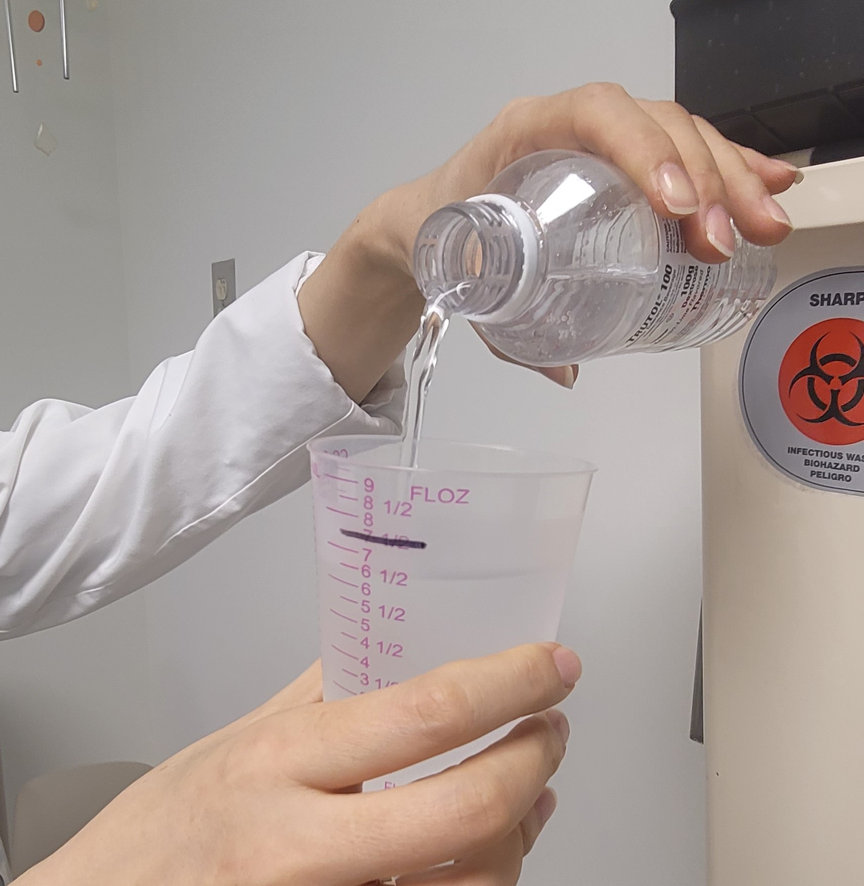
Glucola Dosing
The order will specify the dosage for the glucose tolerance test in grams
Example:
Dosing Guidelines:
  1-hr GTT = 50gm (150 mL)
  2-hr GTT = 75gm (225 mL)
  3-hr GTT = 100gm (300mL)

Slide 11
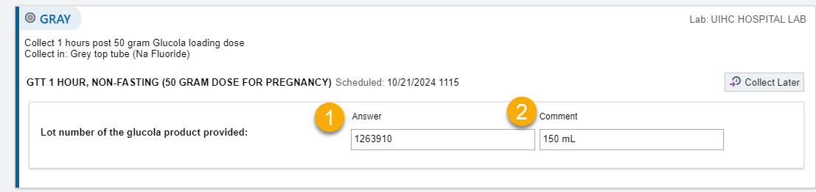
Documentation in EPIC
After you’ve released the order in EPIC, prior to printing the labels for collection…
Enter the lot # of the product you are giving the patient.
Enter the amount of glucola you have given the patient.

Slide 12
Extenuating Circumstances
If the patient questions the appropriateness of the glucose drink being administered, check the physician’s order. Contact OBGYN clinic if the patient refuses the medication.
If the patient vomits, the test will need to be repeated at a later date. Notify the clinic to cancel.
If the patient arrives outside the allowed draw time window (10 minutes), call the ordering provider to cancel.
12

Slide 13
REFERENCES
Department of Nursing – Guideline DN.G.AC.21.60 Glucose Testing for Patients in the Obstetric and Gynecology (OB/GYN) Clinics

