Slide 1
Abbott i-STAT® System Operation

Slide 2
Abbott i-STAT® System Operation
The following slides contain video segments for instruction on i-STAT usage.

Slide 3
Abbott i-STAT® System Operation
CMH does NOT use glucose test strips with the i-STAT system

Slide 4
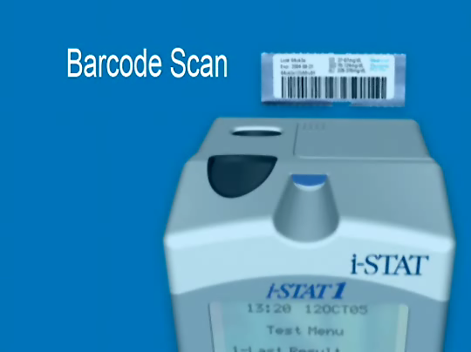
Abbott i-STAT® System Operation
*********NOTE*********
CMH does not utilize the glucometer strip function with the i-STAT analyzers.
Use Barcode Scan for:
1. User ID (employee badge)
2. Patient ID (armband)
3. Cartridge Lot Number
4. Control Lot Number
5. External Simulator

Slide 5
Abbott i-STAT® System Operation

Slide 6
Abbott i-STAT® System Operation

Slide 7
Abbott i-STAT® System Operation

Slide 8
Abbott i-STAT® System Operation Cartridge Handling
Standard precautions must be used when handling patient specimens and quality control material
Cartridges are stored refrigerated at 2°-8°C until manufacturer’s expiration OR at room temperature for time designated on individual cartridge package (example 14 days or 2 months).
Cartridges may not be returned to refrigerator after warming to room temperature.
At temperatures < 2° C, cartridges must be discarded
At temperatures > 8° C, cartridges expire at room temp expiration.

Slide 9
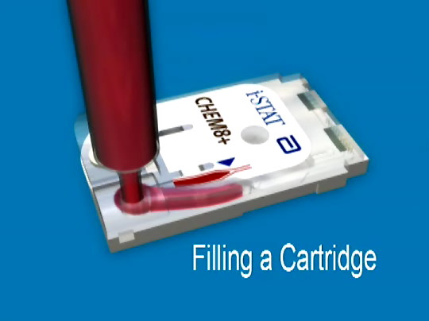
Abbott i-STAT® System Operation
The chamber in the cartridge should be filled to the blue triangle mark without spilling over the sample well.

Slide 10
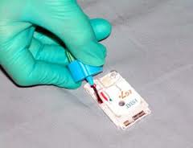
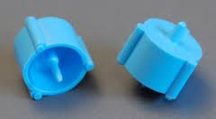
Abbott i-STAT® System Operation
For Creat, Chem8+ and Troponin testing we will be using a light green lithium heparin tube and a Saf-Evac™ device to load the cartridges.

Slide 11
Abbott i-STAT® System Operation
*********NOTE********
For CMH i-STAT analyzers, you may be prompted to enter the user ID, cartridge information and patient ID or quality control information BEFORE inserting the cartridge.
Follow the prompts on the analyzer.

Slide 12
Abbott i-STAT® System Operation NOTES:
Patient identification is obtained by scanning the patient’s armband where applicable.
For Troponin cartridges, a Chem8+ cartridge must be run first to screen for hemolyzed specimens. (Hemolysis will cause an increase in potassium and a decrease in troponin.)
Analyzers must be cleaned between patients with a Super-Sanicloth.
Printed results from the i-STAT1 printer are not acceptable as a permanent chartable record. The results are printed on heat sensitive paper and will fade with time.

Slide 13
Abbott i-STAT® System Operation NOTES:
An internal electronic simulator automatically runs every 8 hours to determine if the analyzer is working properly.

Slide 14
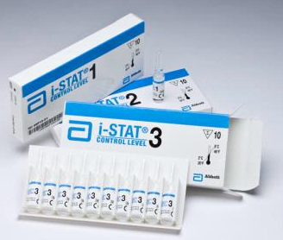
Abbott i-STAT® Quality Control
ACT Controls
ABG, Creat Controls
Troponin Controls
CHEM8+ Controls

Slide 15
Abbott i-STAT® Quality Control
Liquid Quality Control is required in the following intervals:
CHEM8+, Crea, Troponin:
Monthly
With each new lot/shipment
ABG and ACT:
Every 8 hours during times of testing
With each new lot/shipment

