Slide 1
B-ketone testing
on precision xceed pro meter

Slide 2
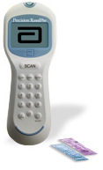
B-ketone testing on precision xceed pro meter
  The Precision XCeed Pro Meter tests for β-ketones in whole blood as well as glucose.
  Point of Care β-Ketone testing will be performed with a capillary puncture by ED and ICU. All other β-Ketones will be drawn in a small green lithium heparin tube and sent to Lab for testing

Slide 3
B-ketone testing on precision xceed pro meter
The Precision Xceed Blood β-Ketone test strips have chemistry to specifically measure
β-hydroxubutyrate, the primary ketone body developed when a patient is developing ketoacidosis.

Slide 4

B-ketone testing on precision xceed pro meter
The β-Ketone Strips are purple and are handled in the same manner as the glucose strips.

Slide 5
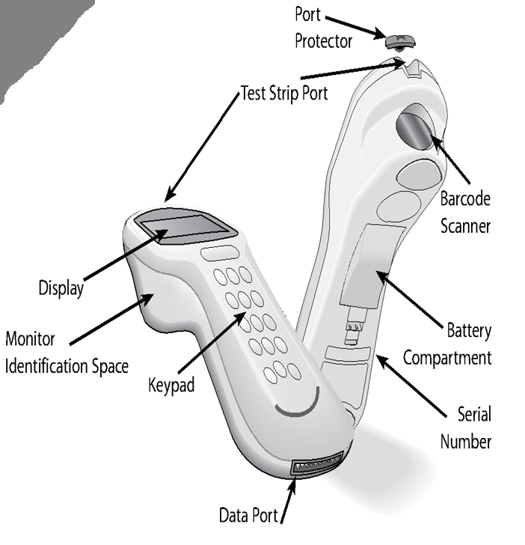
Abbott PXP Components
Port Protector
Test Strip Port
Barcode Scanner
Display
Keypad
Data Port
Battery Compartment

Slide 6

Quality Control (QC) Testing Requirements
Β-Ketone strips use the same controls as the glucose strips
Both B-Ketone and glucose QC are not required if only testing for one of the analytes. For example: a glucose test is needed. The glucose test may be performed if the glucose QC is acceptable. Ketone QC would not have to be performed in this case. The meter knows which test is requested by the strip that is scanned.

Slide 7
Quality Control (QC) Testing Requirements
Controls are required once every 24 hours as needed for testing , e.g. glucose test – run QC/ no ketone test - no QC
One high and one low control are required with each QC test
Control solutions expire 90 days after opening or on the manufacturer’s expiration date – whichever comes first
Open and Expiration dates are to be written on each vial.
Dates are to be checked daily to prevent the use of expired reagents.
Failed QC may be repeated once
Subsequent QC may be run ONLY if there has been a change to determine the failure problem, i.e..
  Use new vial of QC solution
  Use new box of strips

Slide 8
Patient Testing
Verify correct patient by confirming two patient identifiers (name and date of birth)
Turn meter on
Choose patient test
Scan user ID (Employee badge) – DO NOT SHARE BADGES
Enter patient ID by one of the following methods:
  Scan patient armband (required for areas where patients are fitted with one such as ED and inpatient areas)
  Hand enter patient ACCOUNT number (not medical record number) for those patients who are registered in the CMH system but are not issued an armband
  Enter an alternate identifier ONLY in facilities who do not register their patients in the CMH system
Scan test strip barcode.
  The test strip lot number and expiration date, control solution ranges, and lot specific calibration information are all entered into the meter upon scanning the test strip barcode.
Enter sample type if prompted (capillary or venous)
Insert strip in meter

Slide 9
Patient Testing (continued)
Obtain blood sample
  Follow capillary blood collection procedure
  Fresh, whole blood from venipuncture may be used [fresh at point of care or placed in a small green lithium heparin tube and tested within 30 minutes]
  Whole blood from a line is discouraged due to contamination from solutions
Apply sample to top or end of test strip
  DO NOT HOLD THE METER IN A VERTICAL FASHION – THIS WILL ALLOW THE SAMPLE TO RUN INTO THE SAMPLE PORT AND DAMAGE THE ELECTRODES
Ensure that the sample is adequate in amount (you will hear an audible beep and the 10 sec. testing countdown will automatically start when amount is adequate). If not, a second drop of blood may be added within 30 seconds.
Review patient result
Dock meter – results will cross to HMS

Slide 10
Expected results
The blood β-ketone test measures β-hydroxybutyrate (β-OHB) the most important of the three ketone bodies in the blood.
Normally, levels of β-OHB are expected to be <0.6 mmol/L. β-OHB levels may increase if a person fasts, exercises vigorously or has diabetes and becomes ill.
If the blood β-Ketone result is 0.0 mmol/L and the blood glucose level is 300 mg/dl or higher, or the results are not consistent with physical symptons, repeat both the ketone and the glucose tests with new test strips.
If the blood β-Ketone result is between 0.6 and 1.5 mmol/L and the blood glucose level is 300 mg/dl or higher, this may indicate development of a problem that could require medical intervention.
If the blood β-Ketone result is higher than 1.5 mmol/L and the blood glucose result is 300 mg/dl or higher, this may indicate the risk of developing diabetic ketoacidosis (DKA).

Slide 11
Result interpretation
Β-Ketone Result (mmol/L) | Blood Glucose Level (mg/dl) | Action/Interpretation
<0.6 |  | Expected level
0.0 | >=300 | Repeat ketone and glucose testing
0.6 – 1.5 | >=300 | May indicate need for medical intervention
>1.5 | >=300 | At risk for DKA

Slide 12
Recalling Patient Results
Turn meter on
Press menu
Choose 1- Data Review
Scan or enter your ID
Choose 3- All Patient Data
Find Result
  Patient ID will be at top of screen
  Time and date will flash
  Press 1 to scroll back through results

Slide 13
Docking the Precision XCeed Pro Meter
Docking the meter performs the following functions:
  Downloads the QC and Patient test results.
  Uploads information from the PXP system to the meter including:
    User ID
    Competency due dates
    Strip information
        Lot Number, expiration date
    Reference Ranges
Meters should be docked as soon as patient testing is complete
Successful docking has occurred when the arrows on the display are moving in a counterclockwise motion
If the error message “last upload incomplete” is seen on the display, the meter did not dock successfully.
DO NOT LEAVE METER IN DOCKING STATION

Slide 14
Maintenance
(cleaning and disinfecting)
Cleaning:
  Wipe meter down with an alcohol based cleaner after each patient use for infection control
    Super Sani-cloth is acceptable
    Visually inspect the port protector for blood and clean or replace if contaminated
Disinfecting:
  Each day when performing controls
    Wash meter thoroughly with Super Sani-Cloth
    Remove and disinfect or replace port protector if necessary
    Document on maintenance sheet
Isolation Patients
  Follow isolation protocol. Isolation bags for the glucometer are available on the isolation carts.

Slide 15
Troubleshooting
Follow directions on meter screen
Most common error is “wet strip error”
  Most likely cause is sample has entered test strip port.
  Allow meter to dry and use another meter
  Contact POC Coordinator and send meter to Lab.
Refer to troubleshooting section in PXP user’s guide (located at G:\!CMH Employees\Point of Care Policies\Waived Testing)

