Slide 1
Lessons
Introduction to the i-STAT System
i-STAT System Orientation
Sample Collection and Handling
Performing a Patient Test
Quality Control
Troubleshooting

Slide 2
Lesson 1
Introduction to the i-STAT System

Slide 3

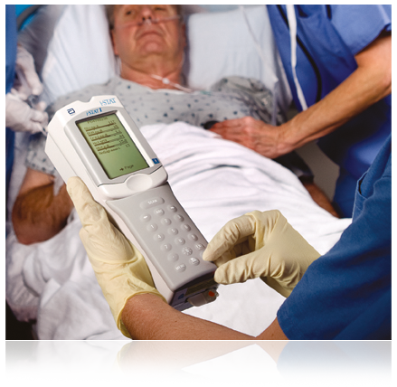
Introduction to the i-STAT System

Slide 4

i-STAT System Bedside Testing – Imagine
Results
Accurate and reliable
Lab-quality
i-STAT System
Easy to use
Provides results within minutes
Requires only a few drops of blood

Slide 5
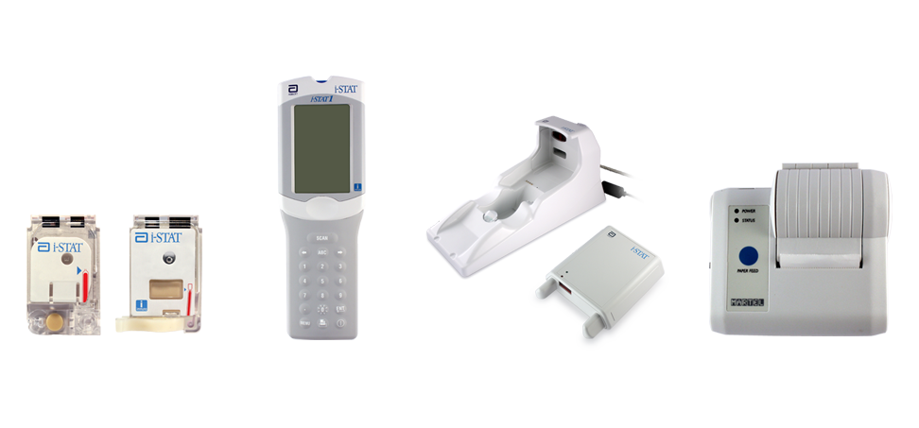
Components of the i-STAT System
Primary System Components
Cartridge
Handheld
Downloader
Printer

Slide 6
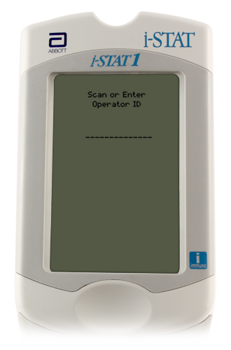
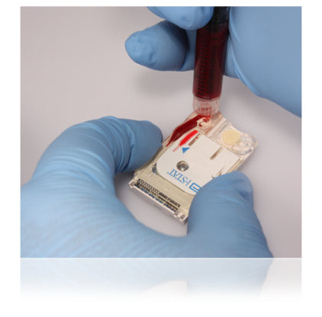
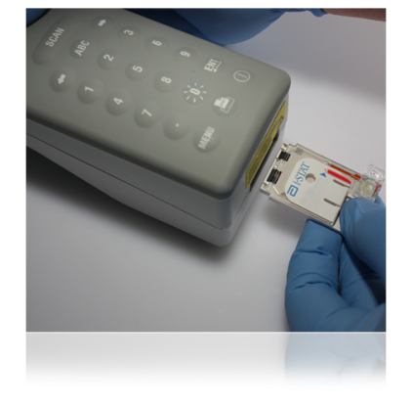
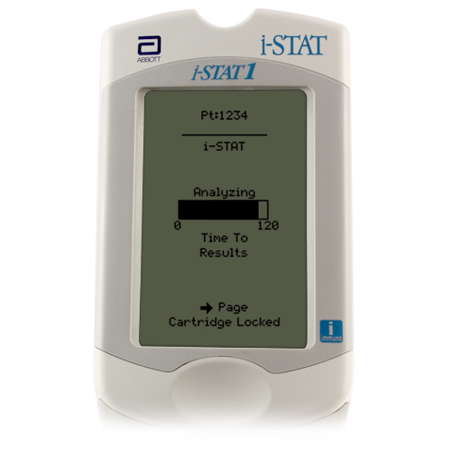
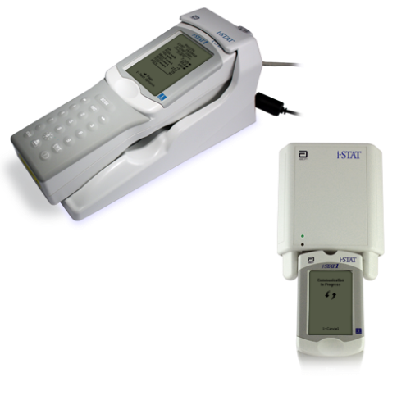
The i-STAT System Testing Process
Enter information into handheld
Obtain the blood specimen and fill cartridge
Insert cartridge; results will appear within minutes
Download results

Slide 7
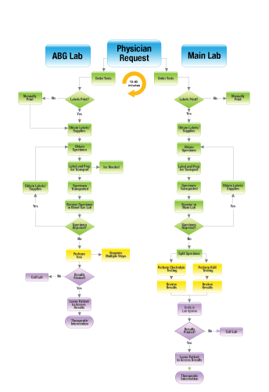
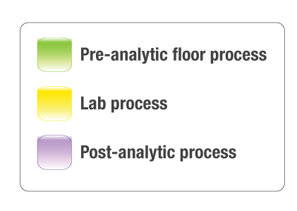
Traditional Lab Process vs i-STAT System Process
Traditional Blood Analysis Process
Lab Process
Many steps and handoffs
Variability in turnaround time for results
Testing is not performed at the patient’s bedside

Slide 8
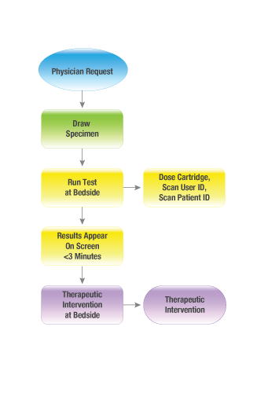
Traditional Lab Process vs i-STAT System Process
i-STAT System Process
Fewer steps
Faster results
Entire process managed by a single person at the patient’s bedside
i-STAT System Process

Slide 9


Why Should You Care About Switching to the i-STAT System?
The i-STAT System
Expedites the delivery of information when every minute counts
Reduces the number of steps required to obtain lab results
Brings testing to the bedside
Requires smaller sample size
Decreases wait time for lab-quality results

Slide 10
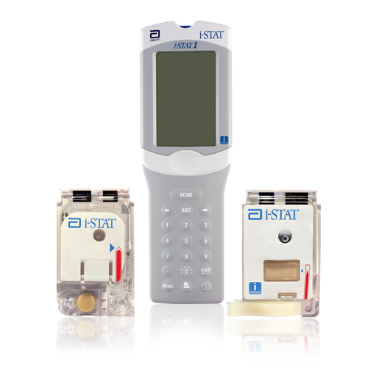
Goals of the i-STAT System Training Program
In subsequent lessons of this training program, you will learn about:
The i-STAT System features
Sample Collection and Handling
Performing Patient Tests
Quality Control, if applicable
Troubleshooting

