Slide 1
Lesson 2
i-STAT System Orientation

Slide 2
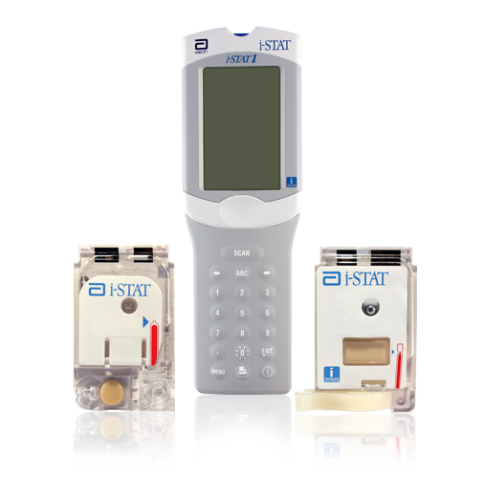
Welcome and Learning Objectives
At the end of this lesson, you will be able to:
Identify the features and components of the i-STAT System
Explain the basic operational process
Explain routine care of the handheld

Slide 3
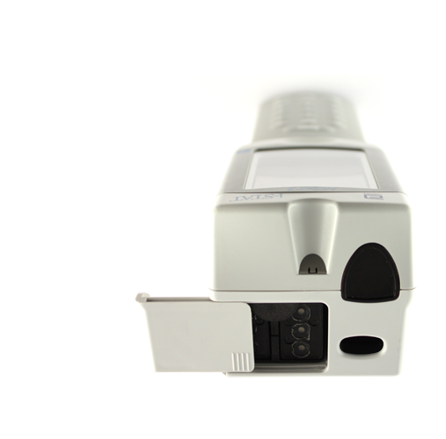
Handheld External Components
Handheld: Top
Battery compartment
Infrared eye
Barcode scanner
Battery
compartment
Infrared eye
Barcode scanner

Slide 4
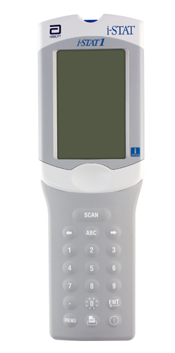
Handheld External Components (cont.)
Handheld: Front
Display screen
Keypad
  SCAN key
  Arrow keys
  ABC key
  Number keys
  Decimal Point key
  ENT key
  MENU key
  Power key
Display screen
SCAN key
Arrow keys
ABC key
Number keys
Keypad
Decimal Point key
MENU key
ENT key
Power key

Slide 5
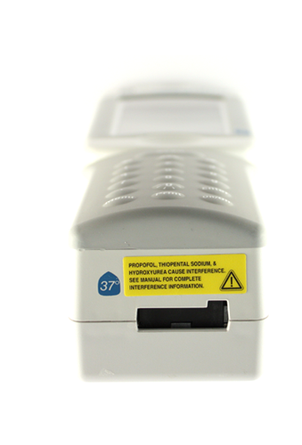
Handheld External Components (cont.)
Handheld: Bottom
Cartridge port
Cartridge Port

Slide 6
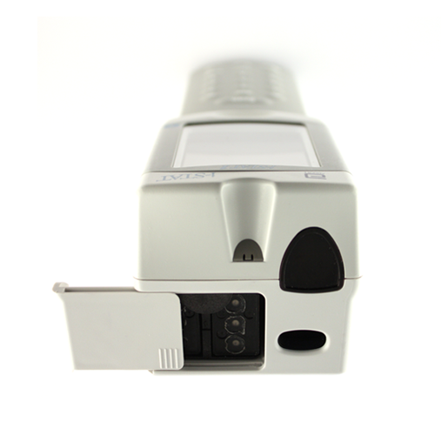
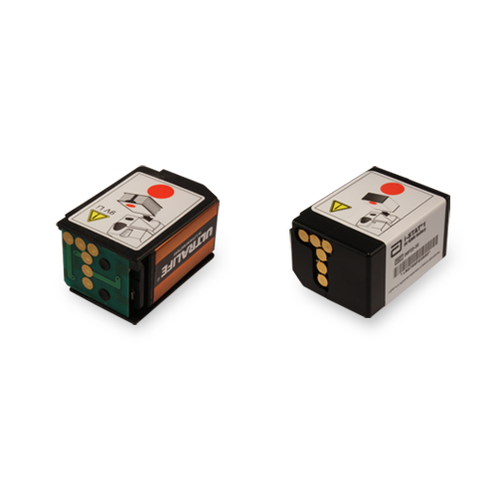
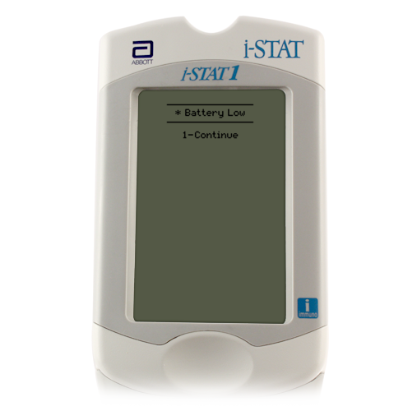
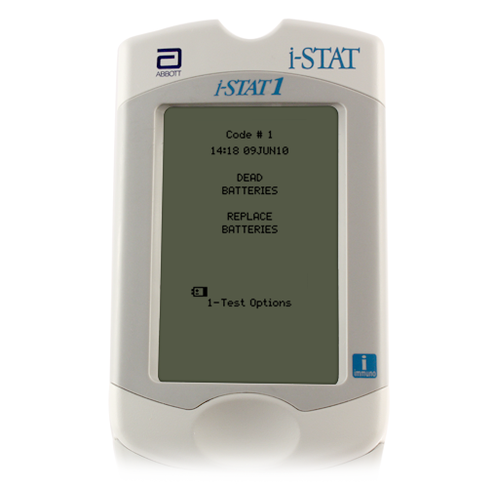
Batteries: 9 Volt
Battery compartment
9-volt lithium disposable batteries
Abbott rechargeable battery pack
Change the batteries when:
“Battery Low ” message is displayed
9-volt lithium disposable batteries
Abbott rechargeable battery pack
Battery
compartment

Slide 7
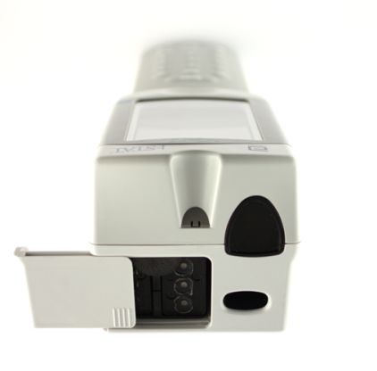
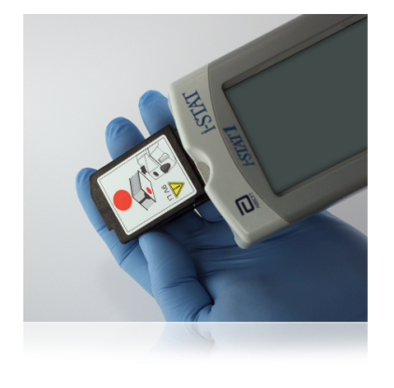
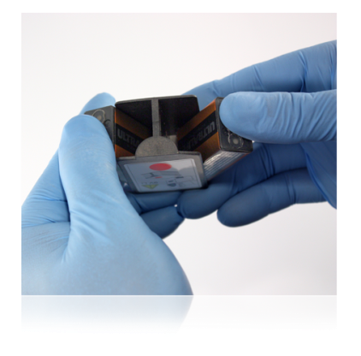
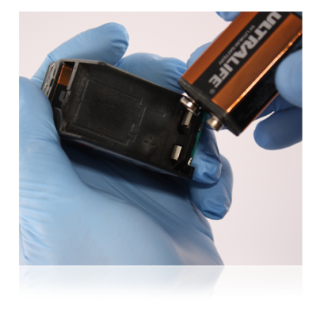

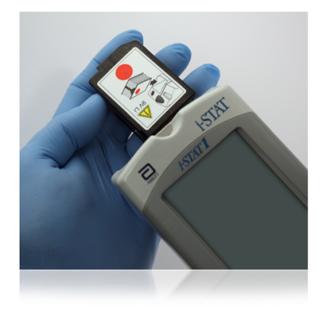
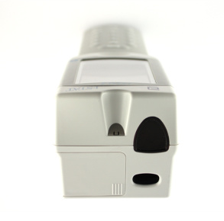
Batteries: Disposable 9 Volt
For 9-volt batteries
Slide open the battery compartment
Tilt the handheld to slide out the battery carrier
Remove the batteries by pushing sideways with thumb
Insert new batteries into the carrier
Replace the carrier with gold dots facing down and red dot facing the screen
Slide battery compartment cover back into place

Slide 8
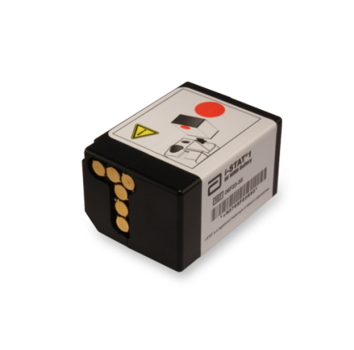
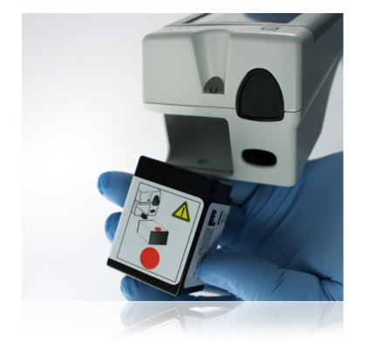

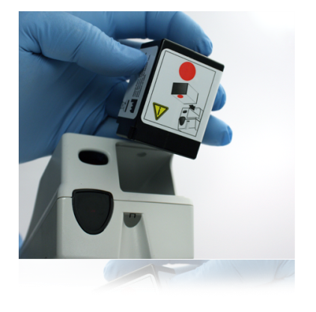
Batteries: Rechargeable
For rechargeable batteries
Slide open the battery compartment
Tilt the handheld to slide out the battery pack
Insert new battery pack with gold dots facing down and red dot facing the screen
Slide the battery compartment cover back into place
Important notes:
Rechargeable batteries are NOT disposable. The battery pack can be recharged and reused.
Use only a rechargeable battery pack purchased from Abbott Point of Care.

Slide 9
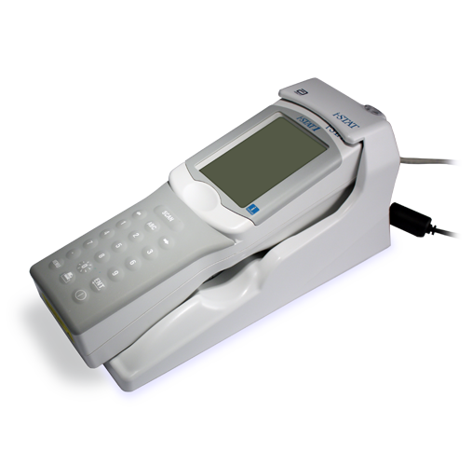
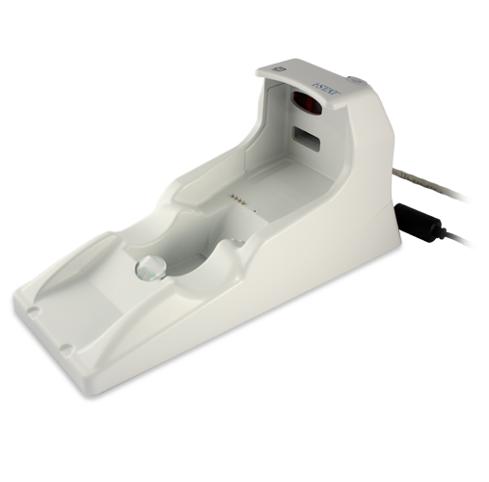


The Rechargeable Battery Pack
Recharging the batteries
In the handheld
In the Downloader/Recharger battery compartment
Recharging in the handheld
Handheld must be properly placed in Downloader/Recharger
Red or green status light illuminates when charging
Battery compartment
Status Light

Slide 10
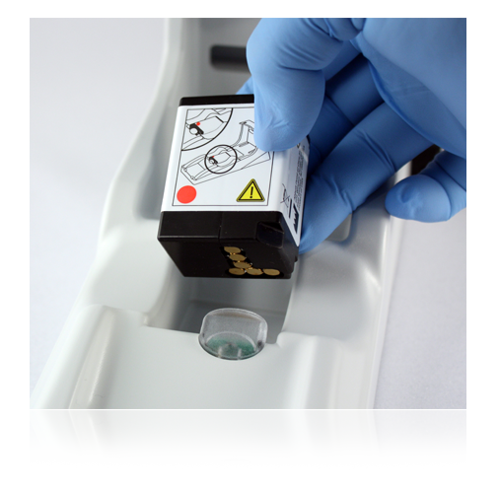
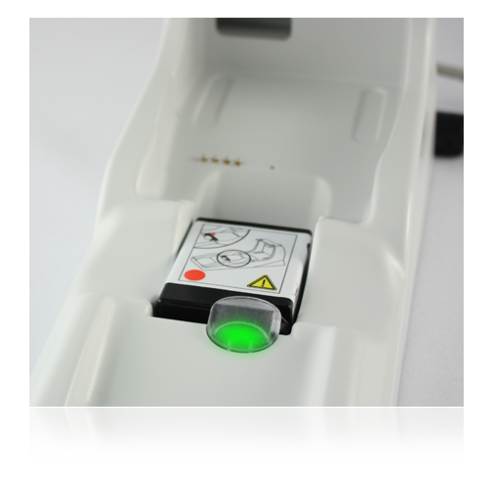
The Rechargeable Battery Pack (cont.)
Recharging in the Downloader/Recharger
Use the spare battery compartment
Red dot facing up; gold contact pads facing the foot
Green light near the battery compartment illuminates when charging

Slide 11
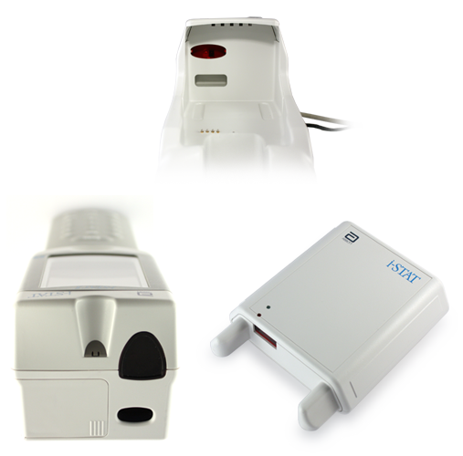
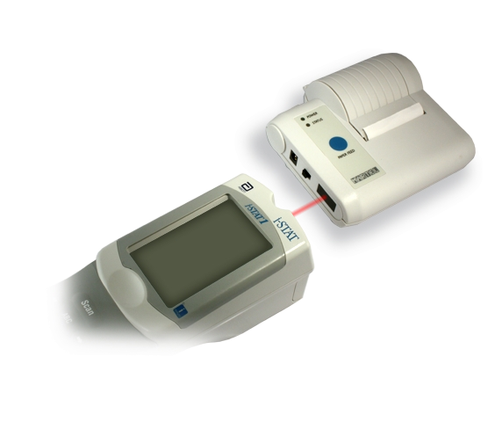
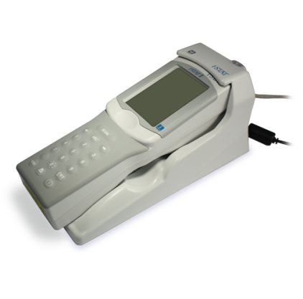
The Infrared Communication Window
Infrared communication window
Designed for communication
  Downloaders
  Printers
Accomplished by aligning infrared communication windows
Infrared communication window

Slide 12
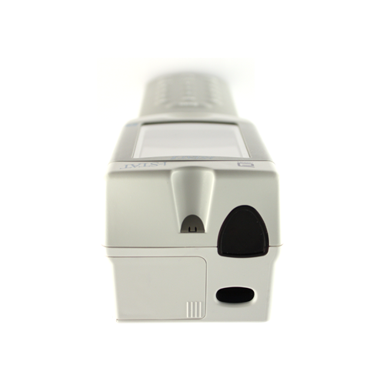
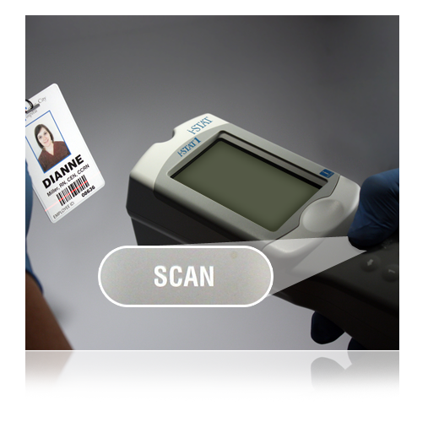
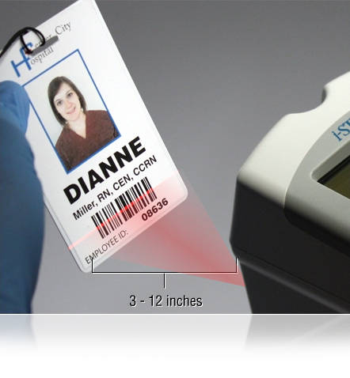
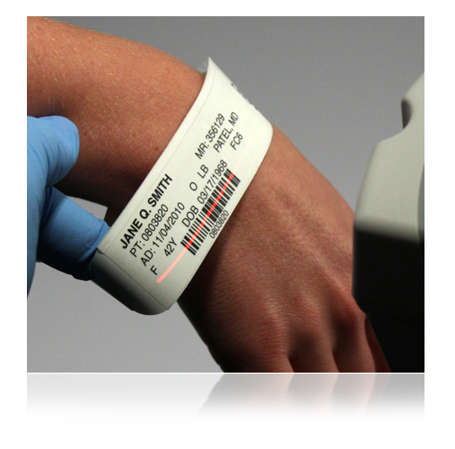
The Barcode Scanner
Used to scan
Operator IDs
Patient IDs
Cartridge lot number barcode
To scan
Hold the handheld 3 to 12 inches away from the barcode
Press and hold down the SCAN key
Laser beam must cover the entire length of the barcode
Wait for the beep or for laser beam to disappear
Release the SCAN key
Repeat if prompted
Barcode scanner
The barcode scanner is a class II laser device. Momentary exposure is not known to be harmful—however you should never point the scanner at anyone or look into the laser beam.

Slide 13
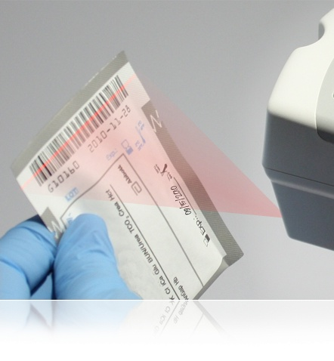
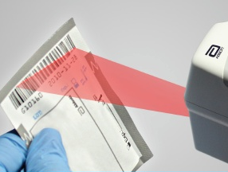
The Barcode Scanner (cont.)
If the scan is unsuccessful, try again.
Make sure the barcode is completely covered by the red beam
Press and HOLD the SCAN key
Tilt the barcode away from strong light
The barcode scanner is a class II laser device. Momentary exposure is not known to be harmful—however you should never point the scanner at anyone or look into the laser beam.

Slide 14
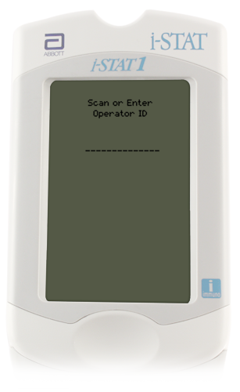
Handheld Display Screen
Display screen
Test results
Entry prompts
Troubleshooting guidance

Slide 15
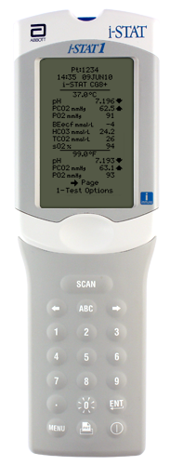
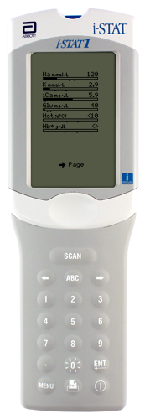
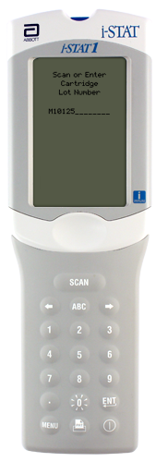

Handheld Keys: Arrow Keys
Arrow keys
Right Arrow key is for navigating pages within a test result
Left Arrow key is a backspace to clear keypad entries

Slide 16
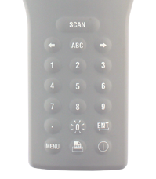
Handheld Keys: ABC Key
ABC key
Press ABC to enter letter mode
Use the Arrow keys to scroll through the list
Select the letter by pressing ABC key again
If another letter is required, press ABC again to re-enter letter mode

Slide 17
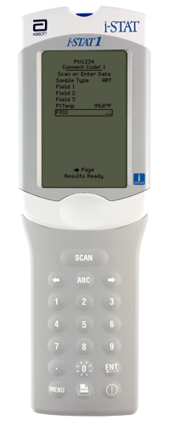
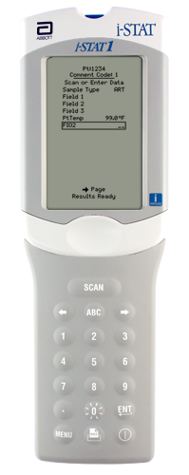
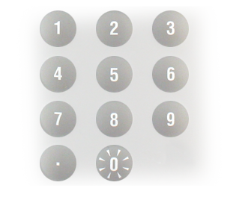
Handheld Keys: Numeric Keys and Decimal Point Key
Numeric keys and Decimal Point key
Used to enter numbers and decimal points
Press desired number to enter
Pressing and holding “0" key will enable backlight
Important note:
Data entry is only possible when prompted.

Slide 18
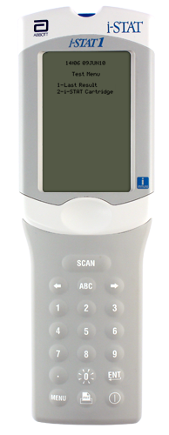
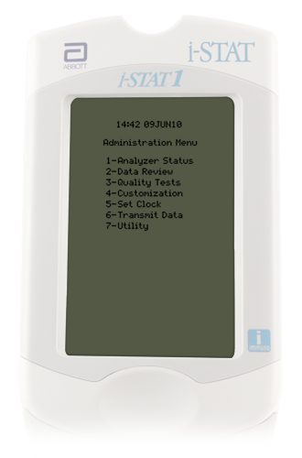
Handheld Keys: MENU Key
Menu key
Toggles between the Administration and Test menus
Escape key

Slide 19
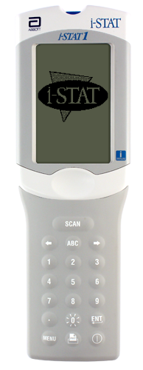
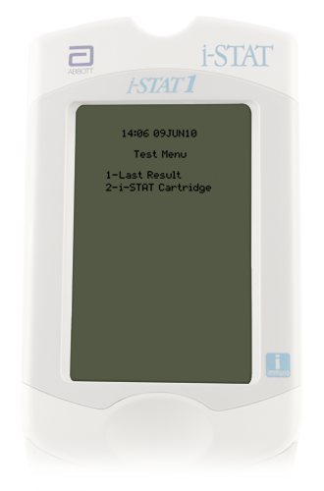
Handheld Keys: Power Key
Power key
Press to turn on the handheld
Press and hold to turn off the handheld

Slide 20
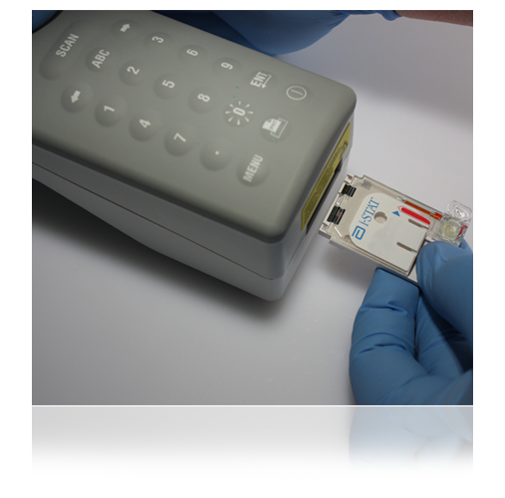
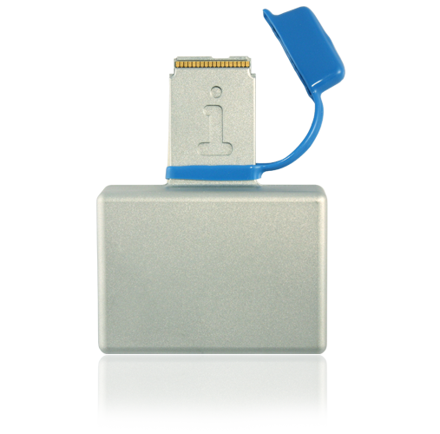
Handheld Cartridge Port
Cartridge port
i-STAT Cartridges
Electronic Simulator

Slide 21
Handheld Test Menu
Test Menu
First menu to appear
Important Note:
This menu is used for patient tests only!
Cartridge Test Menu options
1 = Last Result
2 = i-STAT Cartridge (for a patient test)

Slide 22
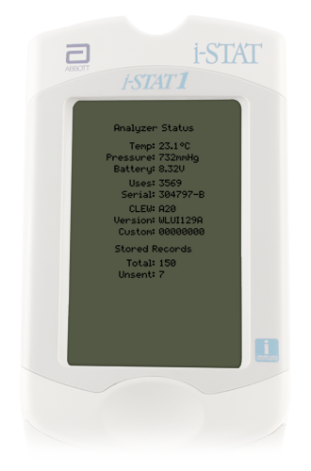
Administration Menu: Analyzer Status
Administration Menu
Analyzer Status
Analyzer Status screen
Press MENU to get to the Administration Menu
Press 1 for Analyzer Status
Information includes:
Total records
Unsent records

Slide 23
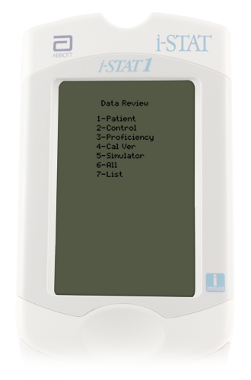
Administration Menu: Data Review
Data Review
Press MENU to get to the Administration Menu
Press 2 for Data Review
7 options for grouping or filtering stored data
View or print any stored record

Slide 24
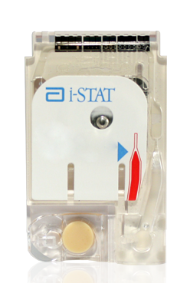
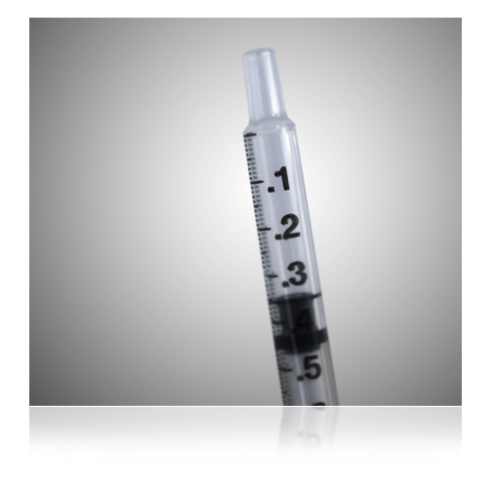
General Cartridge Information
i-STAT Cartridges
Single use
Packaged in boxes of 24 or 25
Require only a few drops of blood

Slide 25

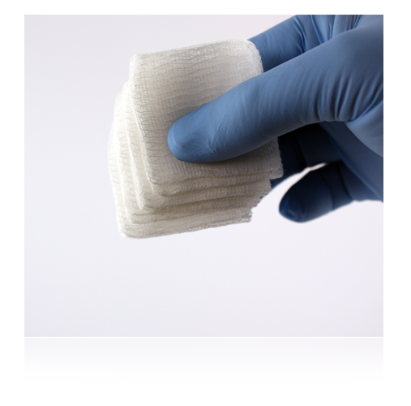
Cleaning the Handheld
Cleaning the handheld
Clean the display screen with
  Mild, nonabrasive cleaner
  Detergent
  Soap and water
  Alcohol
  10% bleach solution
  PDI® Super Sani-Cloth®
Rinse using gauze pad moistened with water
Allow to dry

Slide 26

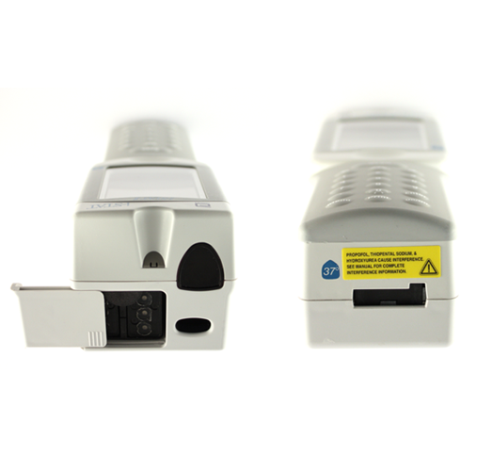

Cleaning the Handheld (cont.)
Decontaminating the handheld
  Use 1:10 bleach solution
  Soak gauze pads, remove excess solution
  Soften, then remove dried blood; do not scrape
  Clean entire surface twice
  Rinse with gauze pad moistened with tap water
Important note:
Do NOT let liquid enter the cartridge port or battery compartment.

Slide 27


Internal Electronic Simulator
Internal Electronic Simulator
Performs internal checks to ensure proper and accurate functioning
Provides independent check on the handheld’s ability to take accurate and sensitive readings
Performs test at specified intervals
Checks whether test needs to be performed each time cartridge is inserted
Performed automatically when needed before the sample is tested
Adds 20 seconds to testing cycle

Slide 28


External Electronic Simulator
External Electronic Simulator is performed if:
Required by facility
Handheld is dropped or damaged
There is an Internal Electronic Simulator failure
Test takes approximately 60 seconds
External Electronic Simulator

Slide 29
Summary
Now that you have completed this lesson, you should be able to:
Identify the features and components of the i-STAT System
Explain the basic operational process
Explain routine care of the handheld

