Slide 1
Lesson 4
Performing a Patient Test

Slide 2
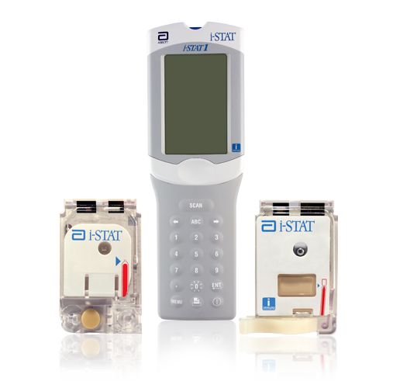
Welcome and Learning Objectives
At the end of this lesson you will be able to:
Prepare the i-STAT 1 handheld
Fill, close, and insert a cartridge
Enter chart page data
View test results
Transmit and print test results

Slide 3
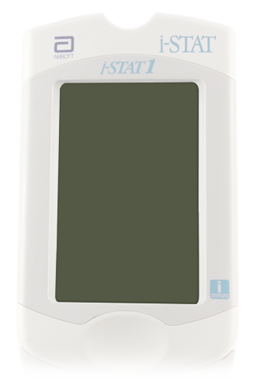
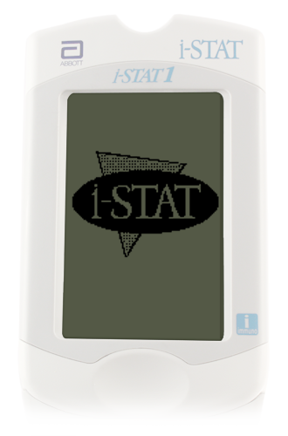
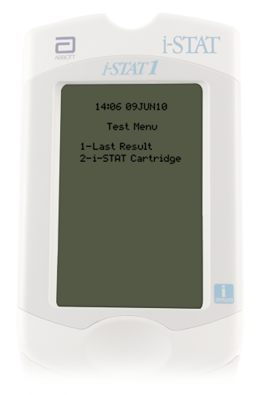
Preparing the Handheld: Turning the Handheld On and Selecting Patient Test
Turn on the handheld
Press the Power key
Test Menu will be displayed
Patient Test option
Option 2- i-STAT Cartridge
Press 2 on the keypad

Slide 4
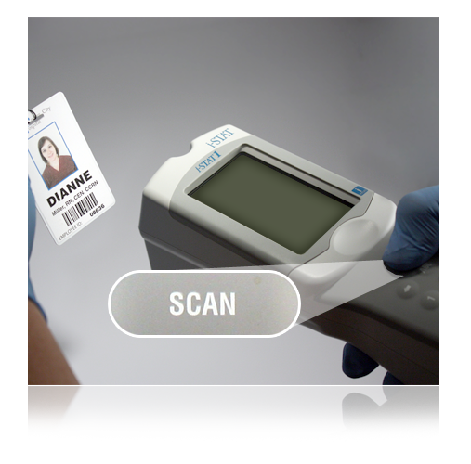
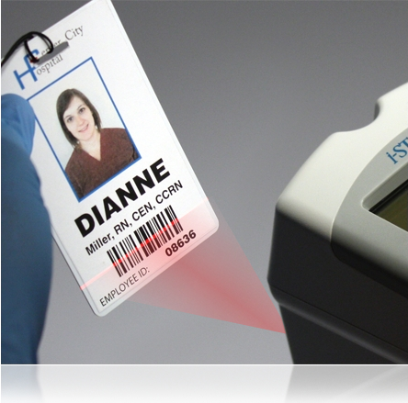
Preparing the Handheld: Entering Operator ID via Barcode Scan
Scan Operator ID
Hold the handheld 3 to 12 inches away from the barcode
Press and hold down the SCAN key
Laser beam must cover the entire length of the barcode
Wait for the beep or for laser beam to disappear
Release the SCAN key
Repeat if prompted
3 – 12 inches
3 – 12 inches

Slide 5
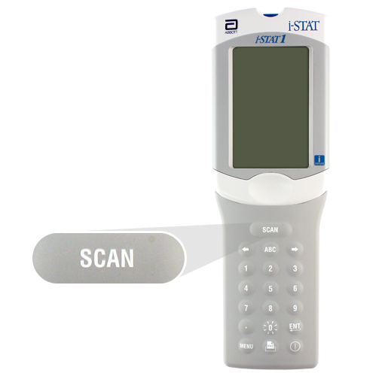
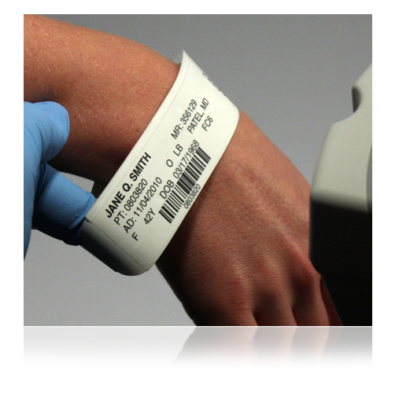
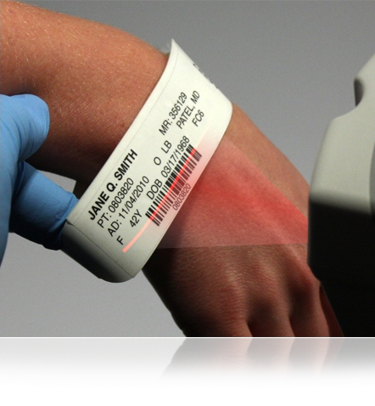
Preparing the Handheld: Entering Patient ID via Barcode Scan
Scan Patient ID
Hold the handheld 3 to 12 inches away from the barcode
Press and hold down the SCAN key
Laser beam must cover the entire length of the barcode
Wait for the beep or for laser beam to disappear
Release the SCAN key
Repeat if prompted
3 – 12 inches

Slide 6
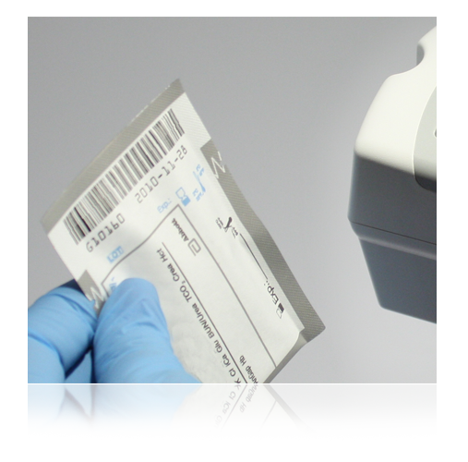
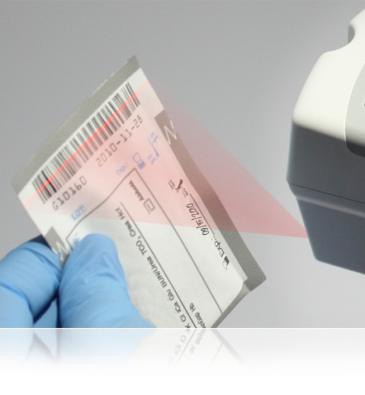
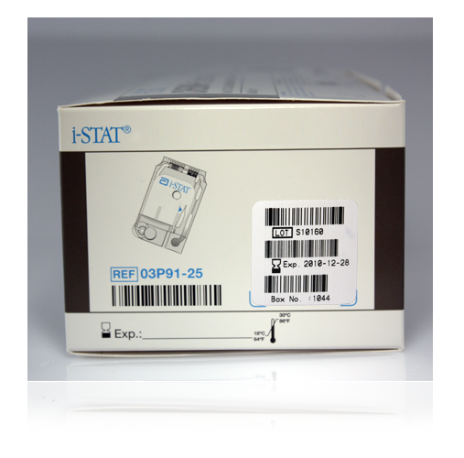
Preparing the Handheld: Scanning Cartridge Lot Number
Scan cartridge lot number
Hold the handheld 3 to 12 inches away from the barcode
Press and hold down the SCAN key
Laser beam must cover the entire length of the barcode
Wait for the beep or for laser beam to disappear
Release the SCAN key
Repeat if prompted
3 – 12 inches
Very Important Reminder:
The correct barcode to scan is the barcode on the cartridge pouch, not the one on the cartridge box!

Slide 7
Preparing the Handheld: Entering Cartridge Lot Number
Scan cartridge lot number
Hold the handheld 3 to 12 inches away from the barcode
Press and hold down the SCAN key
Laser beam must cover the entire length of the barcode
Wait for the beep or for laser beam to disappear
Release the SCAN key
Repeat if prompted
3 – 12 inches
Very Important Reminder:
The correct barcode to scan is the barcode on the cartridge pouch, not the one on the cartridge box!

Slide 8
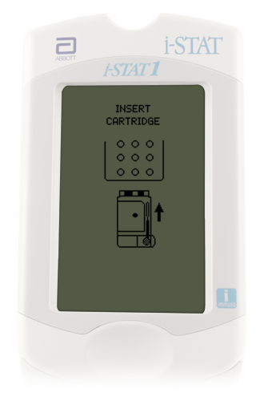
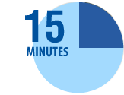
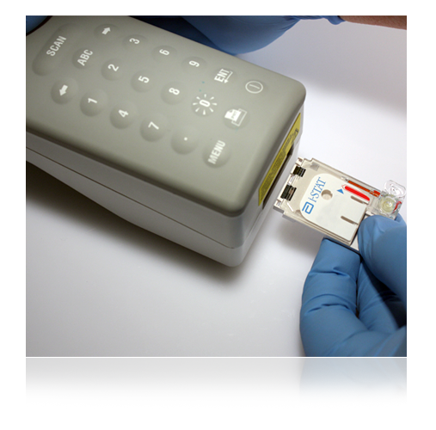
Running a Patient Test: The Insert Cartridge Screen
From the Insert Cartridge prompt, you have 15 minutes to:
Open cartridge pouch
Obtain sample
Fill cartridge
Close cartridge
Insert cartridge into handheld
Sensors first
Label facing up
Note: After 15 minutes the handheld will turn off and require re-entry of information to perform a test.
Important note:
Always mix properly and test promptly!

Slide 9
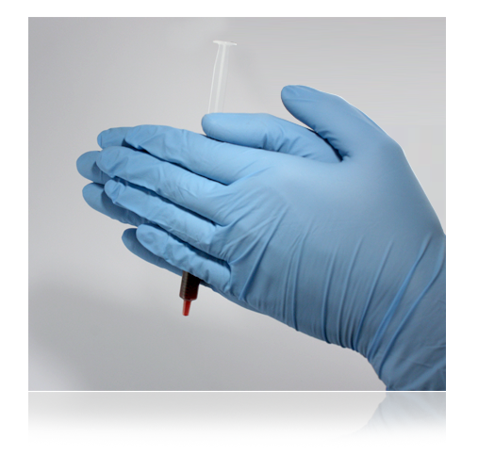
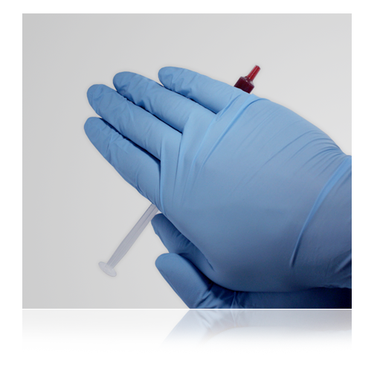
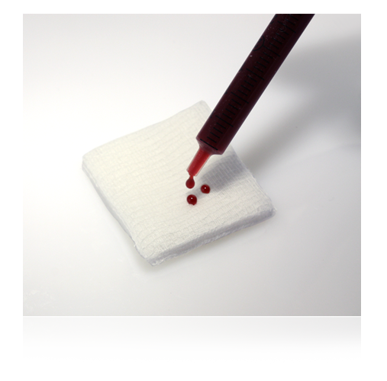
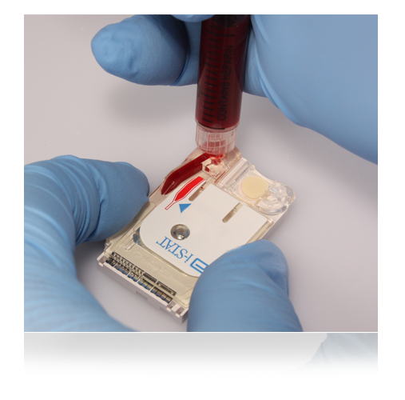
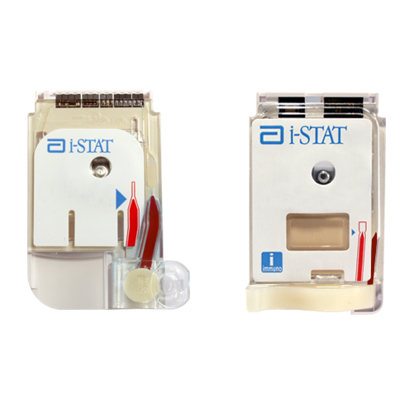
Running a Patient Test: Cartridge Filling Overview
Avoid Quality Check Codes!
Mix the sample thoroughly and gently
Discard first few drops
Fill to the fill mark
Close the closure to seal
Fill mark
closure is closed

Slide 10
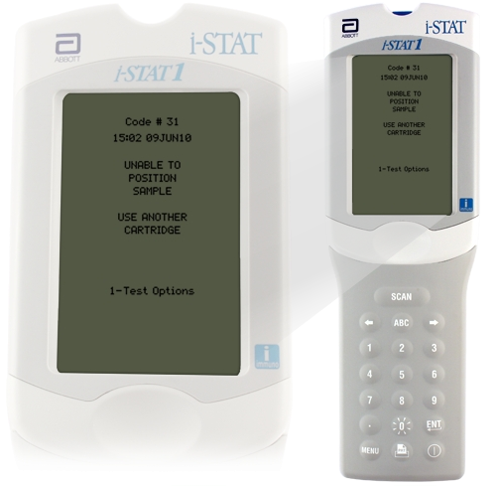
Running a Patient Test: Cartridge Filling Overview
If the cartridge is not sealed, the handheld will return an Unable to Position Sample Quality Check Code.

Slide 11
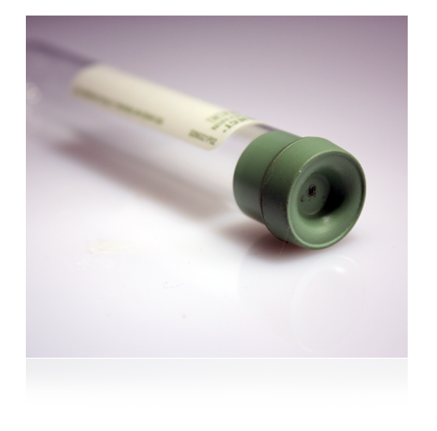
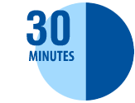
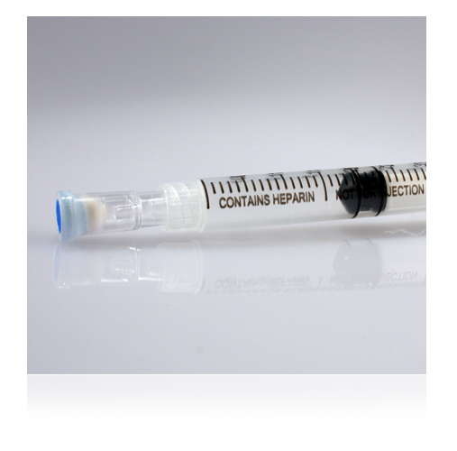
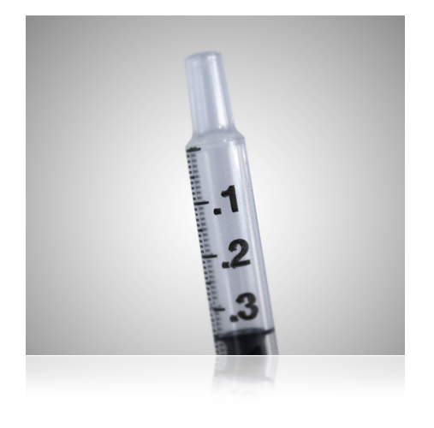
Chemistry Cartridges
Chemistry Cartridges
Whole blood sample
a. green-top tube
b. heparinized syringe
c. non-heparinized syringe
Time to test:
For heparinized samples, test within 30 minutes
For non-heparinized samples, test Immediately

Slide 12
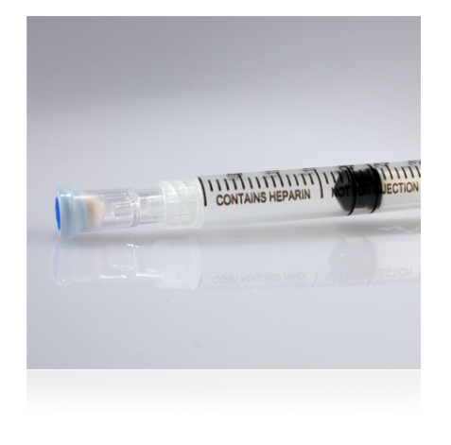
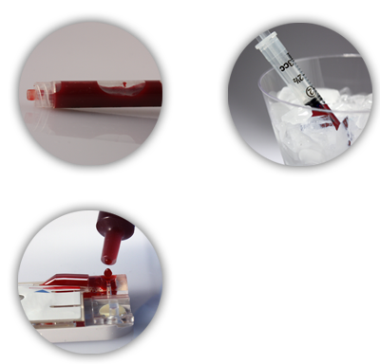
Arterial Blood Gas (ABG) Cartridges
ABG Cartridges
Whole blood sample
Use a syringe
Time to test
For heparinized samples, test within 10 minutes
For non-heparinized samples, test immediately

Slide 13
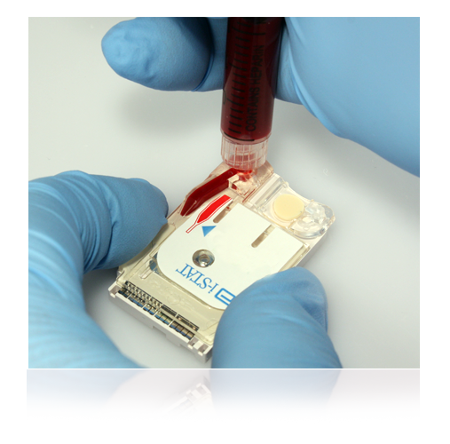
ACT Cartridges
ACT Cartridges
Whole blood sample
Use a plain, plastic syringe
Time to test
Test Immediately!

Slide 14
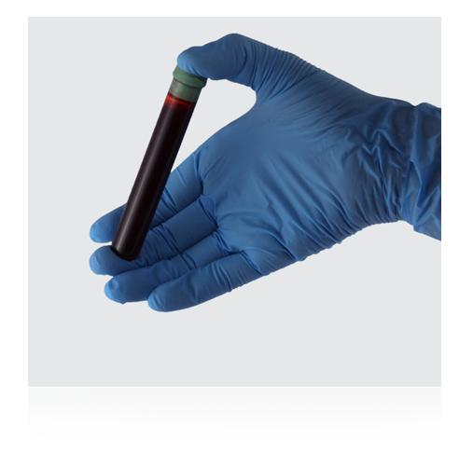
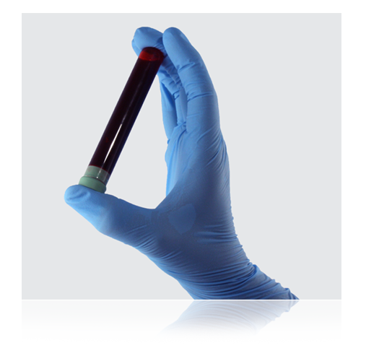
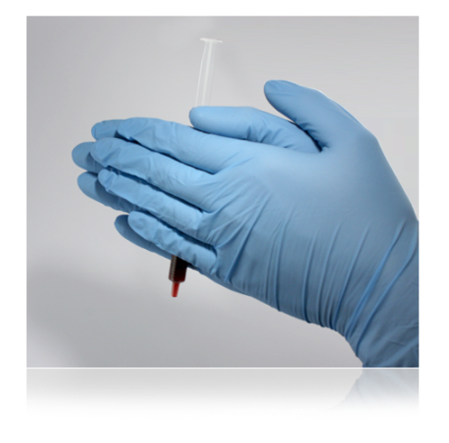
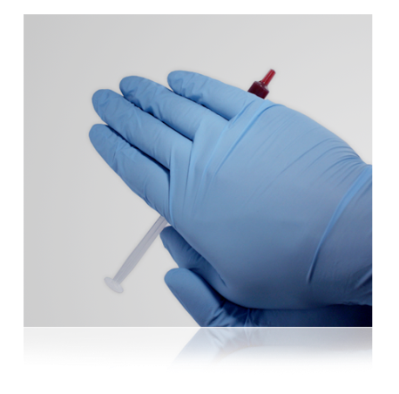
Using an Evacuated Tube to Fill a Cartridge
Using an evacuated tube
Gently invert the tube end-to-end a minimum of 10 times
Draw sample into a syringe or pipette
When using a syringe, vigorously roll the syringe between the palms for at least 5 seconds, invert, and repeat

Slide 15
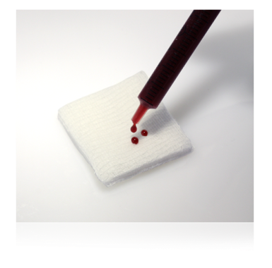
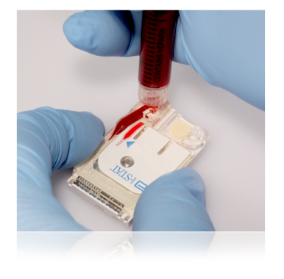
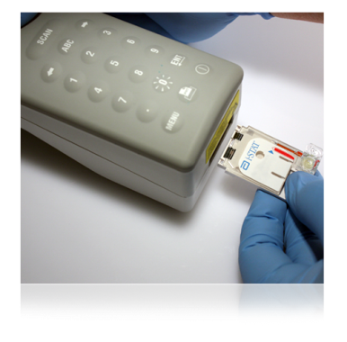
Using an Evacuated Tube to Fill a Cartridge (cont.)
Discard first few drops
Place hub of syringe on top of sample well
Apply gentle downward pressure
Fill to fill mark
Close the cartridge:
Close the closure to seal
Fill mark
closure is closed
If the cartridge is not sealed, the handheld will return an Unable to Position Sample Quality Check Code.

Slide 16
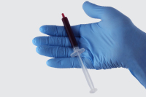
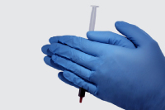
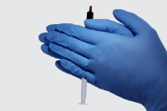
Using a Syringe to Fill a Cartridge
Using a syringe
Vigorously roll the syringe between the palms for at least 5 seconds, invert, and repeat
Discard first few drops

Slide 17
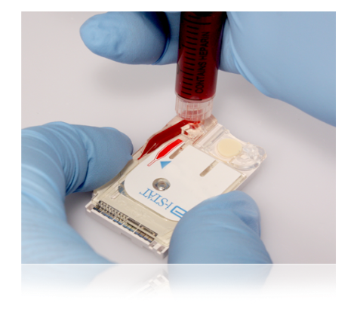
Using a Syringe to Fill a Cartridge (cont.)
Place hub of syringe on top of sample well
Apply gentle downward pressure
Fill to fill mark
Close the cartridge:
Close the closure to seal
Fill mark
closure is closed
If the cartridge is not sealed, the handheld will return an Unable to Position Sample Quality Check Code.

Slide 18
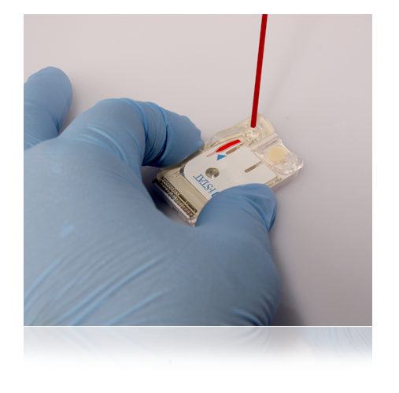
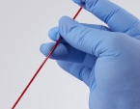
Using a Capillary Tube to Fill a Cartridge
Using a capillary tube
Test Immediately!
Direct one end of capillary tube into sample well
Fill to fill mark
Close the cartridge:
Close the closure
Fill mark
If the cartridge is not sealed, the handheld will return an Unable to Position Sample Quality Check Code.
closure is closed

Slide 19
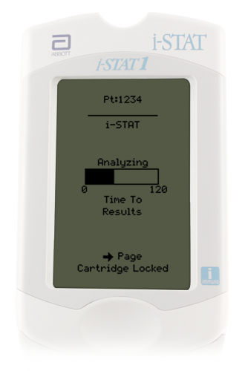
Running a Patient Test: Immediately after Inserting the Cartridge
Running a patient test:
Place handheld on a level, non-vibrating surface or in the Downloader
The message “Cartridge Locked” will display
Do not attempt to remove the cartridge when the “Cartridge Locked” message is displayed
When the test is complete:
Results are displayed
“Cartridge Locked” message disappears
It is safe to remove the cartridge

Slide 20
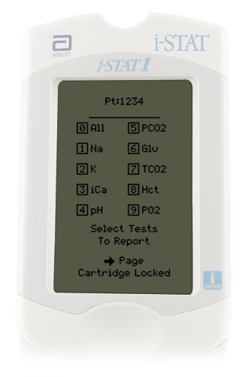
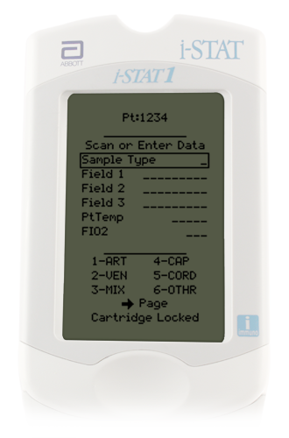
Running a Patient Test: Customizable Test Settings
Handheld Customization Options
Test Select
Chart Pages
Mandatory fields
Designated by facility
Must be completed before test results will be displayed or before next test can begin
If not entered in allotted time = Test Cancelled by Operator

Slide 21
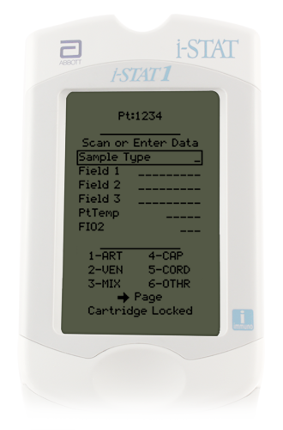
Running a Patient Test: Overview of the Chart Page
Chart Page
Can be programmed to automatically display
Allows entry of patient data
Sample type
Patient temperature
FIO₂
Free fields for additional info
To enter data on the Chart Page:
Use the keypad to enter data
Use the ENT key to navigate to the next field

Slide 22
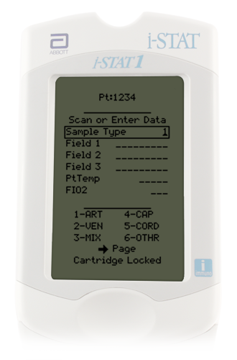
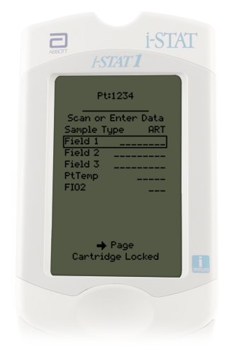
Chart Page: Entering Sample Type
To enter sample type
Refer to the menu at the bottom of the screen
Enter the code for the sample type
Press the ENT key

Slide 23
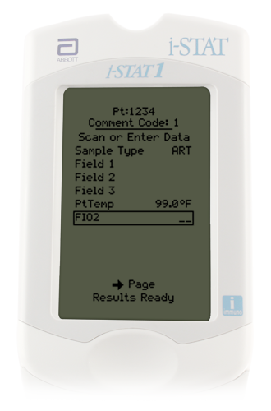
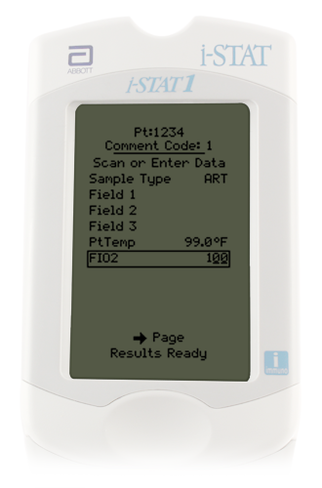
Chart Page: Entering FIO₂
To enter FIO₂
Use the Number keys
Press the ENT key

Slide 24
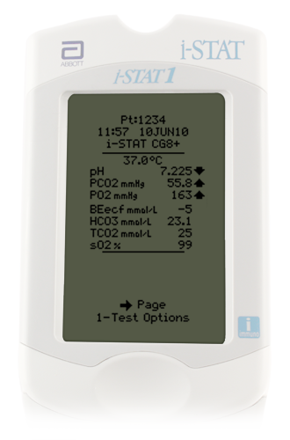
Interpreting Test Results: The Results Screen
Results screen
Patient ID
Time and date of test
Type of cartridge
Test results
May display on 2 pages
Use right Arrow key to navigate

Slide 25
Interpreting Test Results: Reference Range Graphs
Reference ranges
Reference Ranges are indicated by a bar graph with “tic” marks
Bar graph
Before first tic mark = low result
After last tic mark = high result
Between tic marks = result in range
Result in range
High result
Low result

Slide 26
Interpreting Test Results: Critical Value Alerts
Critical value alert
Indicated by up or down arrows
Follow your facility's policy for handling critical results

Slide 27
Interpreting Test Results: Out of Reportable Range Flags
Out of Reportable Range flag
Indicated with a < or > flag
Follow your facility’s policy for handling results that are out of the Reportable Range
Suppressed Result Flag
Indicated with a “<>” flag
Result was dependent on the result that was flagged as < or >

Slide 28
Interpreting Test Results: Star Outs (***)
Star outs
*** appears in place of the test result
Indicates that a sensor on the cartridge is unable to report a result
Follow your facility’s policy for handling *** result

Slide 29
Responding to Patient Tests: Comment Codes
Example comment codes
Numeric codes that represent responses to patient test
Examples:
1= critical value acknowledged
2 = physician notified
99 = repeat test
Comments field appears at the top of the first page of the results screen
Can be optional or required
If required, comment code MUST be entered to view test results or begin a new test
To enter a comment code:
Enter the code for the appropriate answer
Press ENT key

Slide 30
Transmitting Results: Downloader
To transmit results:
Turn handheld off
Place handheld in the Downloader
Look for display screen to show arrows and the message “Communication in Progress”
When transmission is complete:
Screen goes blank
Handheld turns off

Slide 31
Recalling Previous Results: Last Result
To view the last result:
Go to the Test Menu
Press the “1” key

Slide 32
Summary
You should be able to:
Prepare the handheld
Fill, close, and insert a cartridge
Enter Chart Page data
View test results
Transmit and print test results

