Slide 1
Lesson 6
Troubleshooting

Slide 2
Welcome and Learning Objectives
At the end of this lesson, you will be able to:
Define the term “Quality Check Code”
Explain how to proceed when a Quality Check Code appears on the handheld’s screen

Slide 3
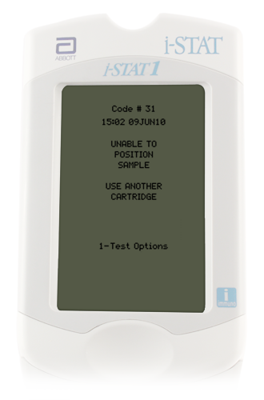
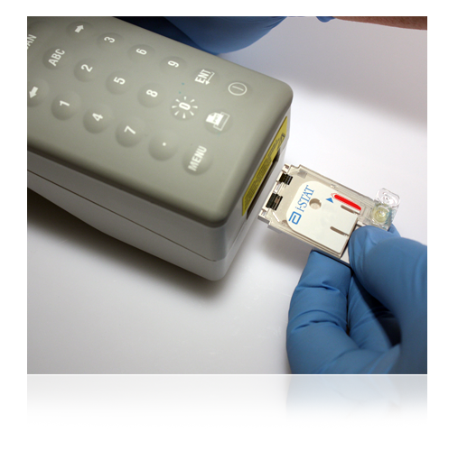
i-STAT System Troubleshooting Overview
i-STAT Quality System
Performs numerous quality checks during patient test cycle
Failed quality check
Cause message
Action message
Quality Check Code

Slide 4
Dead Batteries/Replace Batteries
Indicates insufficient battery power to complete test cycle
To resolve, replace or recharge batteries

Slide 5
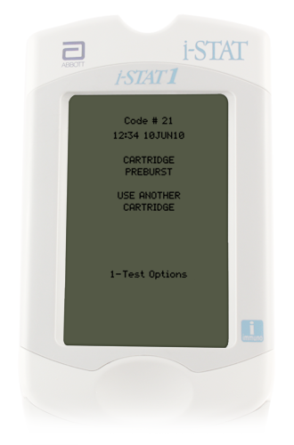
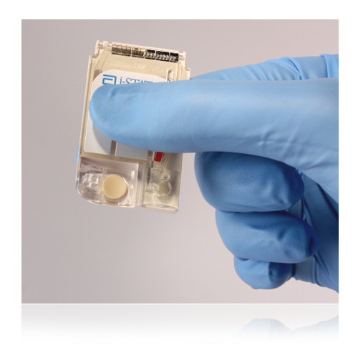
Cartridge Preburst/Use Another Cartridge
Indicates
Handheld detected fluid on sensors too early
Calibration pack burst prior to inserting cartridge
Caused by excessive pressure on center of cartridge
To resolve, repeat test with new cartridge.

Slide 6
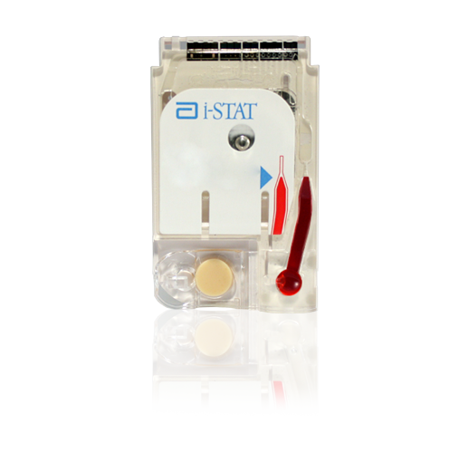
Unable to Position Sample/Use Another Cartridge
Indicates
Handheld did not detect movement of the sample across sensors.
May be the result of:
Clot in sample
Snap closure not closed
Aberrant cartridge
To resolve,
Use another cartridge
If you suspect clotted sample, draw new sample
Snap closure not closed

Slide 7
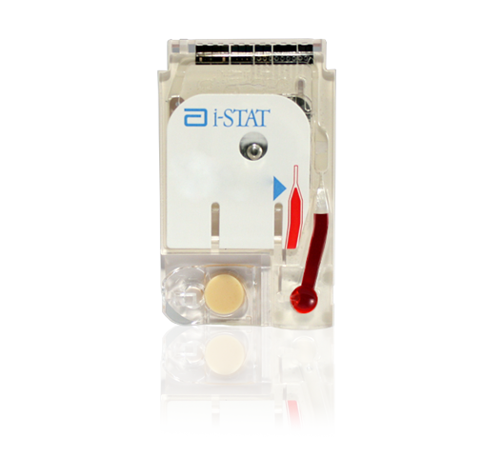
Sample Positioned Short of Fill Mark/Use Another Cartridge
Indicates the sample did not reach fill mark
To resolve,
Use new cartridge
Make sure sample reaches fill mark
Fill mark
Fill mark

Slide 8
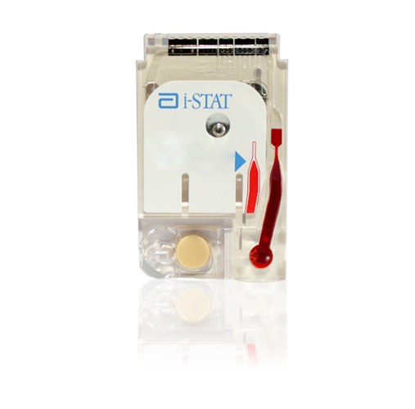
Sample Positioned Beyond Fill Mark/Use Another Cartridge
Indicates the sample extended past fill mark
To resolve,
Use another cartridge
Ensure sample does not extend beyond fill mark
Fill mark
Fill mark

Slide 9
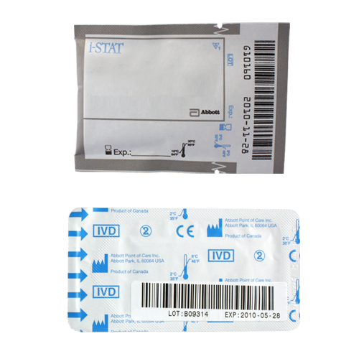
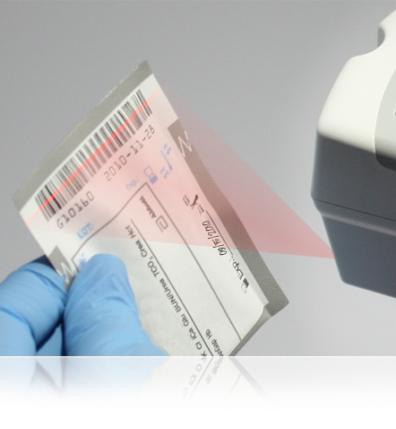
Cartridge Type Not Recognized / Use Another Cartridge
Indicates
Incorrect information was entered in response to the “Scan or Enter Cartridge Lot Number” prompt
Barcode on cartridge pouch may not have been scanned correctly
To resolve,
Use new cartridge
Scan barcode on cartridge pouch when prompted

Slide 10
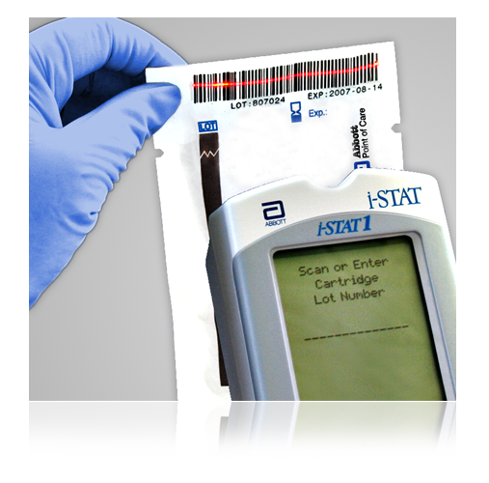
Cartridge Type Not Recognized / Use Another Cartridge
Indicates
Incorrect information was entered in response to the “Scan or Enter Cartridge Lot Number” prompt
Barcode on cartridge pouch may not have been scanned correctly
To resolve,
Use new cartridge
Scan barcode on cartridge pouch when prompted

Slide 11
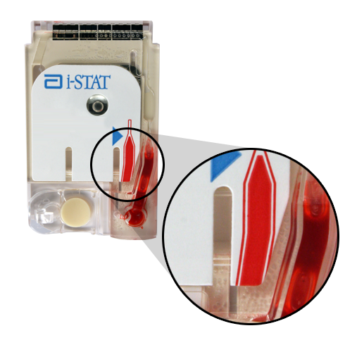
Cartridge Error/Use Another Cartridge
What it indicates
Handheld could not complete test
Various causes:
Clots
Air bubbles
Failure to seal the cartridge using the snap closure
Most often caused by issues in sample handling
To troubleshoot,
Refer to i-STAT 1 System Manual
Follow your facility’s policy for troubleshooting information

Slide 12
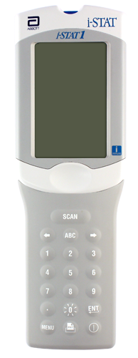
Final Thoughts
To resolve Quality Check Codes
Follow information presented on screen
Refer to i-STAT 1 System Manual
Contact your POCC

Slide 13
Summary
You should be able to:
Define the term “Quality Check Code”
Explain how to proceed when a Quality Check Code appears on the handheld’s screen

Slide 14
Summary
Ensure a quality sample is obtained:
Failure to handle the cartridge properly may cause Quality Check Codes
MIX, MIX, MIX……Always mix properly and test promptly!
Place handheld on a level, nonvibrating surface or in the downloader
Always correlate results with the status of the patient

