Slide 1
Lesson 3
Sample Collection and Handling

Slide 2
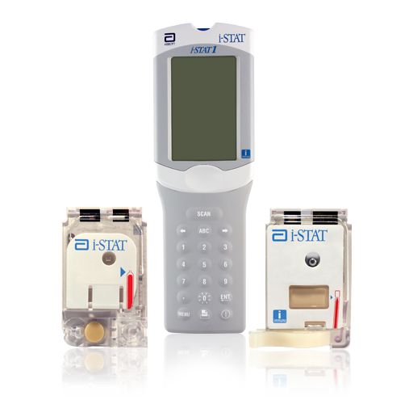
Welcome
At the end of this lesson, you will be able to:
Describe the basic i-STAT Cartridge handling guidelines
Describe proper sample collection and handling practices
List factors that may affect the sample prior to analysis

Slide 3
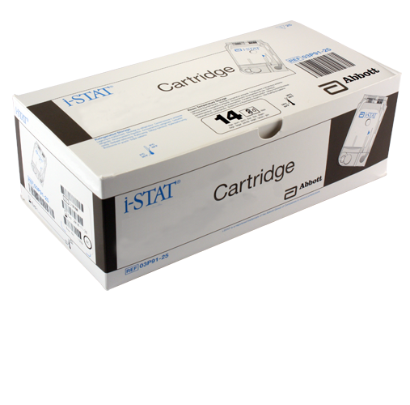
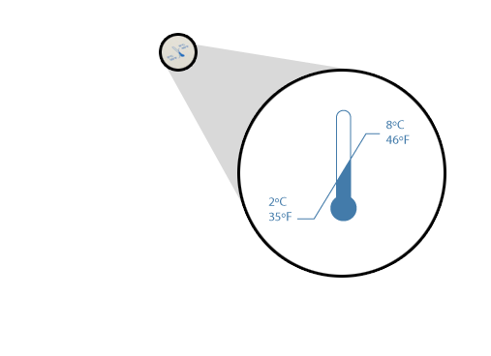
i-STAT Cartridge Overview
i-STAT Cartridges
Self-contained lab analyzers
Analysis, sample manipulation, and waste are confined within the cartridge
Refrigerated storage
May be used until the expiration date
Refrigerated storage range is 2°C - 8°C

Slide 4
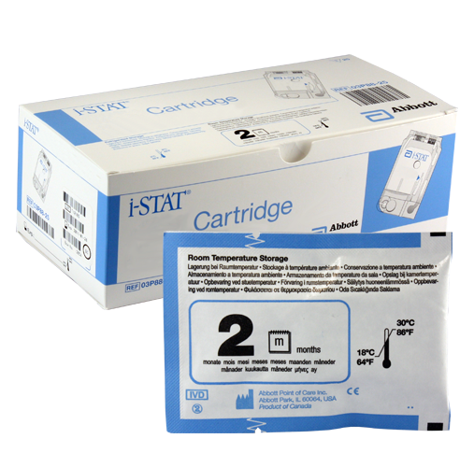
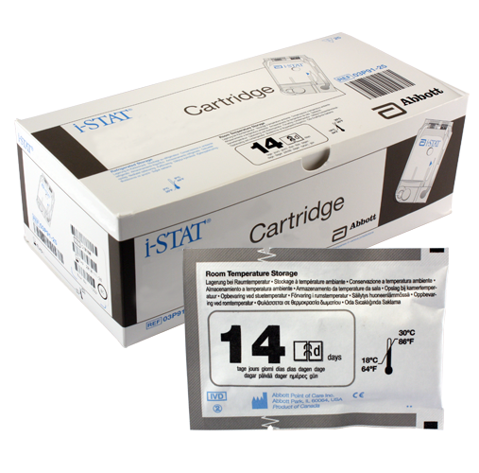
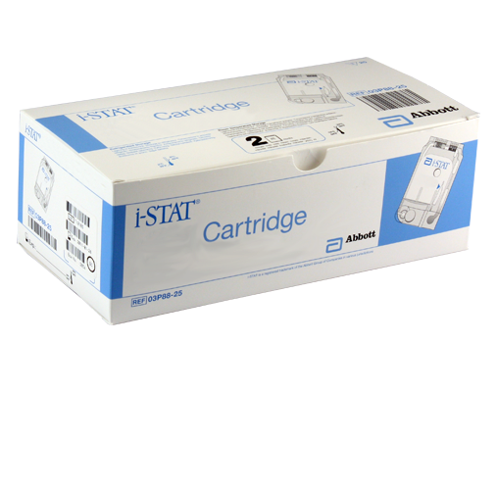
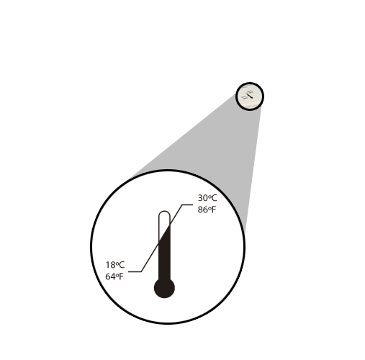
i-STAT Cartridge Overview (cont.)
Room temperature storage
14d = 14 days
2m = 2 months
Room temperature storage range is 18°C - 30°C

Slide 5
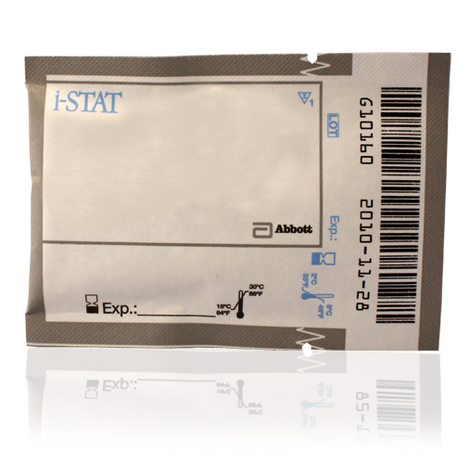
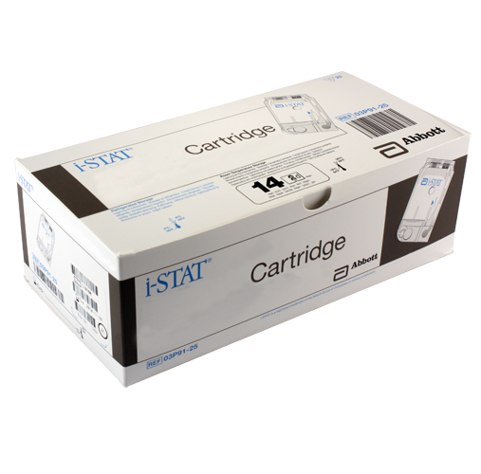
i-STAT Cartridge Overview (cont.)
Cartridges MUST be brought to room temperature before use
5 minutes for a single cartridge
1 hour for a box of cartridges
Do NOT manipulate the cartridge in any way to bring it to room temperature more quickly.

Slide 6
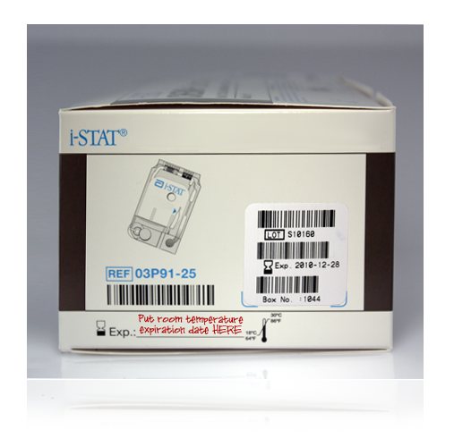
i-STAT Cartridge Overview (cont.)
After removing cartridge(s) from refrigeration
They CANNOT be put back into the refrigerator
The room temperature expiration date must be written on the box or individual cartridge pouch
If the box is marked, cartridges must remain in the box until used
Cartridge disposal
Follow your hospital’s disposal guidelines for products used with blood
Put room temperature expiration date here

Slide 7
i-STAT Cartridge Overview (cont.)
Pouch labeling
Panel name
Analyte(s)
Lot number
Cartridge barcode
Refrigerated expiration date
Room temperature storage expiration date
Lot number
Cartridge barcode
Panel name
Analytes
Room temperature storage expiration date
Refrigerated expiration date

Slide 8
i-STAT Cartridge Overview (cont.)
Measured and calculated results
Analytes above the line are measured
Analytes below the line are calculated
Measured
Calculated

Slide 9
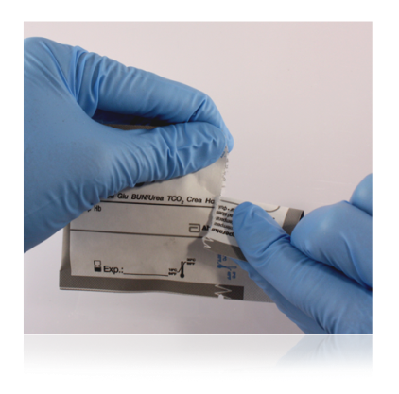
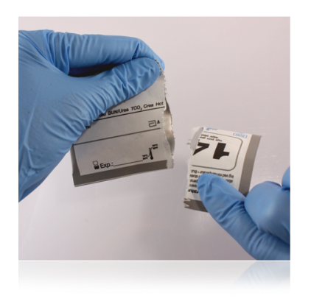
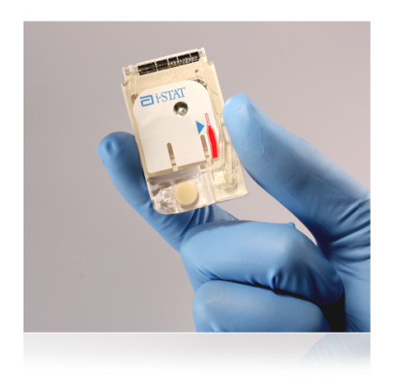
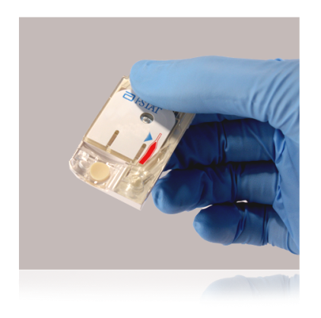
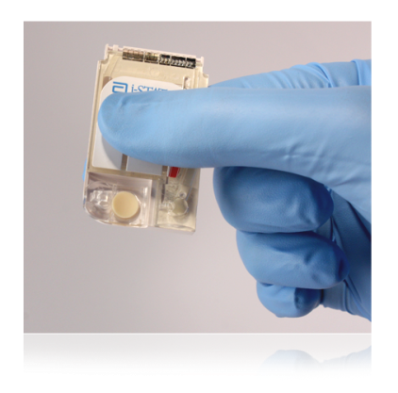
i-STAT Cartridge Overview (cont.)
Handling cartridges
Carefully tear open the cartridge pouch where indicated
Hold the cartridge by the sides or the bottom
Do not touch the sensors or apply pressure to the center of the cartridge
Prior to testing
The handheld will perform quality checks
Failure of a quality check will result in a Quality Check Code

Slide 10
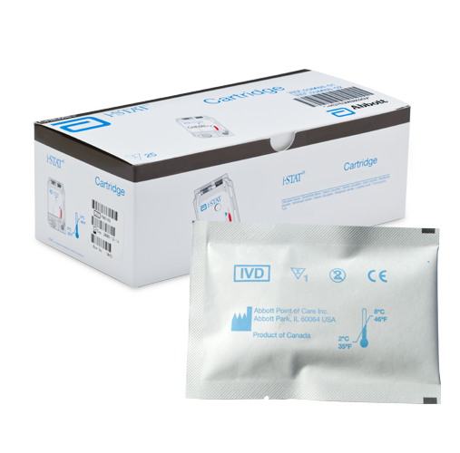
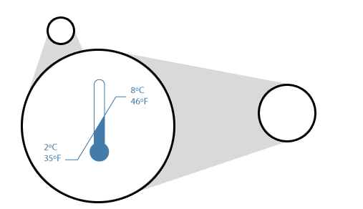
i-STAT Cartridge Overview
i-STAT Cartridges
Self-contained lab analyzers
Analysis, sample manipulation, and waste are confined within the cartridge
Refrigerated storage
May be used until the expiration date
Storage range is 2°C - 8°C
Room temperature storage
14 days
Storage range is 18°C - 30°C

Slide 11
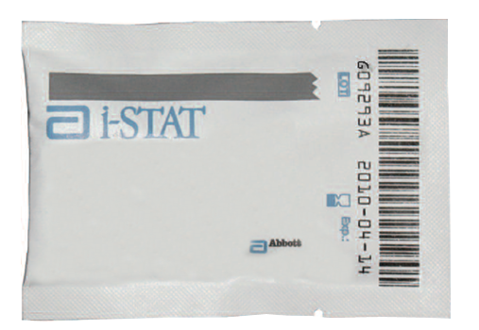
i-STAT Cartridge Overview (cont.)
Cartridges MUST be brought to room temperature before use
5 minutes for a single cartridge
1 hour for a box of cartridges
Do NOT manipulate the cartridge in any way to bring it to room temperature more quickly.

Slide 12
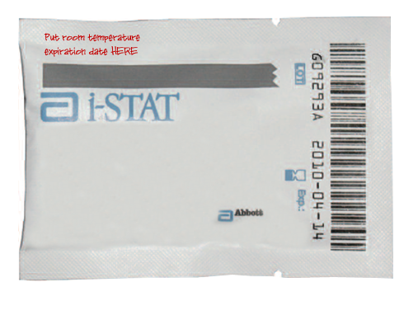
i-STAT Cartridge Overview (cont.)
After removing cartridge(s) from refrigeration
The room temperature expiration date must be written on the box or individual cartridge pouch
They CANNOT be put back into the refrigerator
If the box is marked, cartridges must remain in the box until used
Cartridge disposal
Follow your hospital’s disposal guidelines for products used with blood
Put room temperature expiration date HERE

Slide 13
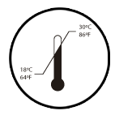
i-STAT Cartridge Overview (cont.)
Pouch labeling
Panel name
Analyte(s)
Lot number
Cartridge barcode
Refrigerated expiration date
Room temperature storage range
Lot number
Cartridge barcode
Panel name
Analytes
Room temperature storage range
Refrigerated expiration icon

Slide 14
i-STAT Cartridge Overview (cont.)
Measured and calculated results
Analytes above the line are measured
Analytes below the line are calculated
Measured
Calculated

Slide 15
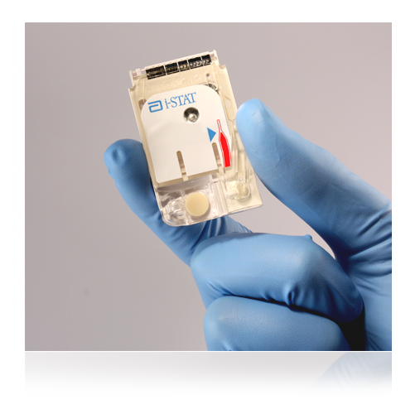
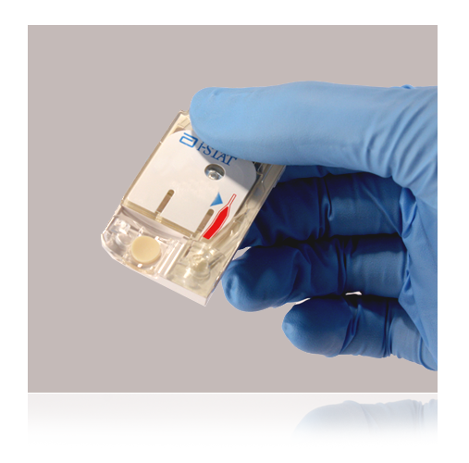
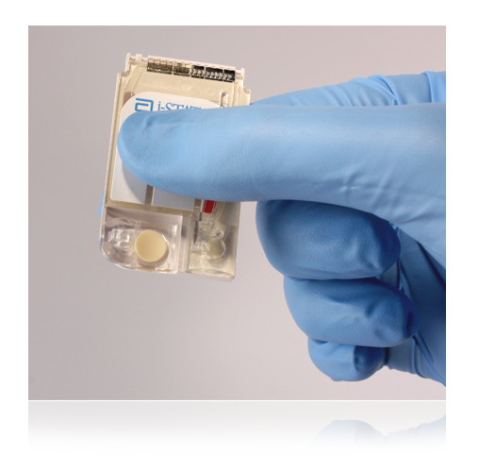
i-STAT Cartridge Overview (cont.)
Handling cartridges
Carefully tear open the cartridge pouch where indicated
Hold the cartridge by the sides or the bottom
Do not touch the sensors or apply pressure to the center of the cartridge
Prior to testing
The handheld will perform quality checks
Failure of a quality check will result in a Quality Check Code

Slide 16
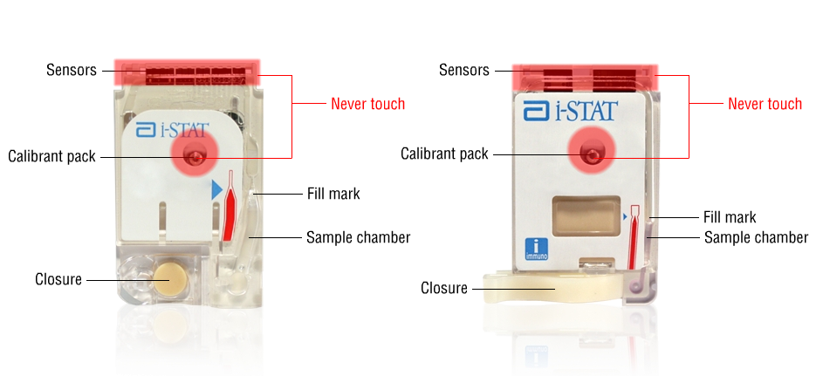
i-STAT Cartridge Components

Slide 17
Sample Collection Techniques
i-STAT System may be used with:
Arterial samples
Venous samples
Capillary samples
Important notes:
Make sure to follow your hospital’s procedures for proper sample collection.
Always correlate results with the status of the patient!
Consult Intended Use Statements for
APOC Products in the Cartridge
and Test Information (CTI) sheets at:
www.abbottpointofcare.com
Within the i-STAT 1 System Manual

Slide 18
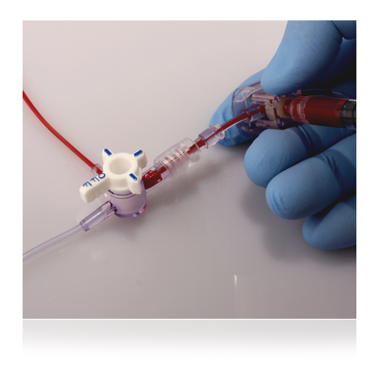
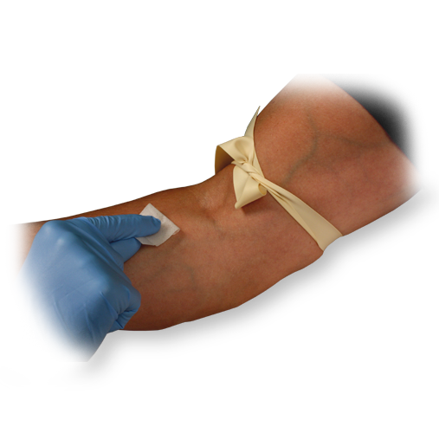
General Sample Collection Techniques
Ensure a quality sample is obtained
IV line
Avoid drawing from an arm with an IV line
IV solutions dilute sample
Indwelling line
Draw sufficient waste
Tourniquet
If applied for more than 1 minute, release and reapply after 2 to 3 minutes to avoid hemolysis

Slide 19
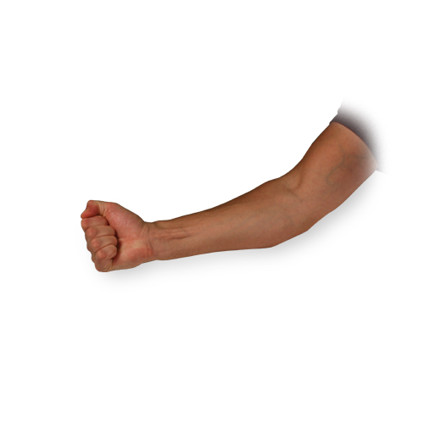
General Sample Collection Techniques (cont.)
Avoid extra muscular activity:
Clenching and unclenching fist
Avoid Hemolysis:
Allow residual alcohol to dry
Discard sample from traumatic draw
Allow to dry

Slide 20
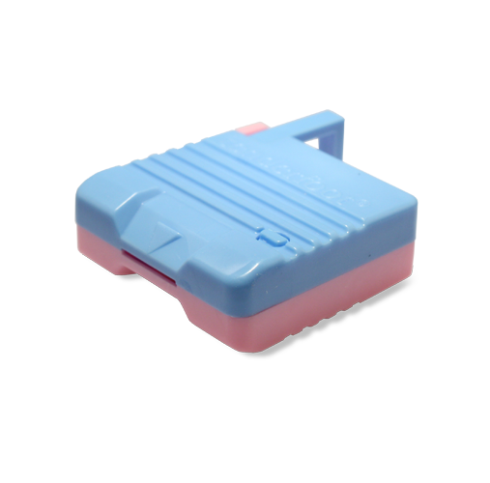
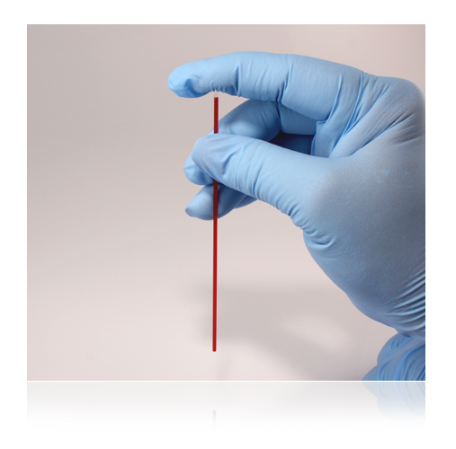
Additional Sample Collection Techniques Using Capillary Tubes
If using a capillary tube
Use a skin puncture device that provides free-flowing blood
Use a heparinized capillary tube
Example of skin puncture device
heparinized

Slide 21
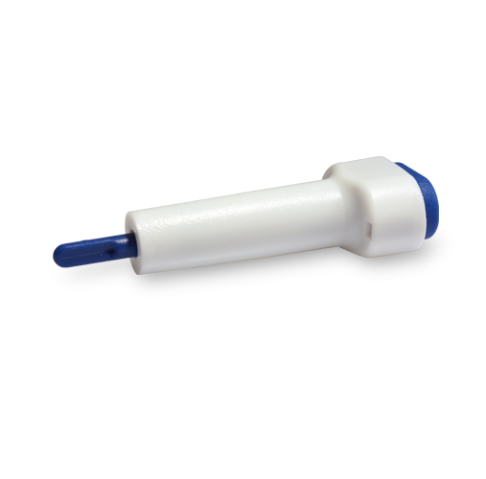
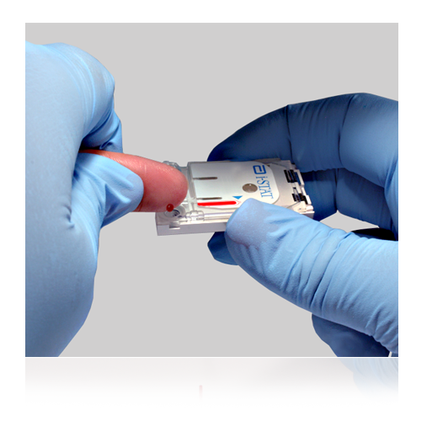
Additional Sample Collection Techniques Using a Fingerstick
When performing a fingerstick
Use a skin puncture device that provides free-flowing blood
Gently squeeze the finger to produce a hanging drop of blood

Slide 22
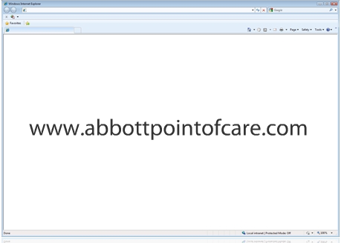
Factors That May Affect Results
Avoid factors that may affect the sample prior to analysis.
Always correlate results with the status of the patient.
References:
Cartridge and Test Information Sheets (CTI Sheets)
i‑STAT 1 System Manual
www.abbottpointofcare.com

Slide 23
Factors That May Affect Creatinine Results
Avoid affecting creatinine results:
Use another testing method if the patient has been administered hydroxyurea (Droxia®, Hydrea®)

Slide 24
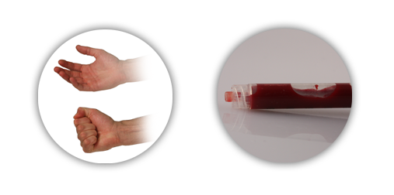
Factors That May Affect pH Results
Avoid affecting pH results:
Avoid extra muscular activity during sample collection
Do not expose to air

Slide 25
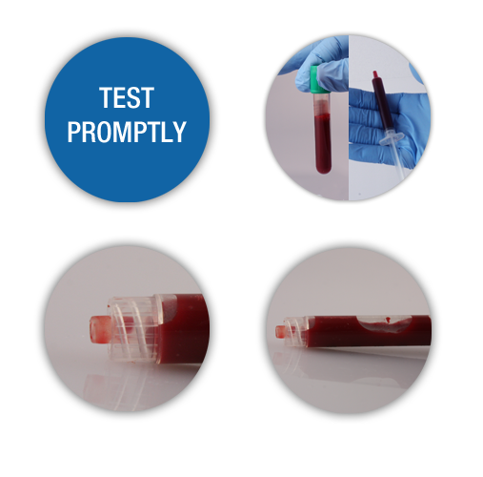
Factors That May Affect PCO₂ Results When Using Blood Gas Cartridges
Avoid affecting PCO₂ results:
Test promptly
Fill blood collection devices completely
Do not expose to air

Slide 26
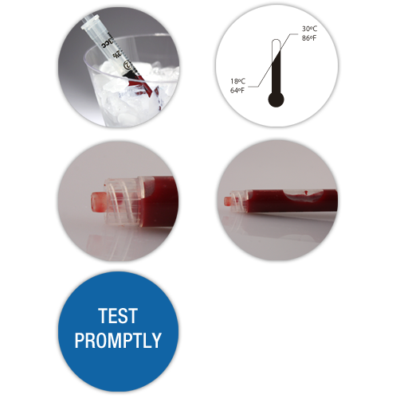
Factors That May Affect PO₂ Results
Avoid affecting PO₂ results:
Do not ice the sample
Ensure the cartridge is at room temperature
Do not expose to air
Test promptly

Slide 27
Factors That May Affect ACT Results
Avoid affecting ACT results:
Don’t use glass tubes
Level testing surface
Flush lines sufficiently
Ensure blood collection device does not contain anticoagulants

Slide 28
Factors That May Affect TCO₂ Results
Avoid affecting TCO₂ results:
Don’t expose to air
Fill blood collection device completely
Test promptly

Slide 29
Summary
Now that you have completed this lesson, you should be able to:
Describe the basic i-STAT Cartridge handling guidelines
Describe proper sample collection and handling practices
List factors that may affect the sample prior to analysis

