Slide 1
Lesson 5
Quality Control

Slide 2
Welcome and Learning Objectives
At the end of this lesson you will be able to:
Describe the internal Electronic Simulator process
Perform an external Electronic Simulator test
Describe the process of performing a quality control test

Slide 3
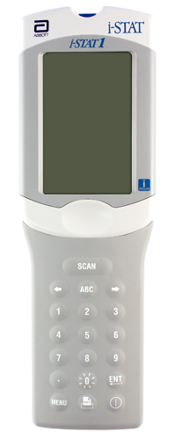
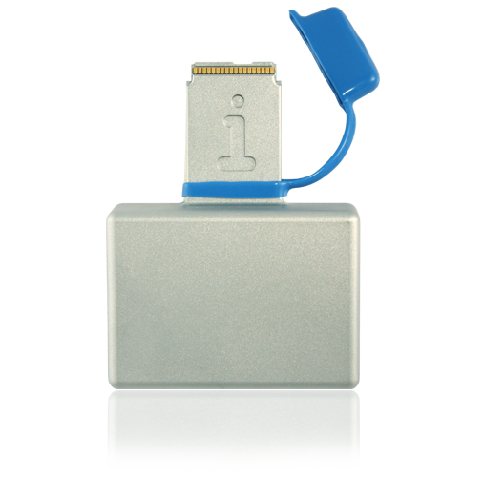
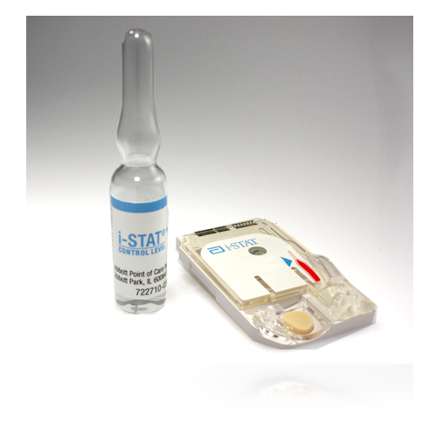
i-STAT System Quality Control
i-STAT System Quality Control
Internal Electronic Simulator test
External Electronic Simulator test
Quality control using liquid controls

Slide 4
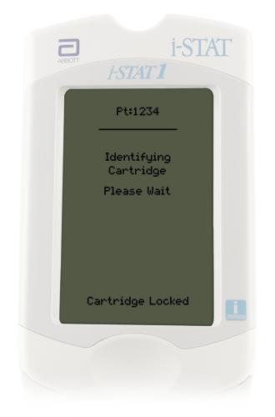
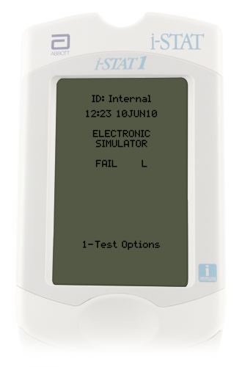
Internal Electronic Simulator
Internal Electronic Simulator
Internal check of handheld’s ability to take accurate and sensitive measurements
Test performed automatically when required
Adds 20 seconds to the testing cycle
If the simulator test passes, the cartridge test cycle proceeds
If the “Electronic Simulator Fail” message appears, follow facility’s policy

Slide 5
External Electronic Simulator
External Simulator
Independent check of handheld’s ability to take accurate and sensitive measurements
Performed after an internal Simulator failure or when required by facility policy

Slide 6
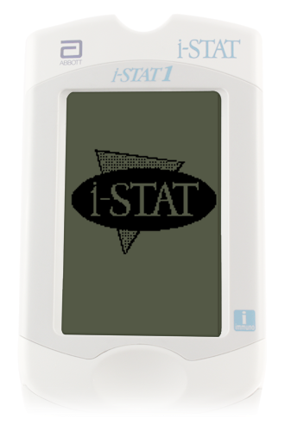
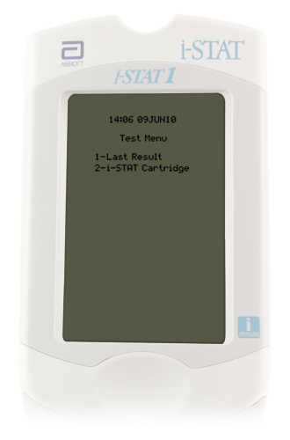
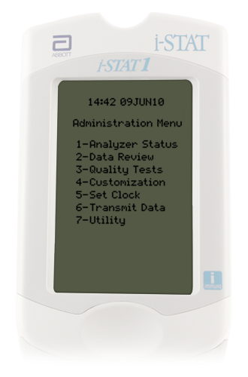
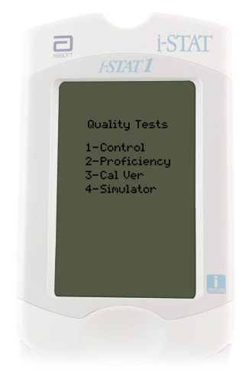
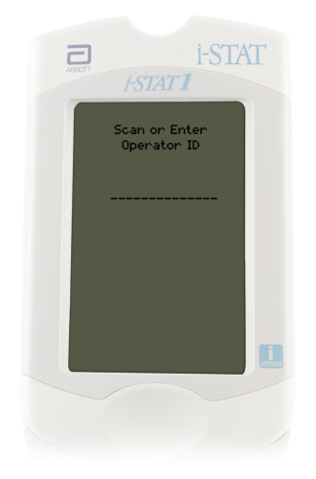
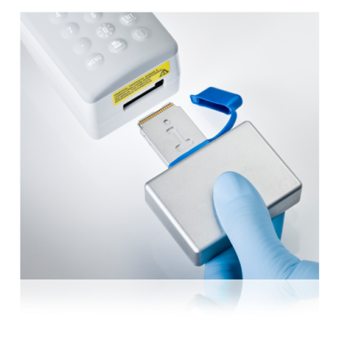
External Electronic Simulator (cont.)
Performing the external Electronic Simulator test
Turn on the handheld
Press MENU
Press 3 for Quality Tests
Press 4 for Simulator
Enter the Operator ID
Enter the Simulator ID
Insert the external Electronic Simulator

Slide 7
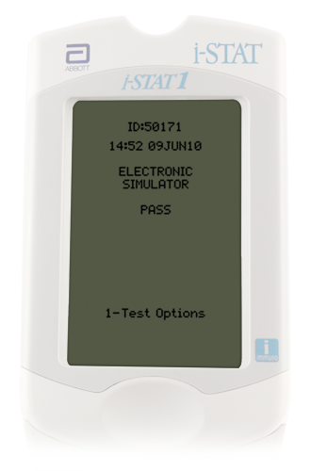
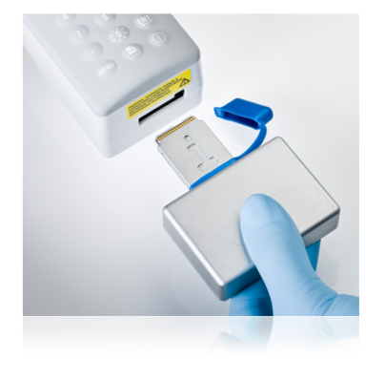
External Electronic Simulator (cont.)
Simulator test results
Testing time is approximately 60 seconds
Will receive a Pass or Electronic Simulator Fail message
If test fails, repeat the test
If test fails twice, follow your facility’s policy

Slide 8
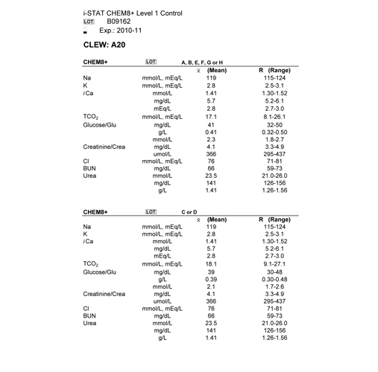
Quality Control Using Liquid Controls: Value Assignment Sheets
Value Assignment Sheet (VAS)
Used to determine if results are within range
Ensure the correct VAS by matching the:
Control lot number
Expiration date
Cartridge type
Cartridge lot designate letter

Slide 9
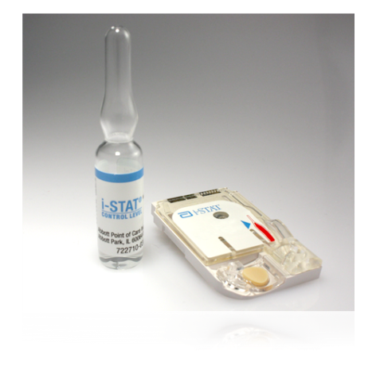
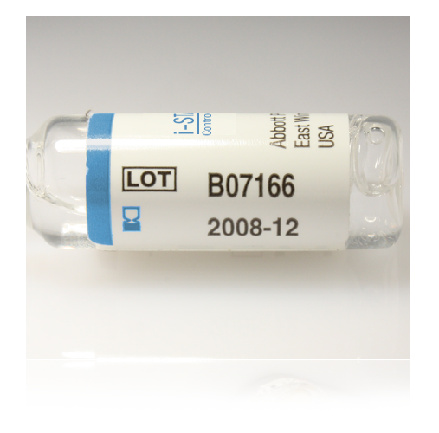
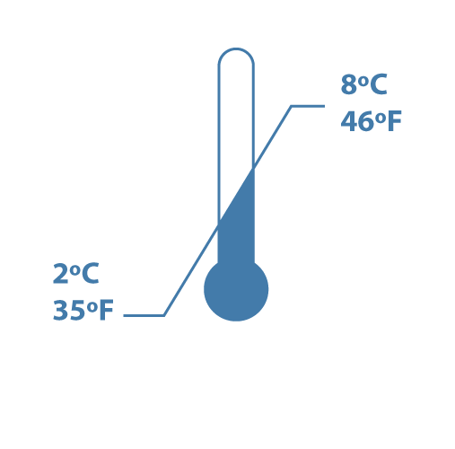
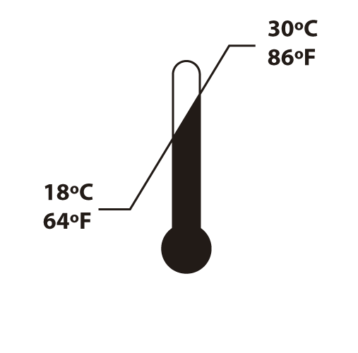
Quality Control Using Liquid Controls for Chemistry Cartridges
Quality Control Using Liquid Controls
Provided in 3 levels
Used to monitor cartridge performance at different points within the clinical range
Can be used until expiration date when stored at 2°C to 8°C
Must be left at room temperature for 30 minutes prior to use
Once removed from refrigerator, unopened control solutions must be used within 5 days
Expiration Date

Slide 10
Quality Control Using Liquid Controls for Blood Gas Cartridges
Quality Control Using Liquid Controls
Provided in 3 levels
Used to monitor cartridge performance at different points within the clinical range
Can be used until expiration date when stored at 2°C to 8°C
Must be left at room temperature for 4 hours prior to use
Once removed from refrigerator, unopened control solutions must be used within 5 days
Expiration Date

Slide 11
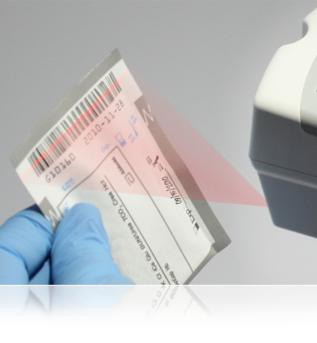
Performing a Quality Control Test Using Liquid Controls
Prepare the handheld
Turn on the handheld
Press the MENU key
Press 3 to select Quality Tests
Press 1 to select Control
Scan or manually enter Operator ID
Scan or manually enter Control Lot Number
Scan Cartridge Lot Number

Slide 12
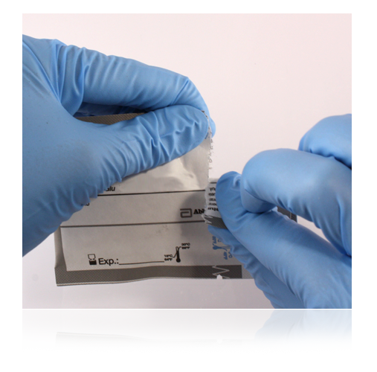
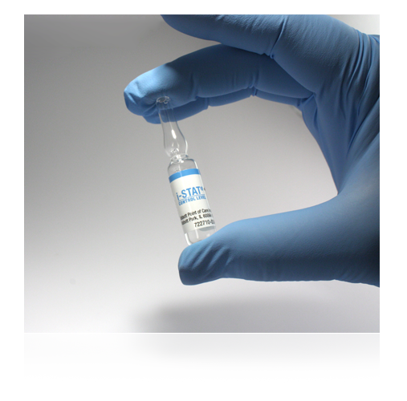
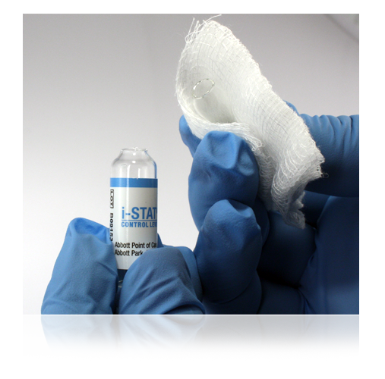
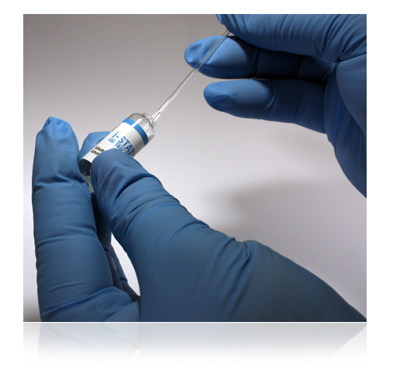
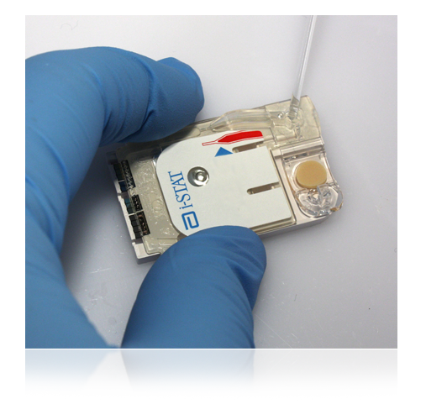
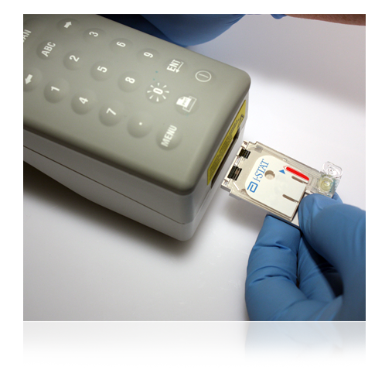
Performing a Quality Control Test Using Liquid Controls (cont.)
Fill the cartridge
Remove cartridge from pouch
Vigorously shake ampule for 5 to 10 seconds
While protecting fingers, snap open the ampule at the neck
Slowly transfer solution from the ampule to the syringe
Immediately fill the cartridge with the control solution
Close cartridge and insert into handheld

Slide 13
Performing a Quality Control Test Using Liquid Controls (cont.)
Review the results
Compare to VAS
If the results fall outside expected range, follow your facility’s policy

Slide 14
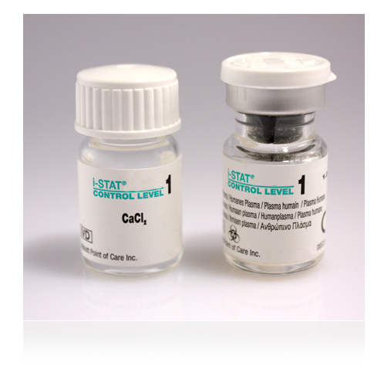
Quality Control Using Liquid Controls for Coagulation Cartridges
Quality Control Using Liquid Controls
Provided in 2 levels
Used to monitor cartridge performance at different points within clinical range
Each level must be reconstituted from:
One vial dry lyophilized human plasma
One vial diluent
Test only one cartridge with reconstituted testing solution

Slide 15
Quality Control Using Liquid Controls for Coagulation Cartridges
Storage Conditions
Can be used until expiration date when stored at 2°C to 8°C
Must be left at room temperature for 45 minutes prior to use
Once at room temperature must be used within 4 hours

Slide 16
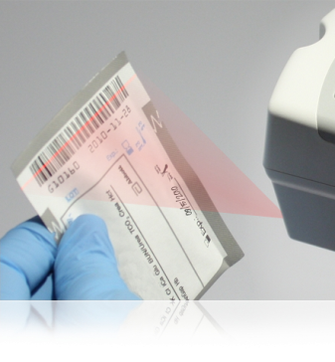
Performing a Quality Control Test Using Liquid Controls for Coagulation Cartridges
Prepare the handheld
Turn on handheld
Press MENU key
Press 3 to select Quality Tests
Press 1 to select Control
Scan or manually enter Operator ID
Scan or manually enter Control Lot Number
Scan Cartridge Lot Number

Slide 17
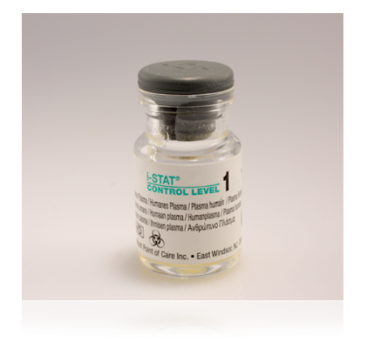
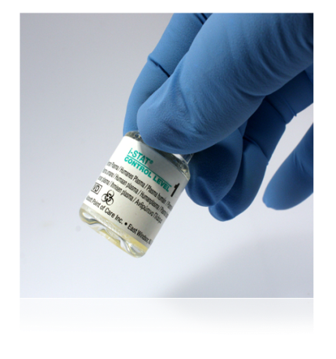
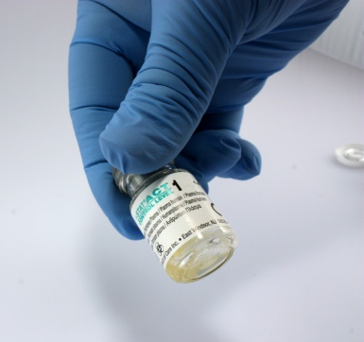
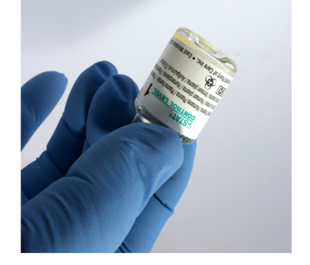
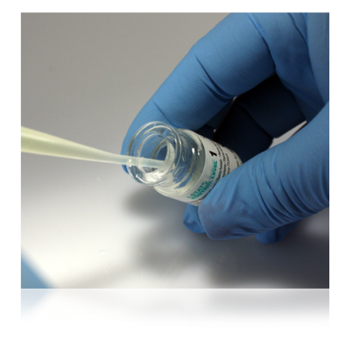
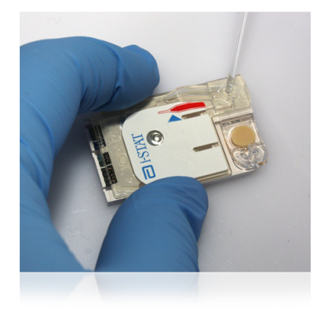
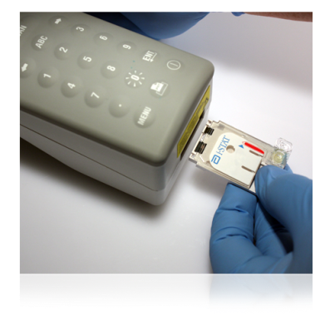
Performing a Quality Control Test Using Liquid Controls for Coagulation Cartridges (cont.)
Fill the cartridge
Remove cartridge from the pouch
Remove cap and stopper from vials
Pour entire contents of diluent into lyophilized plasma vial
Replace stopper
Allow vial to sit 1 minute
Gently swirl vial for 1 minute, then gently invert for 30 seconds
Use plastic pipette or plain plastic syringe to immediately transfer solution from vial into cartridge
Immediately close cartridge and insert into handheld

Slide 18
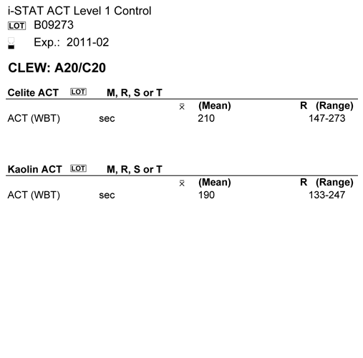
Performing a Quality Control Test Using Liquid Controls for Coagulation Cartridges (cont.)
Review Results:
Compare to VAS
If results fall outside expected range, follow your facility’s policy.

Slide 19
Summary
Now that you have completed this lesson, you should be able to:
Describe the internal Electronic Simulator process
Perform an external Electronic Simulator test
Describe the process of performing a quality control test

